Slide 1

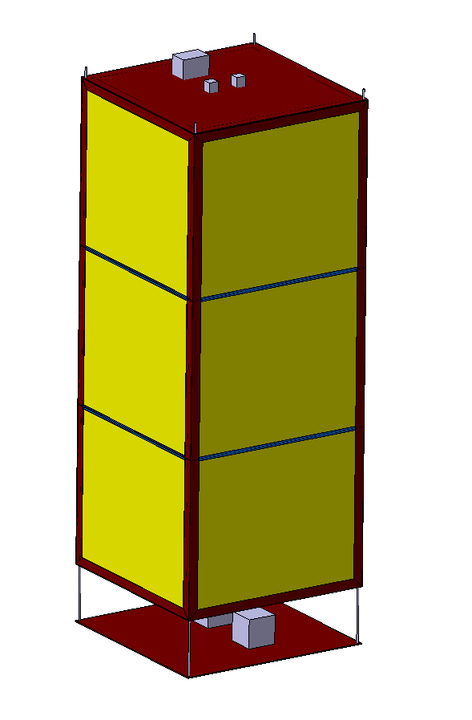
ArgonCube
3D Model
Preliminary

Slide 2
Total Model 0.67 x 0.67 x 1.8 m
W x L x H m

Slide 3
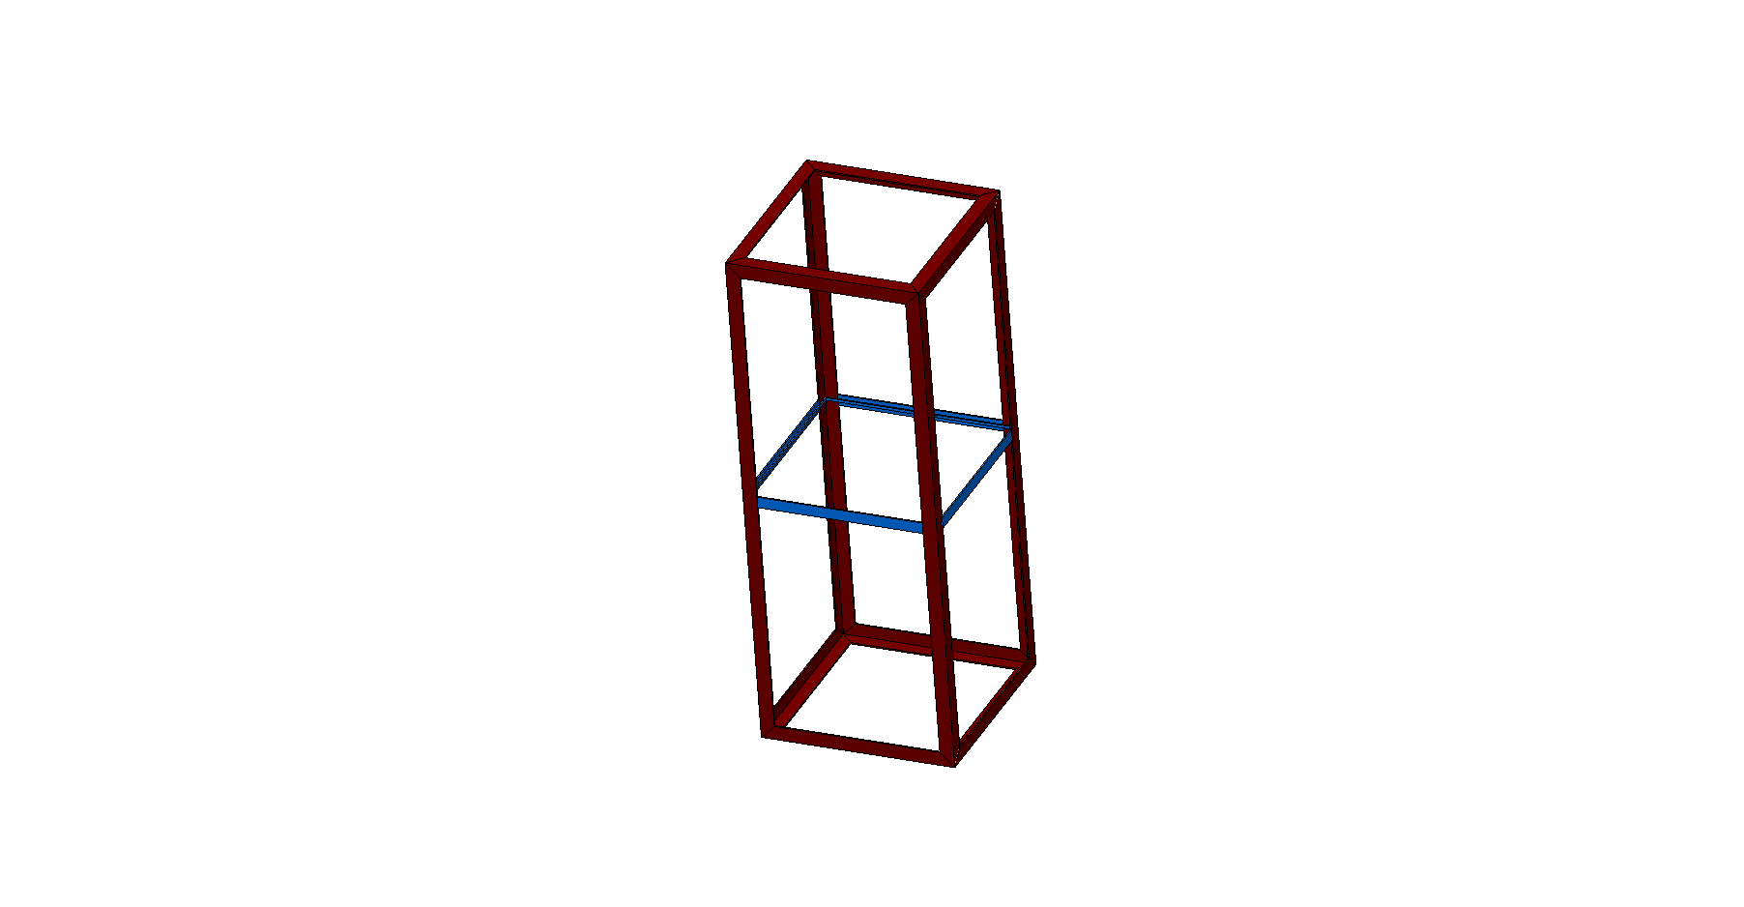
‘Cage’
4 x L profile top
Stainless Steel
4 x L profile side
Stainless Steel
4 x T profile middle
FR4
4 x L profile bottom
FR4
DRAFT

Slide 4
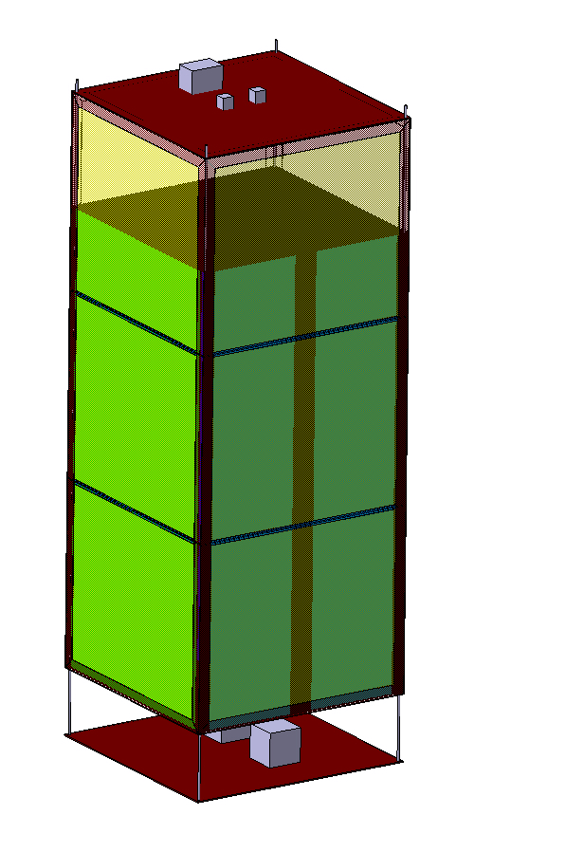
‘Detector’ Parts
Top Flange
Stainless Steel
Read Out Plane
FR4
Cathode
Walls
FR4
Circulators
Field-Shaper
Bottom Flange
Stainless Steel
DRAFT

Slide 5
Installation Procedure

Slide 6
Installation
DRAFT

Slide 7
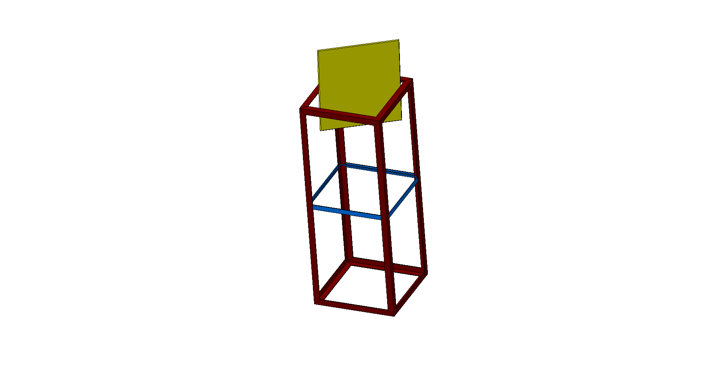
Installation
DRAFT

Slide 8
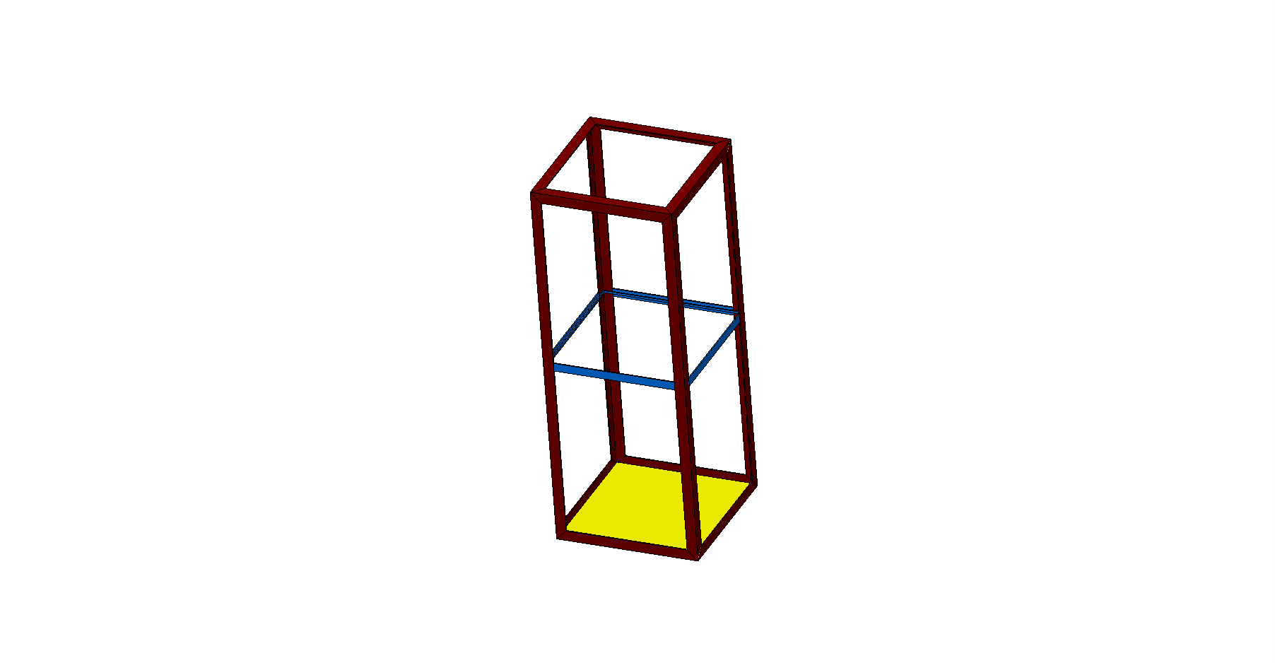
Installation
DRAFT

Slide 9
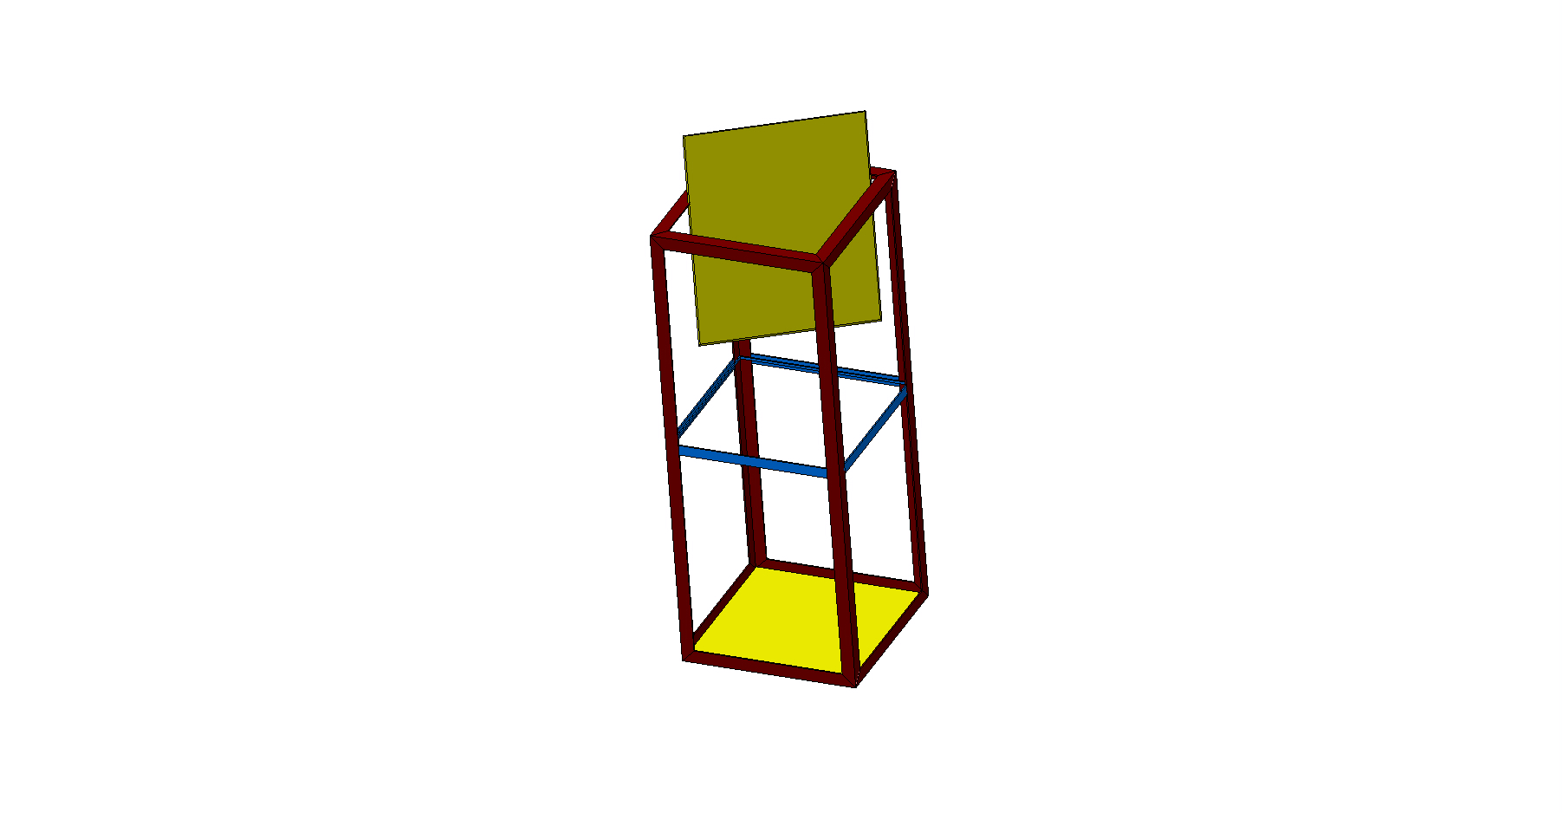
Installation
DRAFT

Slide 10
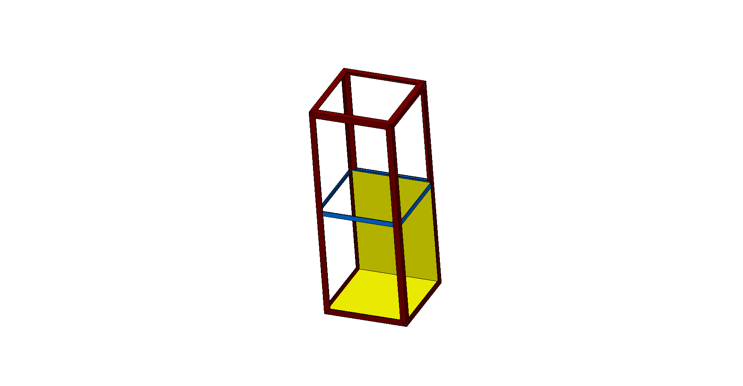
Installation
DRAFT

Slide 11
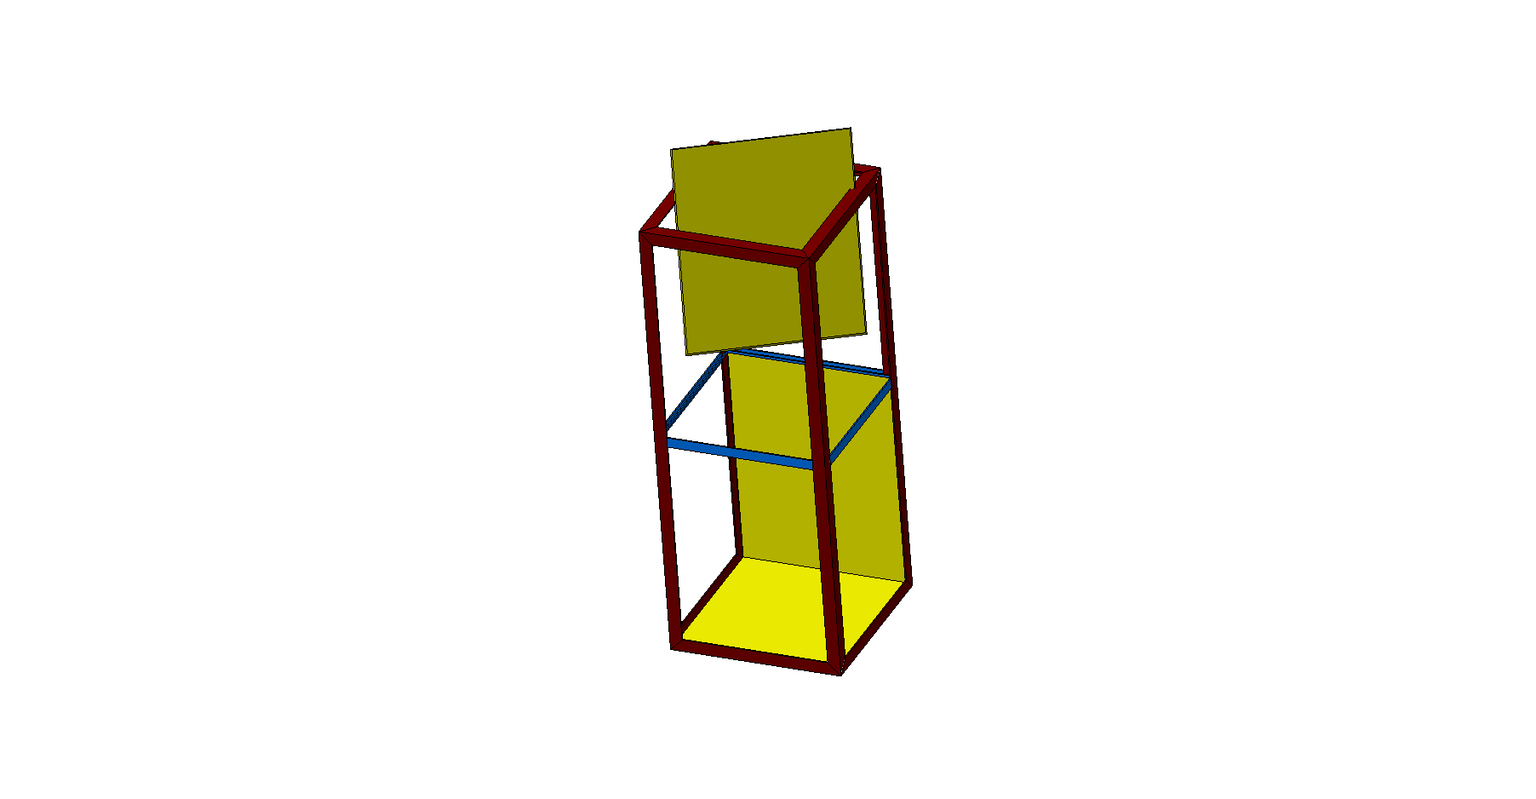
Installation
DRAFT

Slide 12
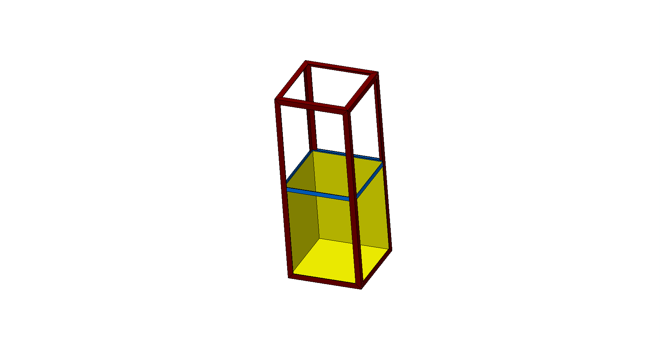
Installation
DRAFT

Slide 13
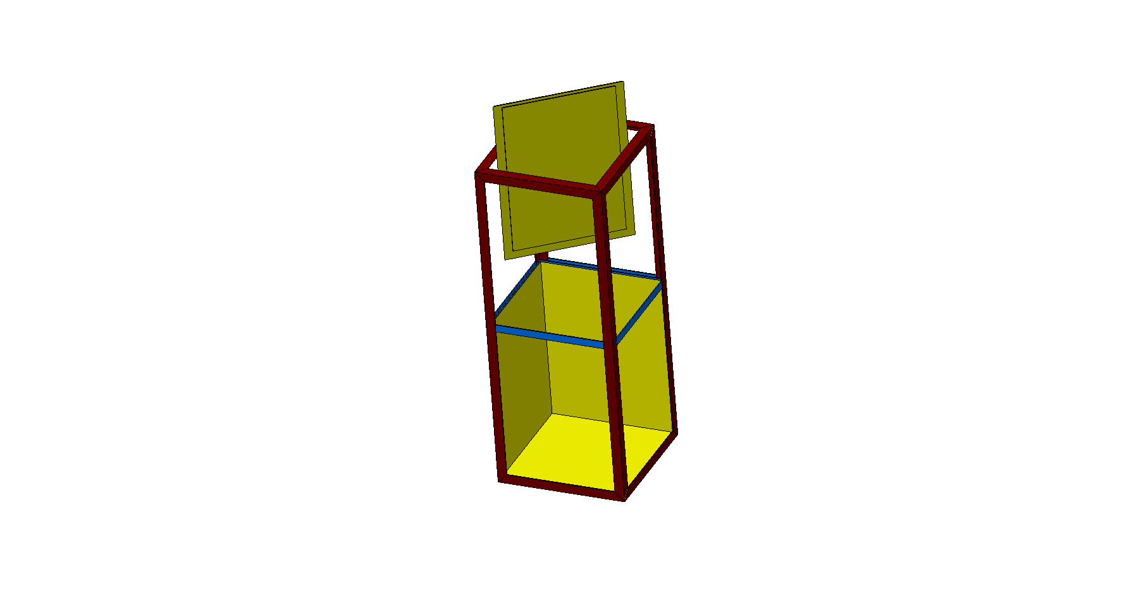
Installation
DRAFT

Slide 14
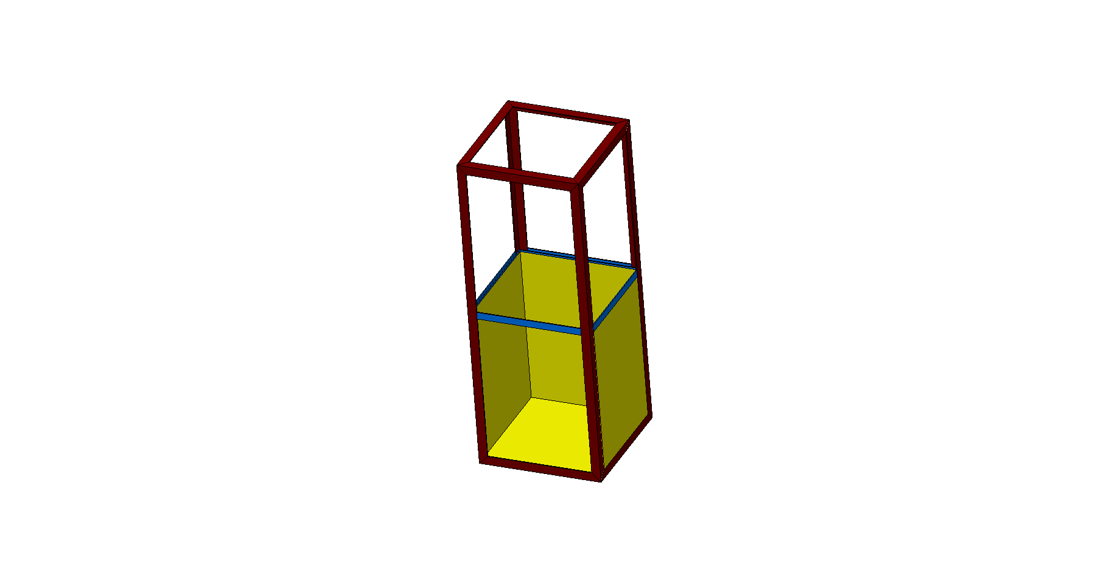
Installation
DRAFT

Slide 15
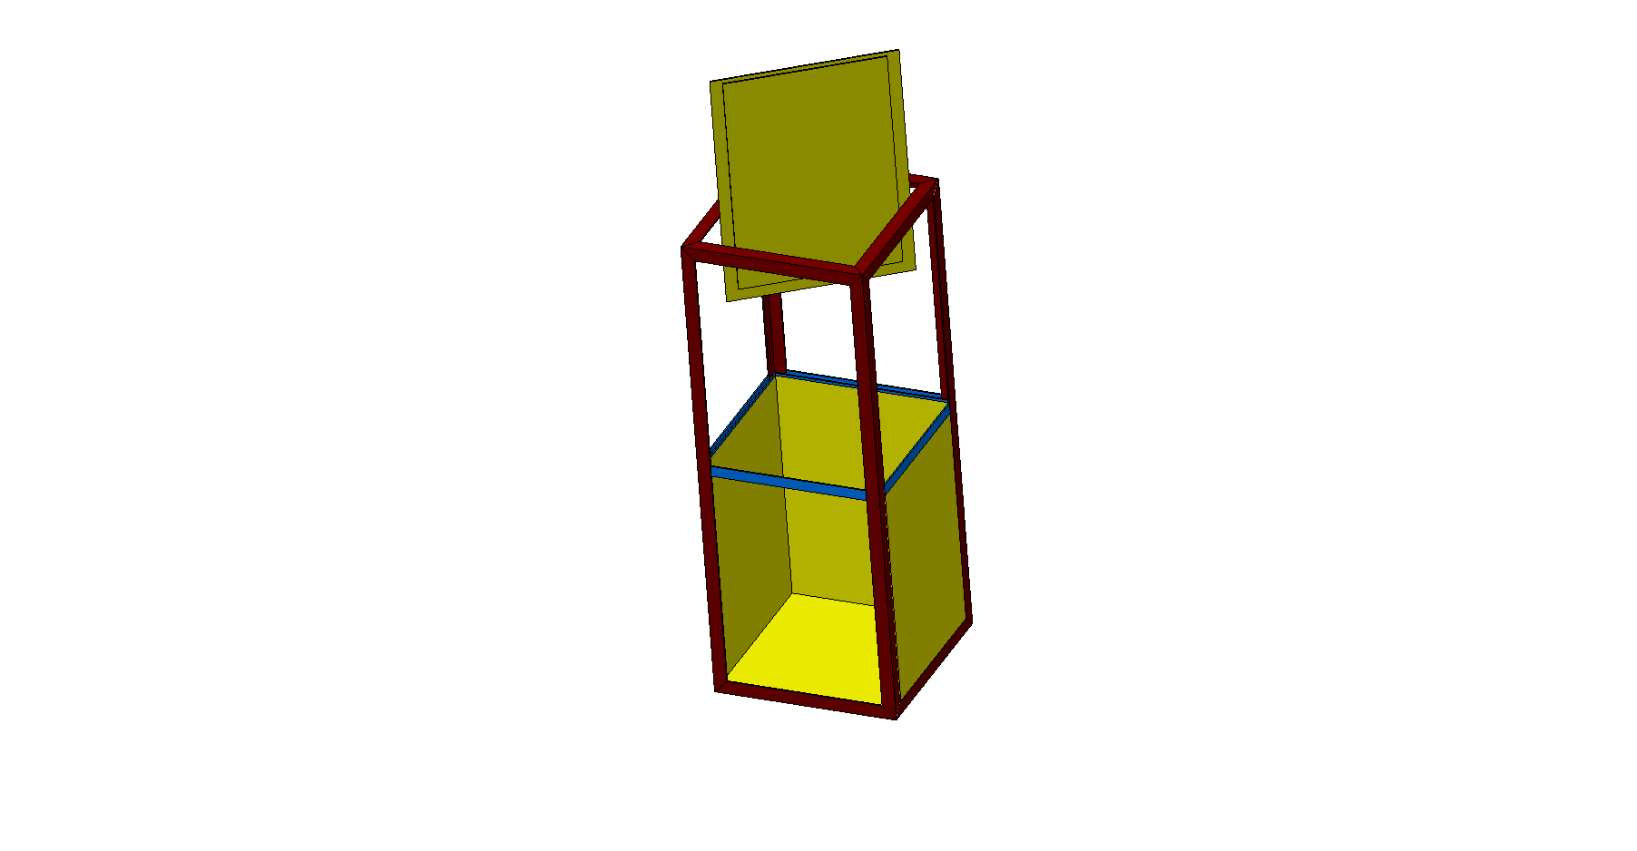
Installation
DRAFT

Slide 16
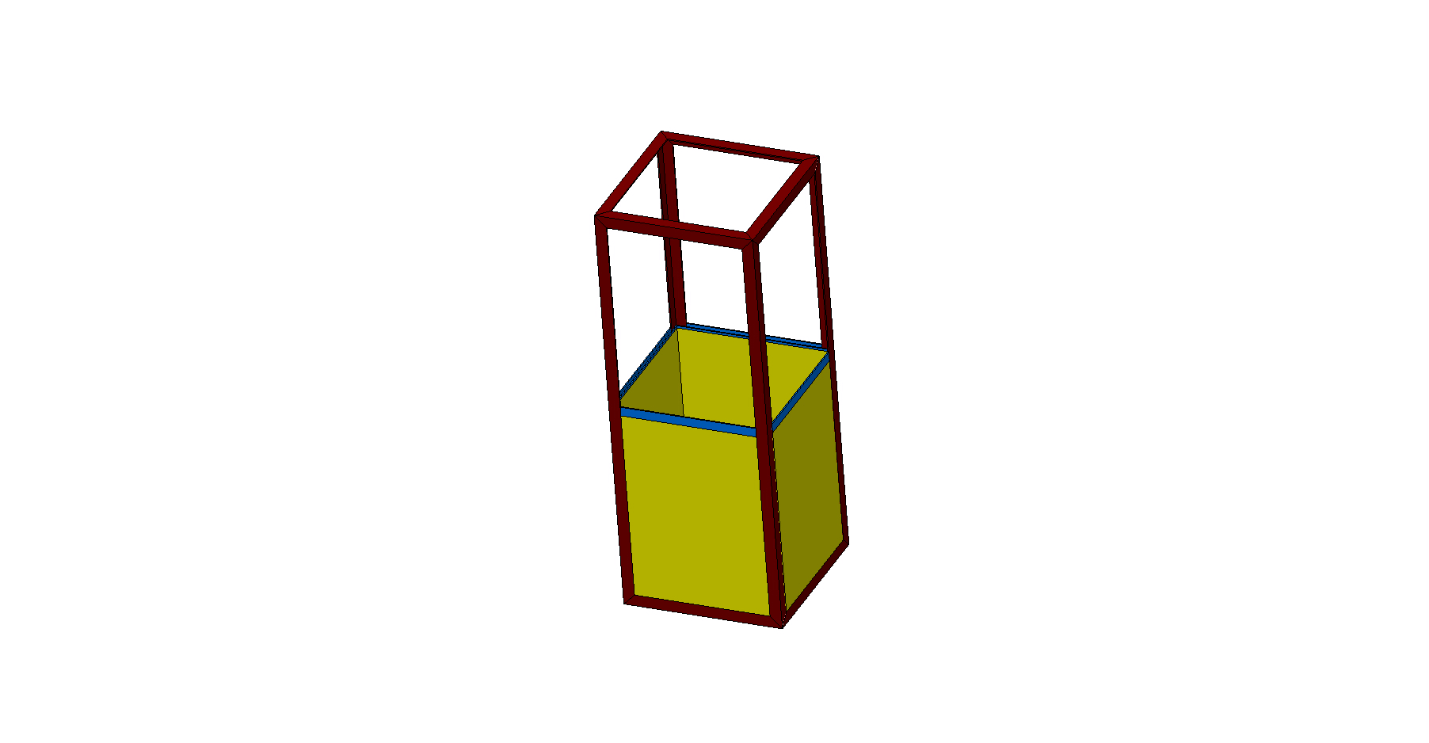
Installation
DRAFT

Slide 17
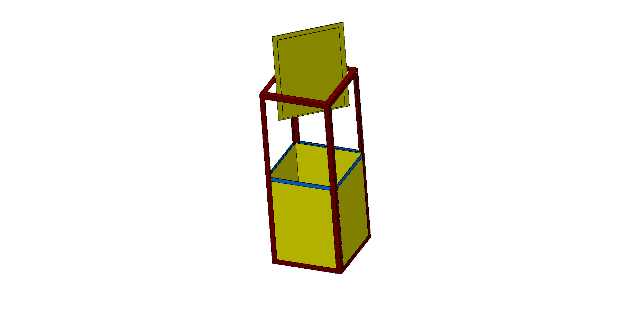
Installation
DRAFT

Slide 18
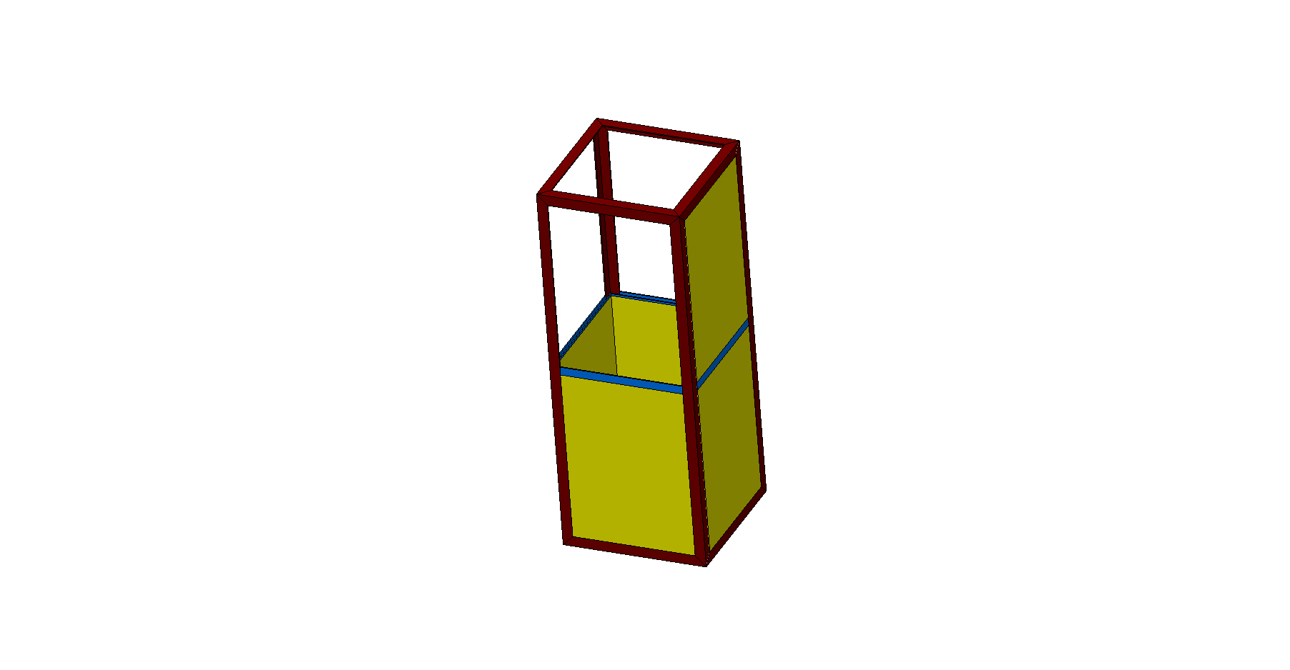
Installation
DRAFT

Slide 19
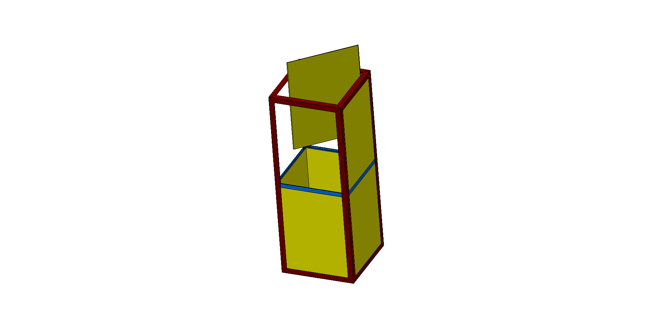
Installation
DRAFT

Slide 20
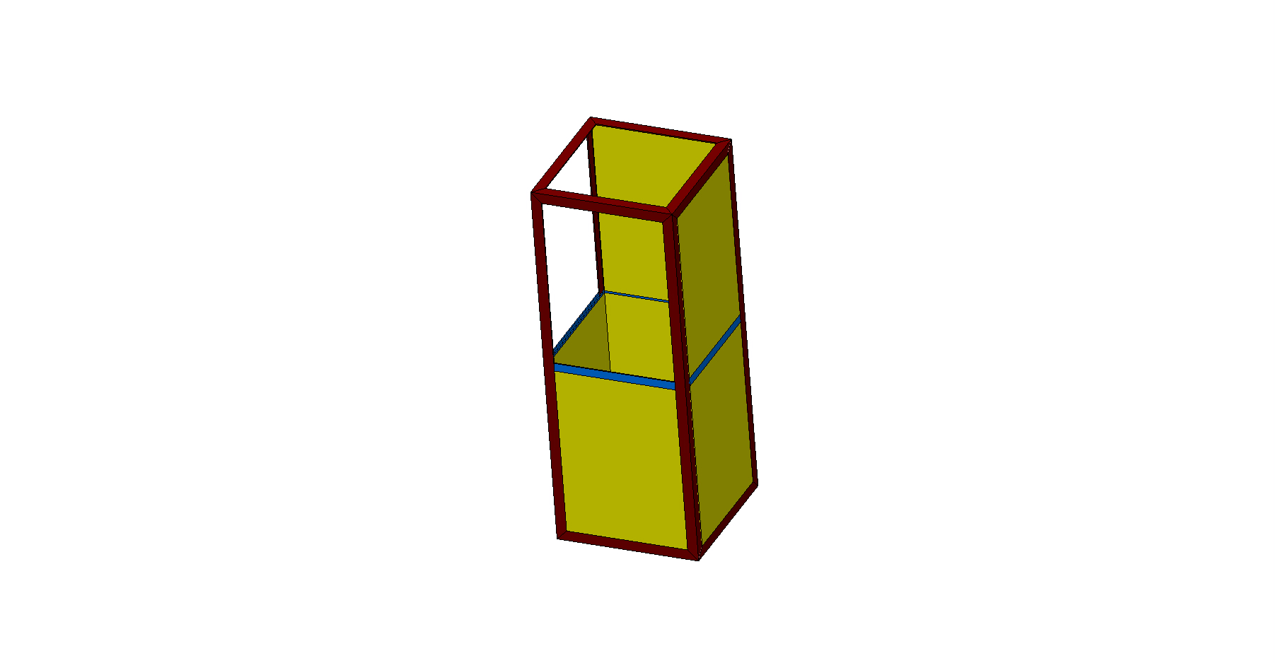
Installation
DRAFT

Slide 21
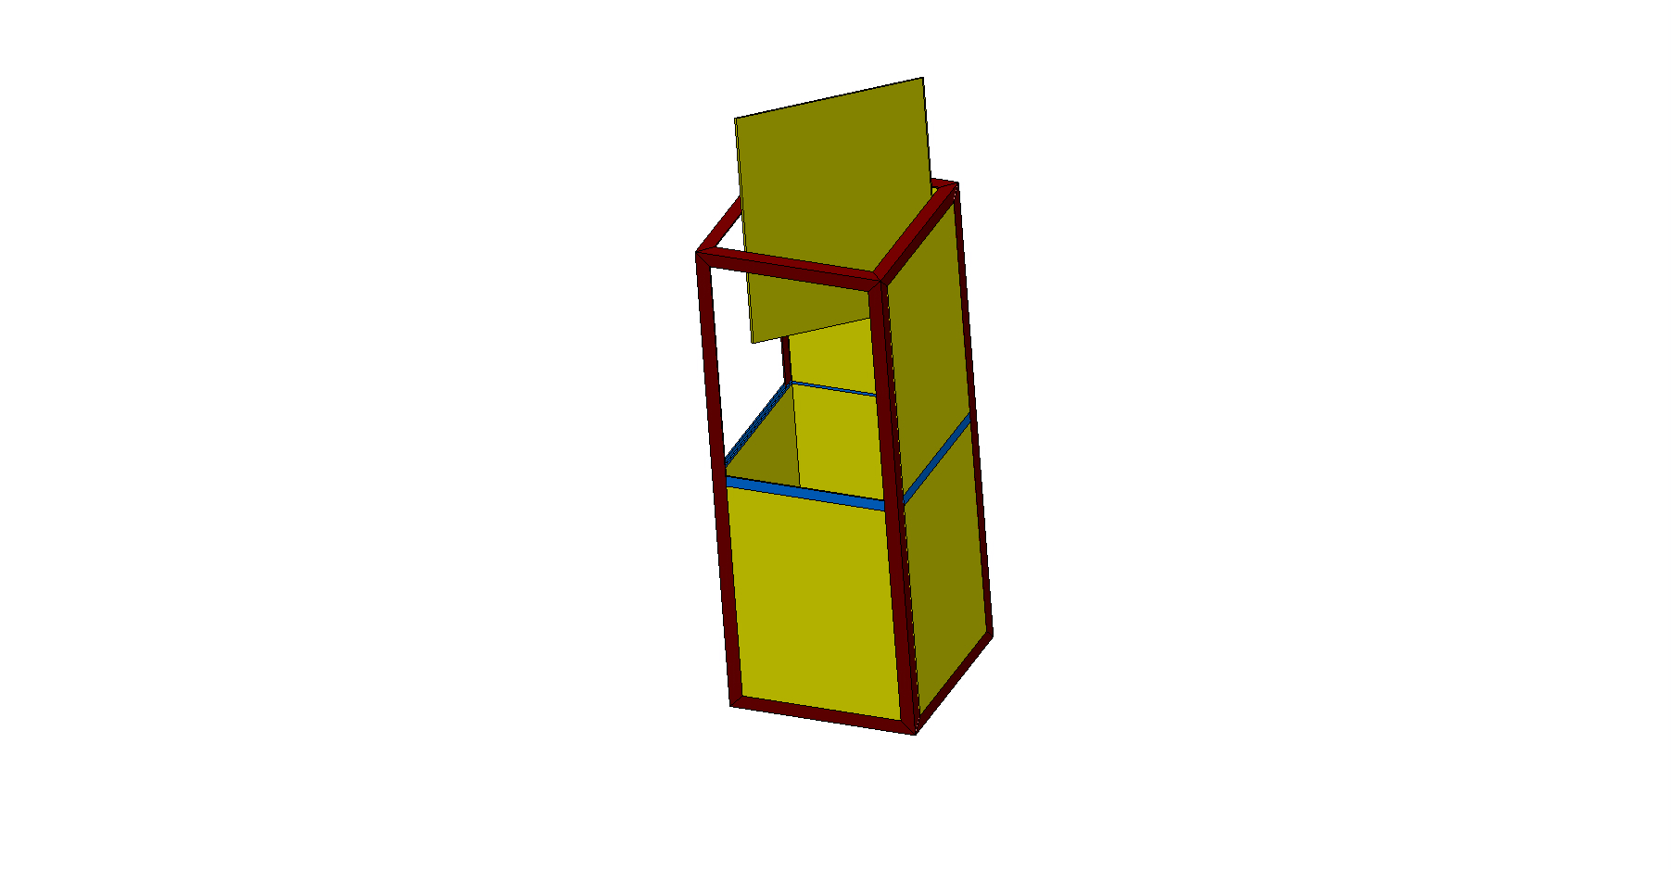
Installation
DRAFT

Slide 22
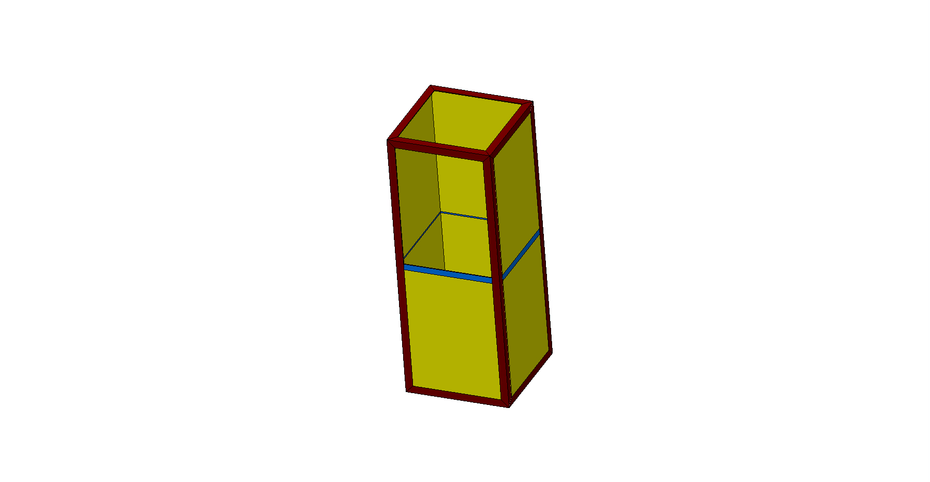
Installation
DRAFT

Slide 23
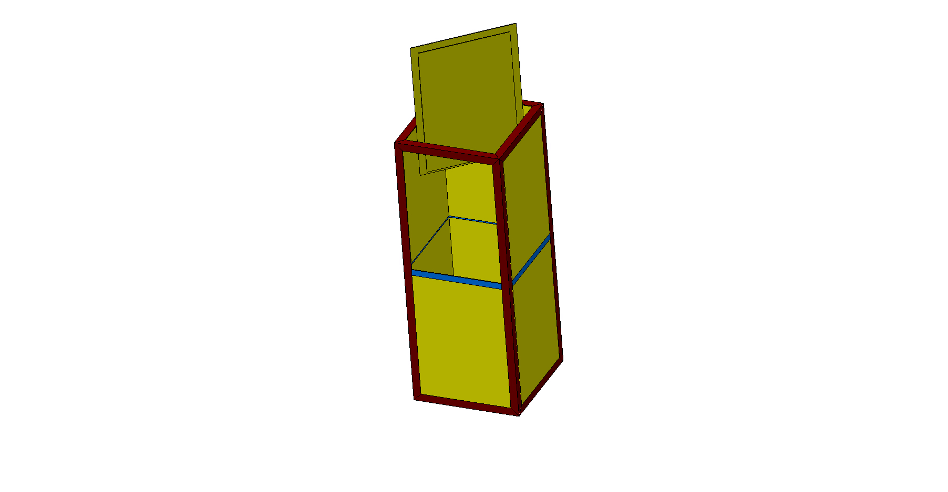
Installation
DRAFT

Slide 24
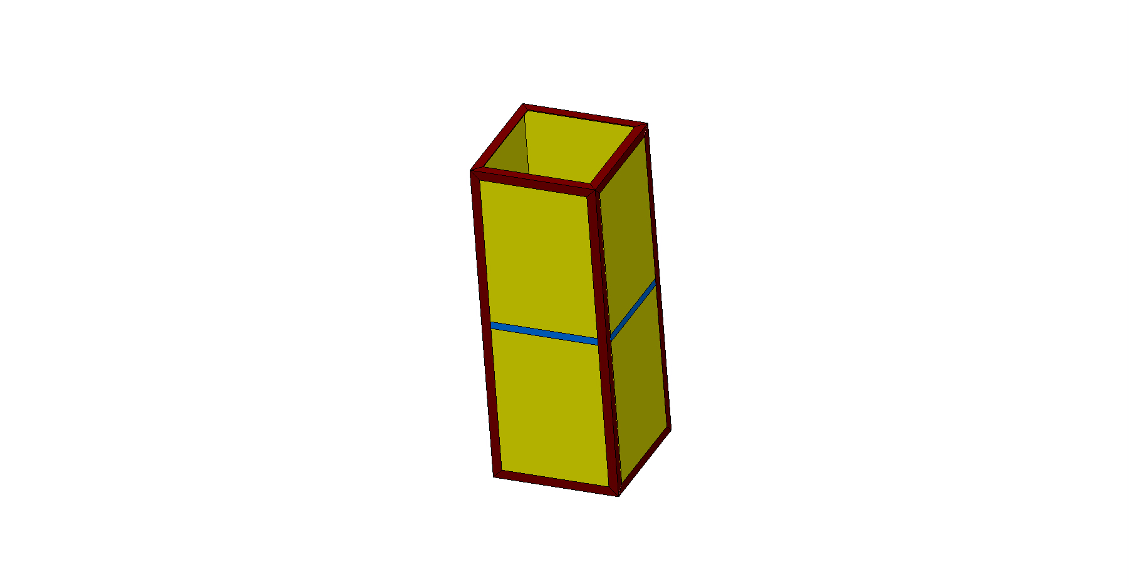
Installation
DRAFT

Slide 25
4 Modules-Installation in the Cryostat

Slide 26
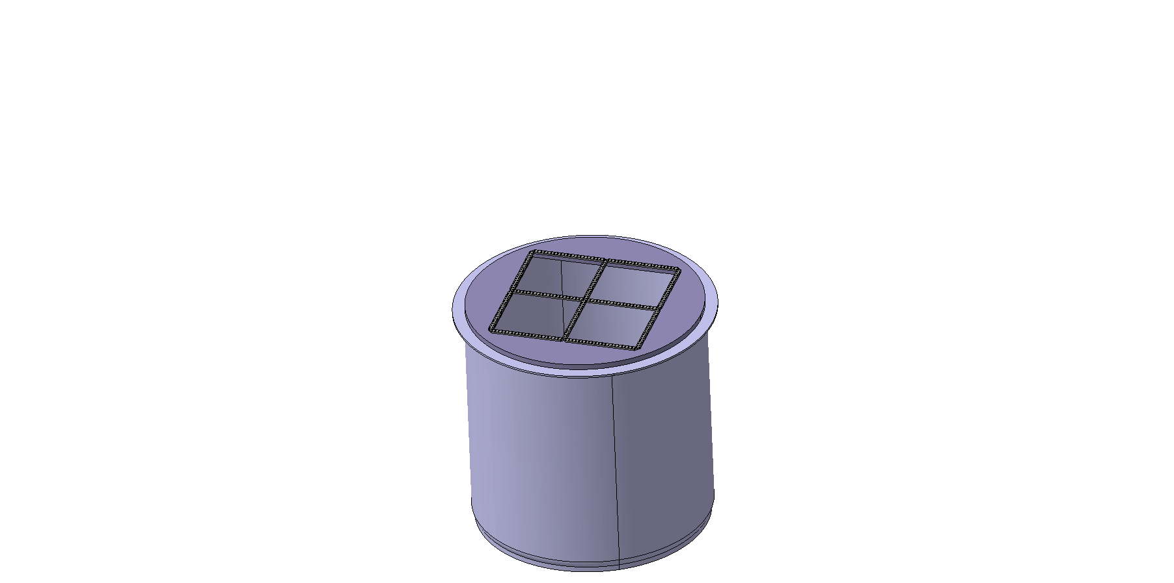
Installation
DRAFT

Slide 27
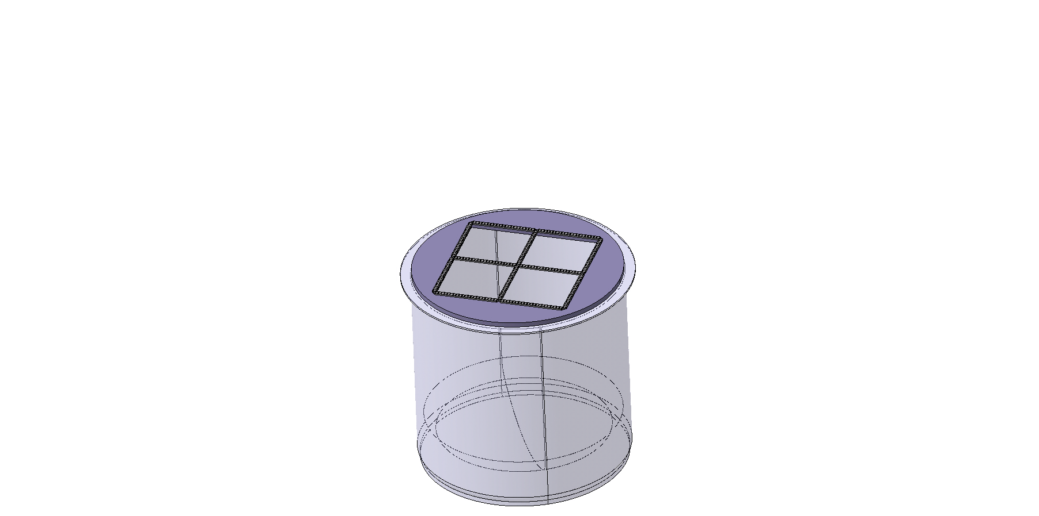
Installation
DRAFT

Slide 28
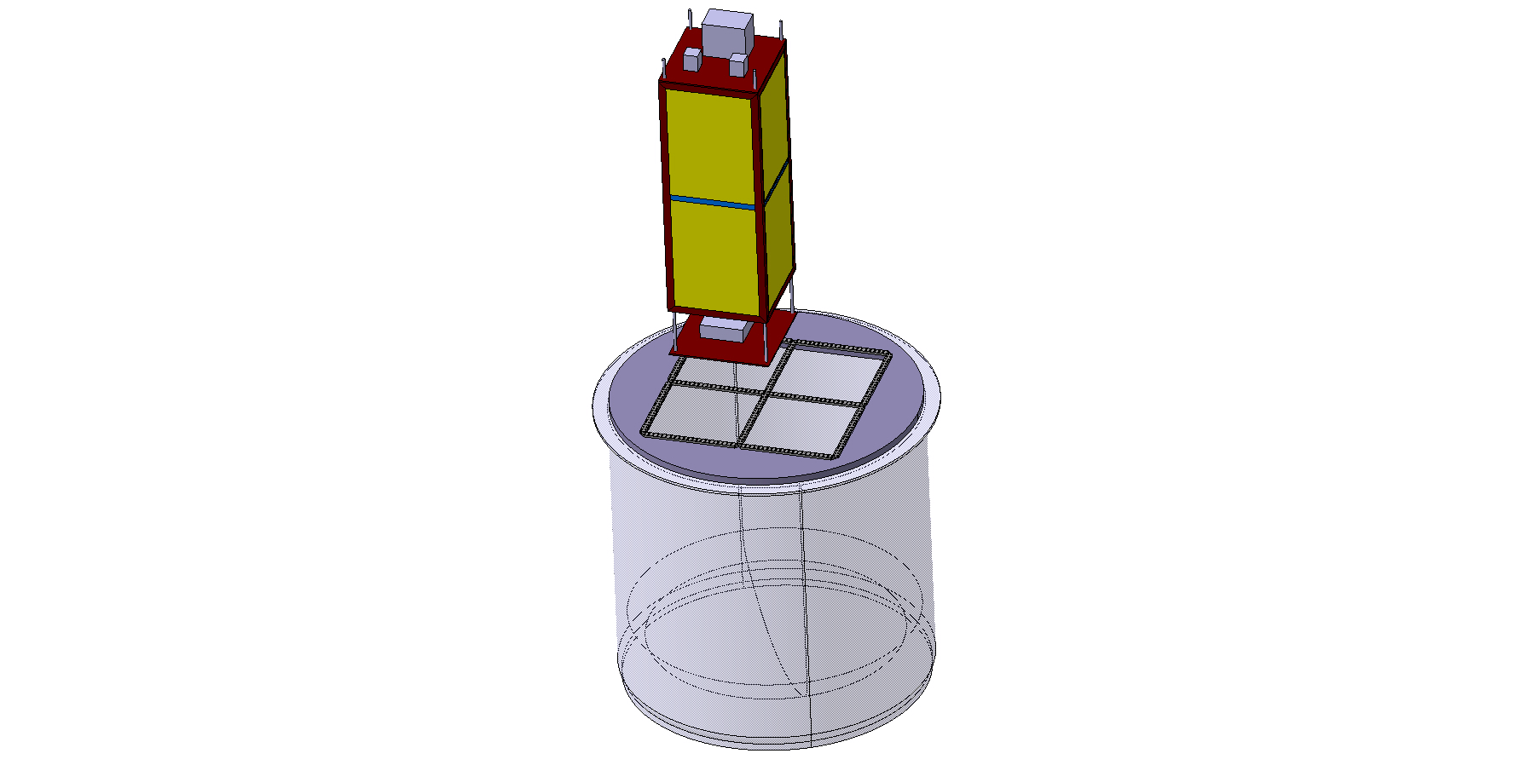
Installation
DRAFT

Slide 29
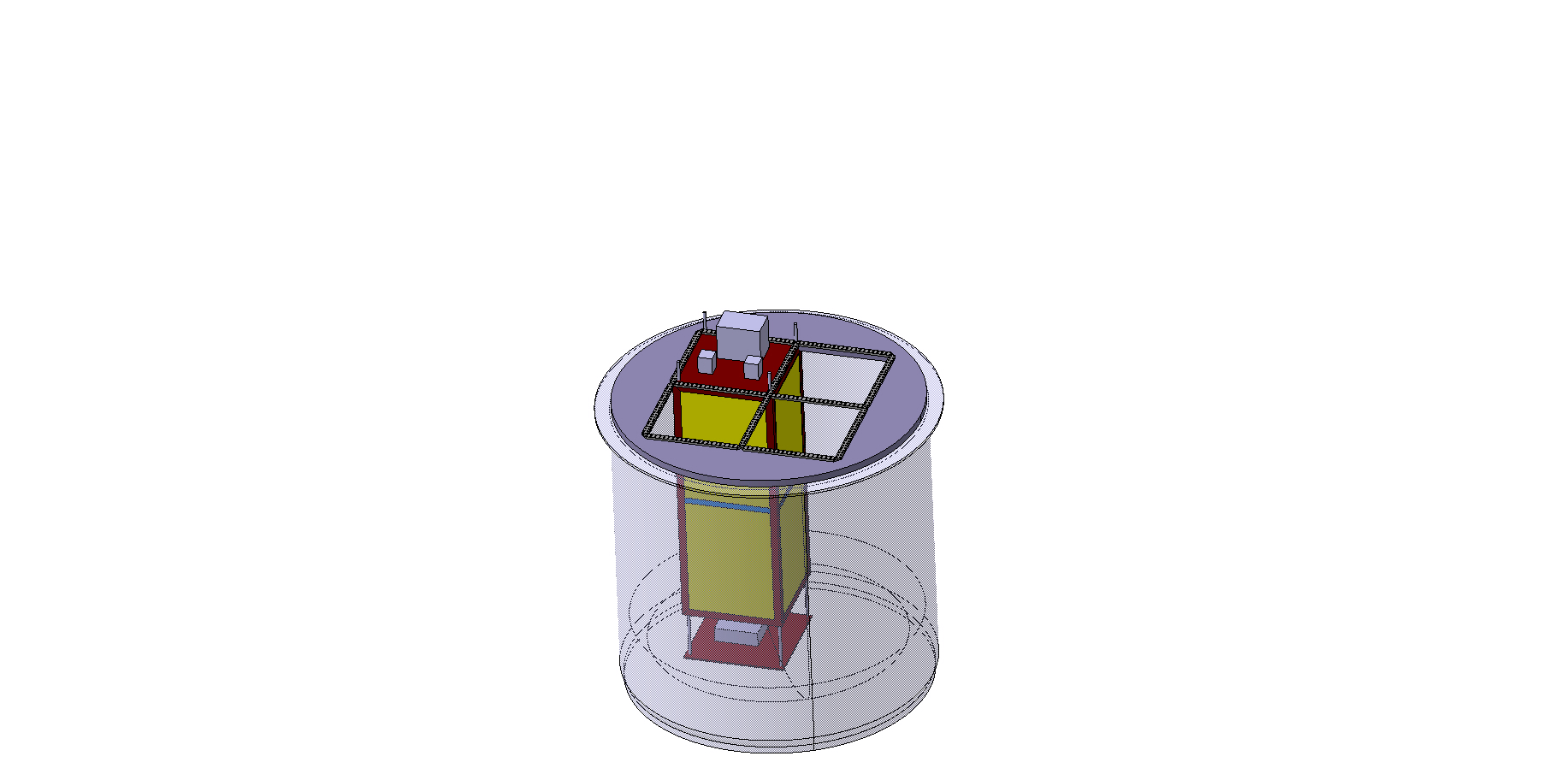
Installation
DRAFT

Slide 30
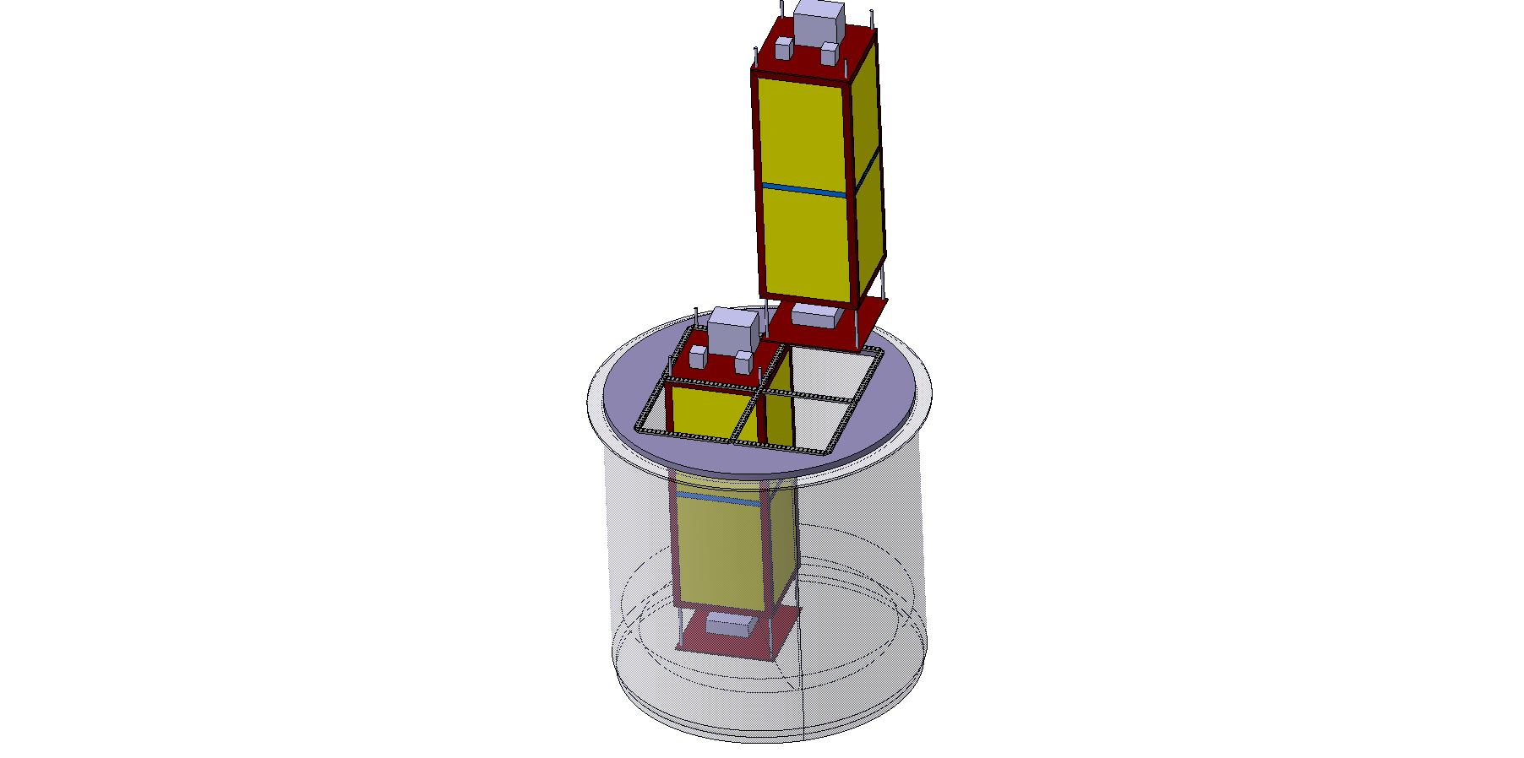
Installation
DRAFT

Slide 31
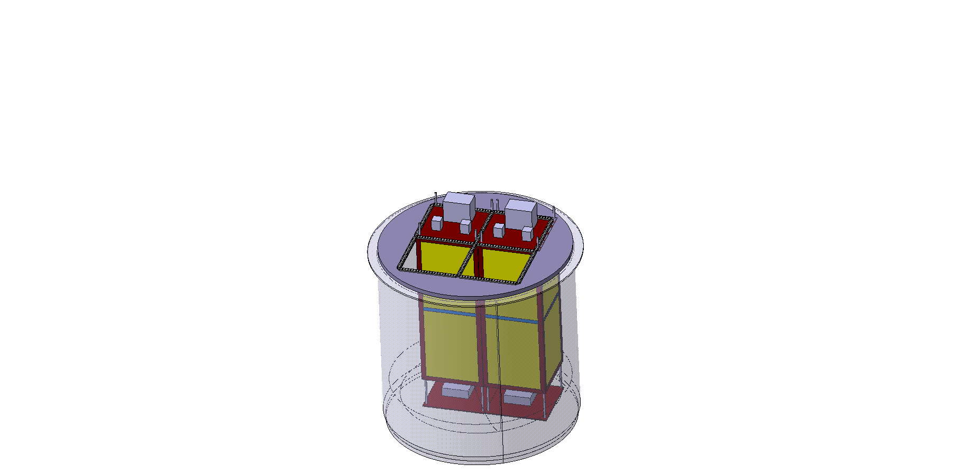
Installation
DRAFT

Slide 32
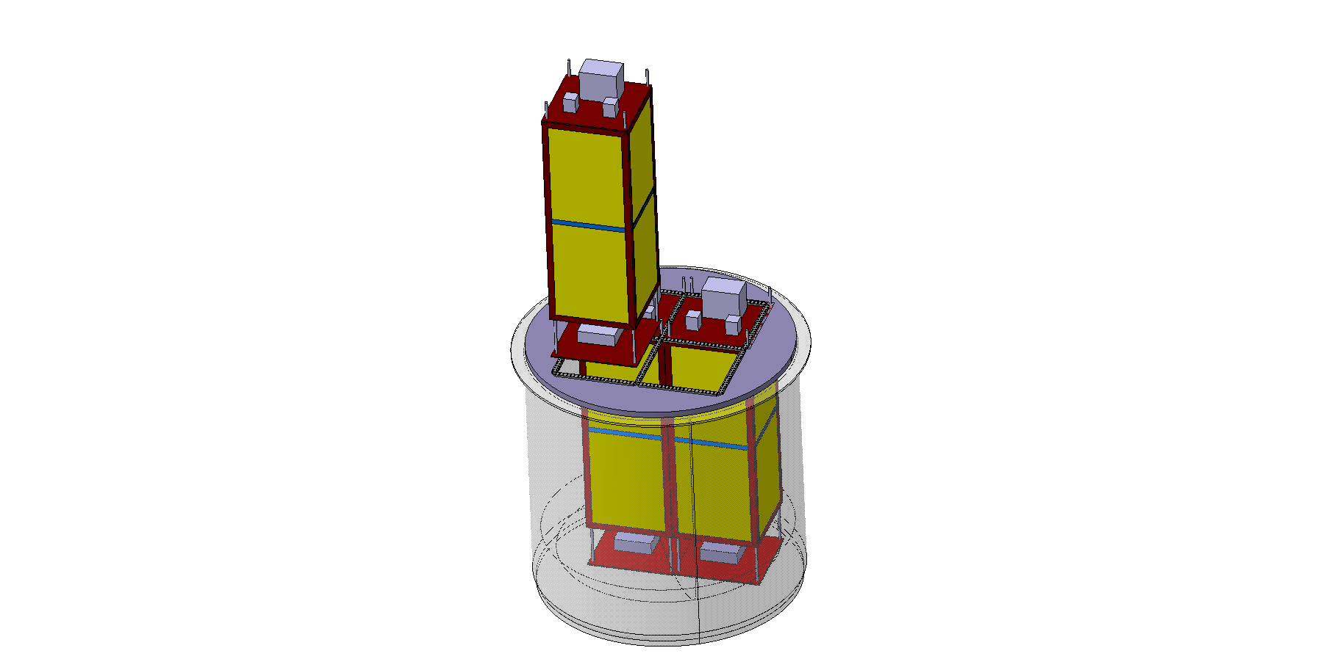
Installation
DRAFT

Slide 33
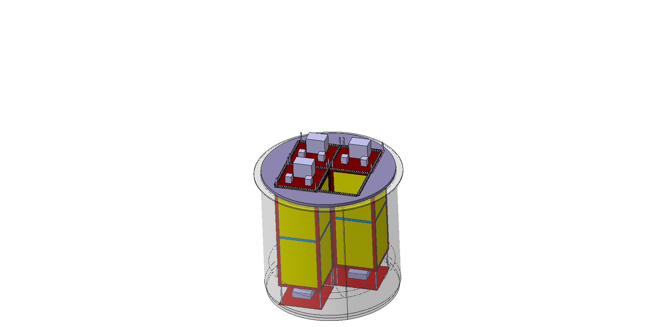
Installation
DRAFT

Slide 34
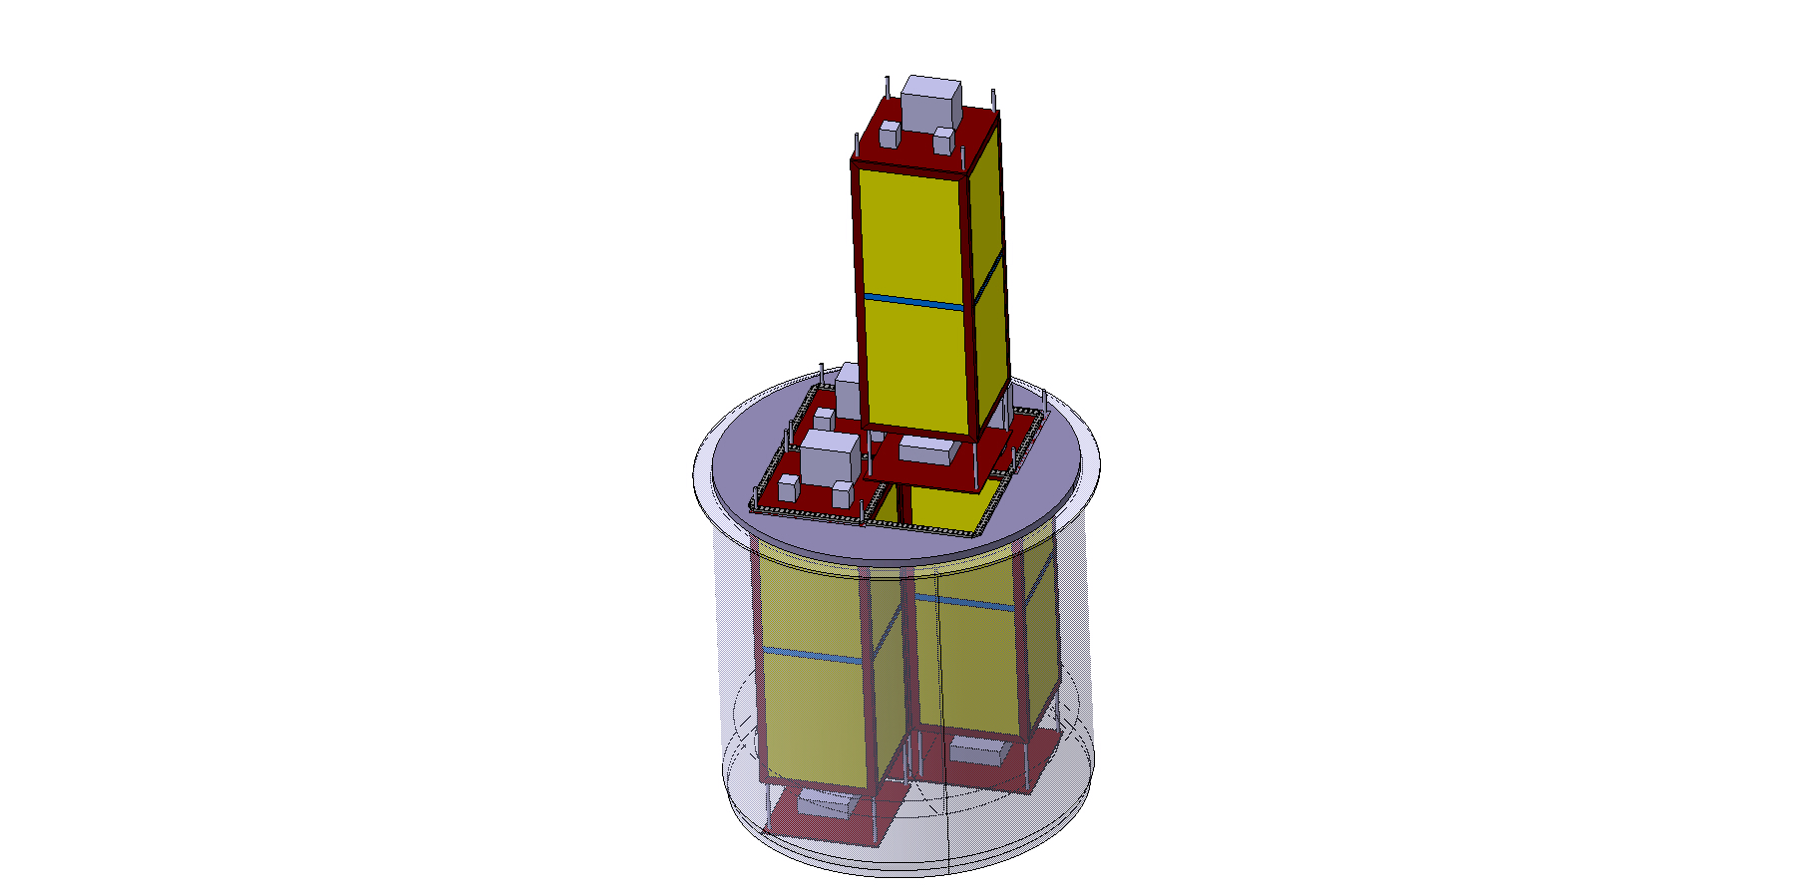
Installation
DRAFT

Slide 35
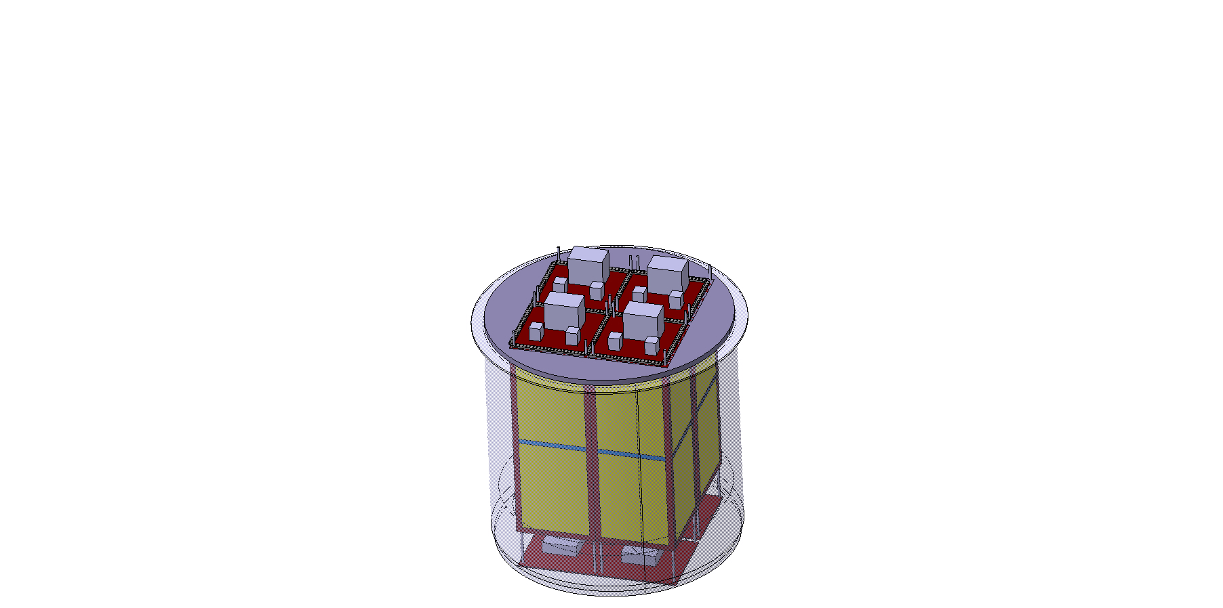
Installation
DRAFT

Slide 36
Maintenance Procedure

Slide 37
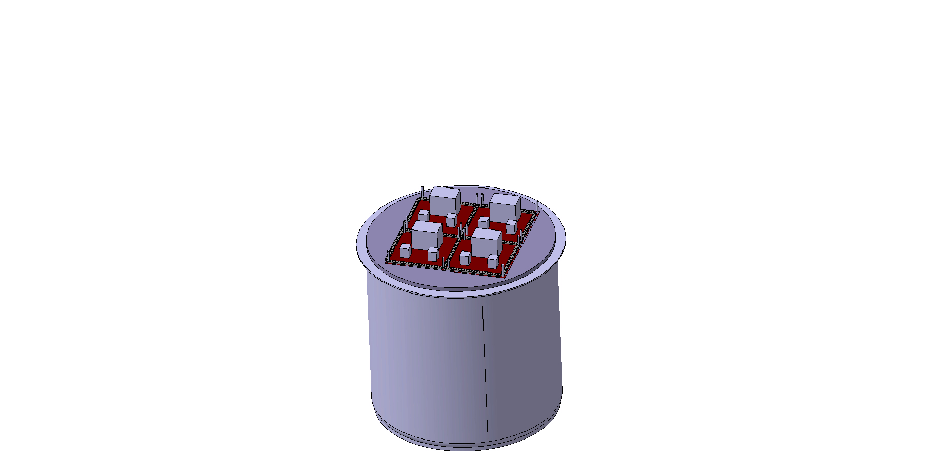
Maintenance
DRAFT

Slide 38
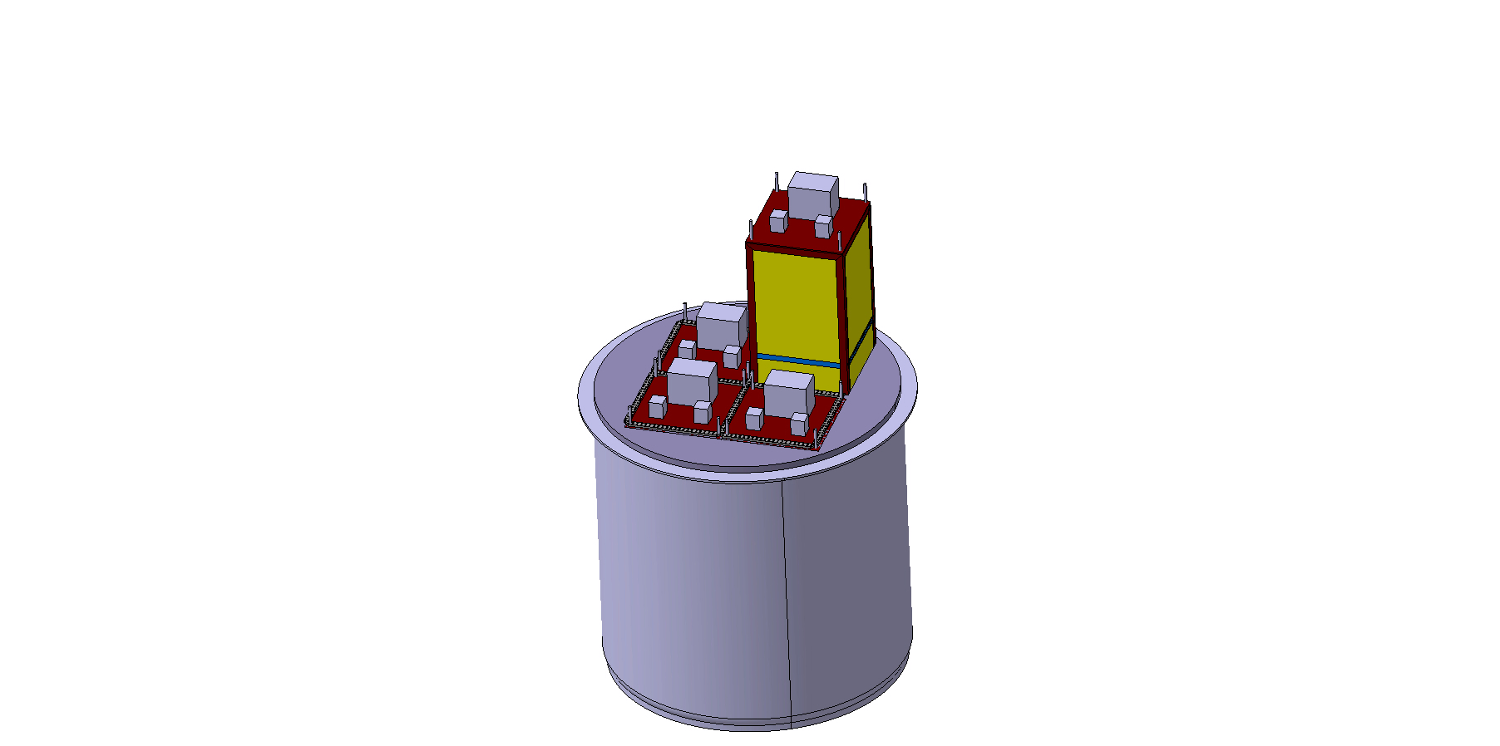
Maintenance
DRAFT

Slide 39
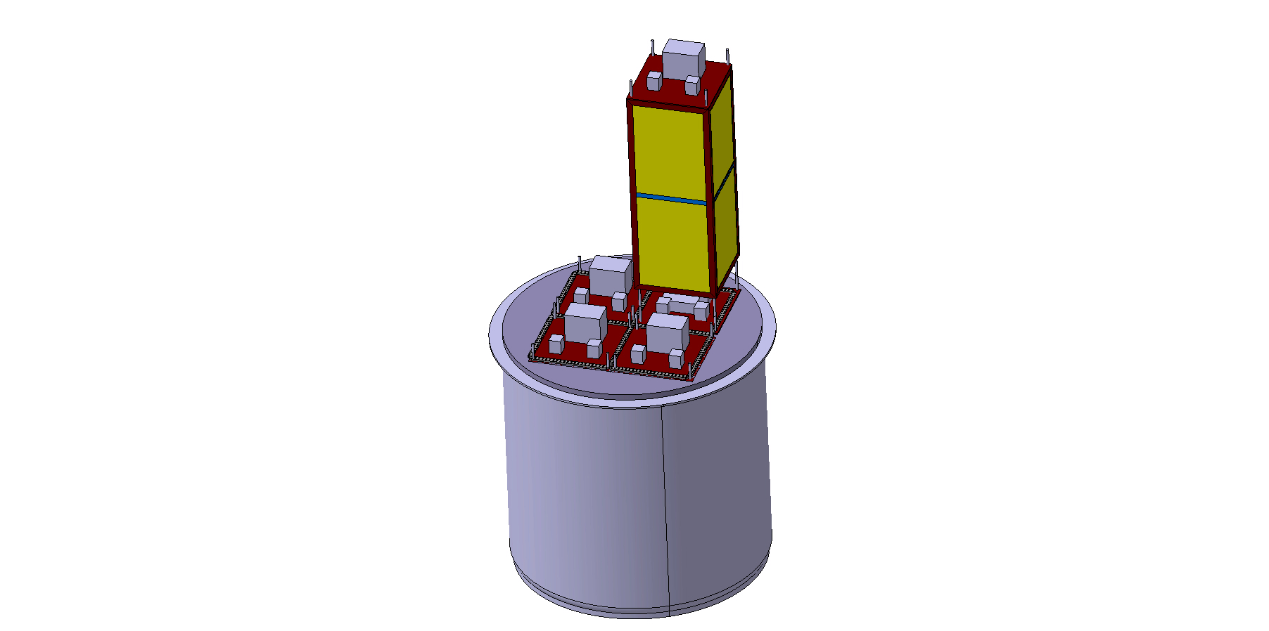
Maintenance
DRAFT

Slide 40
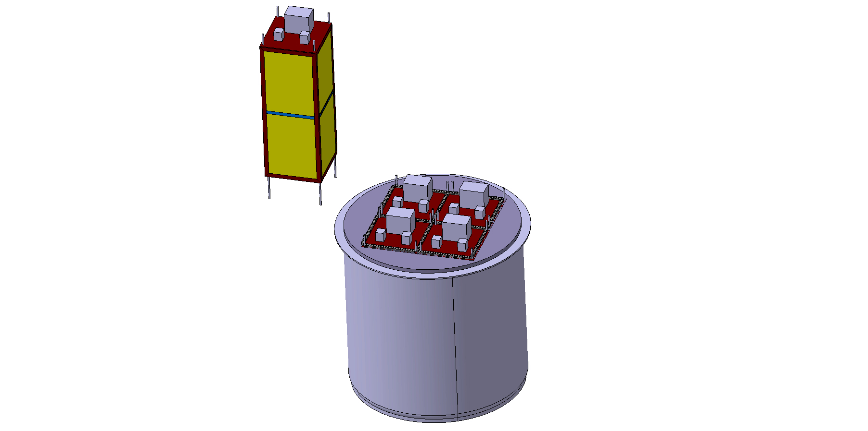
Maintenance
DRAFT

Slide 41
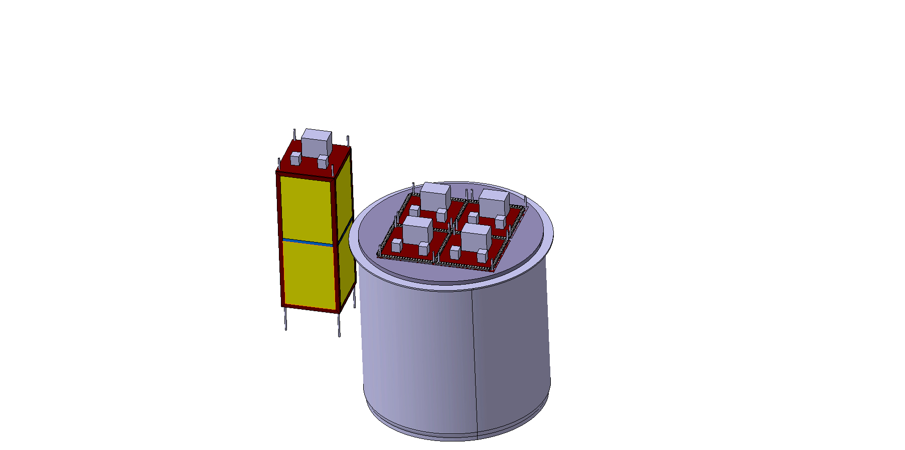
Maintenance
DRAFT

Slide 42
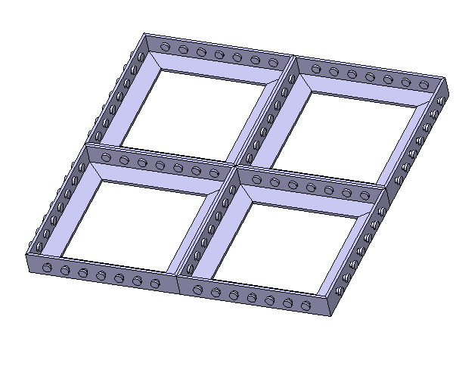
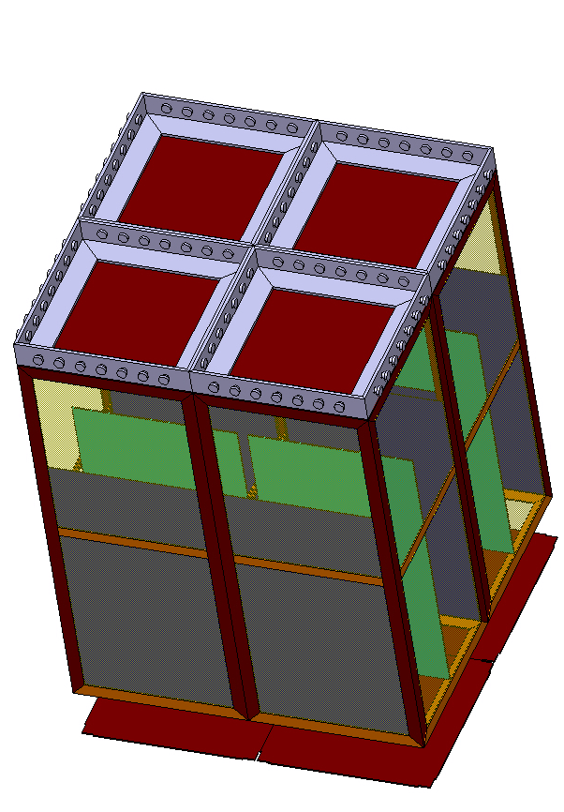
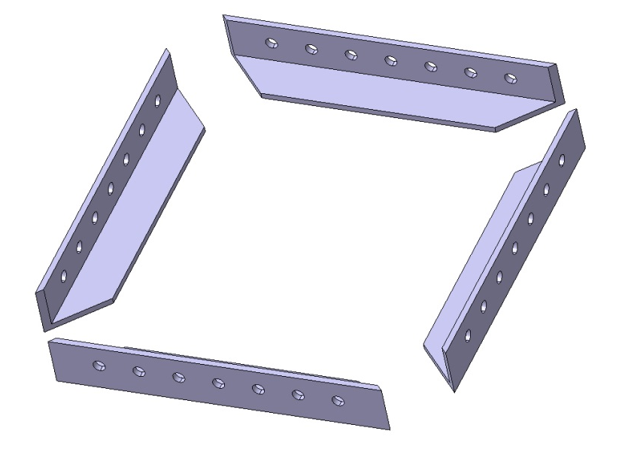
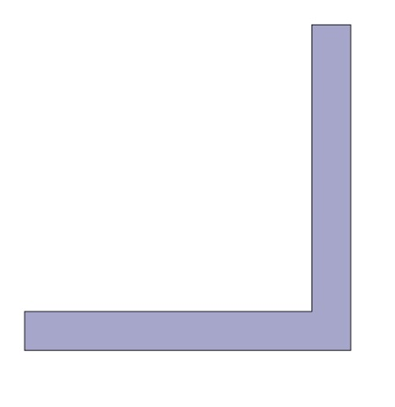
Top Grid
!! 0 mm gap in between the modules
Thickness
12mm
100 mm
100 mm
DRAFT

Slide 43
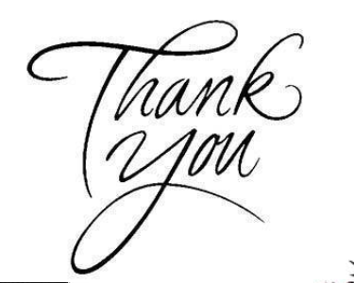
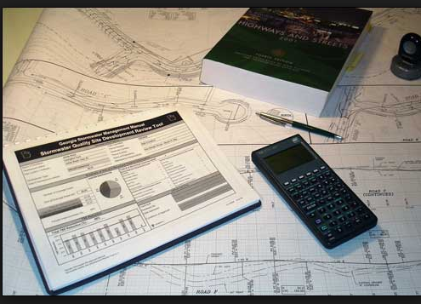
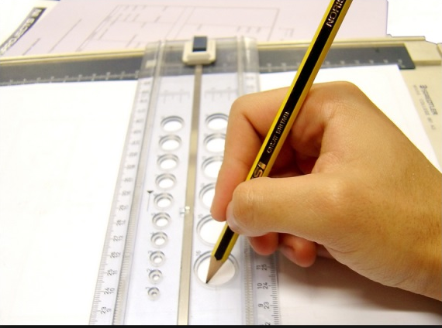
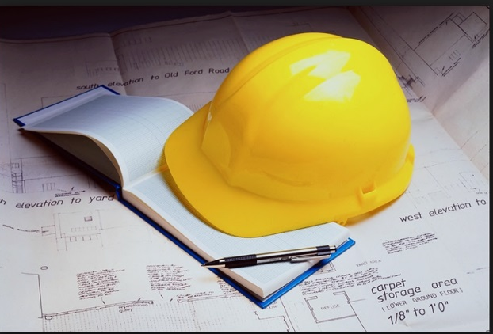
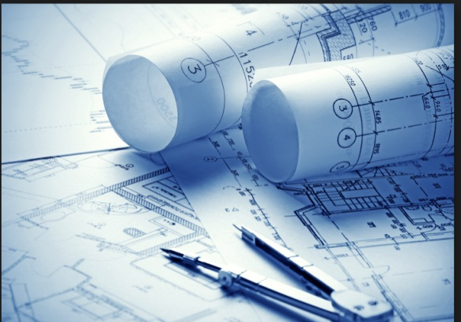
Thank you … questions ?
DRAFT

