Slide 1
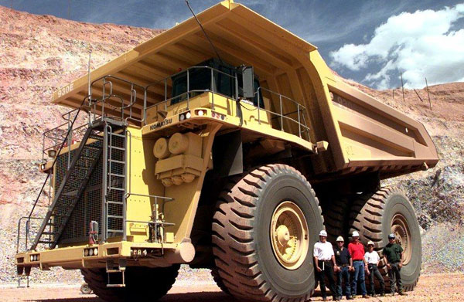
Data Mining – quo vadis?
Sebastian Kuhn
Old Dominion University

Slide 2
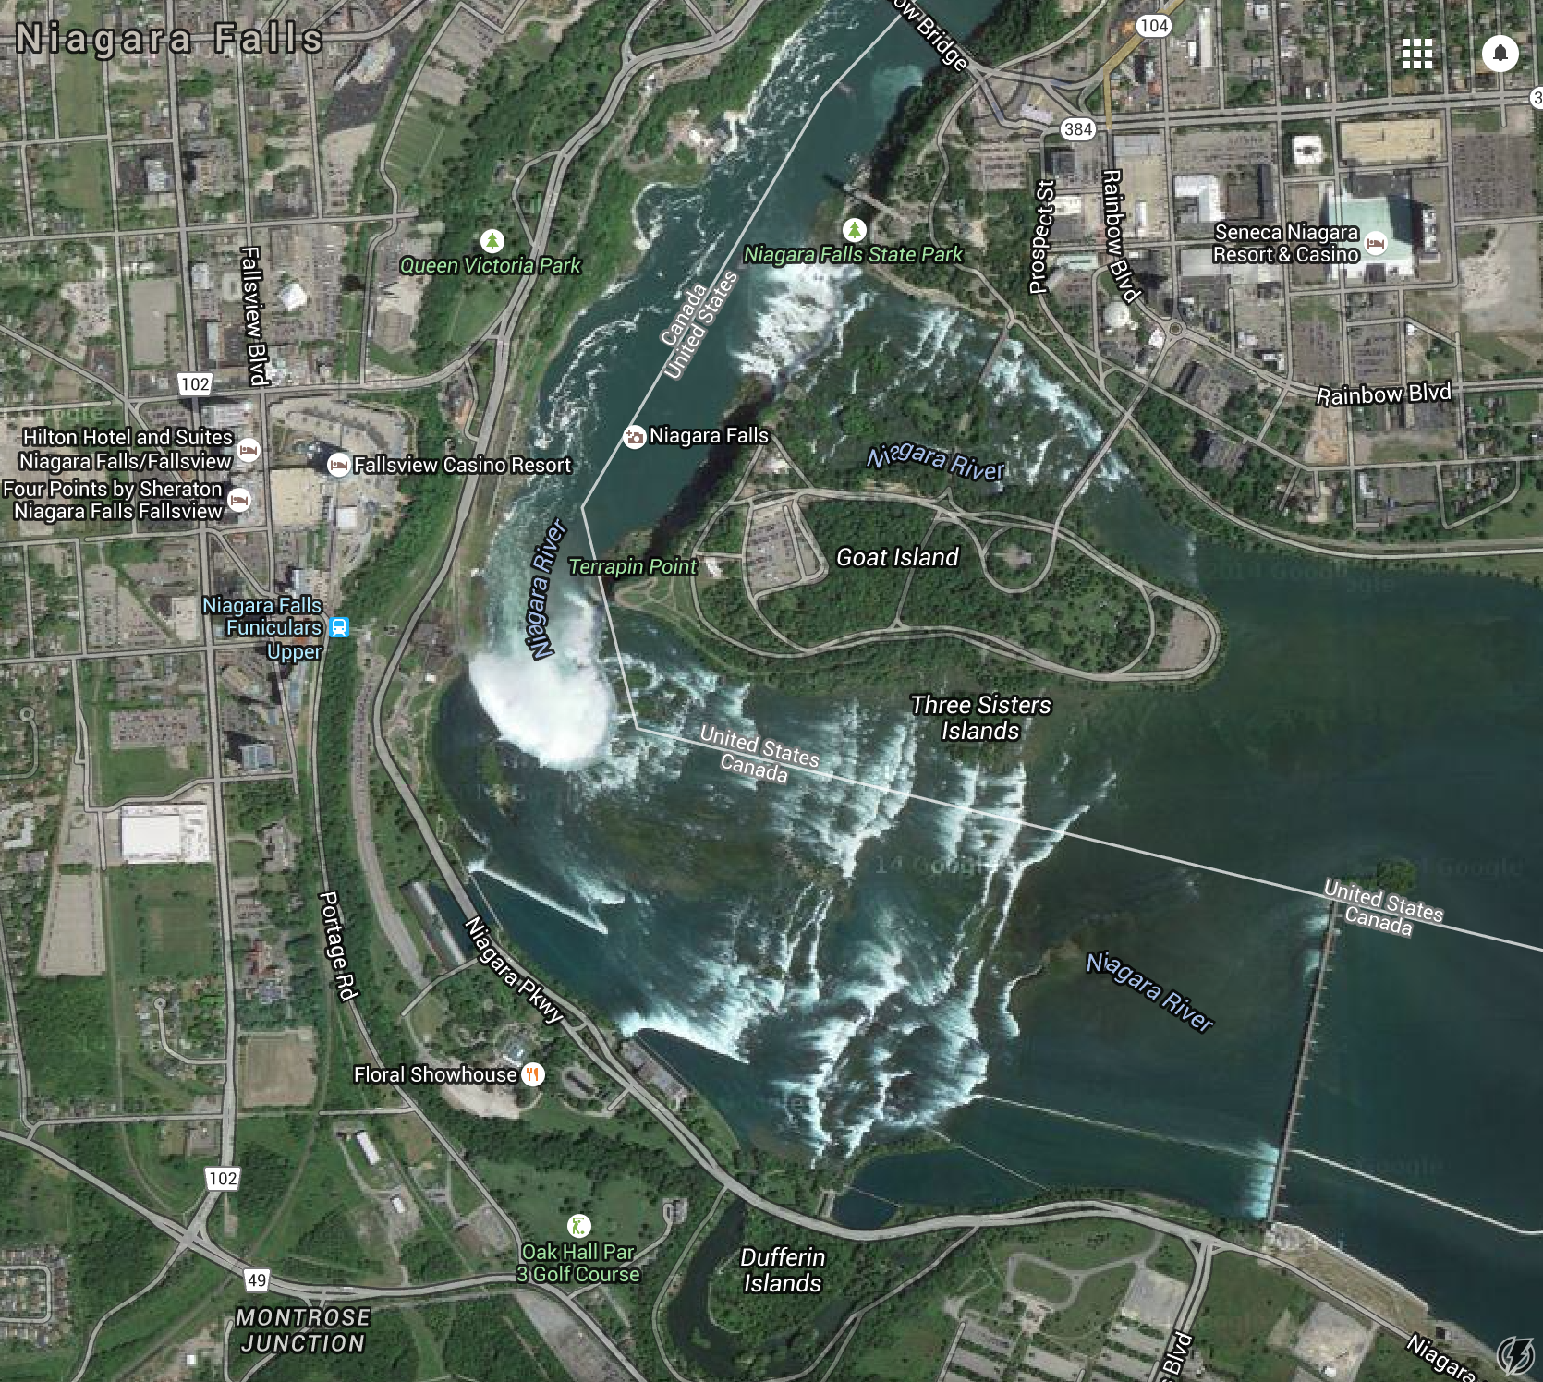
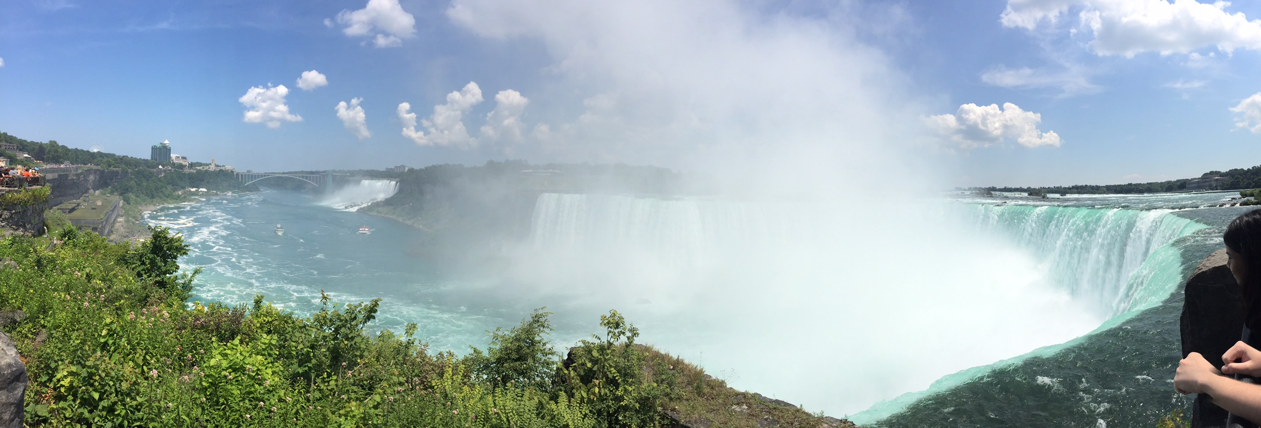
Data Mining – quo vadis?
We are here!
Sebastian Kuhn
Old Dominion University

Slide 3
Overview
What data exist?
  Which ones do we already have converted?
What signals have we proposed to look for?
  Which ones have already looked at?
  Successes and failures
  Ongoing and planned analyses
What else can we do?
What is needed most urgently?
What should we do in the future?

Slide 4
What data exist?
Photon runs? e.g. g11. Also, EG4 and EG1DVCS for additional nuclear+polarized nucleon/deuterium data
“Available” = coatjava version on ODU cluster (M.W., …?)
New EVIO format conversion starting over (Gagik, Lamiaa, Mariana):
e2a, e2b, eg2a,…
Others use root, ntuple or BOS files directly from JLab farm
Notes:
Updates from Lamiaa and Gagik. Presently changing over to CLAS12 standard software

Slide 5
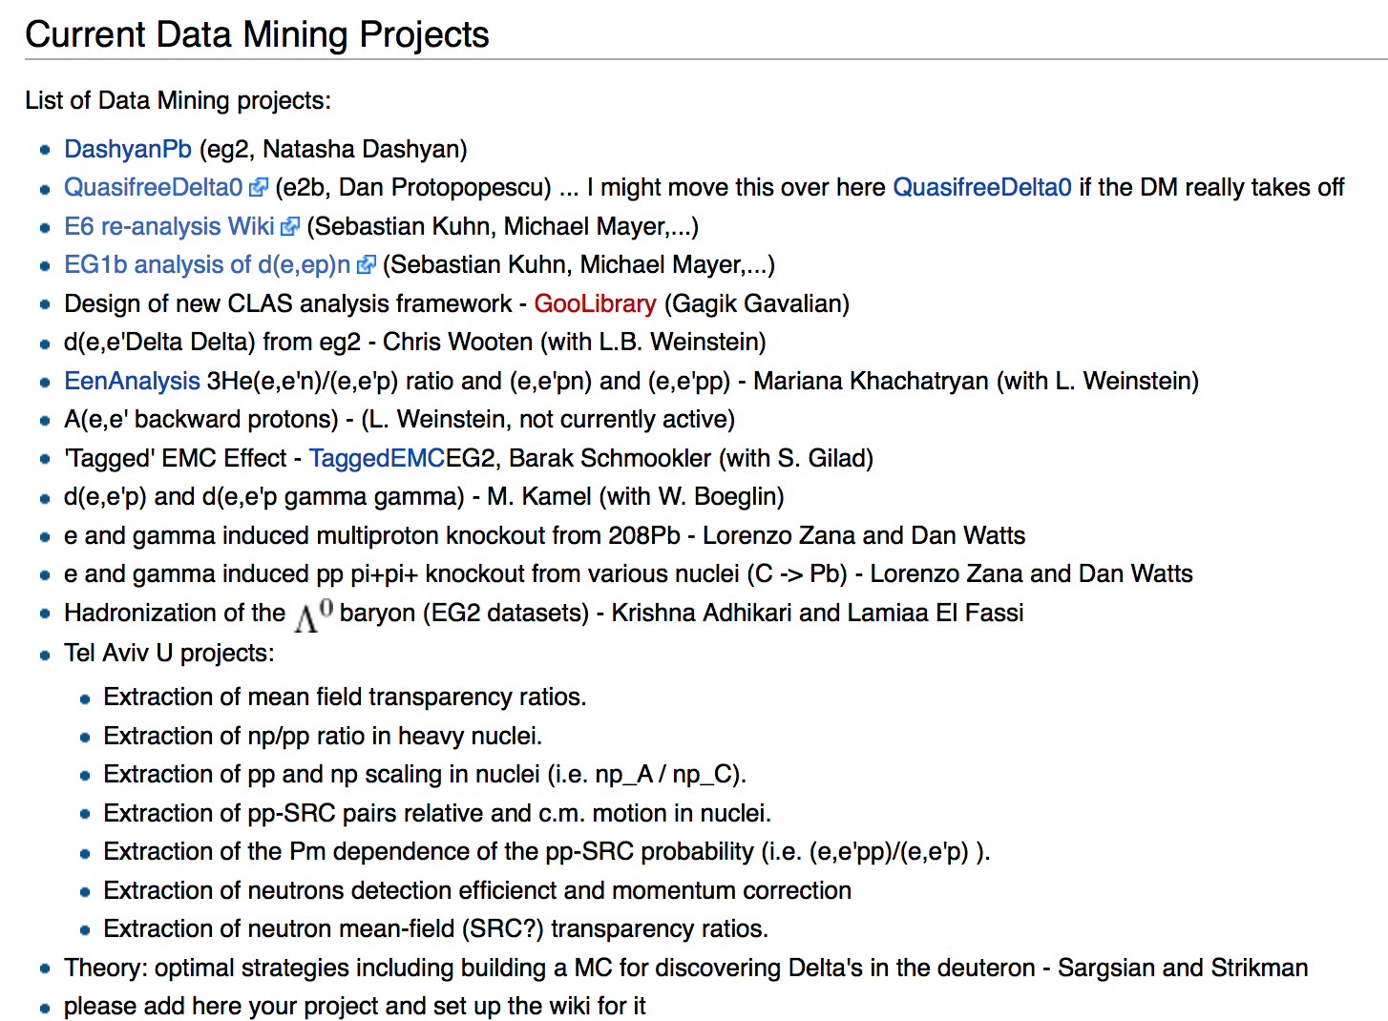
What projects exist?
https://clasweb.jlab.org/wiki/index.php/Nuclear_Data_Mining
Notes:
Please update!

Slide 6
Completed Analyses
pn/pp in heavy (asymmetric) nuclei
Double spin asymmetry in D(e,e’p)n
(M. Mayer; PWG approved, paper about to be submitted)
Transparency in SR pp pair emission from Nuclei

Slide 7
Ongoing Analyses
Validation of neutrino cross section MCs (K.M., S.M,…; MichSU, URoch,)
ω/ρ/φ meson production in medium (M.W., Canisius)
Production length (UTFSM)
EMC ratio tagged on backward p in nuclei (B.S., S.G., MIT)
p/n on ³He as function of momenta (M.K., ODU)
Λ⁰ production in EG2 data (K.A., MissSU)
A(e,e’p)/¹²C(e,e’p) vs. A(e,e’n)/¹²C(e,e’n) as function of momenta (M.D., Tel Aviv)
pp pair c.m. momenta (E.C., Tel Aviv)
3N SRC (E.C., Tel Aviv)
5th SF for D(e,e’p); G_{Mn} from e5 ? (G.G., Richmond)
Δ⁰ production on ³He ? (Glasgow)
(e,e’p) transparency ratio A/¹²C ? (Tel Aviv)

Slide 8
Explored but abandoned channels
ΔΔ from d(e,e’) (eg2, e6)
Notes:
PRESENTLY abandoned means we are discouraged but haven’t given up entirely

Slide 9
What have we promised for the future?
(e,e’pN) over a wide range of A, Z/N, Q² (incl. 0 GeV²) and p_{cm}, p_{rel}
3N SRC
pol. D(e,e’p)n with EG4, EG1-DVCS; 5th SF with E5, E6, EG2, E1e
D(e,e’p_{S})X for other data sets than E6
Backward (and forward!?) Δ from nuclei
CT studies: D(e’ep/Δ) in transverse kinematics, ρ production, S₁₁ production on nuclei
Hadronization (partially underway - ω/ρ/φ,Λ)

Slide 10
What else can we do?
???

Slide 11
What is needed most urgently?
Continue conversion to newest (“final”?) EVIO format and CLARA/Java
Software improvements?
Most urgent new data sets?
Most urgent cuts, corrections, …?
SIMULATIONS? (GEMC???)
What else is needed to support ongoing analyses?

Slide 12
What should we do in the future?
OPTION A:
Complete ongoing analyses, publish and declare victory
OPTION B: Continue work of converting data, simulations etc. as part of overall CLAS/CLAS12 data preservation strategy (slow)
  Gagik working with other run groups like eg1-dvcs
OPTION C: Write another proposal to hire a postdoc to address the most urgent needs and future plans

Slide 13
2014 Proposal - Reviews
Without this initiative these data, that required serious financial and human efforts, would be probably lost. Summary Score: Strongly Encourage Funding (5-6) 6.0
[Panelist] There is, in my opinion, a dramatic mismatch between a beautifully written summary of the physics background and the real task of the personnel for which funding is requested. My feeling is that the request is rather on the higher side and that the work could also be done by a talented PhD student. Summary Score: Encourage Funding (3-4) 3.0
[Panelist] I admit that I found this proposal to be rather strange, and the panel discussions indicated that I was not alone with this impression. Summary Score: Encourage Funding (3-4) 3.0
There is clearly an abundance of topics that can be addressed. These researchers have been involved in these studies for many years. The technique proposed has produced valuable results in the past. This is effort is likely to do so as well. The proposal address inclusion of a user-friendly simulation component to the already implemented data analysis capability. This is a necessary step to produce physics results; the data analysis is only half the job. Summary Score: Strongly Encourage Funding (5-6) 5.0
Nevertheless, it is important to archieve the wealth of data obtained at CLAS6, and this proposal will certainly allow more researchers to take a quick look of existing data to check out their ideas or speculations. This proposal is definitely cost-effective in maximizing the physics output
from JLab 6 GeV programs. Summary Score: Encourage Funding (3-4) 4.0
It is impossible for the reviewer to gauge how much benefit, if any, the data-mining effort has had on these topics or how much benefit is to be expected. …Given this reduction in scope of the project, however, it is
surprising that this, now much less ambitious, program has not progressed much more rapidly. Only three of the eleven data sets have been processed, with a fourth being in progress. Summary Score: Encourage Funding (3-4) 4.0
[Panelist] It is not sufficiently clear how much of the exiting data have been looked at and what has really come out of the existing effort? There are very little details about what the Postdoc will actually do, and thus there is very little basis to refute the conjecture that the personal costs seem inflated for this task.
Summary Score: Discourage Funding (1-2) 2.0
Notes:
Average Panelist: 2.67 Average Reader: 4.75

Slide 14
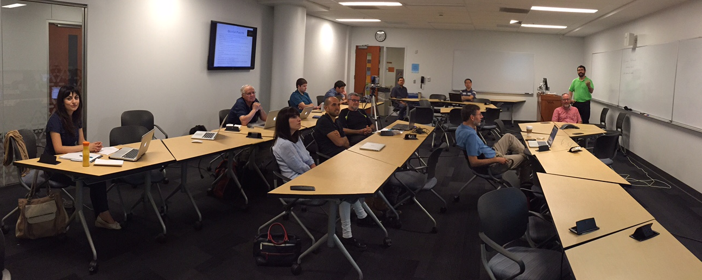
What should we do in the future?
These smart people (and the offsite participants) will have to decide:

