Slide 1

Zenodo: in support of Open Science
Tim SMITH
At CERN-JRC meeting

Slide 2
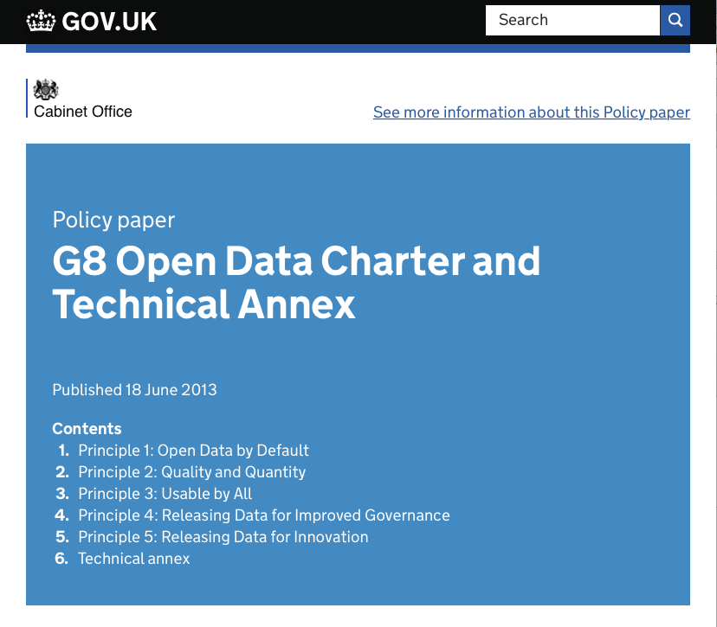
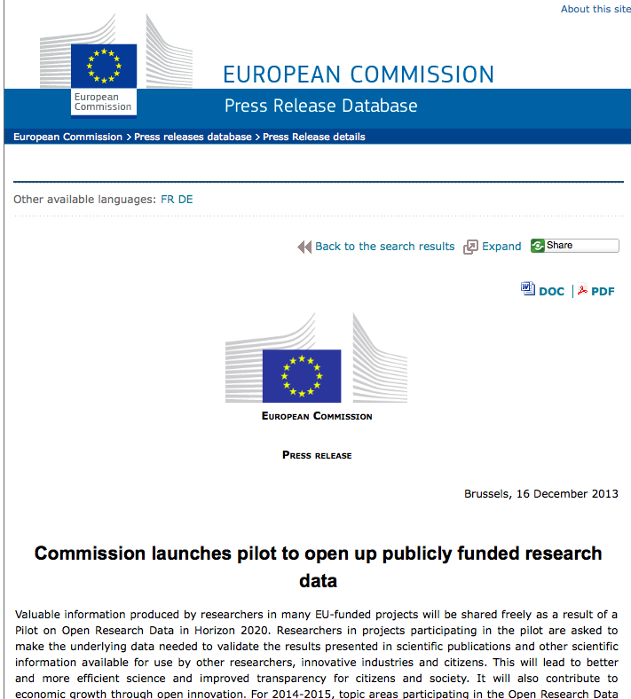


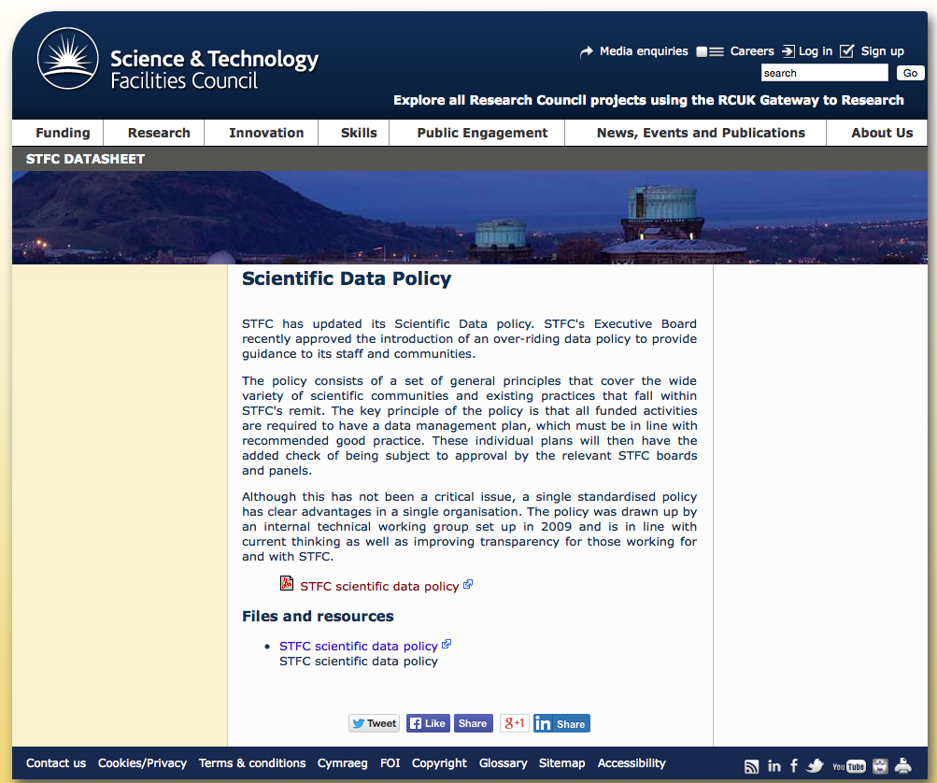
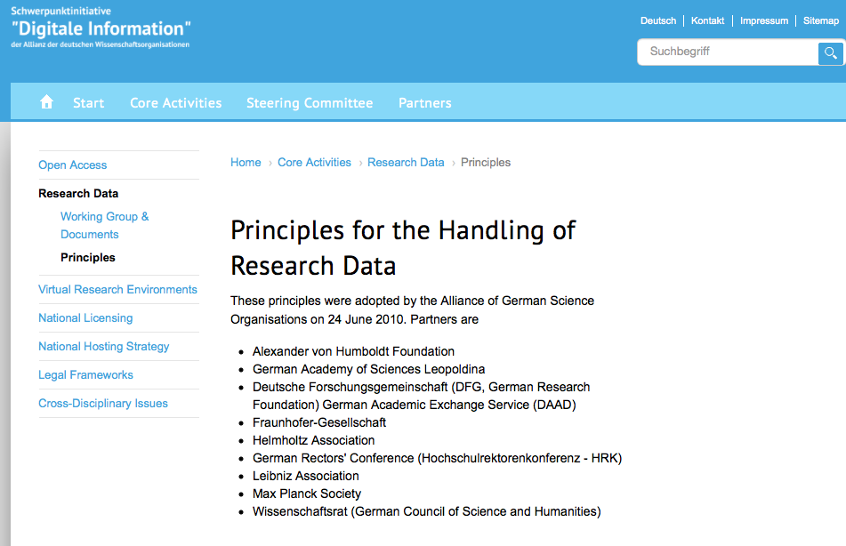

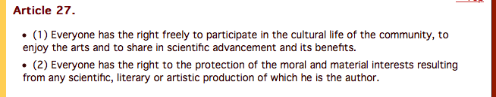
Political Context
Economic Growth
Transparency, Accountability
Public Good
“Scientific Data: open access to research results will boost Europe’s innovation capacity”
Notes:
Open: Maximize the Scientific Value
Report, review, record in the annals of science

Slide 3
Scientific Context
Law
Observation
Hypothesis
Prediction
Falsify
Digital Sensors
Data Acquisition
and processing Chain
Computational Modeling
Experimentation
Conclusion
Reproduction
Validation
Publication
Replication
Theory
Credibility Crisis:
47/53 “landmark” publications could not be replicated
500 Biology papers over 20 years: 80% of data collected no longer available
25% of published preclinical studies could be validated
Notes:
Objective, based on evidence, not linear!
Falsify and replace

Slide 4







Research Data Management
Open Data Pilot:
20% of funded activities
7 major areas (incl. FET, RI)
Notes:
Open: Maximize the Scientific Value
Report, review, record in the annals of science

Slide 5

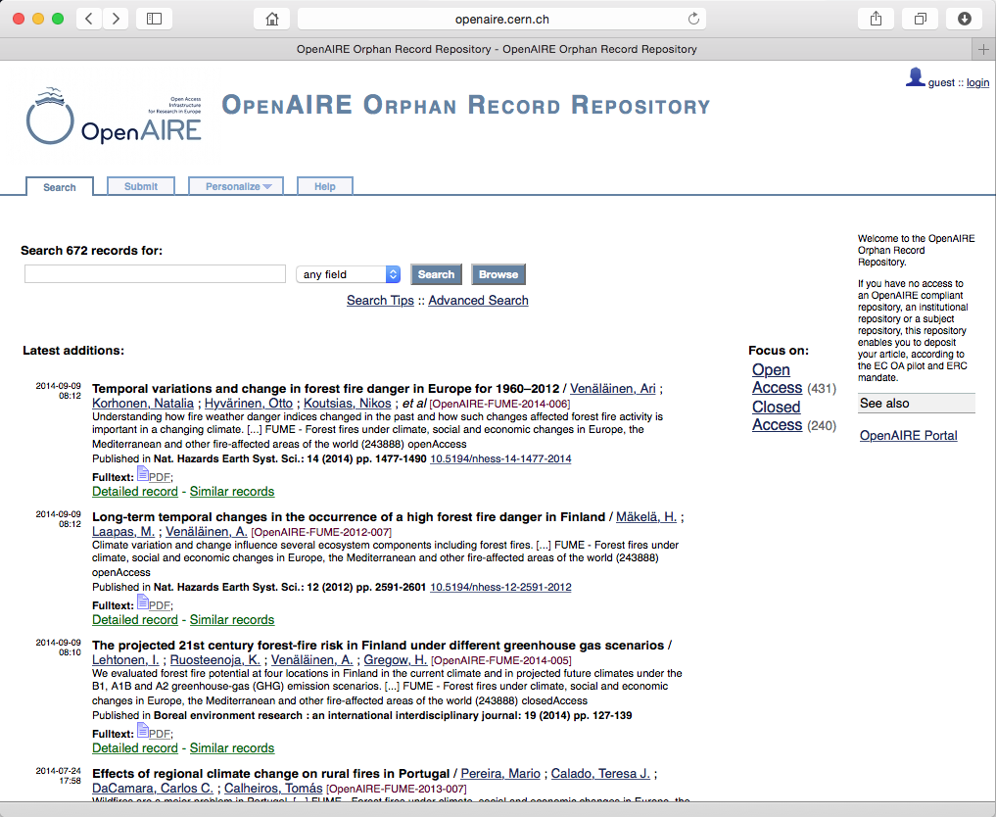




Provenance
EC Open Access Pilot
EC Open Data Pilot
2009-2012
2011-2014, 2015-2018

Slide 6









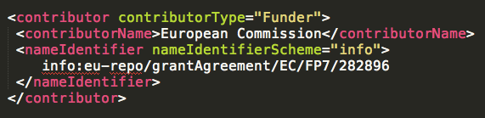

Open Data as a Service

Slide 7
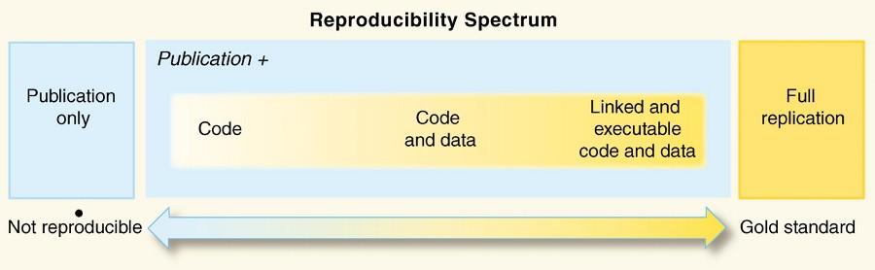

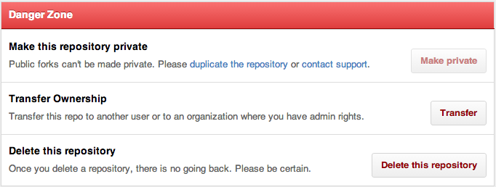
The key: Software

Slide 8
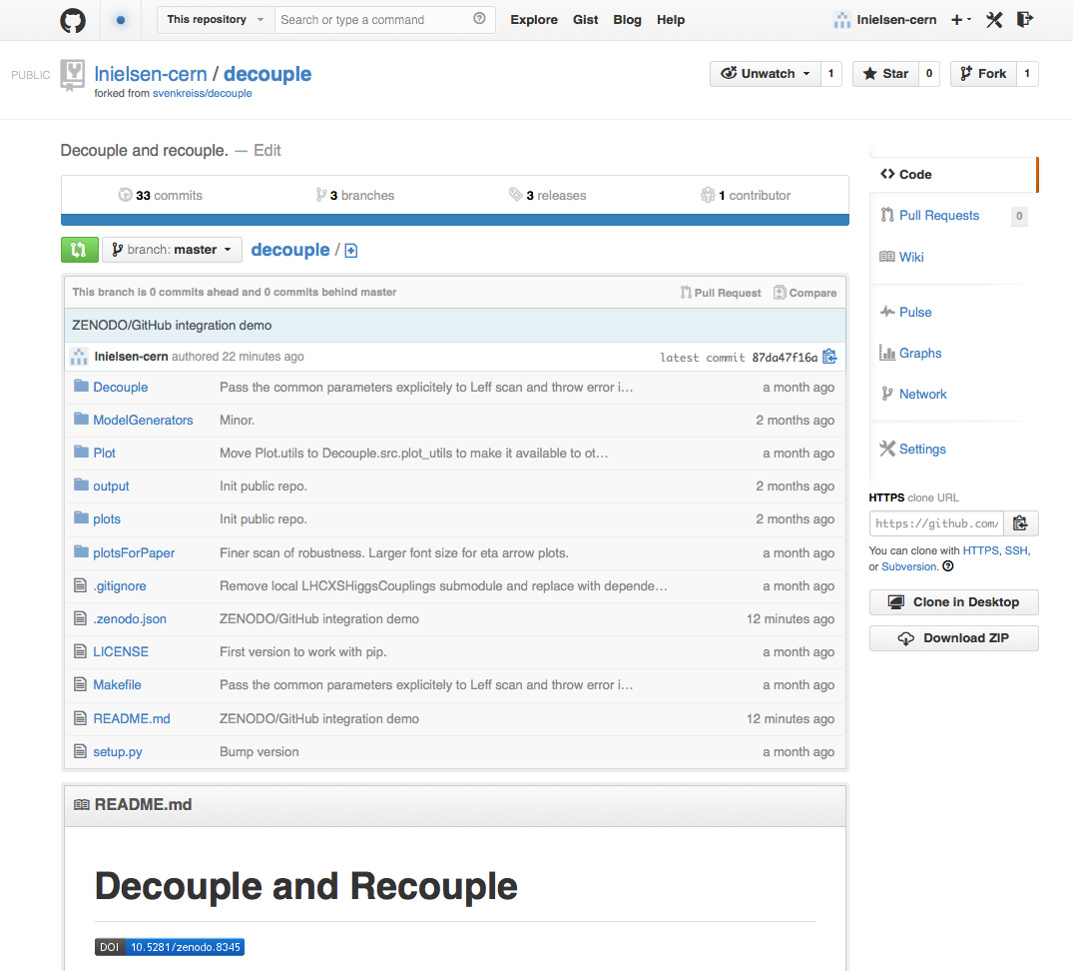
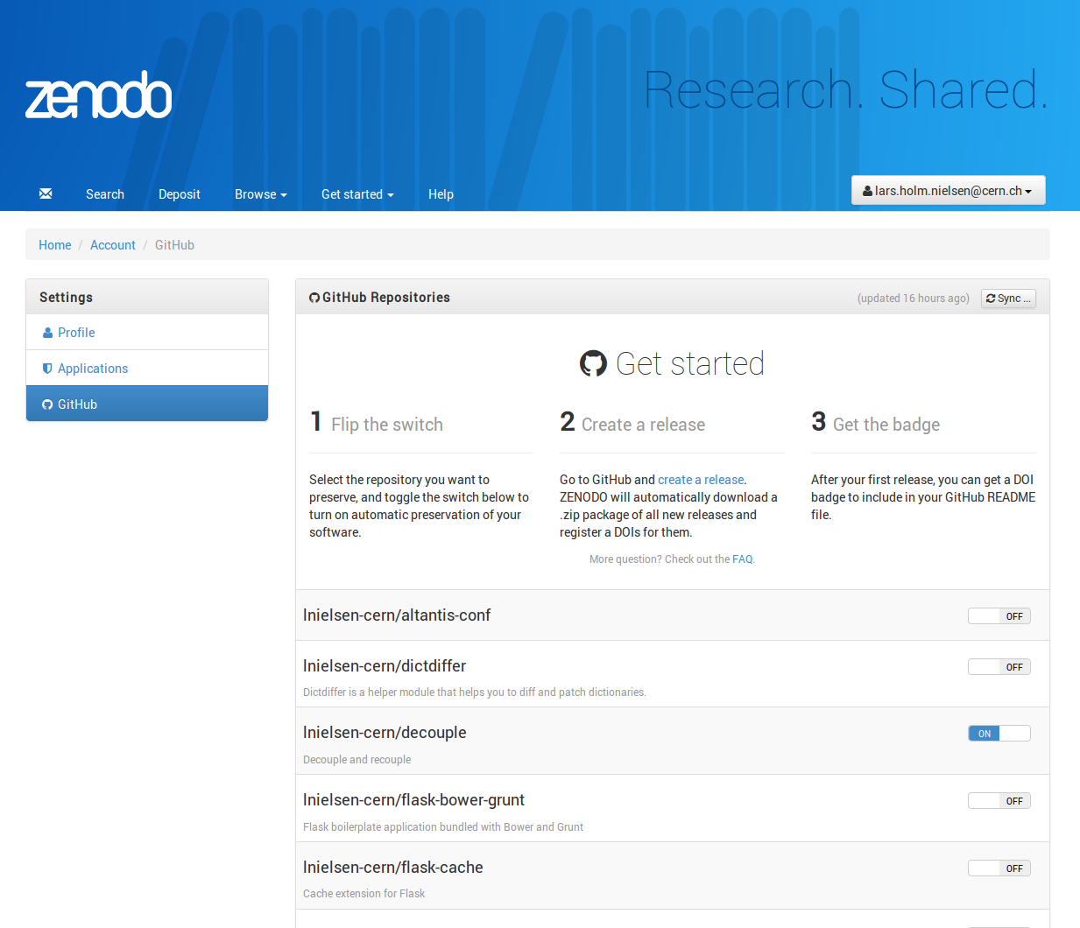



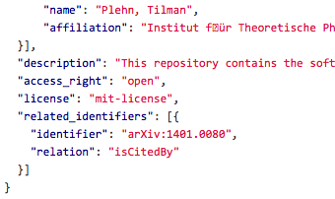



Zenodo – GitHub bridge
.zenodo.json

Slide 9
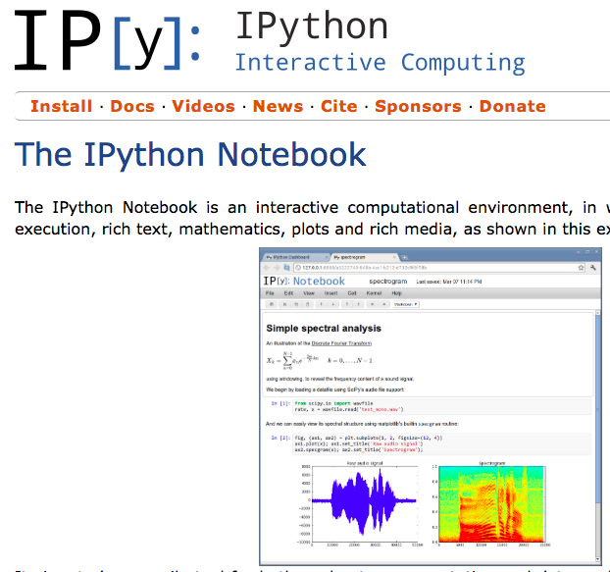
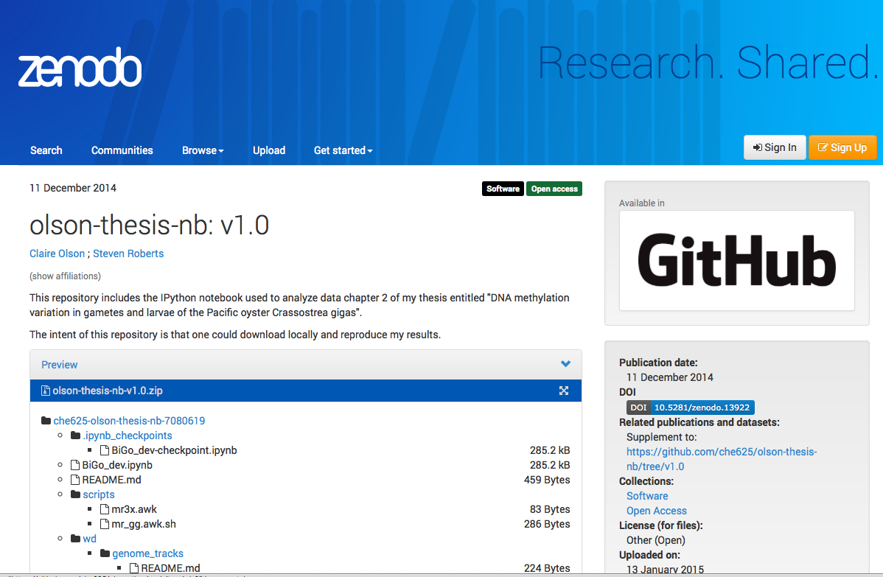

Protocols

Slide 10
Cited from…
eLife
PLoS ONE
F1000Research
PeerJ
BMC:
  J Biomed Semantics
RSOC:
  Phys Chem Chem Phys
IUC:
  Acta Crystallogr. D Biol. Crystallogr.
IOP:
  Astrophys. J.
Proc. Natl. Acad. Sci. U.S.A.
arXiv
Ubiquity
PenSoft:
  Biodivers Data J
Elsevier:
  Curr Opin Behav Sci
  J Quant Spectrosc Radiat Transf
  Mol. Phylogenet. Evol.
  Biochim. Biophys. Acta, Biomembr.
Wiley
  Geosci. Data J
Springer:
  Nat Hazards, Bull. Earthq. Eng.
Oxford Journals:
  Genome Biol Evol
Copernicus Publications:
  Earth Syst. Sci. Data
AIP
Recommended:
EC model grant agreement, ERC guidelines
e-IRG, Academy of Finland, …

Slide 11
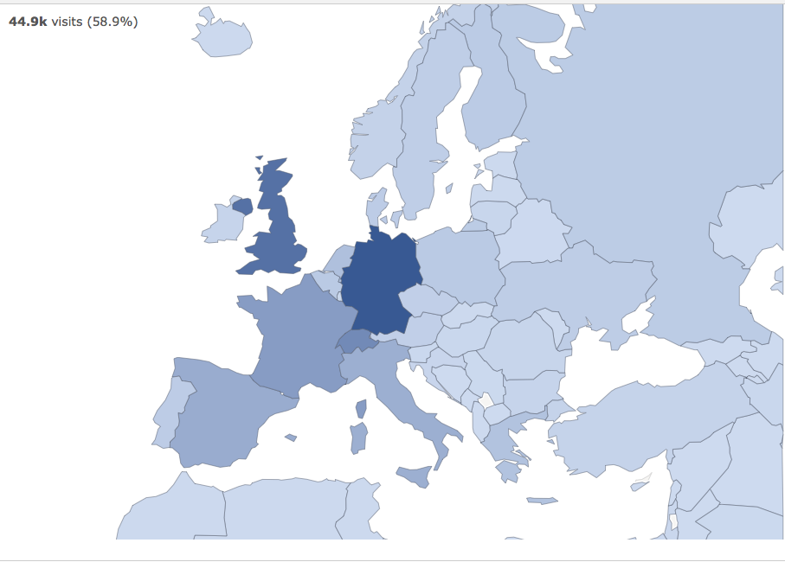
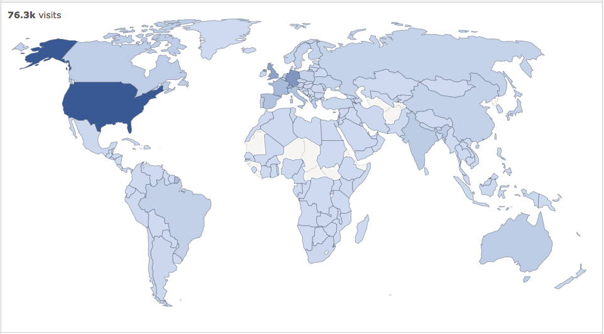
Uploads from…

Slide 12




Lars.Nielsen@cern.ch
Tim.Smith@cern.ch
http://www.cern.ch
http://zenodo.org
@zenodo_org

