Slide 2
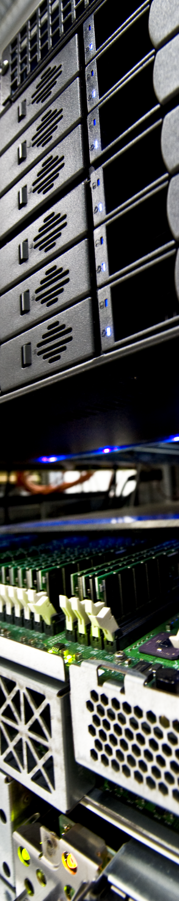

CERN IT Data & Storage Services
DSS
Data & Storage Services
Massimo Lamanna
File and Disk Operations section (DSS/FDO)
JRC visit – 25-JUN-2015
CERN IT Department
CH-1211 Genève 23
Switzerland
www.cern.ch/it

Slide 3
Introduction
Scientific data
  Large data sets (~1 PB/week during LHC running)
  Long (infinite) retention period
  High concurrency (1 LHC experiments: few 10³ physicists)
  Completely distributed infrastructure
    Physicists at universities (o(100) institutes)
    LHC Computing Grid (o(100) centres 20% at CERN)
      Enabled by massive data transfers
  Sharing
    Distributed analysis teams of tens of physicists
Computer centre infrastructure
  IT services built on DSS
    Notably Zenodo
CASTOR
EOS
FTS
CERNBox

Slide 4
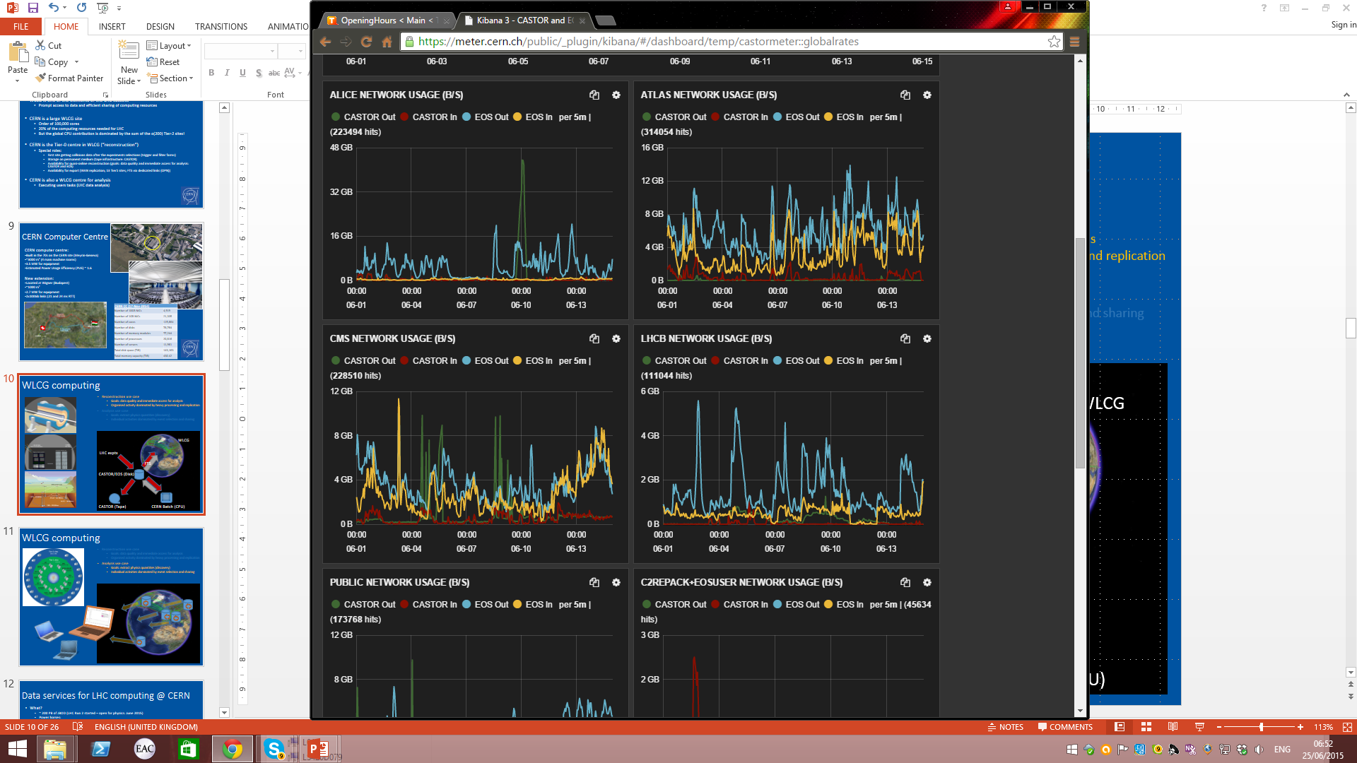
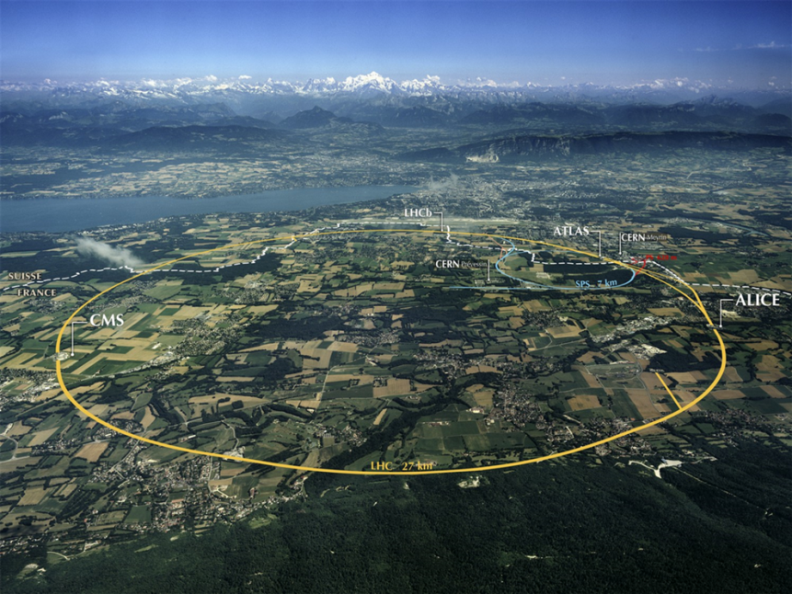
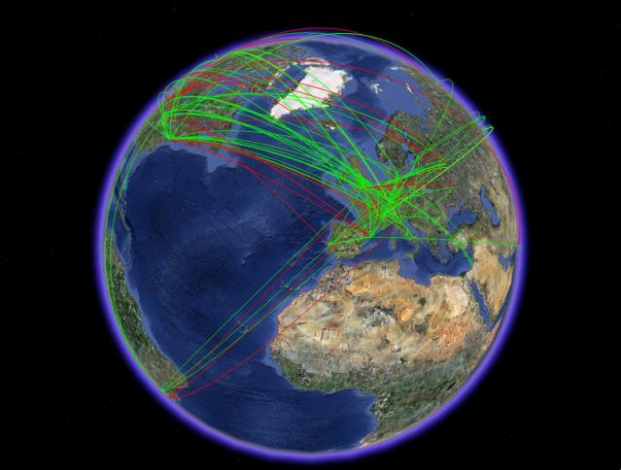
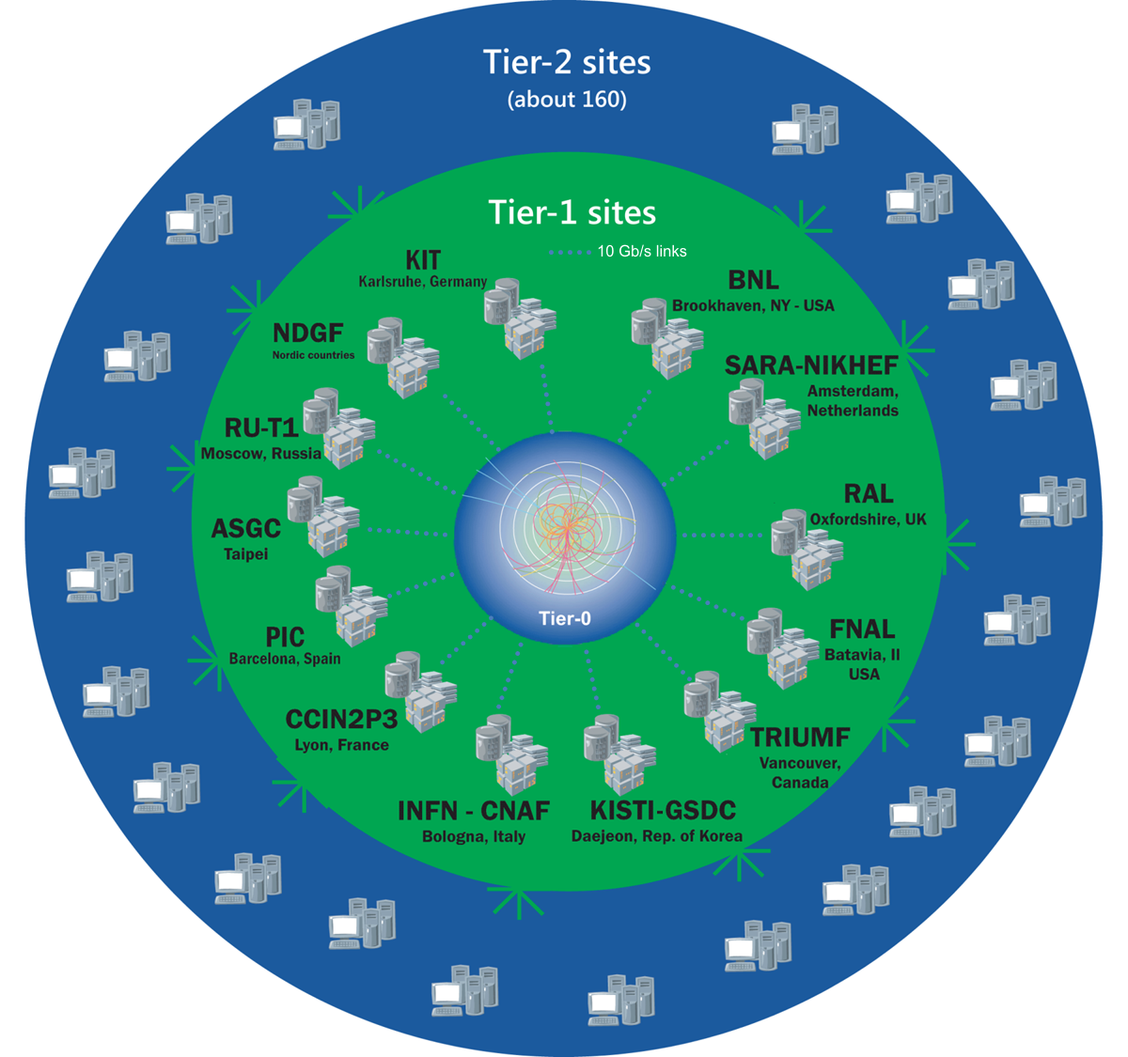



WLCG computing
LHC: largest scientific instrument
27-km hadron collider (1,200 19-m superconductive dipoles)
13/14 TeV pp collisions (PbPb and pPb possible); 4 main experiments
FTS (File Transfer Service) make possible to create federated data repositories across WLCG
LHC expts
FTS
EOS (Disk)
CASTOR (Tape)
CERN Batch (CPU)

Slide 5
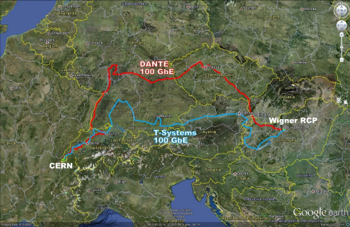
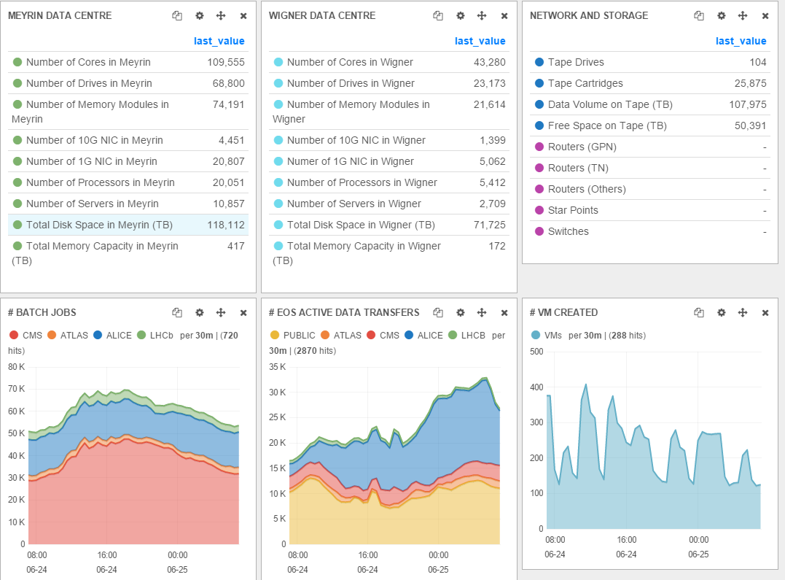
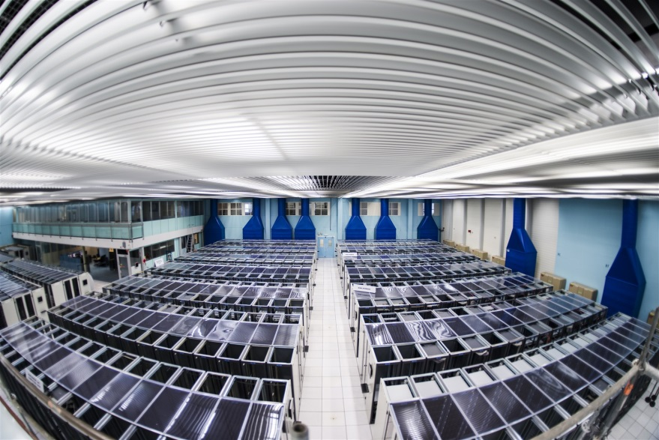
CERN Computer Centre
LHC Computing Grid Tier0
Key numbers
3.5 MW for equipment in Meyrin (CH)
2.7 MW for equipment at Wigner (Hu)
2x100Gb links (21 and 24 ms RTT)

Slide 6
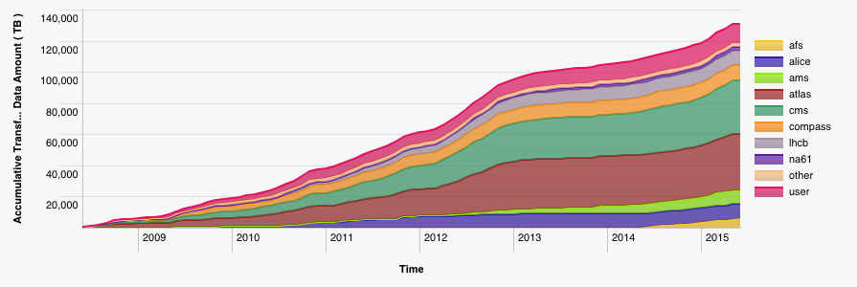
CASTOR: CERN Archive
Data:
~105 PB physics
data (CASTOR)
~7 PB backup (TSM)
Tape libraries:
IBM TS3500 (3+2)
Oracle SL8500 (4)
Tape drives:
~100 archive
Capacity:
~70 000 slots
~25 000 tapes
Data to CASTOR tape (2008-2015)

Slide 7
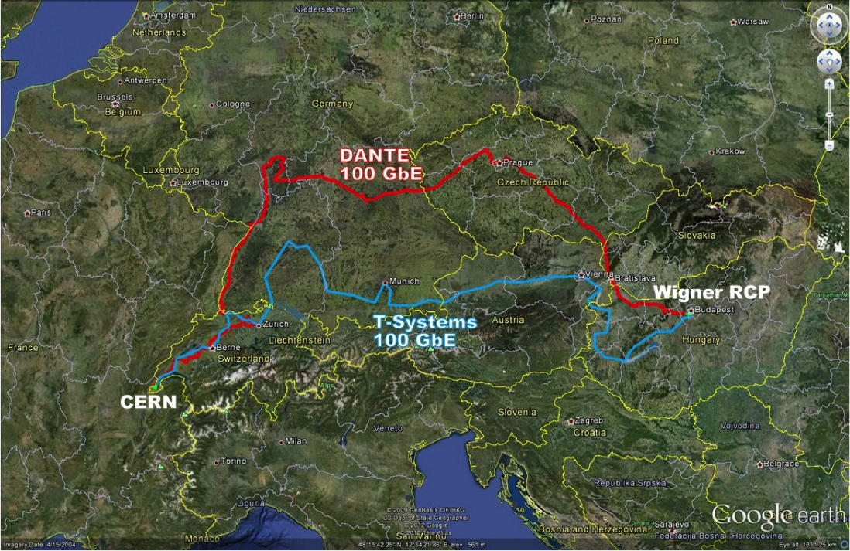
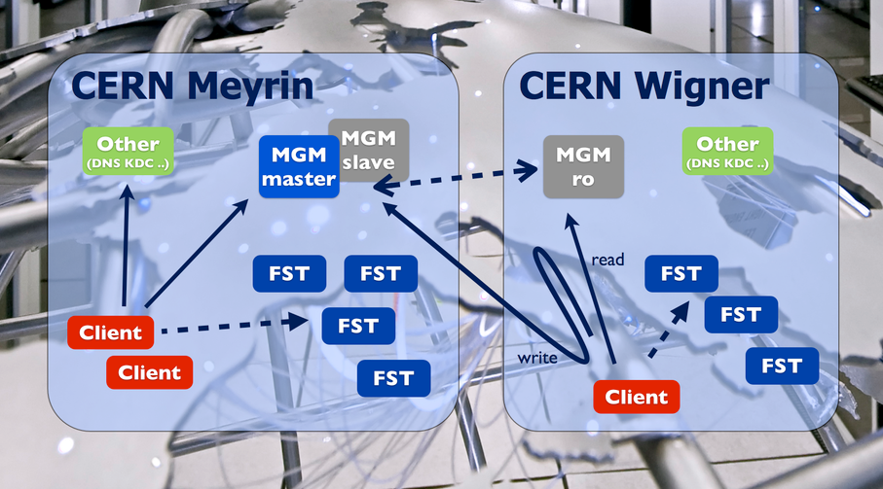
EOS: CERN Storage for LHC
MGM = File Catalogue (NameSpace/Metadata)
FST = Disk servers
140 PB disk space
35000 HD
1000 Nodes (FST)

Slide 8






EOS + CERNBox
Modern cloud storage interfaces
fused with Petabyte storage
fs
webdav
xroot
sync
share
mobile
web
EOS
ACLs
Namespace
Physical Storage

Slide 9
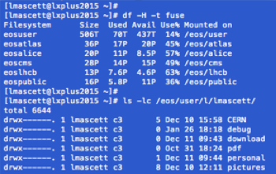

FUSE
fs
webdav
xroot
sync
share
mobile
web
EOS
ACLs
Namespace
Physical Storage

Slide 10
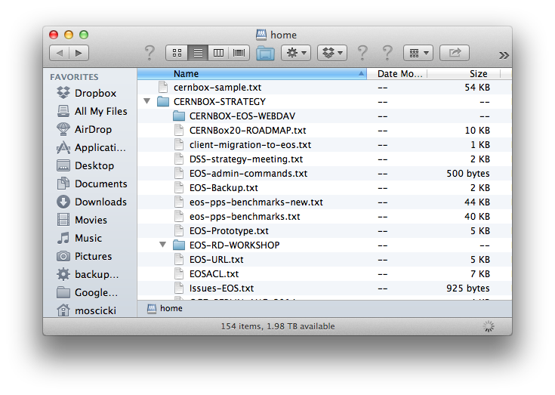


fs
webdav
xroot
sync
share
mobile
web
EOS
ACLs
Namespace
Physical Storage

Slide 11
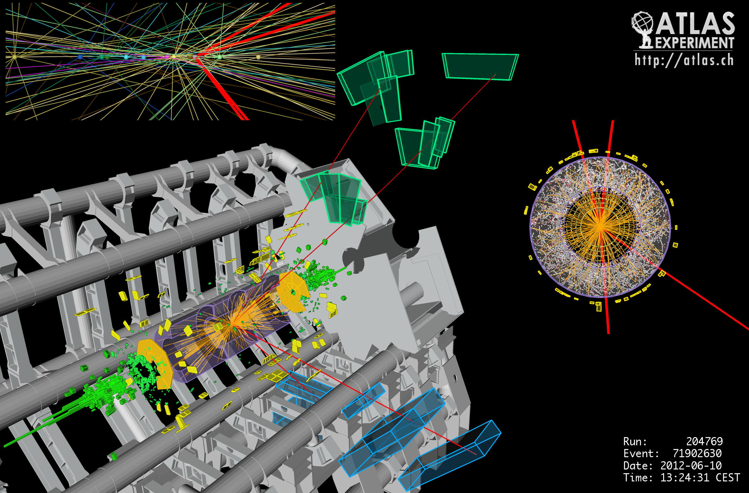

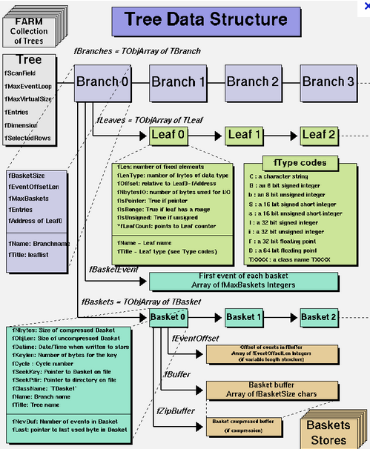
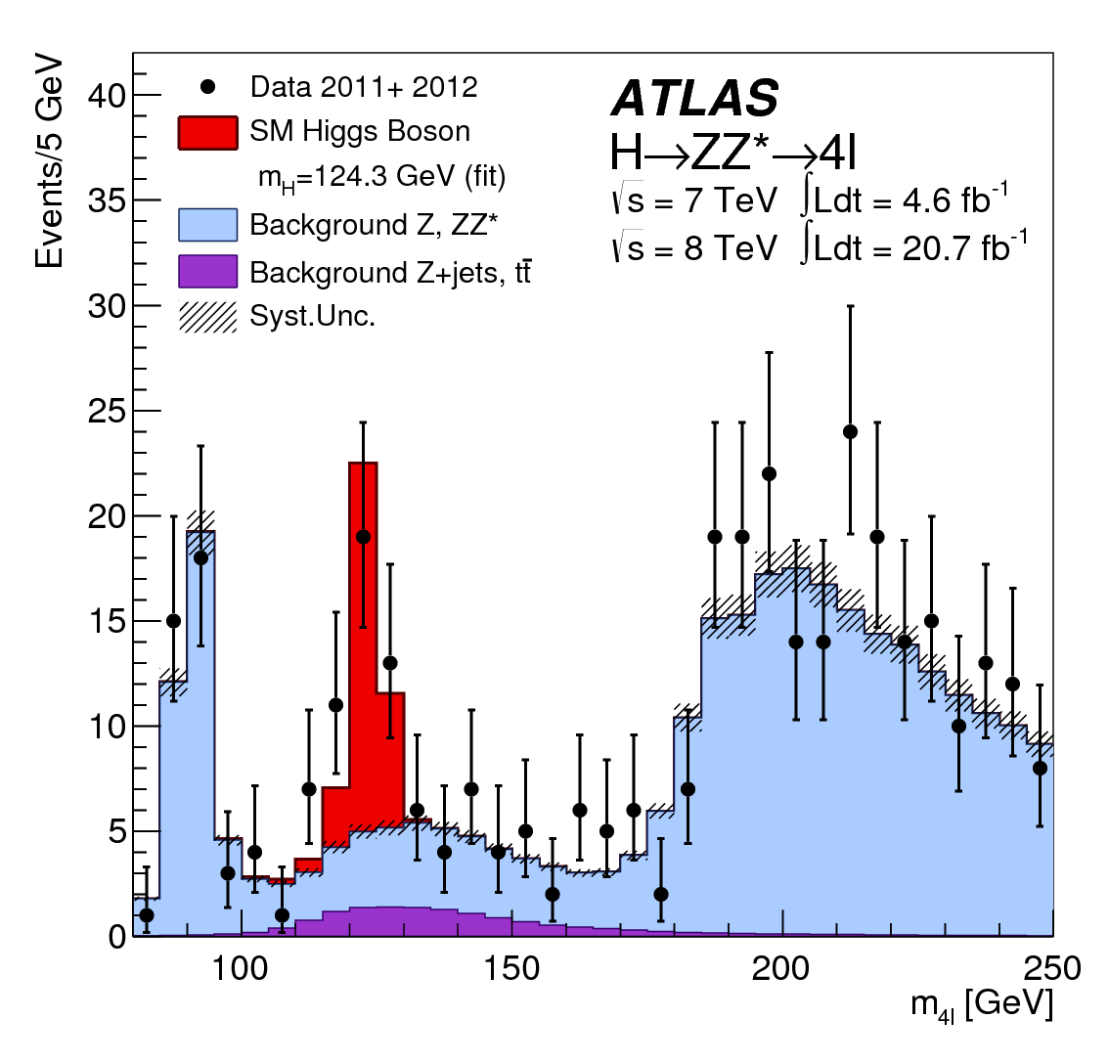
fs
webdav
xroot
sync
share
mobile
web
EOS
ACLs
Namespace
Physical Storage

Slide 12
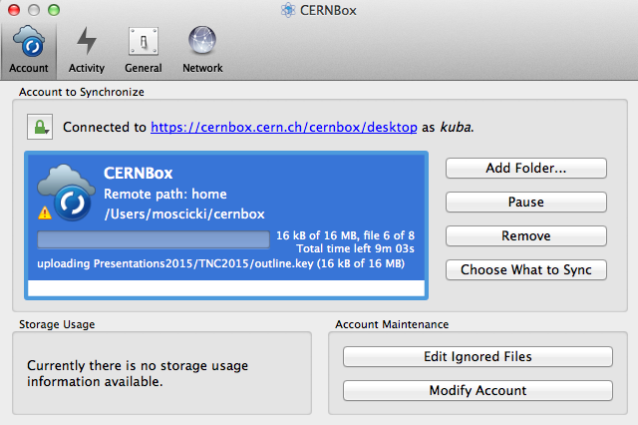


fs
webdav
xroot
sync
share
mobile
web
EOS
ACLs
Namespace
Physical Storage

Slide 13
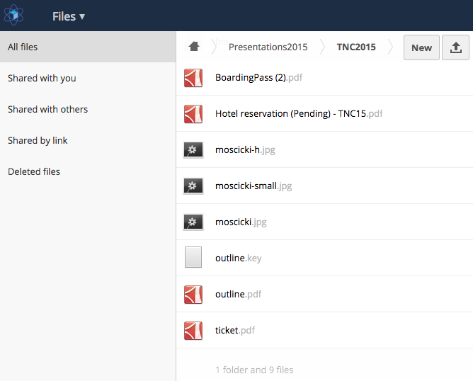
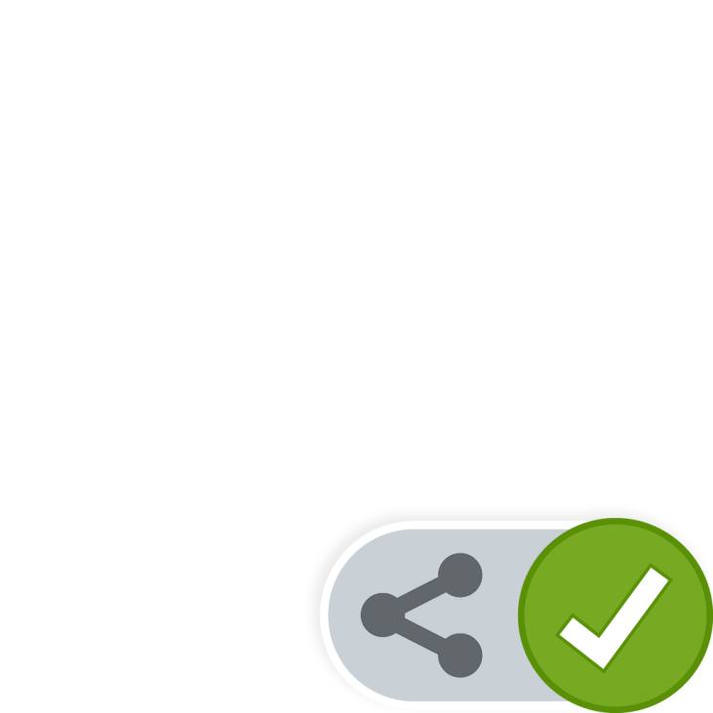


fs
webdav
xroot
sync
share
mobile
web
EOS
ACLs
Namespace
Physical Storage

Slide 14



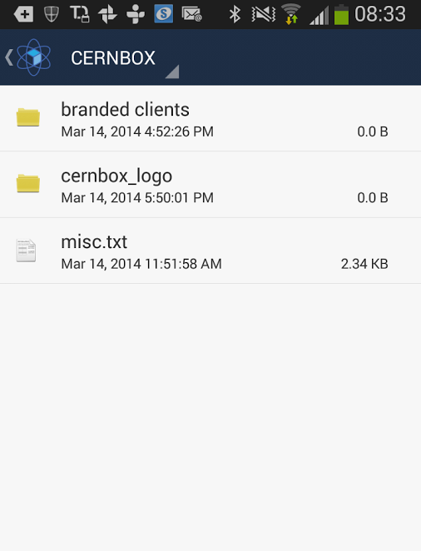



fs
webdav
xroot
sync
share
mobile
web
EOS
ACLs
Namespace
Physical Storage

