Slide 1
MSG - A messaging system for efficient and scalable grid monitoring
James Casey,Operations Automation Team
EGEE User Forum, Catania

Slide 2
Problem statement
Grid monitoring should allow users to see various views of the grid infrastructure
  Site Administrators
  Project level managers
  VO users
All users should be able to base their views of a consistent set of information
  Gather the information once
  Pass it to many consumers

Slide 3
Technical Issues
The infrastructure is :
  Heterogeneous
  Highly distributed
  Spanning multiple administrative domains
  Consisting of unreliable services, sites and network links
You don’t know a priori who might be consuming your information
  The most interesting results usually come via aggregation of various information sources

Slide 4
Required Features…
We need underlying middleware which handles these issues
  Loosely coupled
  Supports broadcast/multicast
  Works with clients in multiple languages
  Resilient to failure of independent components
  Scales to grid size
  ?

Slide 5
Messaging systems as a solution ...
Flexible architecture:
  Deliver messages using different models
  Support synchronous or asynchronous communication
  Durable or transient messaging
  All communication mediated by a broker
Highly Scalable:
  Resilient ‘backbone’ of brokers can be created to give scalability and protection against network issues
  Individual brokers can be failover clusters for reliability
Reliability guaranteed to clients by the middleware
  Information producers can work in a ‘fire and forget’ mode

Slide 6
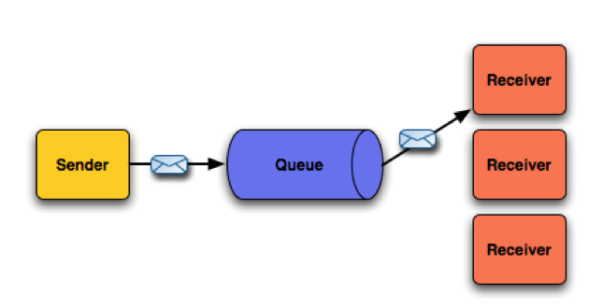
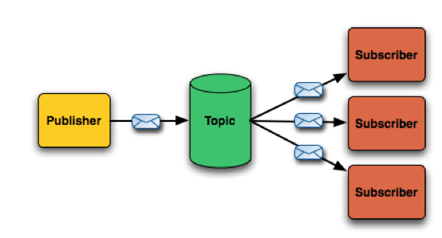
Models of messaging
Point-2-point
Publish-Subscribe
Analogy – person-to-person mailing
One consumer per queue
Once and only once delivery
Broker retains messages until consumed
Analogy – Mailing List
Producers and consumers are not aware of each other
All messages delivered to all subscribers

Slide 7
Apache ActiveMQ
Mature open-source implementation of these ideas
  Top-level Apache project
  Commercial support available from Progess Software
  Widely-used commodity software
Easy to integrate into your code
  Multiple language + transport protocol support
Good performance characteristics
  1K – 20K messages per second depending on features used
MSG – Messaging System for Grids
  Integration of ActiveMQ into our environment
    RPMs, YAIM configuration, monitoring and alarms
  Production grade messaging backbone deployed by SA1

Slide 8
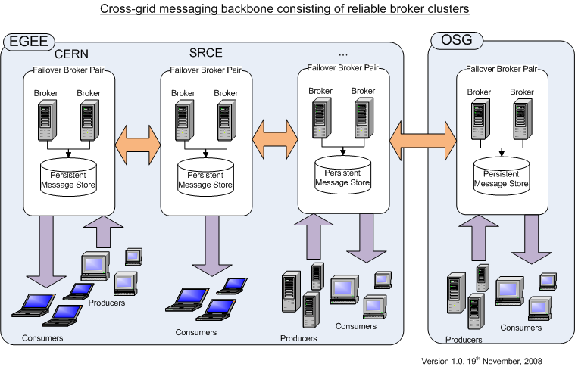
Network of Brokers

Slide 9
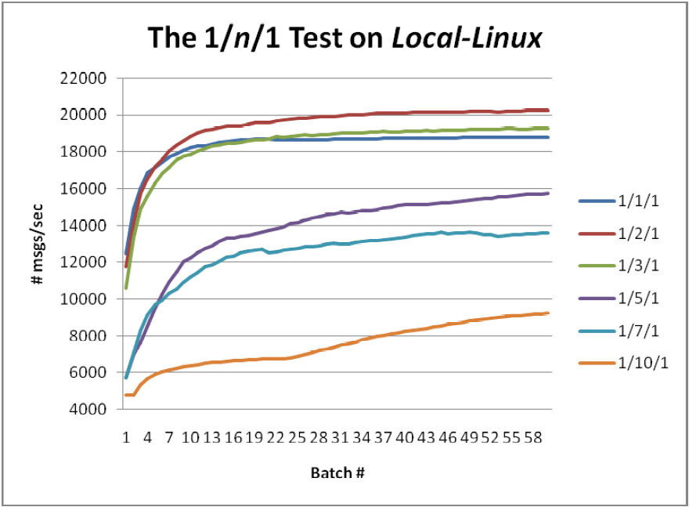
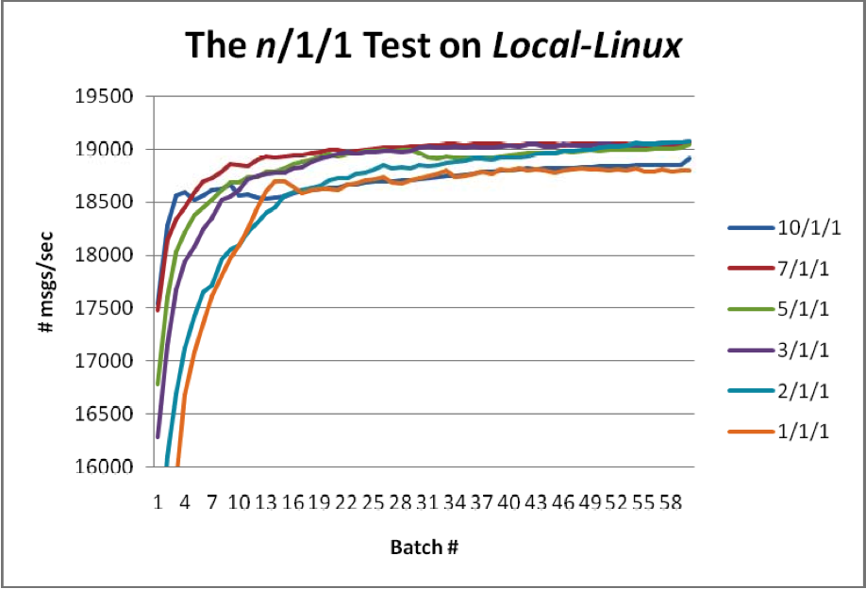
Vendor tests
n producer/1 consumers/1 broker
1 producer/n consumers/1 broker
From “Optimizing FUSE Message Broker” –
http://open.iona.com/resources/collateral/#whitepapers

Slide 10
Talking to a broker - STOMP
Streaming Text Oriented Messaging Protocol
Simple, interoperable wire format
Text based, similar in philosophy to HTTP
Multiple Languages
  C, C++, Java, C#, Perl, PHP, Python, Ruby, Flash, …
Used for producers and consumers
You can write your first client in 30 minutes – guaranteed !
http://stomp.codehaus.org/

Slide 11
An example…
use Net::Stomp ;
my $stomp = Net::Stomp->new ({hostname => ’prod-grid-msg.cern.ch',
port => '6163' }) ;
$stomp->connect () ;
$stomp->subscribe ( {
'destination' => '/topic/grid.probe.results.MySite',
'ack' => 'client',
'activemq.prefetchSize' => 1});
while($should_receive) {
my $frame = $stomp->receive_frame;
print $frame->as_string ;
$stomp->ack({frame => $frame} ) ;
}
$stomp->disconnect ;
use Net::Stomp;
my $body = 'MetricOutput: OK\nServiceUri: myhost.example.org\n\n’;
my $stomp = Net::Stomp->new ({hostname => ’prod-grid-msg.cern.ch',
port => '6163' }) ;
$stomp->connect() ;
$stomp->send({
'destination' => '/topic/grid.probe.results.MySite',
'body' => $body } );
$stomp->disconnect();

Slide 12
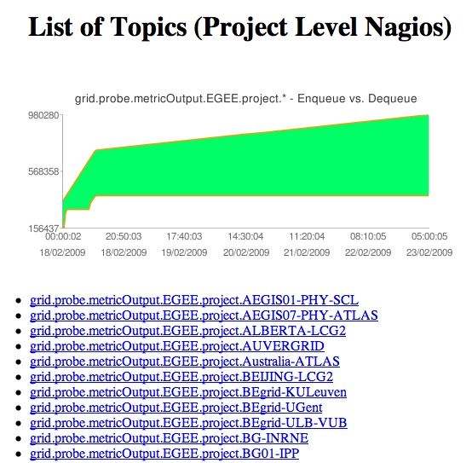
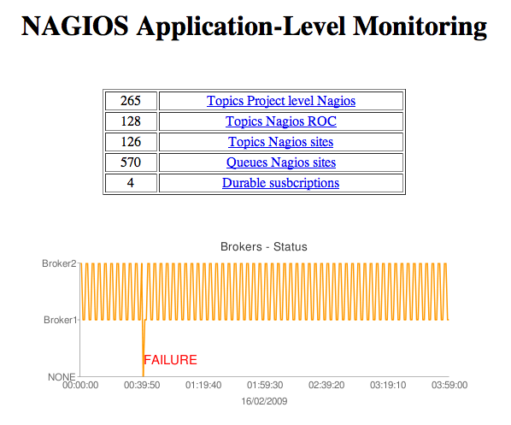
System Management & Monitoring
Example screen shots from system management application

Slide 13
Typical applications of messaging
Many applications in grid monitoring follow a simplar pattern of interactions:
  Gather results at many points
  Collect the raw results and store in a database
  Perform some operation on the raw results
    Summarisation, availability calculation, …
  Publish the summarised results to many clients
    E.g. site monitoring, dashboards, …
  Store historical data in a database and visualize via web client
We provide ‘standard’ components to make this plug and play for many workflows

Slide 14
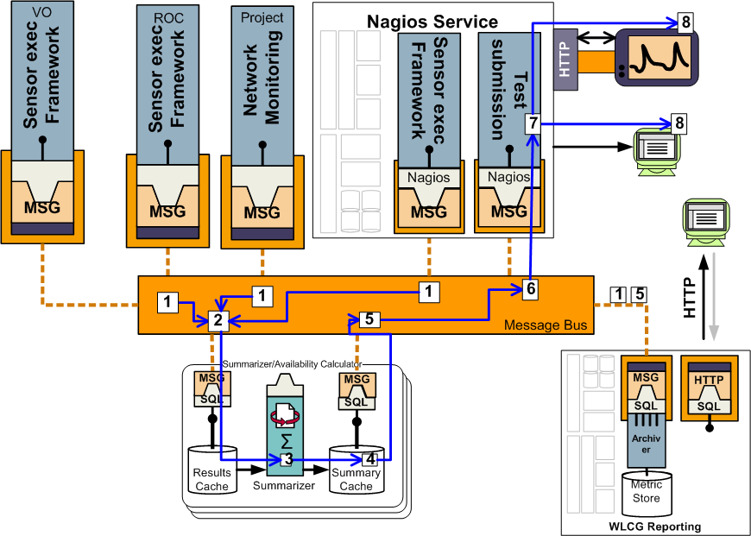
VO, ROC, Project & Local monitoring

Slide 15
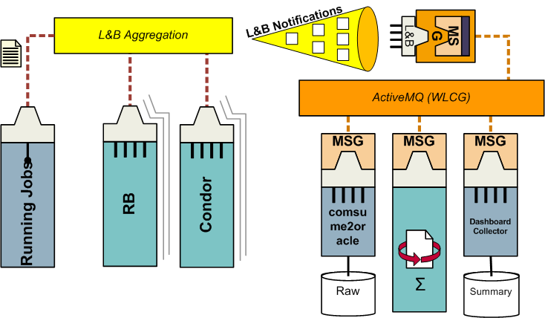
Another application - Usage Reporting
Middleware event publication
  Gridftp transfers, FTS transfers, job records, …
Used to calculate throughput and reliability
Currently handled in GridView, Dashboards
  We use the messaging system to unite these efforts
Messaging is used for the data integration
  Delegate parsing/routing of specific information back to experts
    L&B developers, FTS developers, …
Other integration examples include
  Accounting
  GOCDB synchronization

Slide 16
Currently available data feeds
Testing results from sites (a.la. SAM/Nagios)
Job state changes
  L&B v2.0
Gridftp transfers (a.la. Gridview)
Downtime publications
  Only OSG currently
Worker node configuration
  Software versions, hardware configurations,
  http://gridops.cern.ch/gcm/tests/
All feeds will be documented at
https://twiki.cern.ch/twiki/bin/view/EGEE/MsgNamespace

Slide 17
Future and Summary
MSG is the solution used for the new monitoring architecture
  E.g Talks by John Shade, Emir Imamagic earlier
Adopted as standard monitoring communication system for EGEE
  Replacing R-GMA
We will start working with VO communities to architecture their MSG-based solution
  Some work started with ATLAS/Ganga already
More infrastructure monitoring data will be integrated in the coming months

Slide 18
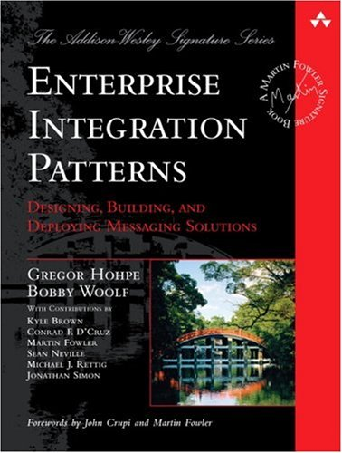
For more information …
MSG
  https://twiki.cern.ch/twiki/bin/view/EGEE/MsgArchitecture
  https://twiki.cern.ch/twiki/bin/view/EGEE/MsgNamespace
Software used:
  http://activemq.apache.org
  http://stomp.codehaus.org
Wikipedia links:
  http://en.wikipedia.org/wiki/Enterprise_messaging_system
  http://en.wikipedia.org/wiki/Message_Oriented_Middleware
  http://en.wikipedia.org/wiki/Publish/subscribe
  http://en.wikipedia.org/wiki/Message_queue
Patterns for messaging systems → → →
  http://www.enterpriseintegrationpatterns.com/index.html

