Slide 1
Wa105 6x6x6
D.Mladenov
M.Nessi
D.Smargianaki
D.Smargianaki
1

Slide 2
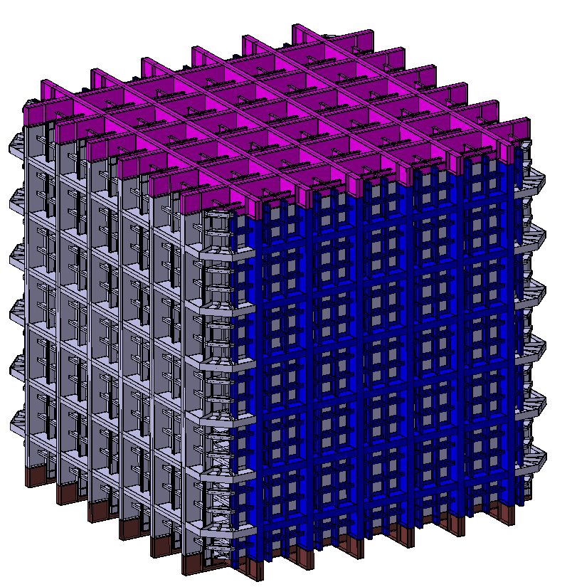
Wa105 6x6x6
*External dimensions
*11.764 m
Roof
2 x Wall
*11.716 m
Without
The roof :
11.116 m
2 x Wall
Floor
*11.764 m
D.Smargianaki
2

Slide 3
Requirements/constraints
EHN1 CE ready by 1-July-2016
We expect that the cryostat preparation/installation will take 6-7 months if done sequentially
Can we start some pre-assembly in January 2016 ?
Can we push the preassembly to the warm and part of the membrane structure?
Can we have the roof be treated separately?
D.Smargianaki
3

Slide 4
wa105 6x6x6
Warm structure
PRE-ASSEMBLY
SEQUENCE
D.Smargianaki
4

Slide 5
Pre – assembly sequence
1. Assemble one by one the floor element and the 4 walls, including the stainless steel plate, on the floor
2. As soon as one is finished it get mounted into a structure
3. With this we prove that the assembly can fit geometrically
4. Once the structure is finished, we measure it. In particular the top to find out how geometrically the roof has to be assembled. We also trace the position of the rods, for a later assembly
5. We bring back one by one the pre-assemblies on the floor and then we add GTT panels where possible
D.Smargianaki
5

Slide 6
Assemble one by one the floor element and the 4 walls, including the stainless steel plate, on the floor
1
D.Smargianaki
6

Slide 7
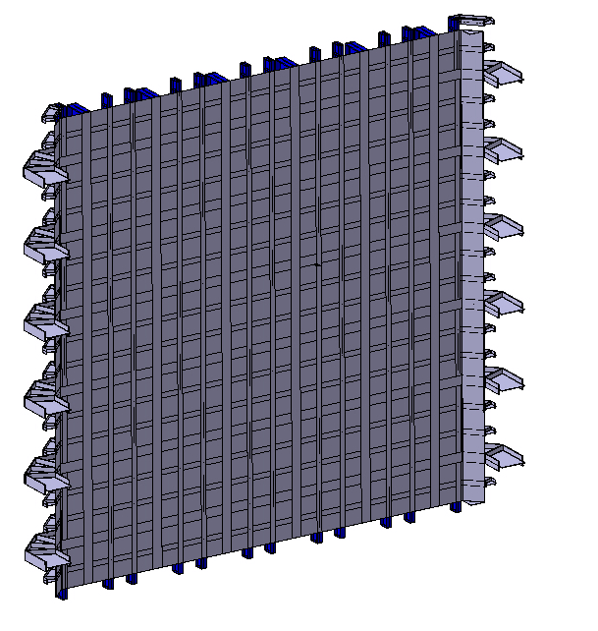
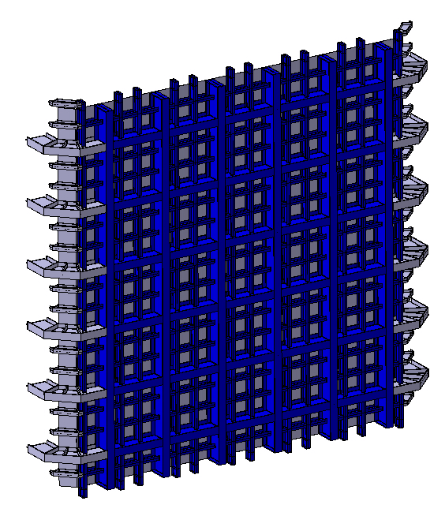
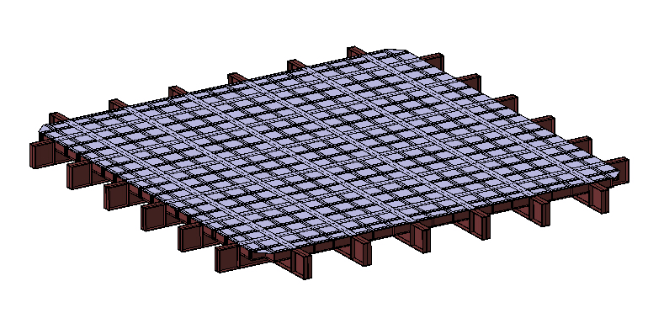
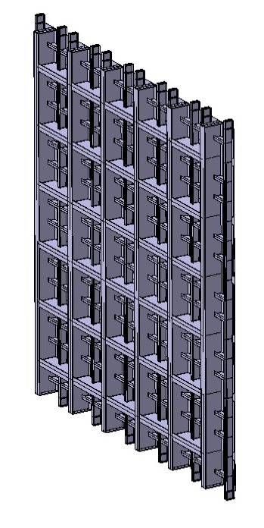
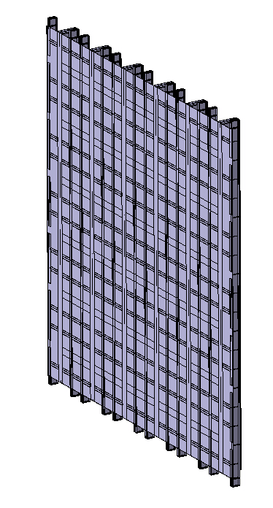
Outer structure pRe - assemblies
1
4 x Wall
Floor
& stainless steel
plate everywhere
D.Smargianaki
7

Slide 8
As soon as one is finished it get mounted into a structure
With this we prove that the assembly can fit geometrically
Once the structure is finished, we measure it. In particular the top to find out how geometrically the top has to be assembled
2
3
4
D.Smargianaki
8

Slide 9
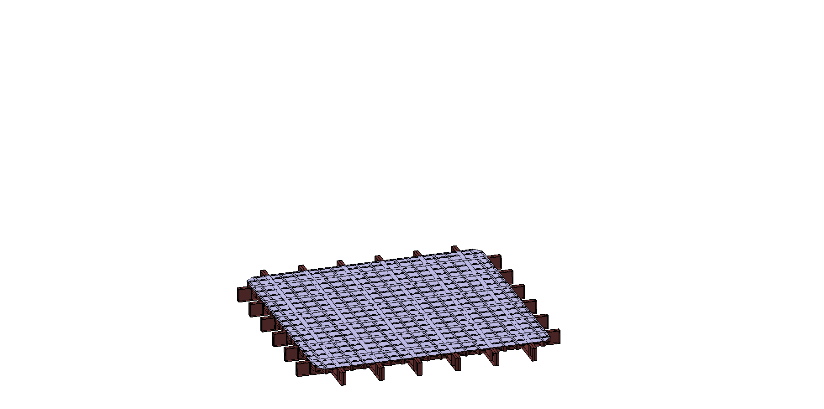
2
D.Smargianaki
9

Slide 10
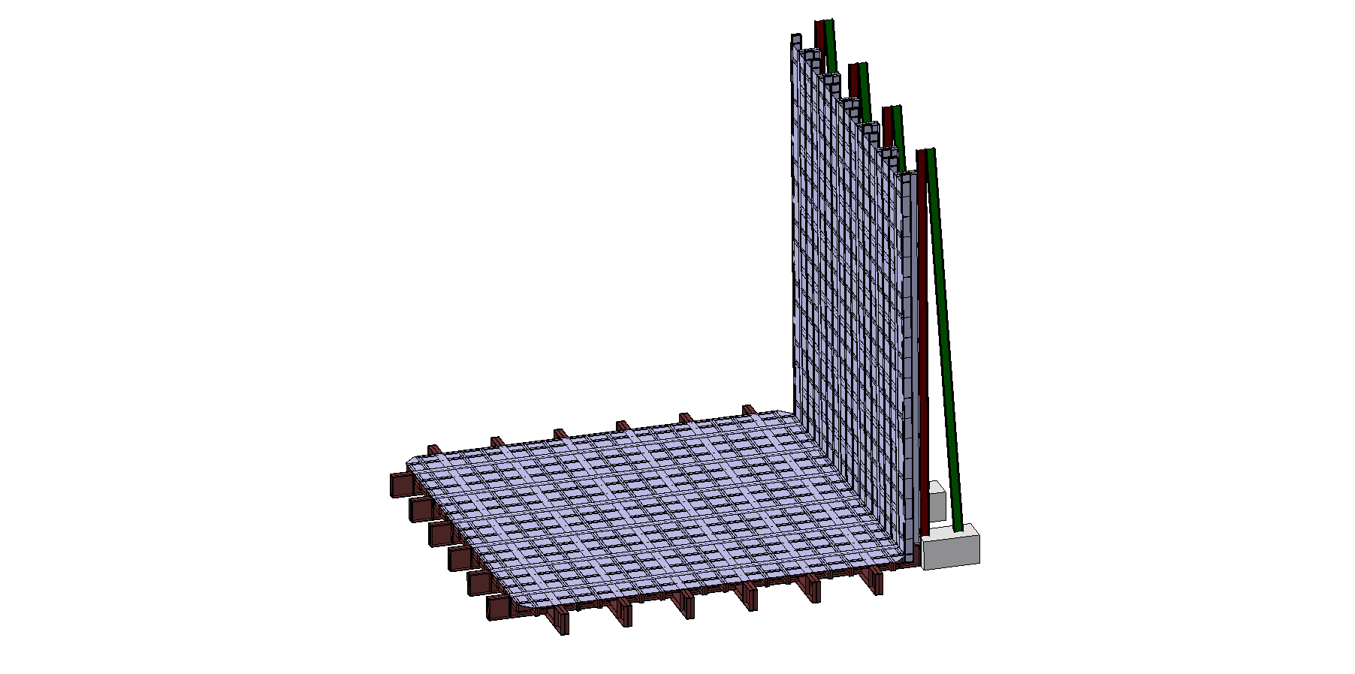
2
D.Smargianaki
10

Slide 11
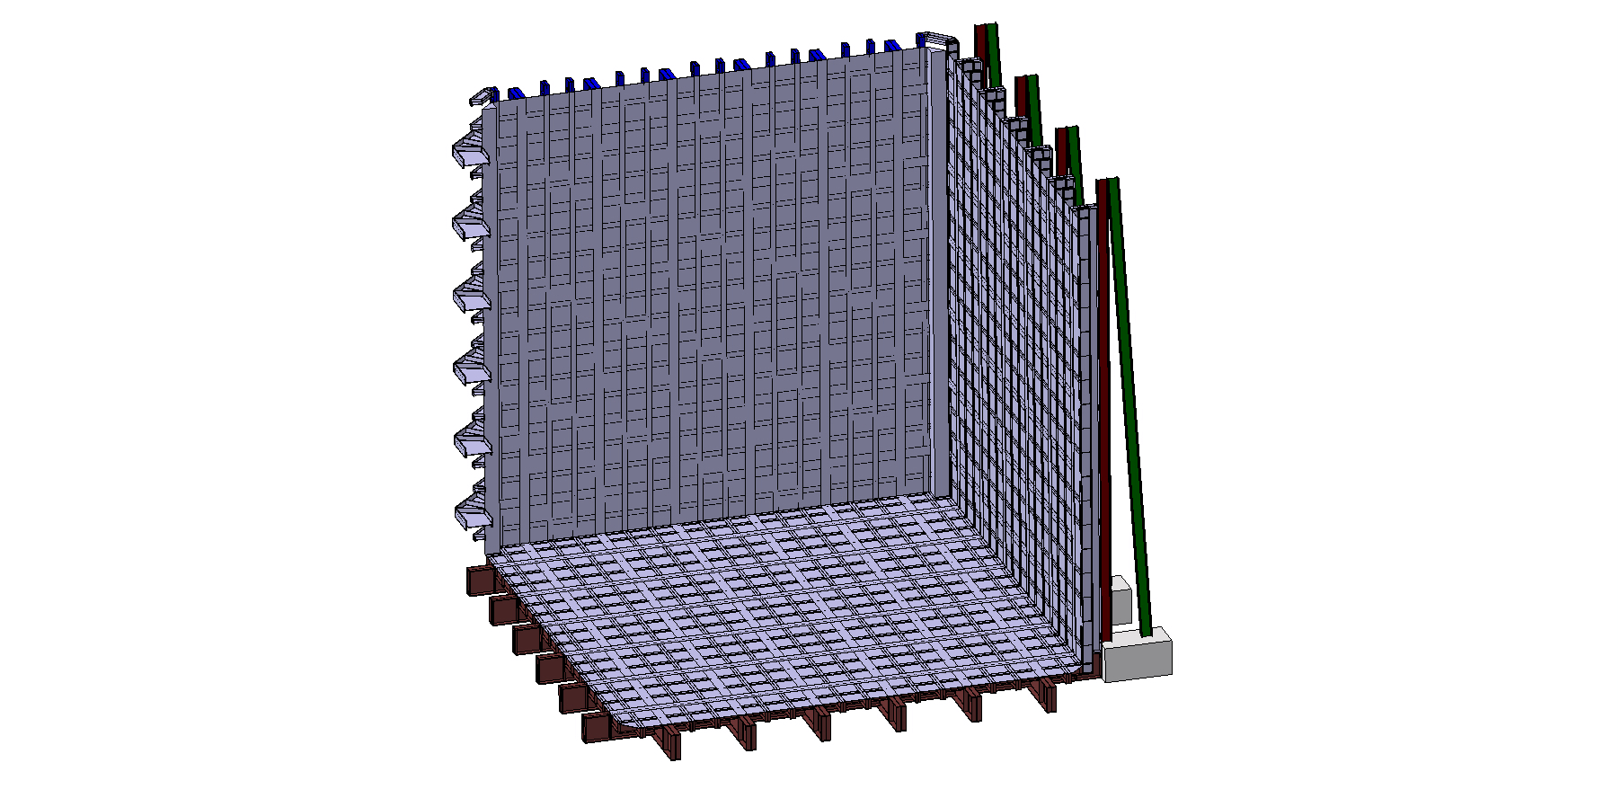
2
D.Smargianaki
11

Slide 12
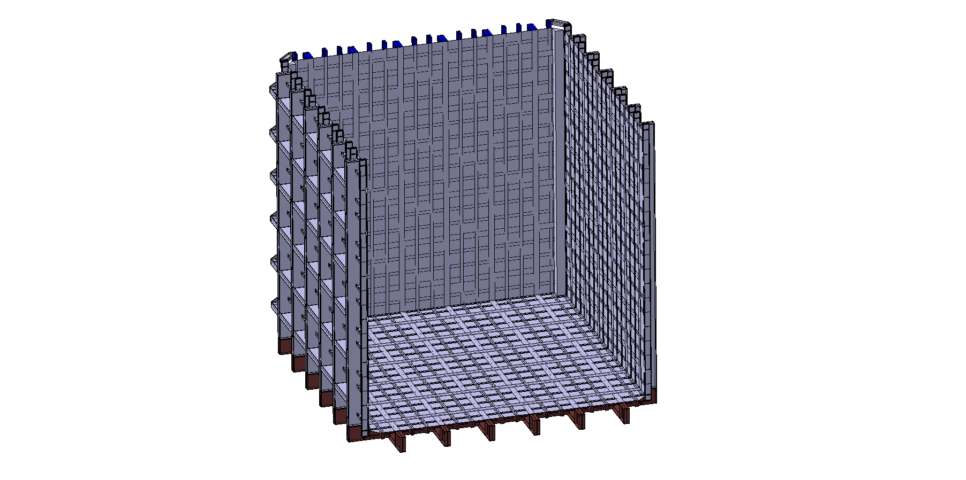
2
D.Smargianaki
12

Slide 13
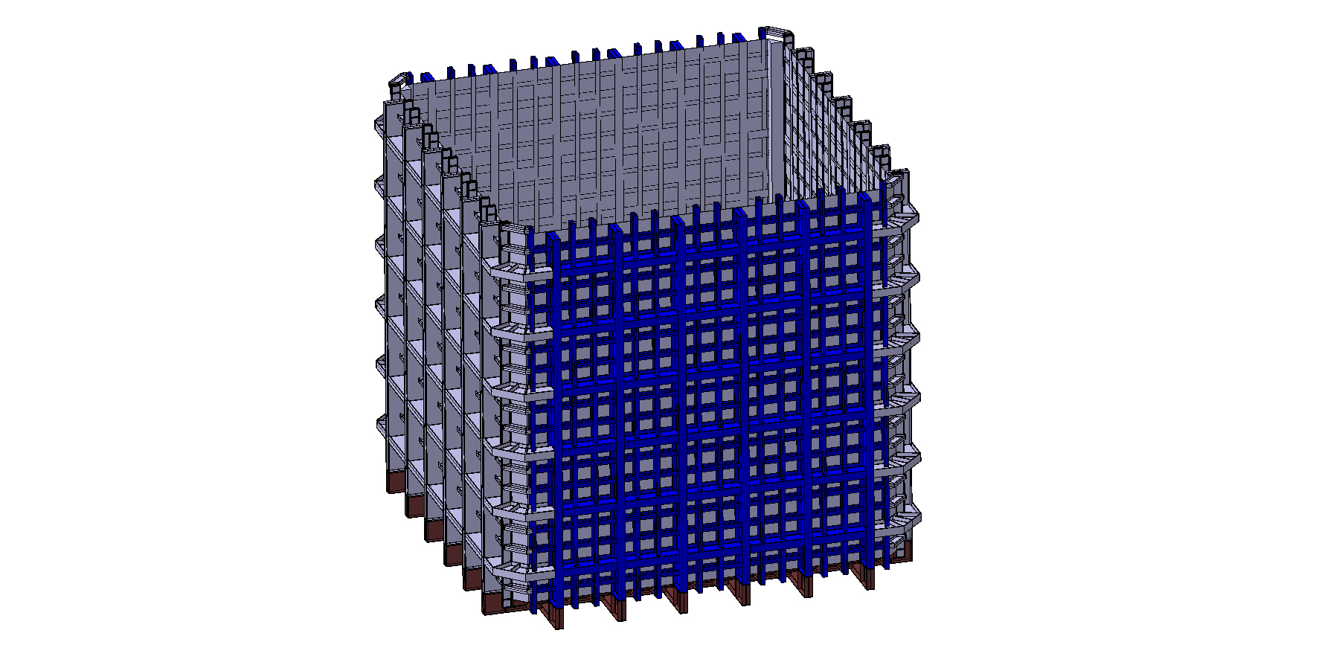
2
3
4
D.Smargianaki
13

Slide 14
Where can we do this ?
We need 15 x 15 m² to do the flat preassemblies, one by one
Then we need 15 x 15 m² for the 3rd assembly
And we need storage place for the components we are taking down later
We need a 40 tons crane in each location
2 teams of 4 persons each, working on the 2 locations
Plus surveyors and QA people
D.Smargianaki
14

Slide 15
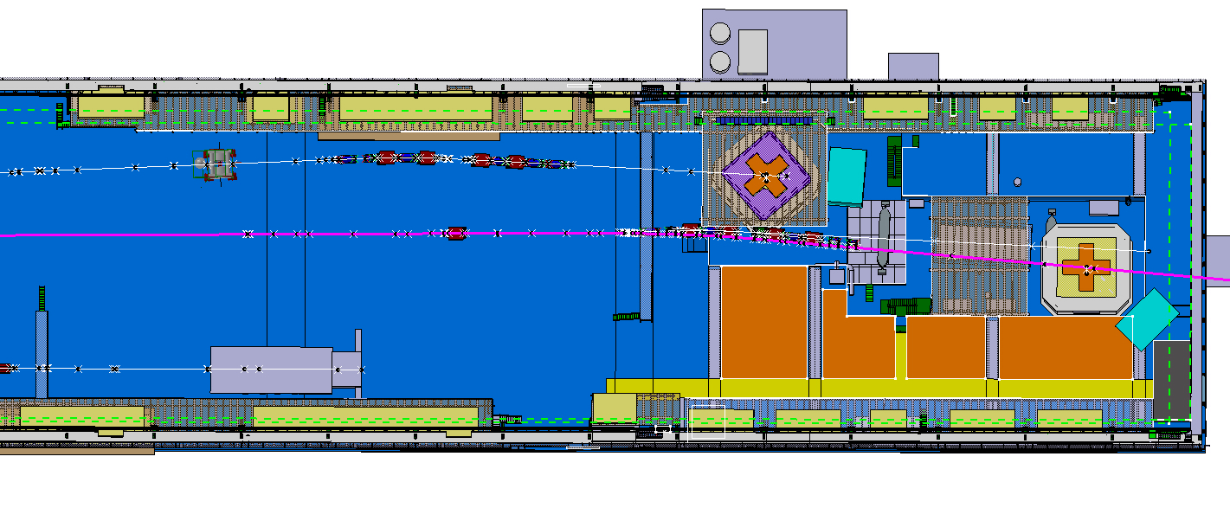
Flat pre-assembly
pre-assembly storage
3rd pre-assembly
D.Smargianaki
15

Slide 16
We bring back one by one the pre-assemblies on the floor and then we add GTT panels where possible
5
D.Smargianaki
16

Slide 17
Outer structure pRe - assemblies
5
4 x Wall
Floor
& stainless steel
plate everywhere
D.Smargianaki
17

Slide 18
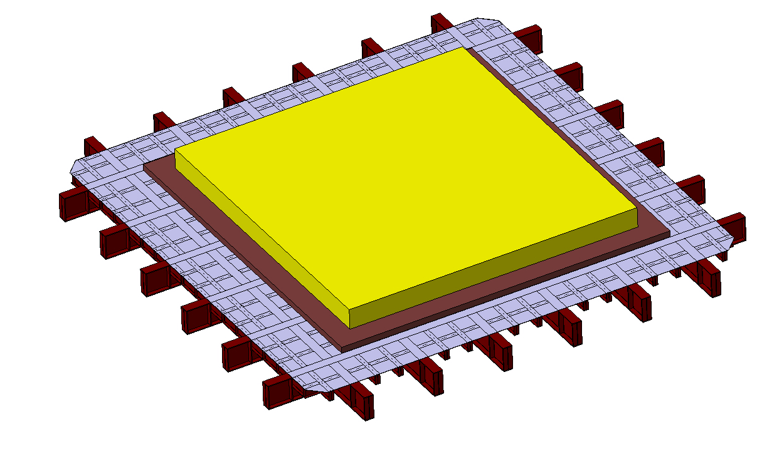
Adding GTT panels
5
Rods in place
Partial secondary membrane
Partial primary membrane
D.Smargianaki
18

Slide 19
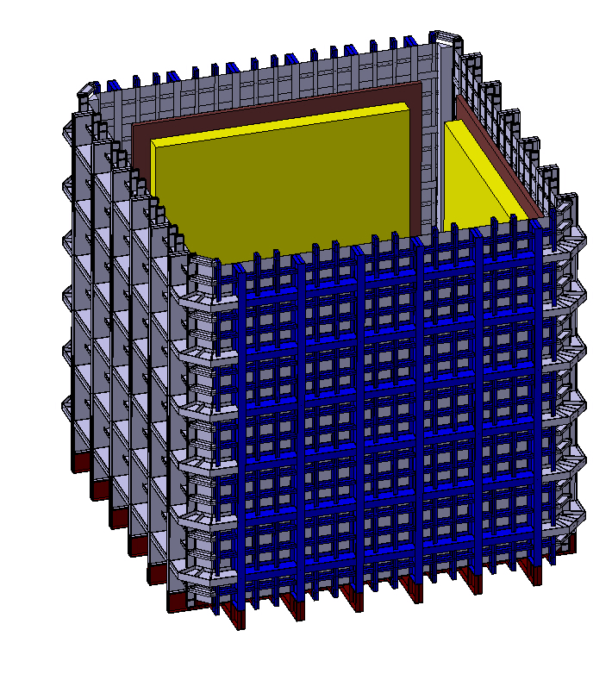
assembly in the final position
Weld SS plate in the corners
Add GTT foam
Add secondary membrane
Finish the last layer of foam
Pose the missing primary membrane
Final welding
D.Smargianaki
19

Slide 20
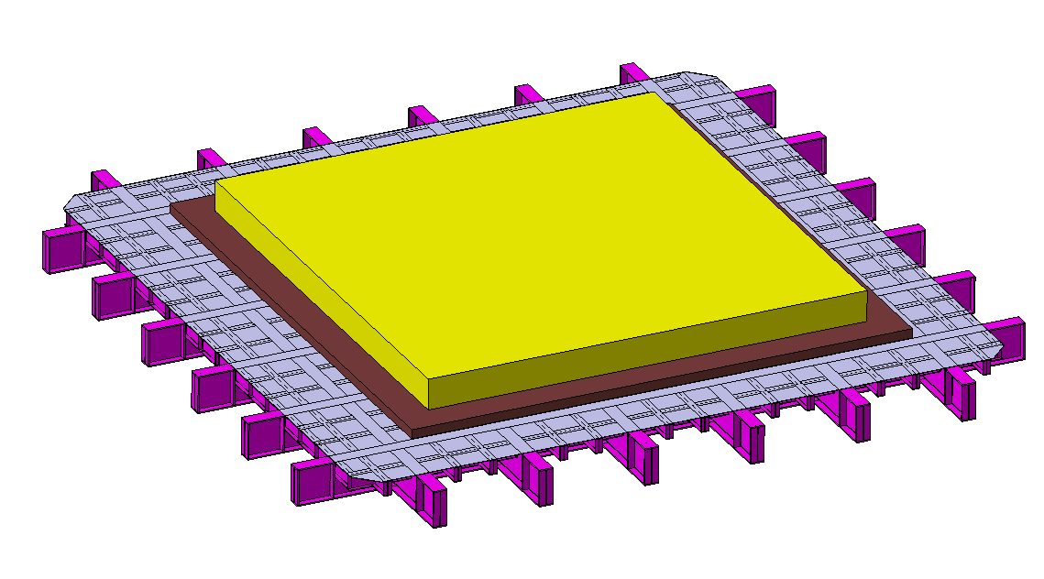
ROOF
Prepare it on the floor
Drill holes for penetration
Weld reinforcement tubes
Install it
Install missing foam and membrane in the corners
Finish welding membrane
D.Smargianaki
20

Slide 21
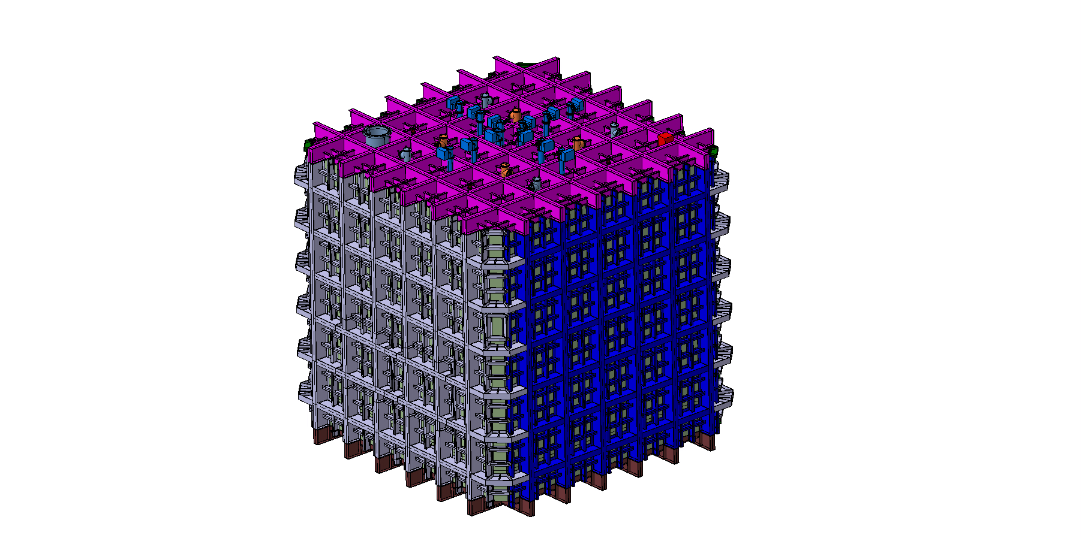
Final assembly
D.Smargianaki
21

Slide 22
BUCKUP SLIDE
D.Smargianaki
22

Slide 23
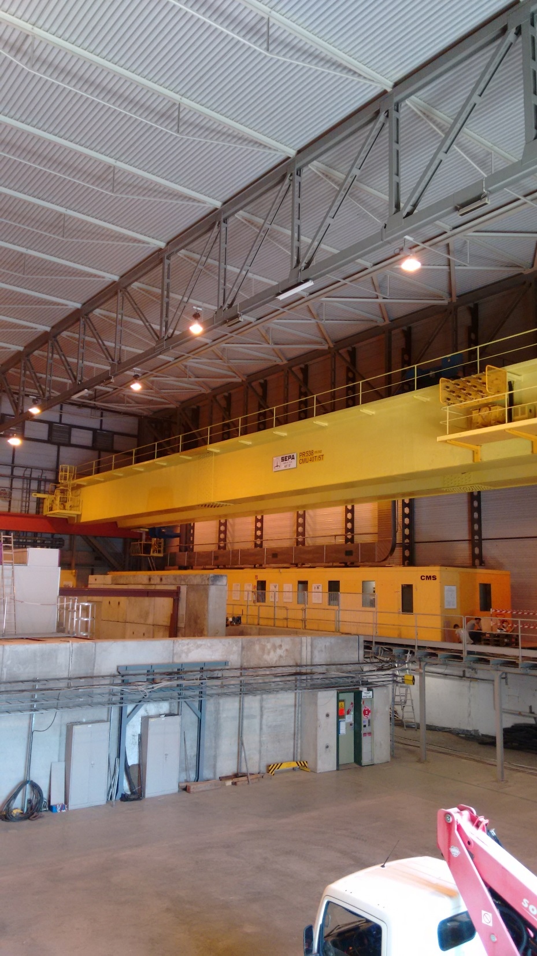
Roof level
EHN1 – some dimensions
First beam level
Distances :
Between floor level & Crane level = 9.5 m
Between floor level & First beam level = 14.2 m
Between floor level & Roof level = 18.2 m
Crane level
18.2 m
14.2m
9.5 m
Floor level
D.Smargianaki
23

