Slide 1
Aggregating Labels in Crowdsourcing Data
19/08/2015
CERN Openlab Summer Students
Lightning Talks Sessions
Maria Priisalu

Slide 2

Crowdsourcing
Many workers
Easy tasks
Multiple answers
Little or no prior knowledge
Aggregate answers
Notes:
What is crowdsourcing?
Crowdsourcing is a method where a large number of paid or volunteer individuals perform relatively easy tasks.
The crowdworkers have little or no prior knowledge in the field of the tasks they are solving.
Since the knowledge in the crowd varies greatly, so does the quality of the answers.
Therefore we need a robust method for aggregating the answers to extract the correct or true answer.
I will from now on refer to answers to tasks as labels.
The results are then used to solve a larger problem, or for creating a training set.

Slide 3



Advantages of Crowdsourcing
Costs less
Faster
Educate the worker
Notes:
Why crowdsourcing?
The field of Artificial Intelligence has evolved greatly, however there are still some tasks that are easily performed by humans, but are computationally hard. Examples of such tasks often lie within image recognition and natural language based problems. Crowdsourcing can be used to improve the existing algorithms in computationally hard fields that often require large training sets.
The advantage of using crowdsourcing is that it can be less costly, and faster than expert system. It can also possibly be used as a means to educate the crowdworkers during the process of gathering answers.

Slide 4


Research in Crowdsourcing
Hybrid systems
Task scheduling
Learning algorithms
Aggregation
Notes:
What research has been done?
Hybrid systems are systems where crowdsourcing is used together with other methods, or used in non classical iterations.
For example WalmartLabs developed a classification system that combines crowdsourcing, rule based classification, machine learning classifiers and expert judgment. This classification system is used for their growing system for goods, where the number of categories and numbers of item grows constantly.
Crowdsourcing is used because experts cost too much, machine learning classifiers do not have a high enough classification on such a dynamic system with little or no training data, and rules are constantly in the need for updates.
Task scheduling is another important task. Since the workers appear and disappear at random intervals with some patterns, and they complete a random number of tasks, there have been developed online scheduling algorithms that schedule out the tasks to workers depending on the recent history. This has shown to speed up projects, and should be used.
Regression and some other methods based on regression have been adapted for crowdsourcing data in a manner such that the estimation of the distribution of the labels is done simultaneously as the regression parameters are learned.
Task aggregation has been explored well for binary and multiclass labels. A large number of the algorithms used build upon the Dawid Skene model.

Slide 5
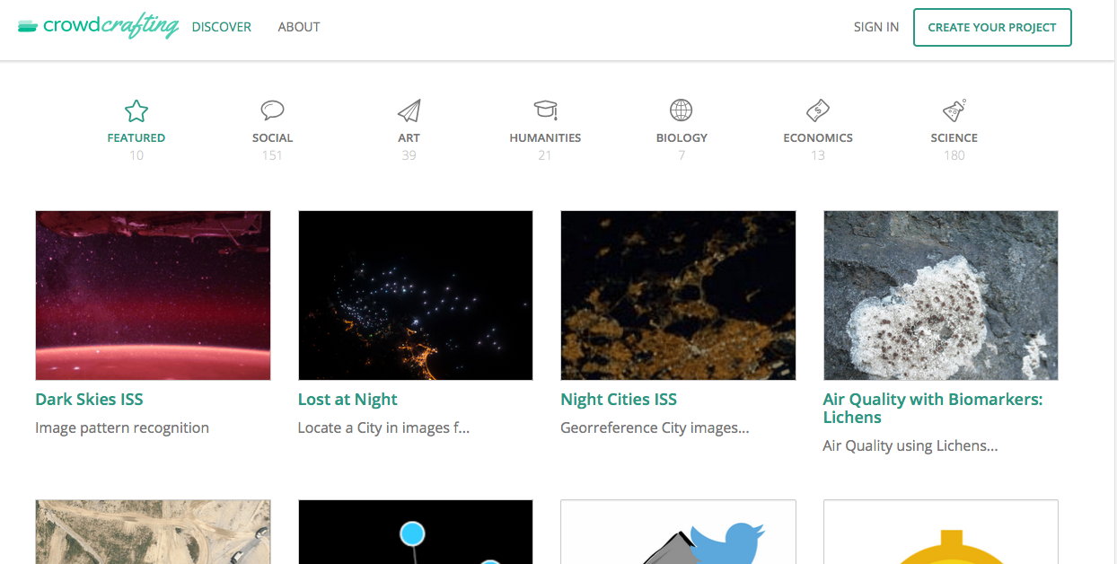
Our implementation
Dawid-Skene model (EM)
Notes:
We implemented the Dawid Skene model for use on Crowdcrafting and GeoTagX data. We implemented this model because currently there was no implementation of any aggregation algorithms known to us that were directly applicable to the output given by these sites.
The main challenge has been to make the label aggregation program applicable in a large variety of scenarios, while keeping it user friendly.
Crowdcrafting and GeoTagX are open source and open science platforms that enable citizens to set up a crowdsourcing projects. The results of the projects are then publicly available.

Slide 6
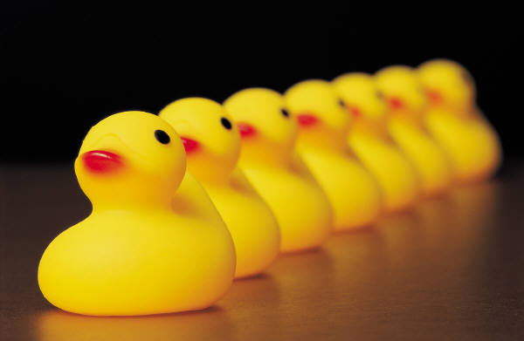
Future (and current) work
Aggregation of other types of labels
Sociological aggregation
Educating the crowdworker
Notes:
Future work
In the future other more refined but also more complex label aggregation algorithm could be implemented.
In larger perspective, there is a need for aggregation methods for different label types, such as labels in the form of coordinates or polygons.
More work can be done also on using our knowledge of the workers as social group to extract true labels. This is something that is currently researched and is proving to be efficient. Currently developed algorithms however ask for the worker’s opinion about their labeling for one more time after being shown the “general” opinion. Algorithms that do not require such extra steps could be possibly developed in the future.
Current research is concentrated on best ways to educate the crowdworkers, with or without their knowledge while they perform the crowdsourcing tasks. This is a vital application of crowdsourcing.

Slide 7

The Webfest
Notes:
I was the main organizer of the 2015 Webfest, an annual hackathon at CERN.
This year we had around 50 participants, 11 teams and 30% of the participants were female.
The winning team developed a platform that gathers data about violence from new articles. This is something that is currently done manually and the system will speed up the process greatly.
Since more than 50% of my time was occupied by organizing the Webfest I unfortunately did not get as much time for the as was initally planned.

