Slide 1
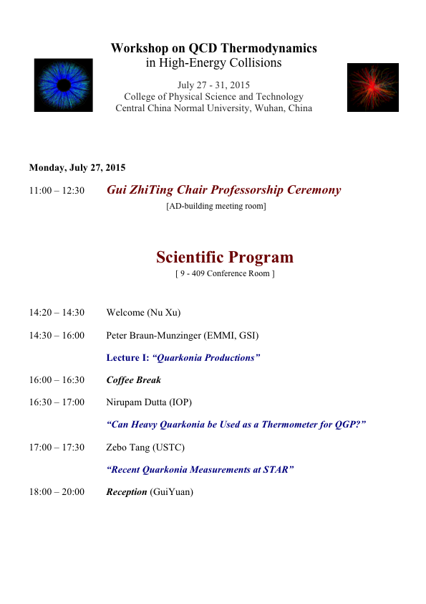
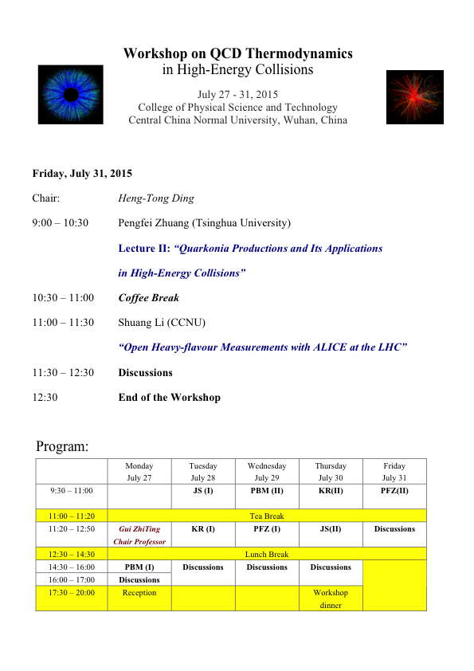
Prof. Dr. Peter Braun-Munzinger (EMMI, GSI)
Prof. Dr. Krzysztof Redlich (University of Wroclaw)
Prof. Dr. Johanna Stachel (Heidelberg University)
Prof. Pengfei Zhuang (Tsinghua University)

Slide 2
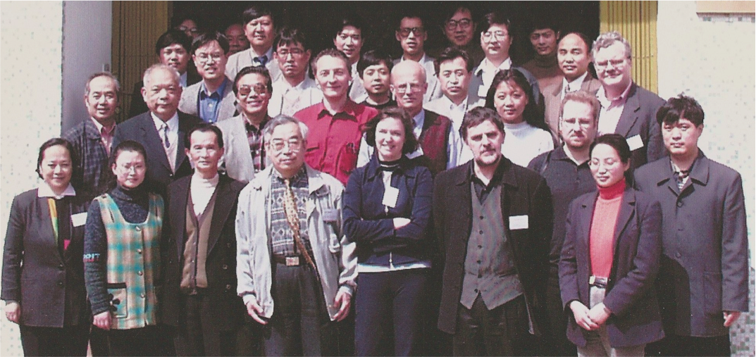
Relativistic Heavy Ion Collision Physics
April, 1999

Slide 3
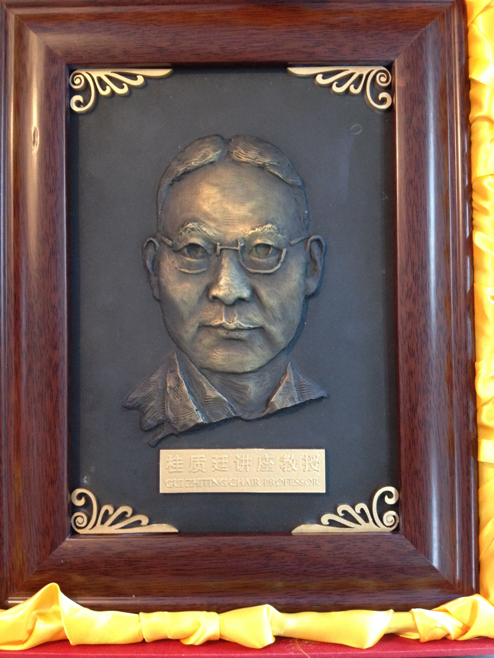
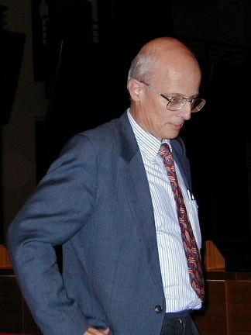
桂质廷讲座教授
Congratulations to Prof. Dr. Peter Braun-Munzinger for the Giu ZhiTing Chair Professorship at the Central China Normal University!

Slide 4
1) Please silent your cell phone
2) Please ask questions:
There is no stupid question
学而不问，非礼也！
nxu@lbl.gov
+86 15926295811 +1 5102898119

Slide 5
Selected Questions
Applicable window of (p)NJL & PQM models
Hydrodynamic + criticality calculations
(chemical, kinetic) freeze out Temperature v.s. crossover Temperature
Fluctuations near CEP
UA(1) symmetry: possibility to detect eta prime mass
  reduction in the HIC experiment

Slide 6
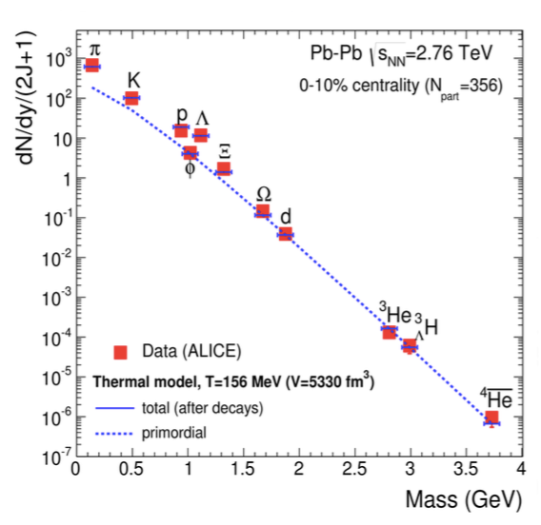
J. Stachel

Slide 7
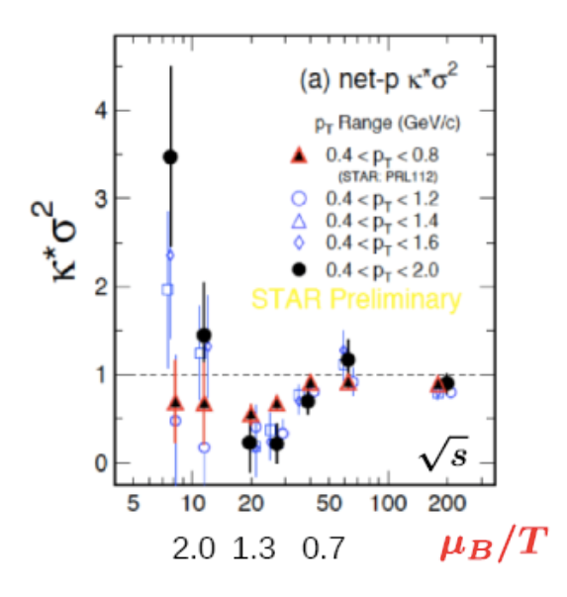

Slide 8
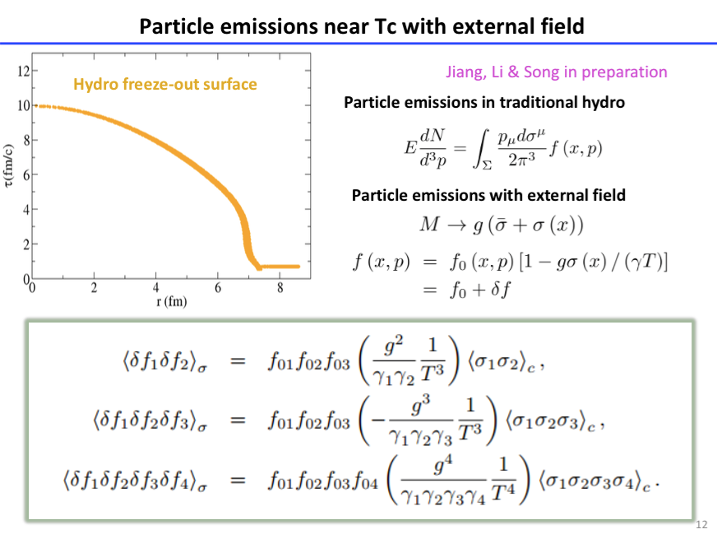

Slide 9
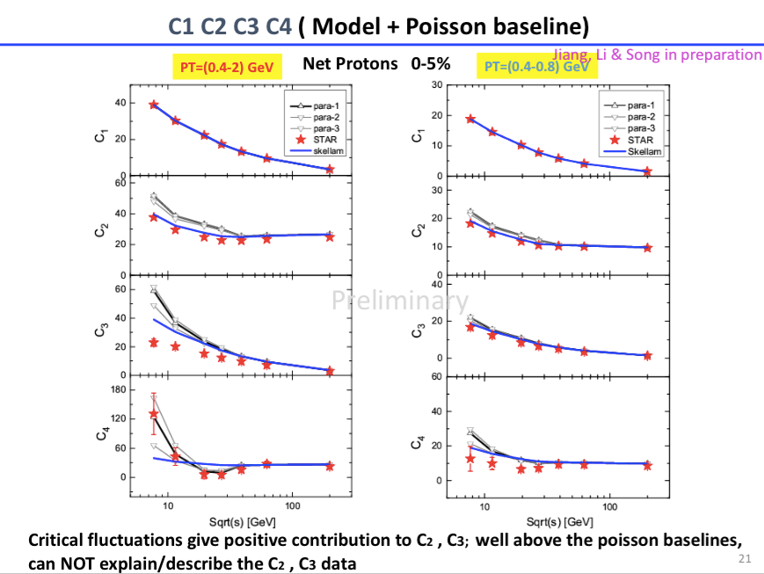

Slide 10
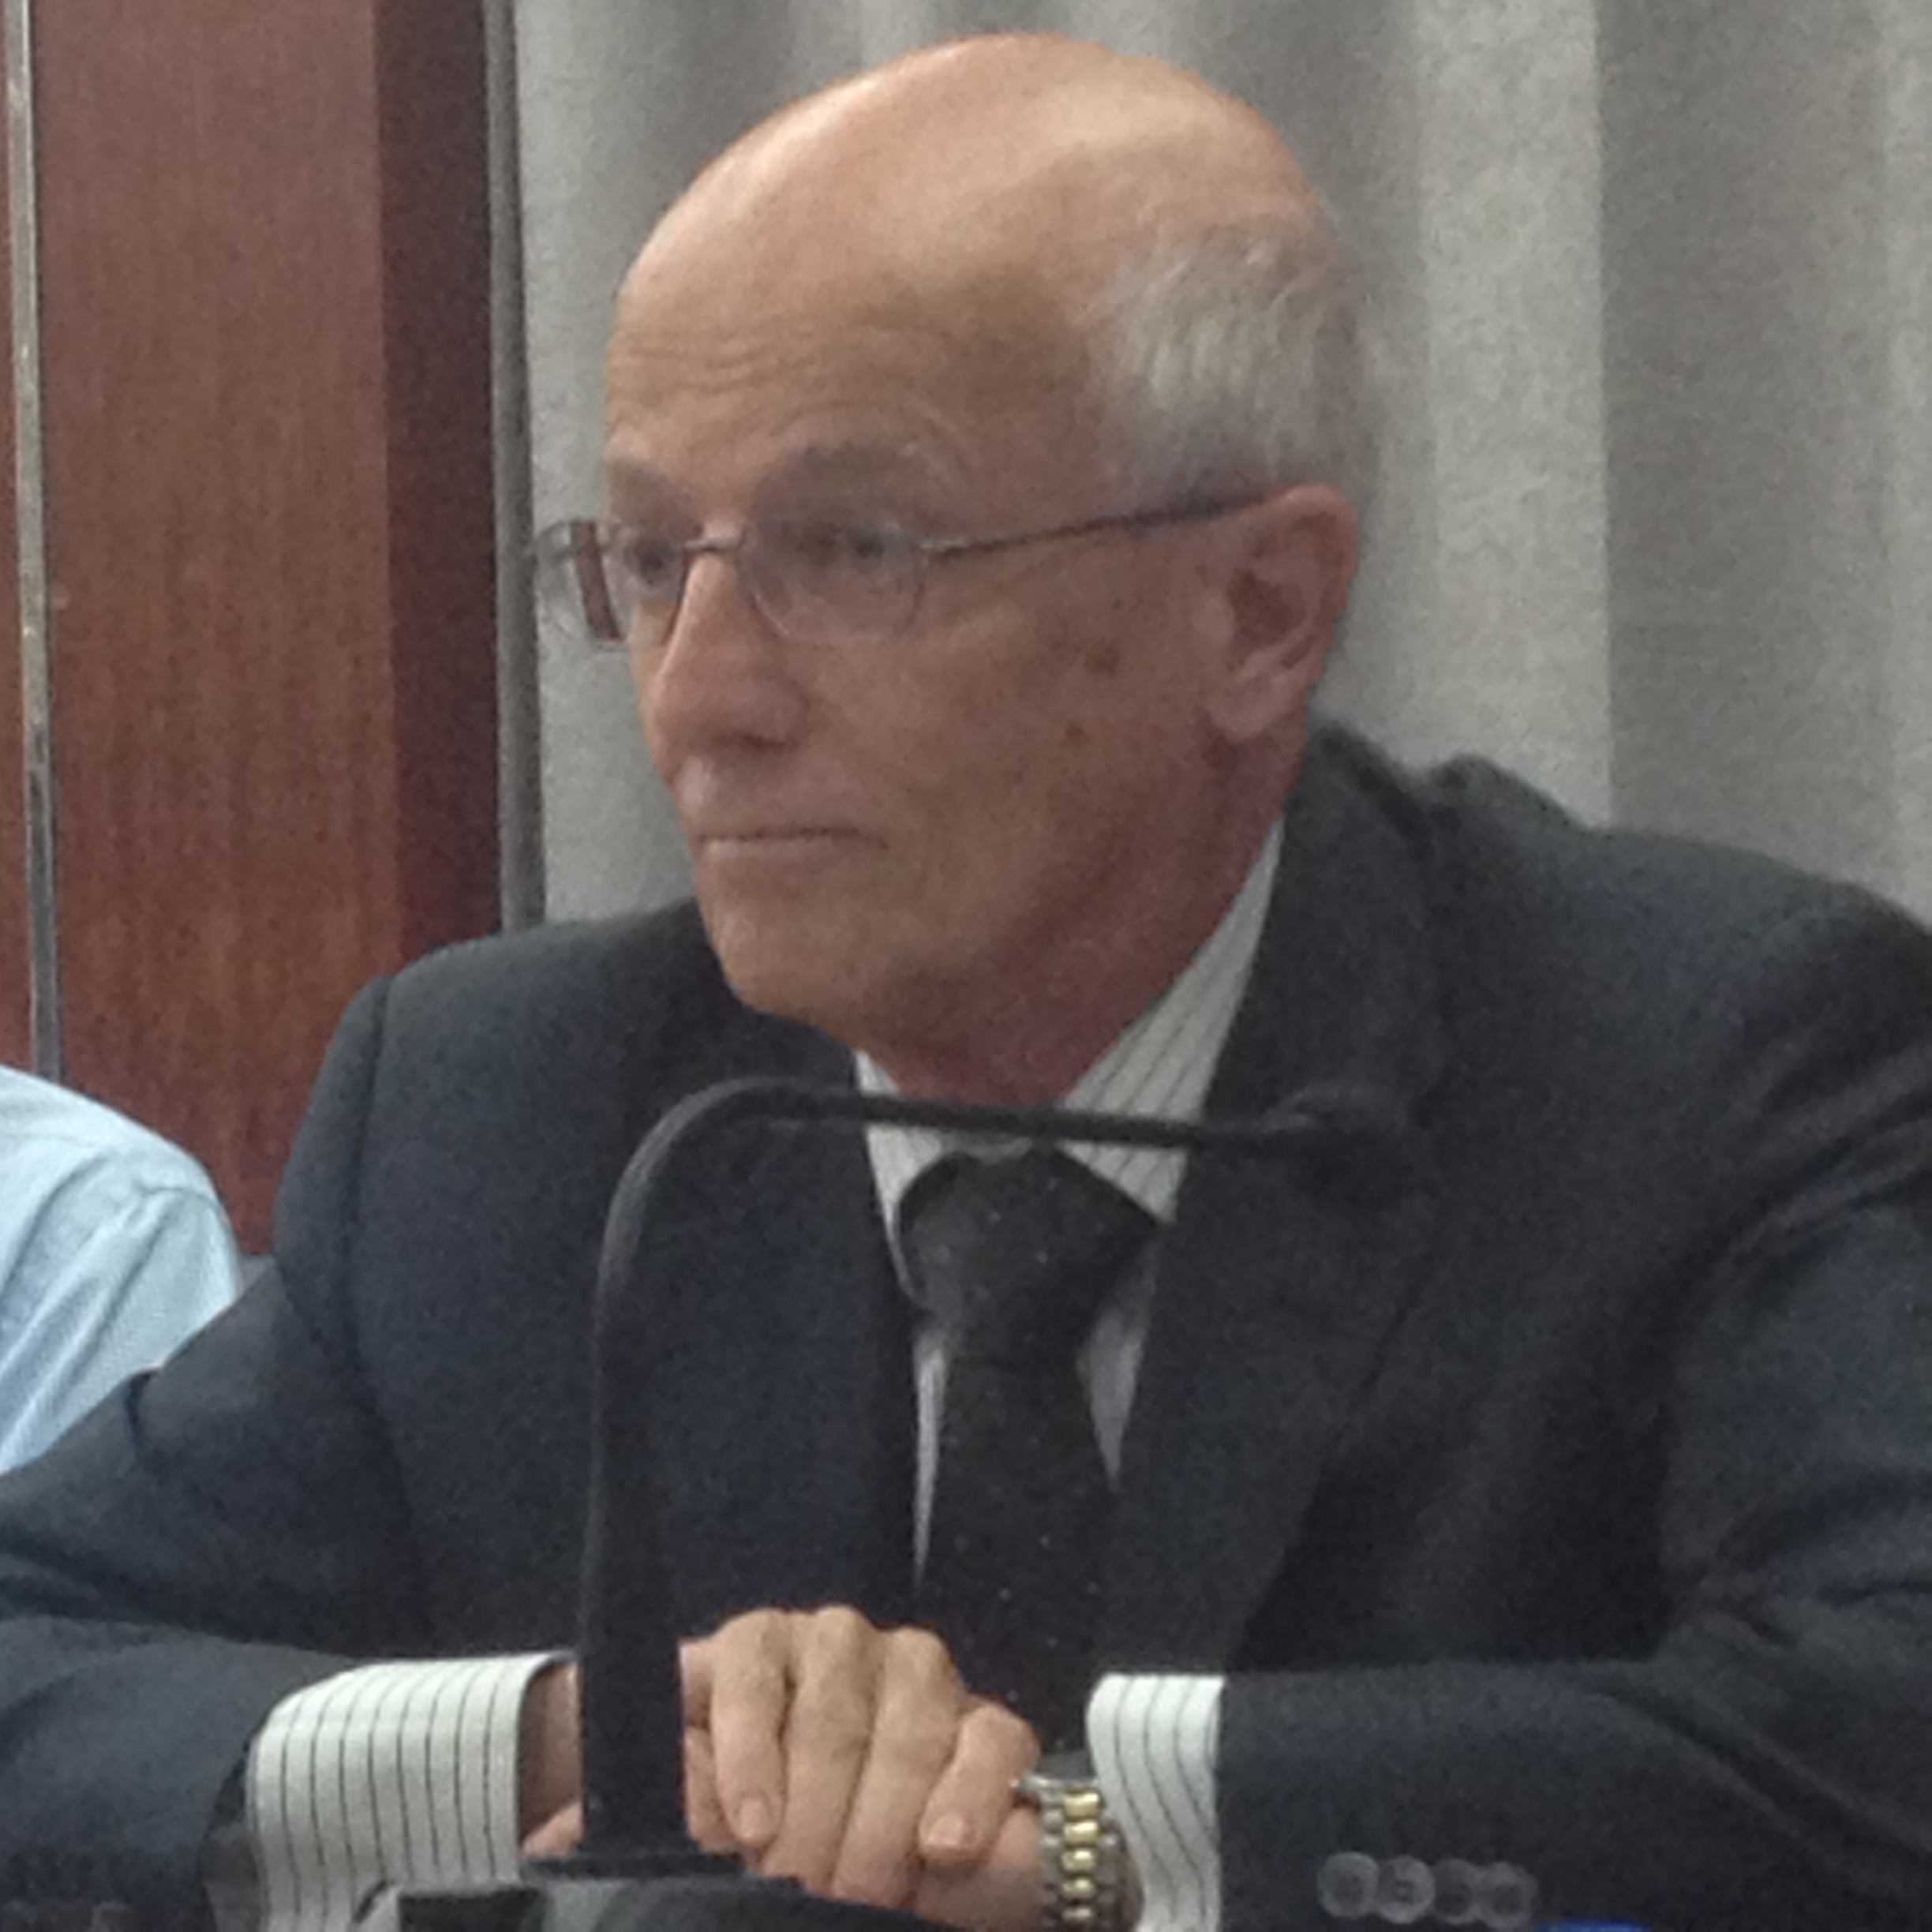
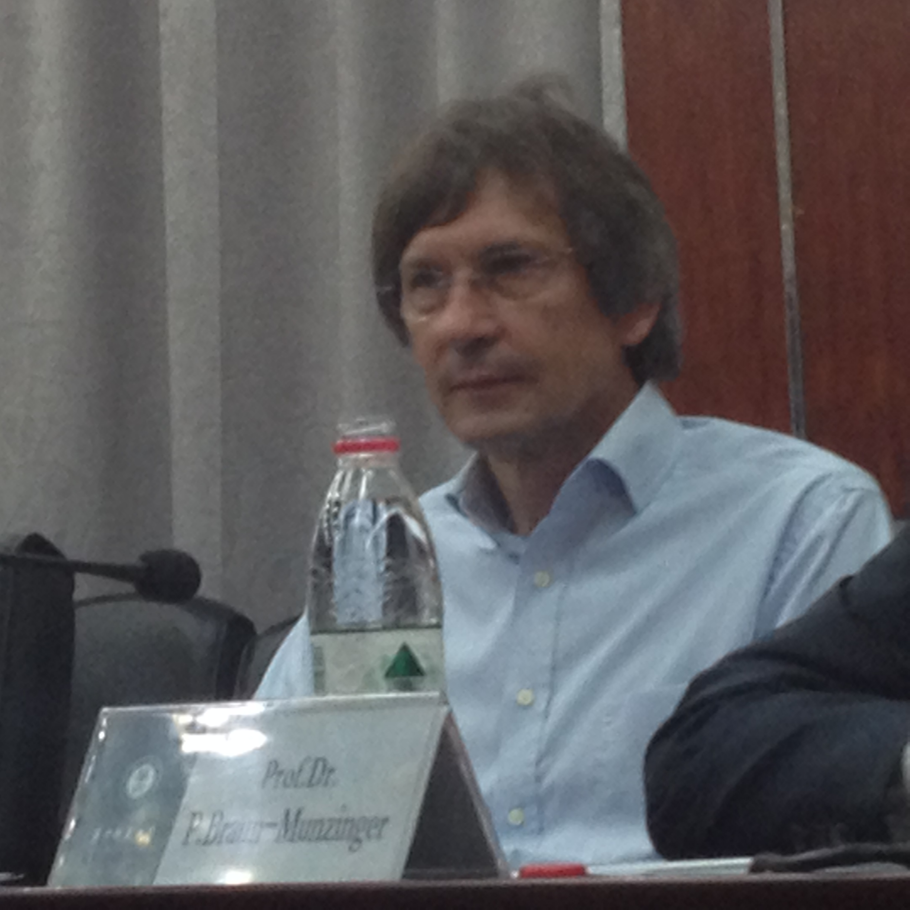
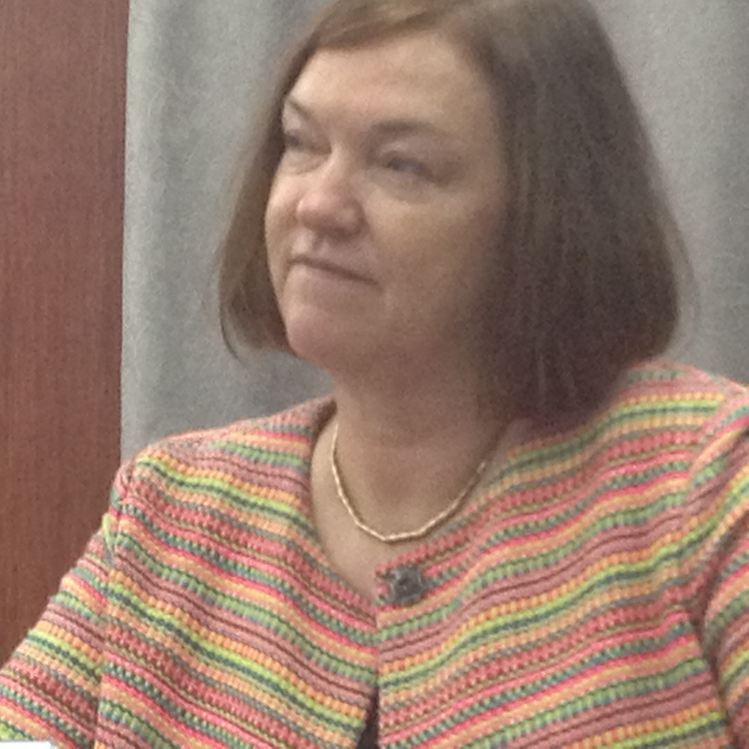
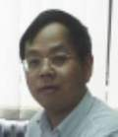
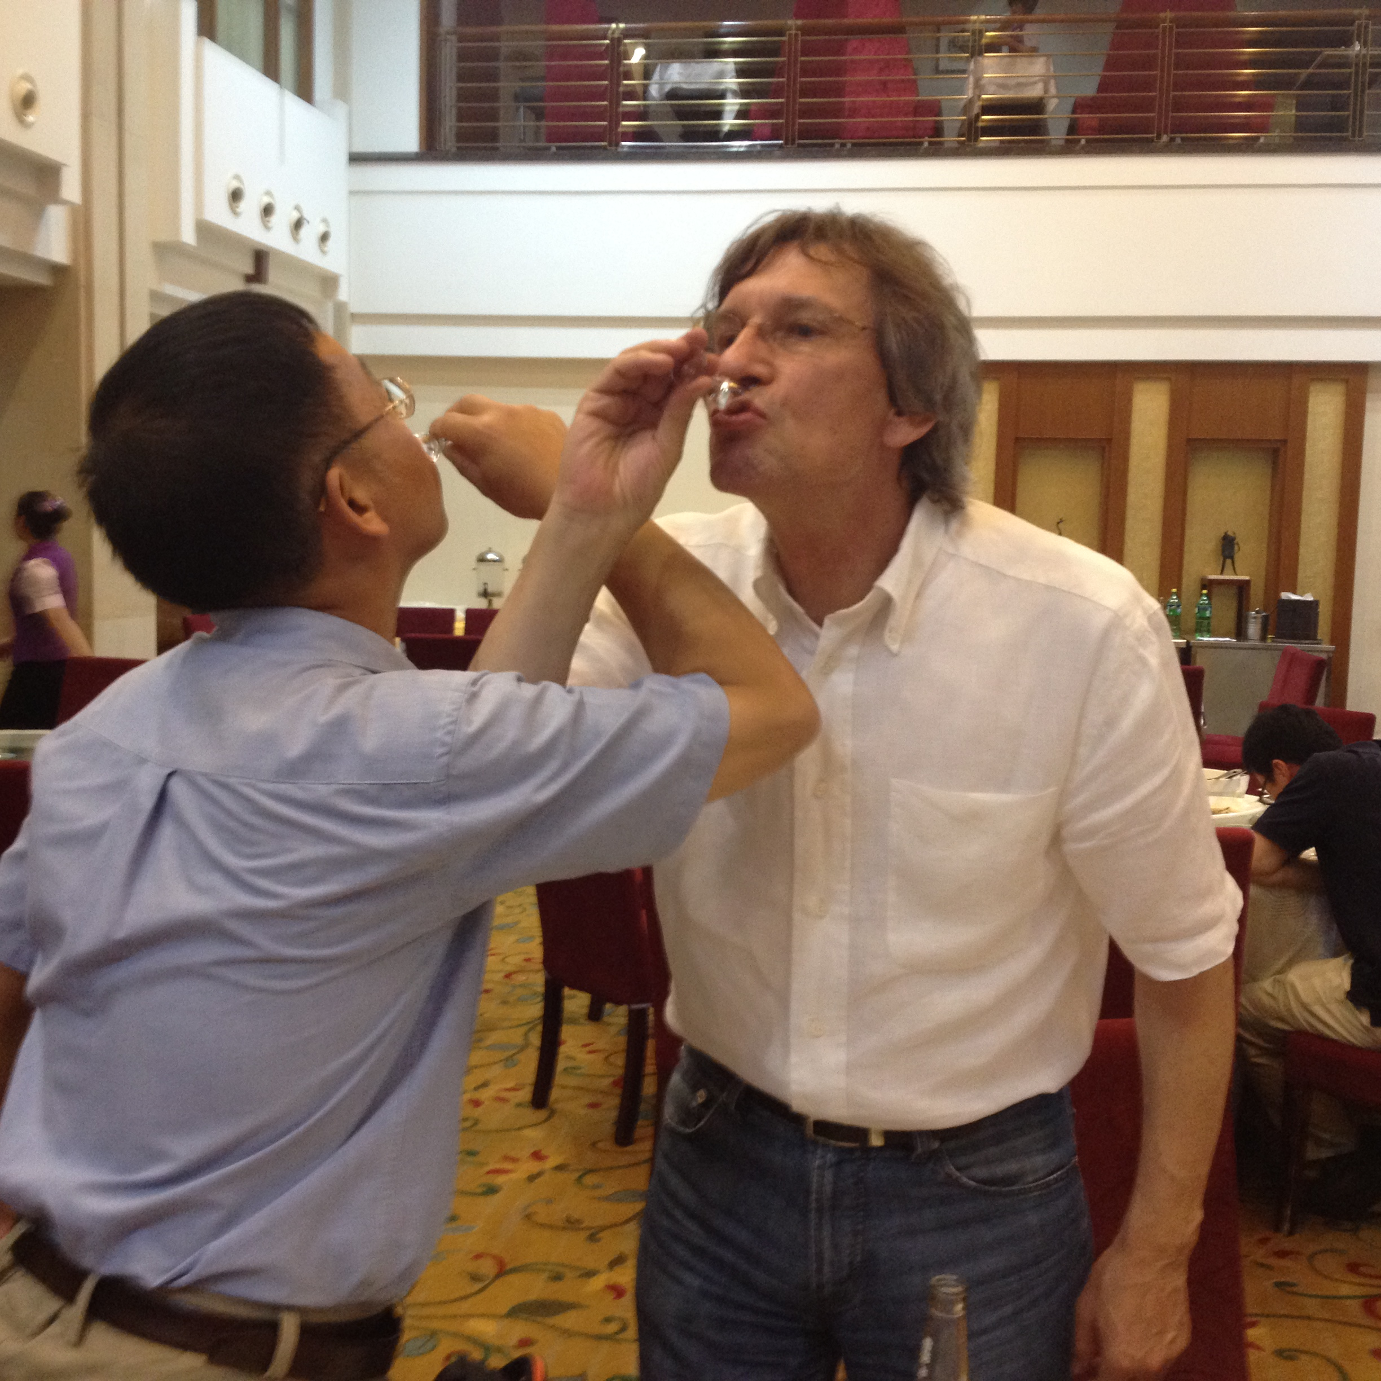
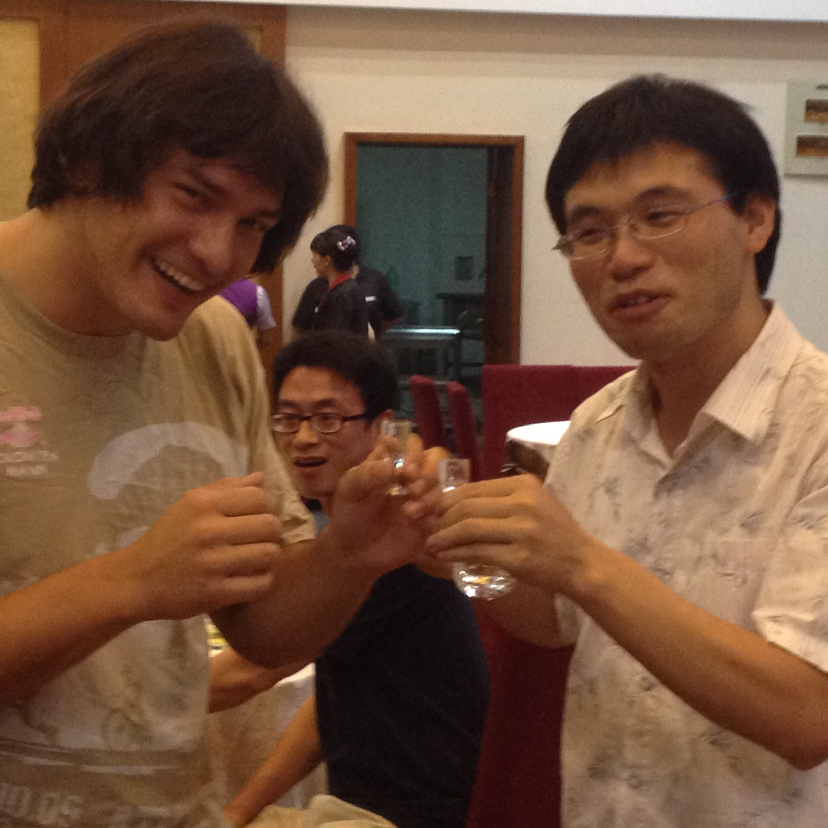
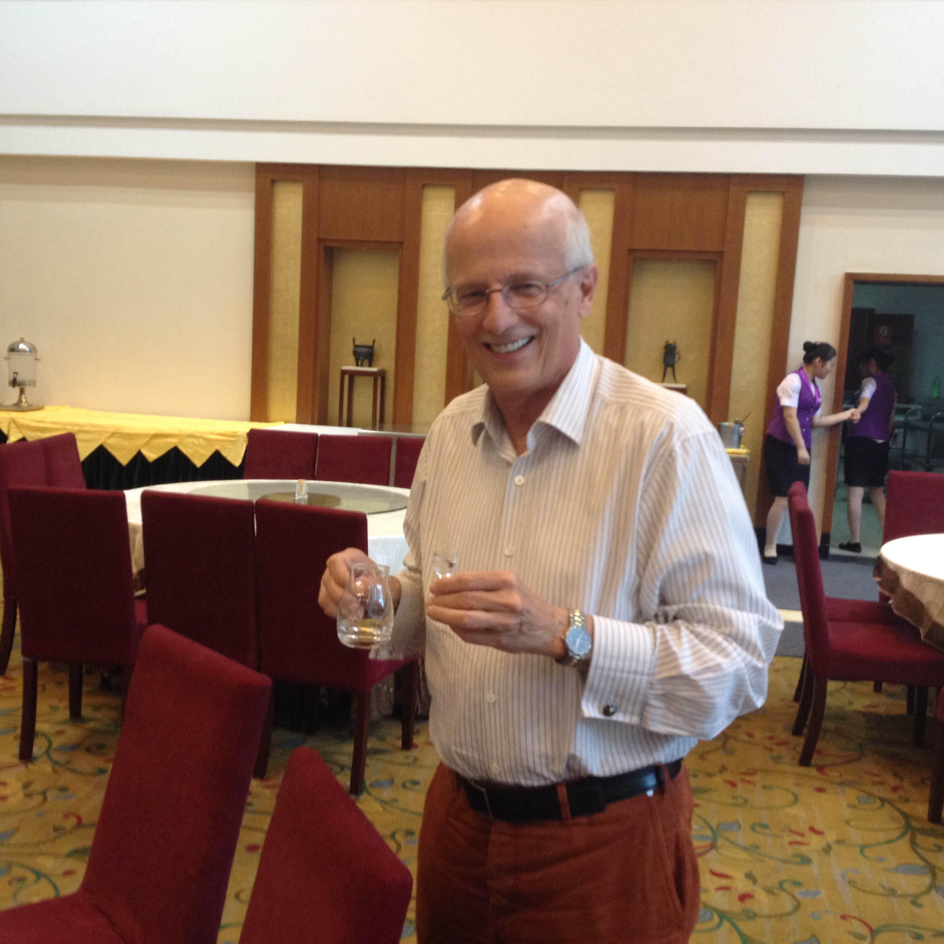
Workshop QCD Thermodynamics
Key Issues:
- Confinement, Screening, Chirality
- Quark-gluon Plasma
- QCD Phase Structure
- Experimental tools, …
Thank you all for participating in the workshop!
Have a safe trip home

