Slide 1


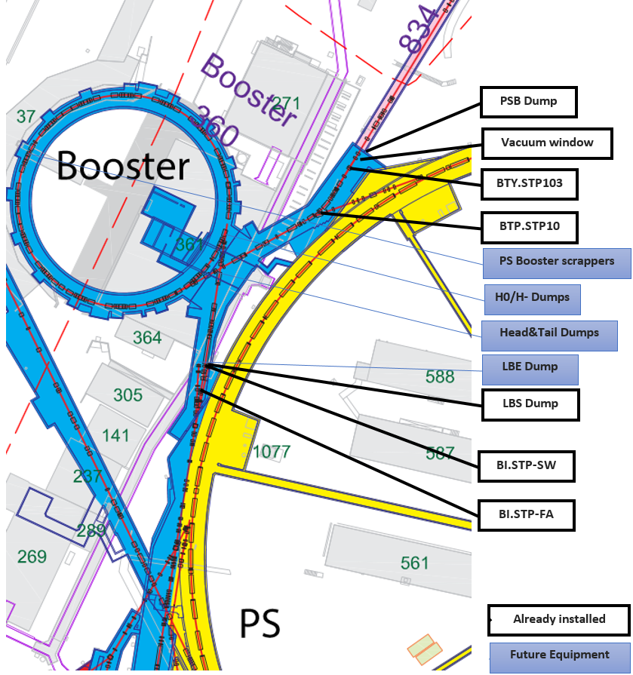
PSB-LIU Intercepting devices

Slide 2
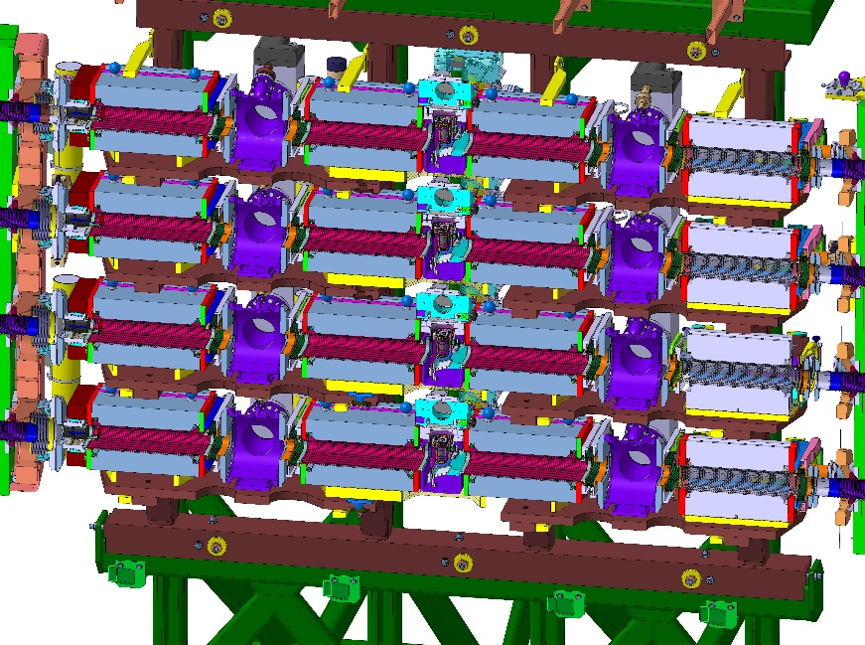
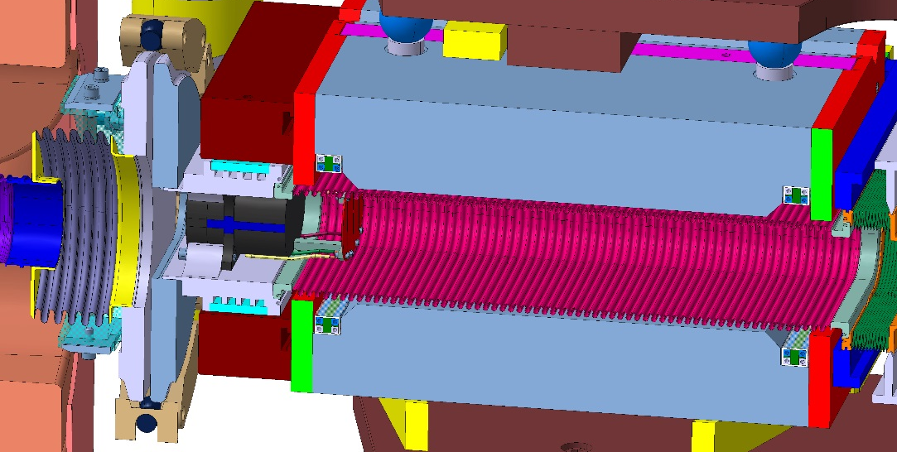
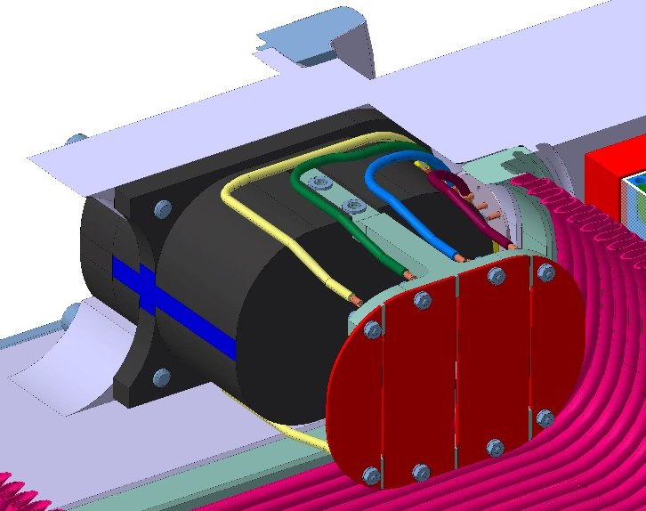
Ho/H- Dumps readiness
Technical Spec: Edms 1293512
Technical drawings: PSBVCDOA0035 & PSBTDIMA0001
EVM Wu id: 91906
To be manufactured: 8 (4 installed + 4 spares)
BSW4 Magnet
Status:
Design completed (EN-MME), drawings have been validate to start production
Titanium dump already ordered and should be delivered soon due to non-conformity (EN-STI/MME)
Screen to be produced (BE-BI)
Control (hardware & software) under study (EN-STI)
Expected delivery date to TE-ABT for integration: Oct 2015

Slide 3
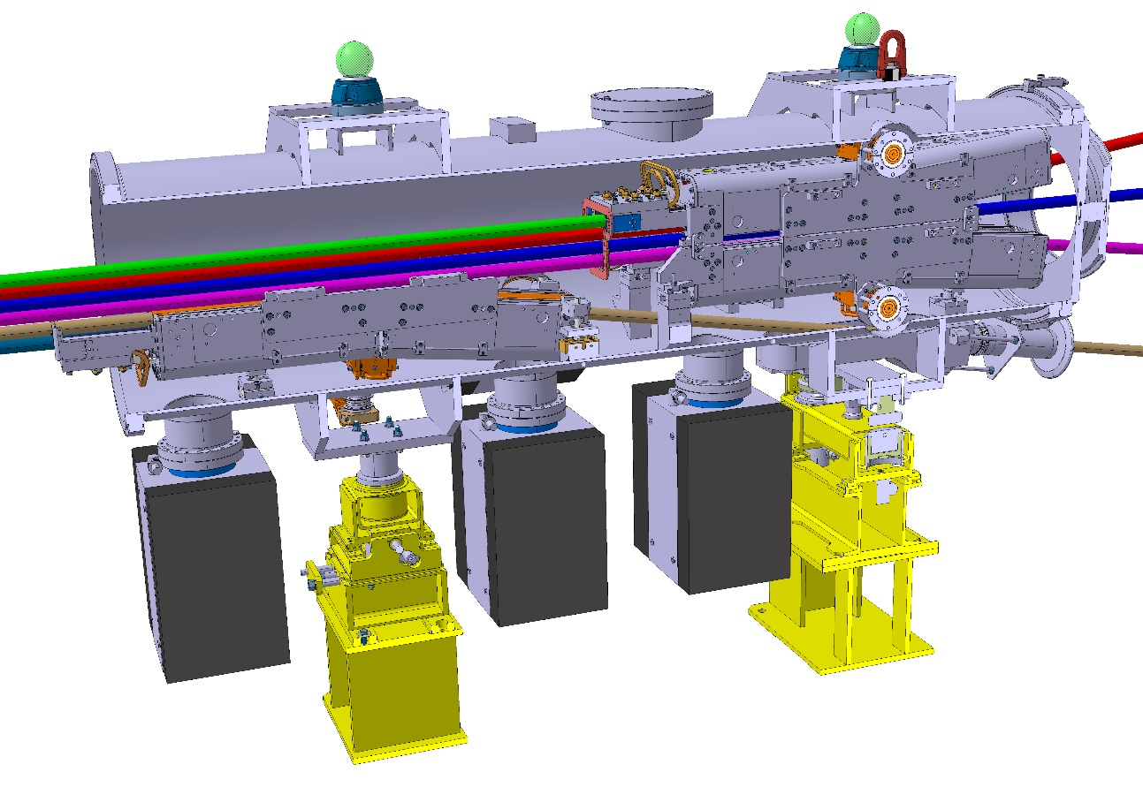
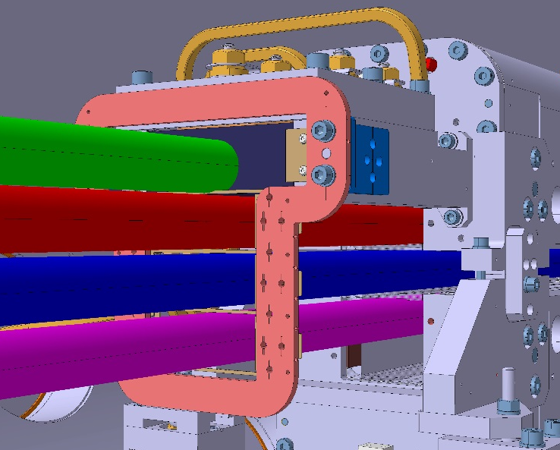
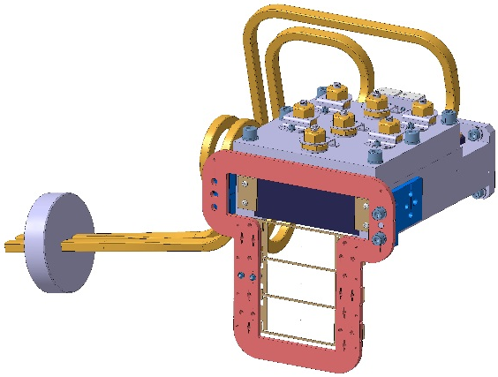
Head&Tail Dumps readiness
Technical Spec: Edms 1145567
Technical drawings: PSBTDI__0001
EVM Wu id: 91905
To be manufactured: 6 (2 installed + 4 spares)
Status:
Design completed (EN-MME), drawings have to be signed soon to start production
Prototype to validate the design already done and approved (EN/STI)
Graphite dump already at CERN (EN-STI)
Screen to be produced (BE-BI)
Control (hardware & software) under study (EN-STI)
Expected delivery date to TE-ABT for integration: Oct 2015

Slide 4

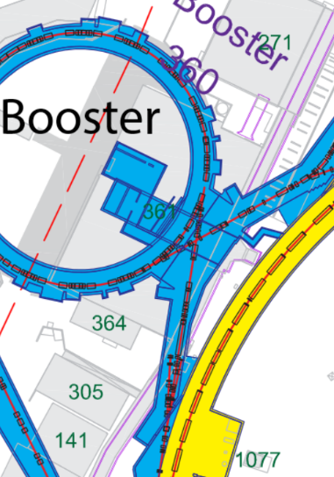
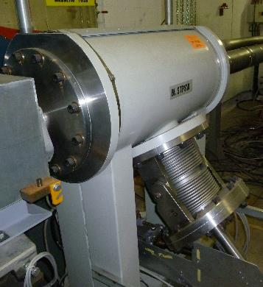
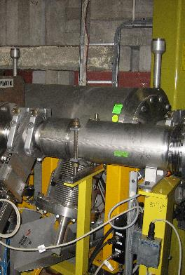
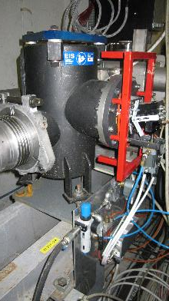
Beam Stopper
Document sur EIS CERN : EDMS 1182293
Document Procédure d’Assurance Qualité EIS : EDMS 1211886
BI.STP-FA
BI.STP-SW
BI.STP.10
Lack of documentation : old drawing, pictures… (still researching to do in old workbook)
Compatibility of the BS with the 160MeV(injection) 2 GeV (ejection) beam to be checked. Pending the arrival of a fellow in the TCD section
Functional Specification of the beam stoppers under preparation

Slide 5
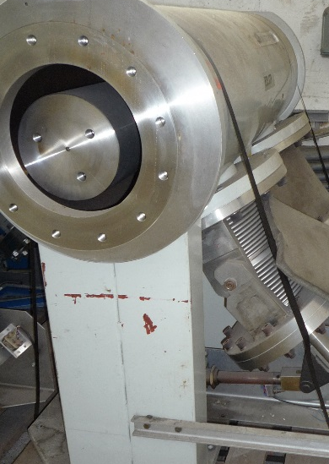
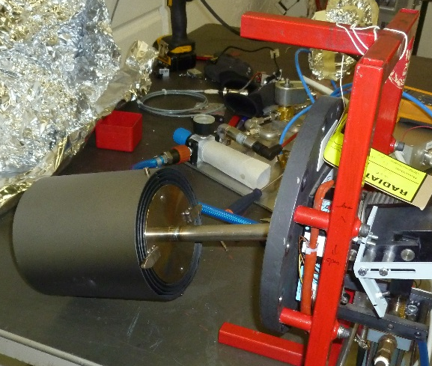
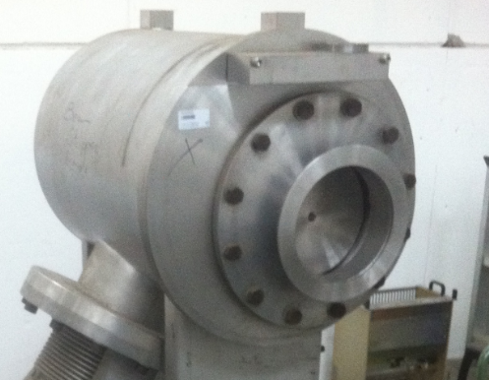
Beam Stopper
EIS CERN Document : EDMS 1182293
Document Procédure d’Assurance Qualité EIS : EDMS 1211886
BI.STP-FA
BI.STP-SW
BTP.STP.10
Asset : PXTBS__005-CR000001
Drawing : PS_LMLTP8137
Dump : 3 Graphite cylinder (Ø150mm max)
The beam see 6 time graphite
Asset : PXTBS__001-CR000002
Drawing : SI.3.23.1002
Dump : 1 stainless steel Cylinder Ø199mm
600 mm long
Asset : PXTBS__002-CR000002
Drawing : SI.3.23.1002
Dump : 2 stainless steel cylinder Ø199mm
2x550mm long = 1100mm

Slide 6
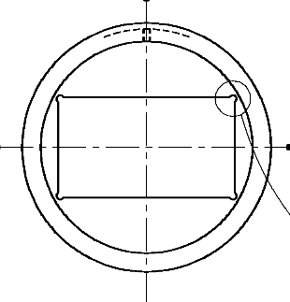
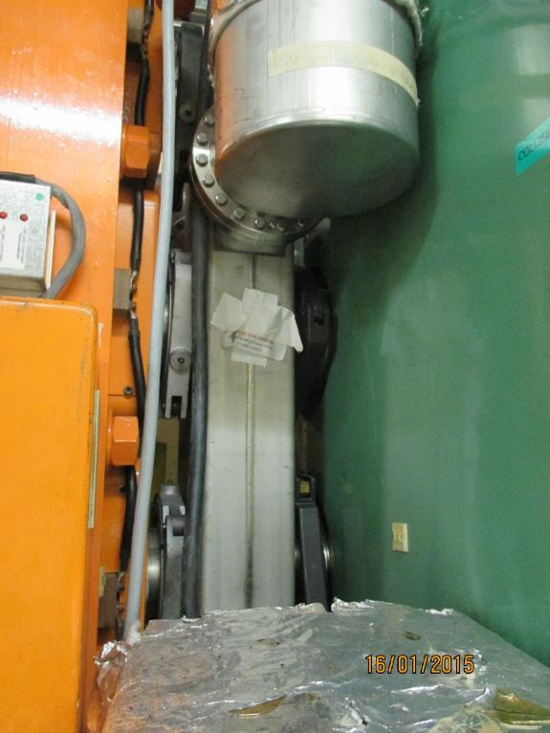
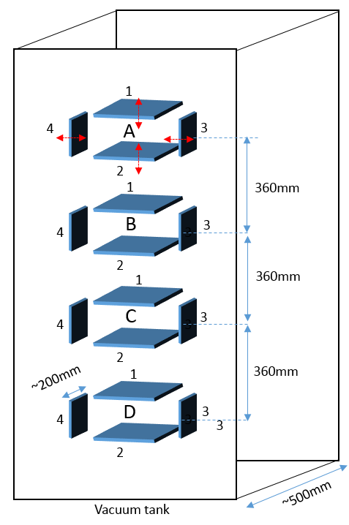
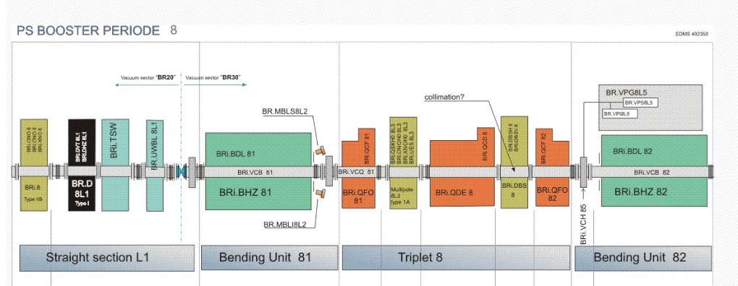
PS Booster Absorber/Scraper
Technical Spec: to be archived in Edms CERN-0000149335
To be manufactured: 1 object + spare
100mm
Specifications:
-New scraper, longer (130mm instead of 47mm)
-If possible: 16 movable independent axis
57 mm
Current position of the WBS:
185mm available space flange to flange
By removing the DBSV8 kicker, one can get 520mm flange to flange
Status:
Start of Fluka simulation to select to best material (July 2015)
Presentation of the SRR (November 2015)
Possible re-consideration of the specification, (under discussion)
Targeted delivery date: LS2 (~2019)

