Slide 1
Considerations for increasing the single-phase fiducial volume
Jim Stewart
July 1 2015
EFIG

Slide 2
History
M. Nessi established a discussion group with the goal of evaluating possible ways to increase the ratio of fiducial volume to cryostat volume. First meeting February 24 2015.
  Attendees: Lee Greenler; Claudio Montanari; Marzio Nessi; Francesco Pietropaolo; Paola Sala; Alberto Scaramelli; Jim Stewart; Daniel Wenman; Bo Yu
We have had periodic meetings since with one face to face meeting in parallel to the CERN single-phase test detector meeting.

Slide 3
Points of Discussion
Need do reduce the volume between the TPC and the cryostat (make the detector bigger).
APA CPA plane ordering.
Fiducial volume cuts.
Fraction of the cryostat used for gas ullage.
  Ground Plane
Space above and below the active detector.
Other topics have included wire pitch, wire angle, single sided APAs, APA frame design, photon detection.

Slide 4
Plane ordering
If the cathode planes are near the wall then the wall detector distance is larger and the stored energy is larger.
APAs near the wall
Increases instrumented volume for fixed cryostat size
Decreases stored energy
Increases number of APAs and readout channels
CPA near the wall
Decreases detector volume
Increases stored energy
Decreases number of APAs
Studied by LBNE as a value engineering exercise VE-FD-27 (docdb8920)

Slide 5
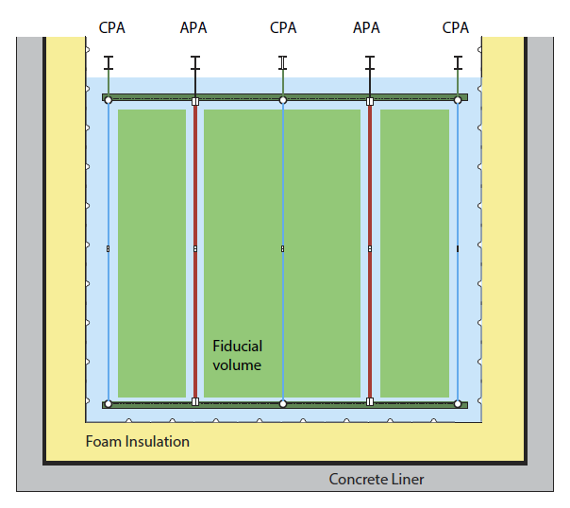
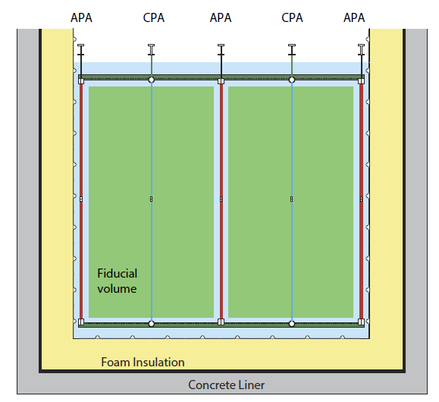
Rearranging the APA/CPA order
Minimize CPA stored energy, reduce TPC to cryostat clearance
LBNE Docdb 8920

Slide 6
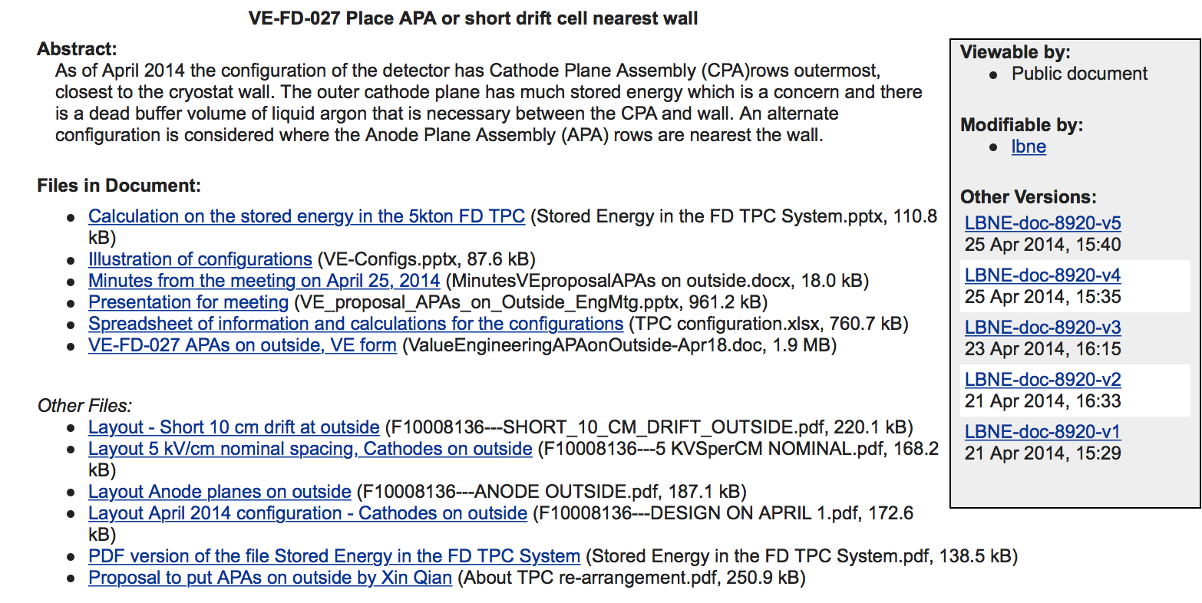
VE-FD-27

Slide 7
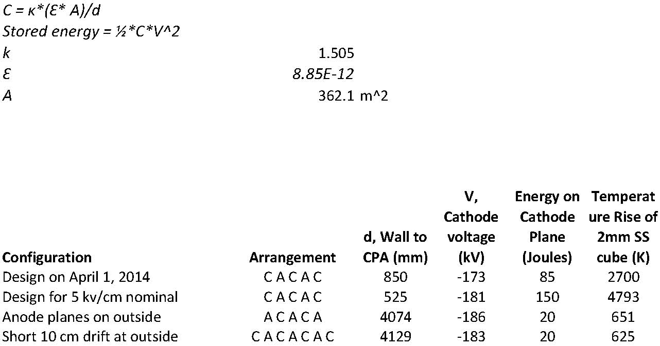
Stored Energy
Cathode-wall stored energy of 150 Joules was enough to melt a 2mm cube of stainless steel. This poses a risk to the cryostat.
The field cage stored energy was on the order of 100 Joules so simply changing the plane ordering did not completely mitigate any discharge risks.
  Also needed to look at the electronics

Slide 8
Other plane ordering considerations
Cost impact was roughly neutral. The cost saved by making the two cryostats smaller roughly compensated for the production of the additional APAs.
  Calculation only valid for two cryostats
The fiducial volume cut on the cathode planes internal to the detector volume was assumed the same as for external cathode planes which is not correct.

Slide 9
VE-FD-27 conclusions
Cost was not the driver for this decision as the cost impact was small. The decision should be based on risk mitigation.
The HV discharge mitigation studies needed to progress as quickly as possible. A unified mitigation strategy including the field cage was needed.
  A solution was needed at the start of the preliminary design.
    HV study is now done.

Slide 10
Decision to change plane ordering
The formation of DUNE and the decision for a CD-1 refresh required that all critical decisions be made in advance of preparing for the reviews.
The decision to go to four cryostats invalidated the cost evaluation in the VE proposal because the option of going from 4 detectors to 3 was not considered.
The decision was made to change the plane ordering as both the lowest risk and the most conservative cost option.
  This increased the cost of the detector and as the cryostat dimensions had been fixed increased the FV from 10 kt to 11.4 kt.

Slide 11
Gas Ullage
The standard ullage for natural gas tankers is 5%.
ICARUS operated at 2%
Reducing the gas volume at the top of the detector could increase the detector volume form 11.4 to 12.6 kt, but there are serious mechanical difficulties for the detector.
Initial considerations need to be driven by the cryogenic system.

Slide 12
Cryostat Safety (my interpretation)
The volume of the cryostat changes with pressure so the liquid level must be such that if an overpressure event occurs and pressure relief happens no liquid leaves the cryostat.
  Do not vent liquid
  Significant ullage is needed (my opinion)
At nominal operating pressure the flexure in the steel cryostat is very small (mm level).
  2% ullage corresponds to 26 cm
One can consider the procedural measure of simply stopping filling if the cryostat is overpressure as sufficient to prevent liquid overflow in case of failure.
Cryostat likely can be filled to 2% ullage.

Slide 13
Cryogenic system requirements
The gas recirculation system will need a minimum gas volume to serve as a buffer needed to regulate pressure.
  As the operating pressure is decreased the buffer volume must increased to allow a reasonable operating pressure range.
A study of the gas system is needed to determine for a given operating pressure the required pressure band and required ullage. This is input to a minimum gas ullage requirement.

Slide 14
Studies for a taller detector
If the ullage can be decreased then one can study making the detector taller or making the cryostat shorter.
Reducing liquid and gas gap at the top increases the electric field in the gas.
  The HV breakdown voltage in gas is much lower than in liquid so it is critical to control the field in the gas.
  Generally agreed that if the cathode moves closer to the roof then a ground plane is needed.
  ICARUS groups strongly support adding a ground plane in any case.

Slide 15
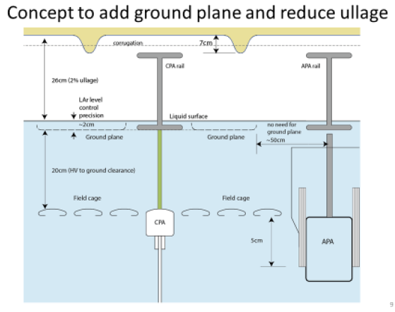

Slide 16
Possible engineering studies needed
Mounting rail support from roof:
Field cage panel connection design:
CPA support from CPA mounting support rail:
Ground plane design and support structure:
Cable routing and cable support in ullage:
Cable connection method to outer side of APA’s:
Shorter APA cold electronics package:
Short APA support to support rail:
Longer APA design:
Physics impact of longer APA:
Cryogenic interfaces at top, bottom, ends:
Ullage requirement for pressure control:
Installation and removal of Equipment at end:
Installation and Integration effort:
Documentation and design development and meetings and reviews:

Slide 17
Next steps
Brainstorming exercise to see how difficult some of the problems are.
  Some may be easy to solve
  Some may be really hard and not worth the risk and effort
Make some models. Sketch some ideas.
List the decisions one would need to make.
Will need to involve the Techboard when it exists.

Slide 18
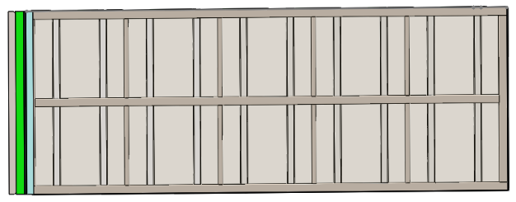
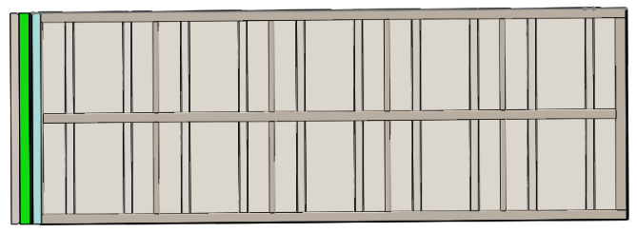
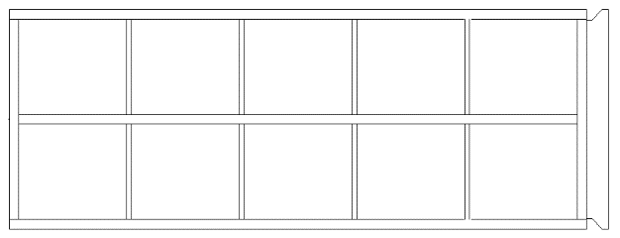
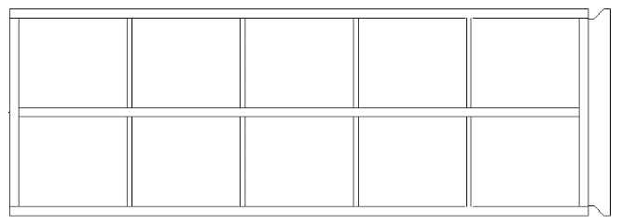
Consequences of APA length increase
6.7% increase in wired area per APA
6.4m length requires longer than standard tubing for side members – sides will have to be spliced or made in two pieces.
Either the diagonal wires will have to wrap more than once around the APA or the wire angle will need to be decreased from current 35.7 deg to 34 deg or less.
~29% increase in flex under own weight when held horizontally
Slightly increased handling difficulty
  Handling around fabrication shop
  Maneuvering down mine shaft and around corners
  Maneuvering into cryostat
Wire fits, edge board sizes and layouts, pin and solder pad locations, etc. all will need to be reworked
6.4m
6.0m
6.4m
6.0m
The biggest costs of changing the length are almost all difficult to quantify; they are changes in detector performance and changes in how the APA is handled during fabrication and installation.
Lee Greenler, UW Phys. Sci. Lab, 1 July, 2015

Slide 19
Further Considerations
The detector is 58 m long but the cryostat is 62 m. How difficult would it be to add an a 26th detector sub-module?
  Each additional set of APAs adds around 0.5kt.

Slide 20
Big Questions
Would one consider extending the cryostat to accommodate additional detector sub-modules?
If the fiducial volume is close to 13.3 kt would one consider only building 3 modules or would you build more detector mass?
How do the options impact a dual-phase alternate? When do decisions need to be made?

