Slide 1
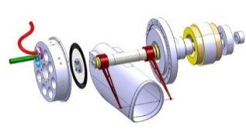
Electronics for the SPS BWS prototype
Electronics for the SPS BWS prototype
J. Emery for the BWS electronics team
Aleksander Cudny, Bernd Dehning, Pierre-Jean Lapray, Emiliano Piselli, Jose Sirvent, Luca Timeo
Contributions: Julien De Freitas, Kamil Florek, Colin Grosjean, Henzer Kevin, Mohamed Koujili, Matteo Macchini, Carlos Daniel Morais Pereira, Cantin Simon.

Slide 2
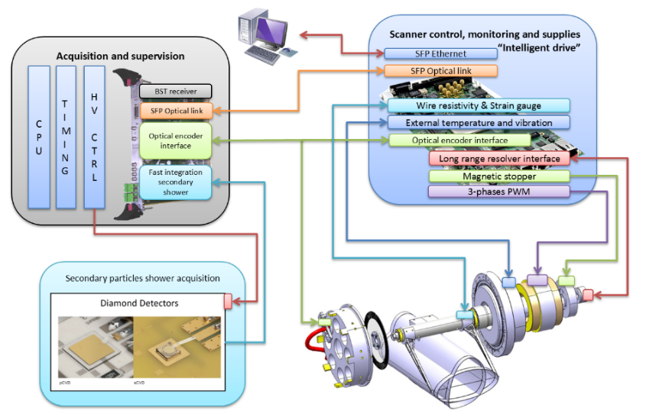
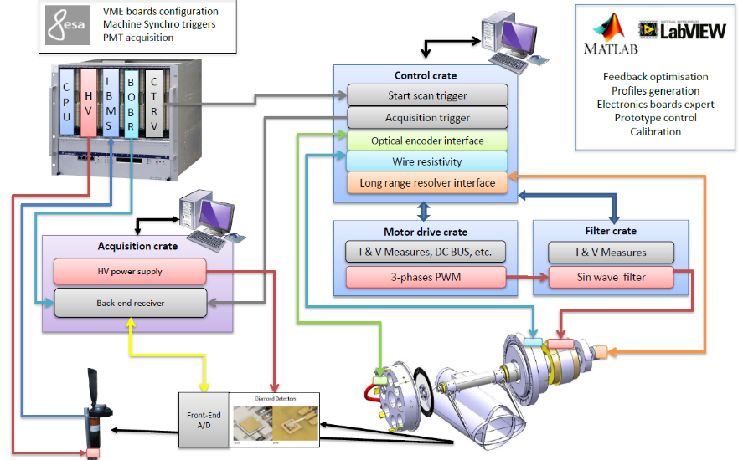
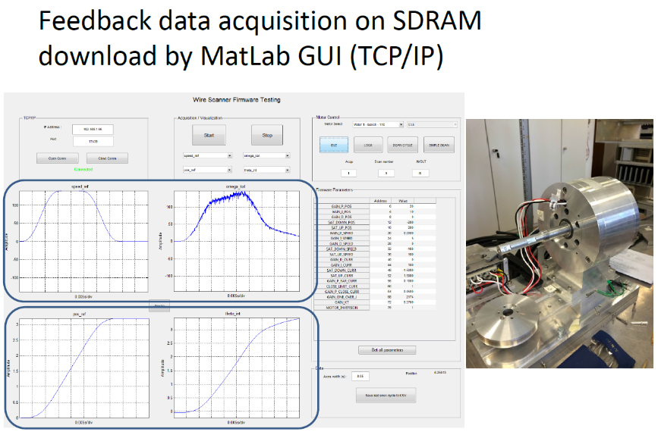
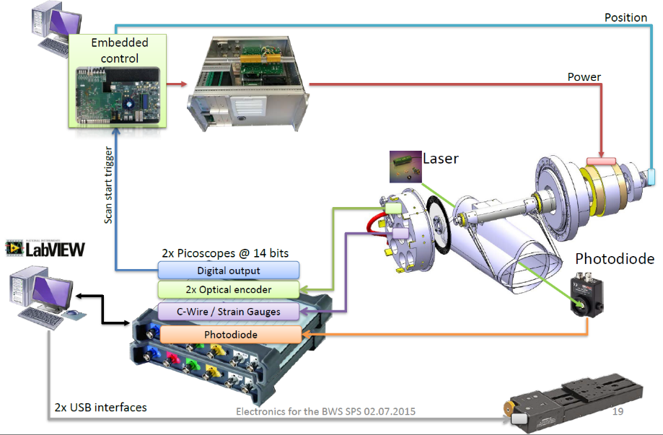
Outlook
Electronics for the SPS BWS prototype
System overview
Prototype setup 2015
Development status
Calibration setup

Slide 3
links
Electronics for the SPS BWS prototype
BWS review 2013 http://indico.cern.ch/event/229959/timetable/#20130418
BWS control electronics specification (references list at the end): https://edms.cern.ch/document/1318827
“A fast and accurate wire scanner instrument for the CERN accelerators to cope with severe environmental constraints and an increased demand for availability” 2014 IEEE Conference on Control Applications (CCA) http://ieeexplore.ieee.org/xpl/articleDetails.jsp?arnumber=6981482
“Secondary particle acquisition system for the CERN beam wire scanners upgrade” 2014 Topical Workshop on Electronics for Particle Physics http://dx.doi.org/10.1088/1748-0221/10/04/C04021

Slide 4

Electromechanical view
Electronics for the SPS BWS prototype
Glass disk
Resolver
Shaft
Magnetic Brake
Motor
Optical fibre light focuser
Wire
Fork
RF shielding chamber (not present in SPS Proto)

Slide 5

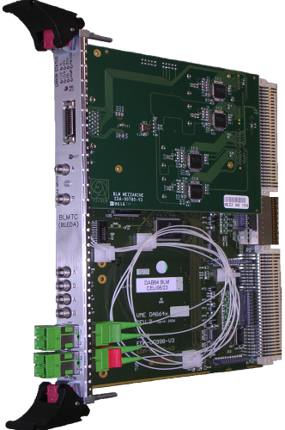
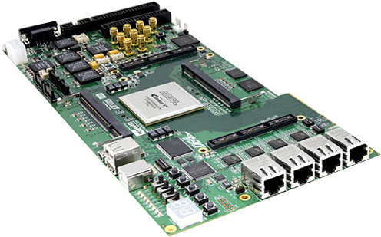
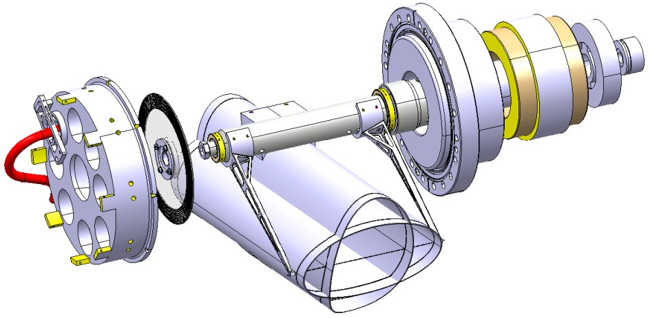
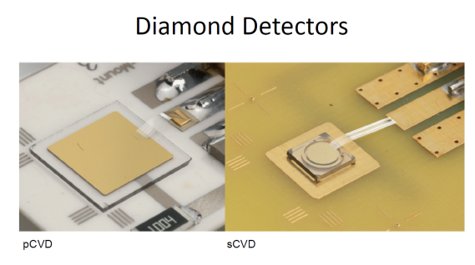
Control and Acquisition electronics
Electronics for the SPS BWS prototype
Scanner control, monitoring and supplies “Intelligent drive”
Acquisition and supervision
SFP Ethernet
CPU
T IMING
HV
CTRL
SFP Optical link
BST receiver
SFP Optical link
Wire resistivity & Strain gauge
Optical encoder interface
External temperature and vibration
Optical encoder interface
Long range resolver interface
Fast integration secondary shower
Magnetic brake
3-phases PWM
Secondary particles shower acquisition

Slide 6
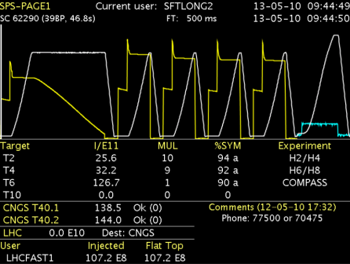
Connections to external systems
Electronics for the SPS BWS prototype
General Machine Timing (GMT)
Low jitter < 1ns Granularity: 1ms
Beam Synchronous timing (BST): - Bunch synchronisation => 25 ns accurate clock - Revolution frequency synchronisation => for LHC 89us pulse period
Triggers: Wire-scan trigger, post-mortem, acquisition
- Granularity: 89us, low jitter < 1ns
Beam Energy and Intensity
CISV? BCT?
Expert monitoring
TCP/IP
SFP Optical link
BST receiver
Wire resistivity & Strain gauge
CPU
T IMING
External temperature and vibration
Control room
CISV receiver
SFP Optical link
Optical encoder interface
Trigger input
Long range resolver interface
Trigger output
Magnetic stopper
3-phases PWM
Trigger input
Intelligent drive
Logging storage Long term storage offline analysis
Acquisition and supervision
- Scan trigger at μs scale use serial data link
- If we need ns scale, use of dedicated line

Slide 7
Goals for this year prototyping
Electronics for the SPS BWS prototype
Experts development & debugging
Beam tests of control electronics & Diamond acquisition
Diamond vs PM+IBMS comparison
Accuracy and reproducibility of mechanics & control with the calibration bench (But without secondary particle acquisition)

Slide 8



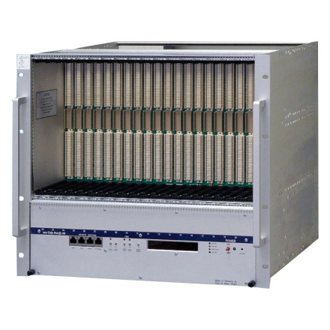

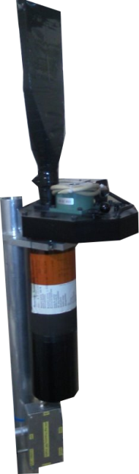
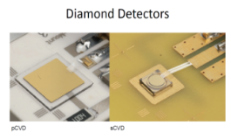
BWS SPS PROTOTYPE - SETUP 2015
Electronics for the SPS BWS prototype
VME boards configuration Machine Synchro triggers PMT acquisition
CPU
HV
I BMS
BOBR
CTR
V
Control crate
Feedback optimisation Profiles generation Electronics boards expert Prototype control Calibration
Start scan trigger
Acquisition trigger
Optical encoder interface
Wire resistivity
Long range resolver interface
Motor drive crate
Filter crate
Acquisition crate
I & V Measures, DC BUS, etc.
I & V Measures
HV power supply
3-phases PWM
Sin wave filter
Back-end receiver
Front-End A/D

Slide 9
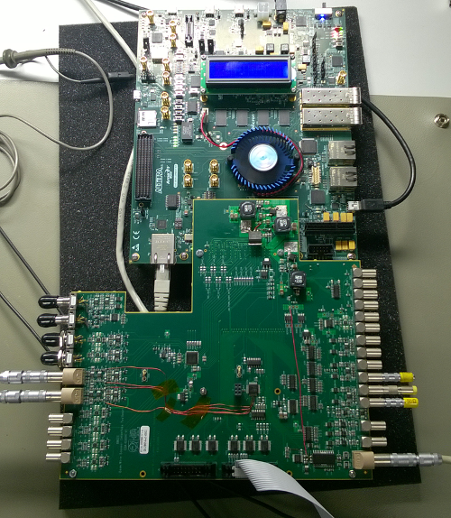
Control crate prototype
Electronics for the SPS BWS prototype
Electronics hardware for control ok
Crate finalisation foreseen for September
Matlab interface ok
Firmware code on-going and well advanced
First movement already performed
Will be ready for machine test foreseen for November-December 2015
FPGA board Firmware development platform
Interface board Scanner actuator control and measurements

Slide 10

Firmware block diagram
Electronics for the SPS BWS prototype
SDRAM MEMORIES
Monitoring (TCP/IP)
HPS EMAC
SW bridge to Internal bus
Hard SDRAM controller
VFC
HWR PROTOCOL
HW bridge Internal bus
Memory loggers
To VME crate & CPU control
Aux IN/OUT
2x Digial in
Triggers
Movement sequencer Safety procedures
2x Digial out
Condition Monitoring online fault diagnosis
Check procedures
PWM
Current Speed Position Feedback
Slow interfaces
Detection Identification
Fast interfaces
Digitalisations (~20 MHz)
CTRL POWER
Digitalisations of the currents, voltages. Controls of the wire, lasers. RDC

Slide 11
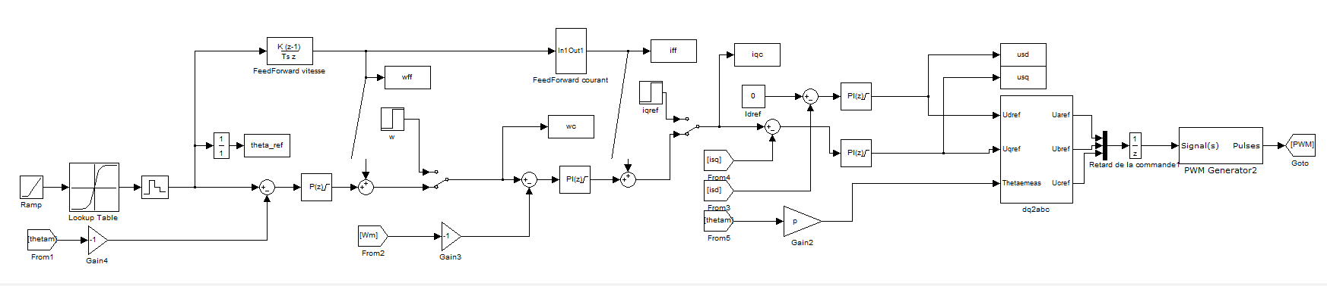
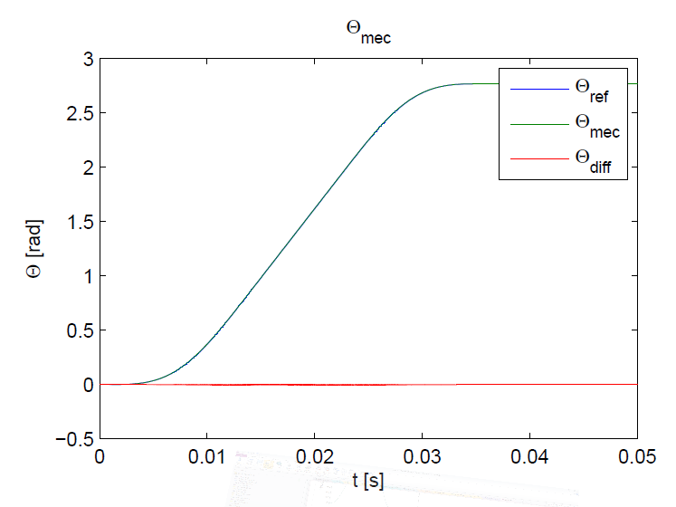
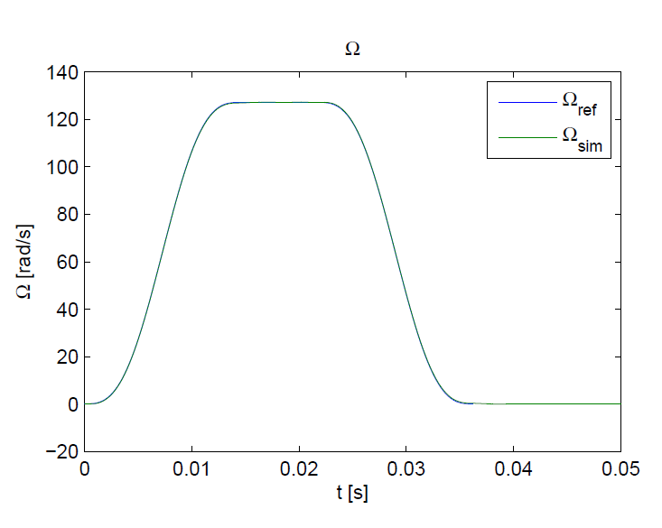
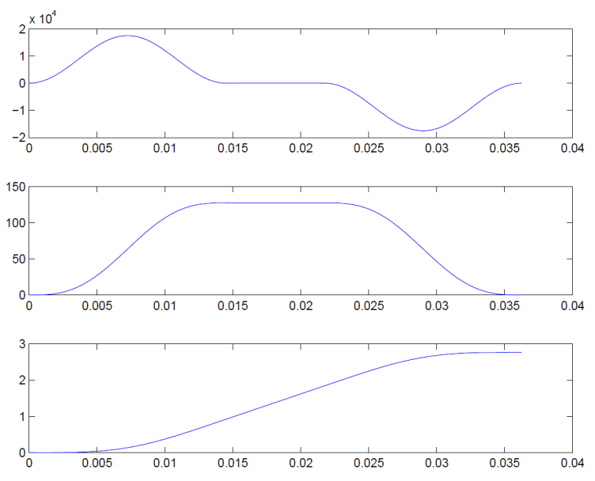
Control feedback model (2013)
Electronics for the SPS BWS prototype
Position Profile
Currents
Park/Clarke
PWM
Pos
Speed
Position

Slide 12
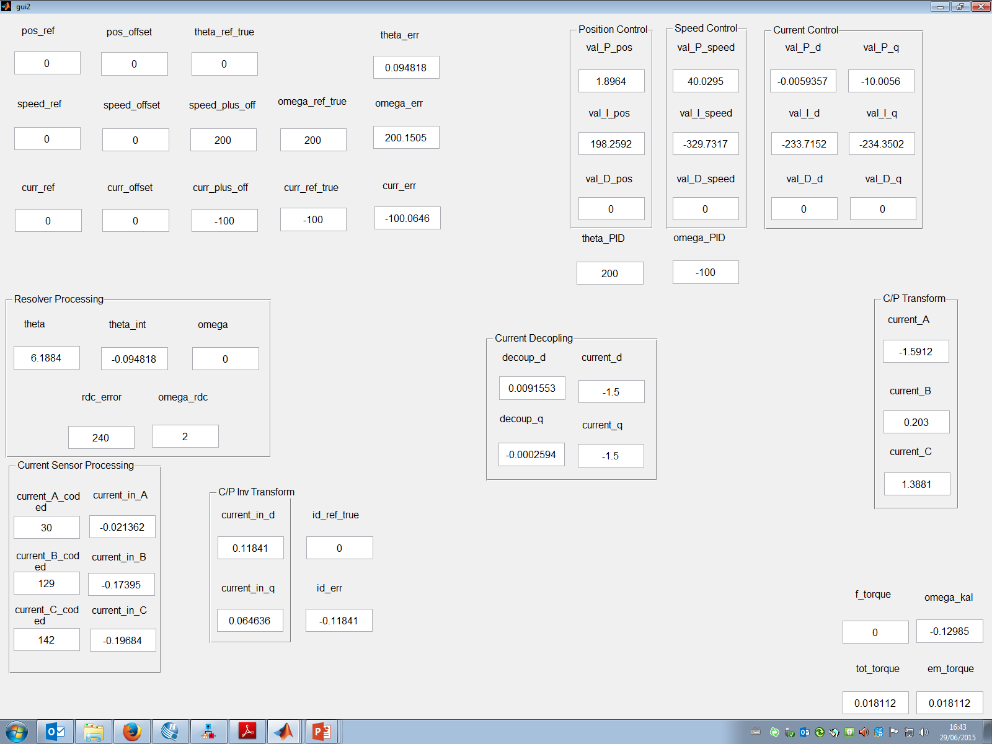
Feedback data monitoring using TCP/IP and MatLab GUI
Electronics for the SPS BWS prototype

Slide 13
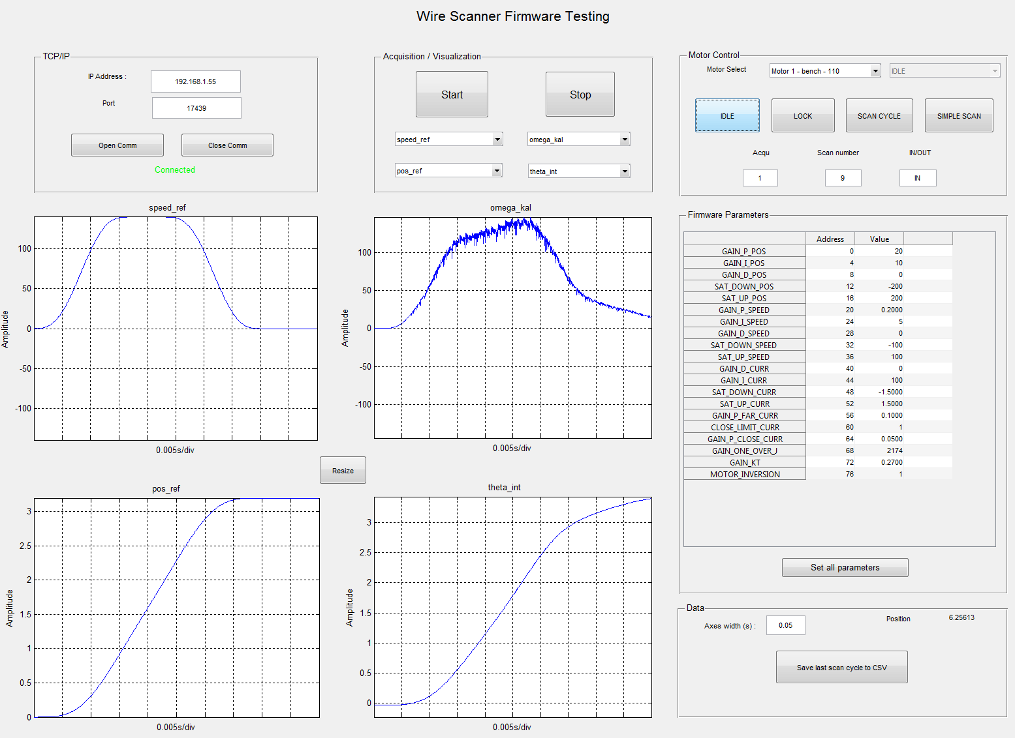
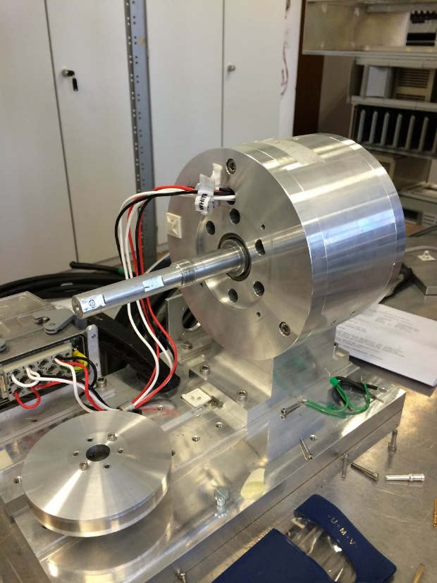
Feedback data acquisition on SDRAM download by MatLab GUI (TCP/IP)

Slide 14
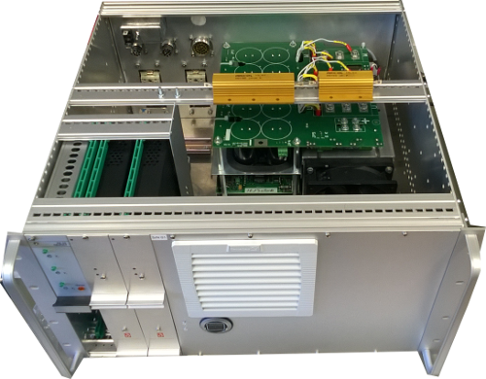
Drive crate prototype
Electronics for the SPS BWS prototype
Electromechanical design well advanced
It can satisfy lab test setup and optimised version
Board for measures, relays and identification design on-going
Motor and control connectors
3 phases power driver
Voltages supplies LV and 400V
measures board design on-going

Slide 15
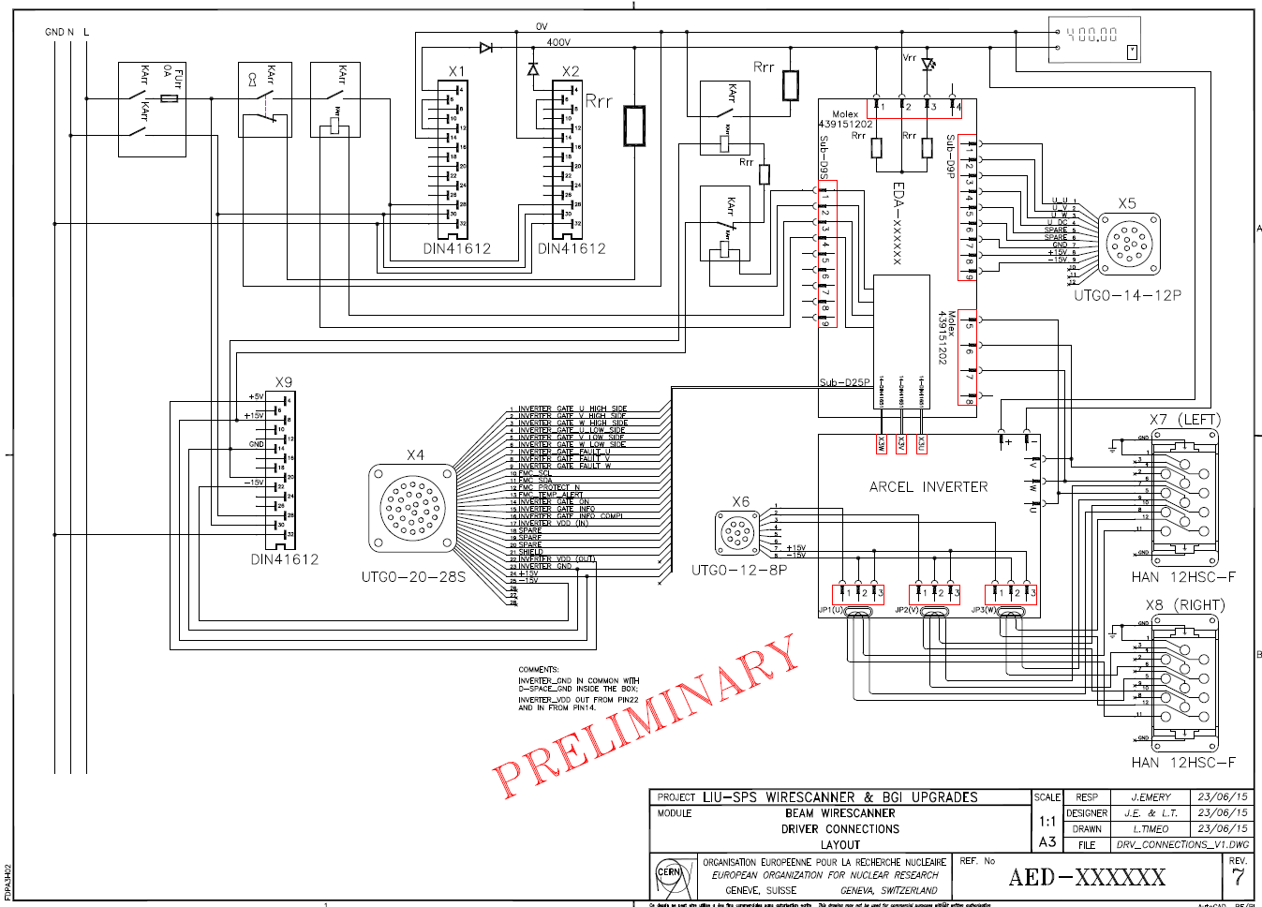
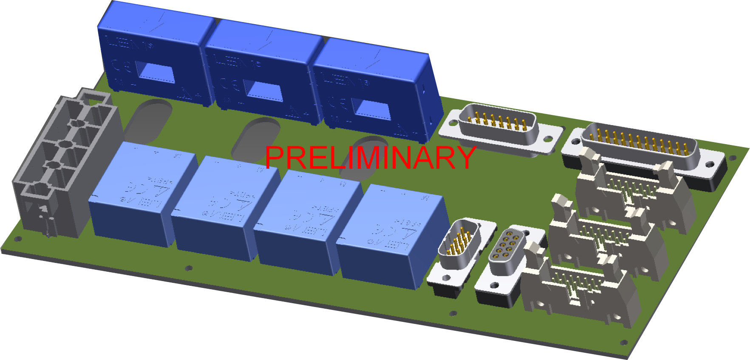
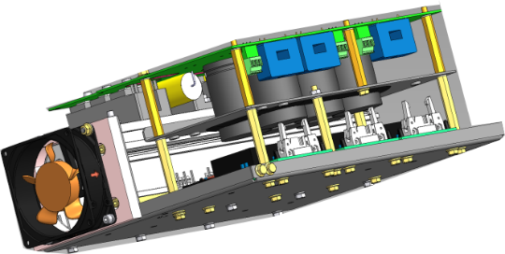
Drive crate schematic
Electronics for the SPS BWS prototype

Slide 16
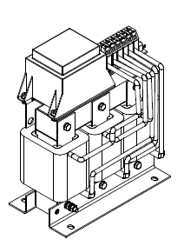
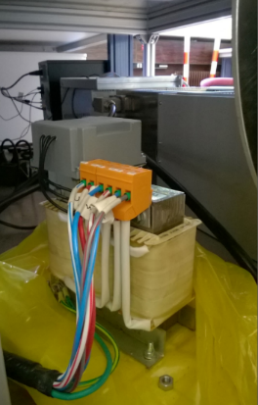
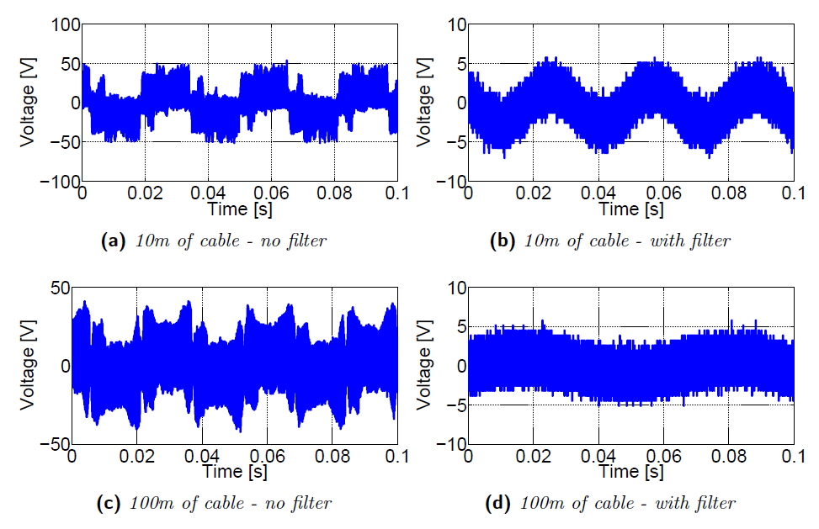
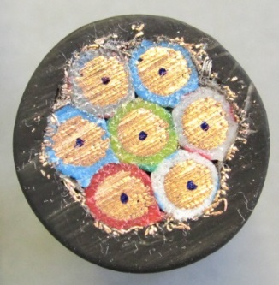
Sin wave filter crate
Electronics for the SPS BWS prototype
Electromechanical integration foreseen 09.2015
Will use the same board as the motor drive crate
Some experiments foreseen with other types of filters, lower PWM periods September-October

Slide 17
Diamond acquisition
Electronics for the SPS BWS prototype
Scope measurements on SPS 517 scanner (June 2015)
Second diamond install planned to study noise source
Tunnel digitalisation should be installed in next SPS TS
Diamond system will probably be moved to the prototype

Slide 18
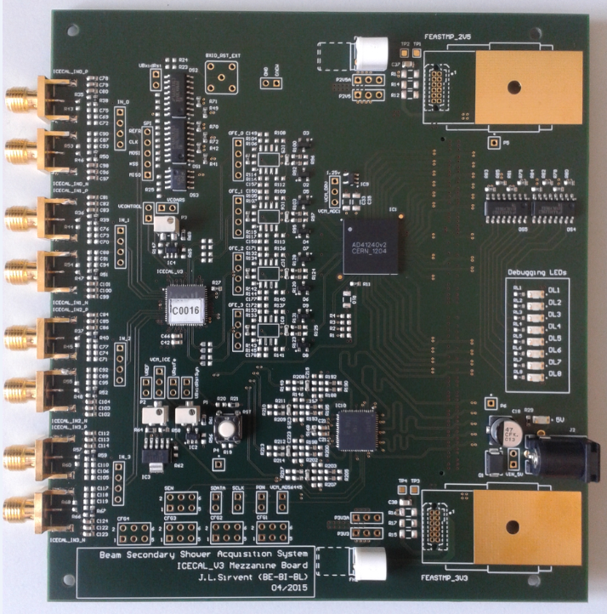
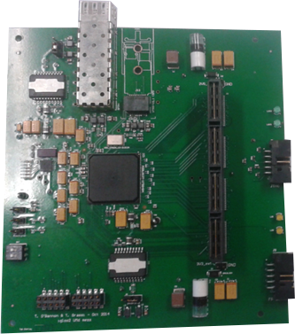

Diamond acquisition setup
Electronics for the SPS BWS prototype
pCVD
DD_1
Amplif.
+
Split
Digital Front-End Prototype
ICECAL or QIE10
Mezzanine
Igloo2_Umd
Mezzanine Board
(from CMS ngCCM)
Beam Pipe
VTRx
pCVD
DD_2
Amplif.
+
Split
Power (FEASTMP)
Bi-directional GBT optical link @ 4.8Gbps
(Data transfer, Synchronization & Control)
HV_1
HV_2
-12V
+12V
Sig_1
Sig_2
To Surface (~80m)
CBH50
CBH50
CB50
CB50
CK50
CK50
SMF
Igloo2 Dev. Kit
GBT Core
SDRAM Storage
PC Communication
Power Supply Instrumentation
Scope

Slide 19

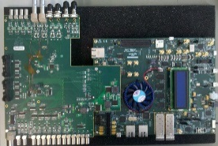
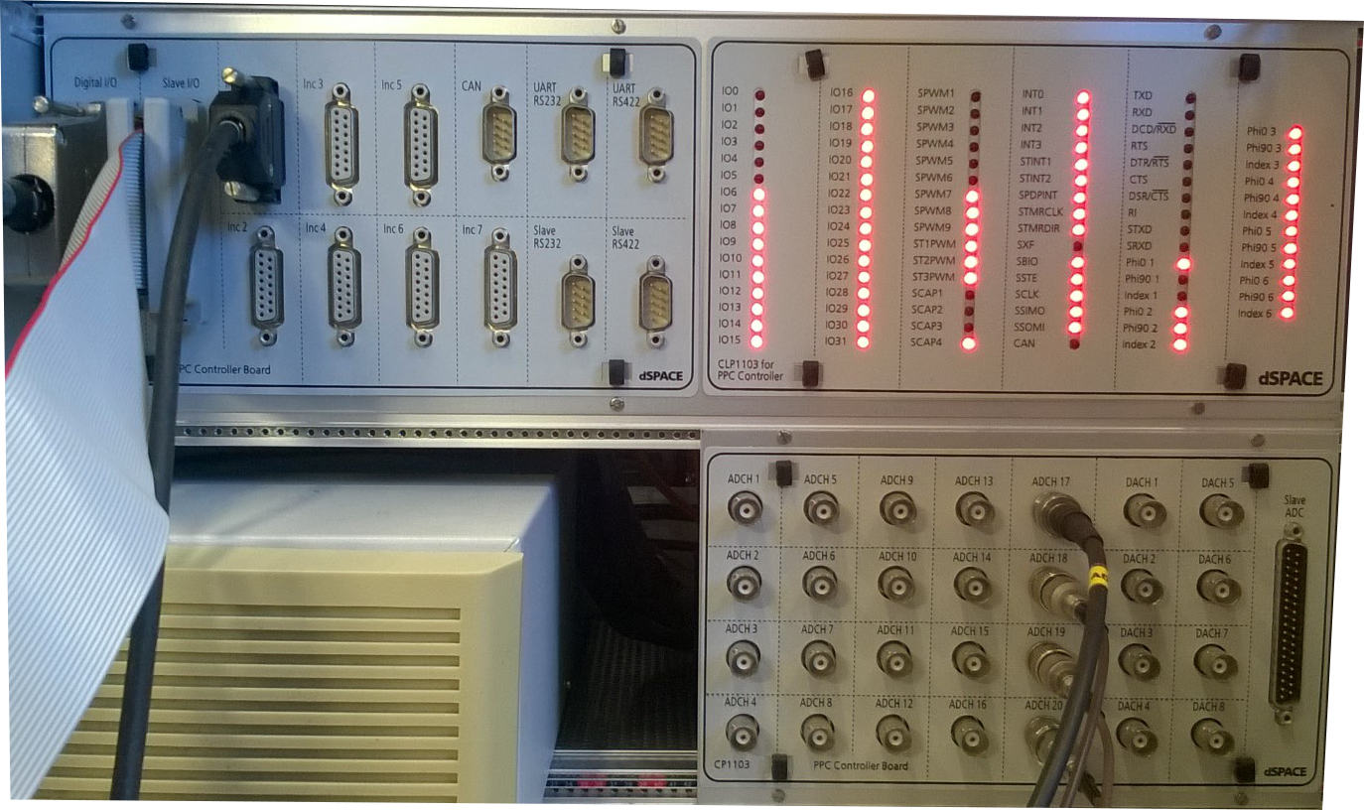
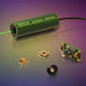
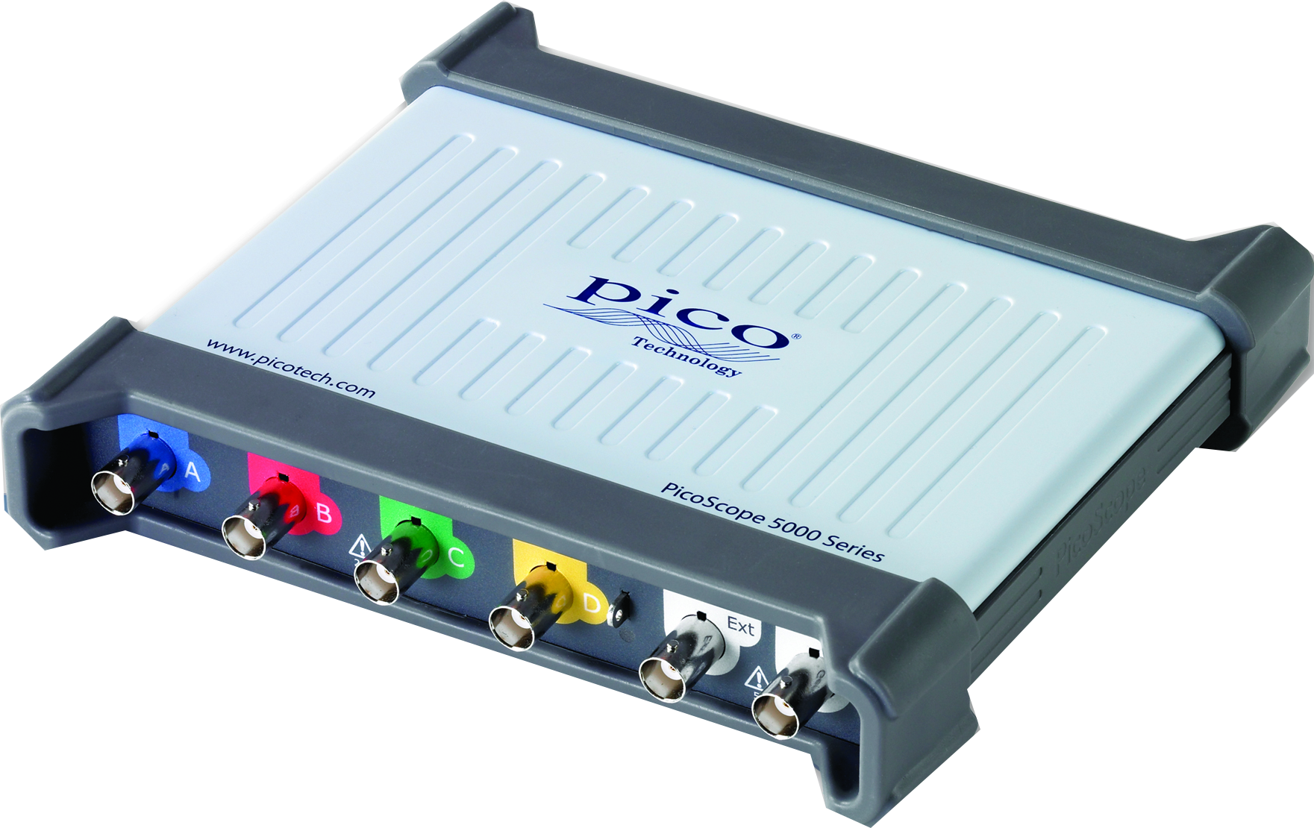
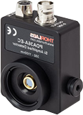
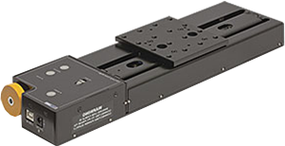
Prototype accuracy & reproducibility determination with the calibration bench
Electronics for the SPS BWS prototype
Position
Embedded
control
Power
Laser
Scan start trigger
2x Picoscopes @ 14 bits
Photodiode
Digital output
2x Optical encoder
C-Wire / Strain Gauges
Photodiode
2x USB interfaces

Slide 20
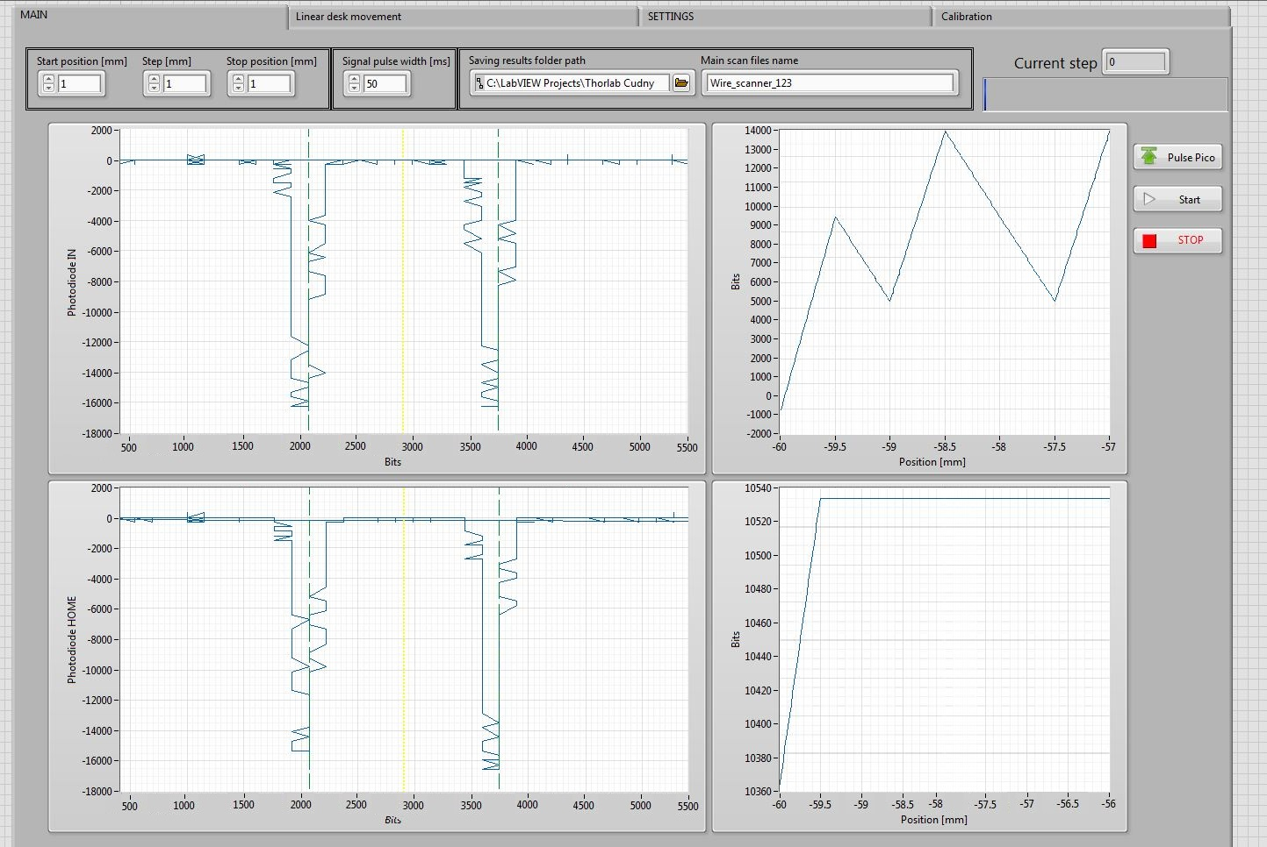
Labview calibration application
Electronics for the SPS BWS prototype

Slide 21
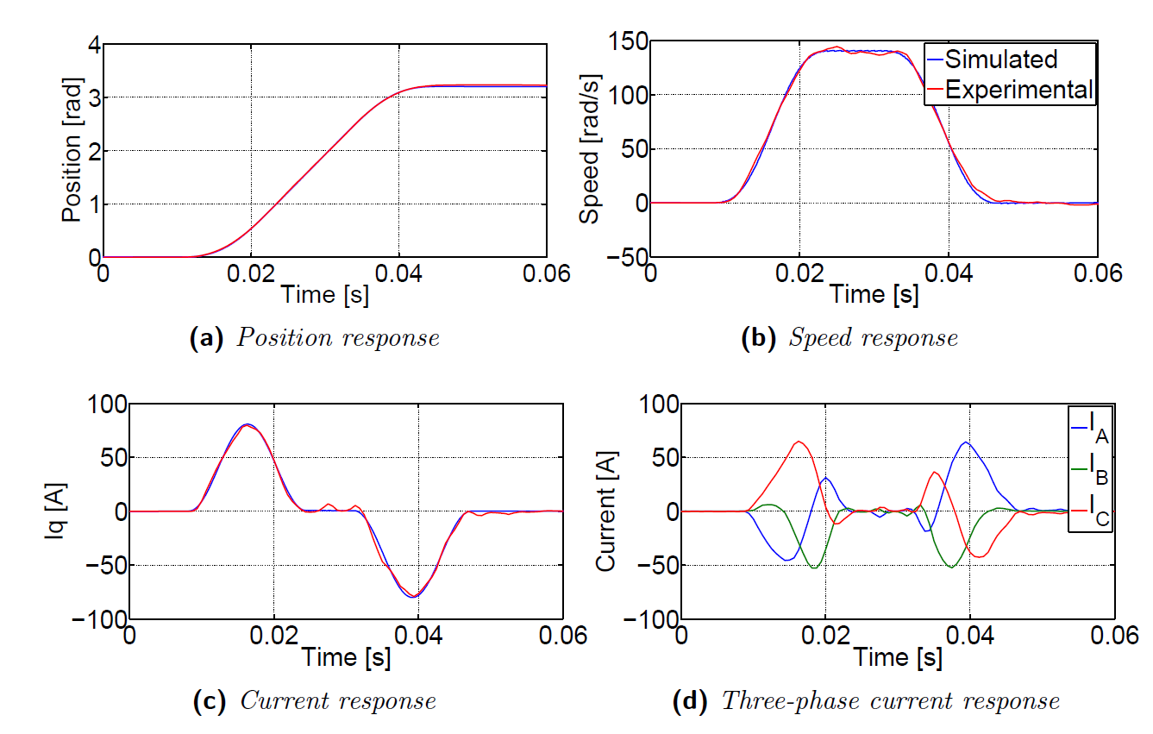
Summary
Electronics for the SPS BWS prototype
Electronics system
BWS SPS prototype setup
Development status
Beam tests foreseen for Nov-Dec
2016: Development of the remaining electronics
2016: SPS Beam tests with modified electronics?
2016: Prototype install in the PS or PSB?
Control of the prototype with DSpace @ 140 rad/s

Slide 22
Additional slides

Slide 23
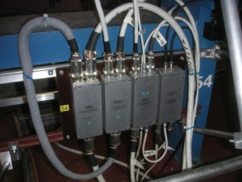
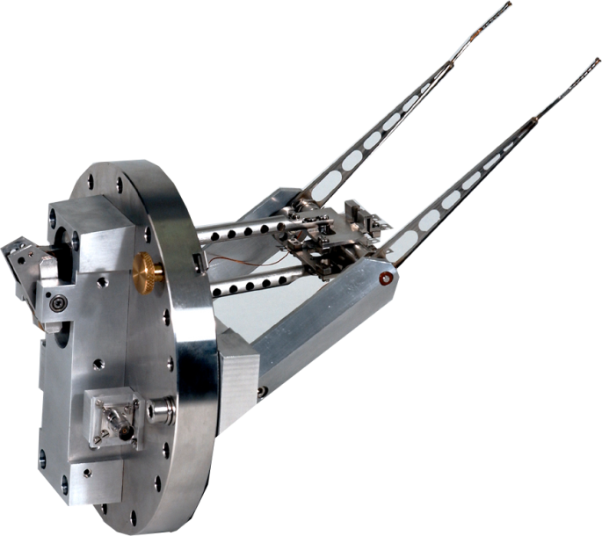
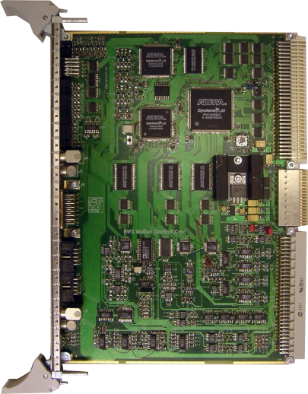
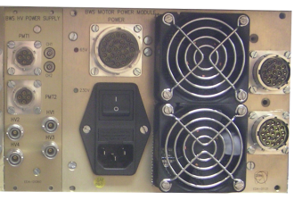
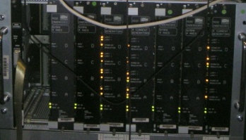
Operational system layout for all scanner types since 2009 (2012 for SPS)
CCC & databases
Up to 270m !
SURFACE INSTALLATION
UNDERGROUND (radioactive)
Multiplexers
CPU
R IO3
T IMING
BOBR
HV
CTRL
DAB+
I BMS
Power
Position
Power amplifier behind the VME
Motion control board
Step motor control
MTG master
BST master

Slide 24

Specification
HOME
Nominal speed @ beam-wire interaction position ≥ 20 [m/s]
Forks angular position measurement accuracy ≤ 5 [µm]
Mechanical bellow removed => All mobile part under vacuum
Large dynamic range => New secondary shower detector chain design
Movement limited to $π$ [rad] => Nominal speed reached in π/3
INTERACTION
IN movement
OUT movement
IN

Slide 25
Design guidelines
Minimisation of complexity - As less as possible electrical connections - Avoid multiplexing channel - Settings and parameters (control and acquisition)
Separate critical and non-critical functions - Instrument safety in the low level hardware - High level software configure, analyse and record the measurements
Early failure detection - Constant hardware Condition Monitoring (CM) - Programmed maintenance

Slide 26
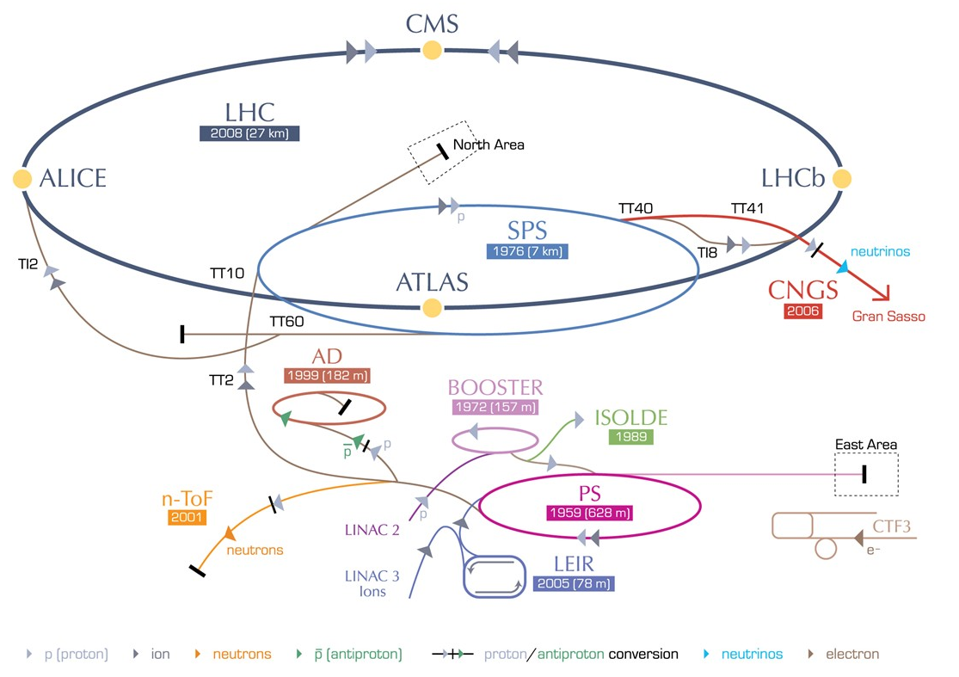
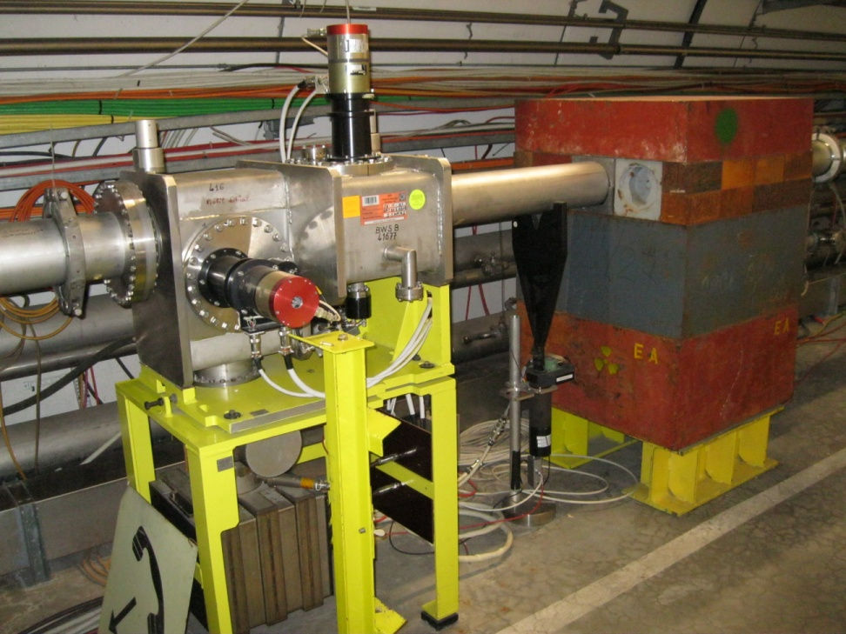
Wire Scanner locations
Accelerator | Number of Systems | Measurement cycles in 2012 | Scanner characteristics
 |  |  | Type | Speed | Precision
LHC | 8 | 16 k | Linear | 1 m·s⁻¹ | 15 μm
SPS | 6 | 26 k | Rotating long | 6 m·s⁻¹ | 40 μm
SPS | 4 | 400 | Linear | 1 m·s⁻¹ | 15 μm
PSB | 8 | 55 k | Rotating fast | 20 m·s⁻¹ | 100 μm
PS | 5 | 32 k | Rotating fast | 20 m·s⁻¹ | 100 μm

Slide 27
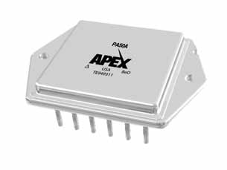
Operational system failures for all scanner types since 2009
Affected Component | machine | Occurrences | Failure source | Mitigation | System under design
Linear Power Amplifier | All & lab | 16 (2 in 2012) | Electrical glitch to unprotected outputs, Use of componant (PA50) on the limit of its specification | Replacement of supplies | Use of switch mode power supplies and filters
Multiplexers | LHC, PS | 3 | Mechanical relay failure in the tunnel | Replacement of relays | Use dedicated cables and control electronics
Step motor controler | PSB, LHC | 2 | Electronic board aging | End of life electronics to be upgraded | Avoid filter wheel by the use of high dynamic detector
Motion control | PS | 1 | VME bus access switch off VME | Replacement of the card | Motion control in the power supply disconected from the VME
CPU RIO 3 | SPS | 1 | Unexpected reboot | Replacement of the card
Cabling / Electronic
BWS Power amplifier
150m
Multiplexers
Step motor control
AOP
Transformer
DC power storage units (Capacitors)
±32V
PA50A
motor
AOP
VME cards / crate
Power amplifier behind the VME

Slide 28
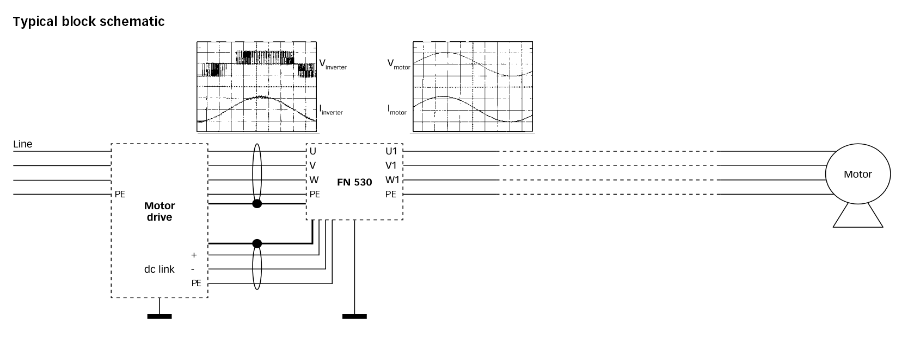
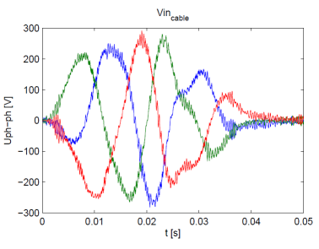
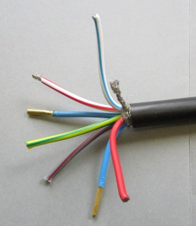


Switch mode output filter principle
Results: Reduction of Electromagnetic Interferences (EMI) Better compatibility with signal cables nearby this cable
No overvoltage at motor side
Shielded power cable 6mm2

Slide 29




Incremental Optical Angular Sensor
laser
Optical fibre
feedthrough
lens
photodiode
disk
10 μm

Slide 30



Interface to the wire resistivity, thermionic and RF induced current
PSB Ring 1 H at 15 m/s
Wire resistivity variation during a movement due to mechanical constraints (See Juan’s talk)
SPS 416 H at 6 m/s
Wire current variation when interacts with beam (thermionic effect)
SPS 416 H at 6 m/s
Wire current variation induced by the beam exitating RF modes inside a cavity (BWS tank)

