Slide 1
Knowledge
Transfer
@CERN
Giovanni Anelli
Knowledge Transfer Group Leader
CERN

Slide 2
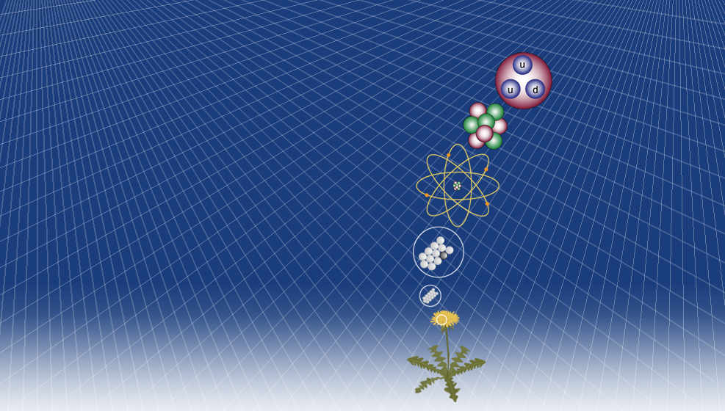
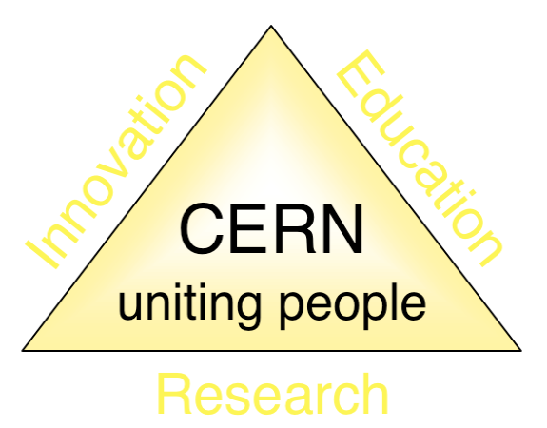
KT: one of CERN’s missions
CERN Mission
Quarks
Proton
Push back the frontiers of knowledge in nuclear research
Develop new technologies for accelerators and detectors
Train scientists and engineers of tomorrow
Unite people from different countries and cultures
Electron
Nucleus
Atom
Knowledge Transfer
Molecule
Matter

Slide 3
The KT Group Mandate
Optimize the impact of CERN’s science, technology and know-how on society and promote knowledge exchange with CERN’s stakeholders.
Function as a catalyst to foster KT transfer between the different stakeholders. Promote and sustain a culture of inventiveness and of knowledge and technology transfer.
Promote, raise awareness and participate in multidisciplinary activities, in particular those relevant to life sciences application.
Key words: dissemination and impact!

Slide 4
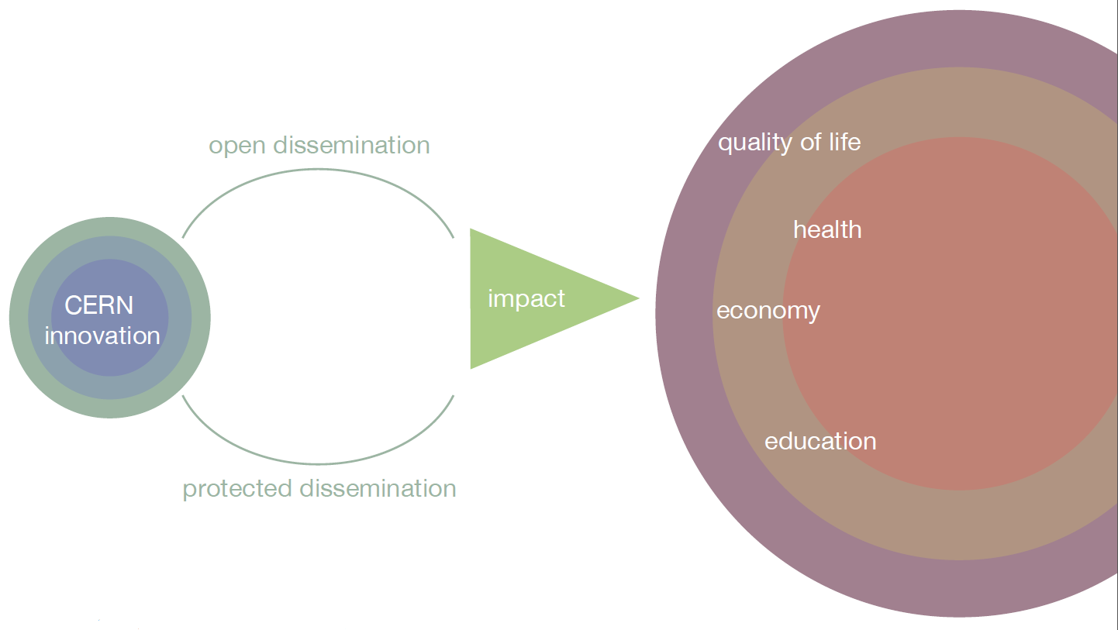
Why KT?

Slide 5
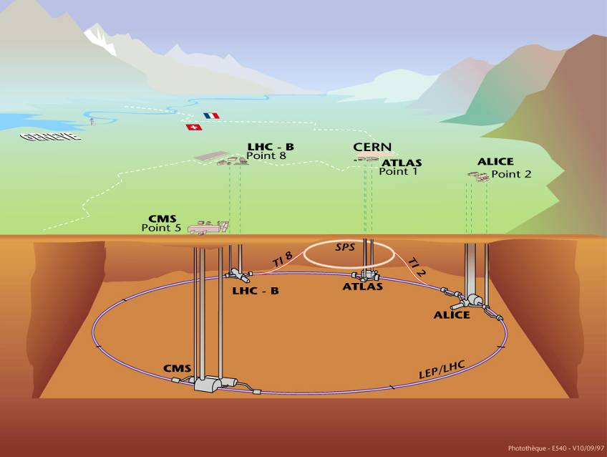




CERN’s areas of excellence
Accelerating
particle beams
Detecting
particles
IT technologies

Slide 6
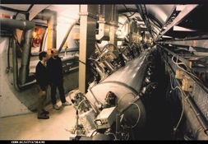
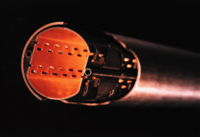

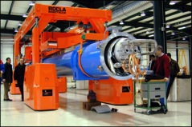
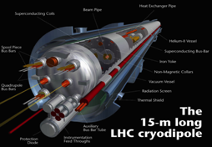
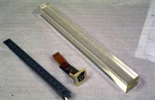
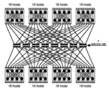
CERN Core Competences
Super-conductivity
(13kA, 7MJoules)
Vacuum
(10⁻¹² Torr)
Cryogenics (1.9 K)
Very high performance
detectors and electronics
Magnets
(10 T)
Data processing

Slide 7
KT happens in many ways
CERN Open Hardware License
Licensing
Service and consultancy
CERN Easy Access IP
A network of Business Incubator Centers in the Member States
R&D Collaborations
KT through procurement
EU Projects
KT through People
The KT group helps making KT happen, and choosing the best dissemination channel

Slide 8
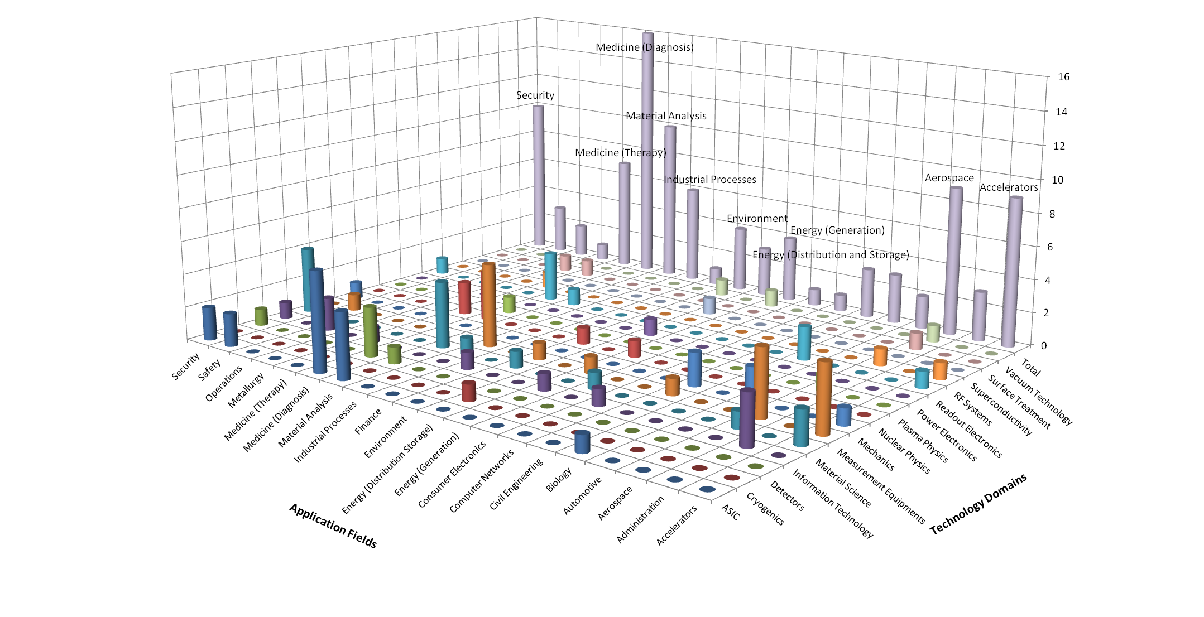
CERN’s Technology Portfolio

Slide 9
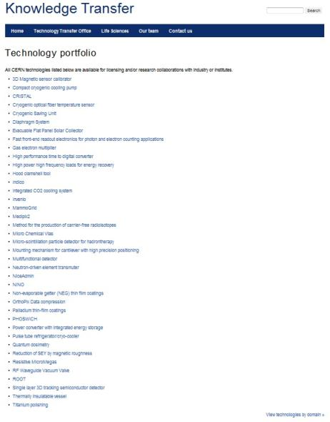
Visit our website to have a look at our technology portfolio in detail
www.cern.ch/
knowledgetransfer

Slide 10
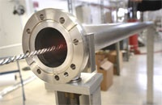
From high vacuum…
NEG (Non-Evaporable Getter thin film coatings)
Technology used to create and maintain ultra-high vacuum in the accelerator vacuum chambers.

Slide 11
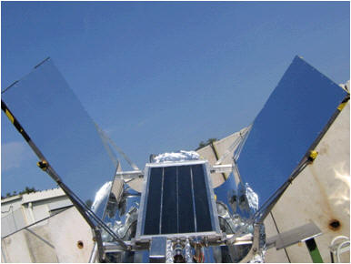
… to solar energy!
License and partnership with a start-up company
Development of a commercial product able to use diffused or indirect light and reach very high temperatures of up to 300 degrees
Development of a prototype production chain

Slide 12
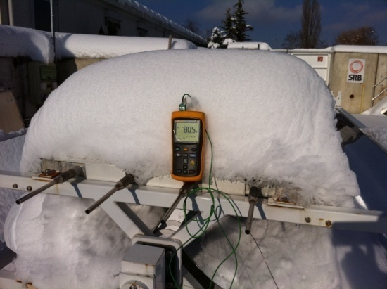
Vacuum is an excellent insulator!

Slide 13
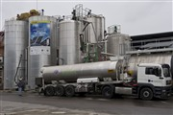
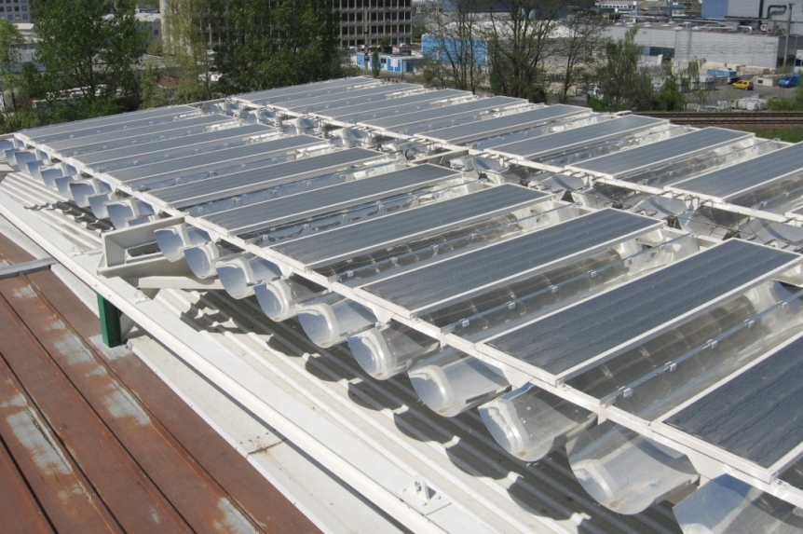
Solar panels plant
Civil-engineering company opened a new solar power plant
Environmentally friendly "solar field" heats close to 80,000 cubic metres of bitumen to 180 degrees.

Slide 14
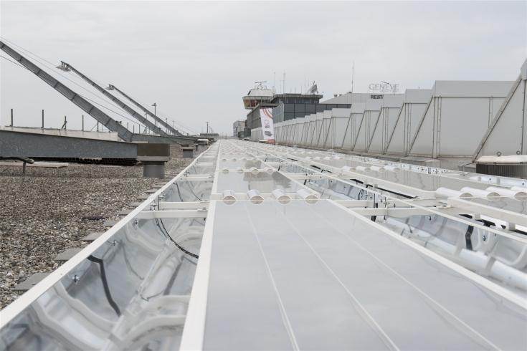
Installation at GVA airport

Slide 15
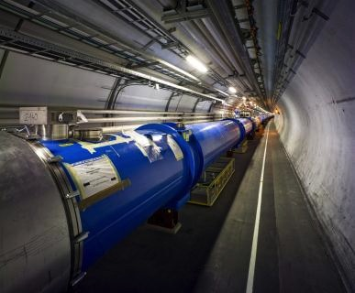
NEG
Licenses to:
SAES, which has developed the product IntegraTorr based on the NEG technology
Italian company
Notes:
IntegraTorr is the product name for the NEG thin film coating that SAES is delivering.
The other companies license is more recent and has not exploited the license as of now.

Slide 16
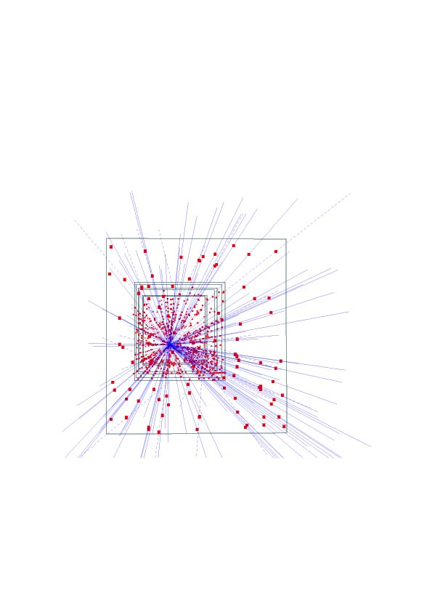
Silicon pixel detectors (SPDs)
Hybrid silicon pixel detectors for tracking applications in High Energy Physics
153 high energy particle tracks flying through a telescope of half a million pixels in the WA97 experiment back in 1995

Slide 17
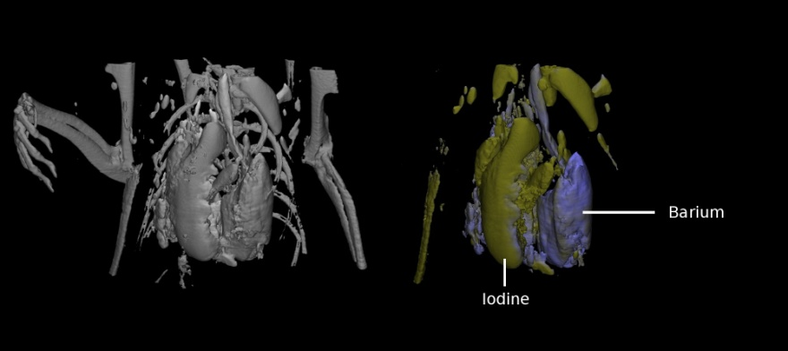
Application: Medical imaging
MARS project
  Colour CT X-ray scanner based on the Medipix technology
(courtesy of MARS Bioimaging Ltd)

Slide 18
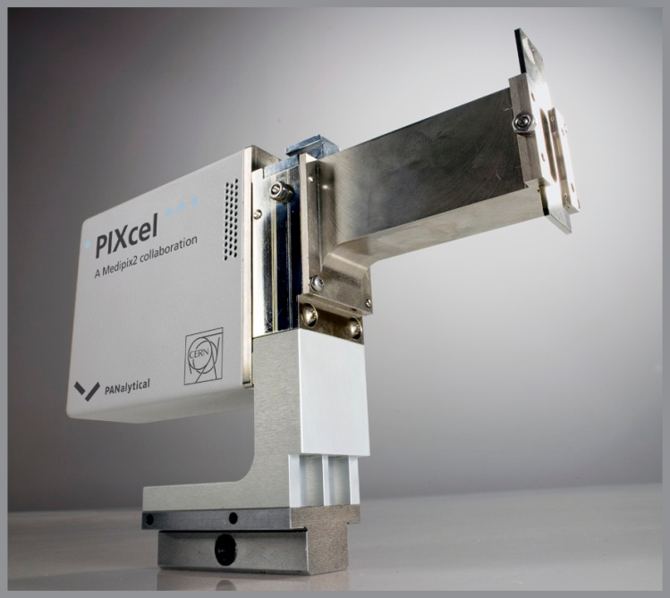
Application: Material analysis
Partnership and license agreements with a company to build a X-ray diffractometer

Slide 19
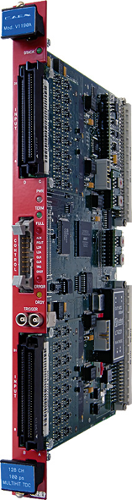
HPTDC
HPTDC
High Performance Time to Digital Converter
Precise time-tagging of electronic signals
CAEN - Costruzioni Apparecchiature Elettroniche Nucleari S.p.A
Holds a licence to and has developed 3 different Time to Digital converters based on the HPTDC
Image: CAEN
Notes:
HPTDC or High Performance Time to Digital Converter, is another CERN developed ASIC, used for precise time-tagging of electronic signals.
CAEN - Costruzioni Apparecchiature Elettroniche Nucleari S.p.A has licensed the technology and developed three different time to digital converter products based on the technology.

Slide 20
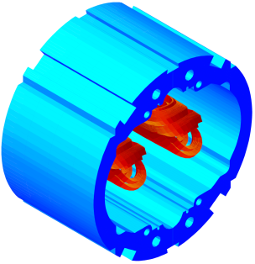
Roxie
R
O
X
I
E
outine for the
ptimization of magnet
-sections,
nd design
nverse field calculation and coil
ROXIE model of the LHC main dipole extremities
License to:
INFN - Laboratori Nazionali di Frascati
Notes:
The ROXIE program was created by Stephan Russenschuck at CERN for the electromagnetic simulation and optimization of accelerator magnets. ROXIE combines powerful geometry macros with the numerical accuracy of BEM-FEM coupling, hundreds of design variables and objective parameters, powerful optimization algorithms, and CAD/CAM interfaces.
ROXIE calculations intervene at conceptual design, detailed electromagnetic design optimization, interfacing with structural mechanics and thermal calculations, technical drawing, machining of endspacers, qualtiy assurance during production by inverse computations, measurement validation, quench post-mortem analysis.
ROXIE is used at 20 HEP-related institutes worldwide. Virtually all superconducting magnets of the LHC except D1 and D2 have been designed using ROXIE.

Slide 21
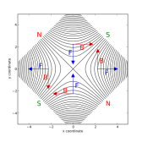

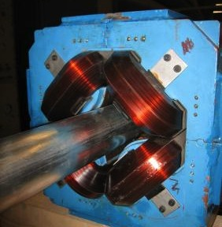
Magnetic Measurement
Technology for measurement of quadrupole magnets with the rotating coil principle
Ansaldo Superconduttori SpA holds a license to the technology
Ansaldo developed and supplied magnets to among other CERN and CNAO
Measurement of quadrupole magnet

Slide 22
Recent cases
Collimator Material Collaboration
Collaboration with company
R&D on the processing, manufacturing, characterization and testing of advanced thermal management materials with high structural and thermal properties
Linac4 Drift Tubes
License to LNL-INFN for the linac4 drift tube linac design and related patent
Purpose of the agreement is for LNL-INFN to be able to manufacture drift tube linac for the European Spallation Source ESS
Large monolithic SiPMs with excellent timing
Shared patent between CERN and INFN
Portable Radiation Survey Meter
Joint ownership agreement between CERN and Politecnico di Milano

Slide 23
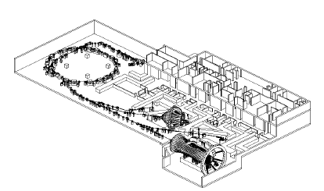
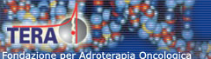
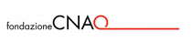
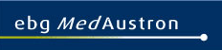
CERN’s PIMMS Study
PIMMS 2000 (coordinated by CERN) has led to:
Treatment centre in Pavia, Italy.
First patient treated with Carbon ions in November 2012!
Treatment centre in Wiener Neustadt, Austria,
foundation stone 16 March 2011, will be ready in 2015

Slide 24
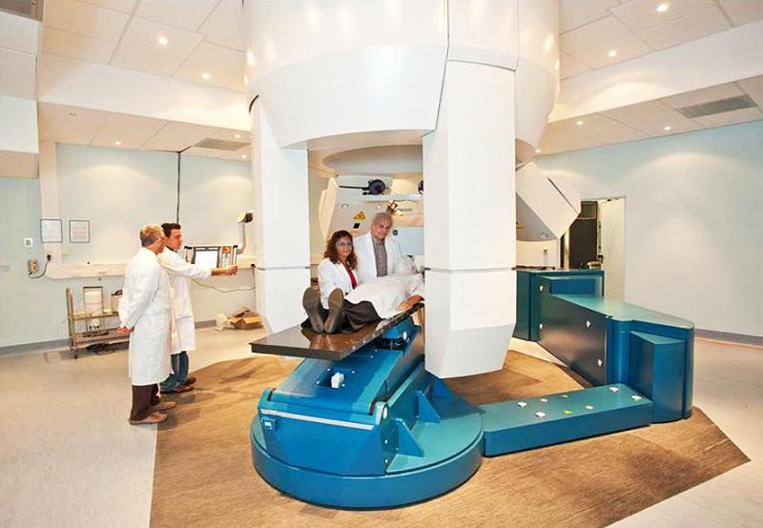
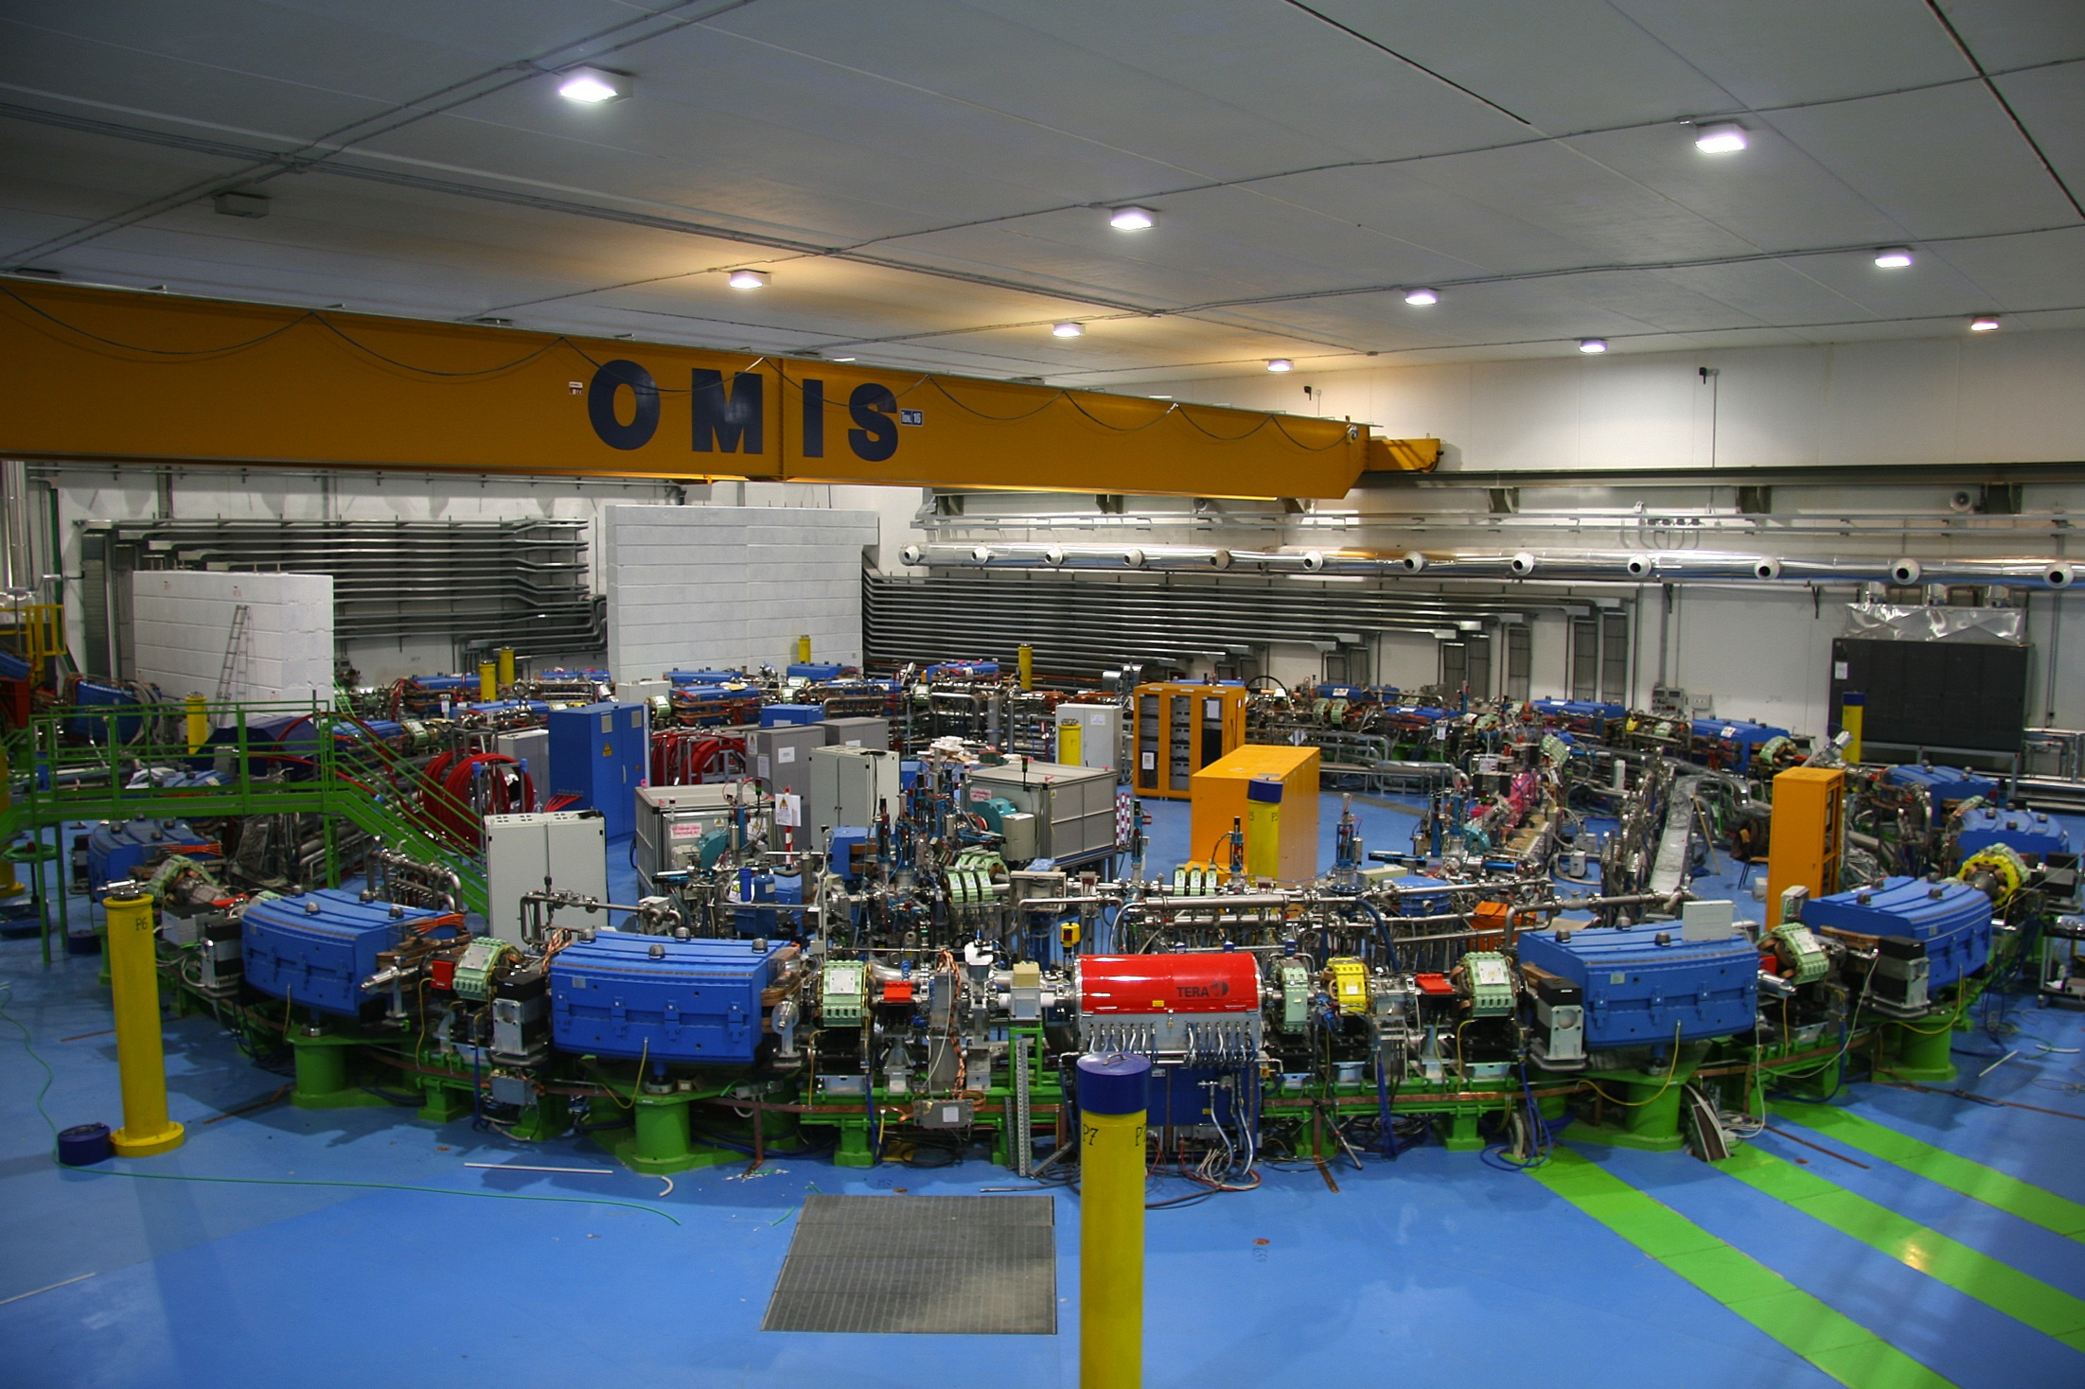
CNAO

Slide 25


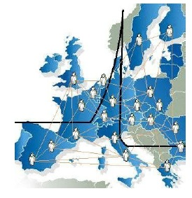
ENLIGHT
CERN philosophy into health field
  Common multidisciplinary platform
  Identify challenges
  Share knowledge
  Share best practices
  Harmonise data
  Provide training, education
  Innovate to improve
  Lobbying for funding
  Coordinated by CERN
> 150 institutes
> 400 people
> 25 countries
(with >80% of MS involved)
Notes:
25

Slide 26






ENLIGHT platform projects
Marie Curie Initial Training Network
12 institutions
29 trainees
Infrastructures for hadron therapy
20 institutions
2008-2012
2009-2014
R&D on medical imaging for hadron therapy
16 institutions
Marie Curie ITN
12 institutions
16 trainees
2010-2014
2011-2015
13/06/2013
Manjit Dosanjh – Zuppinger-Symposium 2013
26

Slide 27
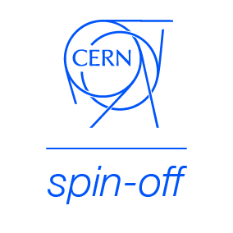
KT implementation ways
Market Pull
Transfer to Existing Companies
Technology Push
Creation of New Companies
Spin-Off Support

Slide 28

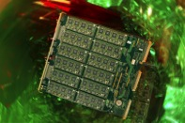

CERN Business Ideas Accelerator
CERN
Pre-Incubator
CERN STFC BIC
Austrian BIC
NIKHEF CERN BIC
NTNU CERN BIC
Technopolis BIC

Slide 29
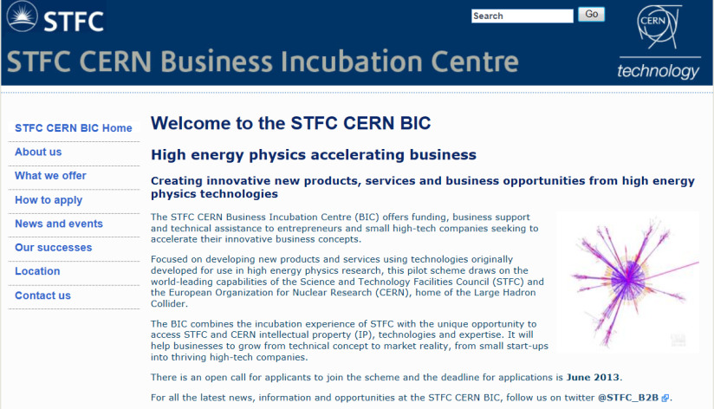
Turning CERN technologies into new business opportunities

Slide 30
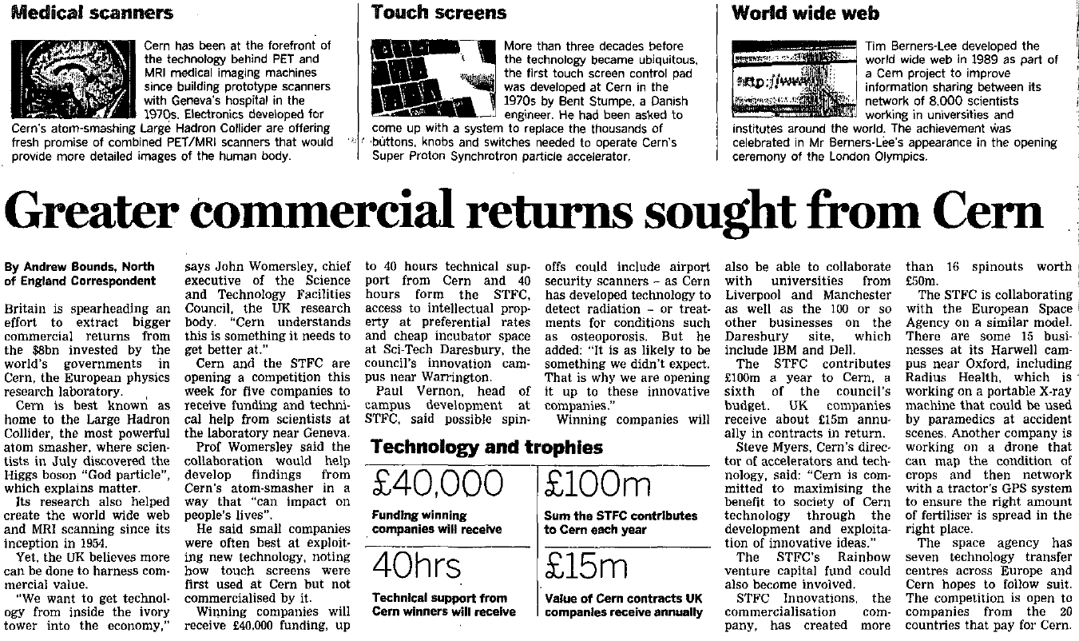
Financial Times, 19.10.2012

Slide 31
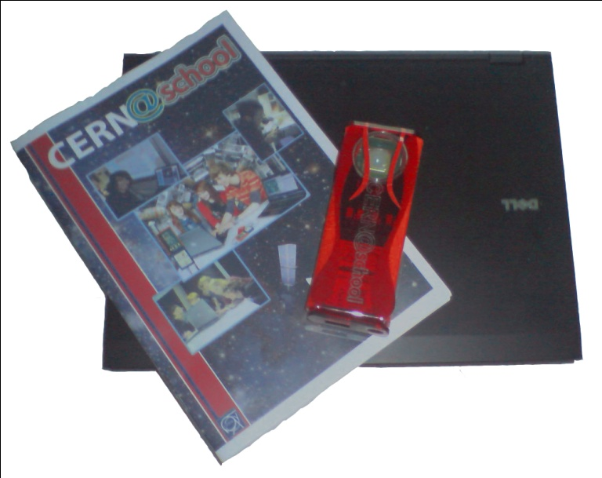
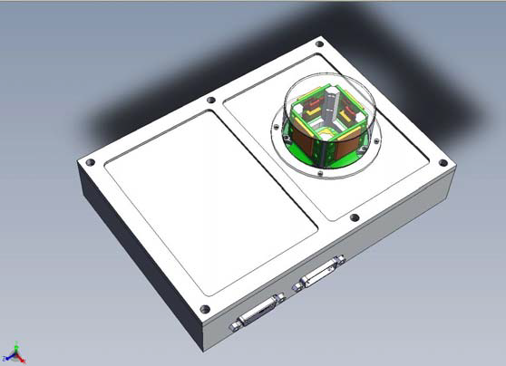

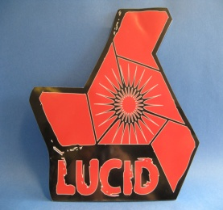
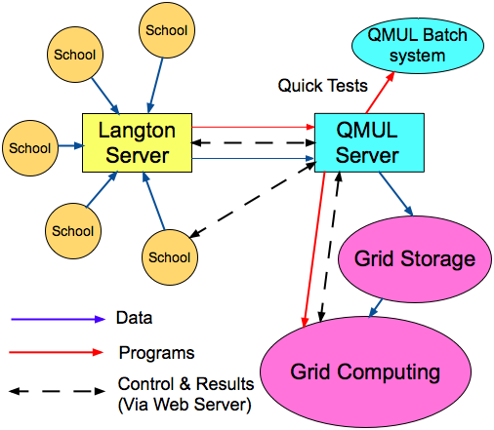
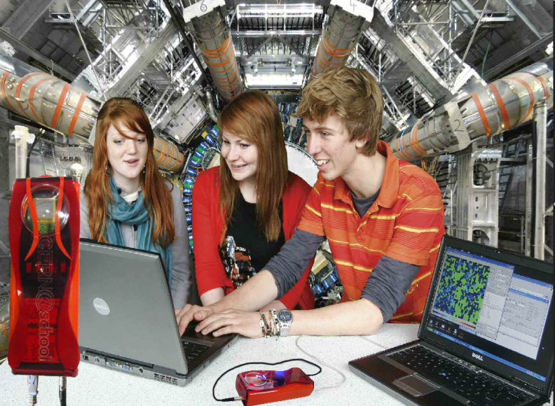
Langton Ultimate Cosmic ray Intensity Detector uses 5 Timepix chips to monitor the radiation environment in Space
CERN@school allows students to use a Timepix chip in the lab to visualise radiation
Data from LUCID and CERN@school detectors will be uploaded to the Grid and made available for students to analyse

Slide 32

CERN Open Hardware Licence
A legal framework to facilitate knowledge exchange across the electronic design community.
In the spirit of knowledge and technology dissemination, the CERN OHL was created to govern the use, copying, modification and distribution of hardware design documentation, and the manufacture and distribution of products.

Slide 33

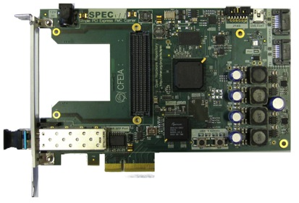
CERN OHL: it is making an impact!
CERN OHL v1.1 Launched in 2011, great interest from the worldwide community
More than 50 hardware designs licensed under CERN OHL
More than 20 companies are using it
The license is being used by people outside our community as well (and for any kind of hardware)
Thanks to the interactions with the community, we improved the license and prepared v1.2

Slide 34
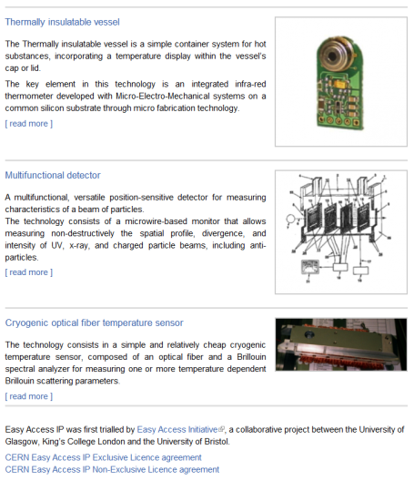
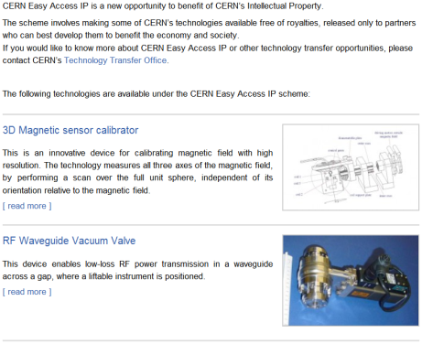
CERN Easy Access IP
Notes:
This is a screenshot of our website.
We have implemented the scheme pioneered by the University of Glasgow. We are ready to give a free license (for some of our technologies) to companies who will demonstrate that they can turn it into a product.

Slide 35
Knowledge Transfer through Procurement
Results from a survey of companies involved in technology-intensive
procurement contracts with CERN.
178 questionnaires analyzed, related to 503 MCHF procurement
budget.
Results:
44% indicated technological learning
42% increased their international exposure
38% developed new products
36% indicated market learning
13% started new R&D teams
52% would have had poorer sales performance without CERN
41% would have had poorer technological performance

Slide 36
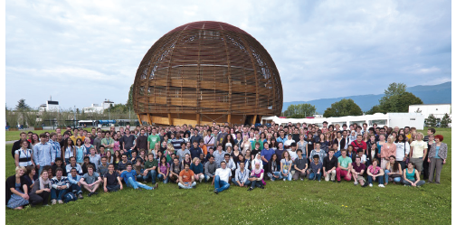
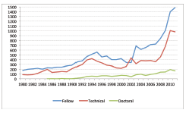
Knowledge Transfer through People
Every year, hundreds of students come to CERN to contribute to our research programs
An opportunity for young people to learn in a multicultural environment
Not only for physicists! Also engineers, computer scientists, administrative students…

Slide 37
Students and fellows selected from Italy

Slide 38
More info / Contacts
www.cern.ch/knowledgetransfer
giovanni.anelli@cern.ch
mail-KT@cern.ch

