Slide 1

The Societal Impact of Open Access to Research
ElHassan ElSabry
Doctoral Candidate
Science, Technology & Innovation Policy Program
National Graduate Institute for Policy Studies (GRIPS)
OAI10-CERN Workshop on Innovations in Scholarly Communication
June 22, 2017

Slide 2
Benefits of Open Access
Benefits to the Academic Community
  e.g. citation advantage
Economic Efficiency
Societal Benefits
  not systematically studied

Slide 3
Research Gap
“little is known about the impact that free scholarly research literature might have on the knowledge and interests of laypeople” (Zuccala, 2010)
“almost no studies have evaluated whether free access to the scientific literature has had an impact […] in non-research contexts” (Davis & Walters, 2011)
the societal impact of open access “still needs to be systematically investigated and documented” (Pinfield, 2015)
“a gap between the hypothetical societal good of open access and the minutiae of usage and interest measurements” (Bankier & Chatterji, 2016)

Slide 4
Discussion about OA vs. Original Research

Slide 5
Research Significance
rising interest among policy makers
open access as an academic versus a social issue

Slide 6
Main Question
What groups of people outside the academic community benefit (or would potentially benefit) from open access to scholarly research?
  Who is claimed to be a beneficiary of open access? (ELPUB2017 paper)
  What evidence is available to support those claims?
  What do we know from other relevant fields of research?

Slide 7
Collecting & Synthesizing Literature on Societal Benefits
Method:
eyeball search (papers collected in a previous study)
relevant keyword search (Scopus & Google Scholar)
citation tracking (forward and backward)
Data:
54 publication discussing societal benefits
Main Finding:
most studies are about industry researchers and medical practitioners

Slide 8
Breakdown of Studies on Societal Benefits
Property | Category | Count
Publication Year | 2001 - 2005 | 5
 | 2006 - 2010 | 11
 | 2011 - 2015 | 29
 | 2016 - … | 8
Document Type | journal / conference paper | 30
 | dissertation / book chapter | 3
 | report | 12
 | opinion article (in academic journal) | 8
Methodology | multiple methodologies | 8
 | theoretical analysis (including review studies) | 8
 | survey | 10
 | interviews / focus group | 3
 | bibliometric analysis | 8
 | experiment | 2
 | case study | 3
 | anecdotal evidence | 11

Slide 9
Open Access Beneficiaries
Beneficiary Group | Available “Studies”
Industrial R&D | 10
Medical Practice | 10
Patients | 5
Policymakers | 5
Individuals | 3
Unaffiliated researchers | 3
Nonprofit Organizations | 2
Students | 2
Legal Practice | 2
Society in general / laypeople | 13

Slide 10
OA & Society in General / Laypeople 1
Large-scale studies:
“The Public Impact of Latin America’s Approach to Open Access” Alperin 2015
  demographic data of on readers on articles on SciElo & RedALyC
  44.5% students – 20% university employees (including faculty) – 35% unaffiliated with university
  40% public sector employees - 40% from the private sector - 20% nonprofits
“Citizens Demand for open access to Academic Papers” Sato et al
  survey of 800 Japanese adults
  55% claimed that open access is useful or slightly useful to them
  “satisfying curiosity” and “research articles being a credible source of information”
  “the gap between academic research and daily life” and “the difficulty to comprehend academic jargon”

Slide 11
OA & Society in General / Laypeople 2
focus group of 23 Dutch citizens (Zuccala)
80% of respondents to a US poll agreed that medical research should be free (Harris Interactive)
links from hobby blogs & patient pages to papers in Kyoto University IR (Sato & Itsumura)
Links to OA papers from 100 random Wikipedia articles (Willinsky)
OA journals 47% more likely to be cited by Wikipedia (Teplitskiy et al)

Slide 12
OA & Society in General / Laypeople 3
discussion and examples of societal impact (Tennant et al)
example cases (bepress)
  “100 Stories of Impact” report
  34 stories of non-academic readers
  only 16 were not about open access to research papers

Slide 13
OA & Researchers in Industry 1
“spillover effects in all sectors of society” which drive “economic, social and technological progress” – European SMEs (Piccara)
Crisis US biotech SMEs (Lyman)
3 company surveys in the UK 1 in Denmark & 1 in Japan
(prc,JISC,RIN) 1,130 respondents
  compare access between: universities and colleges, medical schools and health providers, industry and commerce, and research institutes
  easy access 94% universities, 86% large, 71% SMEs
  dependence on personal subscriptions

Slide 14
OA & Researchers in Industry 2
(prc,JISC,RIN) 2,645 respondents
  easy access 78% large, 69% SMEs
  recent unsolved access problem 44% universities, 86% companies
(JISC) 44 interviews, 9 case studies
  no cases of systematic usage of OA
  (ir)relevance of academic research to industry
(Houghton et al) 98 responses , 23 interviews
  64% of those in research roles need access
  OA in third place as a means of access

Slide 15
OA & Researchers in Industry 3
(Abe et al) 2 surveys
  budgetary constraints as a reason for not using electronic journals
  those with 100 or more titles increased
Pay-per-view
  a way to cope with lack of access
  issues with credit card payment
  55% of DeepDyve users from organizations with less than 100 employees

Slide 16
OA & Researchers in Industry 3
(Bryan & Ozcan)
  3 million patent applications with 130,000 articles from 43 journals
  OA articles received 28-59% more patent citations
(myself ☺ )
  1,104 patents (about 30,000 citations) matched with company financial data
  smaller companies use OA more than large ones

Slide 17
OA & Medical Practitioners 1
many might not be aware of available opportunities
review study by Spedding
(O'Keeffe et al)
  90 US health personnel
  primary research their least favorite
(Lawton & Flynn)
  lack of awareness about OA among Irish practitioners (80% expressed interest)
  over half of repository users are practitioners (not researchers)
(Andrews)
  33% family doctors claimed cost to be a barrier

Slide 18
OA & Medical Practitioners 2
(Hardisty and Haaga )
  those given full-text link twice more likely to read
(Moorhead et al)
  336 US practitioners (including a control group)
  practitioners consult the full text of the articles when given the chance
  49.9% of the articles consulted by physicians were published within the

Slide 19
OA & Medical Practitioners 3
(Maggio et al)
  web log data of over 5000 health personnel working in the Stanford University Hospitals
  20% of the research papers consulted in 2011 were published in 2011
(Maggio et al)
  while 50% of the news stories about cancer papers where published within 2 weeks of publishing the research paper
  25% within one day only

Slide 20
OA & Legal Practice
(Danner)
  legal scholarship is more important for practitioners in civil law countries
(Scherlen & Robinson)
  arguing for OA using social justice theory

Slide 21
OA & Policymakers
earliest two studies (Willinsky) … 2003 & 2004
  29 interviews … insights evidence-based policymaking
  pilot of the “Research Support Tool” with 13 Canadian policymakers
(Nwagwu & Iheanetu )
  availability of journals was not a good predictor of their usage
  journal usage correlates with policymakers’ educational qualification
(JISC)
  17% cost savings (one tenth .. time saving)
  a discussion of indirect benefits

Slide 22
OA & NGOs
(JISC)
  survey of 101 British charities , 10 case studies
  78% used government report most often , 14% research papers
  80% cited high cost as barrier
  majority used research papers – 95% claimed more access, more usage
  structure of academic disciplines
(Moorhead et al)
  92 researchers from US nonprofits
  67% of those given access used it
  2.2 articles/week
role of NPO associations

Slide 23
OA & Patients
PXE International (Sharon Terry)
one third of the 104 members of the Alliance of Taxpayer Access are patient groups

Slide 24
OA & Unaffiliated Researchers
someone with an interest and can spare enough time (whether related to or separate from their daily job)
a professional (normally affiliated) researcher in transition
affiliated but has reasons not to mention affiliation
  governmental research units
  consultants
publishing from time to time after retirement
requests handled by the document supply service of the British Library
  16% individuals
  55% from academic sector
  17% from professional sources
  11% from businesses)

Slide 25
OA & Individual Enrichment
open access political science journal will enhance public engagement with the discipline (Smith)
importance of open access to philosophical literature based on Derrida’s notion of the right to philosophy (Willinsky)
correlating citations & reviews on Goodreads (Zuccala)

Slide 26
Typology if OA Users
Societal Benefits
Claims
Claims
advocates
Scarce
Evidence
review of literature from other fields
policymakers
researchers
Citizen Science
Public Understanding of Science
Information-seeking Behavior
Typology of Non-academic Beneficiaries

Slide 27
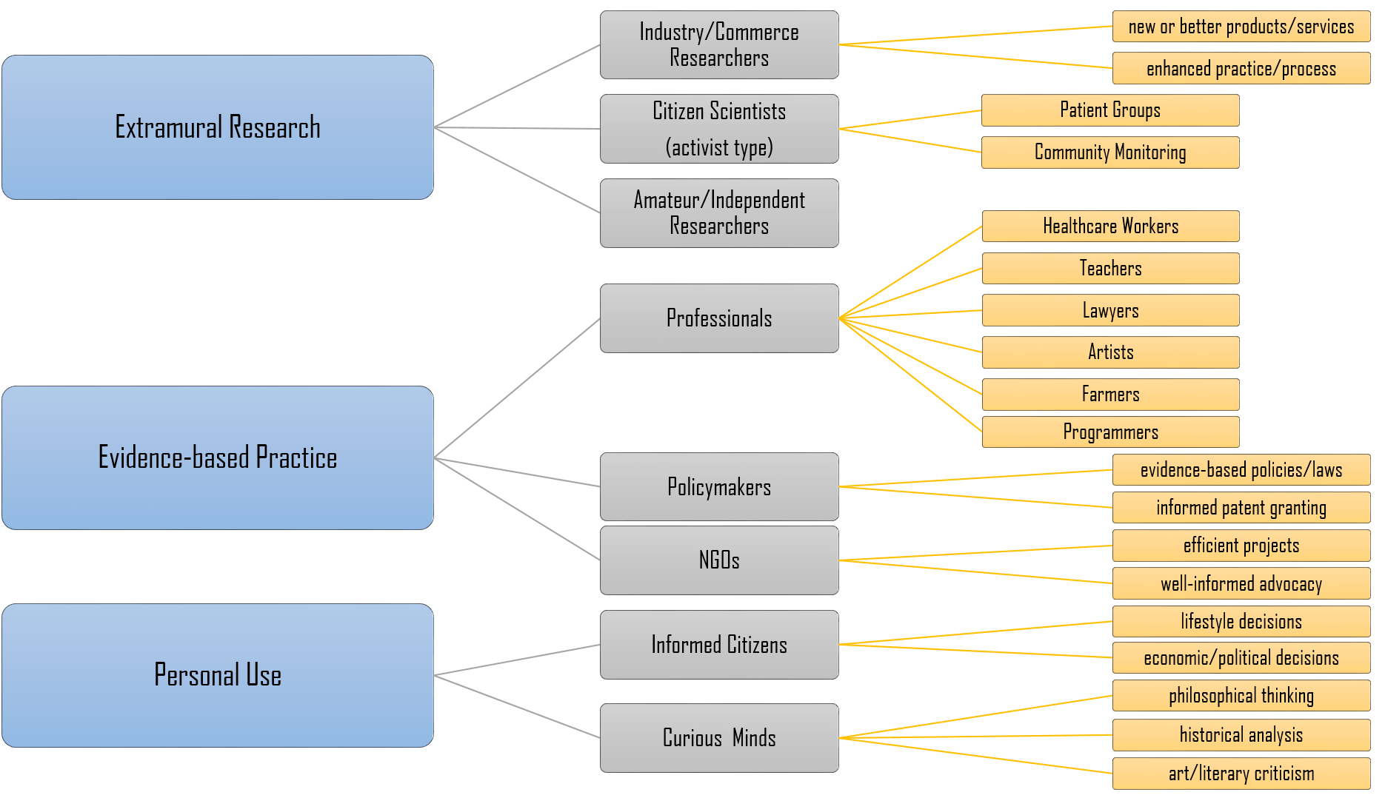
Typology if OA Users

Slide 28
Conclusion: What Impact does Open Access have on Society?
Industry … OA is very useful, serious crisis for SMEs
medical practice … services built using (e.g. clinical guidelines)
unaffiliated researchers … lack of understanding of the phenomenon
legal practice … judges but not lawyers, more in civil law countries
policymakers … those in research units/technical positions
NGO … slightly useful, perhaps more important for unions
patient groups … more systematic research needed (individual vs group)
laypeople … only speculations (except for rare disease patients/families)

Slide 29
Conclusion: Policy Implications
more groups should be on the table
more research than talk, i.e. more funding should target studies about open access
companies participating in national site licenses
  15-17% of subscription revenue from corporations
  SMEs and NGOs taking part through their unions
one to one partnerships (between journals and beneficiary entities)
  “adopting” journals
  e.g. Health Policy & European Observatory on Health Systems and Policies
all of this in parallel with discussions on extensive profits of publishers

Slide 30
Thank You

