Slide 1


Recent experimental results on non-magnetic vibration isolation
Christophe Collette
Credits to:
David Tshilumba, Stef Janssens, Kurt Artoos, Julien Amar, Fares Nassif, Raphaël Furnémont, Lionel Fueyo Roza, Céline Depouhon, Fabrice Matichard, Brian Lantz, Simon-Pierre Gorza, Jennifer Watchi
christophe.collette@ulb.ac.be

Slide 2
Outline
Optical inertial sensor
Active isolation system

Slide 3
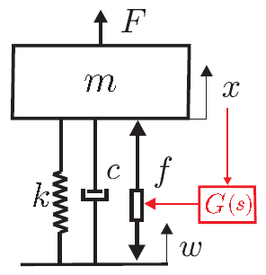
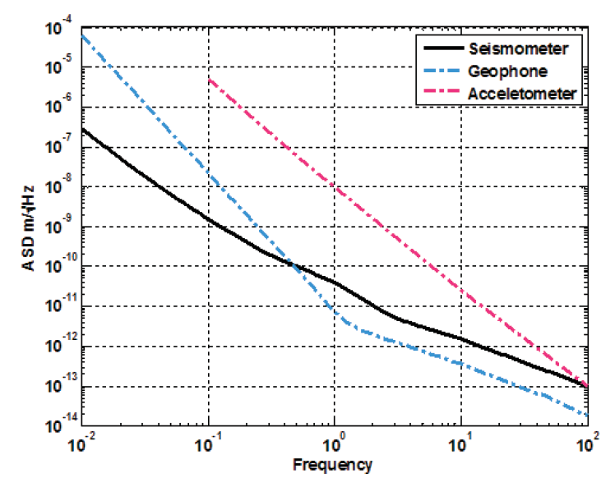
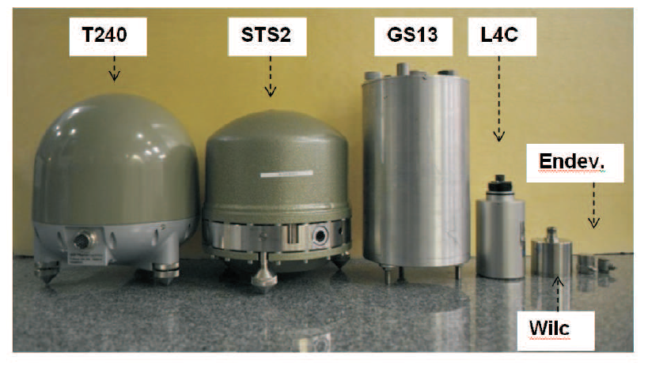
Sensor size and noise
(Courtesy of Brian Lantz)

Slide 4
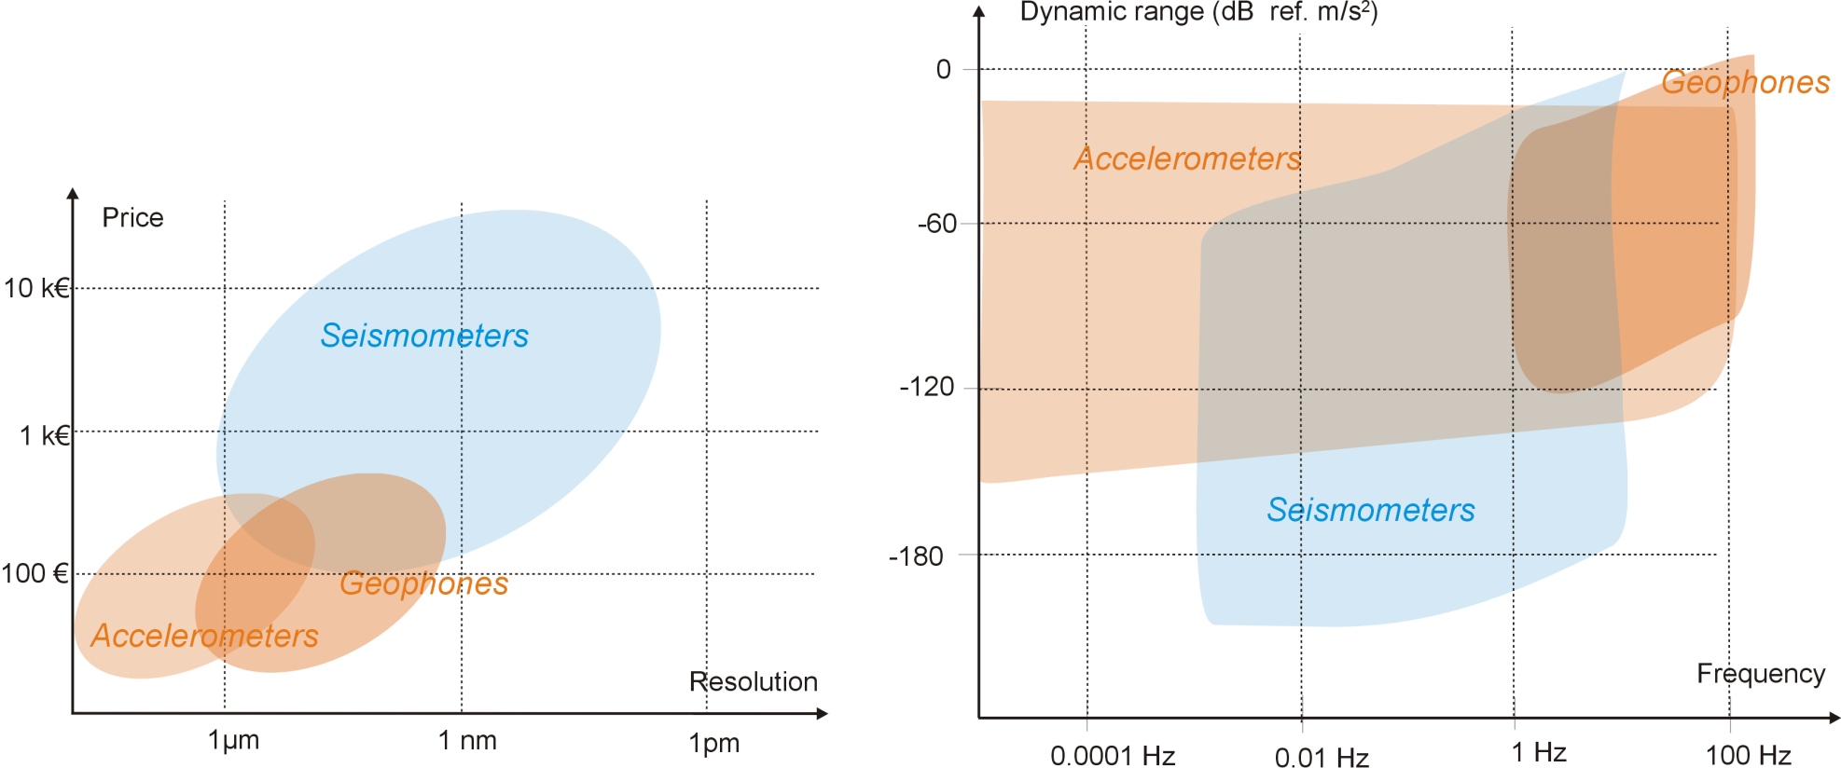
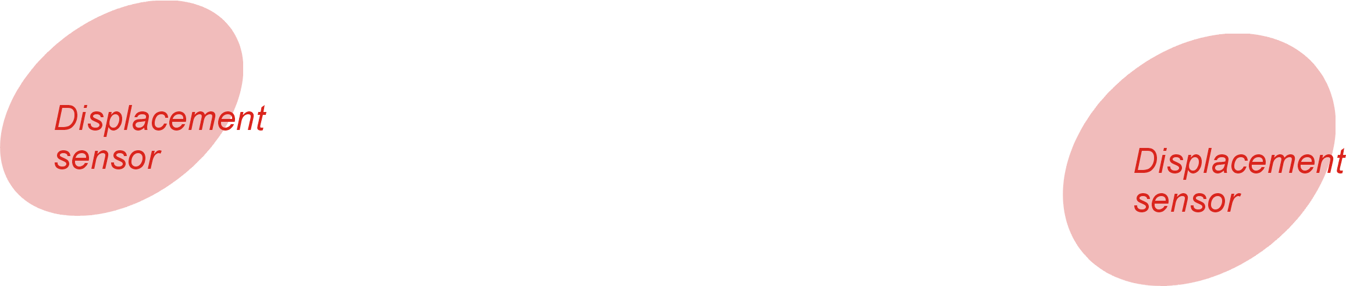
Inertial sensor for active vibration isolation
+ Compatible with magnetic field + Compatible with radiation
+ Small

Slide 5
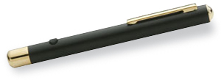
Non-magnetic Optical Inertial SEnsor (NOSE)
Mechanics:
Damping coefficient : 0.0085
Resonance ~ 6 Hz (tunable)
Spurious resonances above 100 Hz
Flexural joint
Optics:
Home made Michelson interferometer
Low cost components (~ 1k$)
No coil and digital demodulation:
High sensitivity 3. Low thermal noise
Continuous calibration 4. Compatibility with hash environment

Slide 6
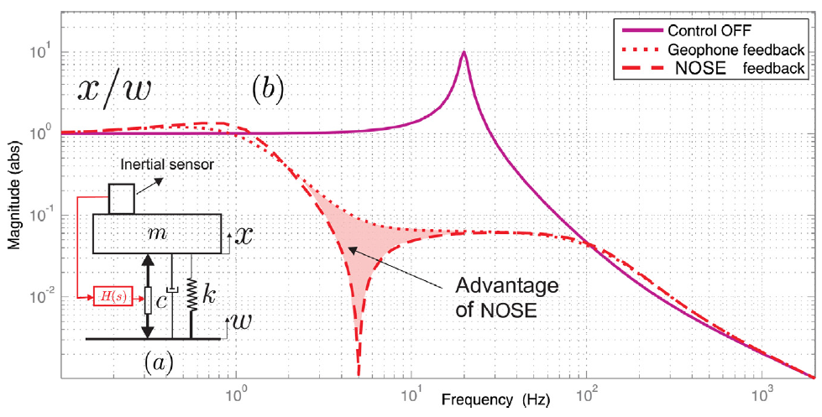
Resonant sensor

Slide 7
Noise budget
Notes:
Cable unplugged from the recorder (ADC noise).
Voltage source alone, when it supplies 9 V (Source noise).
The voltage source supplies 9 V to the circuit, but the photodiode is not connected (Circuit noise)
The voltage source supplies 9 V to the circuit, the photodiode is connected, but the laser switched off (Laser OFF)
The voltage source supplies 9 V to the circuit, the photodiode is connected, and the laser switched on (Laser ON)

Slide 8
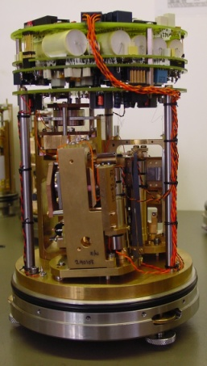
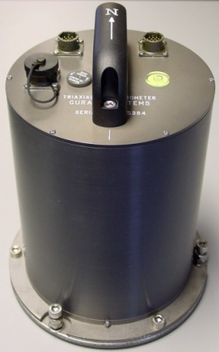
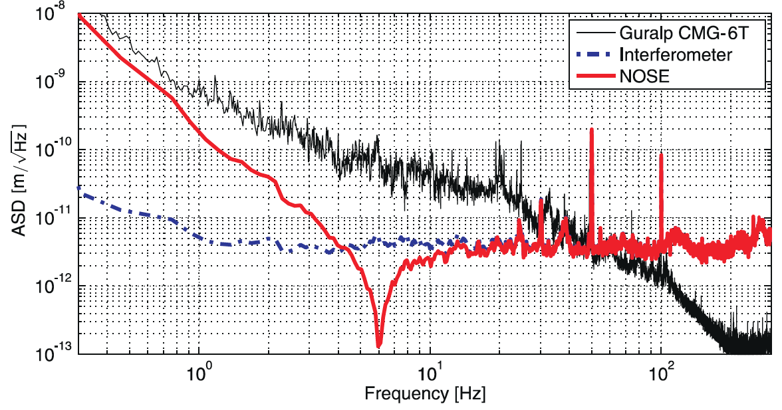
Resolution
3 pm/rtHz above 4 Hz.
COLLETTE C., NASSIF F., AMAR J., DEPOUHON C. and GORZA S.-P., Prototype of interferometric absolute motion sensor, Sensors and Actuators A: Physical, 2015, vol.224, 72-77.

Slide 9
Outline
Optical inertial sensor
Active isolation system

Slide 10
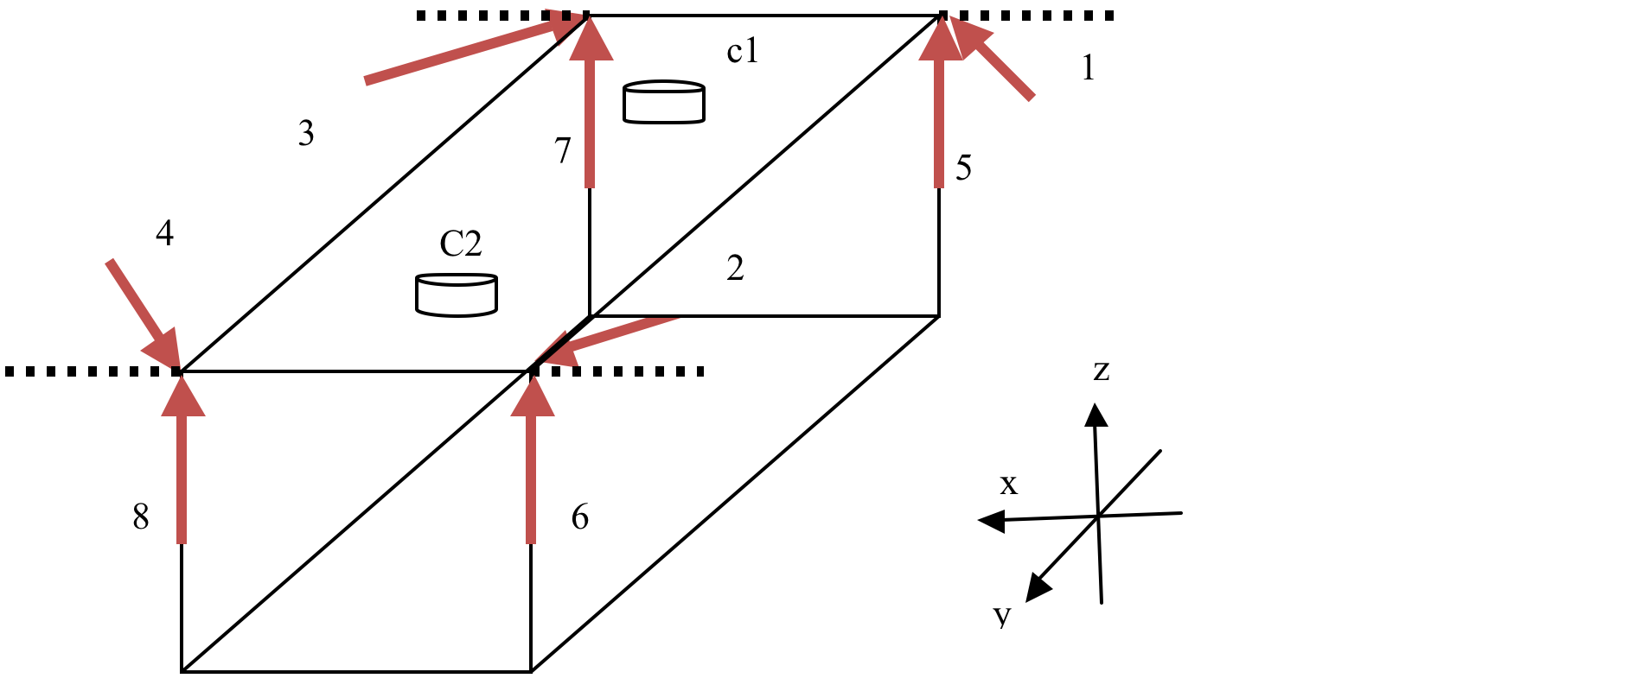
Supporting an extended object
Rigid extended frame
High authority along z
Low authority along x
Some stiffness along y
Redundancy: 8 mounts
Tunable vertical/horizontal decoupling

Slide 11
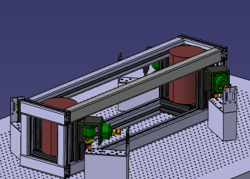
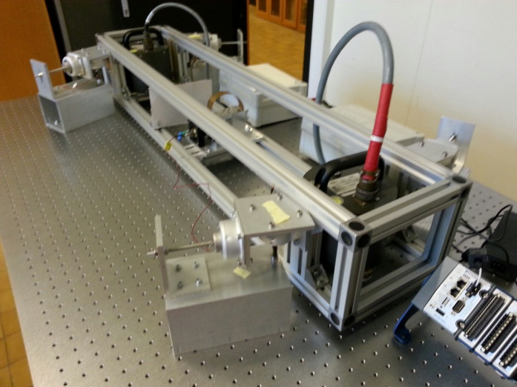
Test bench
COLLETTE C., TSHILUMBA D., NASSIF F., FURNEMONT R., JANSSENS S., ARTOOS K., Vibration isolation of an extended object, Euspen’s 15th conference, June 2015 (Leuven, Belgium).

Slide 12
Test bench
COIL-FREE ACTUATOR (piezoelectric in series with a metallic suspension).
COIL-FREE SENSOR (optical inertial sensor used in the feedback loop).

Slide 13
Active control strategy
Low frequency:
Centralized inertial control
High frequency:
Decentralized force control
COLLETTE C. and MATICHARD F., Sensor fusion methods for high performance active vibration isolation systems, Journal of sound and vibration, 2015, vol.342, 1-21.

Slide 14
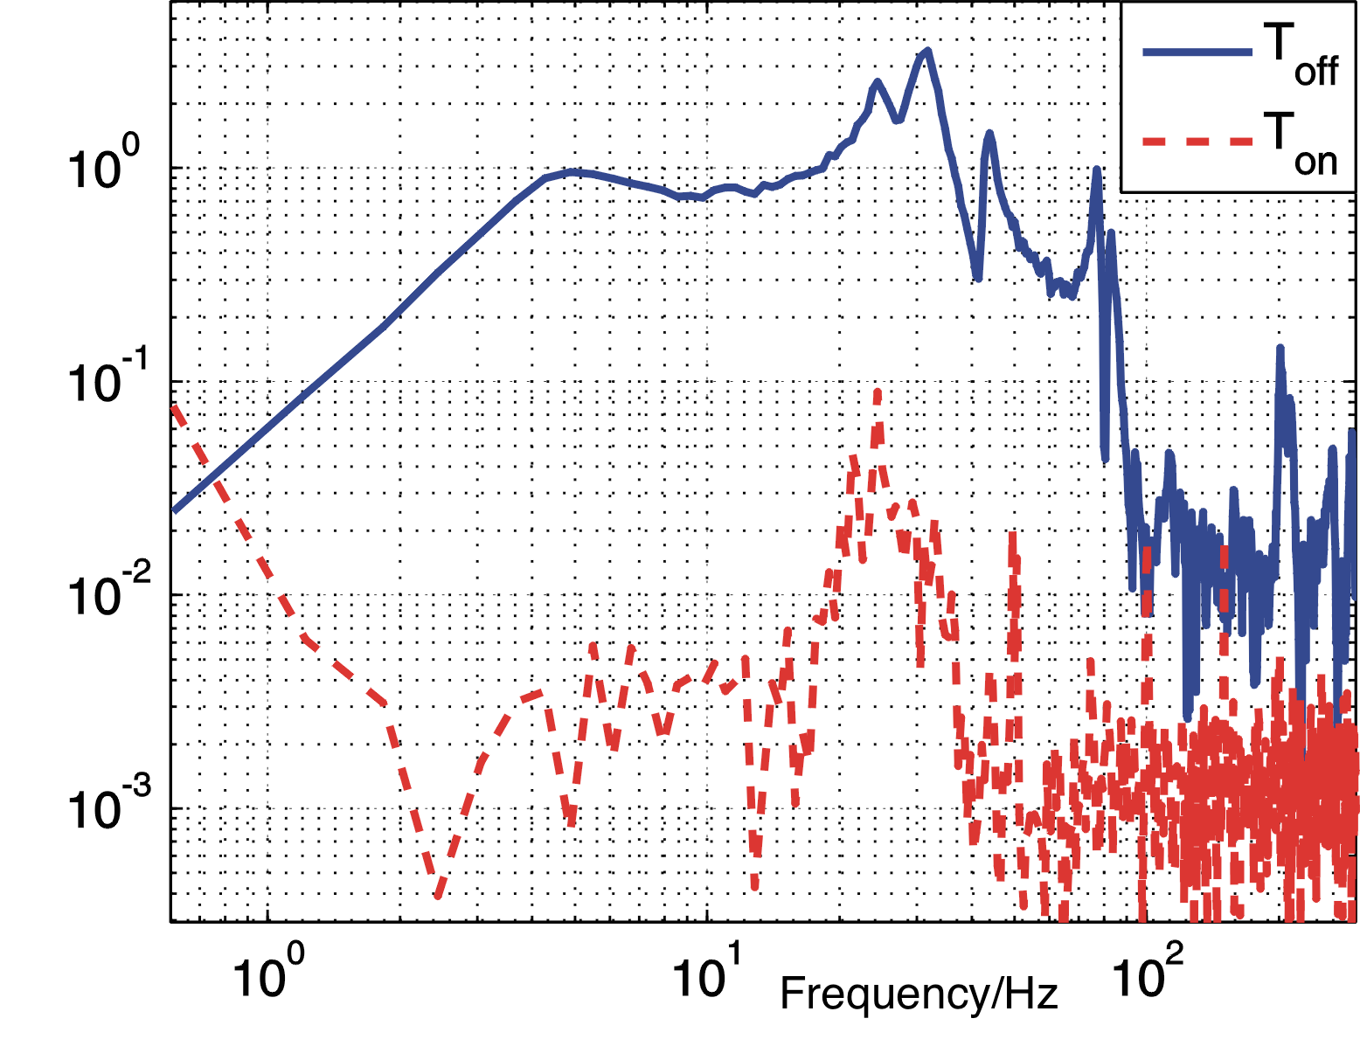
Closed loop performance
Reduction of 2-3 orders of magnitude between 1Hz and 100 Hz
Large stability margins
Sensor noise limited
COLLETTE C., TSHILUMBA D., NASSIF F., FURNEMONT R., JANSSENS S., ARTOOS K., Vibration isolation of an extended object, Euspen’s 15th international conference and exhibition, June 2015 (Leuven, Belgium).

Slide 15
Conclusion:
  Optical inertial sensor (resolution: 3pm/rtHz)
  Active isolation system validated for 1dof (vertical)
Future work:
  Test the other directions

