Slide 1
Other magnets procurement status:
SD0
2 Otupoles for ATF, Japan

Slide 2
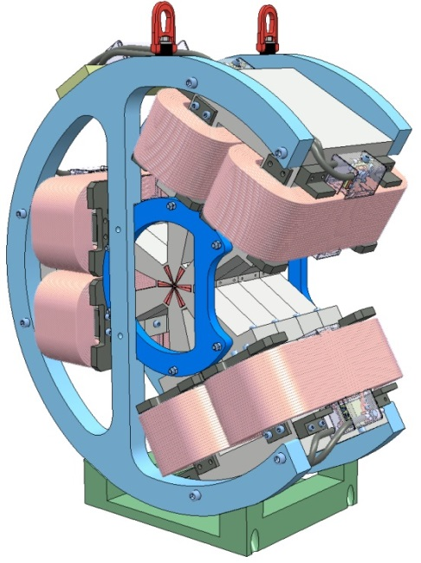
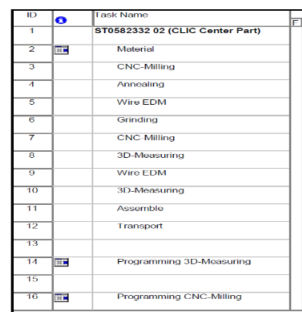
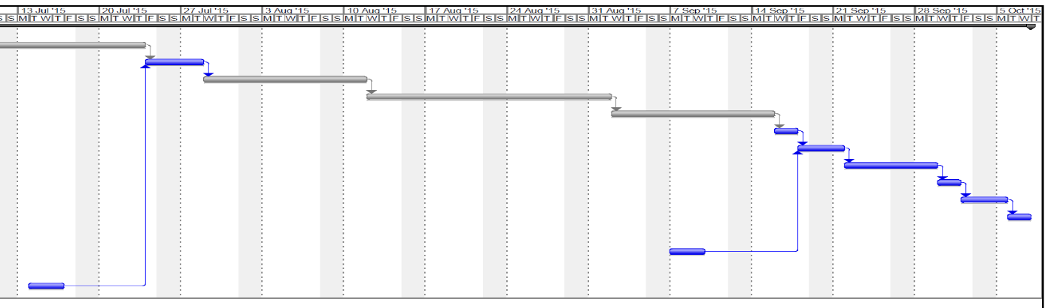
SD0 procurement:
Meet the company VDL (NL) that will provide the core parts (Permendur core by EDM, PM blocks).
No major news (Summer period is still a rough material procurement phase).

Slide 3
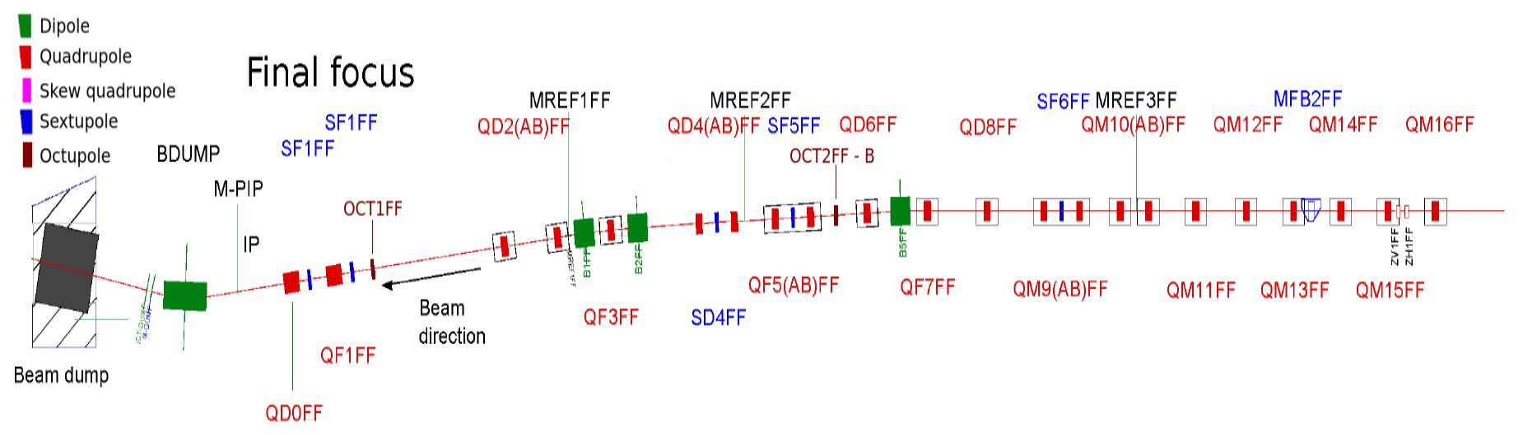
ATF Octupoles procurement:
Aim: improve the beam size reduction from σ_{y} 45nm (achieved) toward a potential minimum of 23 nm.
Magnets, MM, fiducialization, power supplies procured by CERN.
Installation and alignment will shared responsibility (under discussion)
(Ref: “Towards Ultra-Low beta* in ATF2” by M.Patecki (CERN, Geneva) et al. presented at IPAC’15, May 2015,Richmond, Virginia, USA)

Slide 4
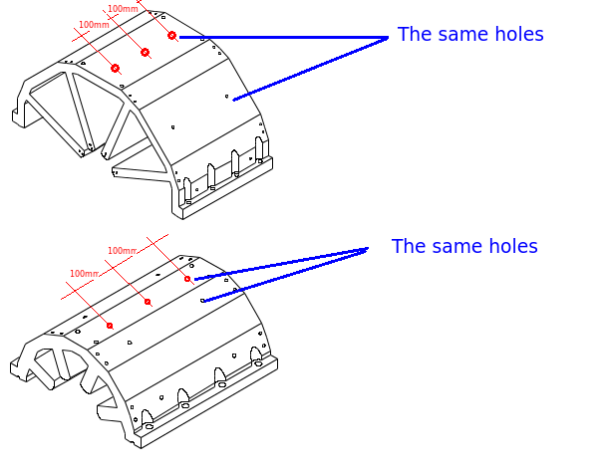
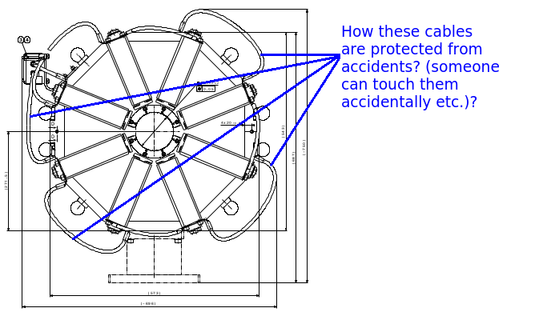
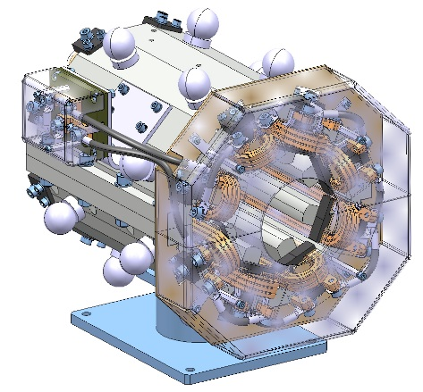
Converging discussions and decisions (long) about integration, alignment, safety aspects, etc…

Slide 5
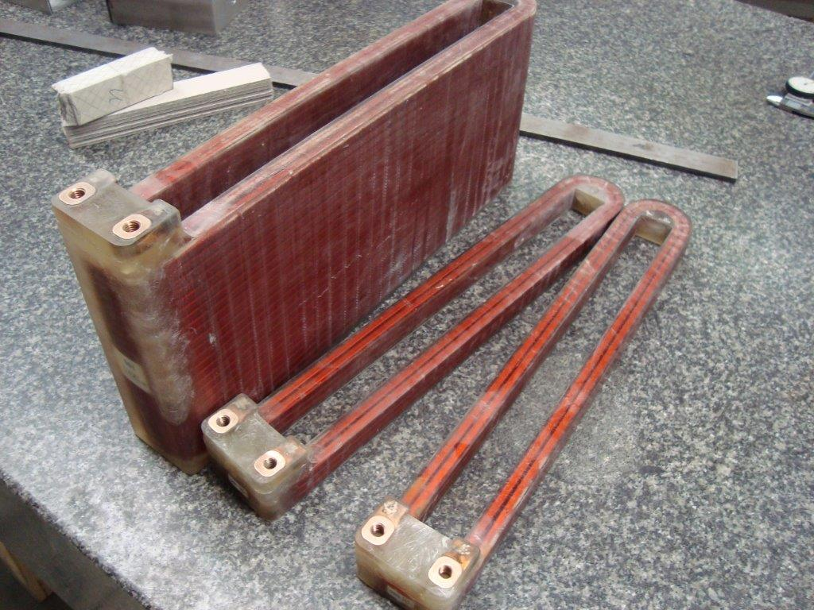
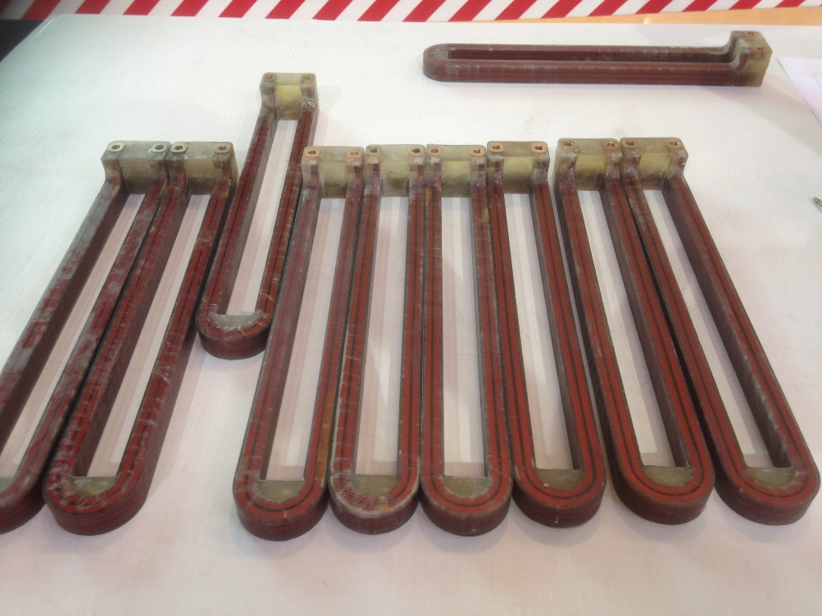
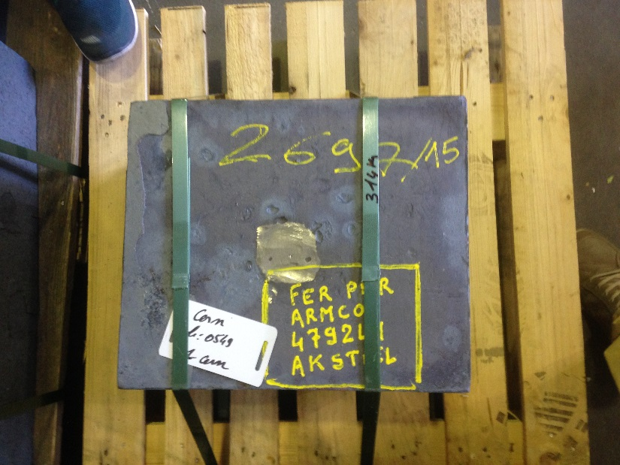
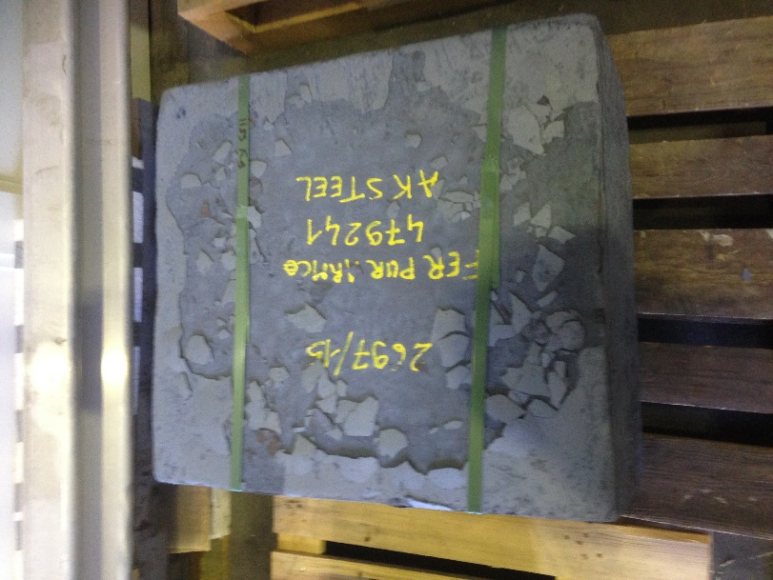
Prototype coils (courtesy of SEF- Toulouse)

