Slide 2
HL-LHC 7 TeV instabilities: impedance model with crab cavities – continued
Kevin Li, N. Biancacci, E. Metral, B. Salvant

Slide 3
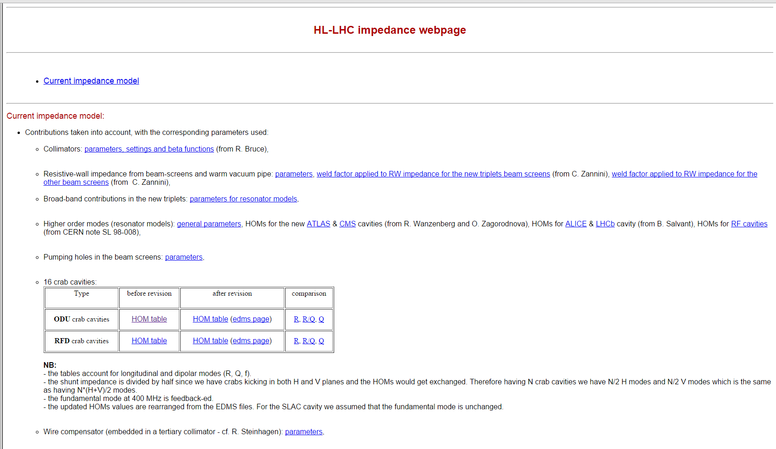
New HOM wake tables
We extend the previous wake table by the full table of specified HOMs
At this point, we have 2 crab cavity designs with the corresponding HOMs (taken from http://impedance.web.cern.ch/impedance/):
  BNL design: old and updated version
  SLAC design: old and updated version
Goal: create new extended wake tables from the HOMs, compare them with each other and agree on common wake/impedance model

Slide 4
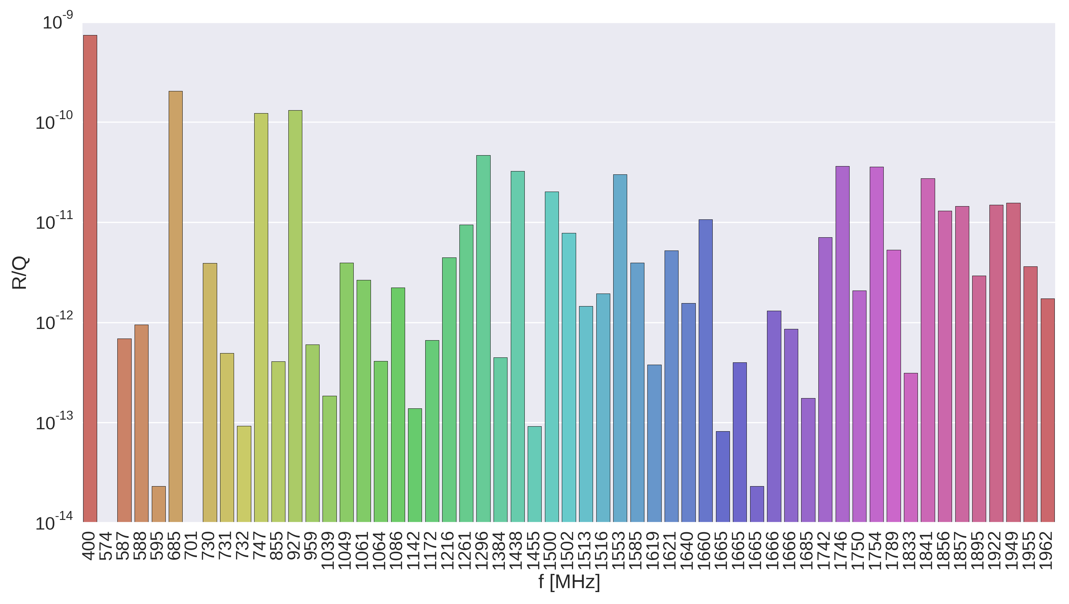
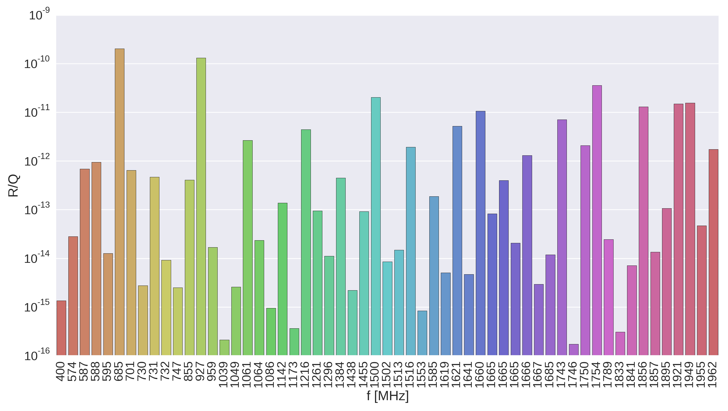
HOMs for BNL and SLAC crab cavities
BNL
R/Q
BNL updated

Slide 5
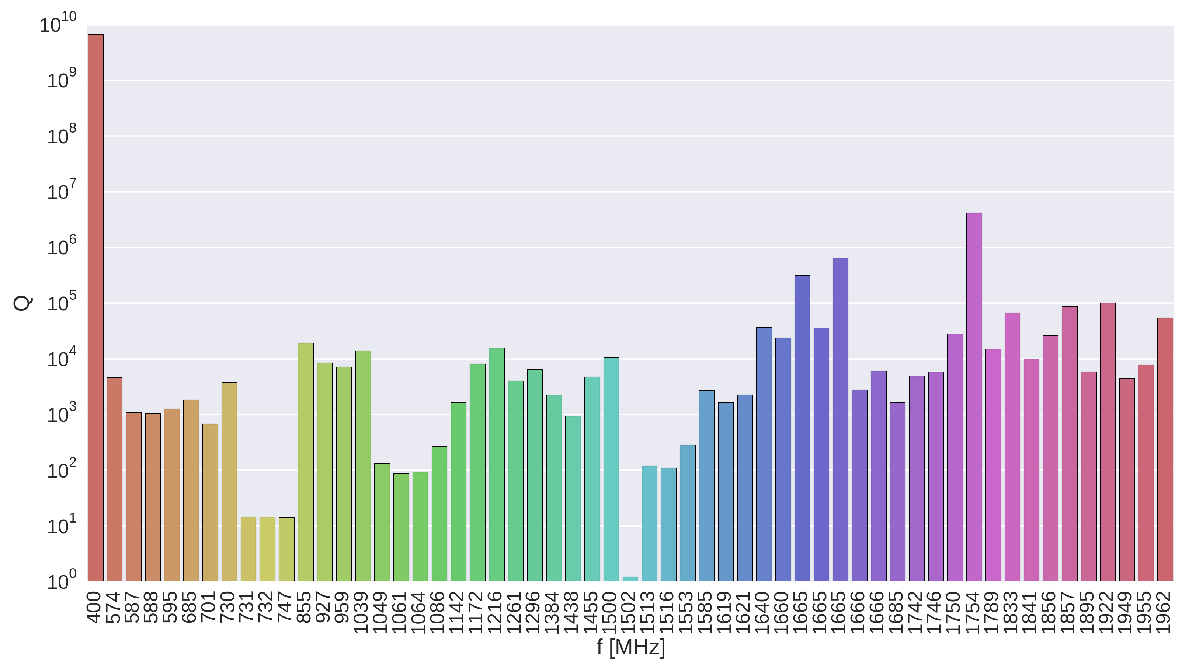

HOMs for BNL and SLAC crab cavities
Damped in the wake tables to Q=1 while keeping R/Q=constant
BNL
Q
BNL updated

Slide 7
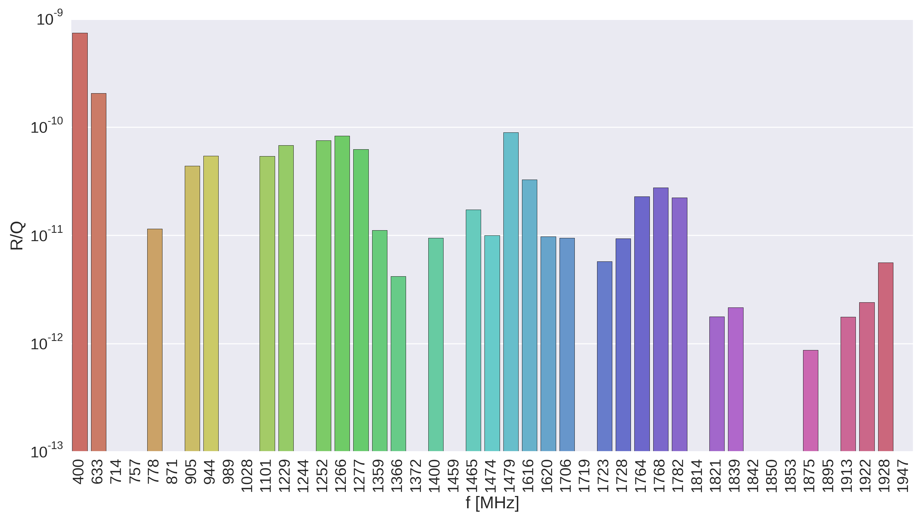
HOMs for BNL and SLAC crab cavities
SLAC
R/Q
BNL updated

Slide 8
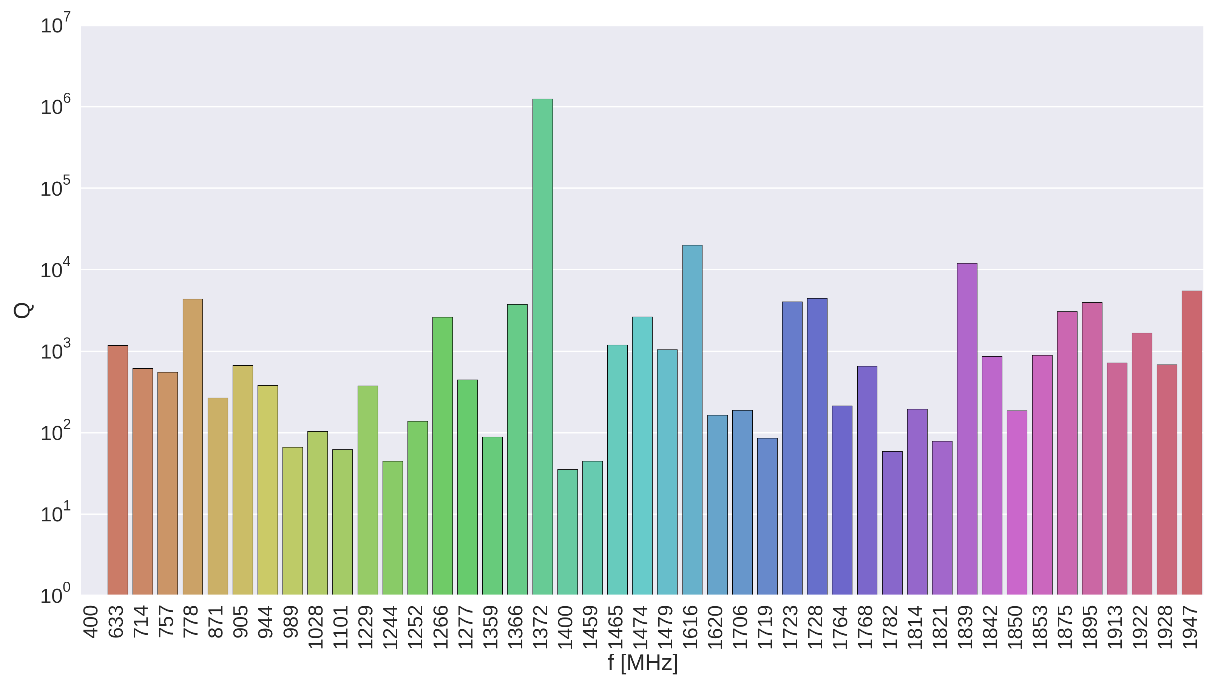
HOMs for BNL and SLAC crab cavities
SLAC
Q
BNL updated

Slide 9
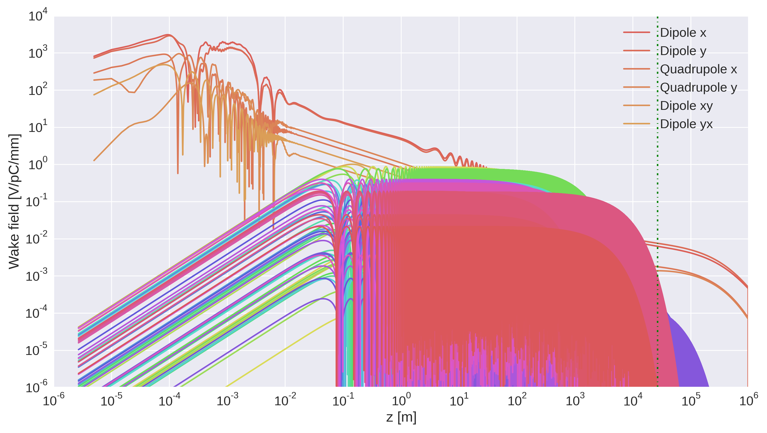
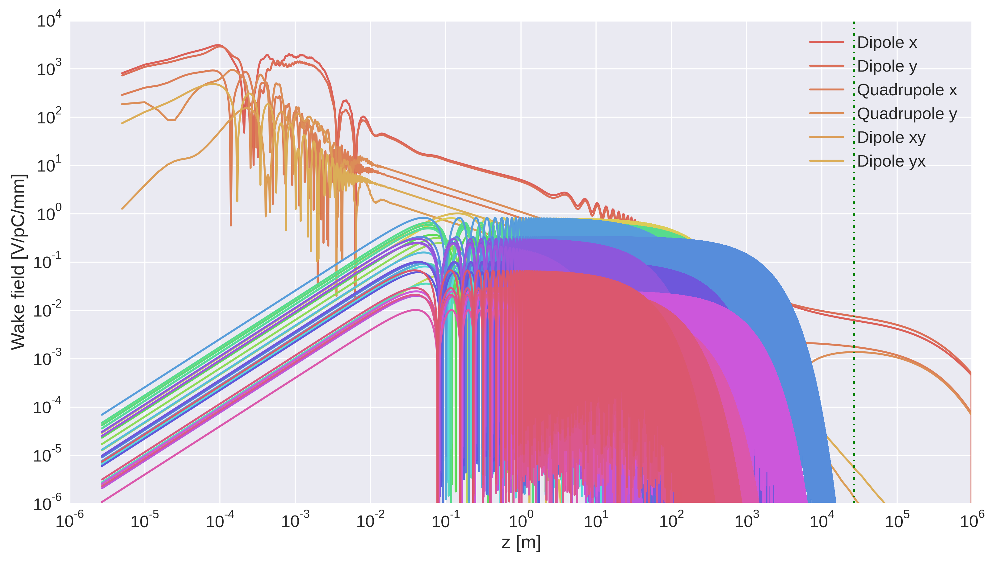
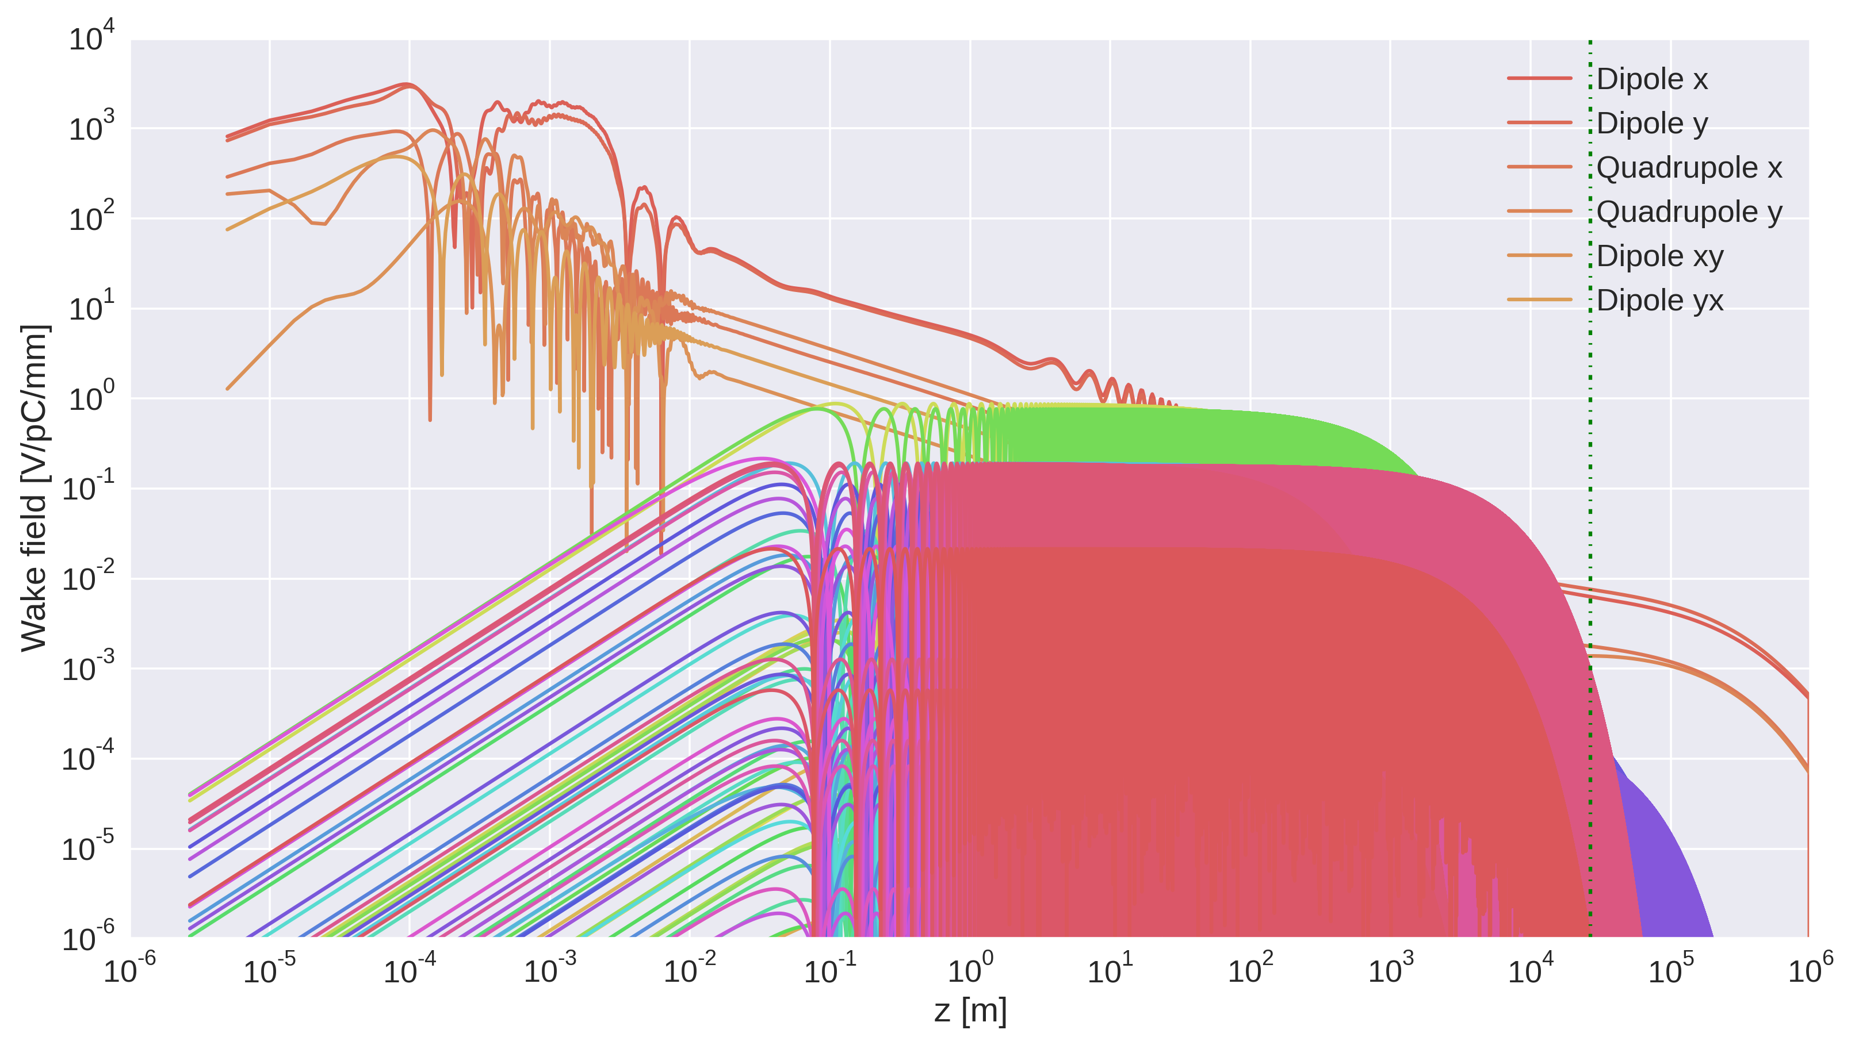
Wakes for BNL and SLAC crab cavities
BNL
SLAC
BNL
updated

Slide 10
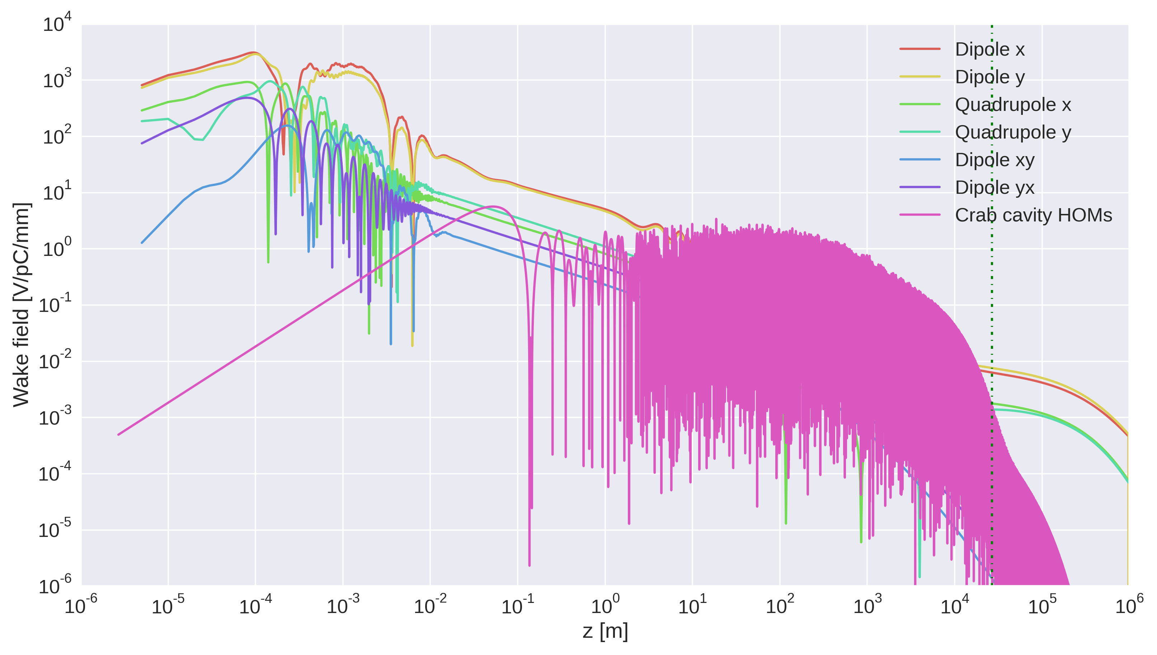
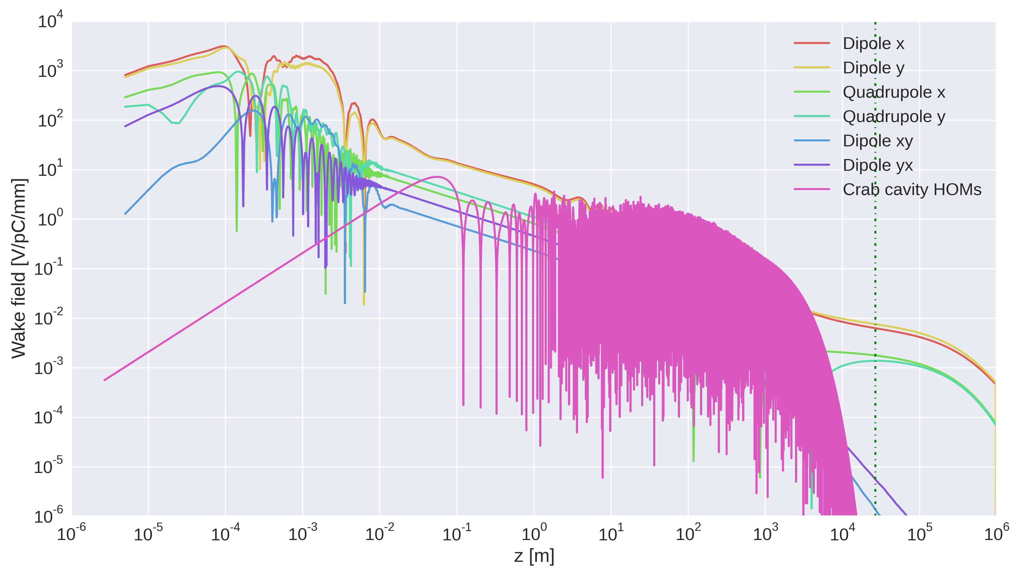
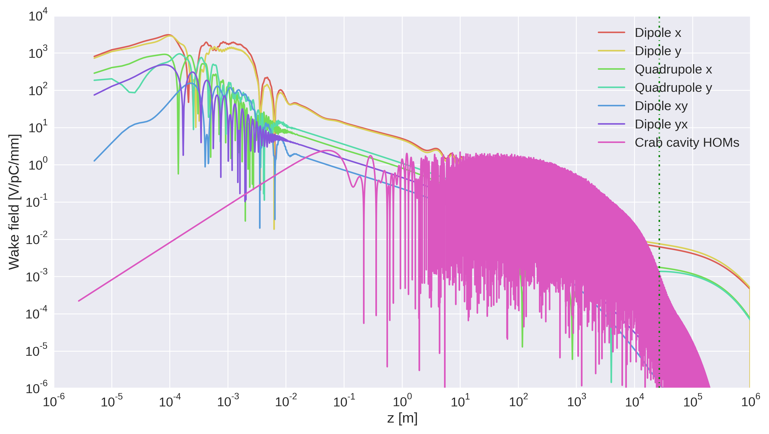
Wakes for BNL and SLAC crab cavities
BNL
SLAC
BNL
updated

Slide 11
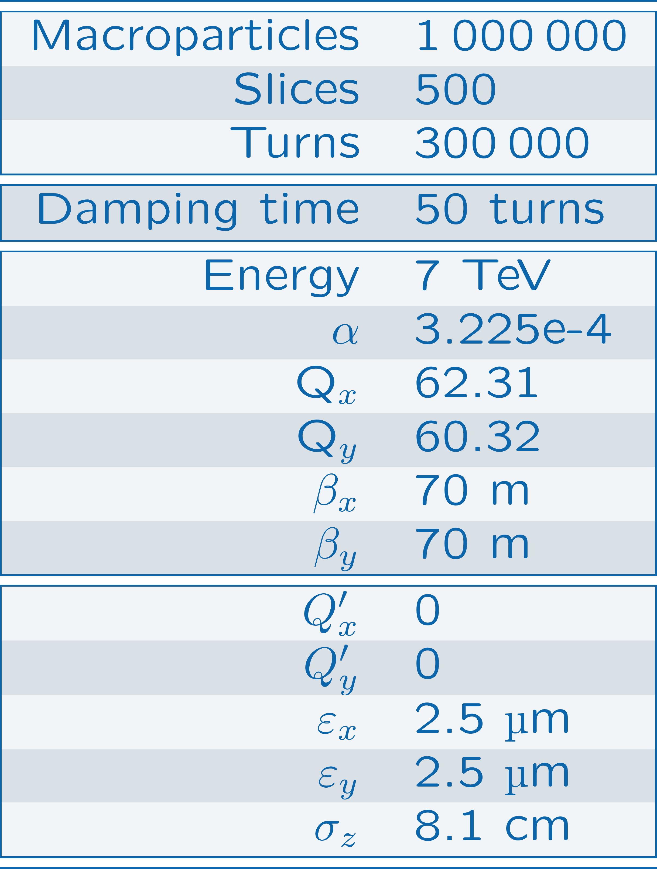
Beam dynamics simulations
Use these 4 wake tables together with the current HL-LHC impedance model (HL-LHC_15cm_7TeV_5umMo+MoC_IP7_TCT5)
Scan
  Intensity [2.3e11, 3e11, 4e11, 5e11]
  Chroma [-20…20]
  Damper gain [25, 50, 250, 5000]
Study & compare instability rise times

Slide 12
Conclusions
We prepared a set of wake tables taking into account the most recent full HOM model for the crab cavities.
These wake tables will be used in conjunction with the HL=-LHC impedance model for beam dynamics simulations.

