Slide 1
Measurement of angular and momentum distributions of charmed hadrons produced in p-Mo collisions
Giovanni De Lellis
The motivation is to reduce the uncertainty on the flux of particles originated from charmed hadrons: HNL and tau neutrinos, a significant fraction of the high energy (electron and muon) neutrinos in general

Slide 2
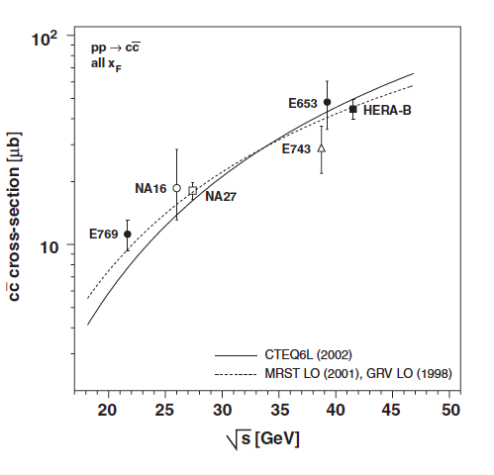
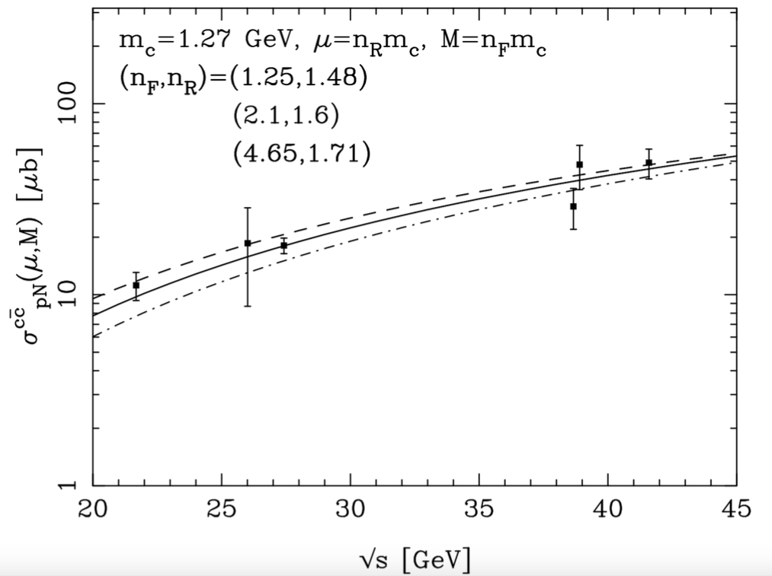
Charm production vs energy
NA27 with 400 GeV protons
Cacciari, Greco, Nason JHEP 9805 (1998) 007
Cacciari, Frixione, Nason JHEP 0103 (2001) 006
arXiv: 1504.04855 SHiP Physics Proposal

Slide 3
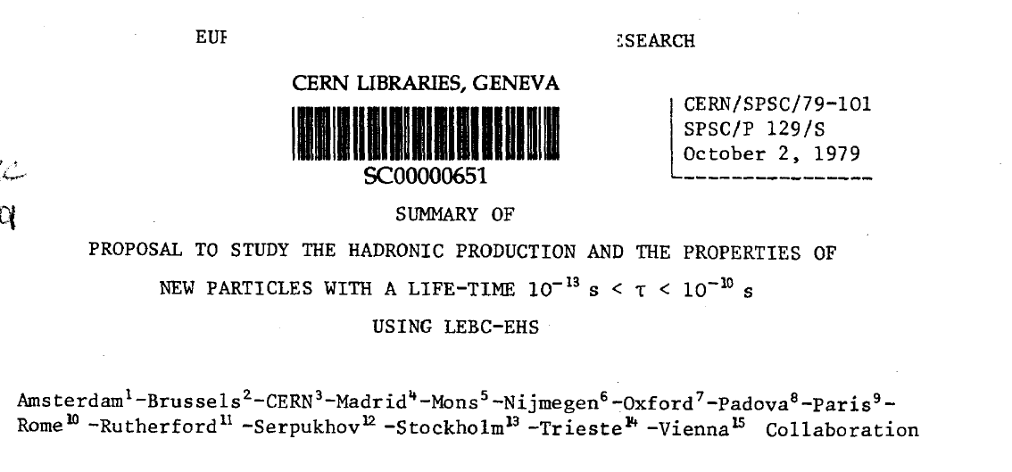
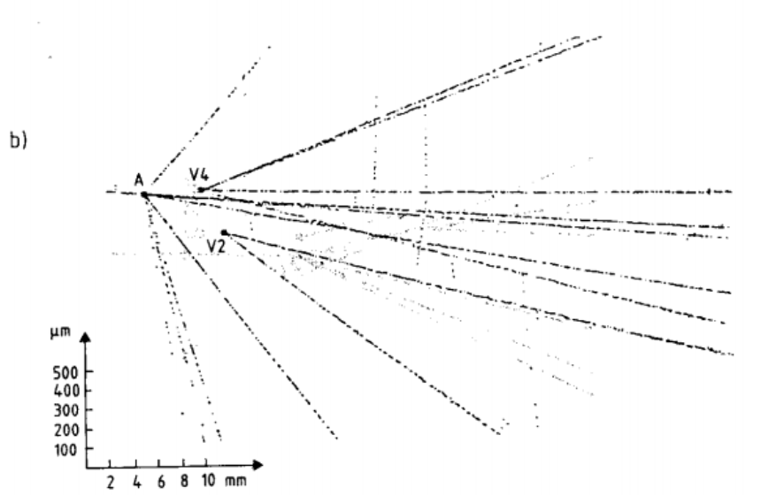
NA27 experiment

Slide 4
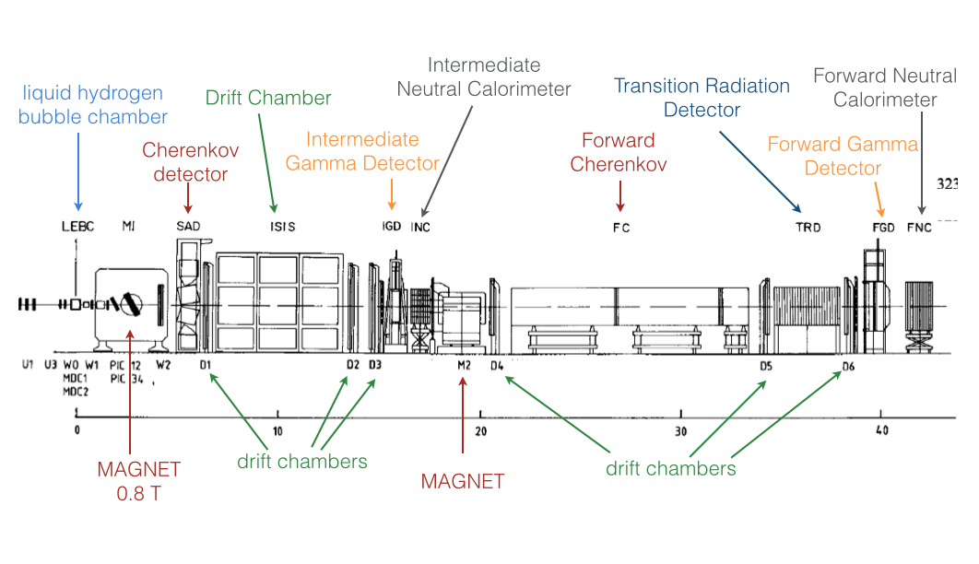

Slide 5
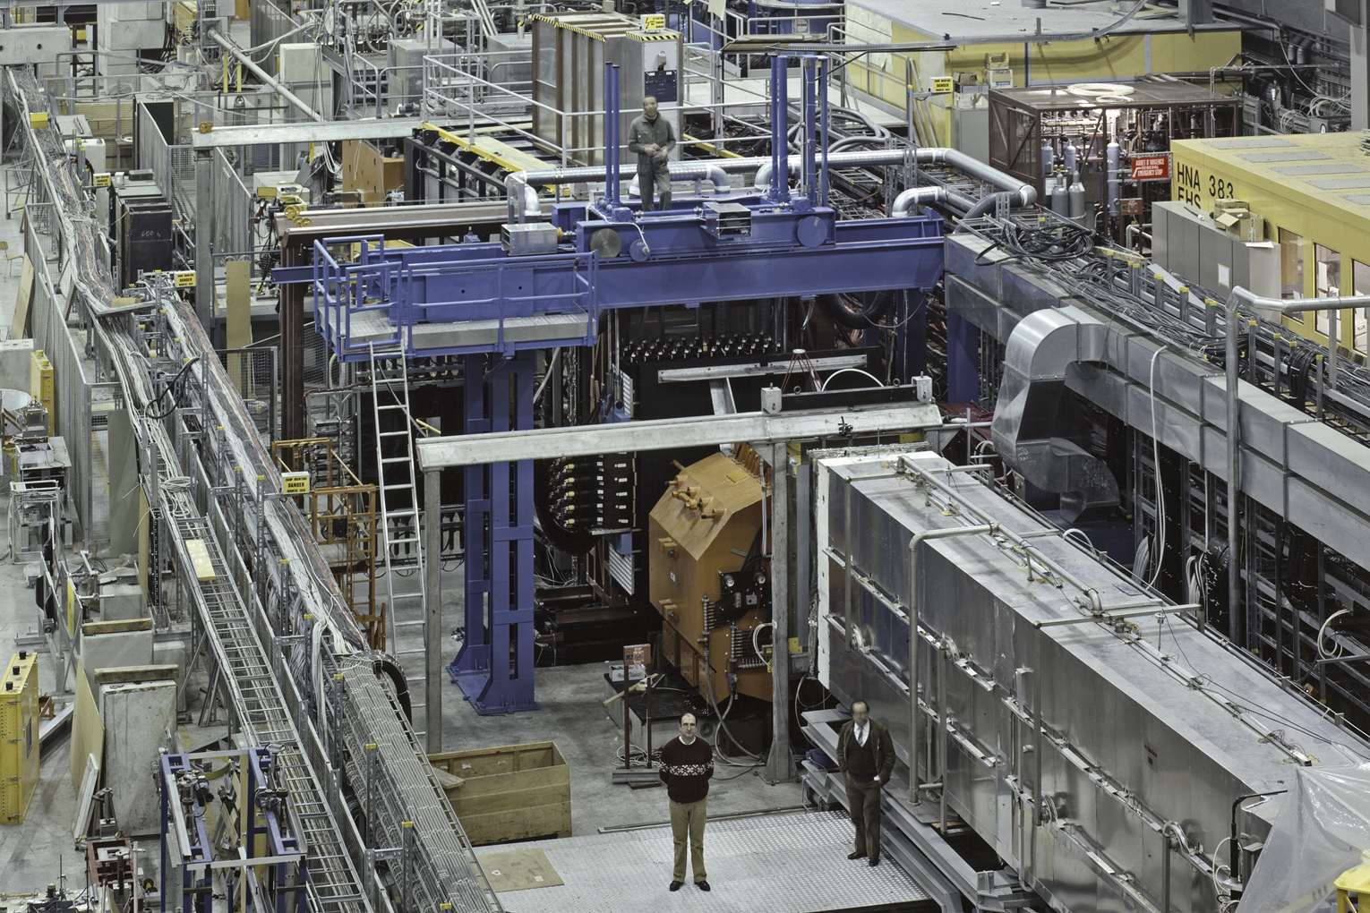
400 GeV run by NA27, M. Aguilar-Benitez, et al., Z. Phys. C 40 (1988) 321.
A total of 98 neutral D0 and 119 charged hadrons (including Λ_{c}) were found

Slide 6



Impact on ν_{τ} Yield
PDG 2014
Physics Reports 433 (2006) 127
JHEP 1309 (2013) 058

Slide 7
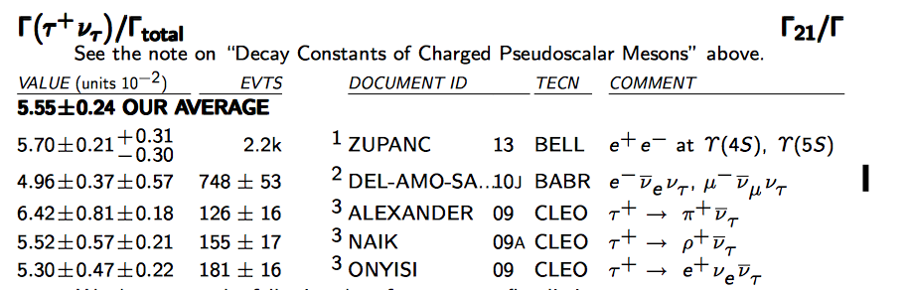
Branching ratio Ds → tau
BES III measurement planned during the coming winter, a dedicated run at the Ds+ Ds- mass
Compared to CLEO, gather ~5 times larger statistics → reduce the statistical uncertainty by a factor of 2. First results available by the end of 2016
Hard to improve (BELL2?)

Slide 8
Proton target
  10% p interactions → exp(-x/λ) = 0.9 → x/λ = -ln(0.9) ~ 0.1 → x = 0.1 λ = 1.5 cm Mo target interleaved with nuclear emulsions
Charm yield ~ 1.7 x 10⁻³
Fraction of charmed hadrons decaying inside the target, <E_{Ds}> = 45 GeV → Fl = 3.3 mm, assume 7.5 mm on average in the target → ~exp(-2.3) ~0.10 → ~ 90% decay inside
Charm tagging in the emulsion (topological, secondary vertex detected within the expected flight length) ~ 50%
Charm momentum measurement by a spectrometer, followed by a muon filter
Overall factor ~ 7.7 x 10⁻⁵
10⁹ protons → 77000 detected charm pairs

Slide 9
Schematics of the detector
SciFi Planes
SciFi Planes
Muon filter
Magnetised
volume
1.5 cm Mo Target
15 emulsion films

Slide 10
Protons and (emulsion) analysis time
10⁹ protons from SPS
Assume 10⁴/cm² in emulsions → 10⁵ cm² x 15 films = 1.5 x 10⁶ cm²
Current speed per system ~ 100 cm²/h → 1.5 x 10⁴ hours → analysis time ~ 2 months for 10 systems

