Slide 1



Muon Detector
Wander baldini
on behalf of the SHIP Muon Group
VI SHIP Collaboration Meeting, CERN 7-9 Oct. 2015

Slide 2
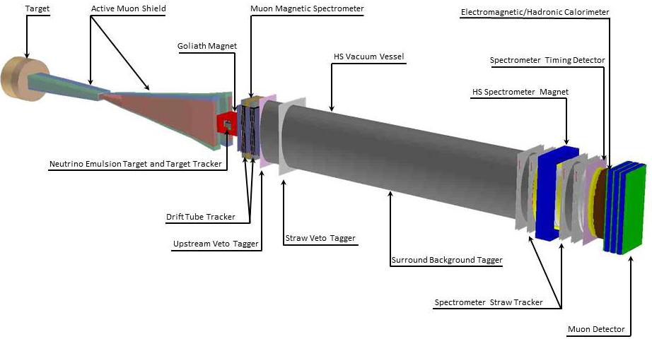
Muon Detector
Brief reminder:
- Muon system of the Hidden Sector detector:
→ Based on scintillating bars with WLS fibers and SiPMs readout
→ Collaboration with, Laboratori Nazionali di Frascati (LNF), INFN-Bologna, INFN-Ferrara and INR-RAS (Russia)
2)
Muon detector
1

Slide 3
Muon detector: Testbeam
Muon test beam scheduled at T9 , CERN-PS, 14-28 October
The Muon test beam has got a grant by CERN, via AIDA2020 European program:
- team leader for the grant: Gaia Lanfranchi (LNF)
- grant: per-diem for 6 people (3 from INFN, 3 from Russia)
- Goal of the test beam:
  - measurement of time resolution of scintillating bars 3 m long, readout by WLS and SiPM: goal ~ o ( 1 ns)
  - find the optimal configuration of scintill./fibers/SiPMs to reach the desired time resolution
2

Slide 4
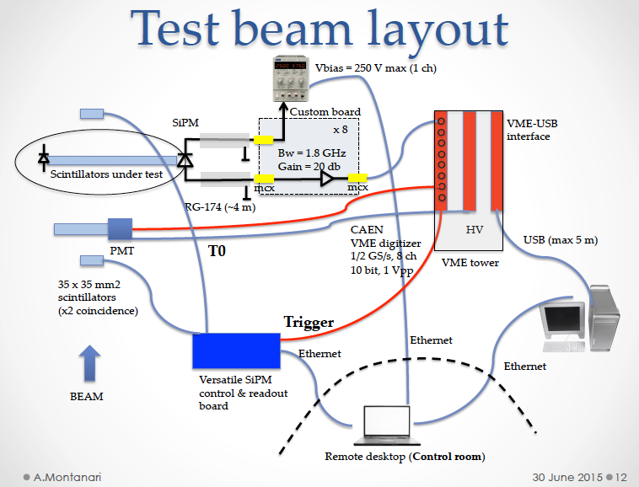
Muon system: test beam organization
People: A. Montanari, N. Tosi, W. Baldini, G. Lanfranchi,
P. Ciambrone + INR group
3

Slide 5
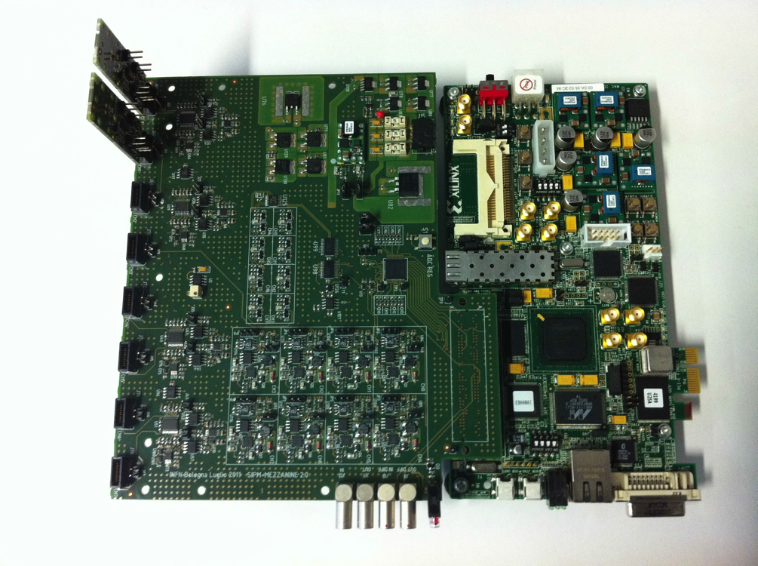
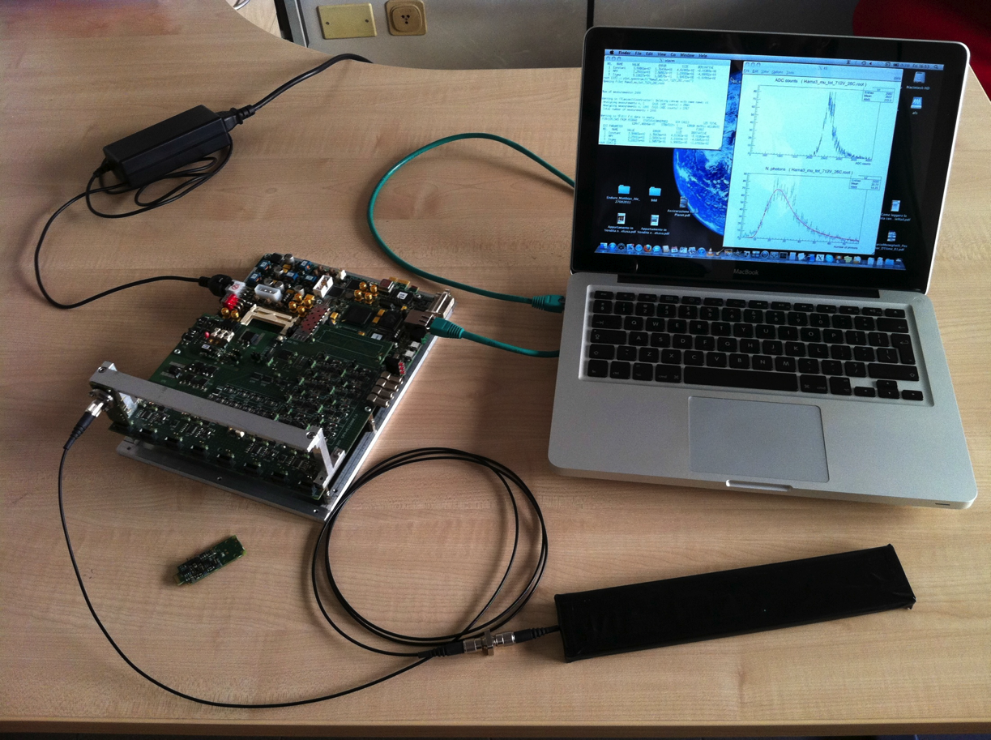
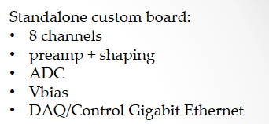
Almost all pieces are in place
Alessandro Montanari (INFN-Bo)
Versatile board for SiPMs
4

Slide 6
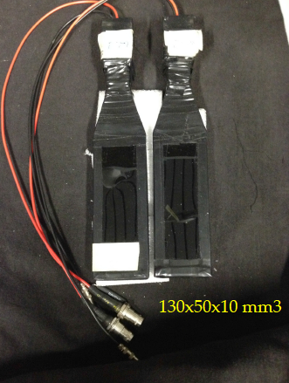
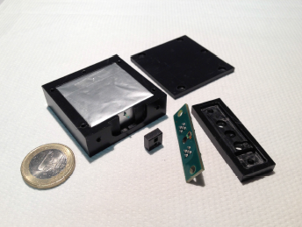
Alessandro Montanari (INFN-Bo)
T0 scintillators:
Trigger scintillators:
5

Slide 7
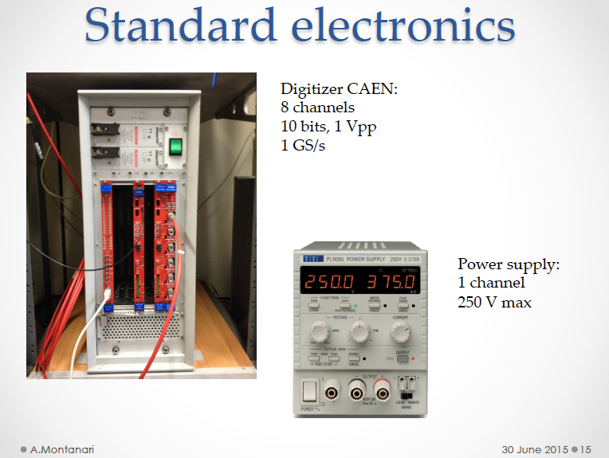
Alessandro Montanari (INFN-Bo)
6

Slide 8
Muon system: test beam organization
RAW scintillators and WLS fibers | OK
Tool for polishing the bars: we plan to use a tool available at CERN | OK
SiPMs order: x FBK (1.2 mm diameter & 3x3 mm²) (BO) : arrived xx Hamamatsu (1x1 mm², 3x3 mm²) (Ferrara): rather unlikely we’ll get them in time for the testbeam | OK …
PCB for SIPM coupling | OK
Trigger (scintillators & electronics) | OK
T0: scintillator +HV | OK
FEE: custom board developed in Bologna ready for test | OK
DAQ: VME crate + Digitizer | OK
Power supply for SiPM biasing | OK
DAQ & Software | OK
Mechanical structure | OK
all material already available in Bologna/Ferrara or borrowed
at CERN, AIDA2020 grant
7

Slide 9
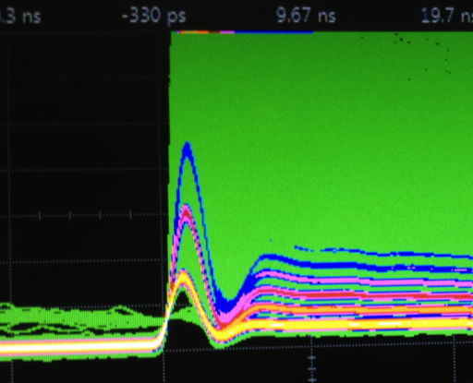
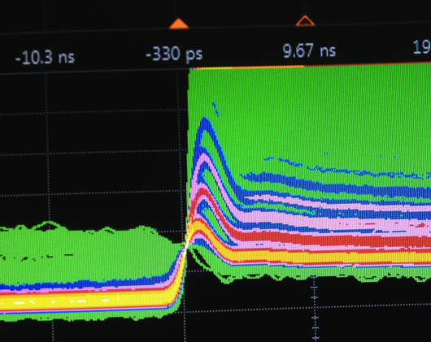
SiPMs
Signals extracted from a scintillating bar instrumented with 1.2 mm and 2 mm
diameter fibers and readout by SiPMs from FBK of dimensions 1.2 mm
diameter and 3x3 mm² and by the custom amplification board
designed & built in Bologna
SiPM FBK 1.2 mm round
SiPM FBK 3x3 mm² square
8

Slide 10
Scintillator Bars
We plan to test some configurations of scintillators / WLS fibers / SiPMs:
FNAL-NICADD scintillators:
  Bars 3m long:
    cross section 1.0 x 4.5 cm² and 2.0 x 4.0 cm², readout with one Kuraray fiber Y11 Φ=2.0 mm and AdvansiD SiPMs square 3x3 mm² on both ends.
  Shorter bars (25cm) with different readout configurations:
    n. of fibers (1 vs 2), producer (Kuraray vs Bicron), round 1.2 mm SiPMs etc...
    this is to compare time resolution and light yield of different combinations
INR – RAS scintillators: see next slide
9

Slide 11



INR – RAS: 6 types of scintillator bars (12 pcs)
<- Readout
<- Readout
#bar
Size I : 7x100x3000 mm³
1
2
2 pcs.
011,012
3
4
009,010
2
2 pcs.
1
Size II : 7x50x3000 mm³
1
2
3 pcs.
005,006,008
007
1
1 pcs.
Size III : 7x30x3000 mm³
001,002,004
3 pcs.
003
1 pcs.
10

Slide 12
Light yields in p.e./MIP for 3 positions
#bar |  |  | L1=2.6 m | L2=1.5 m | L3=0.4 m
001 | Readout 1 | Width 3cm | 9.2 | 11 | 16.3
002 | Readout 1 |  | 15.8 | 19.8 | 30.3
003 | Readout 1 |  | 23.7 | 33.3 | 49.4
004 | Readout 1 |  | 23.1 | 30.2 | 42.1
005 | Readout 1 | Width 5 cm | 20.7 | 24.3 | 38.9
006 | Readout 1 |  | 24.9 | 29.9 | 44.7
007 | Readout 1 |  | 18.6 | 16.4??? | 24.4
008 | Readout 1 |  | 22.9 | 26.9 | 41.8
009 | Readout 1 | Width 10 cm | 10 | 14.1 | 21.6
010 | Readout 1 |  | 11.6 | 19.7 | 29.3
011 | Readout 1 |  | 12.5 | 16.3 | 23.3
 | Readout 3 |  | 14.0 | 18.1 | 26.7
012 | Readout 1 |  | 7.6 | 10.2 | 13.7
 | Readout 3 |  | 8.6 | 11.4 | 16.9

Slide 13
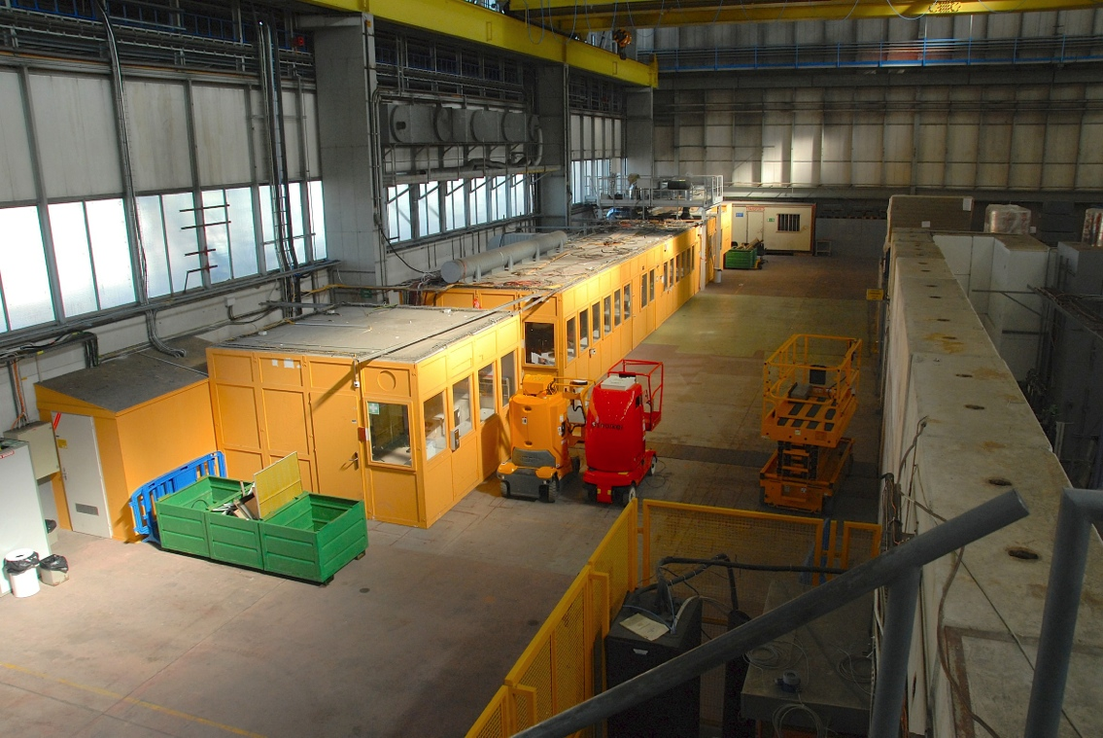
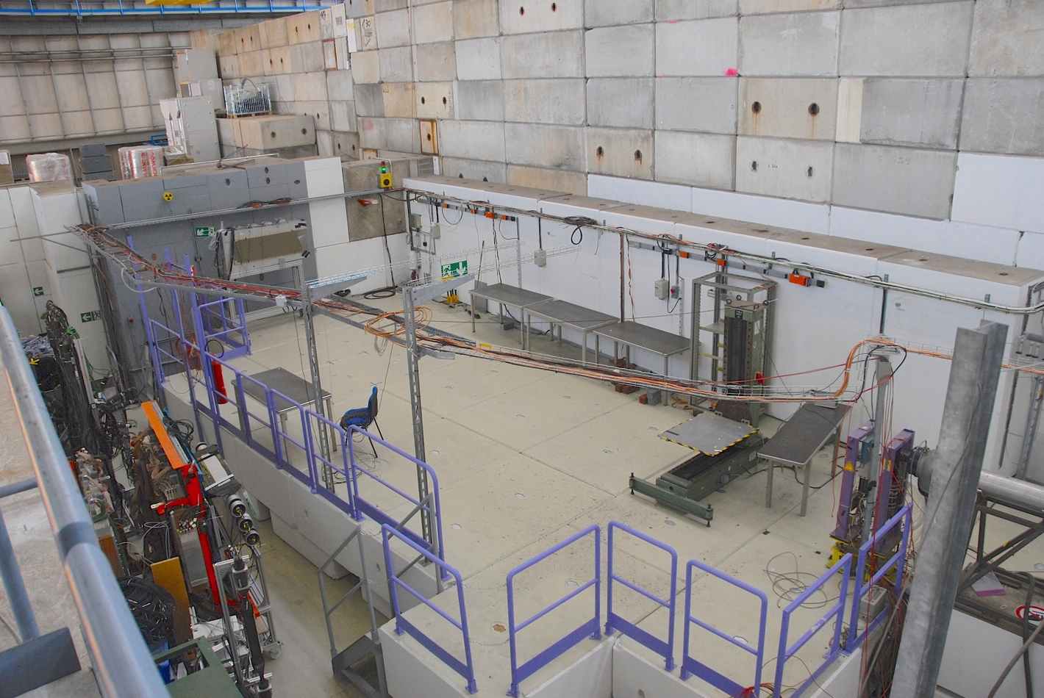
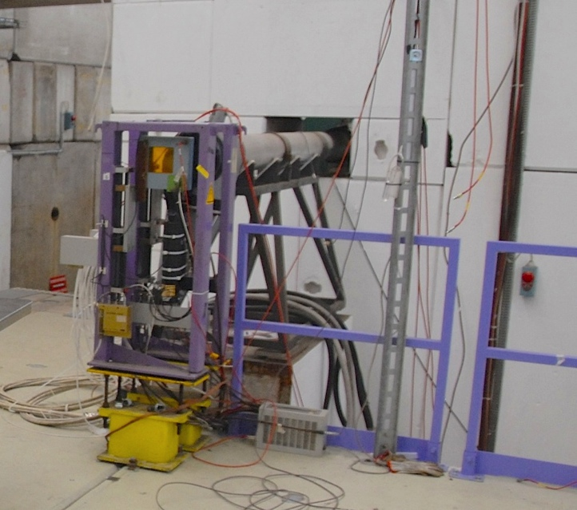
T9 Experimental Area
Control Room
Experimental Area
Beam Pipe
11

Slide 14
Muon system: conclusions and future steps
The testbeam is imminent, we are ~ready to start...
The main goal is to measure the time resolution of various configurations scintillator/SiPM
Next Steps:
Testbeam data analysis
Writing of a Paper (to be submitted to NIM, JINST?)
Usage of testbeam data/signals to:
  develop the FEE with o(1 ns) total time resolution
  choose the optimal parameters for the detector:
    Final scintillator dimensions
    SiPM type
12

