Slide 1
EHN1 extension
Beam lines integration

Slide 2
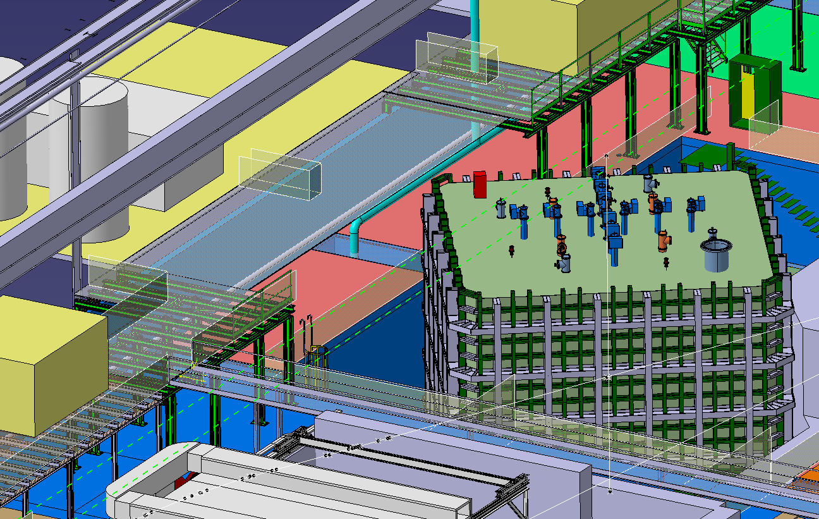
Metalic structure
18 meters

Slide 3
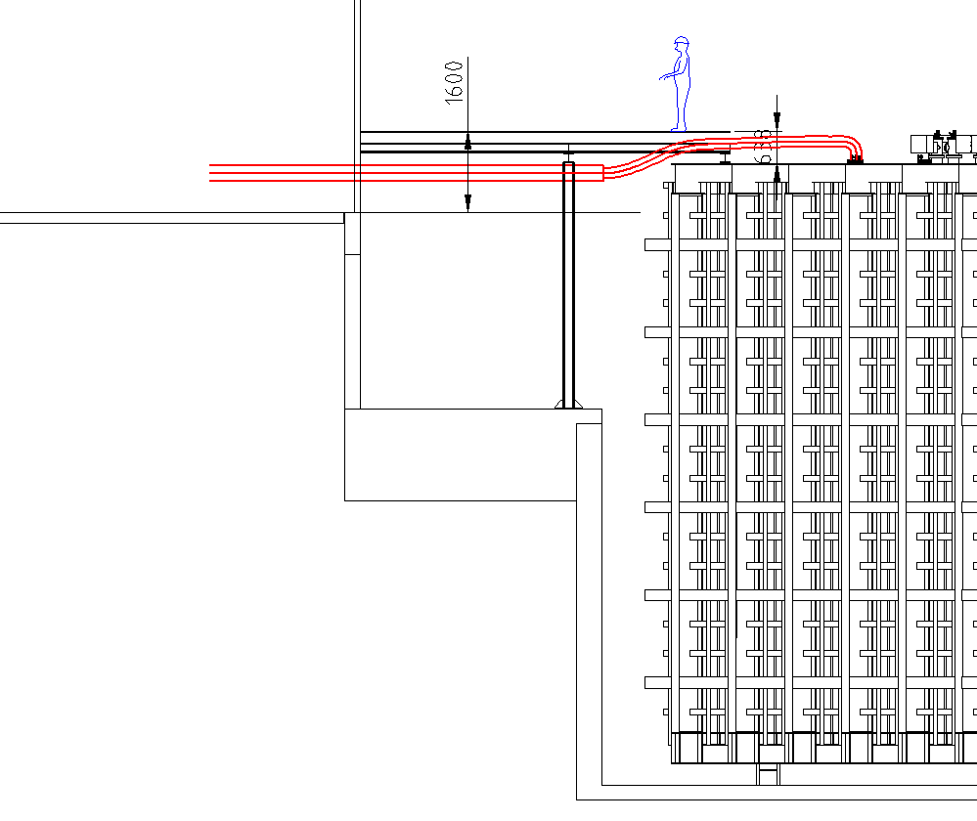
Solution 1,6 meter higher than counting rooms
Cryo plant
False floor
Cryo plant
Counting room level
Cryo lines

Slide 4
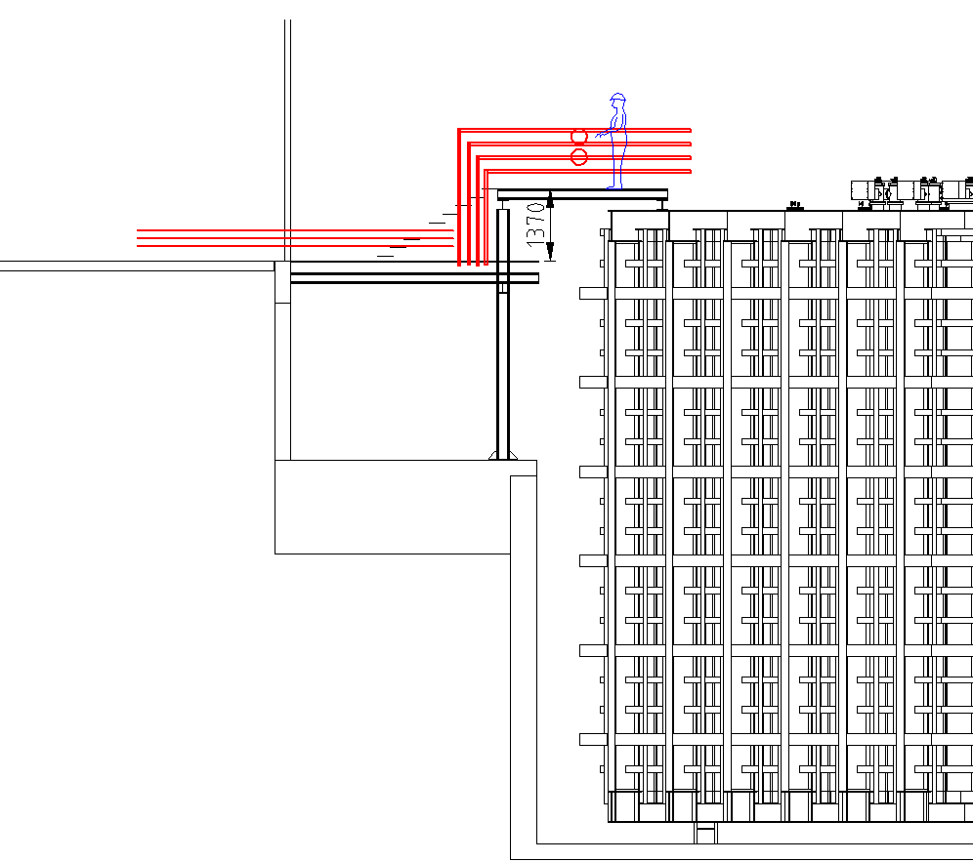
Solution with nominal height
Cryo plant
Cryo lines
Counting room level
Acces passerelle with Stairs

Slide 5
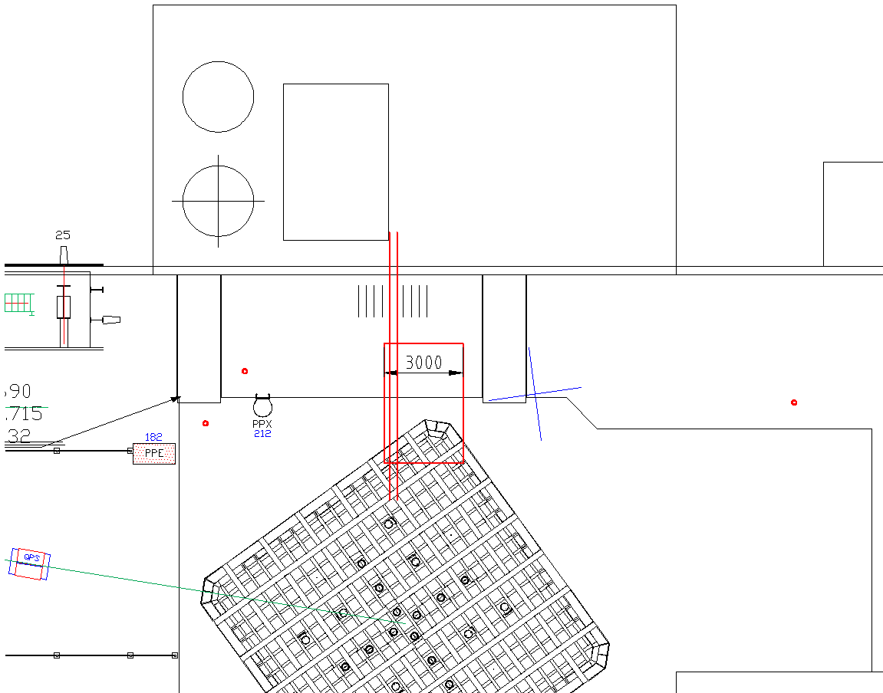
Solution with nominal height
Bridge over cryo lines

Slide 6
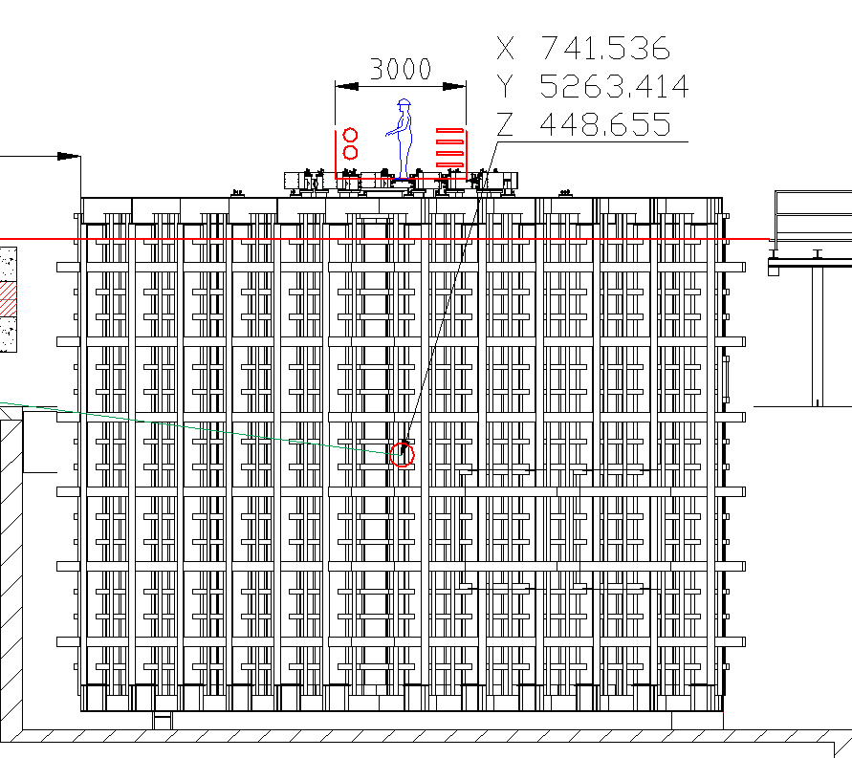
Solution with nominal height

Slide 7
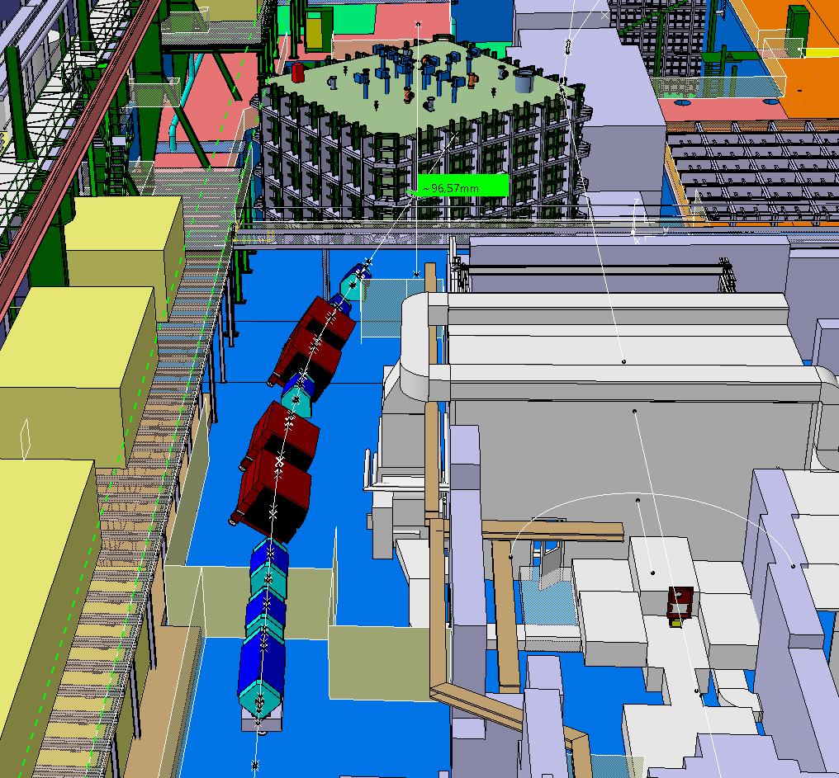
H2 beam to WA105

Slide 8
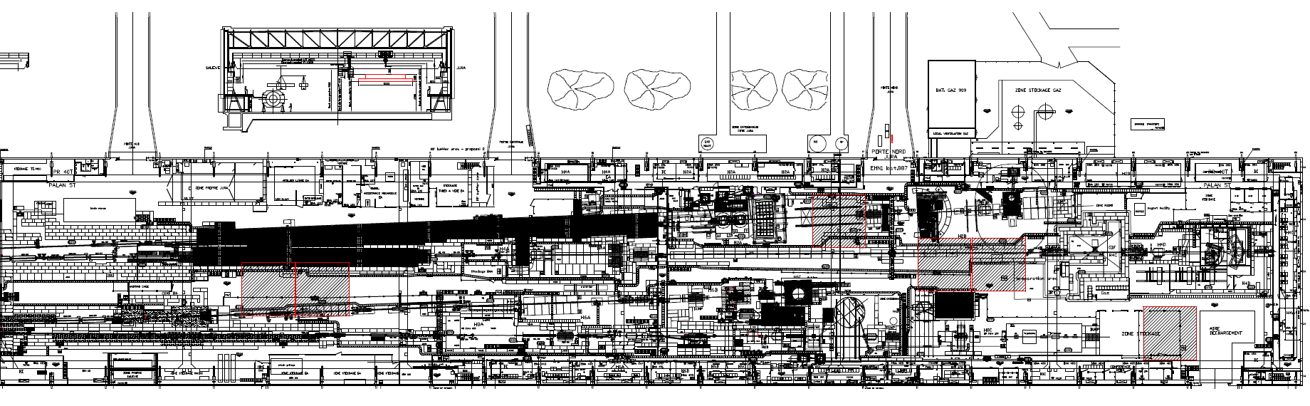
12x12m² storage location
Height available under crane beam
3,4m
4,7m
5,5m
5,5m

Slide 9
