Slide 1
Cold powering test results of MBHSP102
Gerard Willering, TE-MSC-TF
14-07-2015
With thanks to Jerome and Vincent and all others from TF for their contribution and to all for delivering a nice magnet, instrumentation, etc.

Slide 2
Reporting on test results
Today:
Test program / test overview
Quench behavior and quench localisation
Powering performance
Quench back
Mechanics
Next week:
Magnetic measurements
Protection studies

Slide 3
Introduction
DS11 T tests so far at CERN
When | Name | Coils | Conductor | OL ground wrap | Powering limitations
Summer 2014 | MBHSM101 | 105 | RRP 108/127 | 100 µm glass | Reached 96 % of I_{ss} at 1.9 K
November 2014 | MBHSP101 | 106 107 | RRP 108/127 RRP 108/127 | none 100 µm glass | Limitation in coil 107, only 4 quenches in 106, reached 82 % of I_{ss.}
June 2015 | MBHSP102 | 106 108 | RRP 108/127 RRP 132/169 | None 100 µm glass | Reached 88 % of I_{ss}, but coil 106 detrained down to 81 %.
August 2015 | MBHSP103 | 109 111 | RRP 132/169 RRP 132/169 | 100 µm glass 200 µm glass
October 2015 | MBHDP101 | 106-108 109-111 | See above | See above

Slide 4
Cooldown and instrumentation
Cooldown
Cooldown MBHSP101: 60 hours due to 100 K delta T
Cooldown MBHSP102: 30 hours due to 150 K delta T.
No negative effect on training visible.
For MBHSP103 probes are requested in the holes of the yoke to measure real delta T.
Instrumentation
All voltage taps were available from beginning to the end of the test.
A few gauges had no signal, see presentation Christian
The magnetic measurement shaft gave excellent quench localisation measurements.
Note that a defect in the instrumentation was found before cool down in the wiring outside the coil. This seemed a repetitive issue that is treated now.

Slide 5
Training program
Training at 1.9 K, 10 A/s
Target current 12.5 kA
Training not interfered with other tests, only splice measurement.
4 Quenches per day

Slide 6
Training
6 quenches to nominal
10 quenches to initial target of 12.5 kA
Only 3 or 4 re-training quenches for coil 106 after de-collaring and re-collaring
Coil 108 only showed 4 or 5 (de)-training up to 12.3 kA, it never quenched again up to 12.8 kA.
Memory after thermal cycle is good, with one quench just below nominal.
Target of 12.8 kA (12 T) reached in the second cool down.

Slide 7
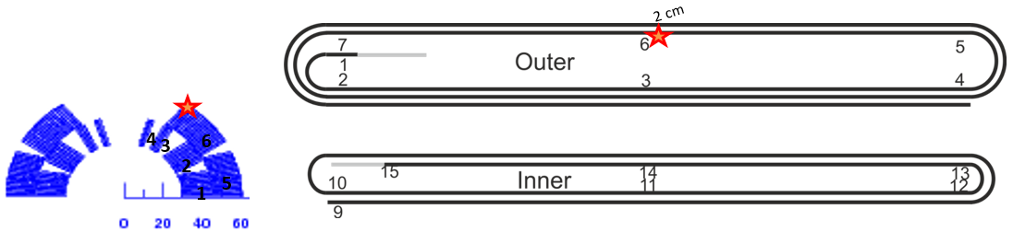
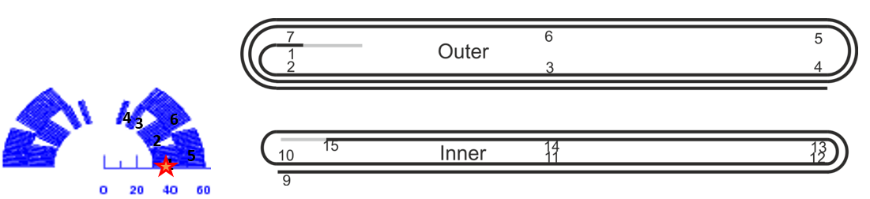
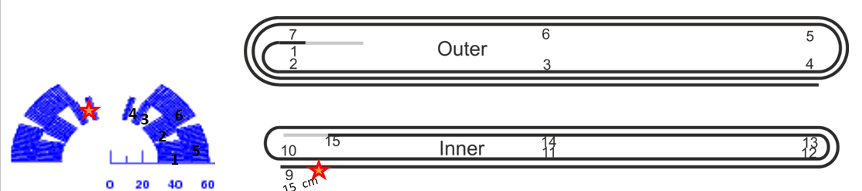
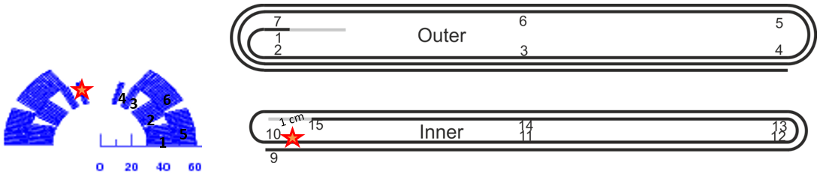
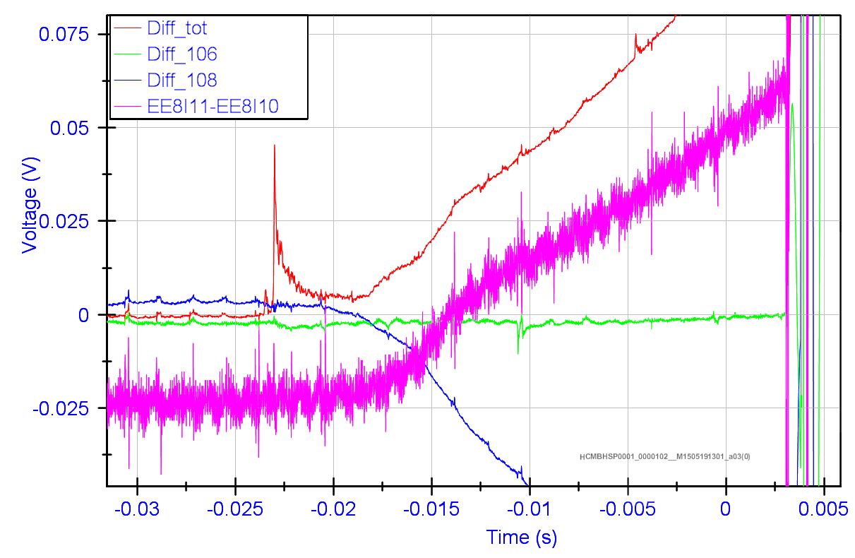
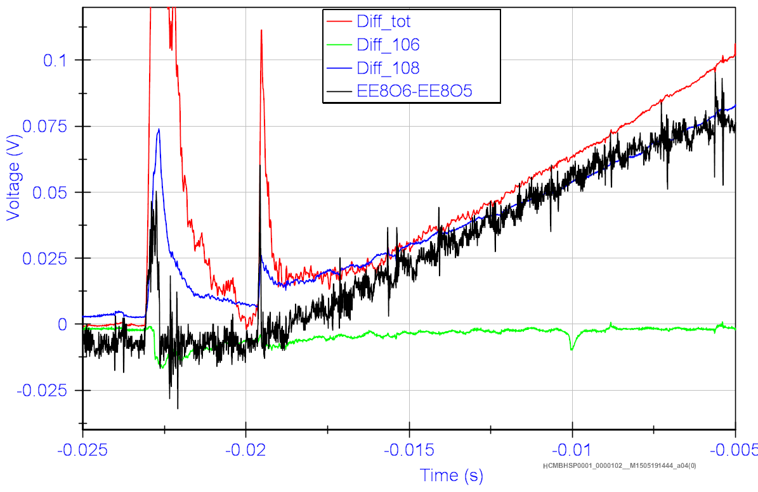
Training coil 108
4 quenches in coil 108:
Quench 1, 2, 7, 9
7
2
9
1
Large precursors in the two low-current quenches (8 and 9.2 kA)
4 different quench locations.

Slide 8
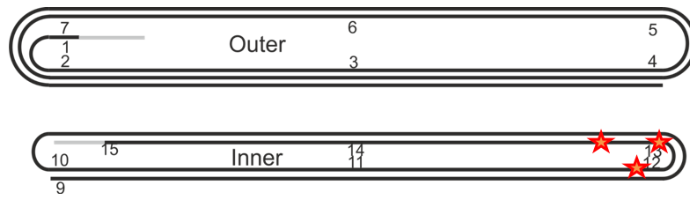
Training coil 106 – First 3 quenches
Quenches close to the head of the inner layer, high-field turn.
Confirms the quench location of the training of coil 106 in MBHSP101.

Slide 9
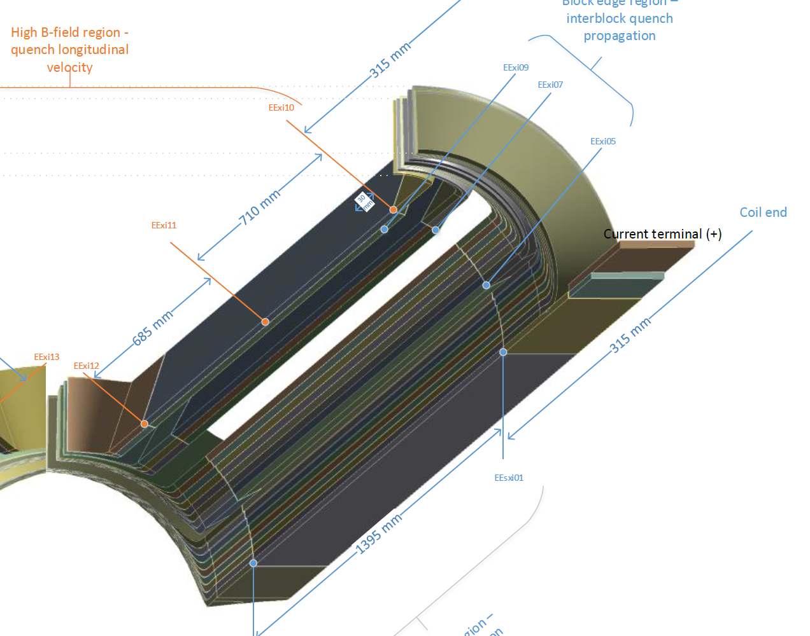
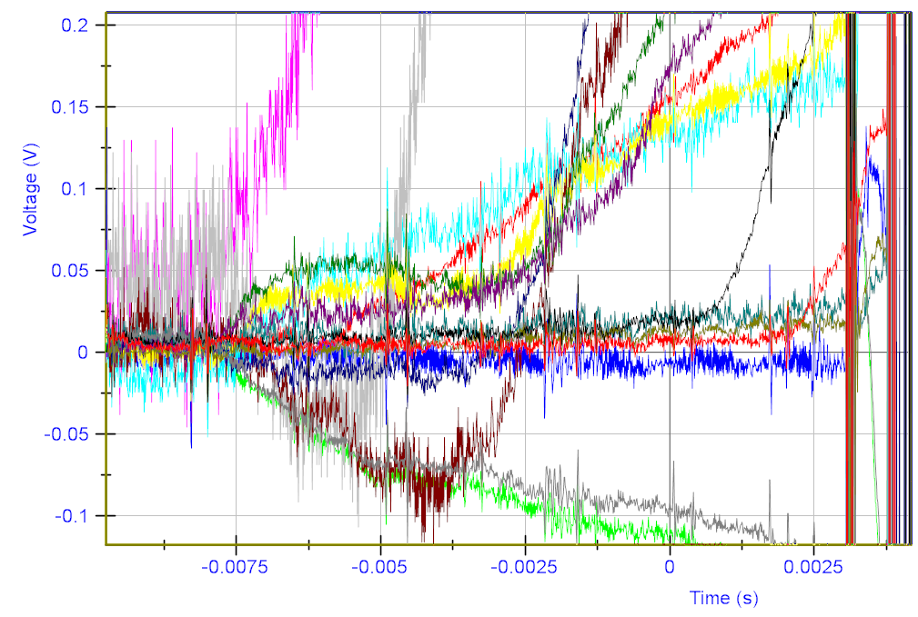
Training coil 106 – quench 8
Quench 8 was a “massive” quench:
In coil 106 the whole cross-section of the inner layer quenched within 1 ms at the coil head.
This was followed by a detraining in coil 108…
No special signals were seen in mechanical measurements, see presentation Christian

Slide 10
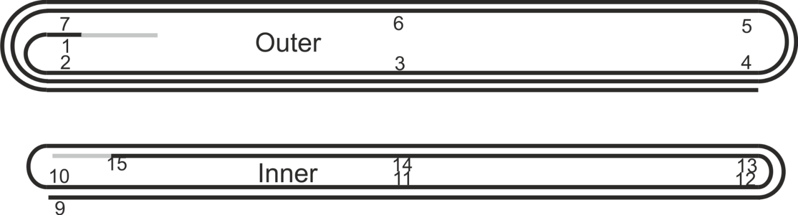
Training coil 106 – Further training and detraining at 1.9 K
Quench location overview coil 106
Different training location than the first 3 training quenches and the training in MBHSP101.

Slide 11
Training coil 106 – Powering at 4.3 K
At 4.3 K two identical quenches at identical temperatures. Seems to be the limiting point of the coil, but difficult to conclude on 2 quenches.
Detraining to 11.5 kA in the same region. Very similar quench pattern as the 1.9 K (de)training quenches.

Slide 12
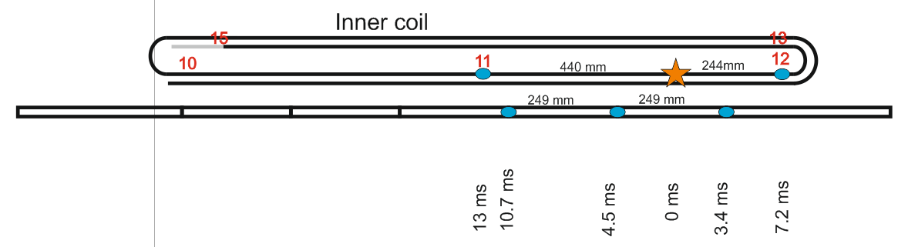
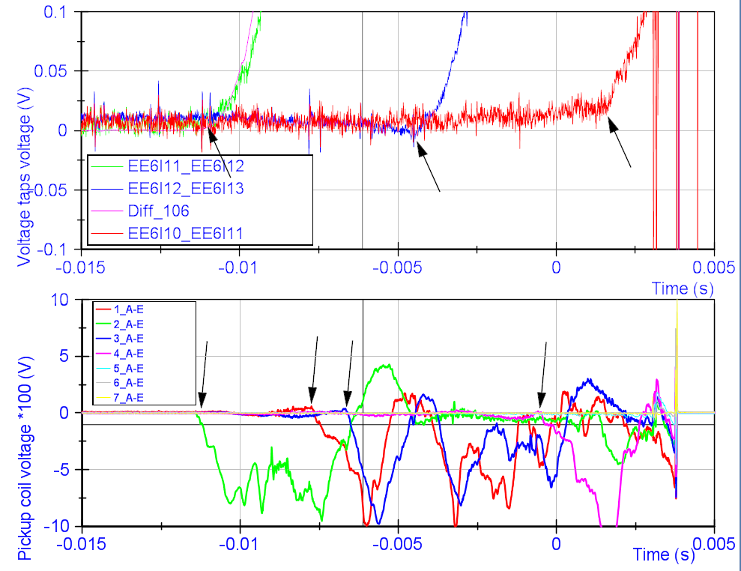
Quench localisation
Voltage taps
MM shaft
Onset time of signal
Voltage taps
MM segments
Very good agreement between the results for quench localisation.
Possibly more info can be extracted.
This will be a new standard measurement for the next series of tests.

Slide 13
Stability test/holding current test
10 hours at nominal current, followed by a magnetic measurement cycle and a ramp to 12.5 kA without quench.
2.5 hours at 12.3 kA, no quench.
Note the length of the test days from 8h to 20h
No sign of any instability

Slide 14
Ramp rate dependence
No quench at 200 A/s up to nominal current.
Quench at 300 A/s at 10.8 kA.
No further ramp rate dependence tests are done, considering:
quench back results
High ramp rate without quench
Limited test time

Slide 15
Magnetic measurements
3 flavours of magnetic measurements,
See presentation of Lucio next week for results

Slide 16
Resistance and RRR
Coil | Conductor | R _{Troom} (mΩ) | RRR
105 | RRP 108/127 | 422 | 95
106 | RRP 108/127 | 423 | 65
107 | RRP 108/127 | 422 | 75
108 | RRP 132/169 | 407 | 165
109 | RRP 132/169 | 400 | ??
111 | RRP 132/169 | 401 | ??
Data from electrical measurements in B927 at T_{room}, confirmed by measurements in SM18
Resistance from EESxOI to EESxOO, normalized to 293 K
Resistance at room temperature for 108/127 cables is 5 to 6 % higher.
RRR is much higher for coil 108 then 105, 106 and 107.
Splice resistances
3 out of 4 Nb₃Sn-NbTi joints are measured, result: 0.3 ± 0.1 nΩ

Slide 17
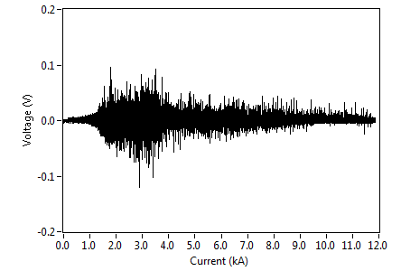
Flux jumps
Maximum peak -120 mV.
Measurement frequency 5 kHz
With a threshold of 50 mV, minimum validation time is needed of 5 ms if a single threshold and evaluation is taken for the full range.

Slide 18
Energy extraction tests – Quench back
EE switch opened, no QH firing. All resistance in the coil due to quench back.
Discharge from 11 kA, R_{EE} = 61 mΩ
Coil 106 and 108 have about the same start time of quench back, but resistance growth in coil 106 is much faster.

Slide 19
Quick conclusions
Small detraining of coil 106 up to nominal current
Rather fast training curve up to nominal current
Coil 108 only quenched 4 times.
Stable powering 10 hours OK.

Slide 20
Backup slides

Slide 21
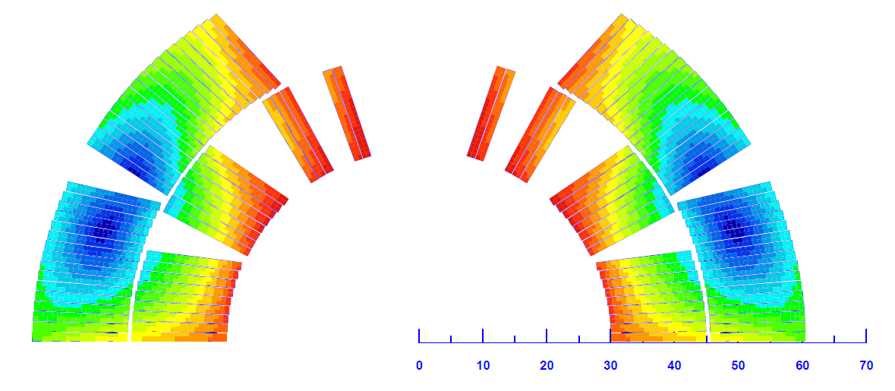
Training in the single coil HCMBHSM101- coil 105
Initial training 4.3 K mainly around the pole
Initial training 1.9 K mainly on outer block 6
Slight detraining after the thermal cycle for 1.9 K, not for 4.3 K.
The training is rather random without real ‘weak spots’.
Roxie image by
S. Izquierdo Bermudez

