Slide 1
HV-HR CMOS Detectors for FCC-ee (and also hh)
ITK

Slide 2
General considerations for Si tracking at FCC
FCC-ee
  Cost of present (planar pixels):
    Sensor 25-40 euro/cm2
    FE : 14 euro/cm2
    Bump-bonding : 40-45 euro/cm2
  Low amount of material <<1% X0 per layer
  Granularity : few μ pitch
FCC-hh
  Radiation hardness
  Low power (for cooling)

Slide 3
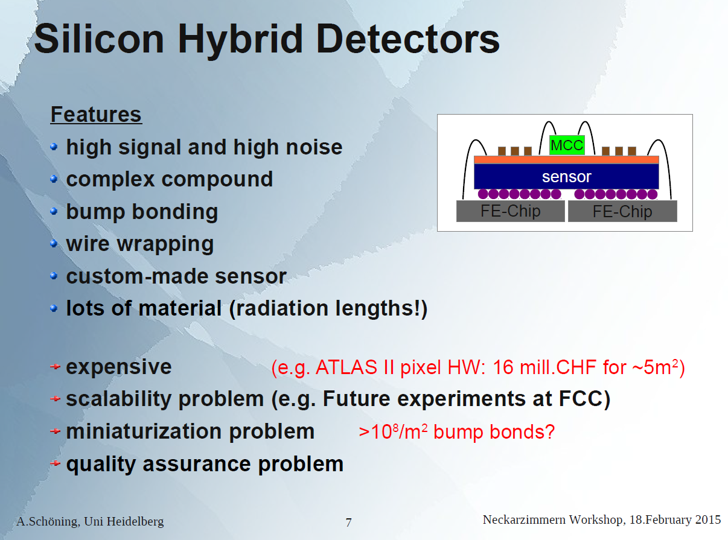

Slide 4
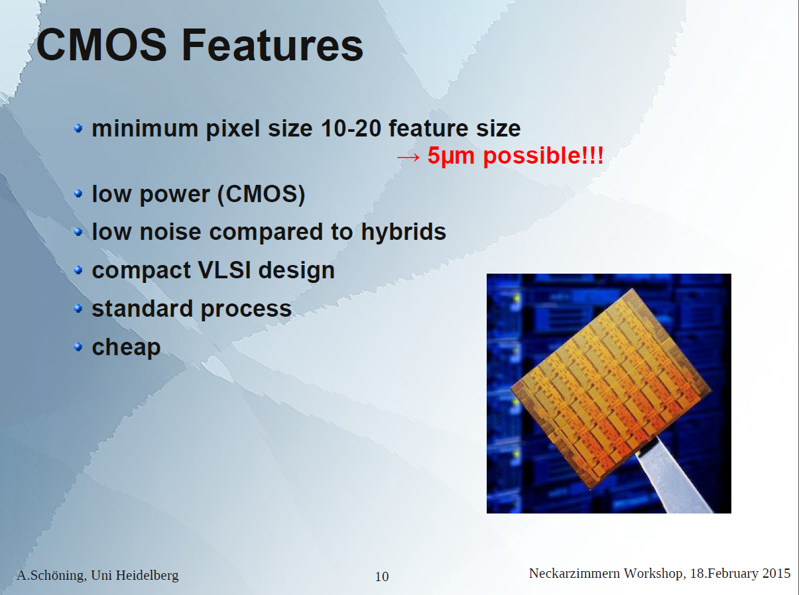

Slide 5
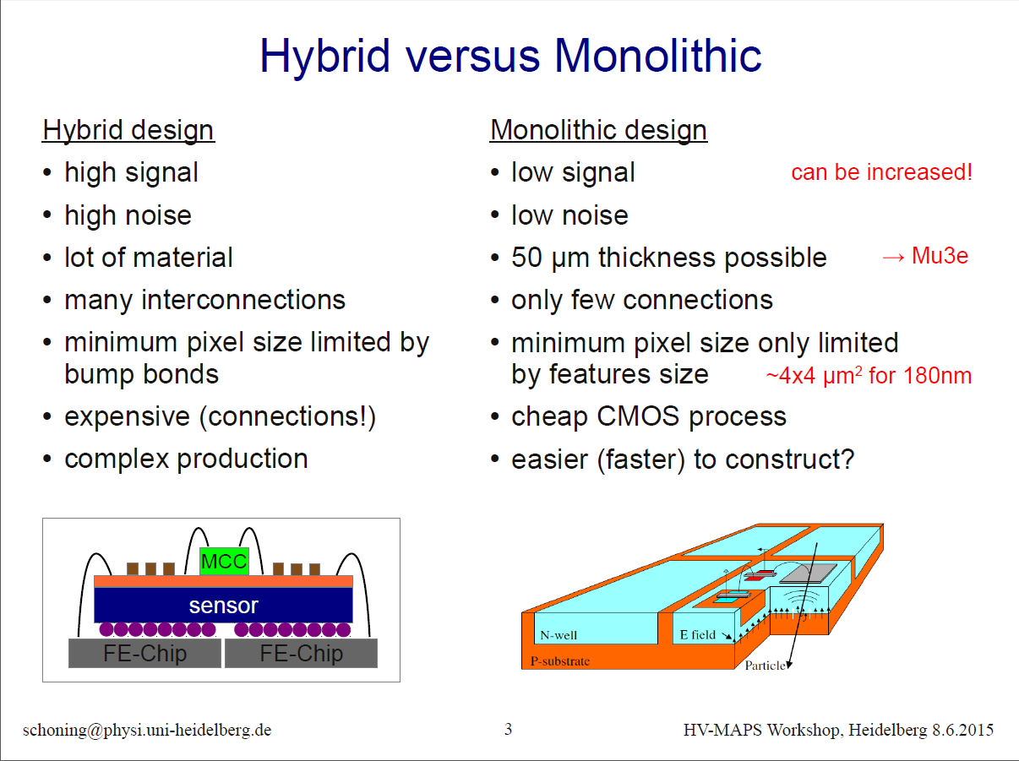

Slide 6
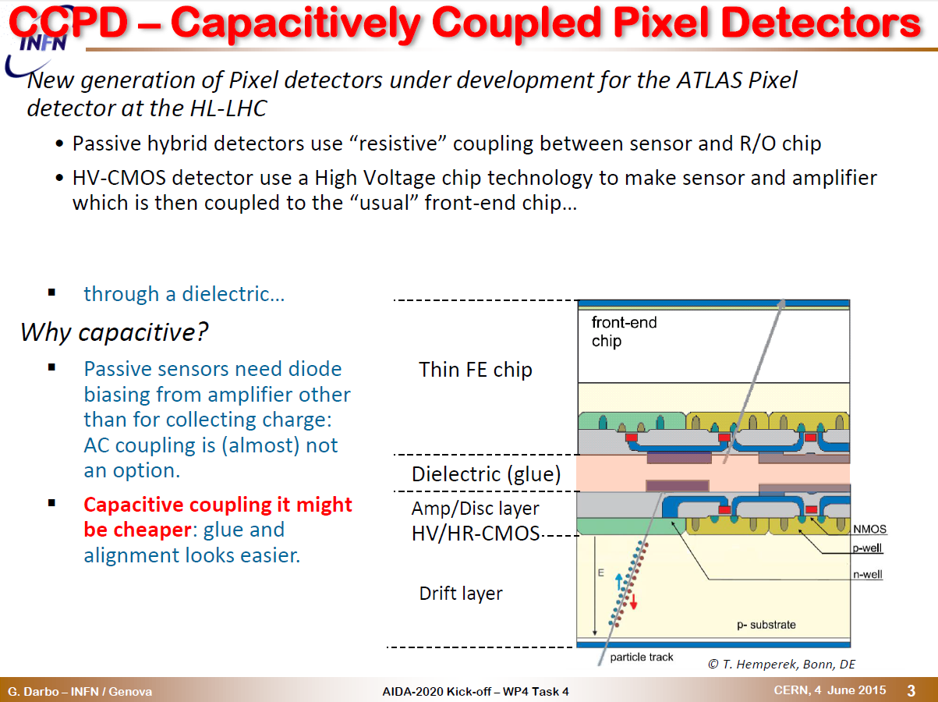

Slide 7
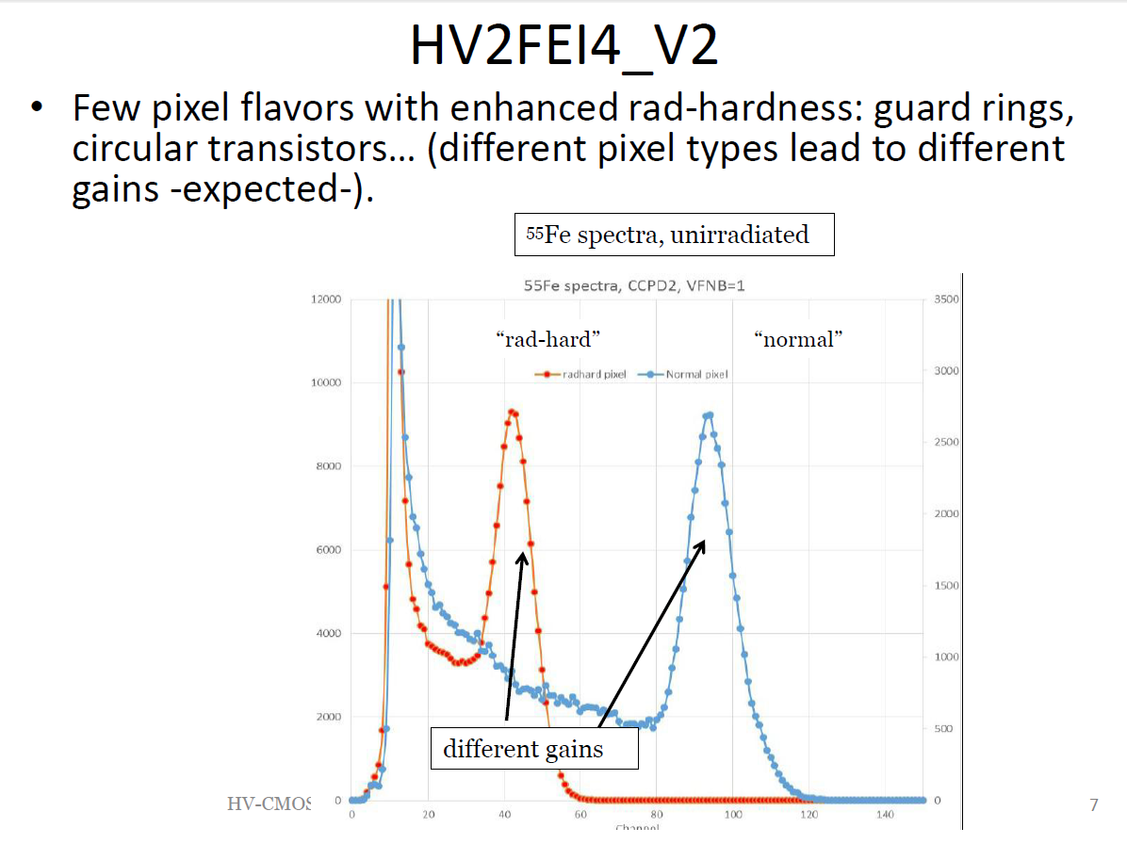

Slide 8
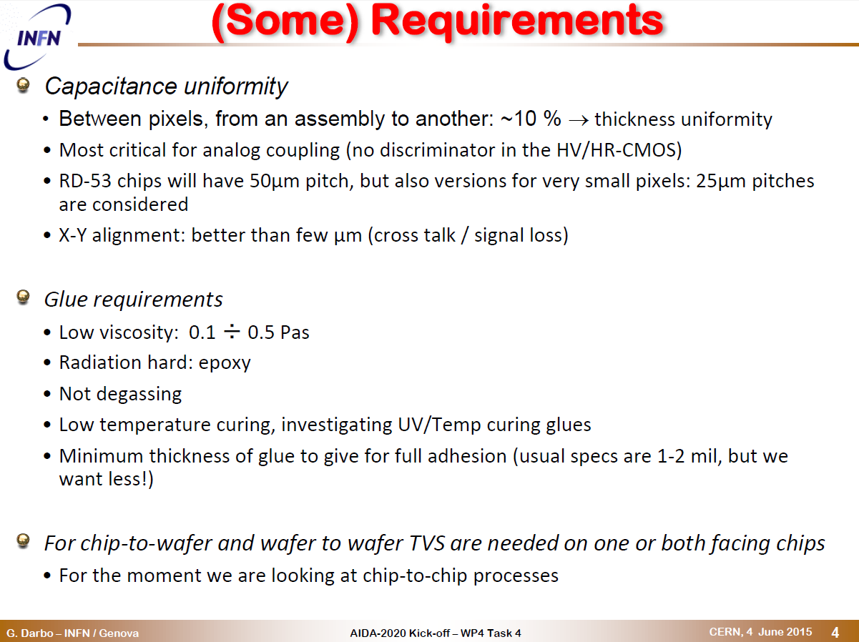

Slide 9
Irfu activities
Participation to the design of a 150 nm Lfoundry demonstrator chip (in HL-LHC context)
Interest to start R&D on the mechanical aspects of capacitive coupling
Expertise developed will be useful for FCC-ee
Monolithic pixels (HV-MAPS) best choice for FCC-ee, given low expected occupancy

Slide 10
