Slide 1
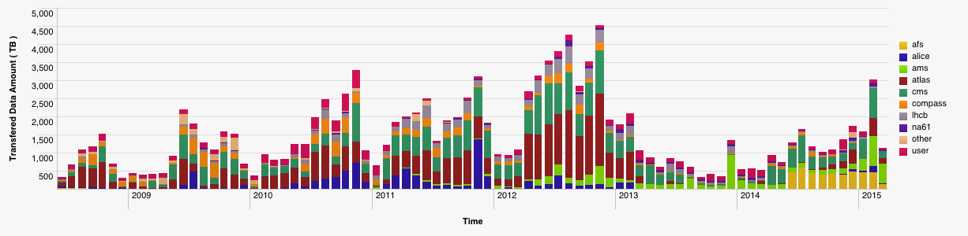
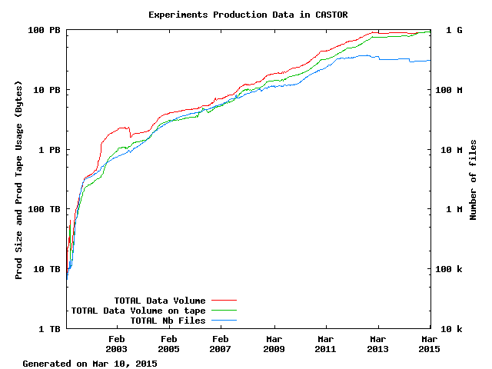
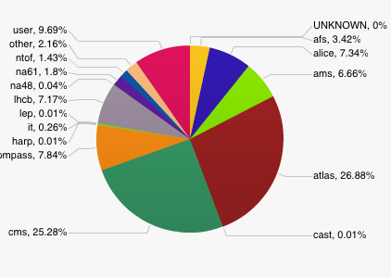
Scale of data today …
CERN New data
27 PB
Data:
~105 PB physics
data (CASTOR)
~7 PB backup (TSM)
Tape libraries:
IBM TS3500 (5)
Oracle SL8500 (4)
Tape drives:
~100 archive
Capacity:
~70 000 slots
~25 000 tapes
15 PB
23 PB
CERN Archive
>100 PB
1 billion files

Slide 2
CERN Data
Scientific data
  Large data sets (~1 PB/week during LHC running)
  Long (infinite) retention period
  High concurrency (1 LHC experiments: few 10³ physicists)
  Completely distributed infrastructure
    Physicists at universities (o(100) institutes)
    LHC Computing Grid (o(100) centres 20% at CERN)
      Enabled by massive data transfers
  Sharing
    Distributed analysis teams of tens of physicists
Computer centre infrastructure
  IT services built on storage infrastructure
    Notably Zenodo
CASTOR
EOS
FTS
CERNBox

Slide 3






EOS + CERNBox
Modern cloud storage interfaces
fused with Petabyte storage
fs
webdav
xroot
sync
share
mobile
web
EOS
ACLs
Namespace
Physical Storage

Slide 4
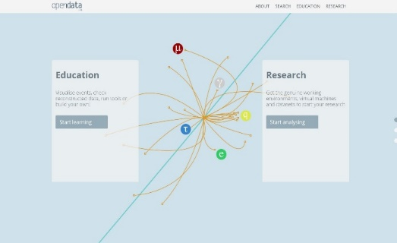

Open Data – Open Knowledge
CERN & the LHC experiments have made the first steps towards Open Data (http://opendata.cern.ch/)
  Key drivers: Educational Outreach & Reproducibility
  Increasingly required by Funding Agencies
  Paving the way for Open Knowledge as envisioned by DPHEP (http://dphep.org)¹
¹ICFA Study Group on Data Preservation and Long Term Analysis in High Energy Physics
CERN has released Zenodo, a platform for Open Data as a Service (http://zenodo.org)¹
  Building on experience of Digital Libraries & Extreme scale data management
  Targeted at the long tail of science
  Citable through DOIs, including the associated software
  Generated significant interest from open data publishers such as Wiley, Ubiquity, F1000, eLife, PLOS
¹Initially cofunded by the EC FP7 OpenAire series of projects

Slide 5
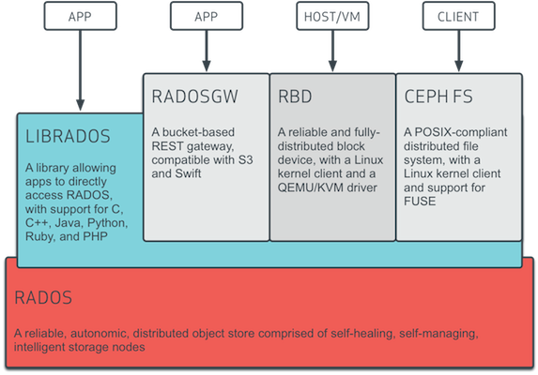
Ceph Architecture and Use-Cases

Slide 6
3PB of Ceph
47 disk servers/1128 OSDs
5 monitors
Dual Intel Xeon E5-2650
32 threads incl. HT
Dual 10Gig-E NICs
Only one connected
24x 3TB Hitachi disks
Eco drive, ~5900 RPM
3x 2TB Hitachi system disks
Triple mirror
64GB RAM
Dual Intel Xeon L5640
24 threads incl. HT
Dual 1Gig-E NICs
Only one connected
2x 2TB Hitachi system disks
RAID-1 mirror
1x 240GB OCZ Deneva 2
/var/lib/ceph/mon
48GB RAM
# df -h /mnt/ceph
Filesystem Size Used Avail Use% Mounted on
xxx:6789:/ 3.1P 173T 2.9P 6% /mnt/ceph

Slide 7
Deployment
Fully puppetized using forked upstream module: https://github.com/cernceph/puppet-ceph
Automated machine commissioning and maintenance
  Add a server to the hostgroup (osd, mon, radosgw)
  OSD disks are detected, formatted, prepared, auth’d
    Also after disk replacement
  Auto-generated ceph.conf
  Last step is manual/controlled: service ceph start
Mcollective for bulk operations on the servers
  Ceph rpm upgrades
  daemon restarts

Slide 8





Potential Use-Cases

Slide 9
Backup

Slide 10
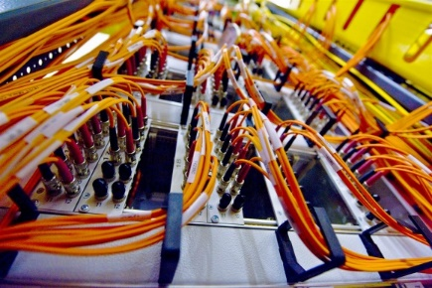
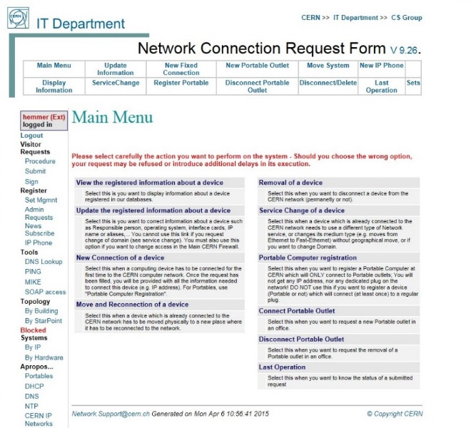
CERN Networks
Campus Network
  ~180,000 registered devices
  Servers, PCs, Macs, phones, tablets, …
  Structured Cabling: Over 65,536 UTP sockets
  Wi-Fi: ~1,600 access points, ~15,000 active devices per day
Technical and Experiment Networks
  Dedicated networks for safety, controls, cooling, electricity
  Filters access to/from the outside world
24x7 First line support through contractors
Significant investment in automation through custom developments
External Networking
  High speed links to Wigner Data Centre in Budapest, WLCG Tier-1 sites, Academic and Research networks, general Internet
  CERN Internet Exchange Point: ~40 companies interconnect at CERN
  (including K-Net)

