Slide 2

INFN Agile Immersion
Tim Bell
@noggin143

Slide 3
Logistics
Rooms
  Meetings in 600-R-001 both days
  Lunch at R2
  Toilets in building 513 near computer centre
Wifi
  Eduroam available
  Otherwise, fill out the form and put Tim Bell as the contact

Slide 4
Agenda
Details at https://indico.cern.ch/event/407658/
Small slots with a few questions already
  Intended to be very interactive
  Some slides for some sessions
  Feel free to ask anything further
I will also add links to the Indico page for extra information

Slide 5
Introductions

Slide 6
LHC Data Growth
Expecting to record 400PB/year by 2023
Compute needs expected to be around 50x current levels if budget available
PB per year
2010 2015 2018 2023

Slide 7
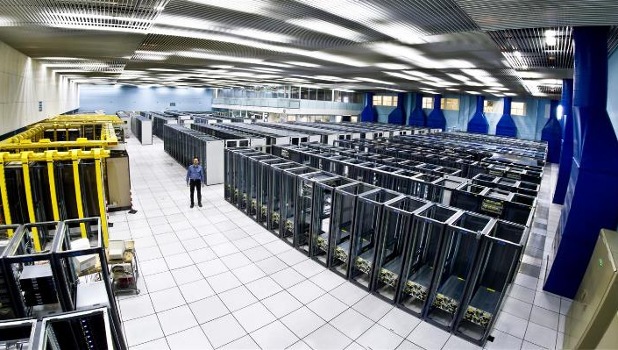
THE CERN MEYRIN
DATA CENTRE
http://goo.gl/maps/K5SoG
Notes:
Recording and analysing the data takes a lot of computing power.
The CERN computer centre was built in the 1970s for mainframes and crays. Now running at 3.5MW of power, it houses 11,000 servers but is at the limit of cooling and electrical power. It is also a tourist attraction with over 80,000 visitors last year!
As you can see, racks are only partially empty in view of the limits on cooling.

Slide 8
Public Procurement Cycle
Step | Time (Days) | Elapsed (Days)
User expresses requirement |  | 0
Market Survey prepared | 15 | 15
Market Survey for possible vendors | 30 | 45
Specifications prepared | 15 | 60
Vendor responses | 30 | 90
Test systems evaluated | 30 | 120
Offers adjudicated | 10 | 130
Finance committee | 30 | 160
Hardware delivered | 90 | 250
Burn in and acceptance | 30 days typical with 380 worst case | 280
Total |  | 280+ Days
Notes:
However, CERN is a publically funded body with strict purchasing rules to make sure that the contributions from our contributing countries are also provided back to the member states, our hardware purchases should be distributed to each of the countries in ratio of their contributions.,
So, we have a public procurement cycle that takes 280 days in the best case… we define the specifications 6 months before we actually have the h/w available and that is in the best case. Worst case, we find issues when the servers are delivered. We’ve had cases such as swapping out 7,000 disk drives where you stop tracking by the drive but measure it by the pallet of disks.
With these constraints, we needed to find an approach that allows us to be flexible for the physicists while still being compliant with the rules.

Slide 9
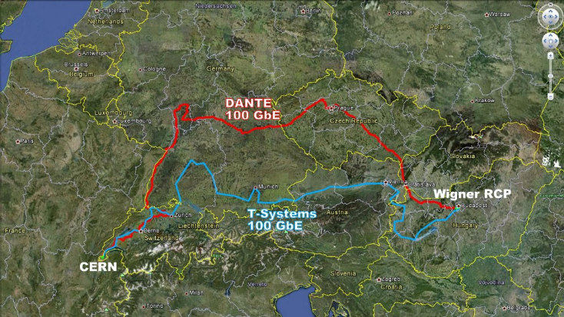

Slide 10
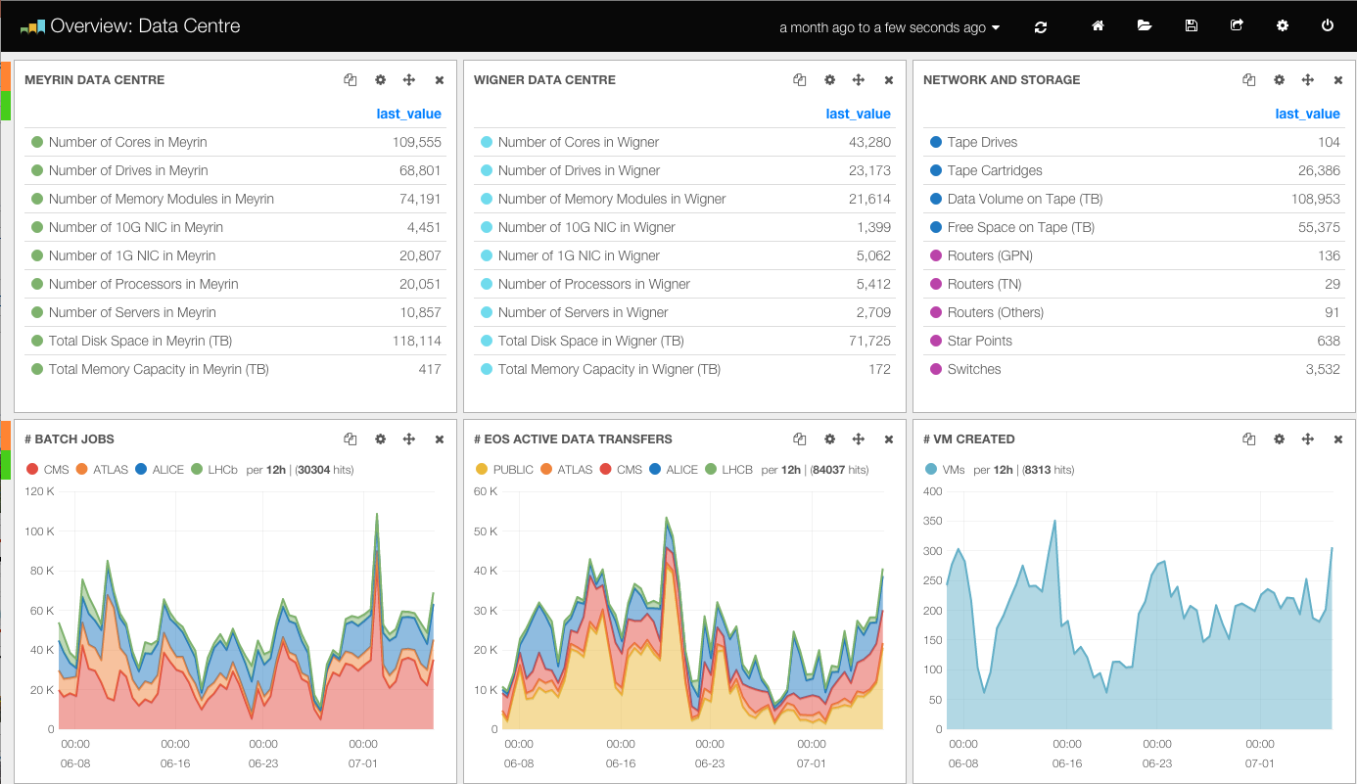

Slide 11
Good News, Bad News
Additional data centre in Budapest now online
Increasing use of facilities as data rates increase
But…
Staff numbers are fixed, no more people
Materials budget decreasing, no more money
Legacy tools are high maintenance and brittle
User expectations are for fast self-service
Notes:
With the new data centre in Budapast, we could now look at address the upcoming data increases but there were a number of constraints.
In the current economic climate, CERN cannot be asking for additional staff to run the computer systems.
At the same time, the budget for hardware is also under restrictions. The prices are coming down gradually so we can get more for the same but we need to find ways to maximise the efficicency of the hardware.
Our tools for management were written in 2000s, consist of 100,000 of lines of perl over 10 years, often by students, and in need of maintenance. Changes such as IPv6 or new operating systems would require major effort just to keep up.
Finally, the users are expected a more responsive central IT service… their expectations are set by the services they use at home, you don’t have to fill out a ticket to get a dropbox account so why should you need to at work ?

Slide 12
Innovation Dilemma
How can we avoid the sustainability trap ?
  Define requirements
  No solution available that meets those requirements
  Develop our own new solution
  Accumulate technical debt
How can we learn from others and share ?
  Find compatible open source communities
  Contribute back where there is missing functionality
  Stay mainstream
Are CERN computing needs really special ?
Notes:
We came up with a number of guiding principles…
We took an approach that CERN was not special. Culturally, for a research organisation this is a big challenge. Many continue to feel that our requirements would be best met by starting again from scratch but with the modern requirements.
In the past, we had extensive written procedures for sysadmins to execute with lots of small tools to run, These were error prone and often the guys did not read the latest ones before they performed the operation. We needed to find ways to scale the productivity the team to match the additional servers.
One of the highest people cost items was the tooling. We had previously been constructing requirements lists, with detailed must-have needs for acceptance. Instead, we asked ourselves how come the other big centres could run using these open source tools yet we had special requirements. Often, the root cause was that we did not understand the best approach to use the tools rather than that we were special.
The maintenance of our tools was high. The skills and experienced staff were taking up more and more of their time with the custom code so we took an approach of deploy rather than develop.
This meant finding the open source tools that made sense for us, trying them out. Where we found something that was missing, we challenged it again and again. Finally, we would develop in collaboration with the community generalised solutikons for the problems that can eb maintained by the community afterwards. Long term forking is not sustainable.

Slide 13


O’Reilly Consideration
Notes:
So how did we choose our tools ? There were the technical requirements are a significant factor but there is also the need to look at the community ecosystem.
Open source on its own is not enough.. Our fragile legacy tools were open source but were lacking a community. Typical example of this is the O’Reilly books.. Once the O’Reilly book is out, the tool is worth a good look.
Furthermore, it greatly helps to train new staff… you can buy them a copy and let them work it through to learn rather than needing to be guru mentored.

Slide 14
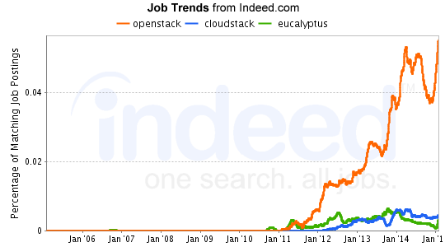
Job Trends Consideration
Notes:
CERN staff are generally on short term contracts, 2-5 years and come from all over the member states.
They come to CERN, often out of university or their 1st jobs. We look for potential rather than specific skills in the current tools.
After a time at CERN, they leave with expert skills and experience in our tools which is a great help for finding future job opportunities and ensuring motivation to the end of their contracts.

Slide 15











CERN Tool Chain

Slide 16
Upstream OpenStack on its own does not give you a cloud service
Packaging
Integration
Burn In
SLA
Monitoring
…
Metering and chargeback
Autoscaling
Monitoring and alerting
Remediation
Cloud is a service!
High availability
Config management
Scale out
Log processing
Infra
onboarding
Capacity planning
Metrics
OpenStack APIs
CI
Network design
Upgrades
Cloud monitoring
Builds
Net/info
sec
SLA
Alerting
Incident resolution
Customer support
User experience
Source: eBay

Slide 17
High Level Status
Production in time for Run 2
  Cloud
  Configuration Management
  Monitoring
Ramp up of capacity completing for 2015
Contributions upstream or in https://github.com/cernops

Slide 18
Backup

Slide 19
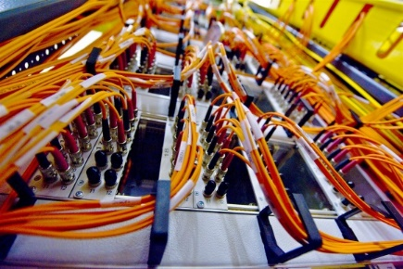
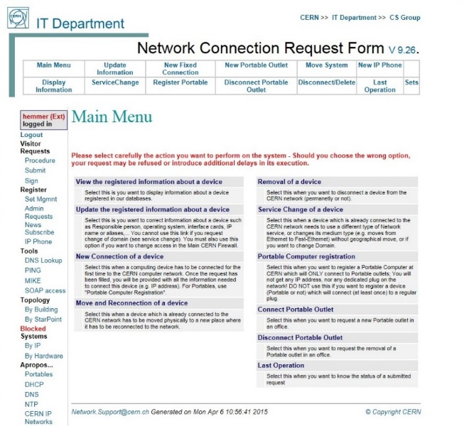
CERN Networks
Campus Network
  ~180,000 registered devices
  Servers, PCs, Macs, phones, tablets, …
  Structured Cabling: Over 65,536 UTP sockets
  Wi-Fi: ~1,600 access points, ~15,000 active devices per day
Technical and Experiment Networks
  Dedicated networks for safety, controls, cooling, electricity
  Filters access to/from the outside world
24x7 First line support through contractors
Significant investment in automation through custom developments
External Networking
  High speed links to Wigner Data Centre in Budapest, WLCG Tier-1 sites, Academic and Research networks, general Internet
  CERN Internet Exchange Point: ~40 companies interconnect at CERN
  (including K-Net)

