Slide 1
INFN & Cloud
CERN, 16-17 July 2015

Slide 2
Outline
INFN & Cloud
INFN – Corporate Cloud
Regional Experiences
  Bari DataCenter
  CNAF - T1 & Cloud@CNAF
  Padova - Cloud Area Padovana
Cloud users

Slide 3
INFN
INFN = Istituto Nazionale di Fisica Nucleare (National Institute for Nuclear Physics)
  Italian research agency dedicated to the study of the fundamental constituents of matter and the laws that govern them, under the supervision of the Ministry of Education, Universities and Research (MIUR).
  It conducts theoretical and experimental research in the fields of subnuclear, nuclear and astroparticle physics, in close collaboration with Italian universities.
    Strong experience and know-how also in cutting-edge technology and instruments. Among them, long-standing experience on HPC, distributed storage and computing (Grids and Clouds)
Strong focus also on technology transfer programs.
  Transfer of technologies and know-how to Italian and European companies, developed within INFN scientific programs.
2015-07-16

Slide 4
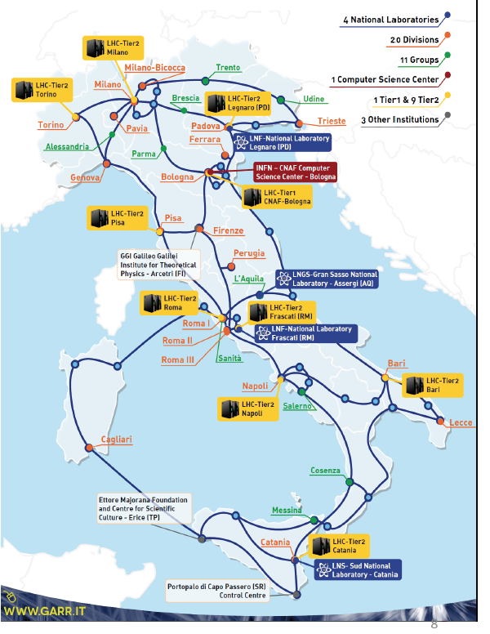
INFN sites
INFN sites
  About 30 among full INFN branches and collaboration groups hosted in university departments
  4 national laboratories: Catania, Frascati, Gran Sasso, Legnaro
  3 national centers:
    CNAF, National Center for Research and Development in Informatics and Telematics, Bologna
    GSSI, Gran Sasso Science Institute, L’Aquila
    TIFPA, Trento Institute for Fundamental Physics and Applications, a Trento
2015-07-16

Slide 5
INFN Computing
Heavily distributed nature
  Local computing groups
    day-to-day support to users and local services
  Centrally coordinated teams
    central services – mainly CNAF & LNF
Areas
  Local computing services at INFN sites (e.g. local networks, mailing, support for local users, …)
  Basic services and central services (e.g. network services, HA infrastructure, Authentication and Authorization Infrastructure, web servers, …)
  Computing for administrative services (Sistema Informativo)
  Big computing centres (Tier-1 and Tier-2’s) and distributed computing infrastructure (Grid)
  Computing in the experiments and in national and international projects
=> Largely benefitted from advancements in the technology, especially in the fields of distributed computing and virtualization techniques

Slide 6
INFN & Cloud Activities (2)
The INFN infrastructure must be, by its nature, inclusive, allowing the use of many resources as possible, also heterogeneous.
  Mechanisms of federation and orchestration to access at the IaaS level to different resources
Two documents In preparation phase :
  A strategy paper on the use of Cloud technology in INFN
    It should provide guidelines for the development of instruments and for integration into INFNs computing infrastructure of external and/or shared resources
    The aim is to optimize the management of resources
  A technical document on the architecture of the INFN-CC (INFN Corporate Cloud)
    a homogeneous infrastructure (based on Open Stack) localized in a limited number of sites, that implements systems of replication, distribution of functions and geographical high availability

Slide 7
INFN Corporate Cloud (1)
The INFN Cloud Working Group has now been active for almost three years within the INFN Commissione Calcolo e Reti (CCR).
  A number of projects related to Cloud Computing started in INFN thanks to the knowledge and expertise that were the outcome of the activity of the Cloud Working Group.
Since almost two years a restricted team, the INFN Corporate Cloud (INFN-CC) working group, has been planning and testing possible architectural designs for the implementation of a distributed private cloud infrastructure and realized a prototype
Overview
  INFN-CC is a multi-regional OpenStack installation
    some services are centrally managed and common to all regions while other services are local and associated to a single region.
    Based on a small number of sites (core) => 3
  The main goal -> standard IaaS interfaces to an homogeneous but distributed cloud environment focused on the deployment of highly available, distributed network services and applications

Slide 8
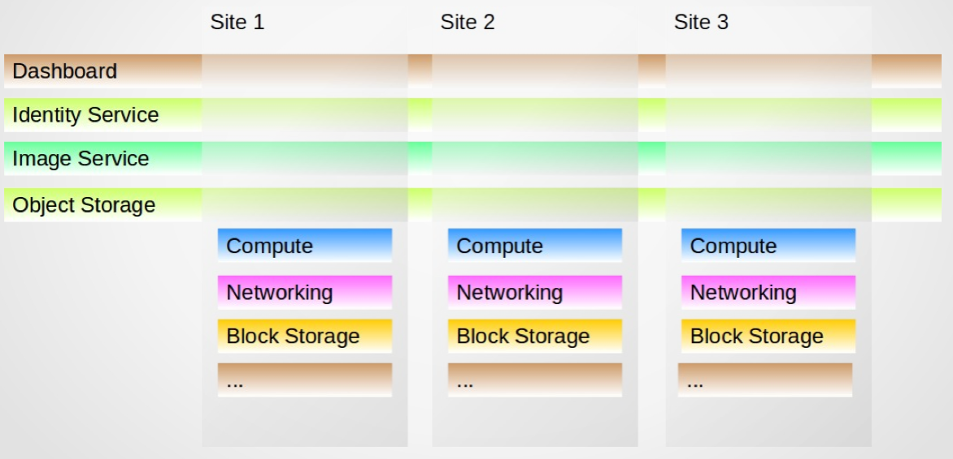
INFN Corporate Cloud (2)
Highlights
  Common, distributed Identity Service backed by the INFN AAI LDAP.
  Common, distributed Swift Object storage for
    VM image/snapshot repository
    Block device backup
    Personal data ….
  Common, distributed Image Service backed by the above Object Storage
  DNS HA + cloud.infn.it DNS domain
Working on:
Log collection and analysis
Infrastructure automation
Infrastructure management
Infrastructure monitoring (nagios → zabbix)
Deployment of use cases
Notes:
Percona XtraDB, HAProxy – load-balancer & HA Provider
DNA HA multimaster – dynamic
Use cases: - web sites and portals; - web based applications; - information/documentation/data sharing tools; - authentication/authorization services (kerberos, ldap, radius servers, IdPs);
- mail services, where performance requirements are satisfied on a virtualized environment; database services; - room booking, calendars; - test and development environments; - educational and training environments.

Slide 9
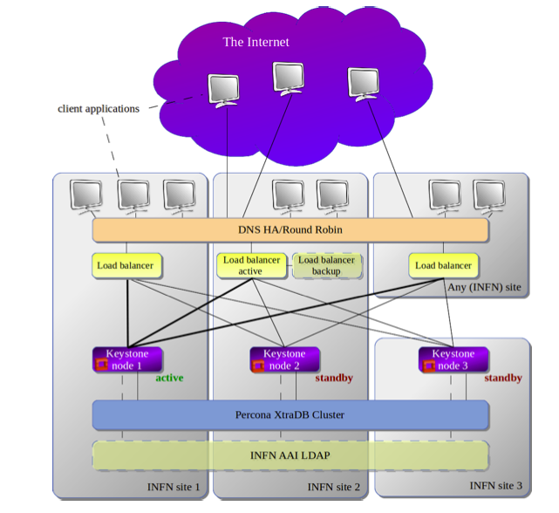
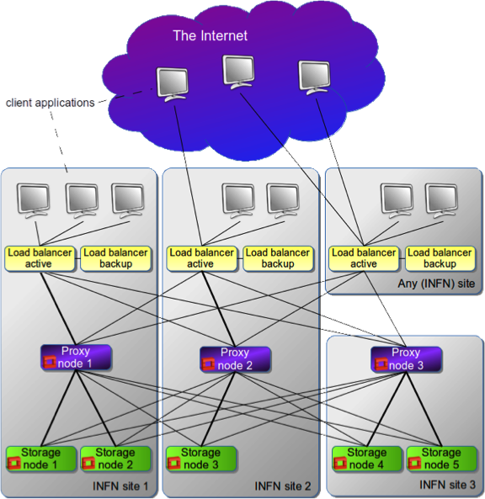
INFN Corporate Cloud (3)

Slide 10
BARI Cloud Activities

Slide 11
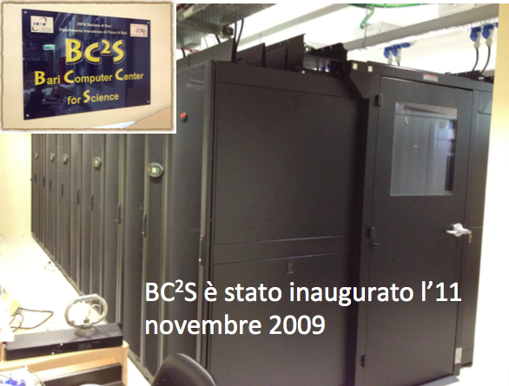
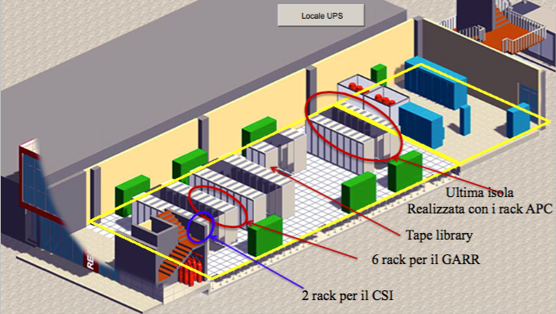
Bari: Bc²S => ReCaS D.C.
ReCaS:
CPU: 128 server (AMD) (36 INFN - 92 UNIBA) 8192 core (2304 INFN - 5888 UNIBA)
HPC:
  20 nodes ( 800 core)
    INFINIBAND connection
  20 Graphic NVIDIA Tesla K40
Storage:
  3552 TB - DELL (1152 INFN - 2400 UNIBA)
  IBM System Storage TS3500 Tape Library =~ 2500 TB (UNIBA)
Network:
  LAN flat-matrix, 10Gbs ,2 Huawey (active/passive)
Bc²S:
CPU: 4’000 Core=~250 nodes
GPU: 2 Tesla C2070
Storage:
  1’700 TB disk-space, single POSIX FS shared between all nodes (Lustre)
Network:
  each node ~1Gb/s bandwidth
Notes:
ReCaS – 4 D.D. BA, CT, Cosenza, NA – INFN, UNINA, UNIBA 13.7 Meuro 01.10.2011 – 22.07.2015

Slide 12
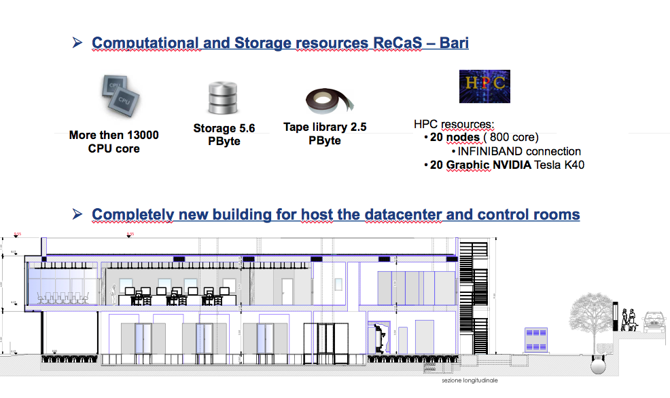
Bari New Data Center

Slide 13
Bari Cloud Activities (1)
HardWare:
  HUAWEI CE 12800
  Host directly connected with the core switch at 10 GB
  Host multi disk used for cloud storage
Provisioning
  Foreman
Deployment tool
  Puppet
Openstack deployment
  Private cloud to provide local services
  Public cloud to support several projects in which are involved
Deployment details
  MySQL backed consolidated with galera cluster
  Rabbitmq AMQP backend running in cluster mode
  HAproxy as endpoint frontend
  VLAN tenant network
  linuxbridge
  No Neutron L3 agent
  CEPH RBD used as backend for Glance, Cinder and Nova

Slide 14
Bari IaaS: EGI Fed Cloud instance
Born within a national project is now used by several diverse use-cases
Both within EGI Fed Cloud and locally
Actual size of the cloud infrastructure:
  INFN-Bari/UNIBA
    600 CPU/core
    3TB di RAM
    110 TB replica 3
    10 Gbit/s internal network
    10 Gbit/s external network
    256 Public IPs

Slide 15
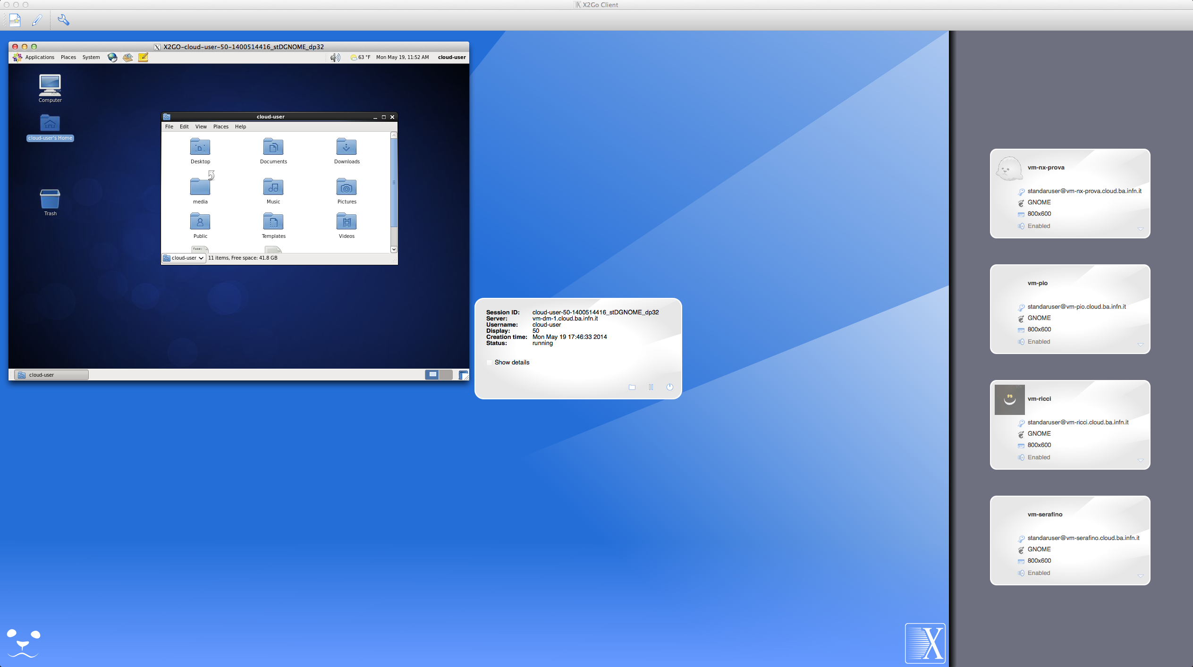
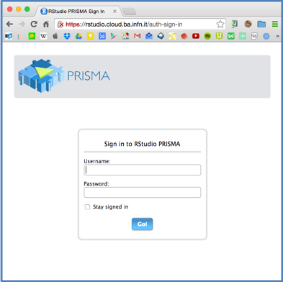
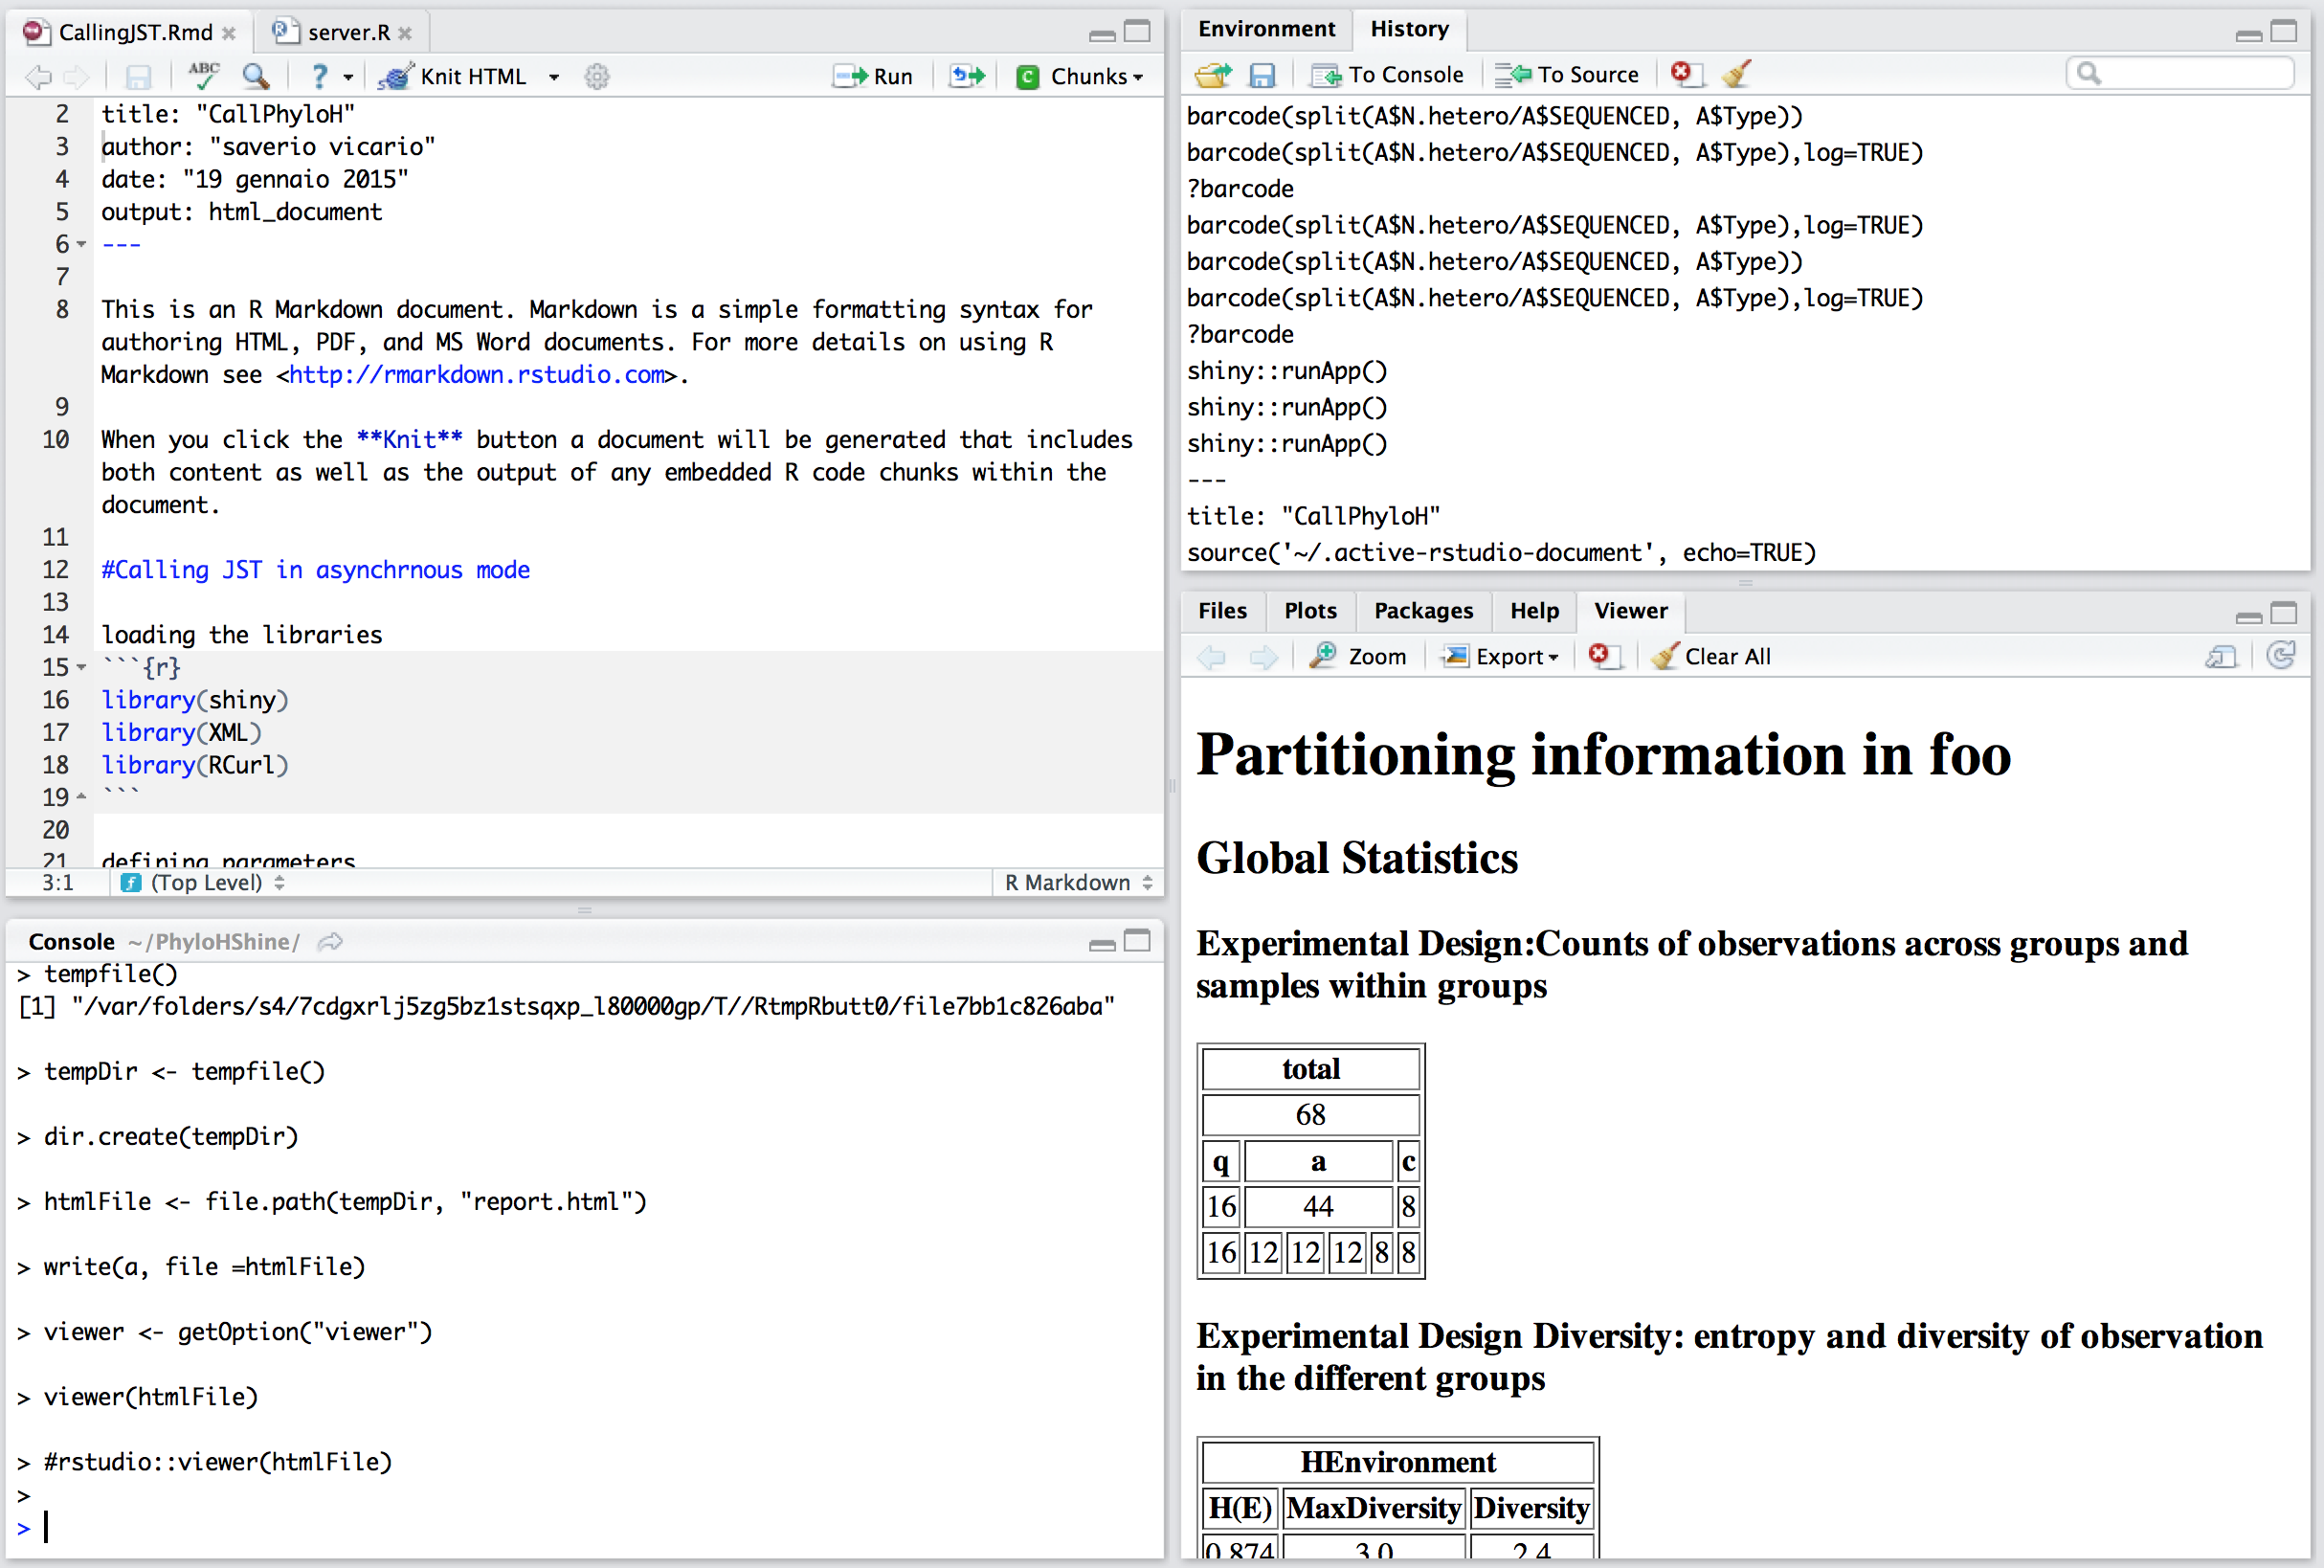
Bari: PaaS
Desktop as a Service
RStudio as a Service

Slide 16
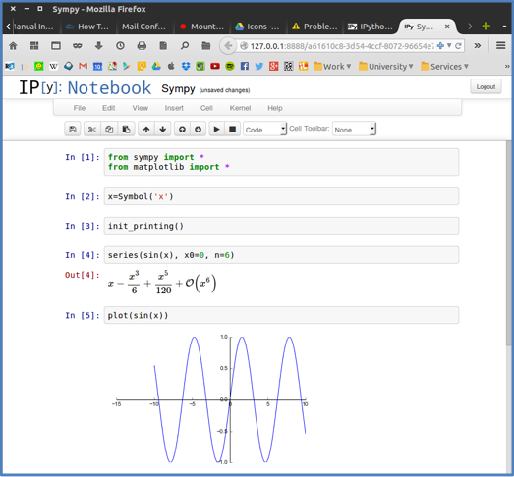
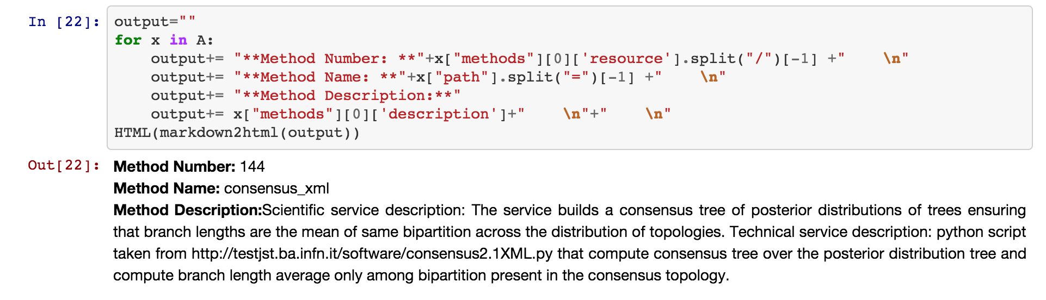
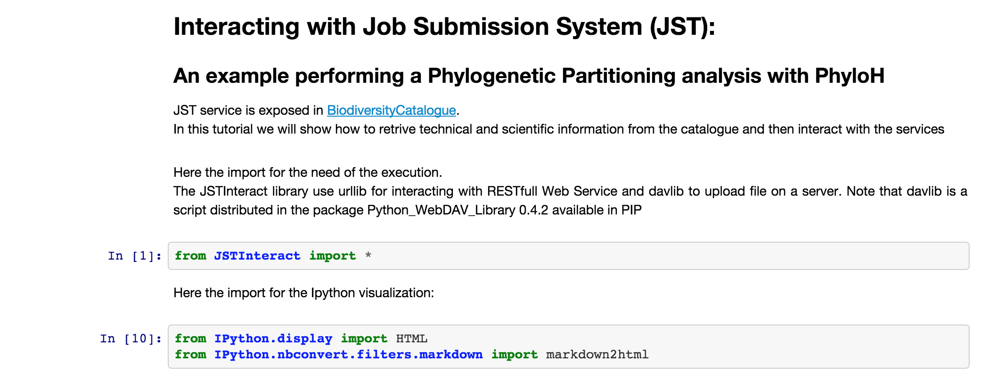
Bari PaaS: iPython as a Service

Slide 17
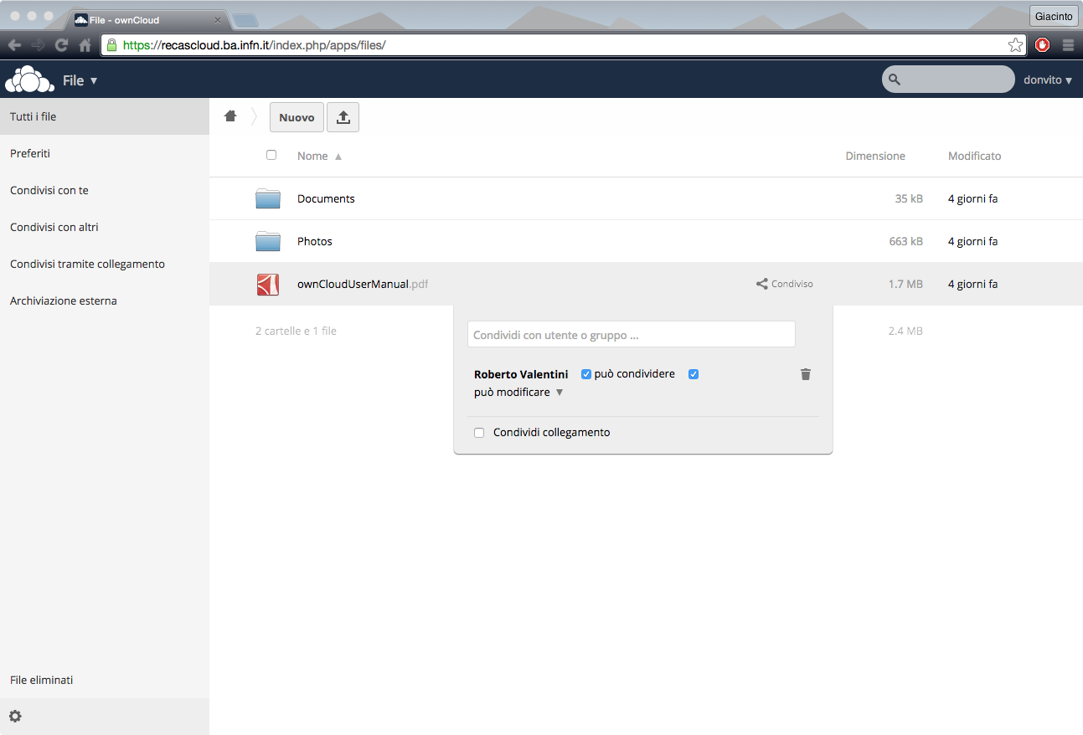
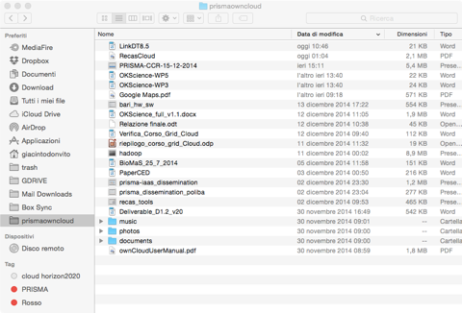
Bari PaaS: Personal Storage as a Service

Slide 18
CNAF Data Center & Cloud Activities

Slide 19
The Data Center
The Data Center staff (a.k.a. Tier-1) manages the basic services
  Facilities
  Network (including the main GARR PoP)
The Data Center hosts several computing services:
  The scientific computing
    WLCG Tier-1
    Computing center for several experiments
    LHCb Tier-2
    Tier-3 (co-managed with INFN Bologna)
    HPC cluster
  INFN ICT national services
  The infrastructure grid services
managed
by DC staff
operated by other groups
2015-07-16

Slide 20
The Data Center
It is the main INFN computing centre providing computing and storage services to ~30 scientific collaborations
Tier-1 for LHC experiments (ATLAS, CMS, ALICE and LHCb)
  Particle physics at accelerators
    Kloe, LHCf, CDF, Agata, NA62, Belle2 (formerly also Babar and SuperB)
  Astro and Space physics
    ARGO (Tibet), AMS (Satellite), PAMELA (Satellite), MAGIC (Canary Islands), Auger (Argentina), Fermi/GLAST (Satellite)
  Neutrino physics
    Icarus, Borexino, Gerda, Opera, Cuore (Gran Sasso lab.)
    KM3NeT (underwater)
  Dark Matter search
    Xenon, DarkSide (Gran Sasso lab.)
  Gravitational waves physics
    Virgo (EGO, Cascina)
  Gamma Ray Observatory
    CTA, LHAASO
  More (LSPE and EUCLID..) in a near future?
2015-07-16

Slide 21
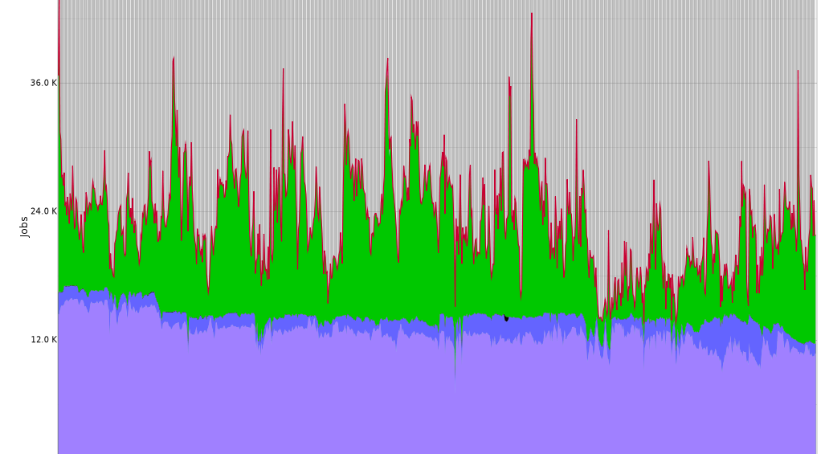
Services and resources: HTC
WLCG Tier-1 standard services offered to all users/scientific collaborations
  CPU resources assigned according to fair share mechanism
  Non grid access supported
  Cloud access under evaluation/test
1 general purpose farm
  Currently ~ 190 KHS06 (~13K job slots)
  ~100K jobs/day
2015 CPU shares
2015 CPU pledges
Farm usage: April 2014 – April 2015
2015-07-16

Slide 22
Services and resources: storage
Standard HSM service for all experiments
  GEMSS (Grid Enabled Mass Storage System)
  Both local and grid access
  Standard protocol set (file, GridFTP, XrootD, http/webdav)
Currently ~17 net PB of disk and ~20 PB of tapes
  1 tape library with 10000 slots (currently up to 85 PB capacity)
Oracle Database services
  Atlas calibration database and (near future) CDF databases for LTDP
  Lemon, Grid-console, VOMS devel, (FTS)
2015-07-16
2015 Disk pledges
2015 tape pledges

Slide 23
Services and resources: HPC
(Small) HPC cluster also available
  24 nodes, 800 cores (~10 Tflops)
  17 GPUs
  3 Intel Xeon Phi
  Nodes interconnected via Infiniband
  Operated with same tools as the generic farm
  Dedicated GPFS storage (70 TB-N)
Pilot project started in Jan 2014, now in production phase
  Cluster used at 80% on average, with a total of about 10k jobs.
Main users: theoretical physics groups (particle acceleration and laser plasma acceleration simulations)
Interest expressed also by Virgo, Atlas etc…
~20 TFlops (dbp)
2015-07-16

Slide 24
What we’d like to focus on during this meeting
Datacenter extension on Wide Area
  Wigner model ?
    Network Requirements
    Storage Infrastructure
    Resources Management tools
      Nodes Installation
      Nodes management
  Opportunistic use of commercial cloud providers
    Which use cases?
    Which data access model?
Cloud access to computing and storage resources
  How it is managed
    Authorization and Authentication (Responsibility delegation?)
    Tenants isolation
    Flexibility on resources allocation between CLOUD and GRID access modes
Jobs traceability
  Identification of real owner of a job (During the execution and after the job termination)
2015-07-16

Slide 25
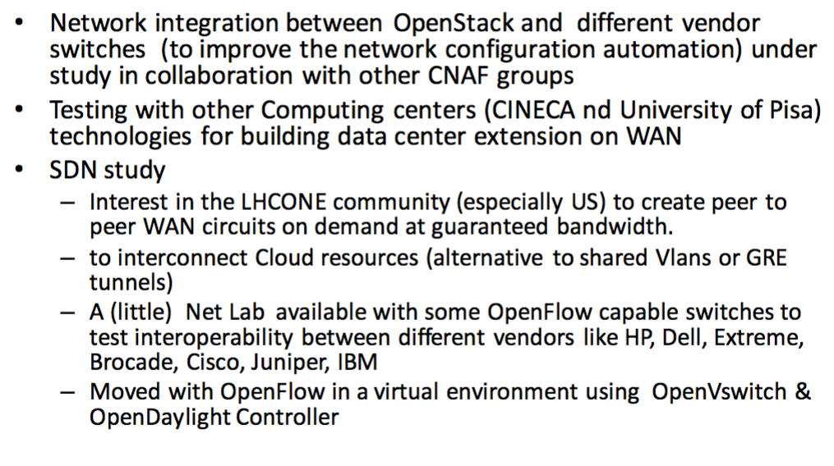
T1 Networking – Experimental
2015-07-16

Slide 26
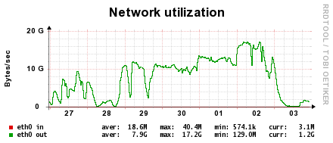
T1 Data Management & Storage
Storage at CNAF is constantly growing as in all other Tier1 at average rate of about 2PB/year, and we are expecting to have almost 18PB of disk storage by year 2016
Operational Conditions
  4 LHC and more than 20 other HEP experiments
  ~18 PB of data online and 19 (35 by the end of 2015) PB near-line (tapes)
  Accessed from 13K concurrent processes
  Aggregated data bandwidth to storage ~ 80 GB/s
    Actually observed:
      on LAN ~ 20 GB/s
      (17 GB/s from CMS)
      and WAN, ~ 2 GB/s
      (saturating 2x10Gbit
      WAN uplinks)
2015-07-16

Slide 27
T1 Data Management & Storage
GPFS = Software Defined Storage
“Why you are using GPFS? It’s boring, it just works…”
GPFS is actively evolving
  3 Major releases in last three years
  Incorporated New architectural approaches
    Hadoop-like: SNC (Shared Nothing Cluster, use of DAS)
    RAIN-like: Native RAID (usnig IBM’s JBOD, commercialized as GSS)
    Geographically distributed: AFM (with local cache, AFS-like)
    Local read-only cache on clients (RAM extension to a SSD)
    Integration with OpenStack (Native support in Glance, Cinder and Swift
IBM GPFS and TSM operational costs
  TSM 25-30K€/year (including CNAF backup service)
  GPFS ~50K€/year (for all INFN sites, “Campus Grid license”)
2015-07-16

Slide 28
T1 Data Management & Storage
Mass Storage System
HSM: GEMSS (Grid Enabled Mass Storage System)
  Integration of IBM GPFS and TSM + specific customization and the SRM interface StoRM
  Very good performance and efficiency
TSM server – core of MSS system
  Current version does not support redundant server configuration
    Using “warm” spare server with shared storage
  New TSM server with FC16 HBA
    Throughput to 900MB/s during re-pack and data migration
  Upgrade to new TSM version (7.1) in under way
    New version supporting “Active-passive” server config with automatic failover
2015-07-16

Slide 29
CNAF T1 & Cloud Activities (1)
Provision and evolution of a Cloud infrastructure to provide virtual services (CPU, storage, database, networking, …) for various use cases
Investigation, together with the Tier-1, on how to better integrate Grid-based and Cloud-based services
Participation & coordination of major national and international projects (OCP, INDIGO)
2015-07-16

Slide 30
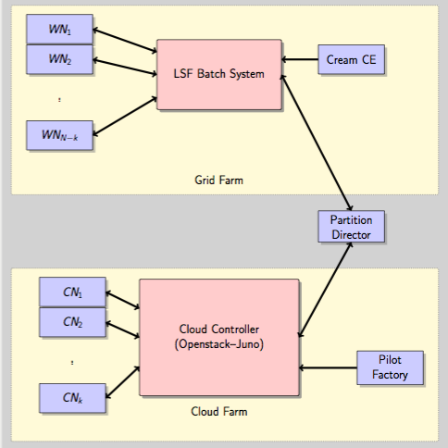
CNAF T1 & Cloud Activities (1)
Cloud Partition
Collaboration with the Tier-1
Dynamically assign nodes belonging to the Grid-enabled Tier-1 farm to a Cloud infrastructure
The partition director uses a dynamic partitioning mechanism similar to the one deployed at the Tier-1 for the provisioning of multi-core resources
2015-07-16

Slide 31
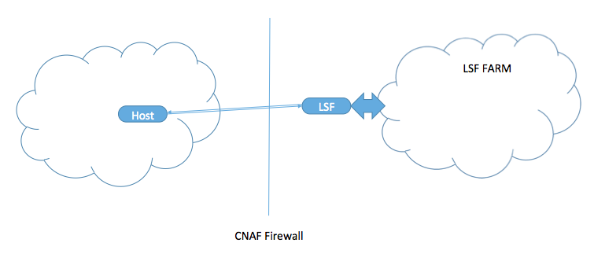
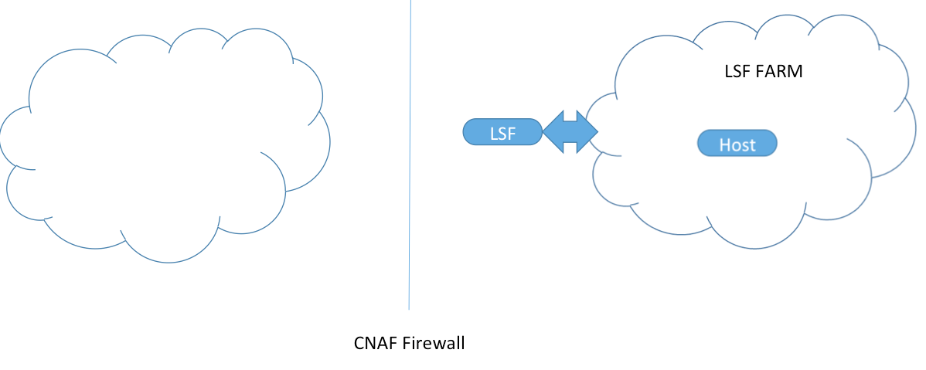
CNAF T1 & Cloud Activities (2)
Dynamic Farm
Collaboration with the Tier-1 and INFN Pisa
Extend the Tier-1 Farm with resources available outside CNAF
Define a VM image that, when run, connects to the Tier-1 LSF batch system and becomes a worker node.
Prototype available
  ARUBA: VMware based computing centre in Arezzo. It offers spare cpu&resources.
    When they need resources, virtual CPUs are slowered down to few MHz.
  Running CMS production multicore jobs there
Evaluating similar solutions, docker based.
2015-07-16

Slide 32
Cloud@CNAF
More recently investigation and implementation of a general-purpose infrastructure based on OpenStack
  Started in the MarcheCloud project (mid-2012-2013)
CNAF-wide initiative, to cover multiple use cases
  Provisioning of VMs for internal research activities
  Provisioning of VMs to other services, e.g. Jenkins slaves
  Provisioning of VMs to experiments, e.g. CMS and ATLAS
  Participation to an INFN-wide repository of VMs
  Support for other projects, e.g. EEE and !CHAOS
  Support for demos, seminars and tutorials
2015-07-16

Slide 33
Cloud@CNAF (1)
    Havana
    1 Controller Node
      Keystone, Glance (LVM) , Heat, Horizon, Ceilometer, MySQL, QPID
      2x8 HT (32) Intel(R) Xeon(R) CPU E5-2450 0 @ 2.10GHz, 64 GB di RAM
    1 Network Node
      Neutron con OVS + VLAN
      2x6HT (24) Intel(R) Xeon(R) CPU E5-2450 0 @ 2.10GHz, 64 GB di RAM
    4 x Compute Node
      Nova per KVM/QEMU
      2 x 8 core AMD con 64 GB RAM per nodo (tot: 64 core e 256 GB di RAM)
    Shared Storage (PowerVault + 2 server GPFS)
      16 TB onGPFS for Nova backend
    1 Web Proxy per la dashboard
    Juno
    2 x Controller Node – HA active/active
      Keystone, Heat, Horizon, Ceilometer, Neutron server, Trove
      HAProxy & Keepalived x API
      Glance & Cinder
    2 x Network Node – HA active/active partial (DHCP agent in active/active, L3 agent in hot standby)
      Neutron con LinuxBridge + VLAN
      2x6 HT (24) Intel(R) Xeon(R) CPU E5-2450 0 @ 2.10GHz, 64 GB di RAM
    13 x Compute Node = 208 CPU + ~814 GB RAM
      Nova per KVM/QEMU, LinuxBridge agent
      2 x 8 core AMD Opteron 6320 @ 2.8GHz con 64 GB RAM
    Shared Storage (PowerVault + 2 server GPFS)
      16TB on GPFS for Nova (instances), Glance (images), Cinder (volumes) backends
    1 Web Proxy for the Dashboard
    3x Percona XtraDB, RabbitMQ, MongoDB, ZooKeeper
    2x HAProxy for Percona (failover, no roundrobin!)
2015-07-16

Slide 34
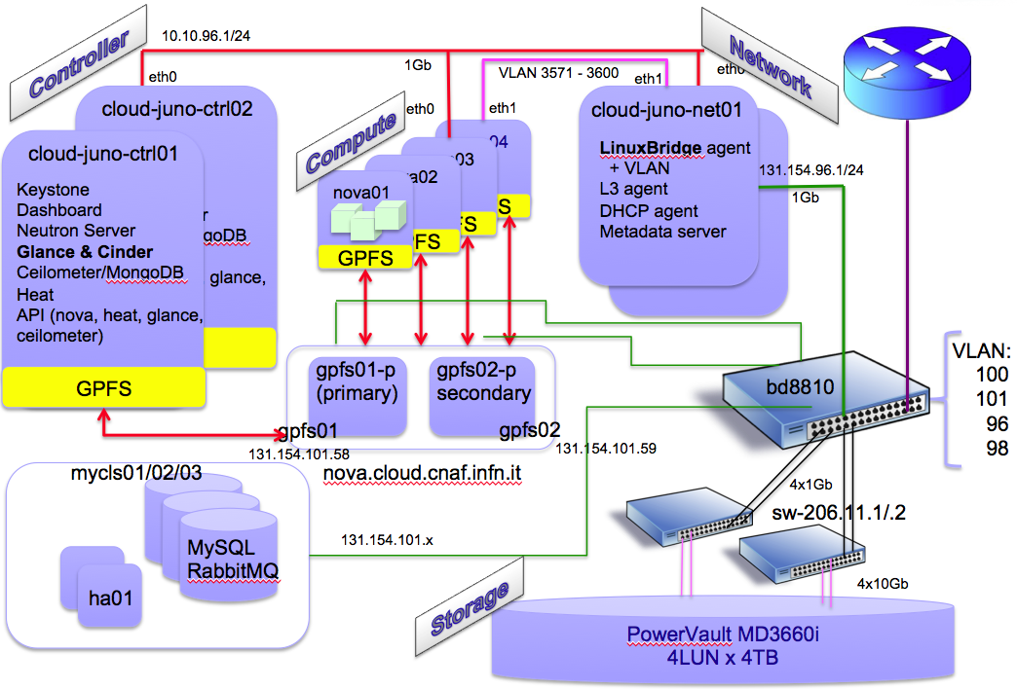
Cloud@CNAF
2015-07-16

Slide 35
Cloud@CNAF
    Tools:
      CNAF Provisioning ( see later slides) – Foreman, Puppet, …
      Rally
    Planned steps:
      Define an adequate networking policy for external access
      Make the infrastructure production-ready
      Implement a seamless upgrade procedure, compatible with the fast release cycle of OpenStack
      Integrate this infrastructure into the INFN-wide “Corporate Cloud”
2015-07-16

Slide 36
CNAF - Provisioning
Purpose
  Supply the node lifecycle management service based on the Foreman/Puppet duo
Users
  All the different CNAF node admins
Activities
  Setup and operate provisioning infrastructure
2015-07-16

Slide 37
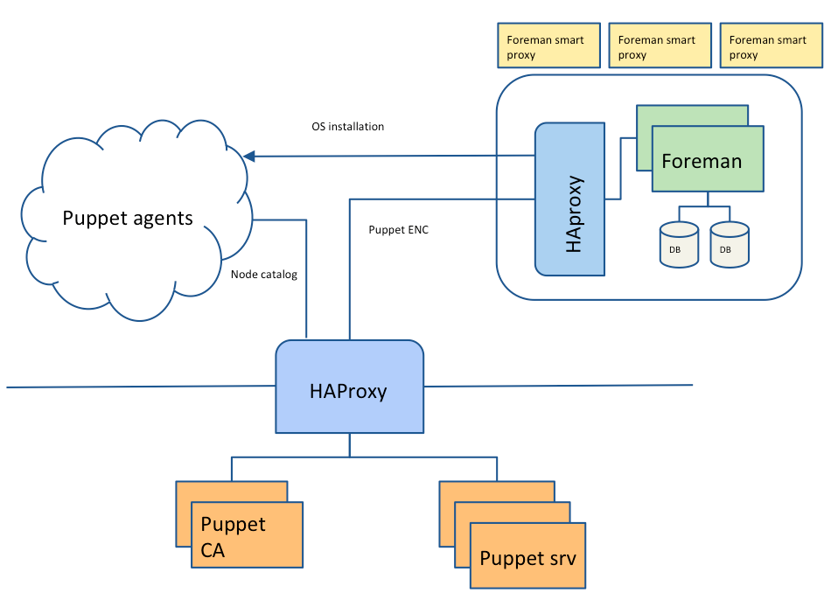
CNAF Provisioning - Architecture
2015-07-16

Slide 38
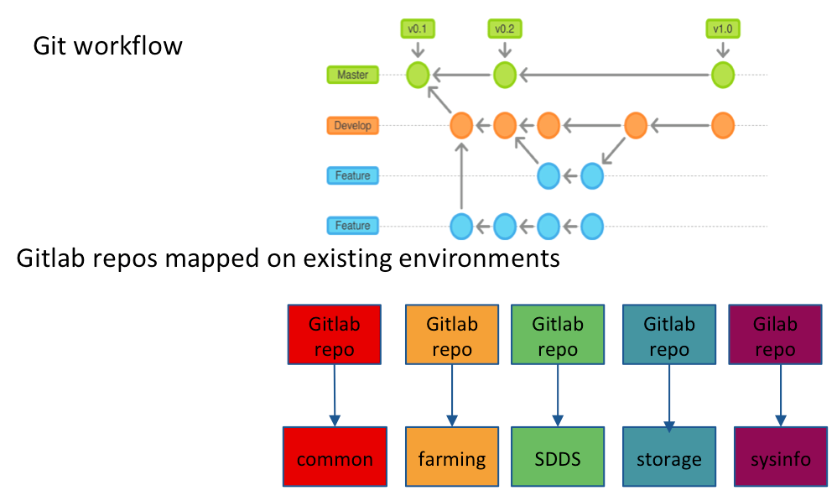
Puppet Modules Development
2015-07-16

Slide 39
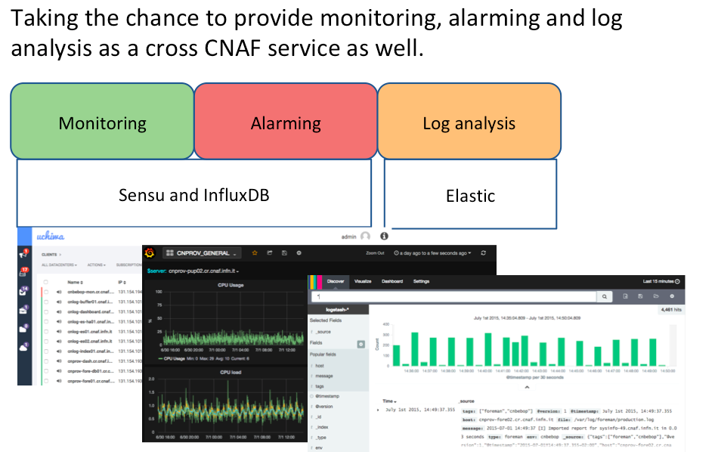
Monitoring, alarming and log analysis
2015-07-16

Slide 40
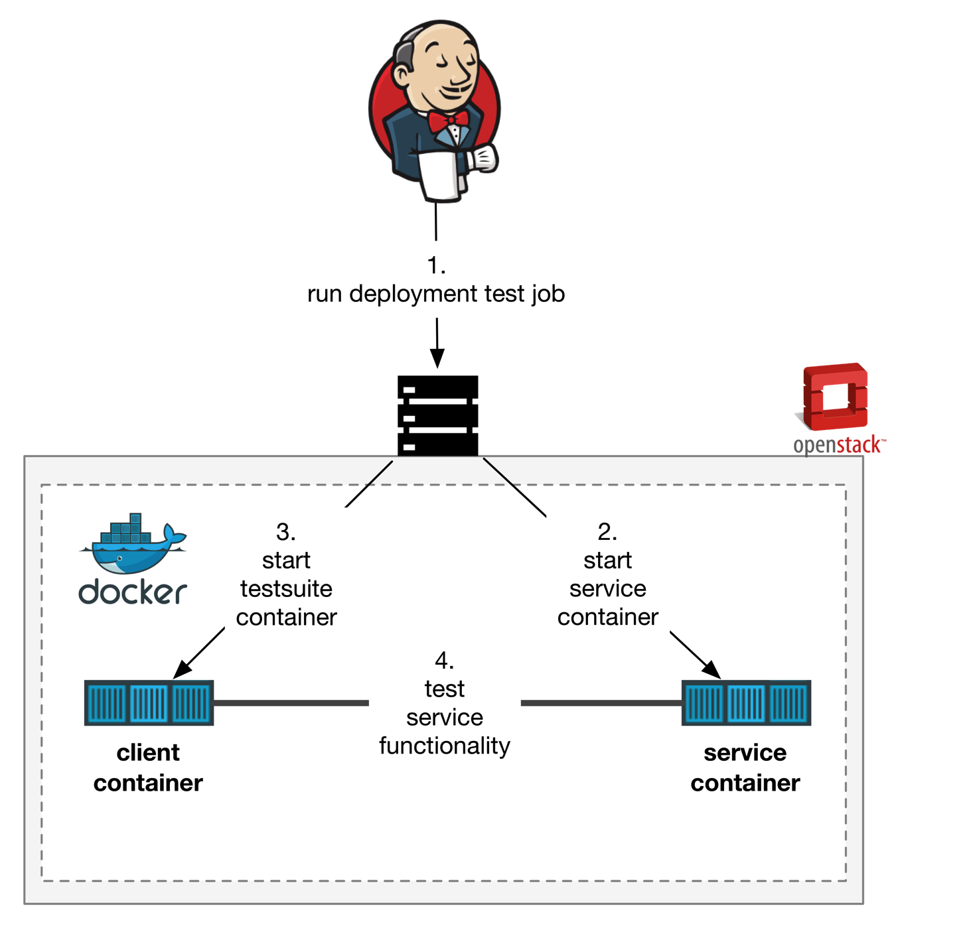
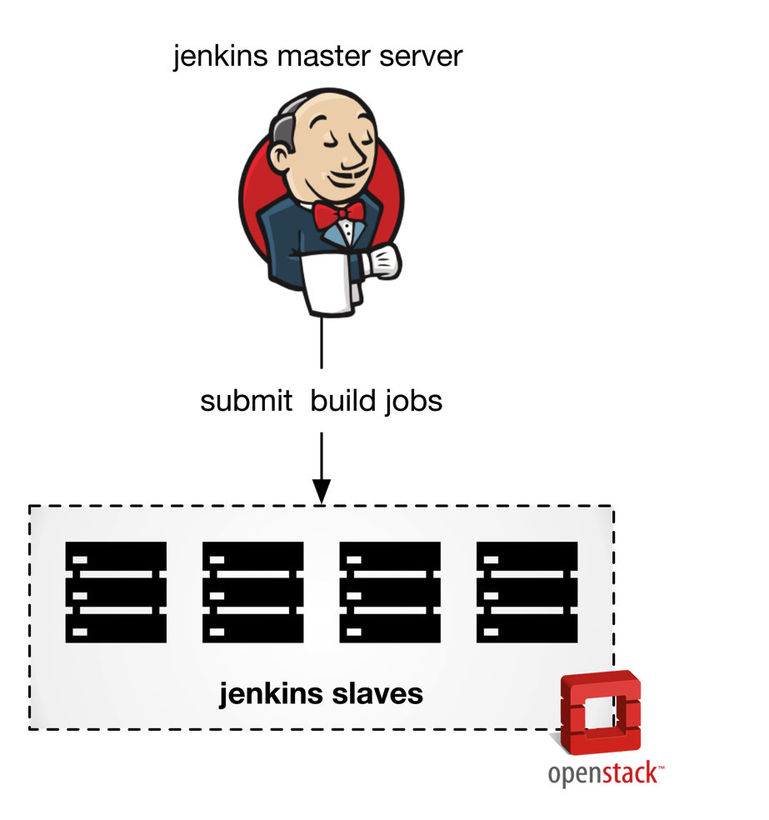
Cloud@CNAF – Middleware Devels
    Build software su VM con environment differenti (EL5, EL6, Debian6, Java6, Java7)
    Nodi provisioned e configurati tramite Puppet
    Deployment in CI di VOMS e StoRM
      Verifica installazione clean e update
      Test di funzionalità
      Recentemente ->Docker
        Vantaggi:
          Velocità di deploy
            Isolamento
      docker-registry
        docker.cloud.cnaf.infn.it
        a (git) repository for images
        Private
2015-07-16

Slide 41

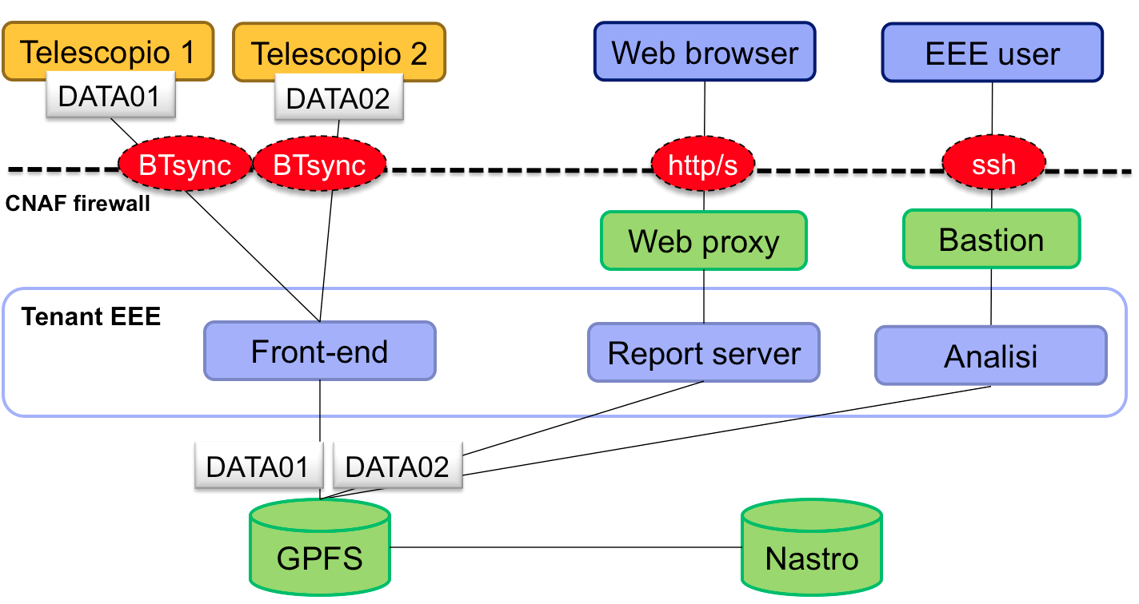
Cloud@CNAF – EEE
EEE - Extreme Energy Events
  47 telescopes (3 INFN, 2 CERN)
  300 MB raw/day/telescope
  55 TB in 5 anni (raw e ricostruiti)
  CNAF for EEE:
    Data archiving (BTSync)
    Resources (VM) for data analysis
      FE, Report Server,
      Analysis-VM (“VO Manager’)
    Storage management
      GPFS volumes through NFS
2015-07-16

Slide 42
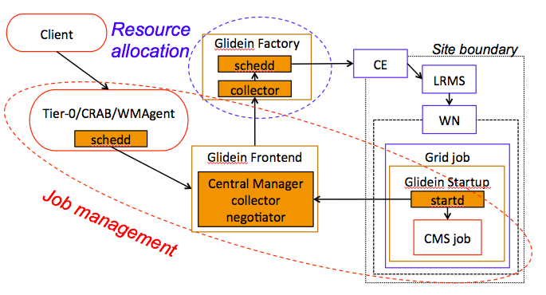
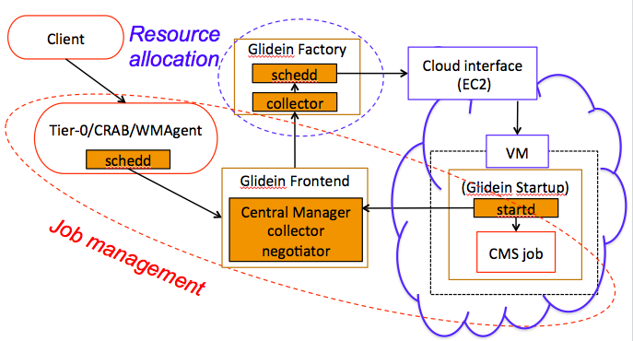
Cloud@CNAF - CMS
Cloud Bursting of T3-Bologna
  extension of the Grid site : WN instantiated on-demand on Cloud
  It does not require direct access to storage but uses srm / xrootd
  Does not use local users but only Grid Pool Accounts
  It is the use case that involves the use of Cloud commercial
Direct submission to OpenStack through GlideinWMS
2015-07-16

Slide 43
Padova Cloud Activities
2015-07-16

Slide 44
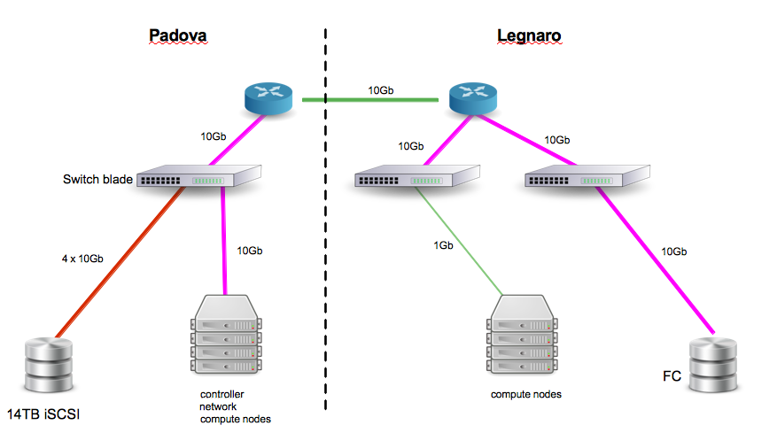
Cloud Area Padovana (1)
2015-07-16

Slide 45
Cloud Area Padovana (2)
Deployed version: IceHouse
  Planning next update (likely to Kilo, “skipping” Juno)
2 nodes configured as Controller + Network nodes configured in HA (@ Padova) with SL6.6
  We used to have 2 nodes configured as storage servers + controller nodes and 2 nodes configured as network nodes, but we had several problems with this conf → we preferred to separate storage and Cloud services
8 compute nodes @ Padova + 5 compute nodes @ Legnaro
  736 cores for VM (overcommit 4:1, 2944 VCPU), 2240 GB RAM (overcommit 1.5:1, 3360 GB RAM)
  On-going migration from SL6 to CentOS7 to prepare for OpenStack update
~ 60 users, belonging to different experiments, using the Cloud in different ways
  Interactive access, batch like use with VMs created by higher level services, etc.
2015-07-16

Slide 46
Cloud Area Padovana (3)
Percona for Database (3 nodes)
Active/Active HA based on HAProxy/Keepalived (3 nodes)
All (not only keystone) SSL-enabled interfaces
  by mean of HAProxy configured as a SSL-terminator
Networking:
  OpenvSwitch driver with GRE tunneling
    “Provider router with private networks”
  cld-nat - linux box acting as router to allow VM access from INFN LAN without FloatingIP
Storage
  43 TB (iSCSI) for Glance + Cinder + Nova instances @ Padova
    iSCSI box with 2 storage servers
    Using GlusterFS (without replica) as backend
    Shared file system for nova instances to support live migration
  96 TB @ Legnaro to be installed (FC)
  No swift

Slide 47
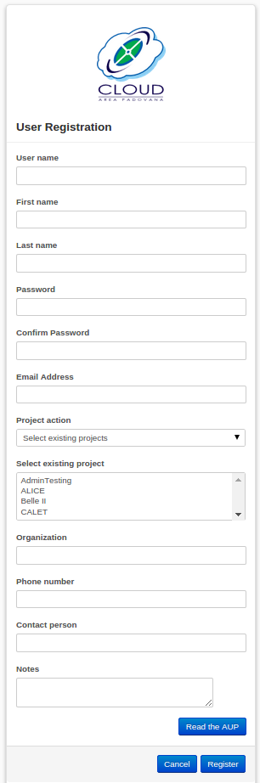
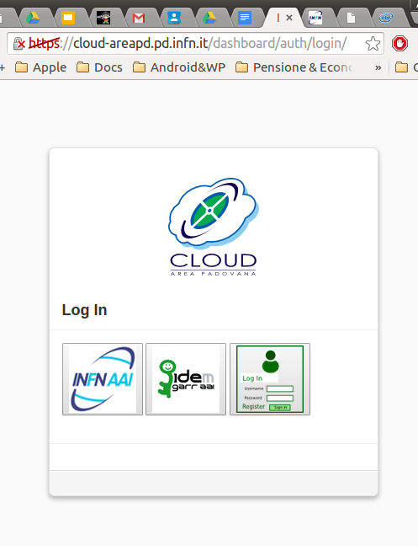
AuthN, Registration, Operations in Cloud Area Padovana
AuthN
  Integration with the INFN's IdP (SAML2) to manage authentication
Registration
  Integrated in the dashboard a module to manage user and project registration (in-house development)
  User can ask the creation of new projects and/or the affiliation to existing projects
  Each project has a manager who is responsible to manage (via dashboard) the membership requests
Operations
  Full automatic installation of compute nodes by mean of Foreman/puppet
    Puppet also used for other services (Nagios and Ganglia configurations, etc.)
    Ganglia and Nagios based monitoring infrastructure
      Several nagios sensors to check functionality and performance of the services
      Basically as a new kind of problem appears, a new ad-hoc sensor is implemented to prevent it or at least to early detect the issue

Slide 48
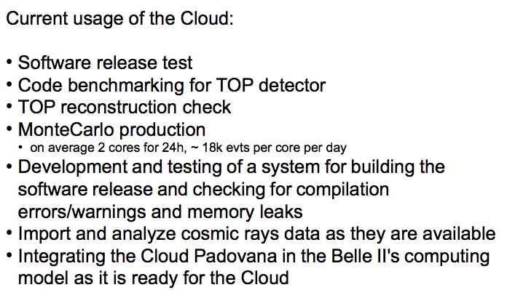
Cloud Area Padovana: Belle II
2015-07-16

Slide 49
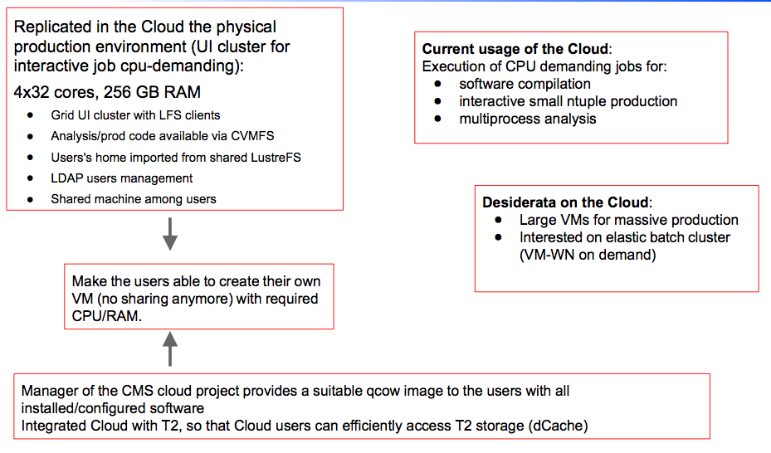
Cloud Area Padovana - CMS

Slide 50
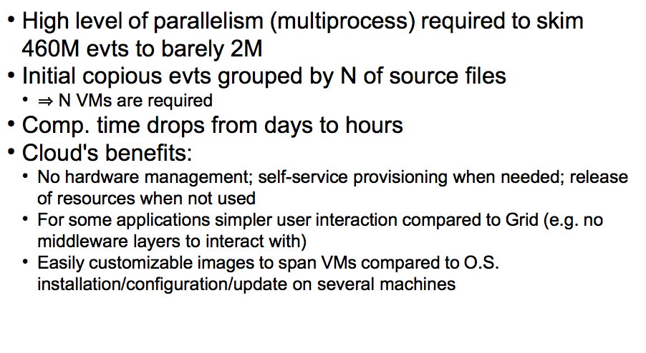
Cloud Area Padovana - LHCb

Slide 51
THANK YOU!!!
2015-07-16

Slide 52
Relevant projects
INDIGO-DataCloud
H2020 EINFRA-1 30-month project
  Led by the SDDS leader
  With a budget of 11.1 M€
The goal is to build a Cloud-based open platform for scientific communities, capable of running on a variety of available infrastructures, filling possible gaps in the existing solutions
CNAF involvement:
  Virtualization of resources (computing, storage, network)
  Identity and Access Management
  Science Gateways and User Interfaces
2015-07-16

Slide 53
Relevant projects
Open City Platform
3-year project funded by the Ministry of Research in the context of the national Smart Cities program
Design and implement interoperable Cloud solutions for e-government and Small and Medium Enterprises
CNAF involvement
  Study and definition of the architectural model
  Study and design of a clustered system for application deployment
  Development of tools for application monitoring
  Development of an automatic IaaS deployment suite
  Set-up of a Cloud testbed for OCP solutions and prototypes
2015-07-16

