Slide 2
CERN AI Config Management
Overview for INFN visit

Slide 3
Agenda
Tools and approach
Foreman
  What we use, what we don’t
  What we like, what we don’t
  Virtual v bare metal
Puppet
  Who uses it
  What do we configure
Scaling infrastructure
Development & change management

Slide 4
Tools & Approach
We wanted “industry leading” config management tool, and a dashboard
  Puppet v Chef at time, Puppet won for us
  Foreman looked better than puppet dashboard and did some “extra” things we wanted
Puppet ecosystem as much as possible
  puppetdb, mcollective, hiera
Problems have more or less been solved upstream
  external datastore (hiera), openstack modules, performance, puppetdb database issues
Some plumbing (mainly around security for multi-admin environment)

Slide 5
Foreman
What we use:
  kickstart generation
  BMC proxy
  hostgroup membership
  environment membership
  parameters (some, not many)
  report visualization / dashboard
  general inventory
  permissions… kinda

Slide 6
Foreman
What we don’t use
  PXE / DHCP management
  module inclusion
  managing virtual stuff
  very limited use of it as an ENC

Slide 7
Foreman
What we like
  visualisation
  kickstart stuff is ok
  hostgroup concept is good for us
What we don’t like
  permissions model
  single point of failure
  some features better implemented in actual puppet
  speed of fixing bugs

Slide 8
Puppet
Who uses it
  Core IT services
  Cloud
  Storage
  Batch
  Windows (sort’ve)
  “VOBoxes”
What do we configure
  Pretty much whole stack
  Some issues with yum v puppet & deployments

Slide 9
Scaling Infrastructure
Most of infrastructure is horizontally scalable
  puppet masters & foreman presentation nodes
Some exceptions
  foreman’s mysql
  puppetdb (though this is being addressed)
Some challenges
  Either shared storage for the puppet masters or keeping them in sync

Slide 10
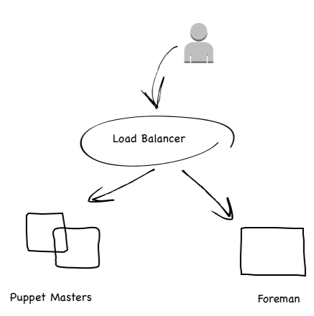
Simple Puppet Infrastructure

Slide 11
Problems with original infra
Spikes in puppet compilation times make for unhappy users
  Most automatic puppet runs do nothing, whilst people manually running puppet expect something to happen, and quickly
Large foreman reports could overload nodes, impacting UI or ENC

Slide 12
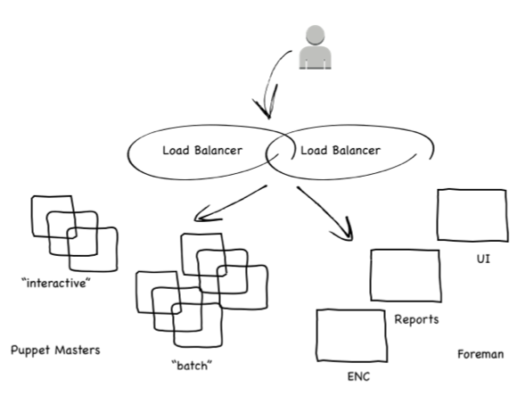
Puppet Infrastructure split by traffic type

Slide 13
Original Dev practices too simple
Puppet modules are a tree on masters, so initial plan was to treat them as single project
One git repo, branches of “production” (master) and “dev” map to puppet environments
Can’t merge dev -> prod without freezing
Used cherry-pick to promote changes

Slide 14
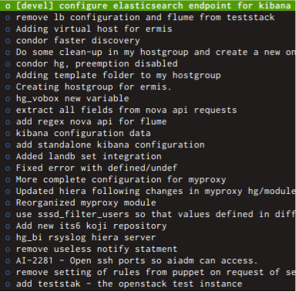
Easy cherry-pick

Slide 15
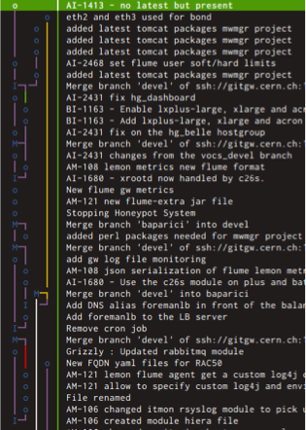
Not so easy

Slide 16
Now: modules are repos
Each module is its own repository
Hostgroup / Module split for services / reusable code
Means that Service Managers and Module Maintainers can move at own pace
the technical challenge was to create the single tree of puppet manifests for the puppet masters
We’d hoped that puppet-librarian would do this

Slide 17
jens
In the end we had to write our own librarian
Puppet environments are collections of module / hostgroup branches
“Golden” environments: “production”, “qa”, and user configurable environments
$ cat production.yaml
---
default: master
notifications: puppet-admins
$ cat ostest.yaml
---
default: master
notifications: os-tweakers
overrides:
hostgroups:
grizzly: ostest
modules:
openstack: ostest

Slide 18
Open sourcing Jens
Jens is available in GitHub since December 2014
  https://github.com/cernops/jens
Tailored for CERN’s needs but adaptable to other organizations/companies
  Particularly, for those running different services under the same puppet infrastructure

Slide 19
Infrastructure is code
Each module and hostgroup is a git repository, but it drives configuration
It’s code, treat it like code, run it like a software project
A running service is configured by many modules, with different groups developing them
Need to manage risk and throughput
Throughput and stability isn’t a 0-sum game

Slide 20

Strong QA process
Mandatory process for “shared” modules
  recommended for non-shared
  module maintainers expected to maintain QA & master branches
  service managers expected to help with QA node coverage
  changes are QA’d for >= 1 week
  anyone can press the “stop” button.

Slide 21
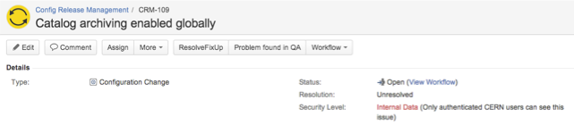

QA process
Currently enforced only by convention and visibility
Emergency workflow possible, with more visibility

Slide 22
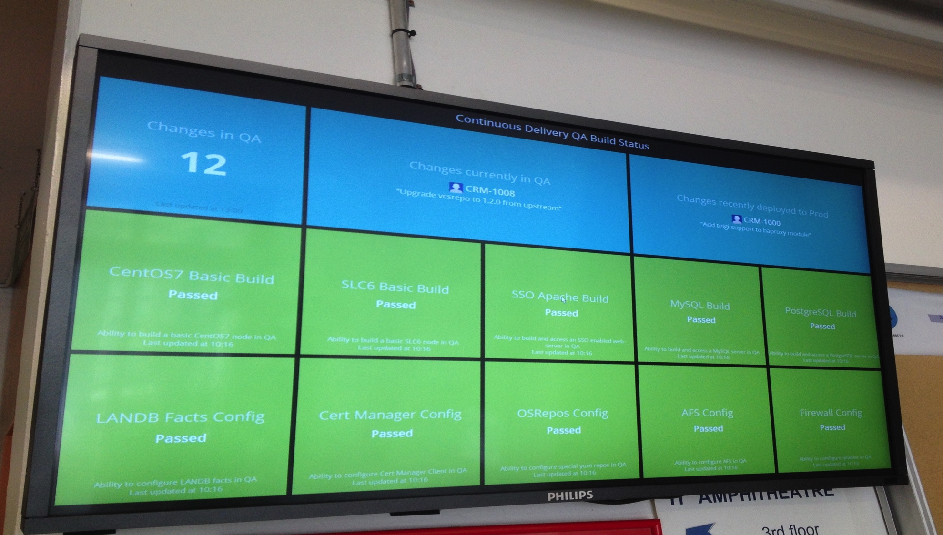
Continuous delivery

Slide 23
Continuous delivery
Continuous tests running against different configuration items
  Help to release changes fast and with confidence
A test in red means Jenkins couldn’t build a working VM

Slide 24
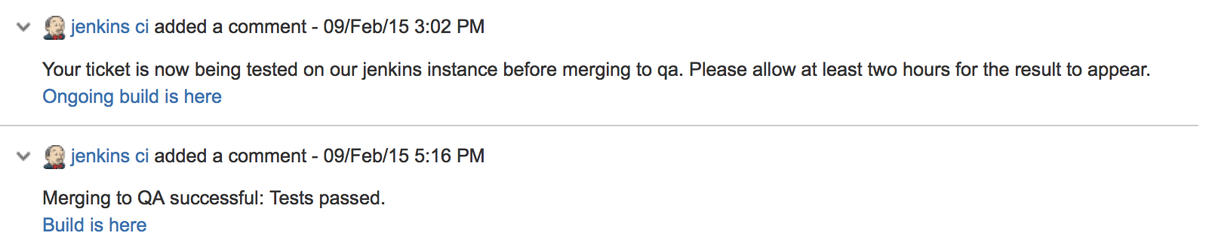
Using CI for releasing changes
Releasing a change simply consists in announcing it via a JIRA ticket
  Jenkins will automatically test it and merge to QA if successful
  A week after, will run tests again and merge to Production

