Slide 1
Cloud Operations
INFN visit
July 16, 2015
Jan van Eldik

Slide 2
Cloud team
7 Service Managers, 7 Service Developers
  With many short-time visitors
Perform service operations, capacity management, upgrades, etc.
  Snow-man weekly rota
Integrate Cloud into standard IT practices
  Account mgmt, h/w repairs, resource workflows, …
Validate new OpenStack features
  That may or may not come to fruition

Slide 3
Operating Systems
Most of our Cloud runs under Linux
  CC7 (aka CERN CentOS 7)
    Nova, Cinder, Keystone, Glance, Horizon, …
      Virtualised in most cases ☺
    2850 Compute nodes
  SLC6
    1670 Compute nodes, being reinstalled
155 Compute nodes run HyperV
  Hosting Windows VMs

Slide 4
SLC6 -> CC7 upgrade
RDO won’t provide packages for EL6 any more
  Except CLIs
Upgrade of ‘controller nodes’ done in Q1
  Rolling replacement of VMs
Compute nodes are more tricky…
  Different strategies for different usecases

Slide 5
SLC6 -> CC7 upgrade
Compute usecases
  Short-lived VMs:
    Vcycle, GlideinWMS, Cloud Scheduler, …
    Disable Nova, wait a week, reinstall, back in production
  Long-lived LSF virtual batch nodes
    Batch team drains & deletes selected VMs
    Cloud team reinstalls
    Back to step (1)

Slide 6
SLC6 -> CC7 upgrade
Service nodes, personal VMs, etc
  Deletion is not an option for 5000+ VMs
Strategy
  Empty compute node by live-migrating VMs
  Reinstall with CC7
  Back to step (1)
But… Live migration not always possible:
  VMs w/ volumes attached, very active VMs, very large VMs, etc…
  Can’t migrate from CC7 to SLC6, can’t (currently) migrate from CC7 to CC7 either.
So we’ll need to plan carefully, and be pragmatic.

Slide 7
RPM packaging
RPMs provide by RDO community
CERN contribute to build process
  SLC6 builds of Nova, Ceilometer, CLI’s
  Starting now: “Big tent” packaging of ec2api
We use Koji@CERN to rebuild some RPMs
  CERN-specific patches (mostly to integrate w/ CERN network)
  Backport some bug fixes

Slide 8
OpenStack major upgrades
CERN approach:
  Skip initial release
  Order components by increasing complexity, considering dependencies
    Nova tends to come last ☺
  Upgrade ~1 component per week
    Gently, gently
  Blog about it
  Go for team lunch
  Repeat every 6 months
Note: minor releases (usually) don’t cause problems

Slide 9
Hardware issues (1)
We run ~20 different hardware models
  Mostly worker node hardware w/ 32 cores, 64 GB RAM, 2 spinning disks
  Also many older, smaller, slower boxes
  We are now starting to purchase machines w/ SSD
  Some OCP hardware also arriving
Matching these resources with the varied demands is challenging.
  Pets vs Cattle, Meyrin vs Wigner, 2-core vs 32-core VMs, etc.

Slide 10
Hardware issues (2)
Optimizing I/O performance
  I/O scheduler, Volume usage, SSD caching, KVM caching
  https://indico.cern.ch/event/392955/
Optimizing CPU performance
  CPU pass-through
  Hypervisor tuning
    work in progress!
Note: some optimizations remove features
  Like live-migration…

Slide 11
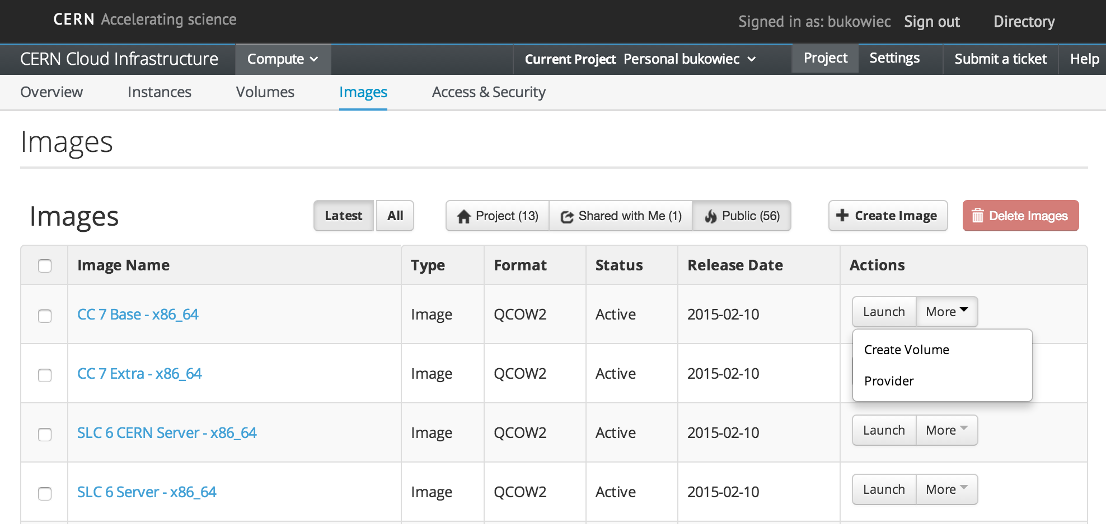
CERN Images

Slide 12
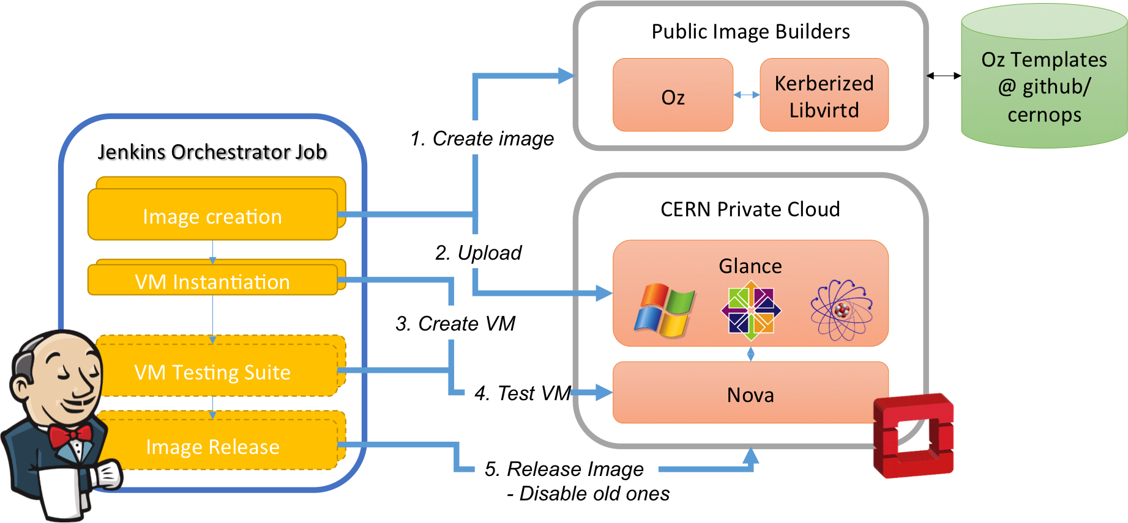
Image Lifecycle
Coming Soon

Slide 13

Friendly and easy interface from where we can organize
and launch jobs on our hosts
  Sharing of sensitive tasks to other groups without exposing credentials or procedures
Operations delegation:
  SysAdmins: Workflows related to hypervisor maintenance
  (h/w intervention, notify users…)
  Cloud-Operations: Project creation, Health reports, Quota update

Slide 14
Operations - Rally
Benchmarking tool for OpenStack
Performance test
Cloud verification
Used for OpenStack Continuous Integration
Check if services work correctly
  Rally runs against QA and Production environments regularly
  We can compare results between the environments.

Slide 15
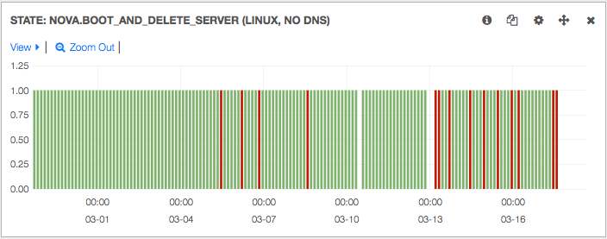
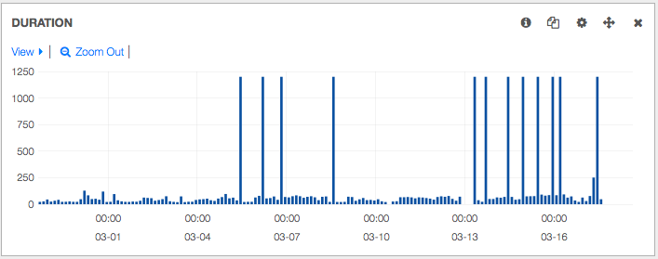

Slide 16
Summary
The CERN Cloud Infrastructure is
  Large: 120000 cores, 14000 VMs
  Popular: ~1800 users
  Diverse: compute nodes (LSF, CernVM, etc), service nodes, R&D, personal VMs…
  Challenging: many upgrades, hardware movements, user expectations
  Fun.

