Slide 1
FCC-ee injector design guidelines
Yannis PAPAPHILIPPOU, CERN

Slide 2
Outline
Target parameters for injector
  Repetition rate, particle flux
Injector parameters for past and future projects
  LEP, SUPERKEKB, CLIC
Tentative parameters for FCCee injector
FCCee design items and work units

Slide 3
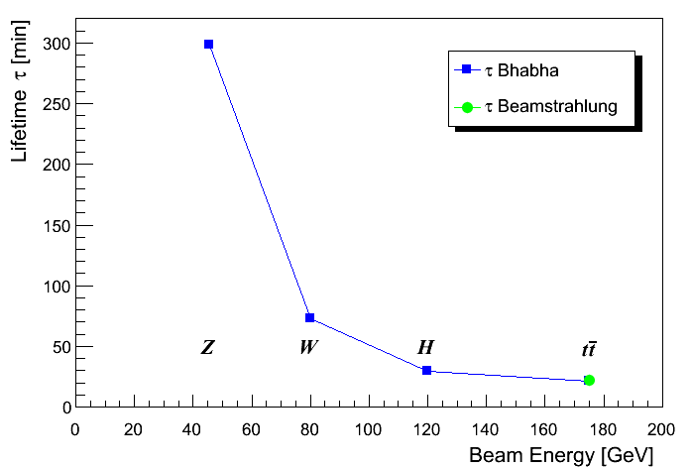
FCCee Luminosity lifetime
Lifetime from luminosity depends on radiative Bhabha scattering total cross-section
For momentum acceptance of 2%, σ_{ee} ≈ 0.15 b ≈ constant with energy (LEP). ⇒ Lifetimes down to ~20 minutes.
Continuous injection (top-up)
n_{ip} = 4
J. Wenninger

Slide 4
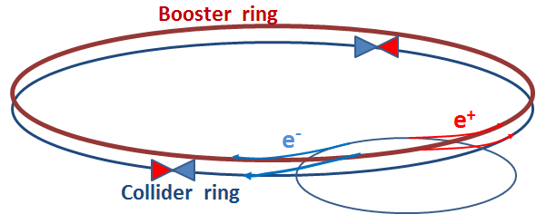
Booster ring considerations
Besides the collider ring(s), a booster of the same size (same tunnel) must provide beams for top-up injection.
Injector complex for e+ and e- beams of ~20 GeV

Slide 5
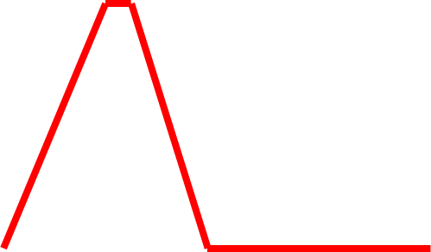
Schematic top-up cycle
beam current in collider (21 min. beam lifetime)
100%
98%
almost constant current
energy of booster ring (for one species)
120 GeV
injection into collider
injection into
booster
20 GeV
12 s

Slide 6
Target injector parameters
Parameter | Z | W | H | tt | LEP2
E [GeV] | 45.5 | 80 | 120 | 175 | 104
I [mA] | 1442 | 151 | 30 | 7 | 1
No. bunches | 16700 | 4490 | 1360 | 98 | 4
Bunch population [10¹¹] | 1.8 | 0.7 | 0.46 | 1.4 | 4.2
Lifetime [min] | 298 | 73 | 29 | 21 | 434
Time between injections [sec] | 361 | 88 | 35 | 25 | 263
Injected top-up bunch population [10¹¹] | 601.2 | 62.9 | 12.5 | 2.7 | 0.34
Required particle flux for top-up [10¹¹p/sec] | 2.10 | 0.89 | 0.44 | 0.13 | 0.001
Required particle flux for full filling [10¹¹p/sec] | 31.3 | 3.3 | 0.7 | 0.1 | 0.02
Booster injector ramp rate [GeV/sec] | 5.2 | 12.2 | 20.4 | 31.6 | 17.1
For defining injector cycle and flux, assumed 2% of current decay between top-ups
  The top energy Fcc-ee defines the maximum time between injections/species (25sec)
  Considering 50% duty factor (Interleaved e⁺/e⁻ injection), injections should be made at a minimum rate of ~0.1Hz
For full collider filling (0.25mA/min for LEP), assumed 20min of filling time and 80% transfer efficiency along the injector chain
Ramp rate for 0.1Hz injection considering linear ramp and short flat bottom and flat top (~100ms)
Note that LEP2 injector parameters are obtained with the same assumptions

Slide 7
LEP pre-injector parameters
Parameters | LIL e- | EPA e- | LIL e- for e+ | EPA e+
energy [GeV] | 0.2 to 0.7 | 0.500 | 0.200 | 0.500
bunch population [10¹⁰] | 2 |  | 0.5 to 20
bunch length [ps] | 15 |  | 15
bunch interval [ns] | 0.333 |  | 0.333
beam pulse length [ns] | 10 |  | 10 to 50
Beam sizes [mm] (rms) | 3 |  | 1
Flux [10¹¹ p/s] | 20 |  |  | 0.7
repetition rate [Hz] | 100 | 0.83 | 100 | 0.09
Number of bunches |  | 1 to 8 |  | 1 to 8
Max. bunch population [10¹¹] |  | 4.5 |  | 3
L. Rinolfi
Flux for electrons quite high, much lower for positrons
  Injection efficiency through the injectors almost 100%
  Betatron Injection efficiency to LEP was ~50% (filled machine)
  Alternative injection scheme was necessary for pushing injection efficiency to ~85% (see below)
Positron accumulation time quite long

Slide 8
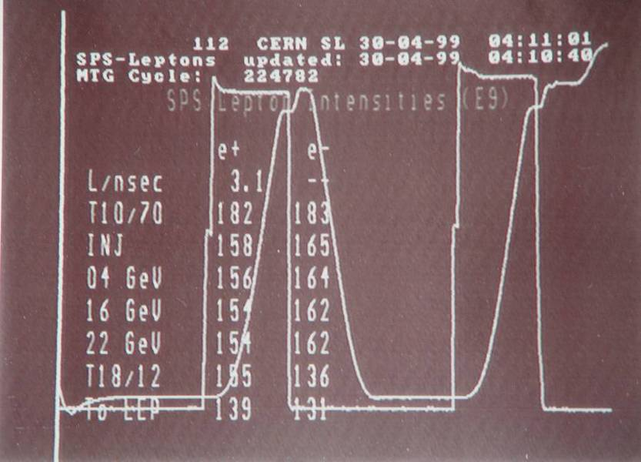
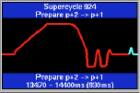
SPS as LEP Injector
P. Collier – Academic Training 2005
Flux of 1.7x10¹¹ p/s for each cycle
  An order of magnitude lower if taking into account machine duty cycle (12s supercycle)
Incompatible with lepton flux requirements for Z and W production (full machine filling)
Need to be stretched for H and tt
Lepton acceleration to 20GeV not possible (~30MV RF needed and not compatible with present proton program)
Ramp rate of 62.3GeV/s provides factor of 2 margin, i.e. even 5sec cycle possible
  Ramp rate can be even faster due to low field requirements (maybe ~1Hz possible)
LEP filling interleaved with FT proton operation
  Initially supercycle of 14.4s and later 12s
4 cycles with 4 bunches (2e⁺, 2e⁻) evolved to 2 cycles with 8 bunches (~2.5x10¹⁰ p/b)
Energy to LEP: 18 → 20 → 22 GeV
Lots of RF for leptons (200MHz SWC, 100MHz SWC, 352MHz SC), all dismantled for impedance reduction
2 Extractions in Point 6 towards LEP

Slide 9
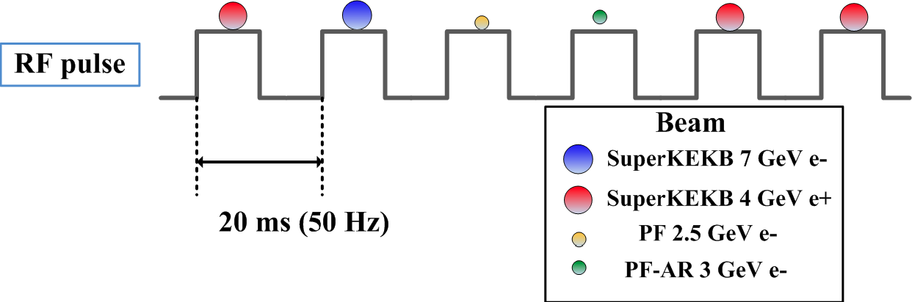
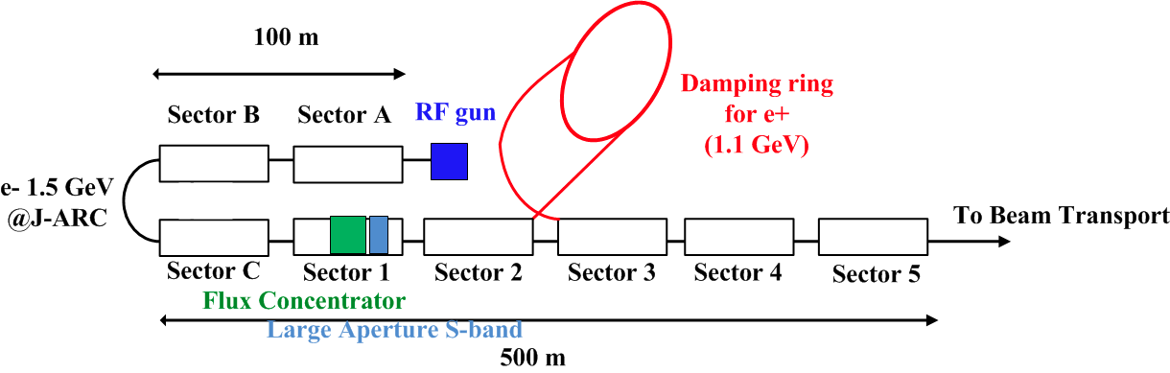
SuperKEKB injector
Lifetime of 6min necessitates top-up
Injector should serve 4 rings
  Repetition rate 50Hz
Positron flux rate at 2.5x10¹² p/s is compatible with FCC-ee needs
Commissioning of the injector has already started
  Collaboration with KEK colleagues essential for gaining experience
K. Oide, FCC-ee 2014

Slide 10
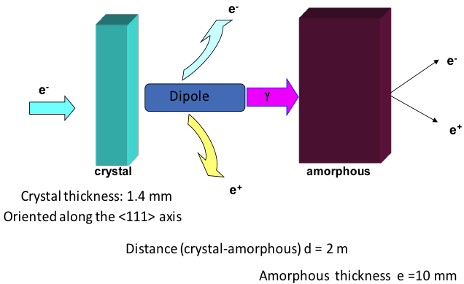
CLIC Main Beam Injector Complex
Pre-injector
e⁺ Linac
Primary 5 GeV e⁻ Linac
Injector Linac
gun
PDR
target
2.86 GeV
Booster Linac
2 GHz
e⁺ DR
BC1
0.2 GeV
Spin rotatator
DC gun
DL’s
Pre-injector
e⁻ Linac
e⁻ DR
9 GeV
PDR
Two hybrid positron sources (only one needed for 3 TeV collider)
Common injector linac
All linac’s at 2 GHz, bunch spacing 1 or 2 GHz before the damping rings
Target Parameters Crystal
Material | Tungsten | W
Thickness (radiation length) | 0.4 | χ₀
Thickness (length) | 1.40 | mm
Energy deposited | ~1 | kW
Target Parameters Amorphous
Material | Tungsten | W
Thickness (Radiation length) | 3 | χ₀
Thickness (length) | 10 | mm
PEDD | 30 | J/g
Distance to the crystal | 2 | m

Slide 11
Positron flux for linear colliders
L. Rinolfi
 | SLC | CLIC (3 TeV) | CLIC (0.5 TeV) | ILC (RDR) | LHeC (pulsed) | LHeC ERL
Energy [GeV] | 1.19 | 2.86 | 2.86 | 5 | 140 | 60
e⁺/ bunch (at IP) [10⁹] | 40 | 3.7 | 7.4 | 20 | 1.6 | 2
e⁺/ bunch (aft. capture) [10⁹] | 50 | 7 | 14 | 30 | 1.8 | 2.2
Bunches / macropulse | 1 | 312 | 354 | 2625 | 100 000 | NA
Rep. Rate (Hz) | 120 | 50 | 50 | 5 | 10 | CW
Bunches / s | 120 | 15600 | 17700 | 13125 | 10⁶ | 20x10⁶
e⁺ flux [10¹⁴p/s] | 0.06 | 1.1 | 2.5 | 3.9 | 18 | 440
SLS injector positron flux flux already compatible with FCCee needs
CLIC injector positron flux satisfies FCC-ee requirements for all energies
  Leaves a lot of margin for capture and transfer losses
  Design quite mature (un-polarized positrons)
  Need damping ring (for positrons)
  Different bunch structure and 20GeV linac for injecting into booster ring
LHeC is orders of magnitude above requirements (challenging design)

Slide 12
Possible FCC-ee injector scheme
LINACS and positron production a downgraded version of the one for CLIC (or upgraded LIL/CTF3)
  2GHz, 50Hz repetition rate, less than 10⁹ p/b
Trains with 3200 bunches (1360for the Higgs and 280 for top production) injected 8 times (7 for the top) in the SPS @ 10GeV in the required 50MHz bunch structure and accelerated to 20GeV
  Need new RF system in the SPS (50MHz?)
SPS duty factor of 0.5 (apart for top) leaving time for fixed target proton physics
  5 cycles of 1.2s in a supercycle of 12s (2 cycles for the top)
Injected into the booster ring (flat bottom of 6s or 2.4s for the top) to be accelerated in 3s to required extraction energy of FCC-ee
Interleaved injection of positrons and electrons
Filling time for full filling 20min
Top-up compatible with lifetime (25s for FCC-ee top)

Slide 13
Tentative FCC-ee injector parameters
Accelerator | FCCee-Z |  | FCCee-W |  | FCCee-H |  | FCCee-tt
Energy [GeV] | 45.5 |  | 80 |  | 120 |  | 175
Type of filling | Full | Top-up | Full | Top-up | Full | Top-up | Full | Top-up
LINAC # bunches | 3200 |  |  |  | 1360 |  | 280
LINAC repetition rate [Hz] | 50
LINAC RF freq [MHz] | 2000
LINAC bunch population [10⁸] | 5.9 | 0.4 | 0.6 | 0.2 | 0.3 | 0.3 | 0.02 | 0.04
# of LINAC injections | 8 |  |  |  |  |  | 7
SPS/BR bunch spacing [MHz] | 50
SPS bunches/injection | 80 |  |  |  | 34 |  | 7
SPS bunch population [10¹⁰] | 2.35 | 0.16 | 0.25 | 0.08 | 0.12 | 0.12 | 0.10 | 0.14
SPS duty factor | 0.5 |  |  |  |  |  | 0.29
SPS / BR # of bunches | 640/3200 |  |  |  | 272/1360 |  | 49/98
SPS / BR cycle time [s] | 1.2 / 12 |  |  |  |  |  | 1.2 / 8.4
Number of BR cycles | 50 | 15 | 50 | 3 | 50 | 1 | 71 | 1
Transfer efficiency | 0.8
Total number of bunches | 16700 |  | 4490 |  | 1360 |  | 98
Filling time (both species) [sec] | 1200 | 360 | 1200 | 72 | 1200 | 24 | 1193 | 16.8
Injected bunch population [10¹⁰] | 18 | 0.36 | 7 | 0.14 | 0.46 | 0.092 | 14 | 0.28

Slide 14
Booster Ring parameters
“Similar” geometry as main ring to fit in the same tunnel
  Need to by-pass experiments
Low emittance @ extraction obtained quite naturally due to the small bending angle
  Good for injection efficiency and top-up
Ultra-low emittances @ injection if keeping the same optics as for collider
  10pm for higgs and top
  Need detuned optics or working @ full coupling to avoid collective effects
Top Energy [GeV] | 45.5 | 80 | 120 | 175
Cycle time [s] | 12
Circumference [m] | 100000
Bending radius [m] | 11000
Injection energy [GeV] | 20
Dipole length | 10.5
Emittance @ injection [nm] | 2.81 | 0.10 | 0.01 | 0.01
Emittance @ extraction [nm] | 14.5 | 1.65 | 1.0 | 1.0
Bending field @ injection [G] | 61
Bending field @ extraction [G] | 138 | 243 | 361 | 531
Energy Loss / turn @ injection [MeV] | 1.287
Energy Loss / turn @ extraction [MeV] | 34.5 | 329.4 | 1667.6 | 7542.6
Long. Damping time @ injection [turns] | 15543
Long. Damping time @ extraction [turns] | 1320 | 243 | 72 | 23
Average current [mA] | 36.1 | 3.8 | 0.8 | 0.1
Average power @ injection [kW] | 46.4 | 4.9 | 1.0 | 0.2
Average power @ extraction [MW] | 1.24 | 1.26 | 1.27 | 0.88
Average power over 1 cycle [kW] | 100 | 105 | 106 | 105
Power from dipoles @ extraction [W] | 189 | 192 | 194 | 133
Power density on bends @ extraction [W/m] | 18 | 18 | 18 | 13
Critical energy [MeV] | 0.02 | 0.10 | 0.35 | 1.08
Radiation angle [μrad] | 11.2 | 6.4 | 4.3 | 2.9

Slide 15
Booster Ring parameters
Top Energy [GeV] | 45.5 | 80 | 120 | 175
Cycle time [s] | 12
Circumference [m] | 100000
Bending radius [m] | 11000
Injection energy [GeV] | 20
Dipole length | 10.5
Emittance @ injection [nm] | 2.81 | 0.10 | 0.01 | 0.01
Emittance @ extraction [nm] | 14.5 | 1.65 | 1.0 | 1.0
Bending field @ injection [G] | 61
Bending field @ extraction [G] | 138 | 243 | 361 | 531
Energy Loss / turn @ injection [MeV] | 1.287
Energy Loss / turn @ extraction [MeV] | 34.5 | 329.4 | 1667.6 | 7542.6
Long. Damping time @ injection [turns] | 15543
Long. Damping time @ extraction [turns] | 1320 | 243 | 72 | 23
Average current [mA] | 36.1 | 3.8 | 0.8 | 0.1
Average power @ injection [kW] | 46.4 | 4.9 | 1.0 | 0.2
Average power @ extraction [MW] | 1.24 | 1.26 | 1.27 | 0.88
Average power over 1 cycle [kW] | 100 | 105 | 106 | 105
Power from dipoles @ extraction [W] | 189 | 192 | 194 | 133
Power density on bends @ extraction [W/m] | 18 | 18 | 18 | 13
Critical energy [MeV] | 0.02 | 0.10 | 0.35 | 1.08
Radiation angle [μrad] | 11.2 | 6.4 | 4.3 | 2.9
Energy loss/turn determined by energy and ring geometry
  Same as for the collider at extraction (~1MeV at injection)
Bending field at injection of 61Gauss
  Has to remain low as energy loss/turn at flat top is already quite high
  Compensation of eddy currents, hysteresis effects and appropriate shielding from FCC-ee main magnets is needed

Slide 16
Booster Ring parameters
Top Energy [GeV] | 45.5 | 80 | 120 | 175
Cycle time [s] | 12
Circumference [m] | 100000
Bending radius [m] | 11000
Injection energy [GeV] | 20
Dipole length | 10.5
Emittance @ injection [nm] | 2.81 | 0.10 | 0.01 | 0.01
Emittance @ extraction [nm] | 14.5 | 1.65 | 1.0 | 1.0
Bending field @ injection [G] | 61
Bending field @ extraction [G] | 138 | 243 | 361 | 531
Energy Loss / turn @ injection [MeV] | 1.287
Energy Loss / turn @ extraction [MeV] | 34.5 | 329.4 | 1667.6 | 7542.6
Long. Damping time @ injection [turns] | 15543
Long. Damping time @ extraction [turns] | 1320 | 243 | 72 | 23
Average current [mA] | 36.1 | 3.8 | 0.8 | 0.1
Average power @ injection [kW] | 46.4 | 4.9 | 1.0 | 0.2
Average power @ extraction [MW] | 1.24 | 1.26 | 1.27 | 0.88
Average power over 1 cycle [kW] | 100 | 105 | 106 | 105
Power from dipoles @ extraction [W] | 189 | 192 | 194 | 133
Power density on bends @ extraction [W/m] | 18 | 18 | 18 | 13
Critical energy [MeV] | 0.02 | 0.10 | 0.35 | 1.08
Radiation angle [μrad] | 11.2 | 6.4 | 4.3 | 2.9
Average current considered for full filling, from a fraction to ~36mA
Average power at injection up to 46kW
Up to ~1.3MW at extraction
Power density up to ~18W/m

Slide 17
Booster Ring parameters
Top Energy [GeV] | 45.5 | 80 | 120 | 175
Cycle time [s] | 12
Circumference [m] | 100000
Bending radius [m] | 11000
Injection energy [GeV] | 20
Dipole length | 10.5
Emittance @ injection [nm] | 2.81 | 0.10 | 0.01 | 0.01
Emittance @ extraction [nm] | 14.5 | 1.65 | 1.0 | 1.0
Bending field @ injection [G] | 61
Bending field @ extraction [G] | 138 | 243 | 361 | 531
Energy Loss / turn @ injection [MeV] | 1.287
Energy Loss / turn @ extraction [MeV] | 34.5 | 329.4 | 1667.6 | 7542.6
Long. Damping time @ injection [turns] | 15543
Long. Damping time @ extraction [turns] | 1320 | 243 | 72 | 23
Average current [mA] | 36.1 | 3.8 | 0.8 | 0.1
Average power @ injection [kW] | 46.4 | 4.9 | 1.0 | 0.2
Average power @ extraction [MW] | 1.24 | 1.26 | 1.27 | 0.88
Average power over 1 cycle [kW] | 100 | 105 | 106 | 105
Power from dipoles @ extraction [W] | 189 | 192 | 194 | 133
Power density on bends @ extraction [W/m] | 18 | 18 | 18 | 13
Critical energy [MeV] | 0.02 | 0.10 | 0.35 | 1.08
Radiation angle [μrad] | 11.2 | 6.4 | 4.3 | 2.9
Critical energies @ extraction as for the collider (up to 1.1MeV for highest energy)
Vertical radiation angle of a few μrads
Needs demanding shielding, absorption scheme and vacuum chamber design

Slide 18
FCCee-injector Design items
Pre-injector parameters
  Refined linac parameters
  Positron production
SPS as booster injector
  Collective effects
  RF system
  Alternative pre-booster ring
Booster design
  Low injection bending field
  Experimental by-passes
  Shielding and vacuum chamber design (high critical energy)
  Integration in the collider tunnel
Top-up injection to the collider
  Different schemes to be worked out (synchrotron, longitudinal, pulsed multi-pole, vertical injection)
  BT element parameters and design
Overall cost and power estimates

Slide 19
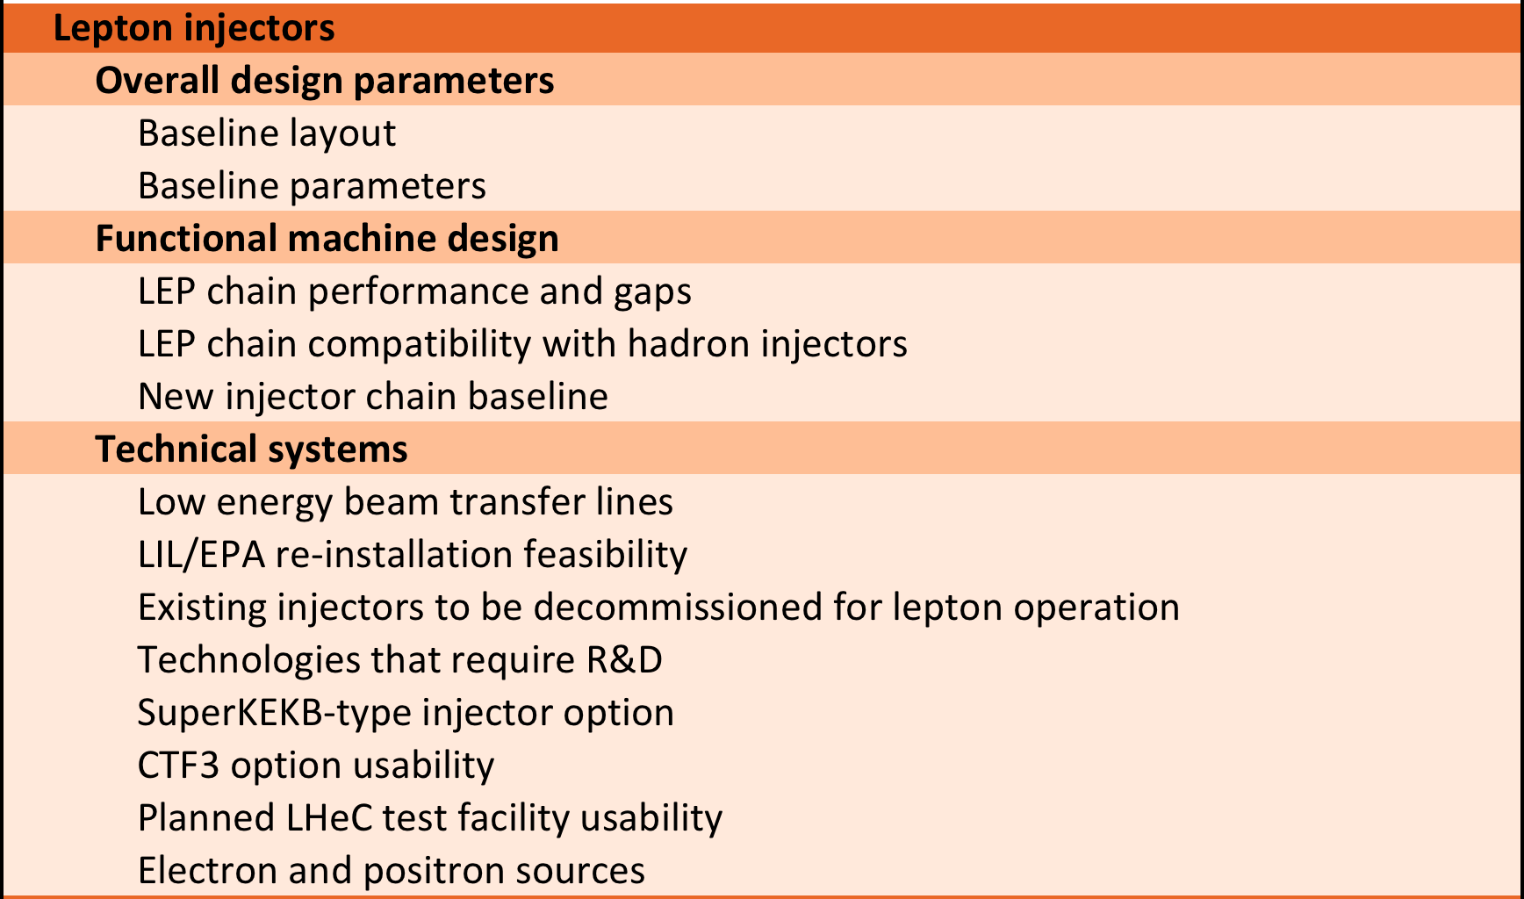
Lepton injector work units

Slide 20
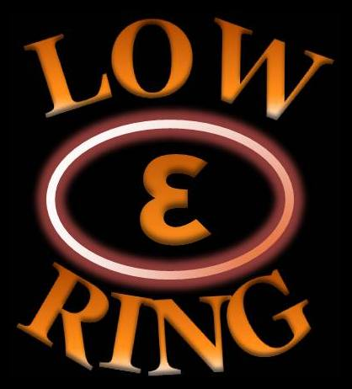
Low Emittance Rings’ Collaboration
Common beam dynamics and technology issues for synchrotron light sources, linear collider damping rings and e+/e- colliders
Formed a EU network within EUCARD2, started on 05/2013
  Coordinated by CERN, INFN/LNF, JAI
  Extended collaboration board including colleagues from US and Japan
  30 participating institutes world wide
  F irst 5 network workshop with 60-80 participants @ Oxford (07/2013), Soleil (01/2014), Valencia (05/2014), Barcelona (04/2015)
Next low emittance rings’ technology workshop on September 2015 at ALBA, Barcelona
FCCee injector but also collider design study should profit from it!

