Slide 1
The LHC
Is COLD
  22. August - all sectors simultaneously at 1.8K;
  30. August first cryogenics OK for complete machine
Is almost fully commissioned
  Powering of complete arcs & arcs together
  7/8 sectors up to 5.5 TeV (sector 56 to 6.5 TeV)
  Robust performance
  Tunnel closure – 5th September – LHC enters operation phase
Becomes clear that it is the intersect of a number of huge systems that must all work more-or-less perfectly
It worked
  Injection tests
  First commissioning with beam
Euston, we have a problem

Slide 2
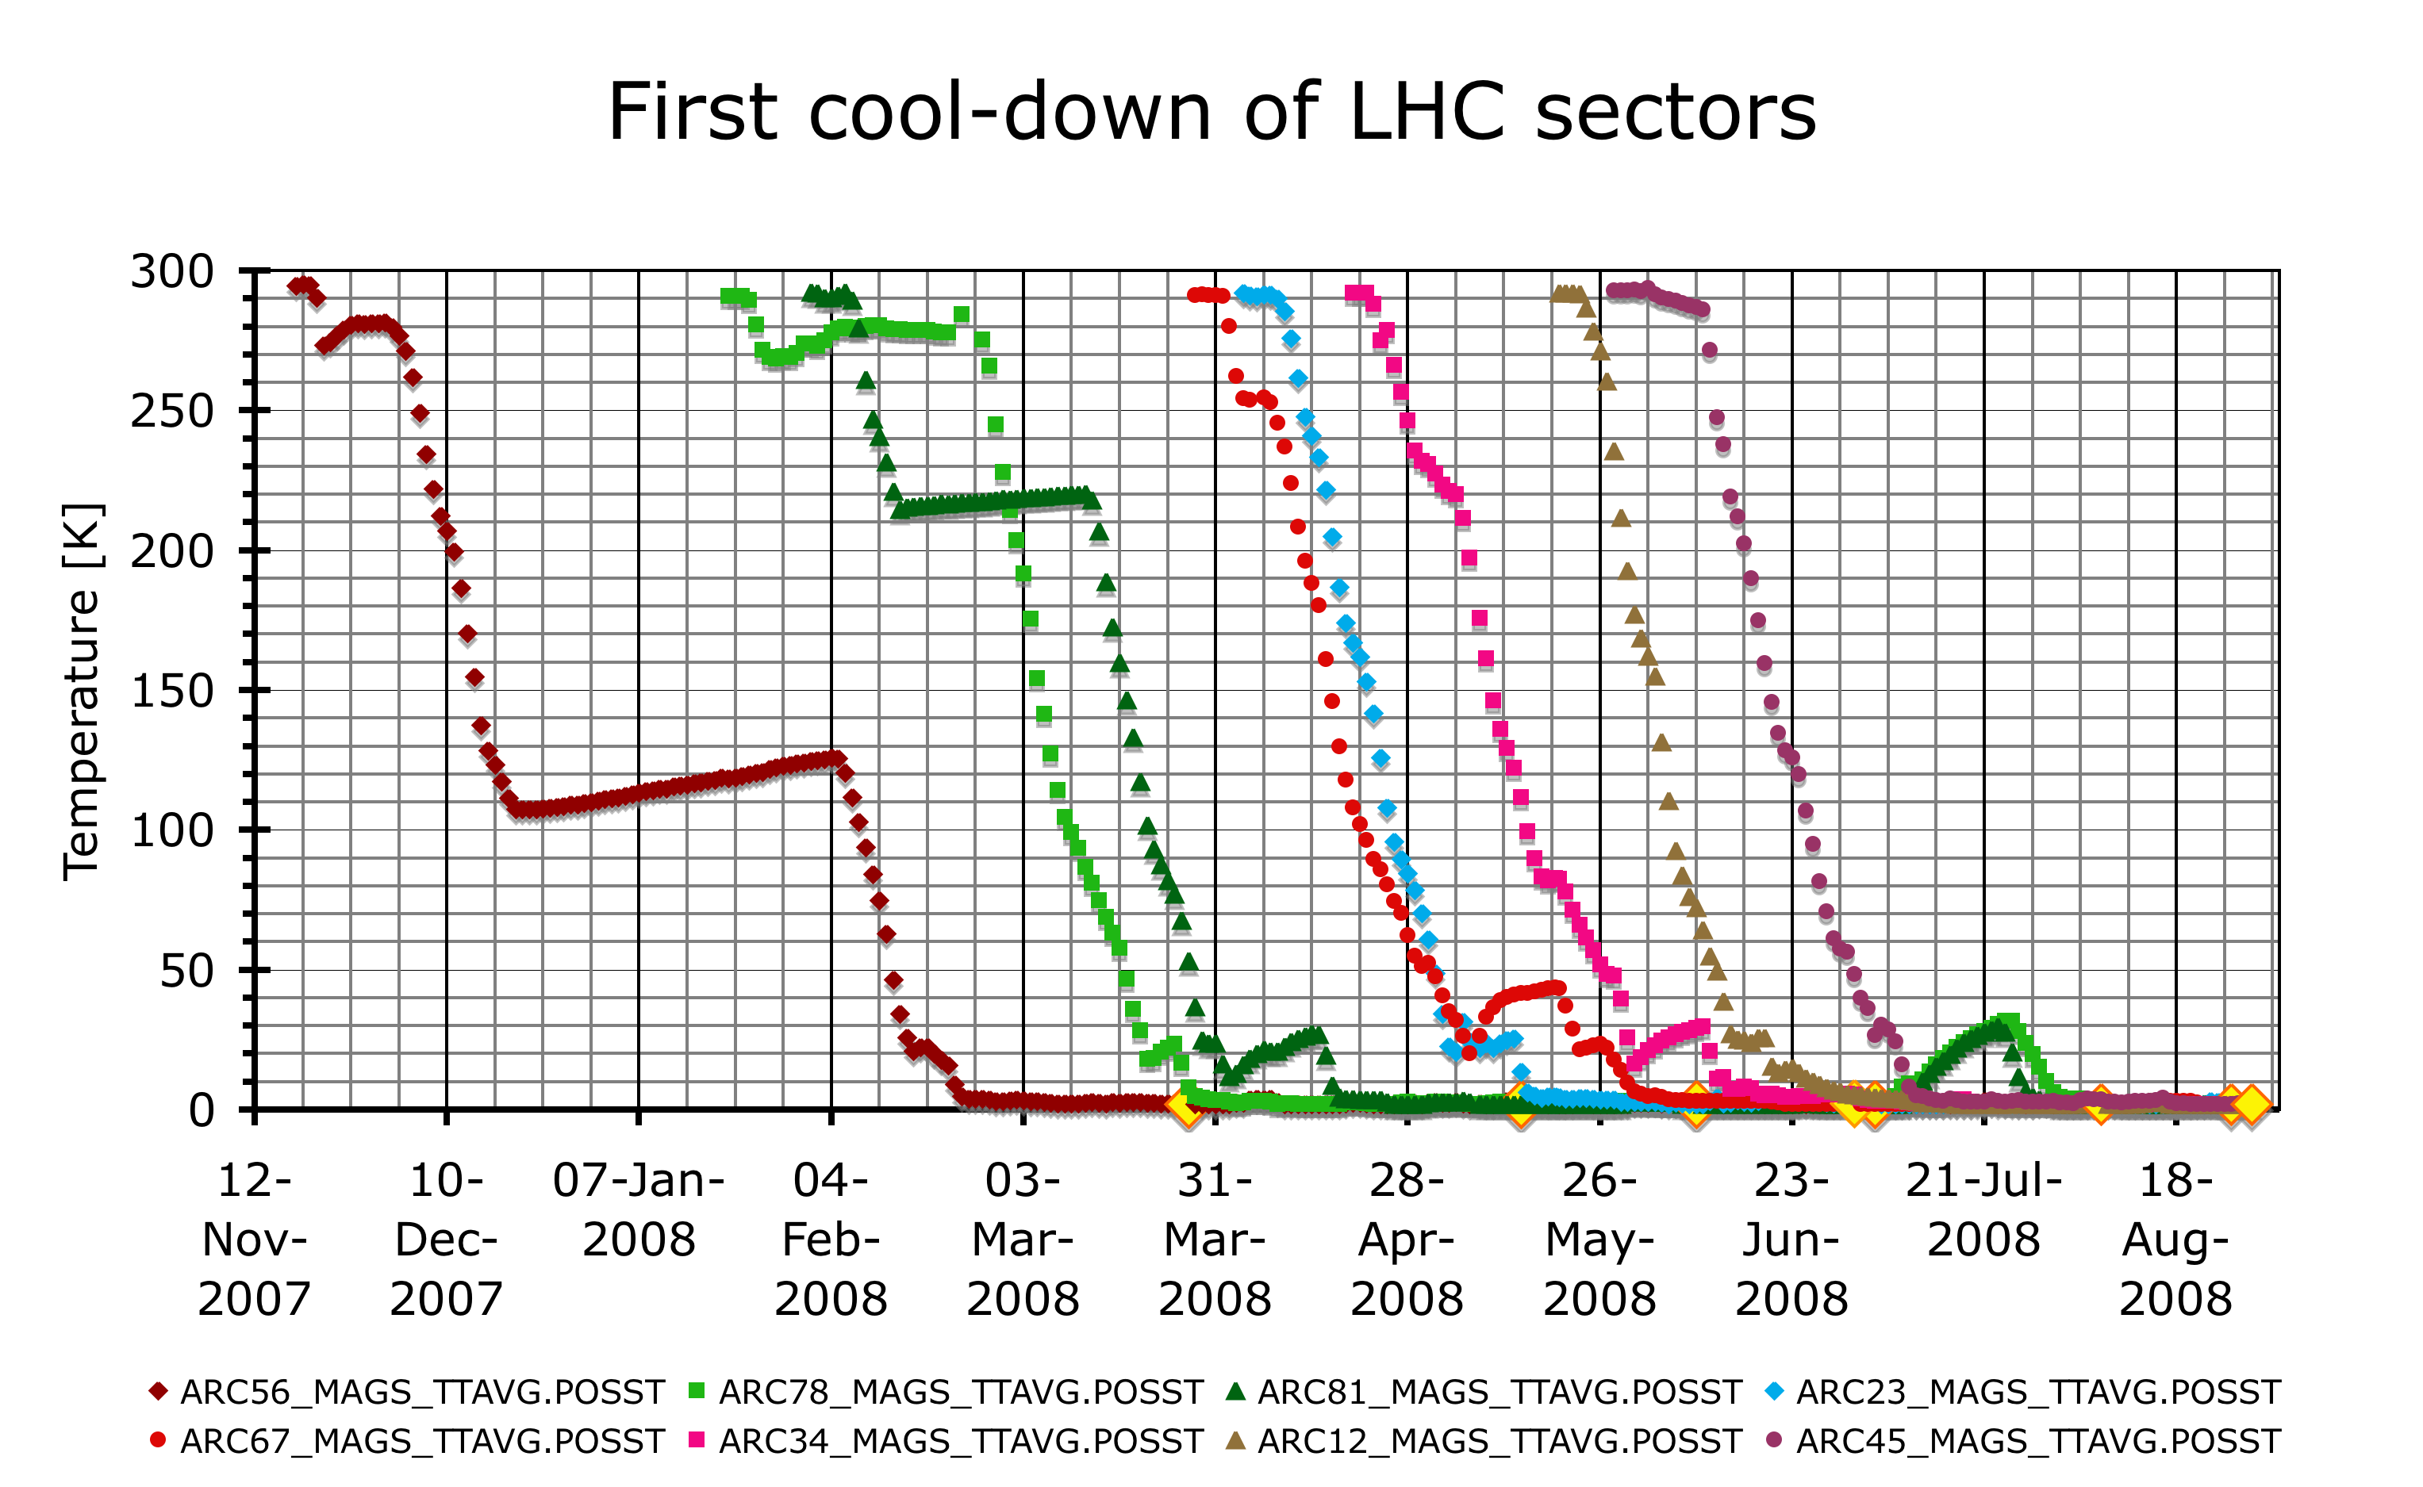
All sectors at nominal temperature
Short in connection cryostats and repairs
UX85 Ph1 works
Christmas and water maintenance shut-down
Open Days
Cooling sectors + Cryo tuning + Powering activities
S. Claudet

Slide 3
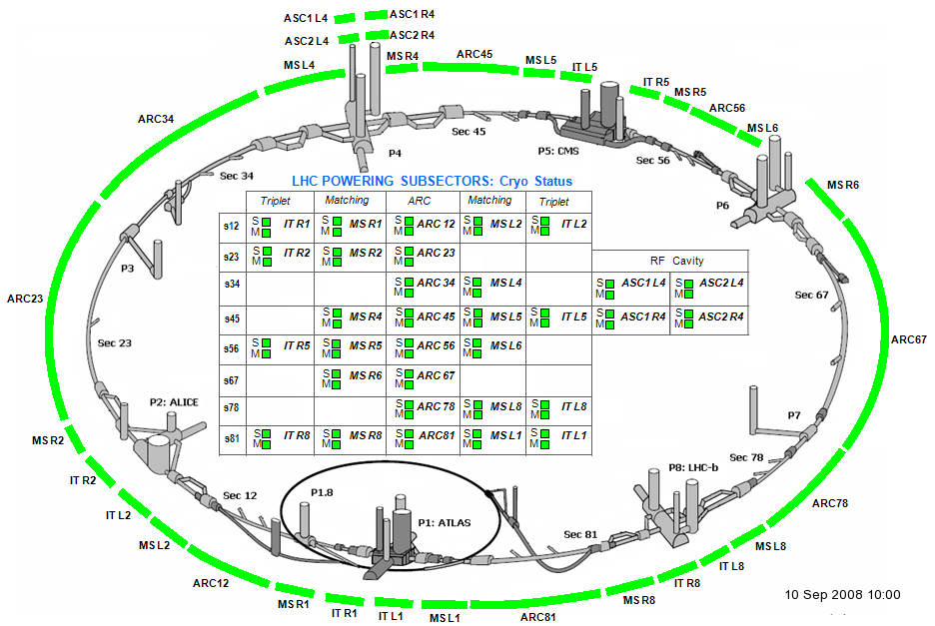
LHC Cryogenics on 10. September
It’s COLD

Slide 4
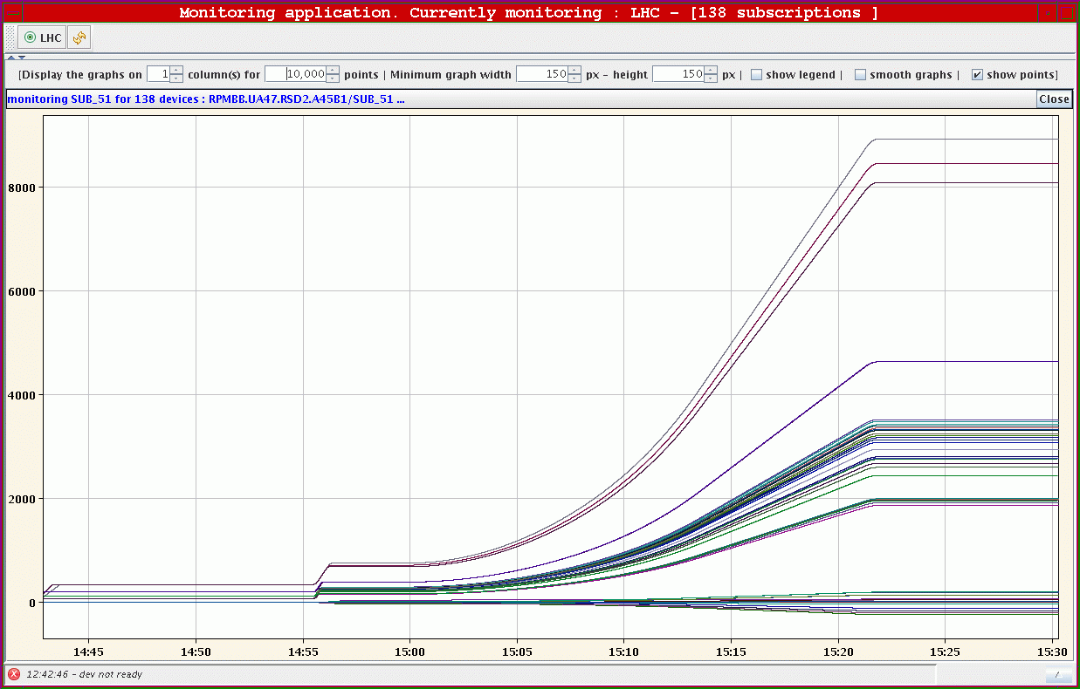
Most circuits - good for 5.5 TeV
Hardware commissioning
  - Powering of complete arc & arcs together
  - 7/8 sectors up to 5.5 TeV (sector 56 to 6.5 TeV)
  - Robust performance of nearly all 1700+ magnet circuits

Slide 5
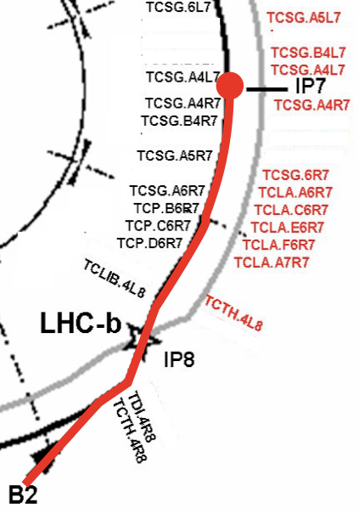
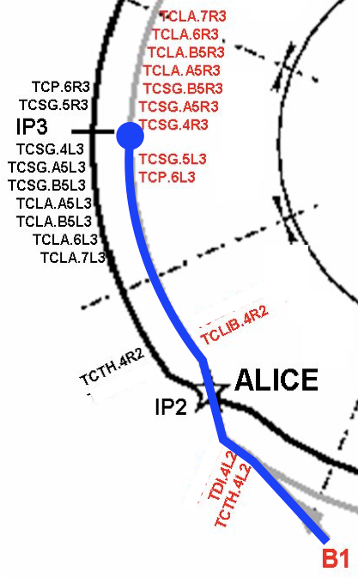
It works! Injection tests

Slide 6
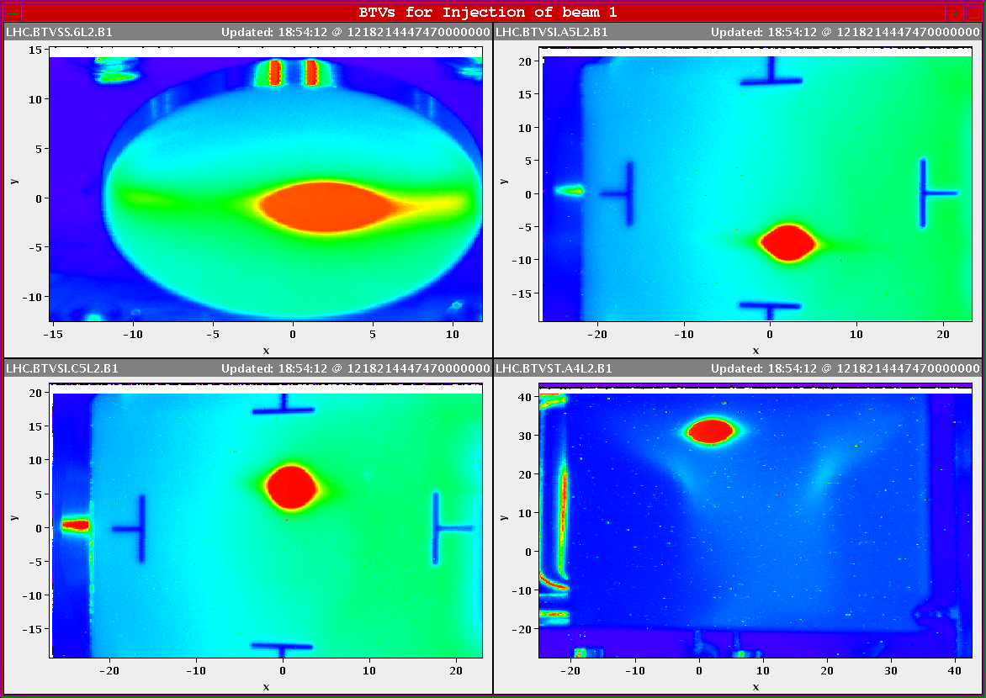
First Beam in LHC

Slide 7
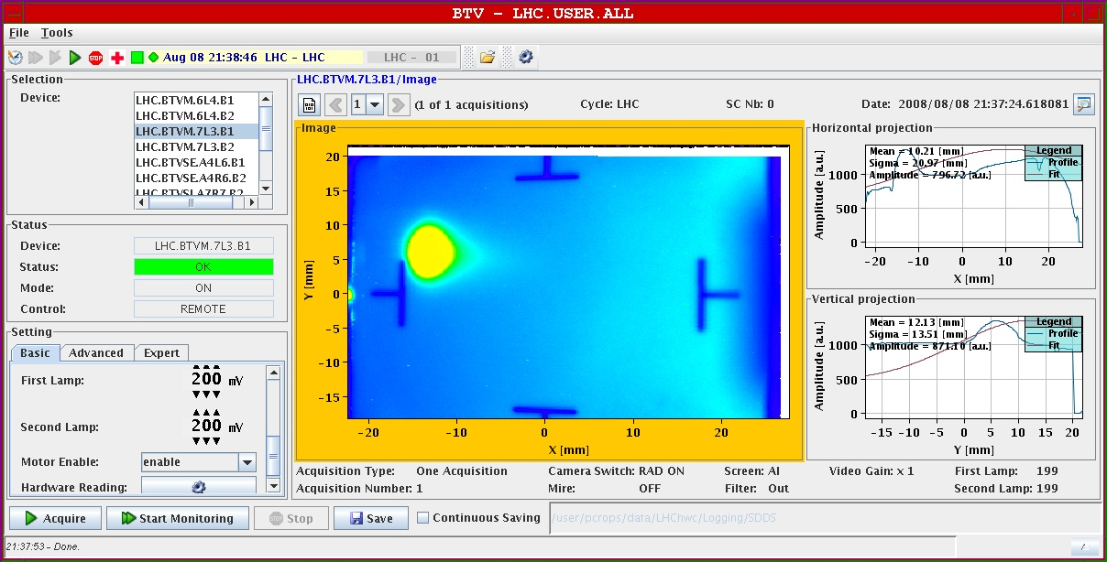
First beam to IR3
Beam stopped on collimator jaw

Slide 8
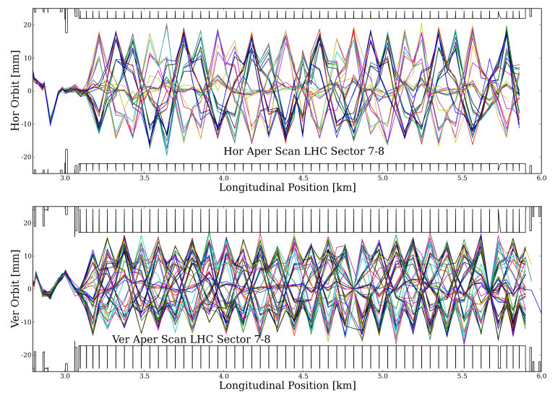
First gentle aperture scans

Slide 9
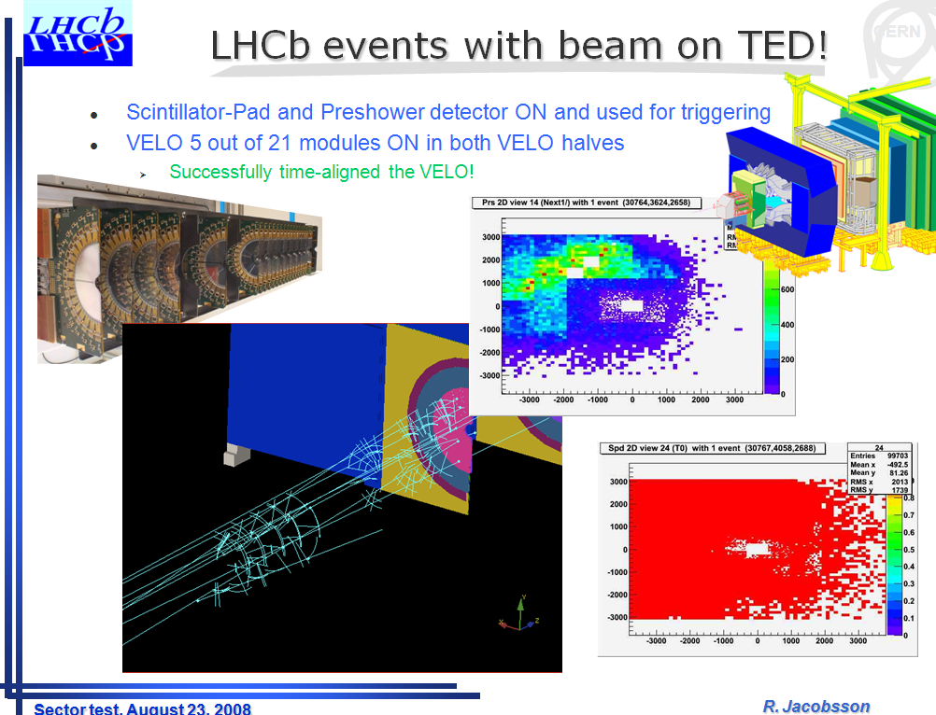
First events

Slide 10
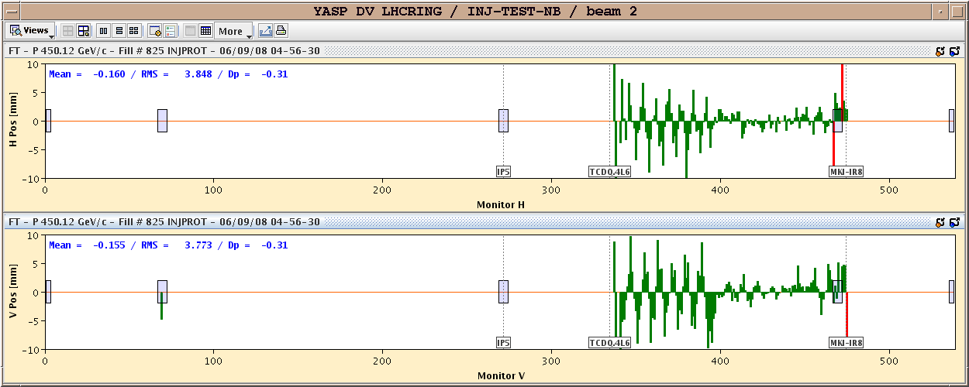
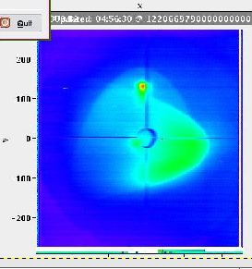
First beam to dump

Slide 11
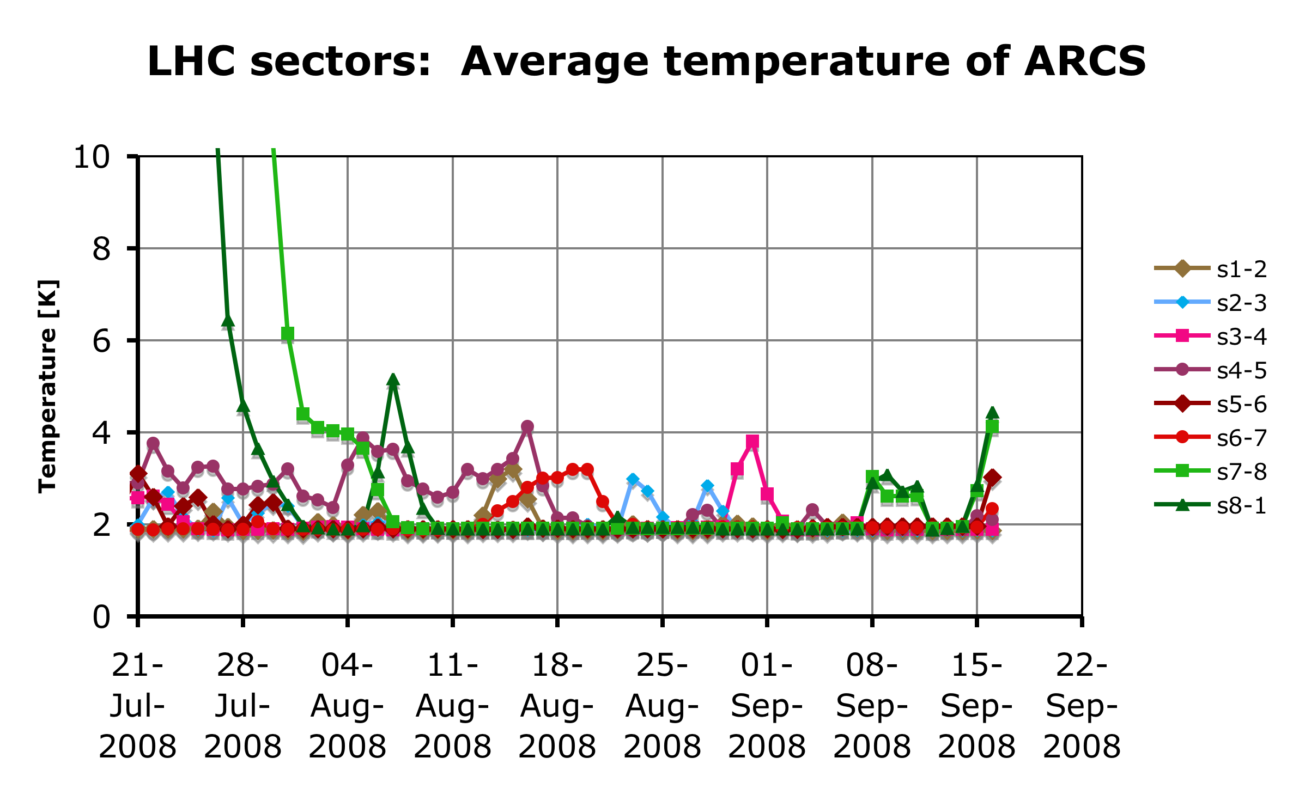
The intersect of a number of huge systems….
UX85 Ph1 works
Oil leak
Air leak
Transfo 1,2 3,4
Oil filters
Tu
Air CC
24V
LHC Beams around the ring for the 1st time !
S. Claudet18. September’08

Slide 12
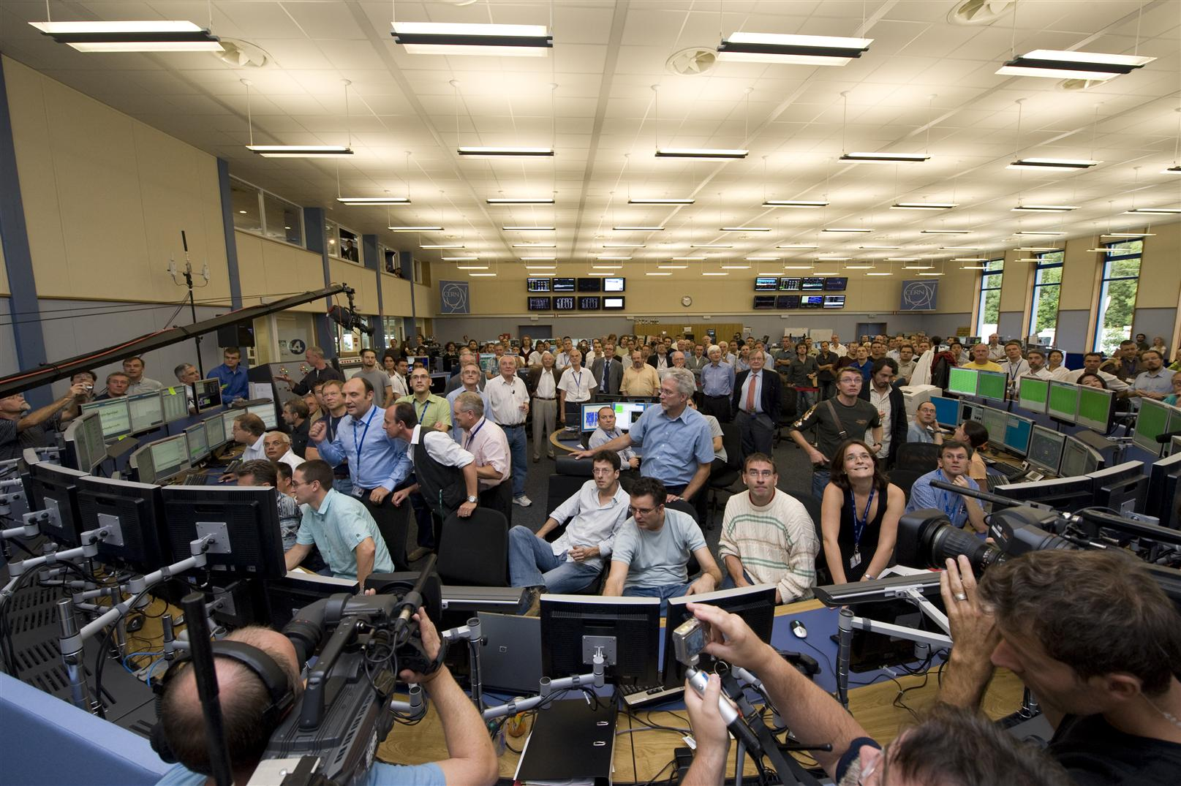
…which all worked nicely on the 10th September

Slide 13
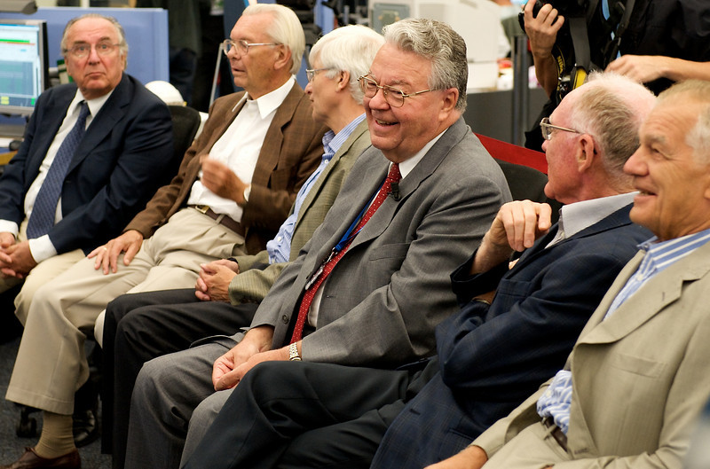
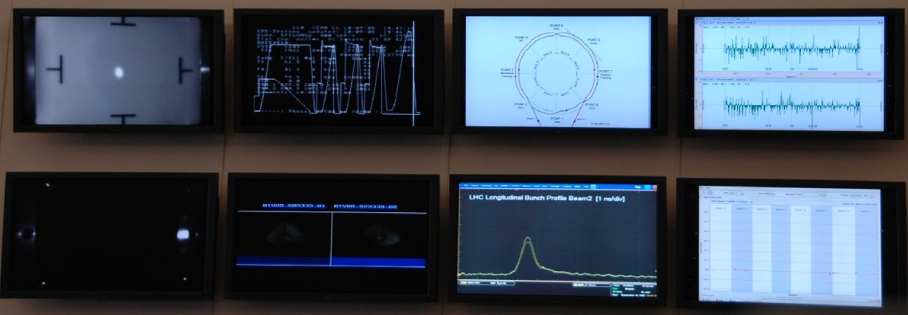

Injection test 5 - piece of cake!

Slide 14
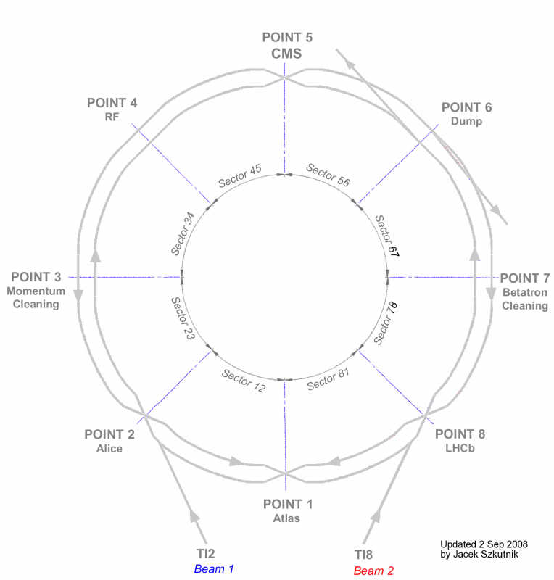
Beam Commissioning
  10. September:
    Established 1. Turn for Beam 1
    Established 1. Turn for Beam 2
    Established circulating beam for Beam2
  Following days:
    RF capture Beam 2
  First beam measurements
    Orbit correction
    Tune & coupling measurement
    Optics verification via kick-response

Slide 15
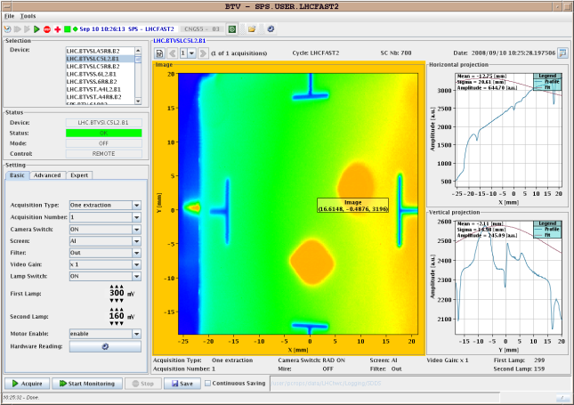
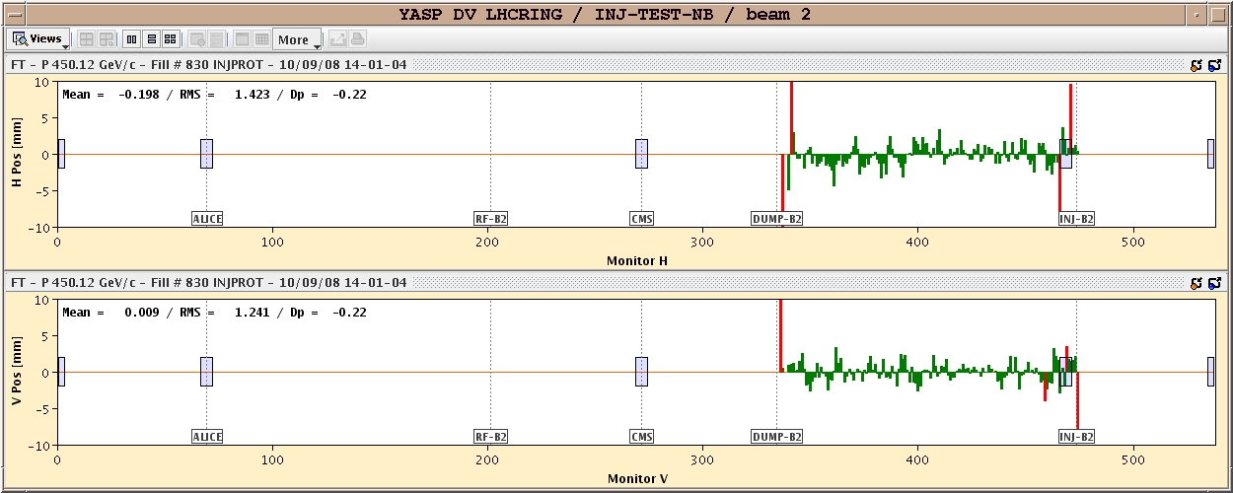
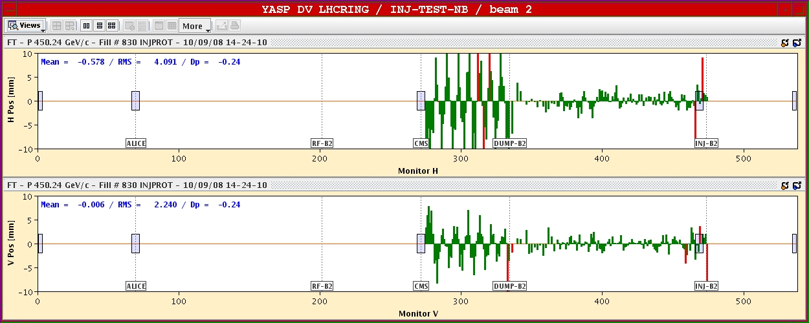
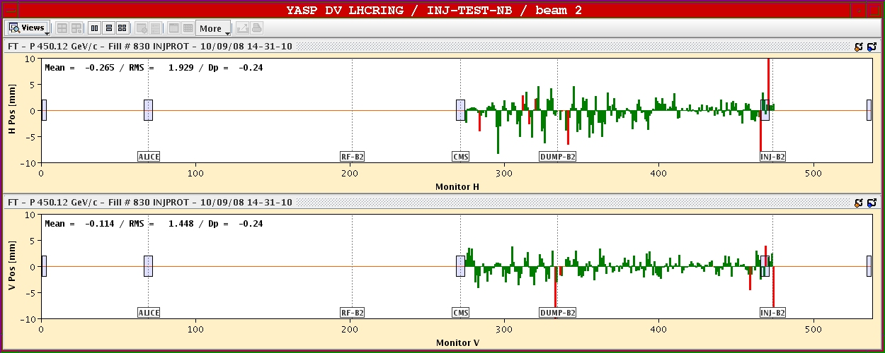
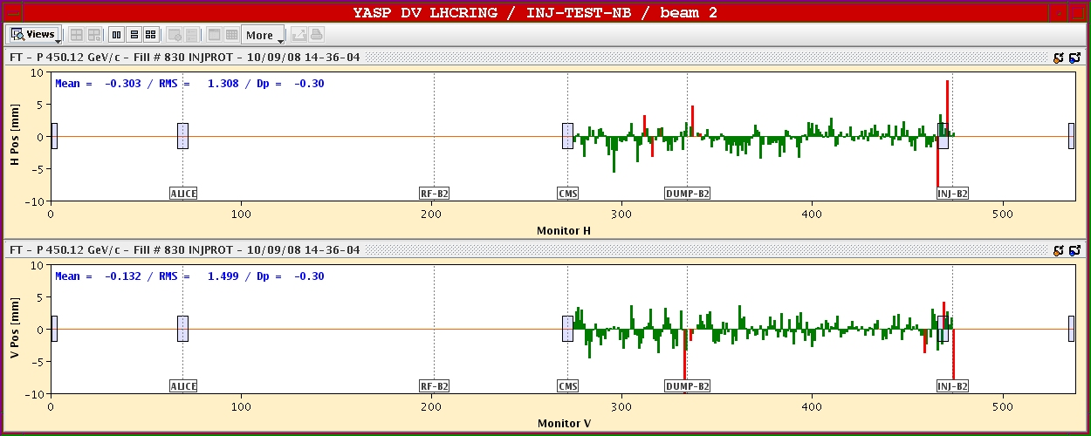
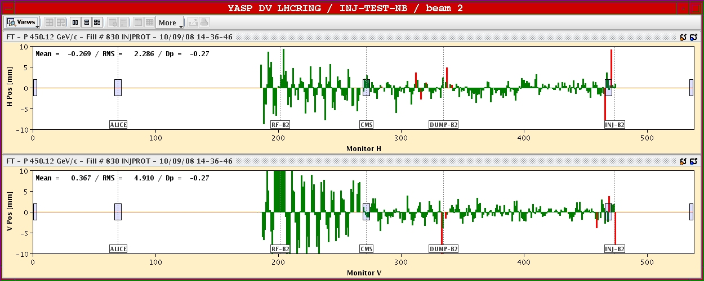
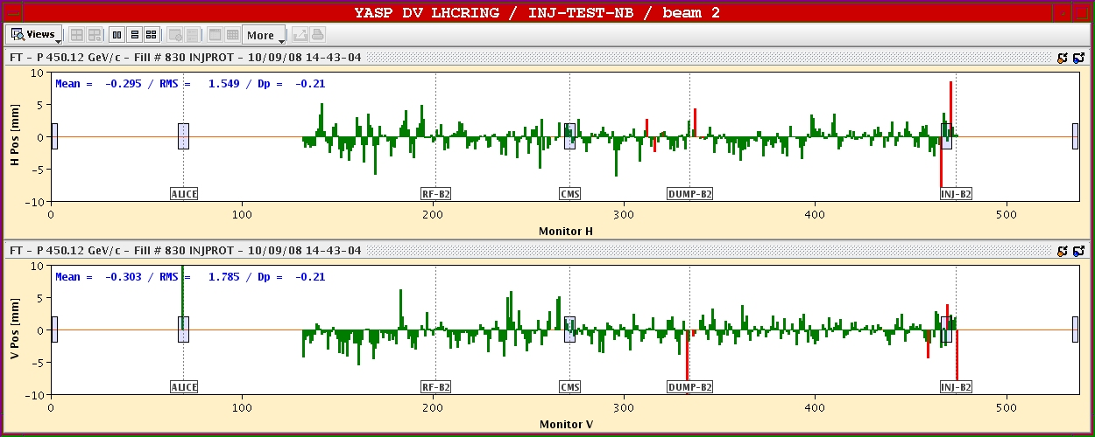
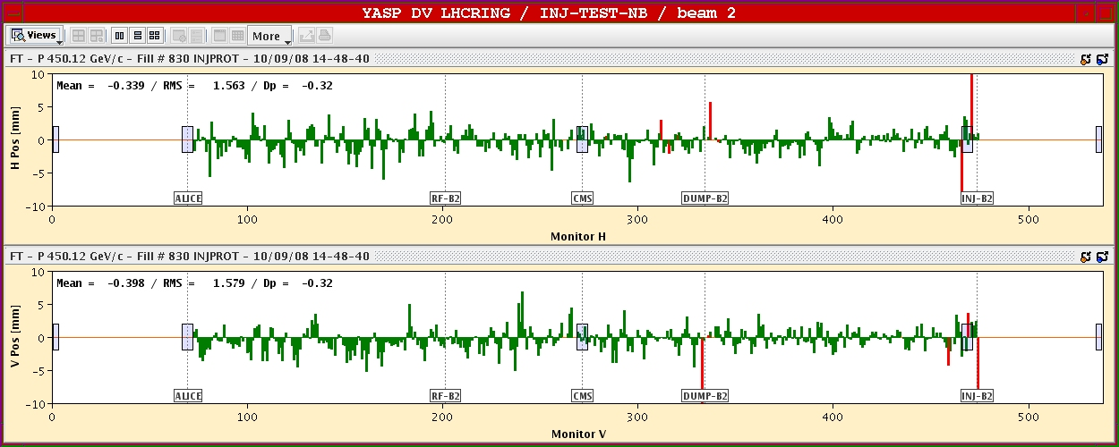
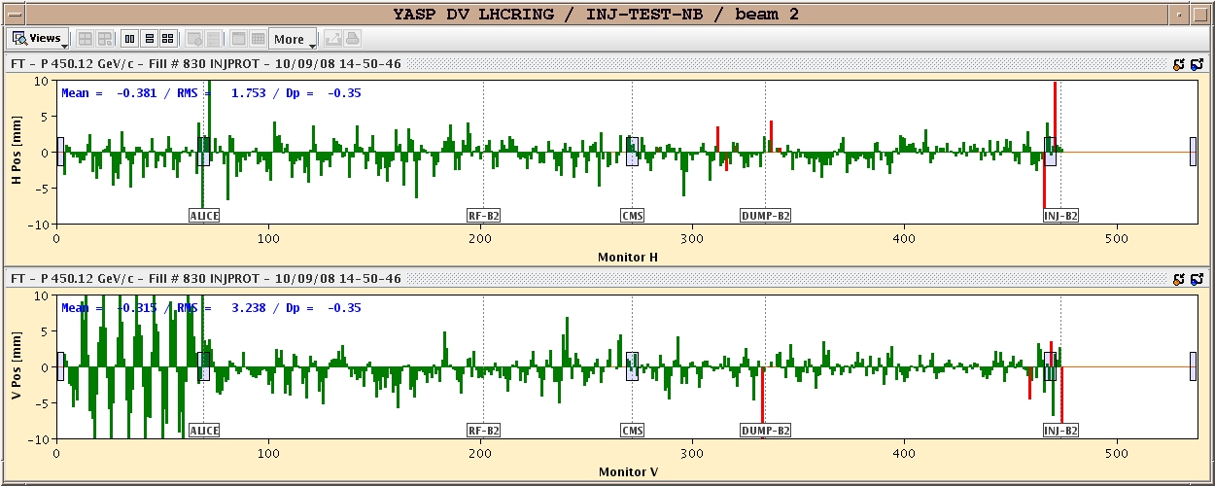
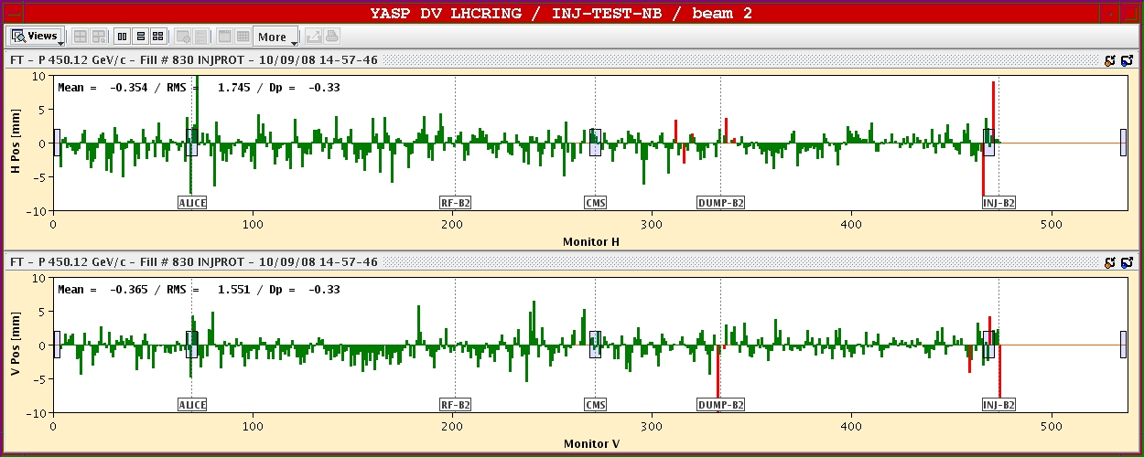
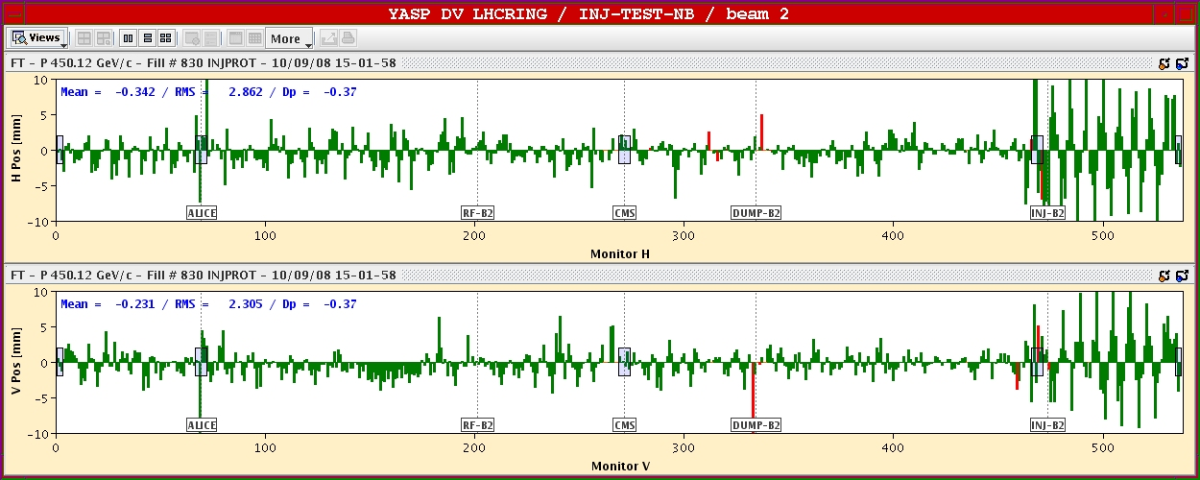
First Turn
  First & Second Turn on screen
  First Turn on BPM system

Slide 16
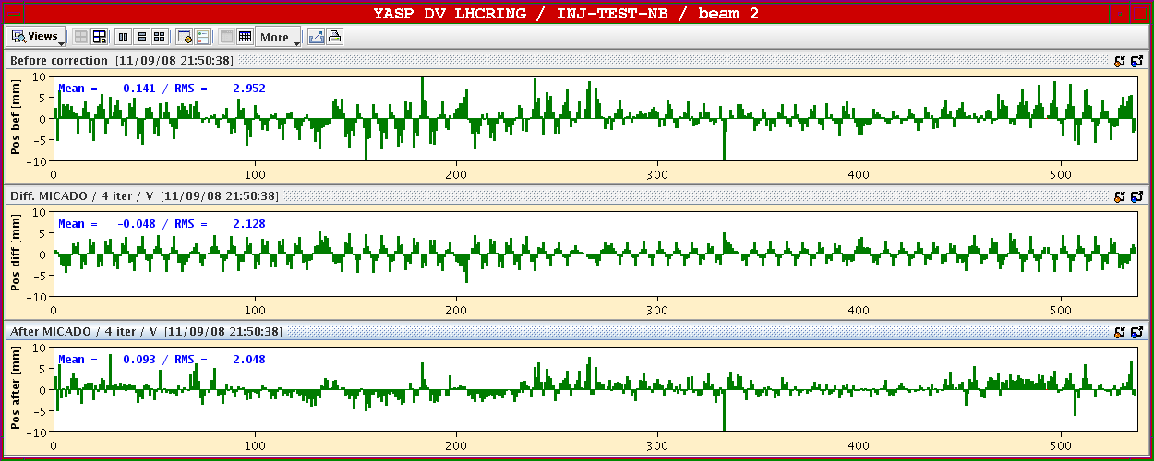
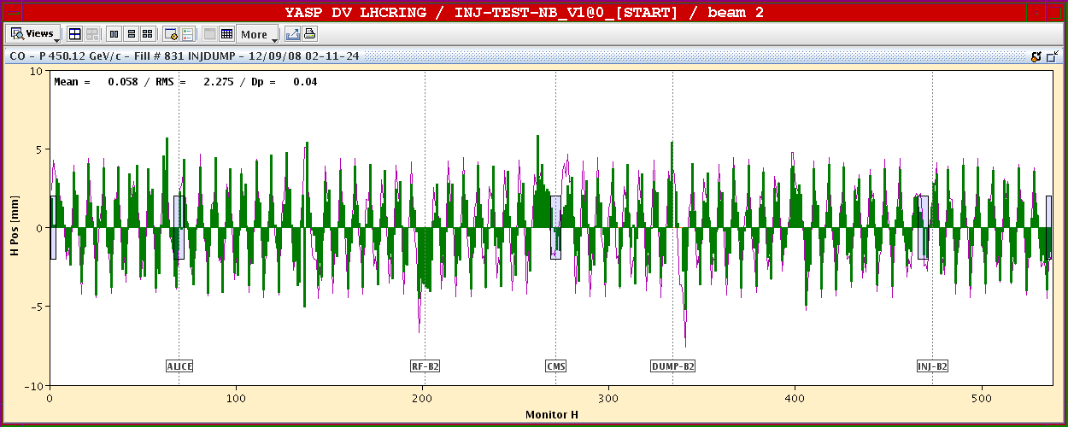
Closed Orbit and Kick Response for Full Machine

Slide 17
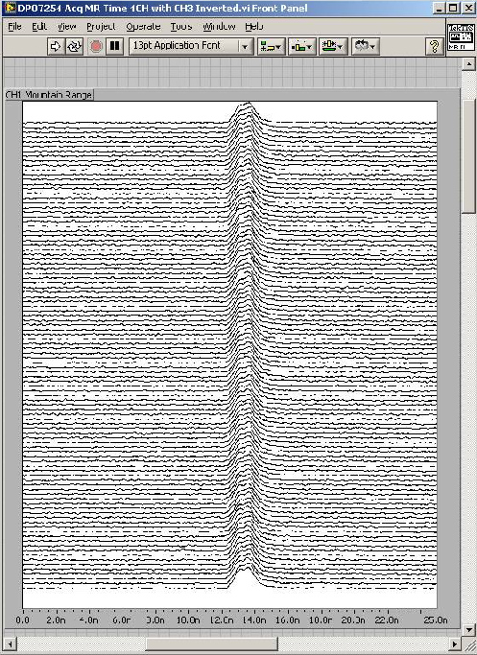
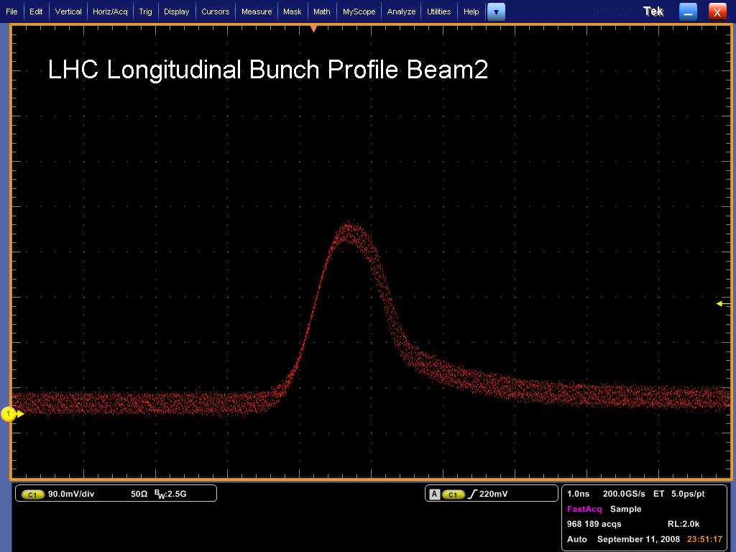
RF Capture
  Captured Beam Current
  Mountain Range display

Slide 18
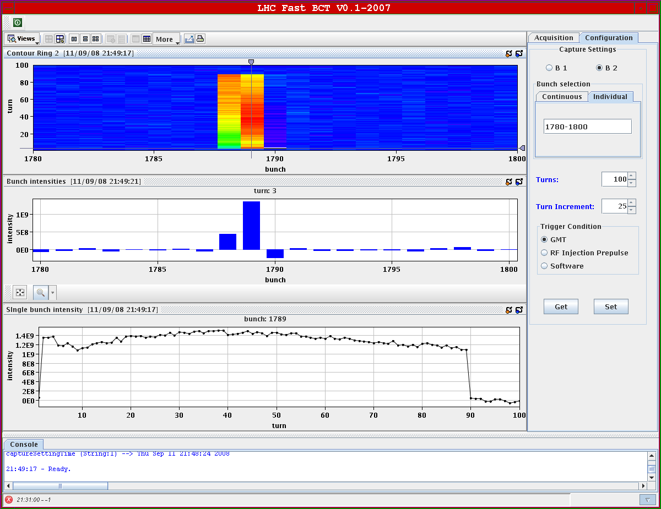
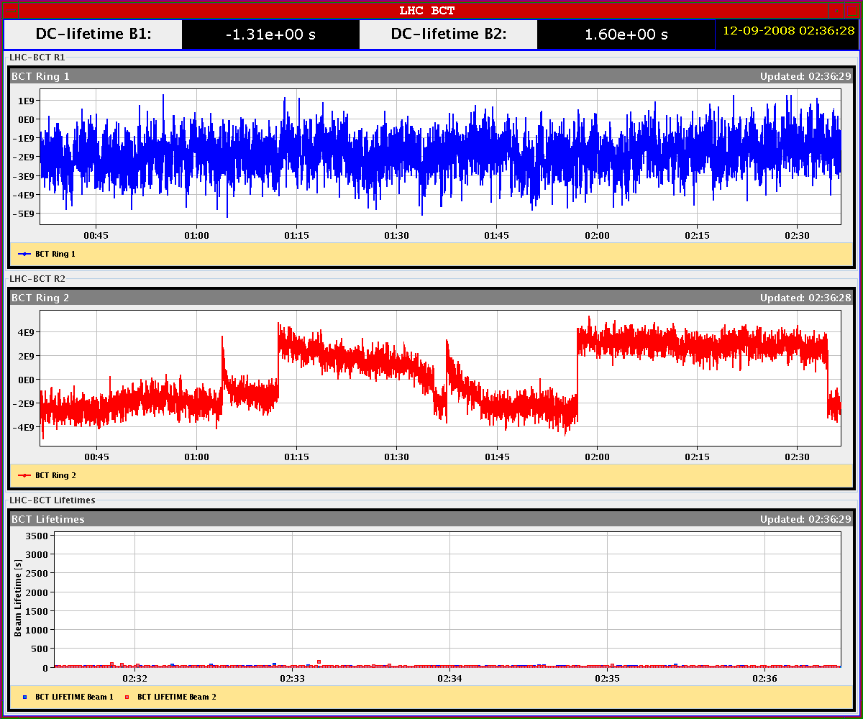
Beam Current Transformer and Beam Lifetime
  BCT versus bunch number and time: several hours beam lifetime!

Slide 19
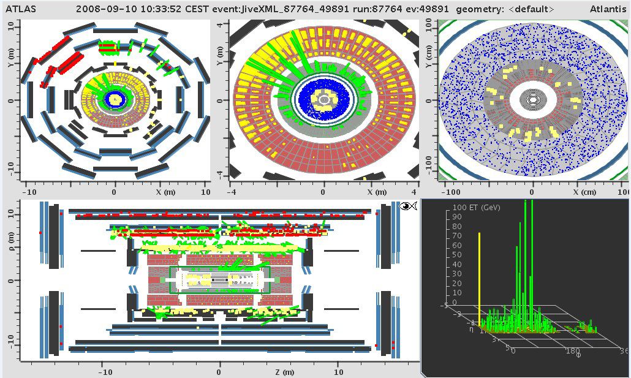
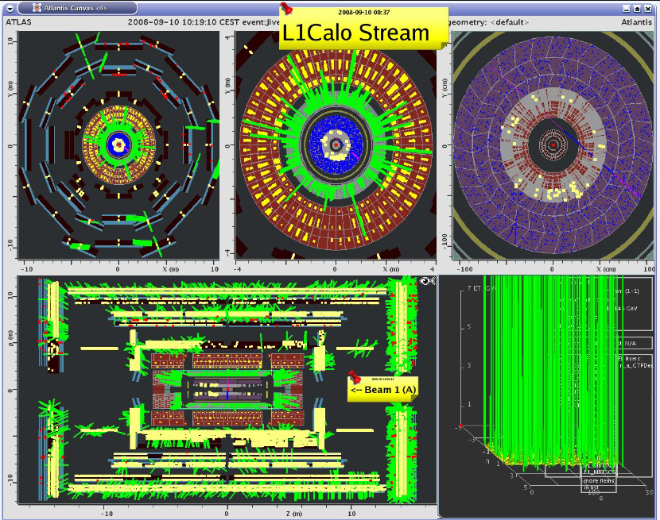
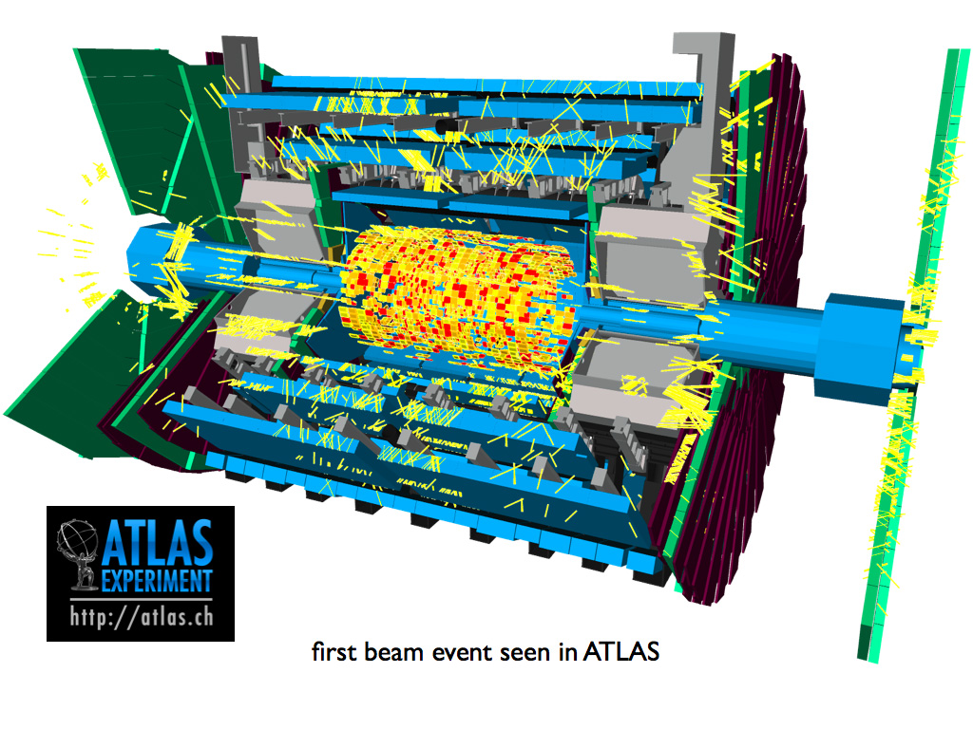
More events

Slide 20
Beam Commissioning
Some higher dimensional power was with us on 10th September
  helped by injection tests and some serious preparation
Remarkably successful
  Aperture clear
  Main magnetic fields OK and excellently predicted
  Beam Instrumentation
  Controls & software
  Access & machine protection
  Achieved a truly remarkable amount in 2-3 days
  BODES VERY WELL FOR THE FUTURE

Slide 21
It’s big
Large transformer failure on 12th September
  Loss of cryogenics in point 8 (Arcs 78 and 81)
Followed by
  Smaller transformer failure
  Lesser cryogenics problems
  Temperature probes on current leads
  etc…
  But essentially felt like regular operations on a big machine.

Slide 22
Friday 19th
Test of main dipole circuit in sector 34
  ramping to 5.5 TeV (9310 A)
  11:18 at around 8700 A
    power converter trips
    energy extraction system fires
    wave of alarms
    103 dipoles quench
Large Helium leak into tunnel
Helium into insulation vacuum:
  3 SSS (quadrupoles) have moved – over pressure on vacuum barriers
  State of dipole thermal shields to be checked
  No damage to tunnel infrastructure

Slide 23
Sector 34
Possible cause:
  quench and opening of busbar splice in SSS interconnect.
  open magnet interconnect next Monday
  clearly have to fully understand problem and prevent its reoccurrence
Consequence:
  warm sector up ~ 3 weeks
  4-5 quadrupoles out for repair
    re-cryostating – cold mass probably OK
  8-10 dipoles out for re-cyrostating
  QRL and vacuum repairs in situ
  re-install magnets
  cool-down
Clear overlap with winter shutdown (NB injectors)
  First beam back to LHC – earliest 1st May 2009

Slide 24
Conclusions
A extremely complex machine with an international profile that with a lot of effort:
  has been brought to 1.9 K
  has been almost completely commissioned to 5.5 TeV
  has had a highly successful and very public three days with beam
  has a serious technical problem
  has the expertise and resources to fix the problem
The physics potential of the LHC remains enormous.
It will work.

