Slide 1

News on platforms and policies
Stefan Roiser

Slide 2
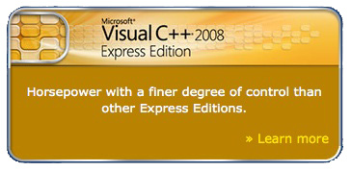
Platform News
Currently porting LCG/AA s/w to new architectures / compilers
  Windows VC9
    We use Microsoft Visual C++ 2008 – Express Edition
      The “free” version – so far no real obstacles found
    Several adaptations needed in configuration
      Need to force the non debug STL for compilation
      Additional files (.manifest)
    Needed to move to new gccxml 0.9.0_20081002 for VC9 support
    Builds take ages – problem with the virtual machine?
  gcc 4.3(.2)
    Including a rebuild of all external packages (32 and 64 bit)
    Running in the nightlies “dev” (HEAD of everything) slot since last week
  slc5
    32 bit and 64 bit installations at our lxbuild xen node (lxbuild116)
    Builds shall start soon with gcc 4.1 (native slc5 compiler)
    no problems expected – we are building gcc 4.1 successful for some time

Slide 3
Tag unification proposal
In the past we diverged for the tag names into different styles. A proposal was setup to
  Unify the tag names again
    Propose to use “Atlas” style, e.g.
  For CMT based projects, derive information about the “host” and “target” - with a clear policy
    Clear distinction between “host” and “target” properties
    Eg. will ease our life for cross compiling
  https:/twiki.cern.ch/twiki/bin/view/SPI/TagsUnifyProposal
x86_64-slc5-gcc41-opt
tag x86_64 host-x86_64
tag i686-slc5-gcc41-opt target-i686 target-slc5 target-gcc41 …
macro_append cppflags “” host-x86_64&target_i686 “ –m32 “

Slide 4
Proposal for a s/w removal
Over time we accumulated a lot of software installations in the afs area (~ 1 TB up to now)
Propose a 2 step process – executed twice/year
  “Call of usage”
    Ask for LCG Configurations currently used
    Compute and mark the number of candidates for removal
  “Backup and Remove”
    Backup a package/version before removal into CASTOR
    Remove the package/version from afs
https://twiki.cern.ch/twiki/bin/view/SPI/SwRemovalProposal

