Slide 1

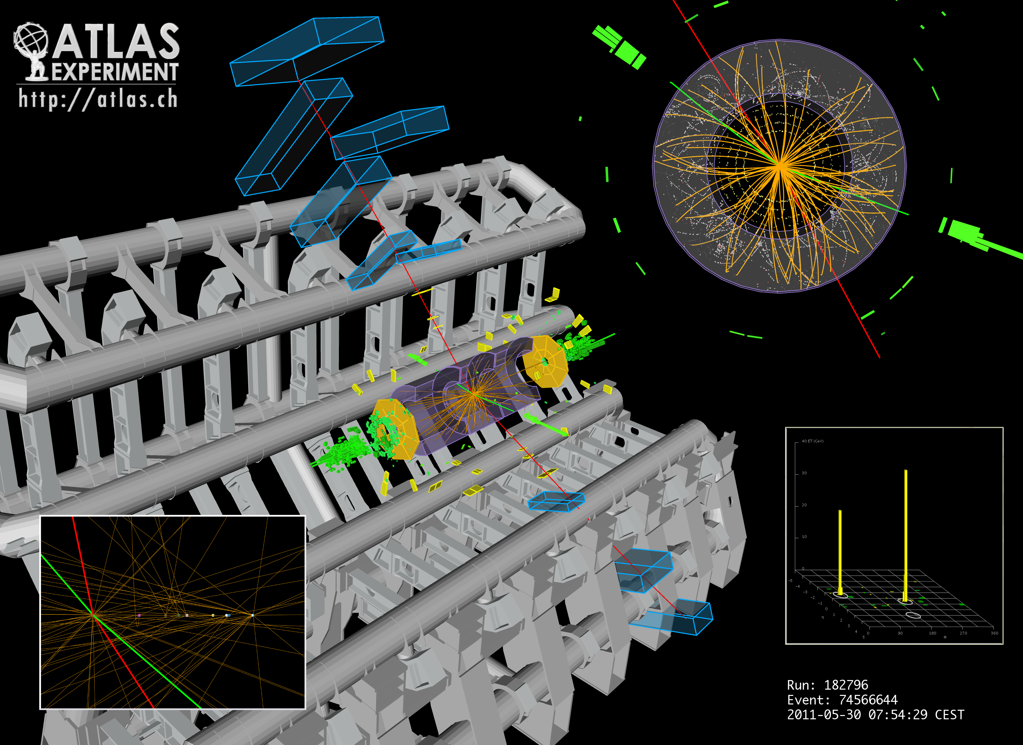


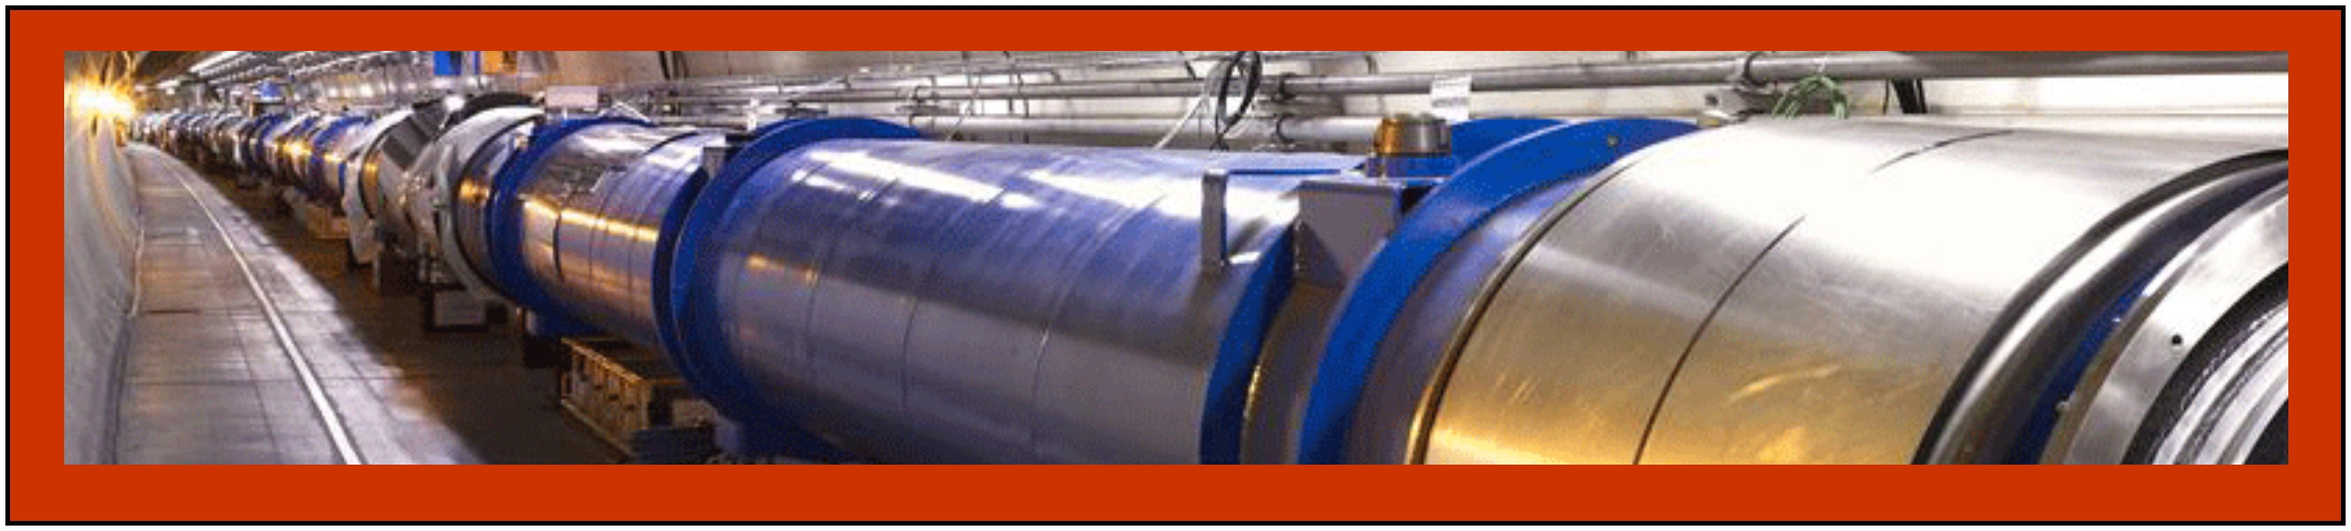
The Higgs boson and our life
The Royal Swedish Academy of Sciences
Fabiola Gianotti (CERN), 17 April 2013

Slide 2
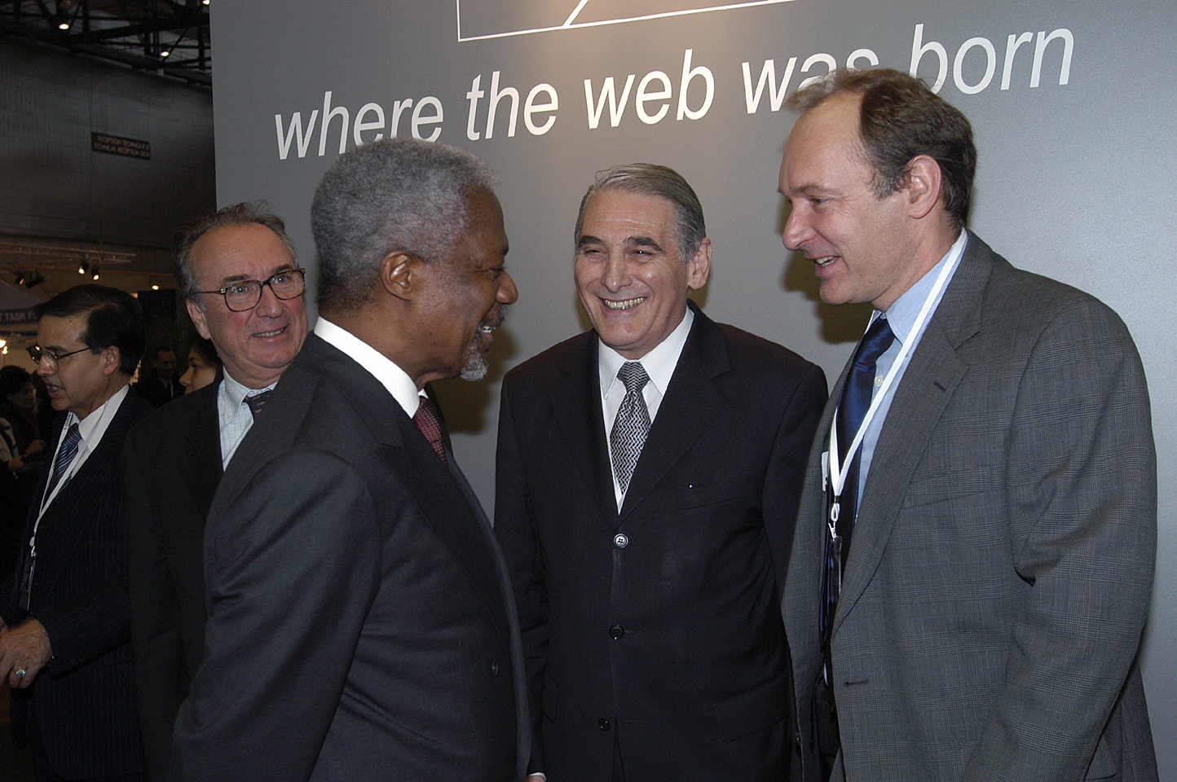
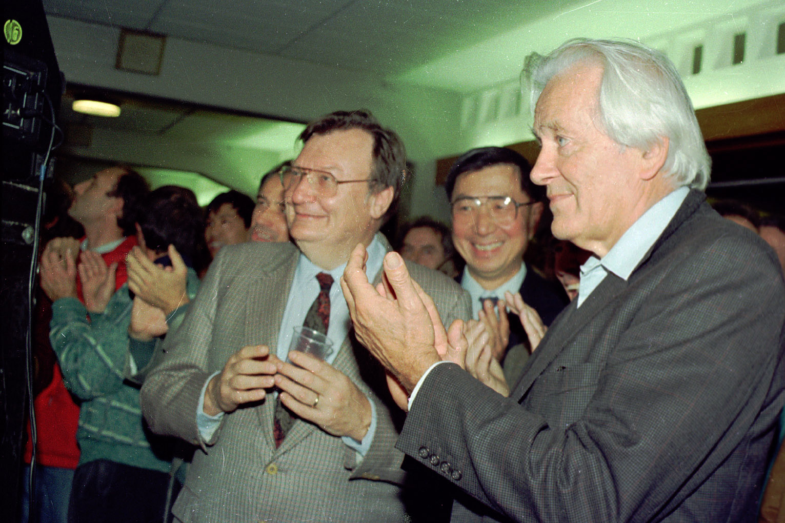
CERN
European Organization for Nuclear Research
The world’s largest particle physics laboratory
More than 50 years of:
fundamental research and discoveries (and Nobel prizes ...)
technological innovation and technology transfer to society
(e.g. the World Wide Web)
training and education (young scientists, school students and teachers)
bringing the world together (10000 scientists from > 60 countries)
Samuel Ting,
Nobel prize, 1976
CERN staff member T. Berners-Lee,
inventor of the WEB, with Kofi Annan
and CERN DG Luciano Maiani
George Charpak,
Nobel prize, 1992
Carlo Rubbia,
Nobel prize, 1984

Slide 3
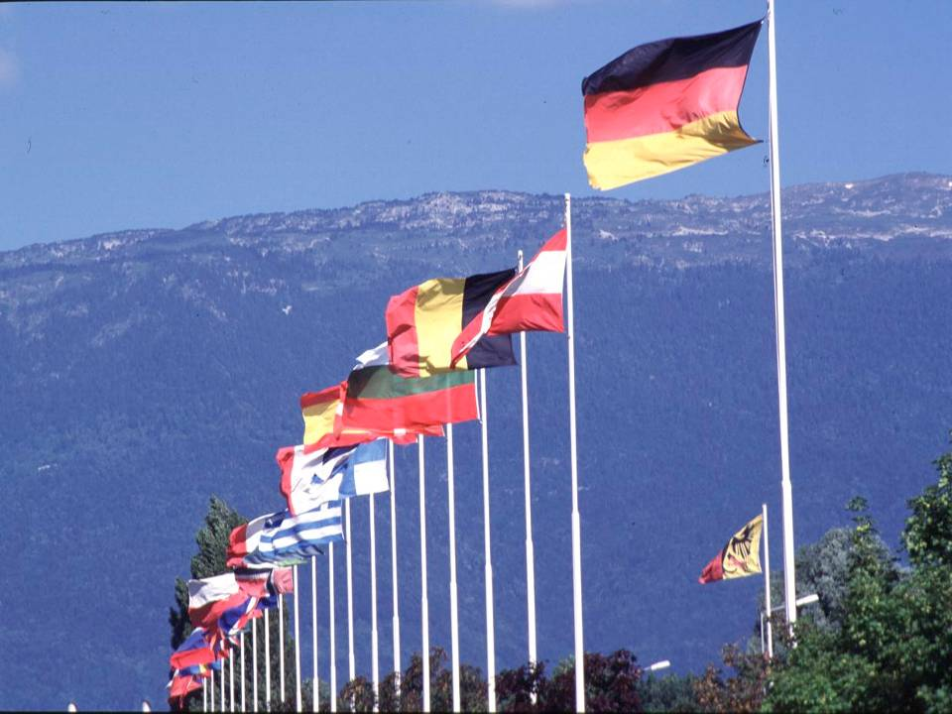

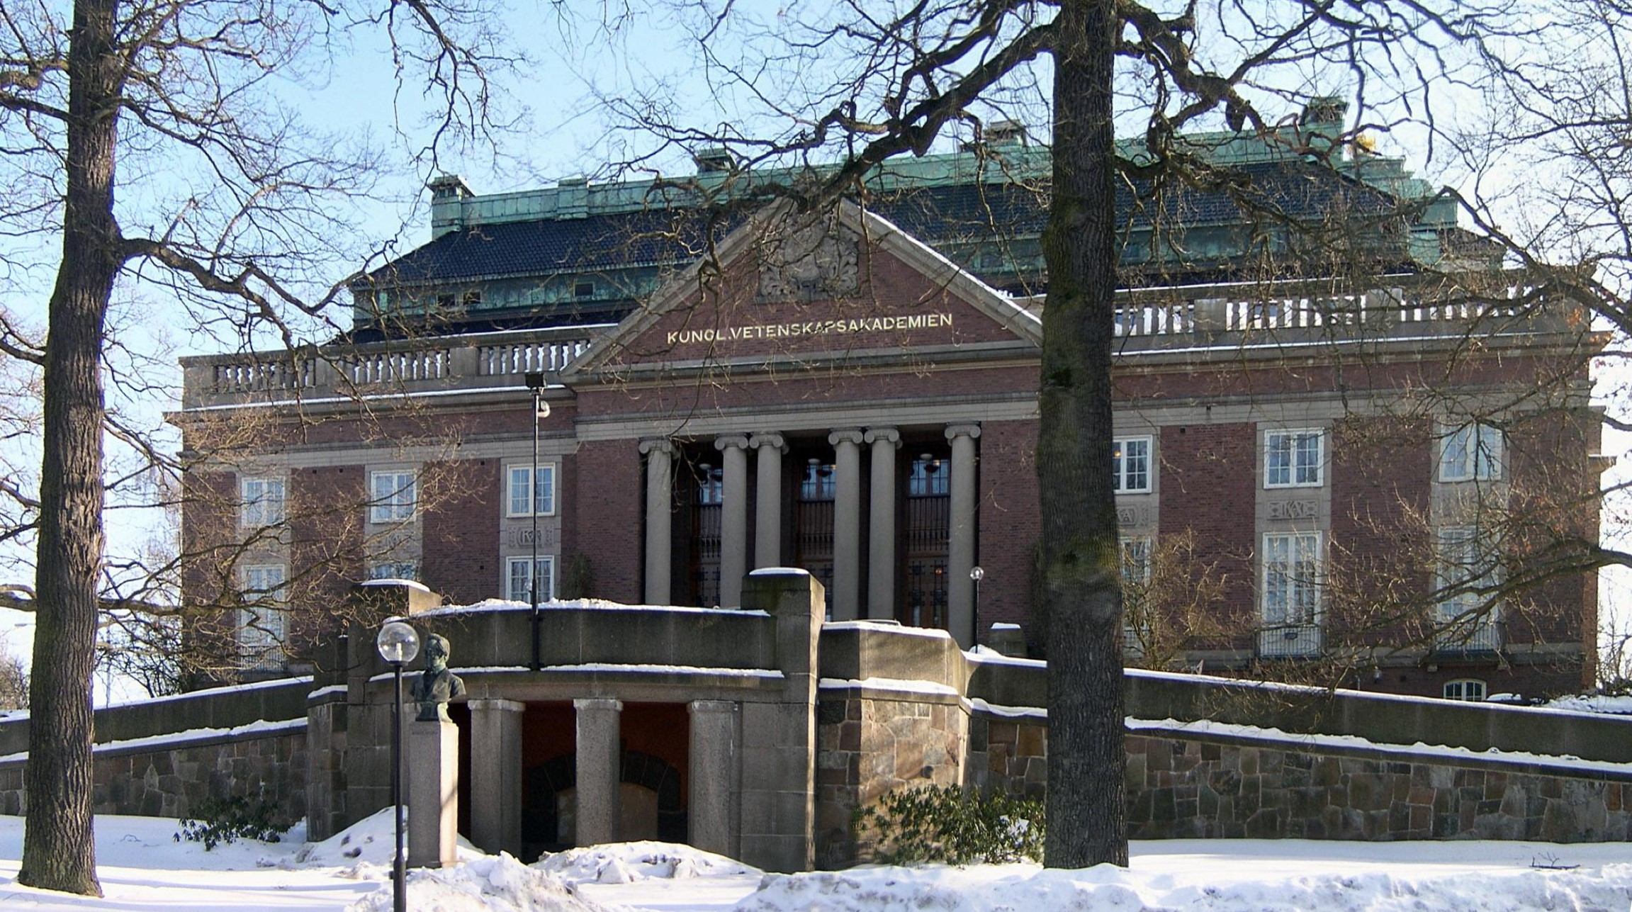
CERN was founded 1954: 12 European States
Today: 20 Member States
Member States: Austria, Belgium, Bulgaria, the Czech Republic, Denmark, Finland, France, Germany, Greece, Hungary, Italy, the Netherlands, Norway, Poland, Portugal, Slovakia, Spain, Sweden, Switzerland and the United Kingdom
Observers: India, Japan, the Russian Federation, United States of America, Turkey, the European Commission and UNESCO
~ 2300 staff
> 10000 users
Budget (2012) ~1000 MCHF (1 cappuccino/European citizen):
each Member State contributes in proportion to its income
Sweden: ~ xxx%
3
Notes:
3

Slide 4
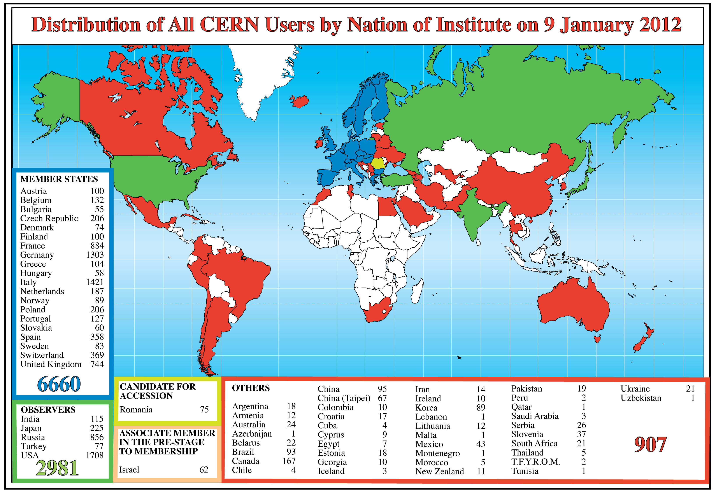
More than 10000 users from > 60 countries
Notes:
4
4

Slide 5
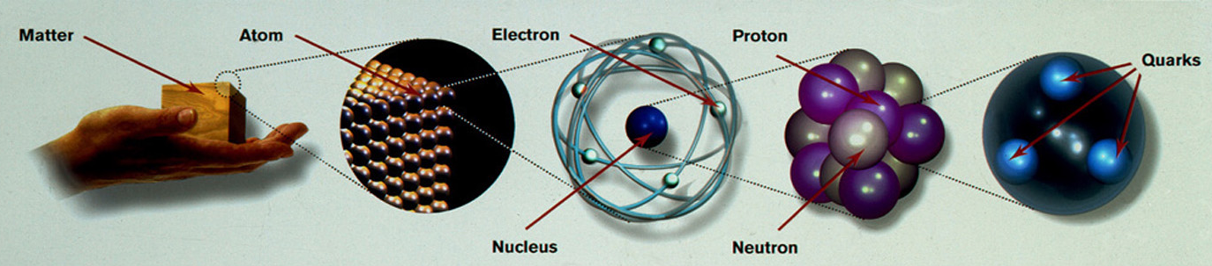
CERN’s primary mission is SCIENCE
Study the elementary particles (e.g. the building blocks of matter:
electrons and quarks) and the forces that control their behaviour
at the most fundamental level
10⁻¹⁰ m
10⁻¹⁴ m
10⁻¹⁵ -10⁻¹⁸ m
Particle physics at accelerators allows us today to study the fundamental laws of nature on a scale of 10⁻¹⁸ m → insight also into the structure and evolution of the Universe → from the very small to the very big …

Slide 6
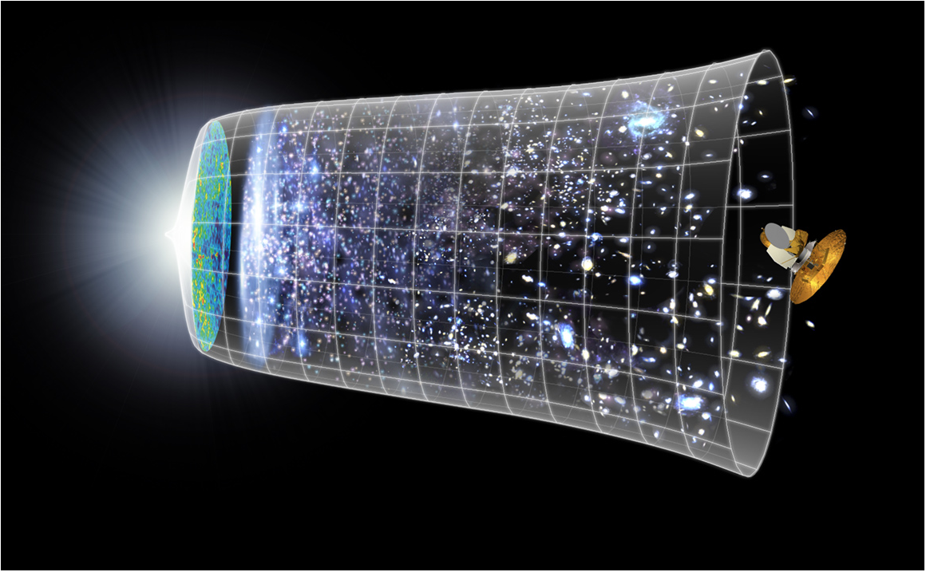
Evolution of the Universe
Big Bang
13.7 Billion Years
Today
10²⁸ cm

Slide 7
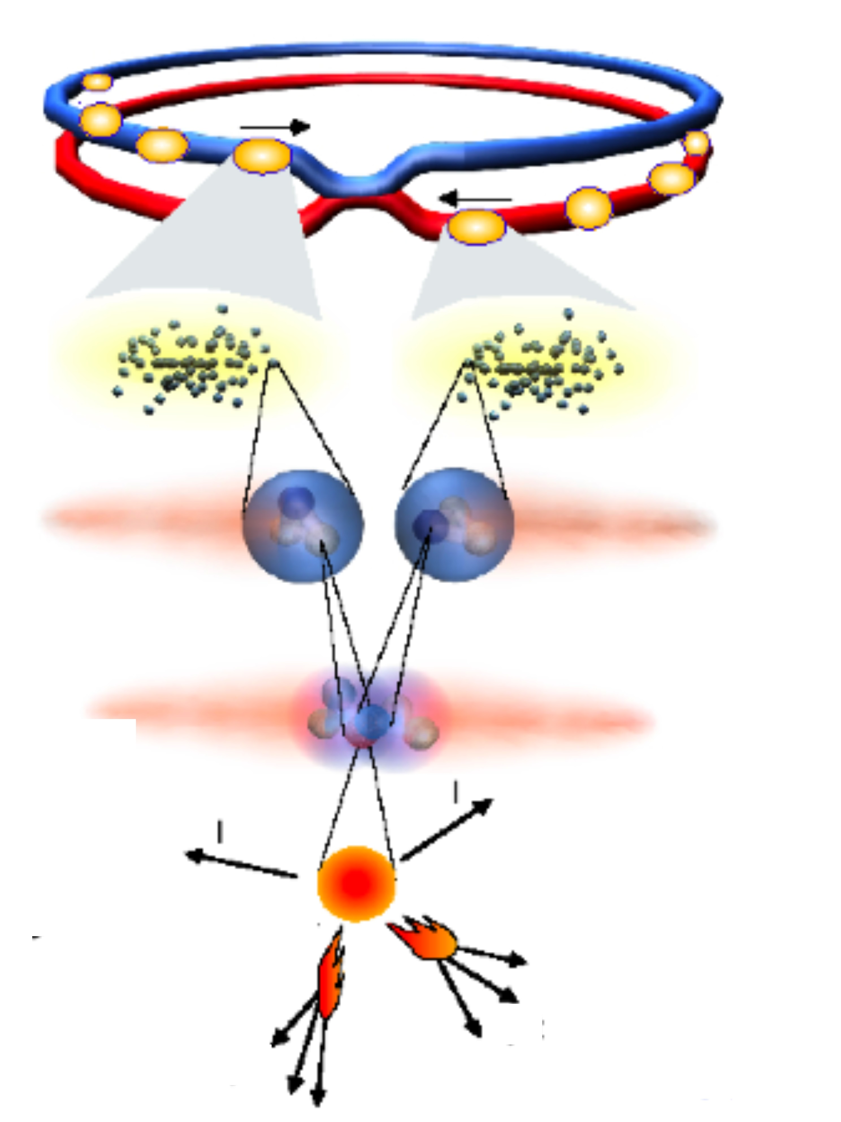
To study the elementary particles and their interactions:
We accelerate two beams of particles
(e.g. protons) close to the speed of light
and make them collide
proton
beams
The colliding protons break into their
fundamental constituents (e.g. quarks)
These constituents interact at high energy:
study the way fundamental matter behave
(new) heavy particles can be produced in the
collision (E=mc²). The higher the accelerator
energy, the heavier the produced particles
can be. These particles then decay into lighter
(known) particles: electrons, photons, etc.
colliding
protons
interacting
quarks
By placing high-tech powerful detectors around
the collision point we can detect the collision
products and reconstruct what happened in the
collision (which phenomena, which particles and
forces were involved, etc.)
production
and decay of
a new particle

Slide 8
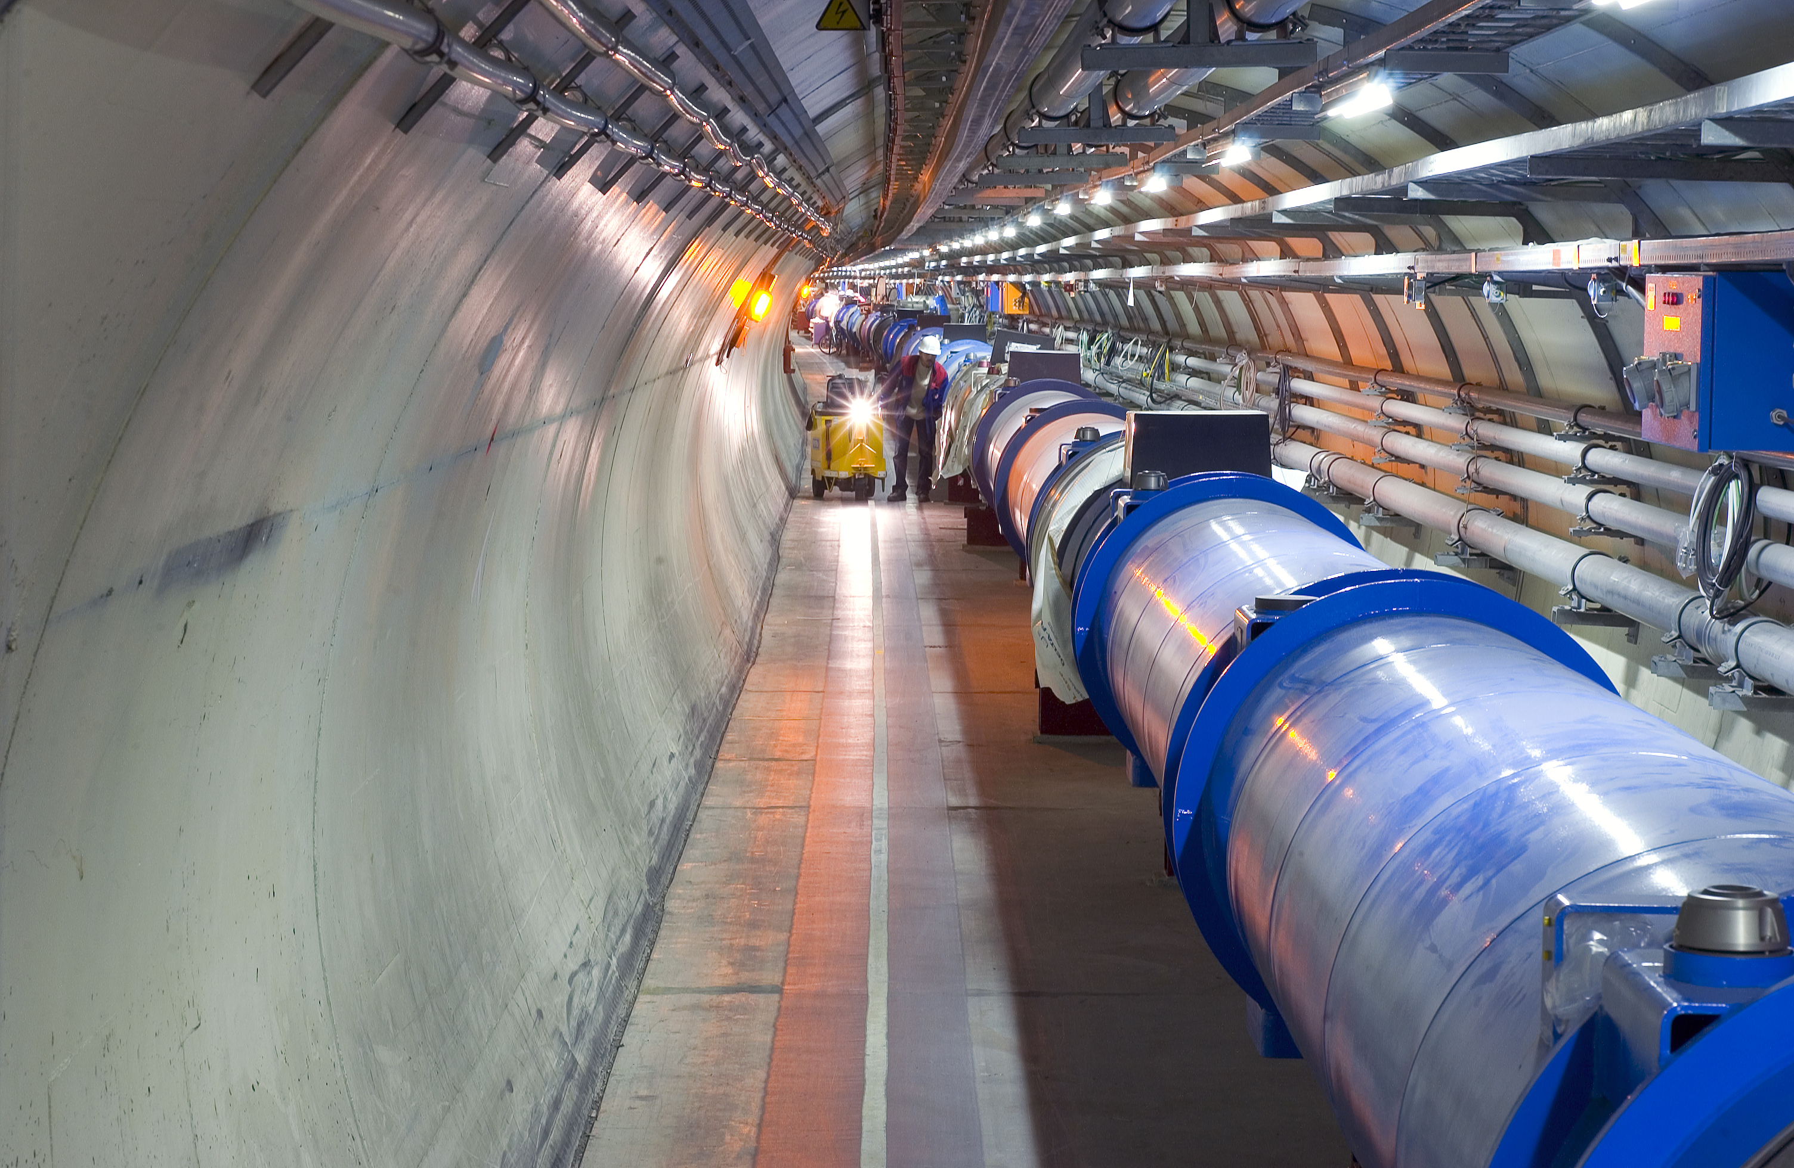
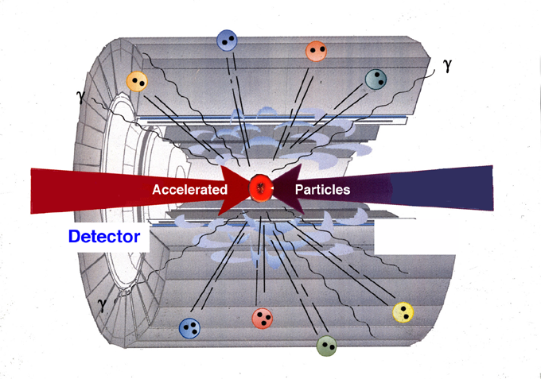
Therefore, we need three things:
Accelerators: underground tunnels (usually rings) containing electric
fields to accelerate particles to very high energy (incrementally at each turn),
and magnets to bend the beams inside the ring and bring them into collision
Powerful giant microscopes to explore the smallest constituents of matter !!
Detectors: massive instruments which register the collision products and
allow to identify the produced particles and measure their energy and trajectory.
Computing: to store, distribute and analyze the vast amount of data produced
by the detectors and thus reconstruct the “event” occurred in the collision.

Slide 9

The Large Hadron Collider (LHC)
the most powerful accelerator
…. and also ….
the most high-tech and complex detectors
the most advanced computing infrastructure
the most innovative concepts and technologies
(cryogenics, new materials, electronics, data transfer and storage, etc. etc…)
the widest international collaborations
ever achieved in accelerator particle physics.
One of the most ambitious projects in science in general.
Operation started 20 November 2009
(> 20 years from concept to start of operation )

Slide 10
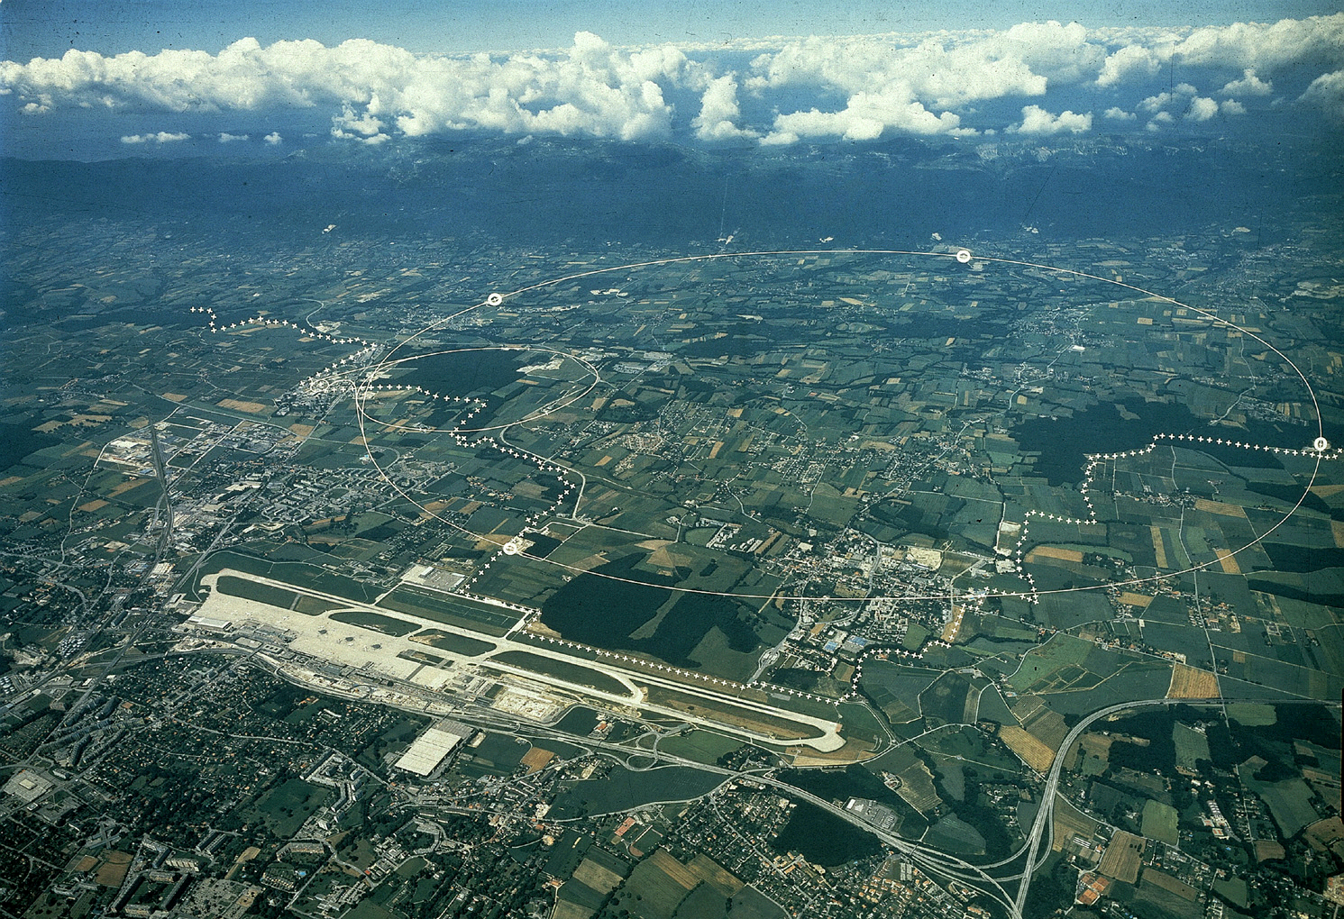
The LHC is a 27 km ring, 100 m below ground, across France/CH
Two proton beams are accelerated in opposite directions.
They collide at 4 points, where 4 big experiments have been installed.
French-Swiss
border
CERN main site
LHC 27 km ring
(previously used for
LEP e⁺e⁻ collider)
Geneva Airport

Slide 11

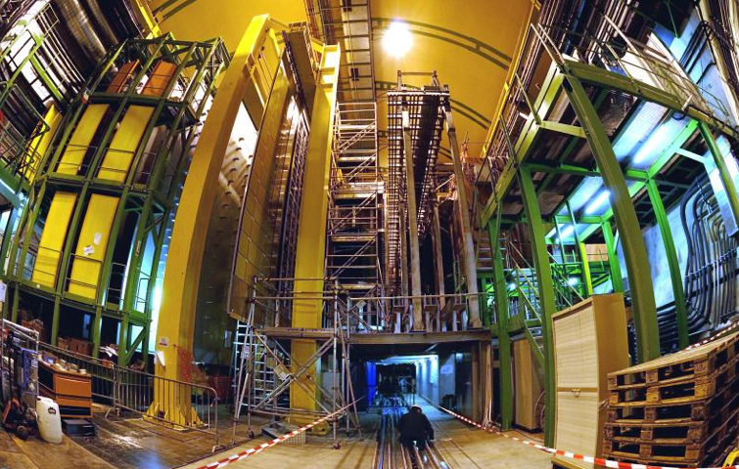
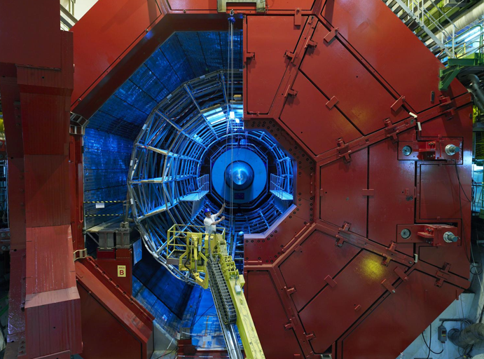


LHCb
CMS
Sweden has made very important contributions to the
LHC accelerator and experiments
Lund
Lund
Stockholm University
Stockholm KTH
Uppsala
ALICE
ATLAS
Notes:
11

Slide 12
Unprecedented energy:
4 TeV per beam particle → collision energy = 8 TeV (1 TeV= 10⁻⁷ Joule)
2015 → collision energy to ~ 14 TeV (7 times larger than the previous collider, Tevatron at FNAL)
Note: huge amount of energy concentrated in the collision point
(14 TeV corresponds to 10¹⁴ times the temperature in this room)
However: small energy on macroscopic scale
(1 μJoule is just enough to swat a mosquito)
The most challenging components
of the LHC are 1232 high-tech
superconducting magnets, providing
a field of 8.3 T (needed to bend
7 TeV beams inside a 27 km ring).
7600 km of NbTi superconducting cable
Work at 1.9K (-270 degrees)
Prototypes of superconducting dipoles developed
and tested by Uppsala with Helsinki in the ‘90s
Electrical power to run the LHC (from French EDF): ~200 MW

Slide 13
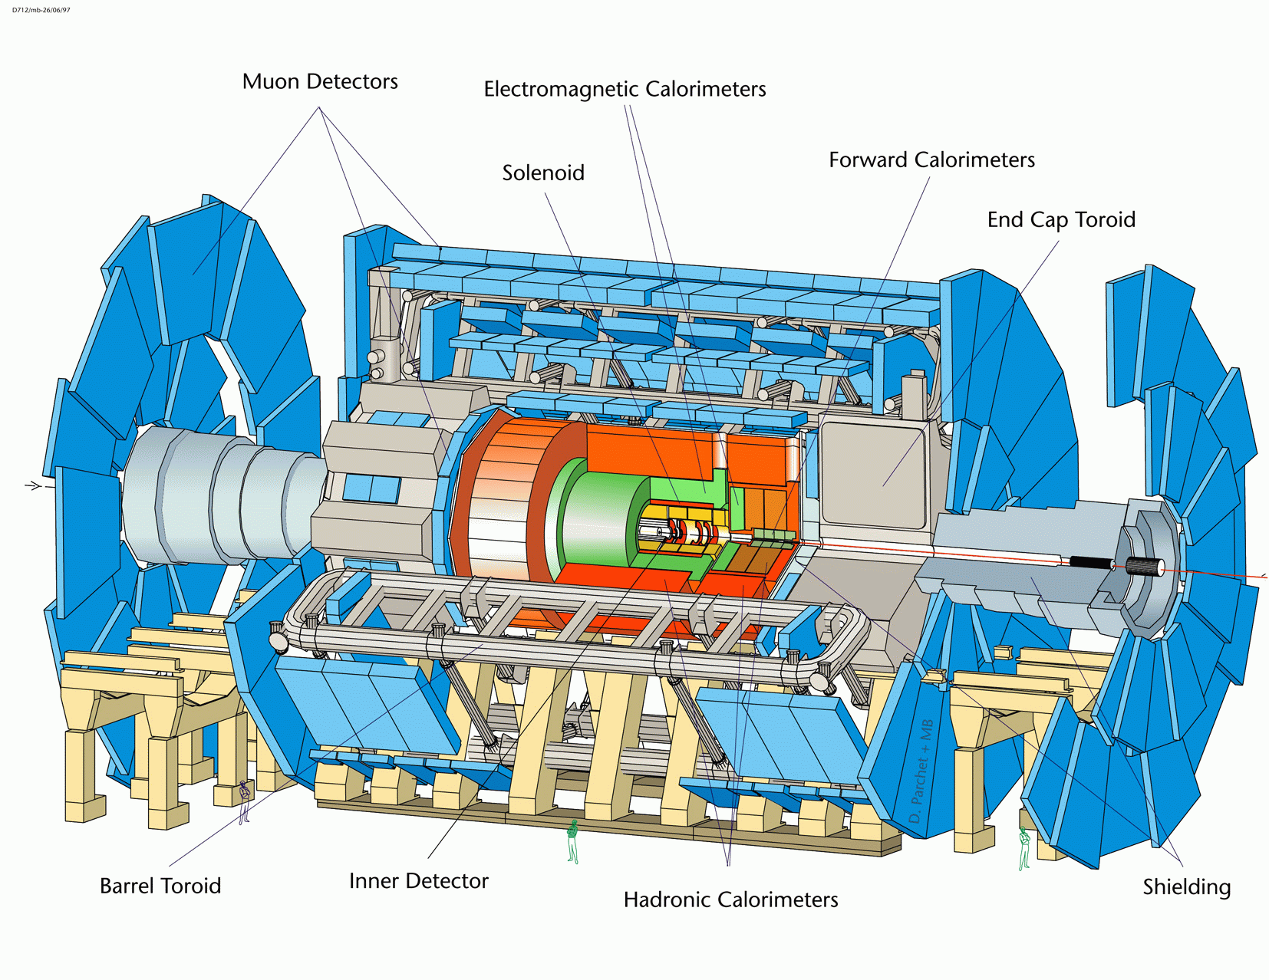
ATLAS
LHC detectors are
much more complex,
performing and
challenging than those
at previous/present
accelerators
a big jump in concepts
and technologies
a human being
Size (length 45m, diameter 25m): to measure and absorb high-energy particles
10⁸ sensitive elements (“individual signals”): to track ~1000 particles per event
and reconstruct their trajectories with ~10 μm precision (1 μm=10⁻⁶ m)

Slide 14
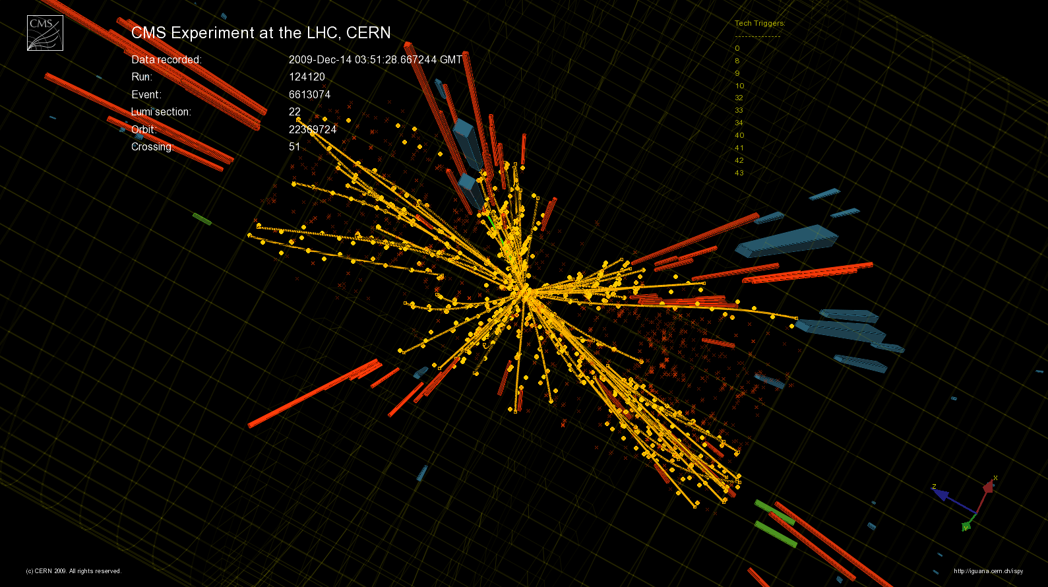
A collision in the CMS detector
Particle trajectories are reconstructed
with precision of few microns
Giant ultra-fast digital camera
40 million beam-beam collisions per second
→ fast response (~50 ns) (1 ns = 10⁻⁹ s)

Slide 15
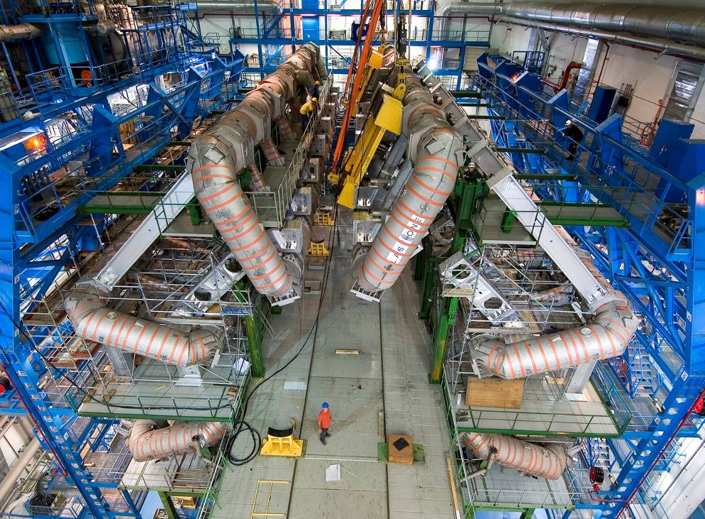
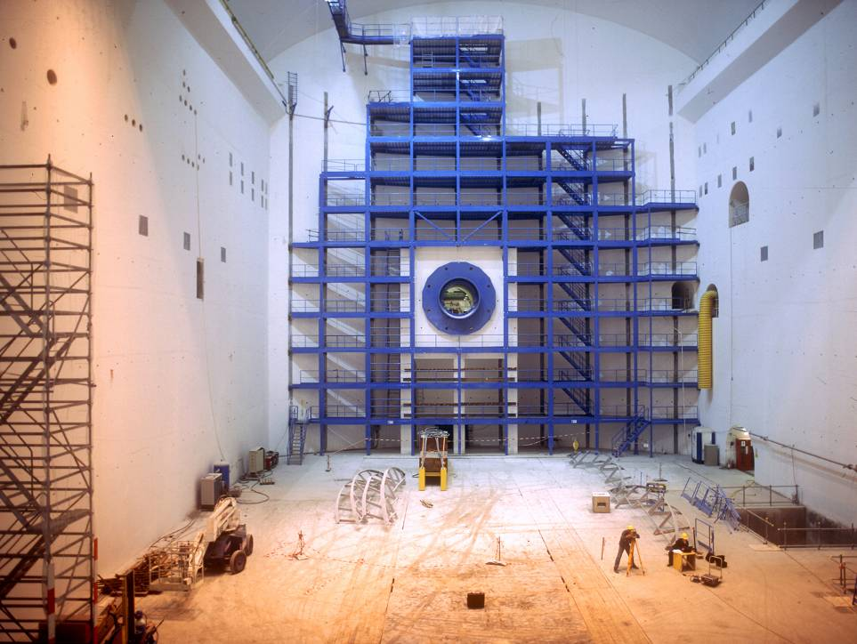
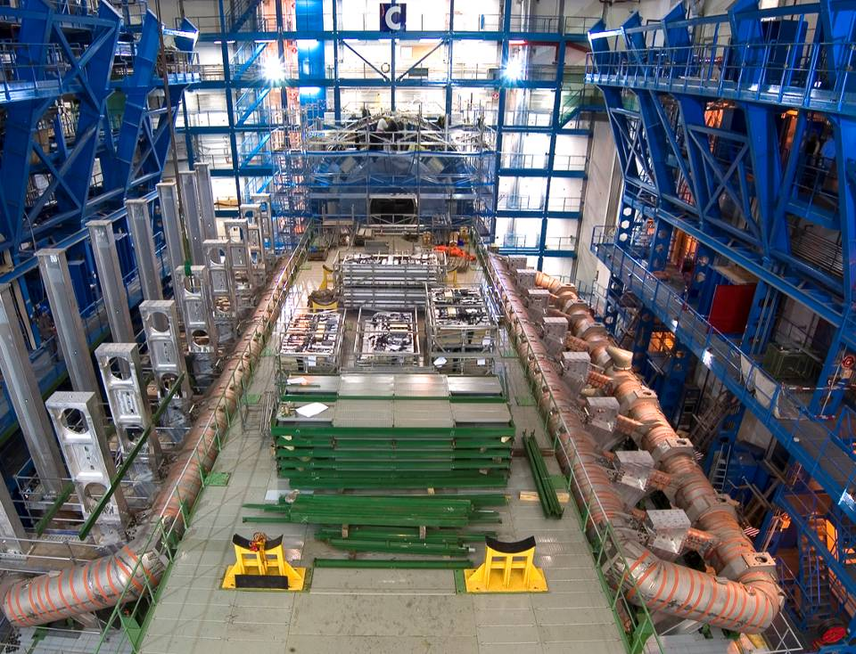
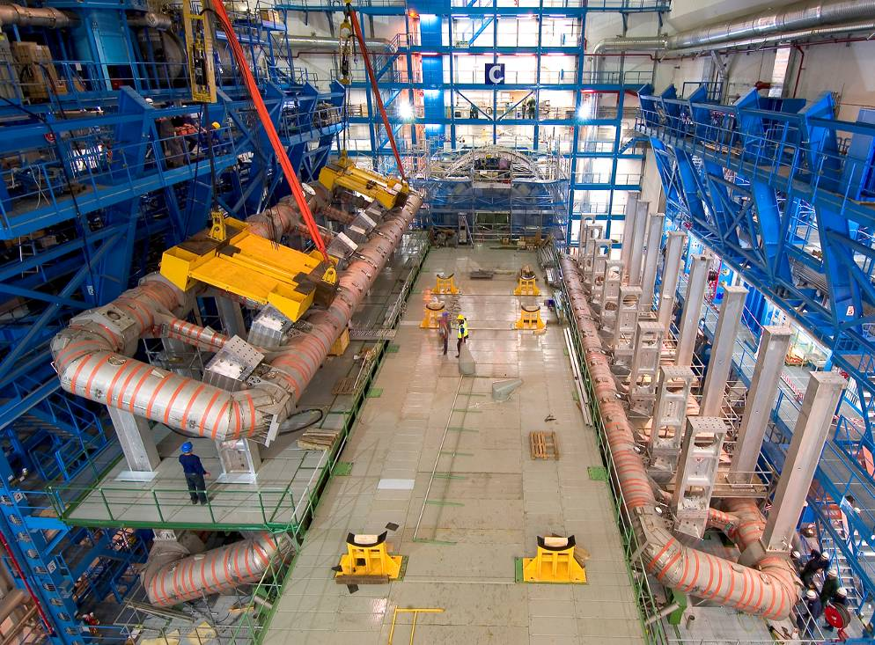
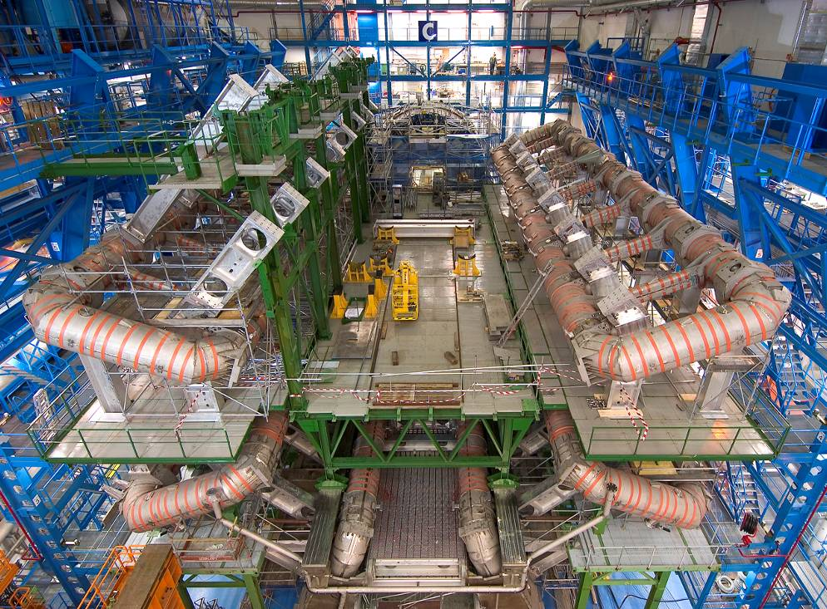
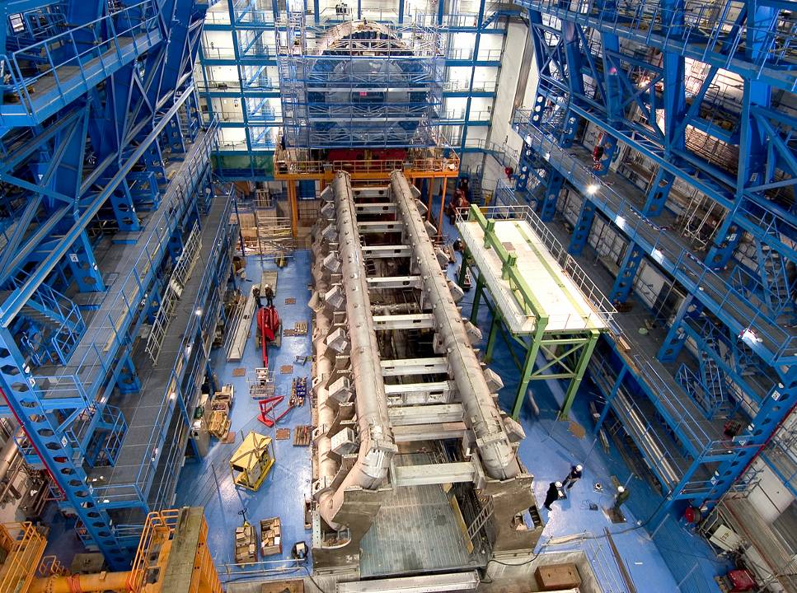
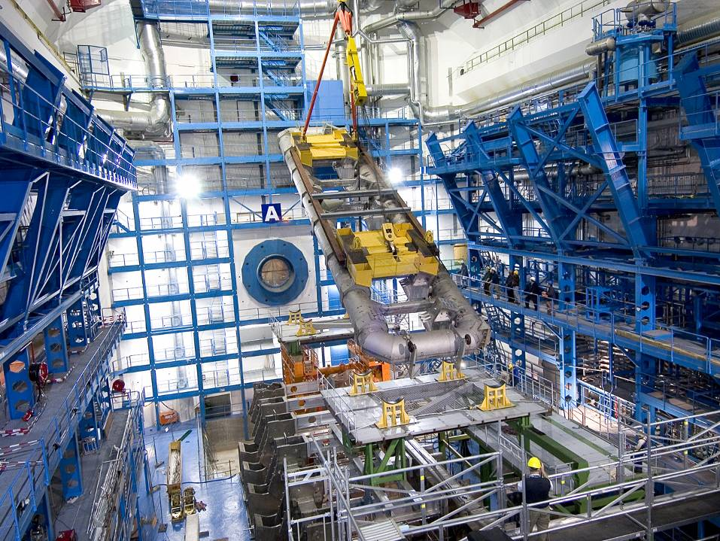
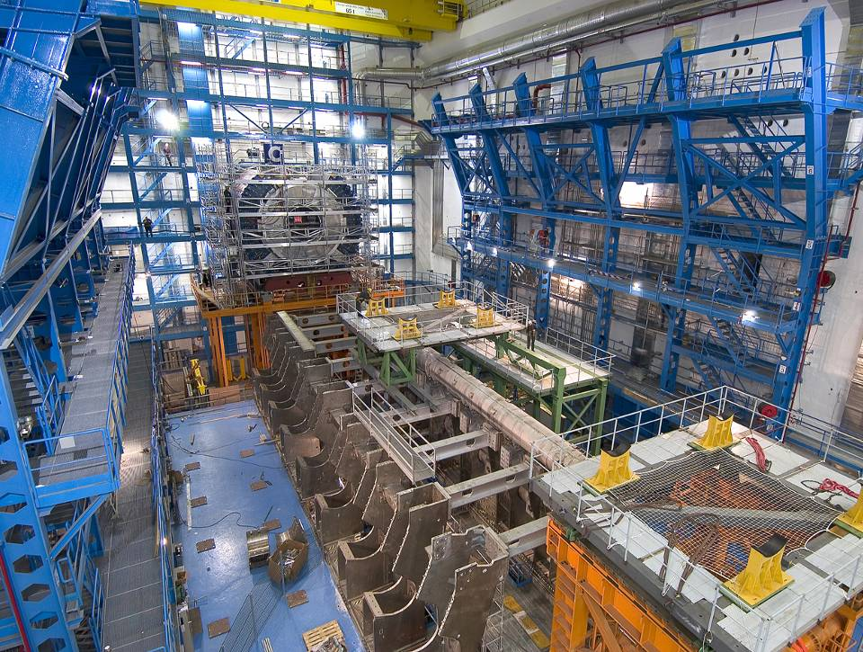
ATLAS: Installation of Barrel Toroid
ATLAS cavern (-100 m) in June 2003
15
Notes:
15

Slide 16
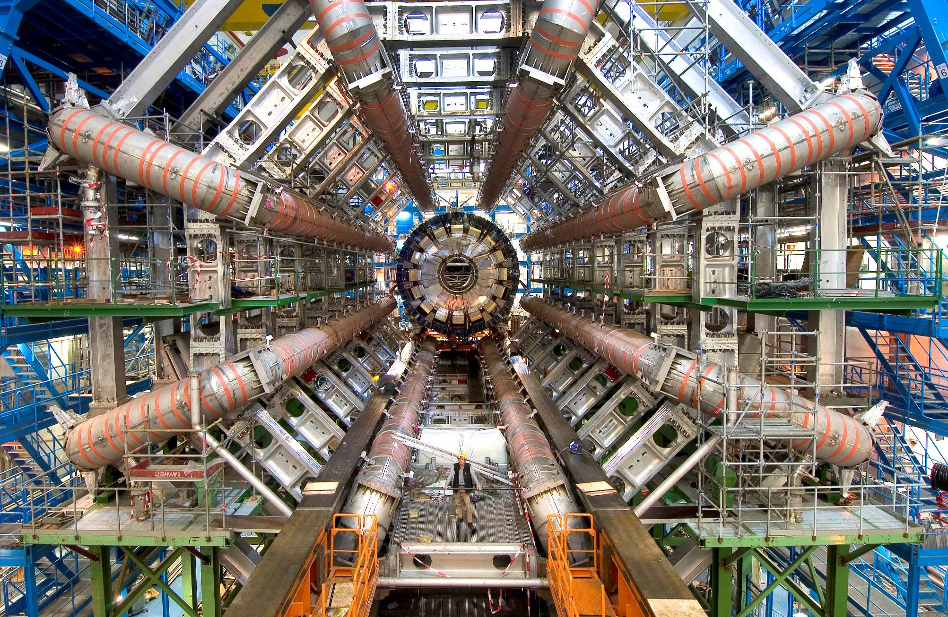
October 2005: Barrel toroid magnet system in place
a (Swedish) human being ..

Slide 17
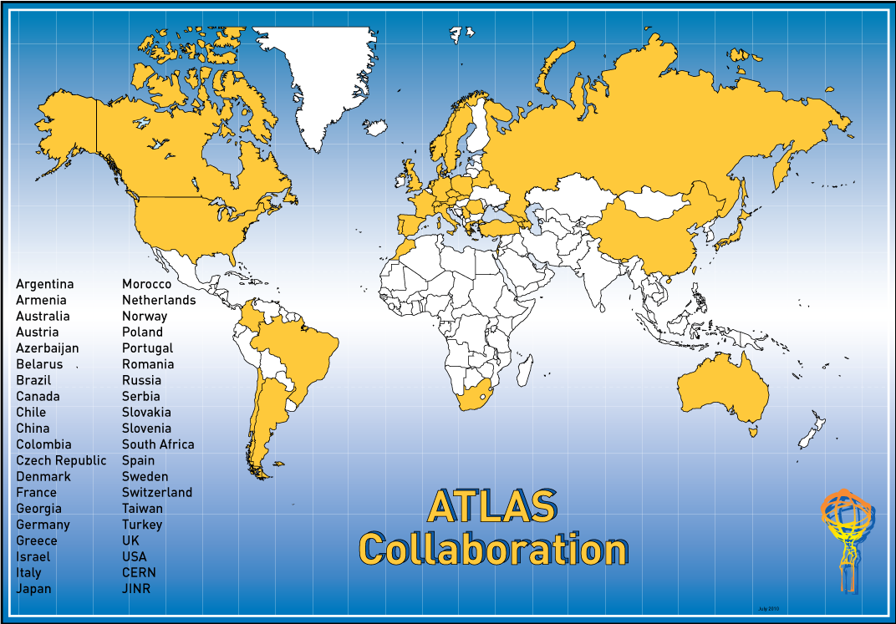
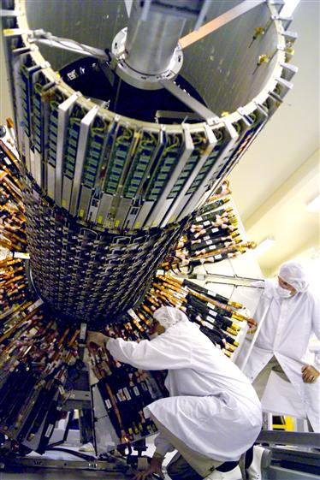
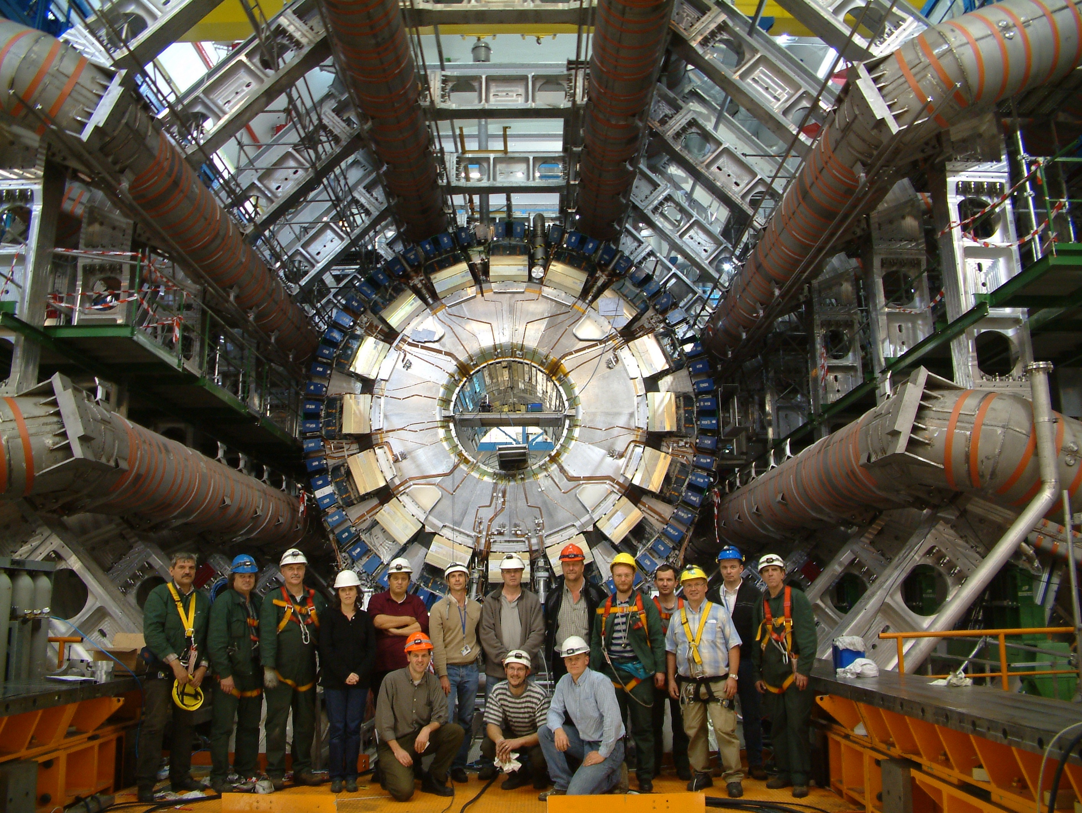
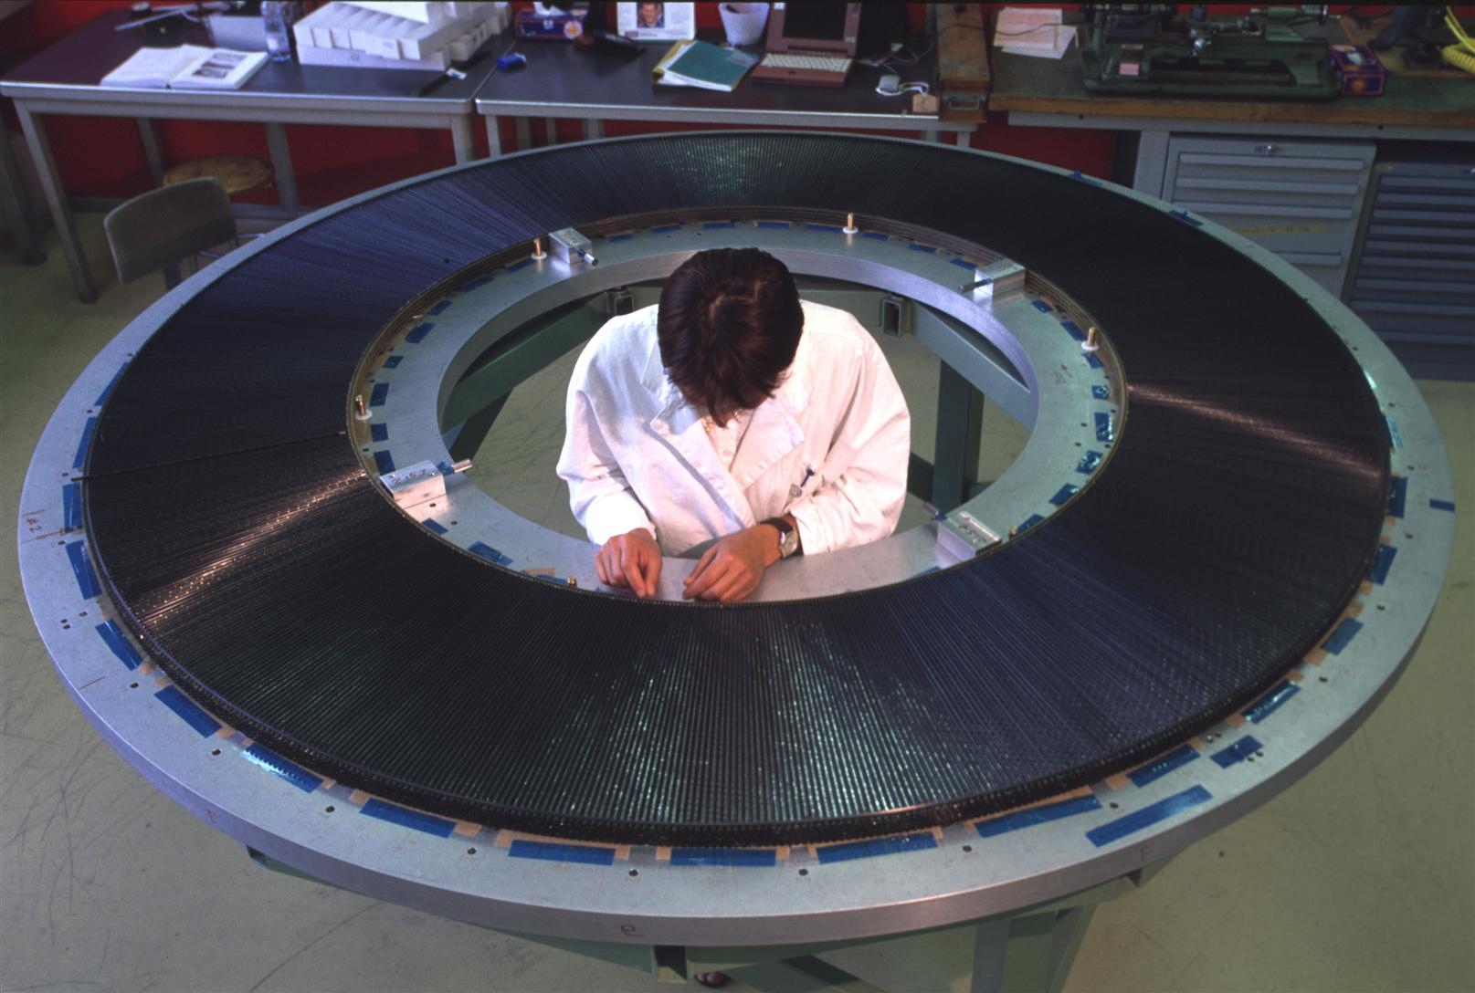

~ 3000 scientists from 176 Institutions from 38 Countries
Sweden:
Lund, Stockholm University, Stockholm KTH, Uppsala
50 scientists (~20 students)
Contributed to inner detector, calorimeter, trigger system, computing,
physics (Higgs, Supersymmetry, ..), future detector R&D and upgrade,

Slide 18
Age distribution of the ATLAS population
All 2690 (< 35 y 47.2%)
Male 81.8% (< 35 y 44.0%)
Female 18.2% (< 35 y 61.3%)
(Status 1.1.2010)
More than 1000 PhD students

Slide 19
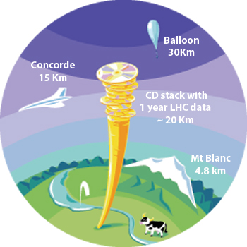
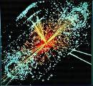
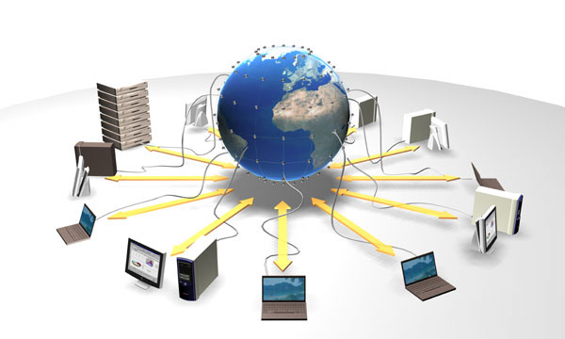
Computing
Each LHC experiment produces ~ 10 PB
of data per year 1 PB=10⁶ GB
This corresponds to ~ 20 million DVD (a 20 km stack …)
Data analysis requires computing power
equivalent to ~100 000 today’s
fastest PC processors.
The experiment international Collaborations
are spread all over the world → computing
resources must be distributed.
Grid
Cooperation of many computer centres
all over the world is needed

Slide 20
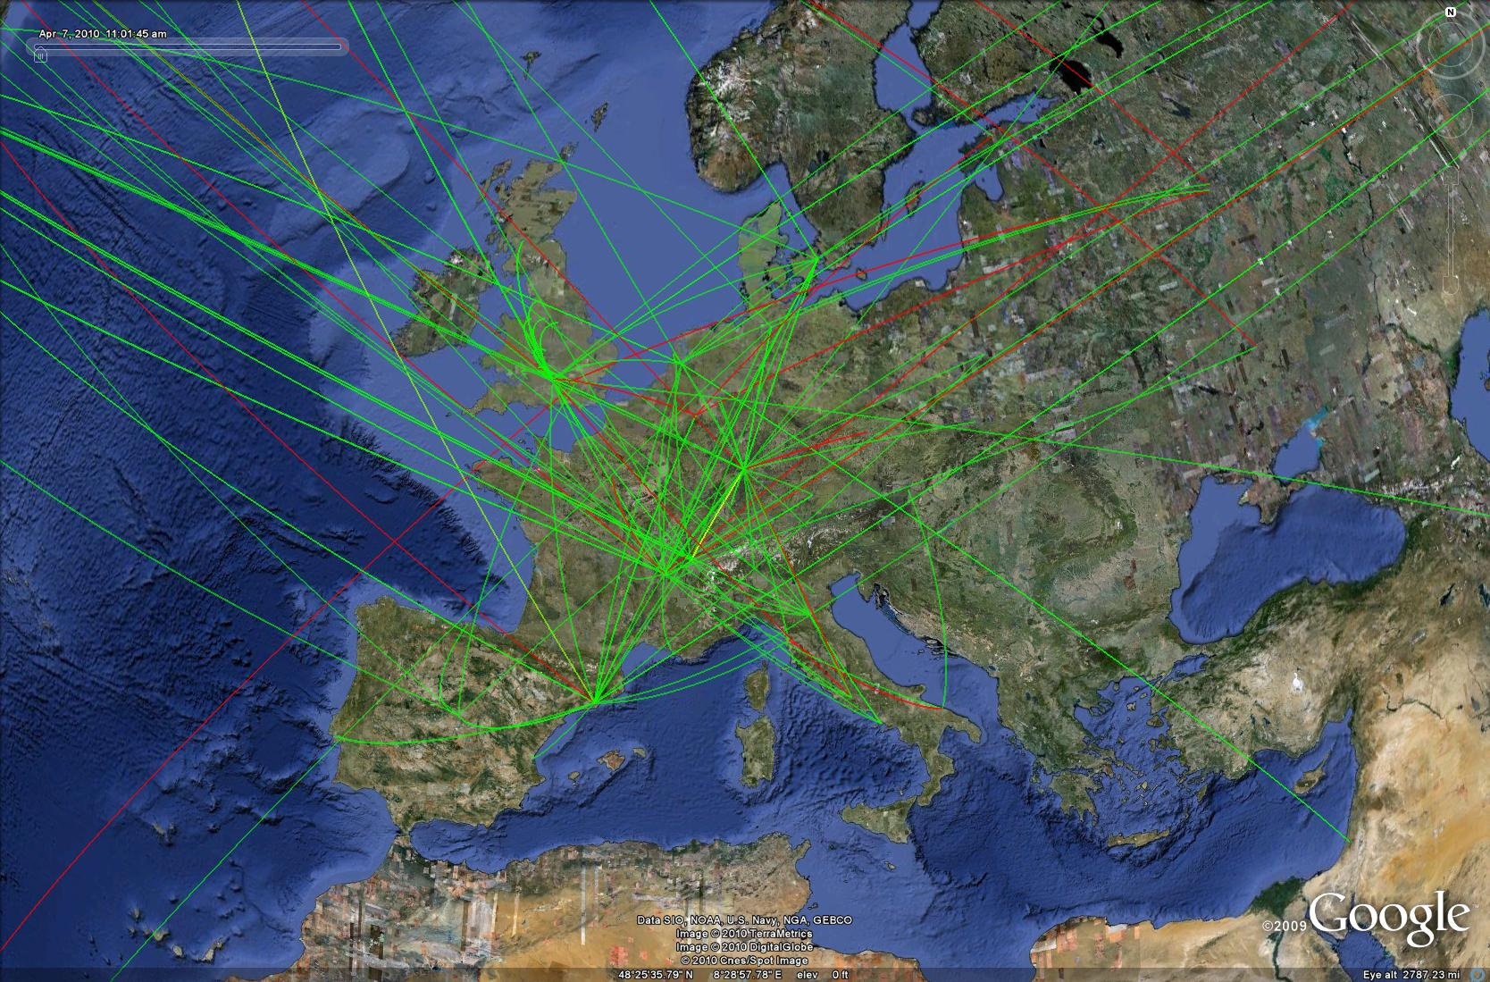
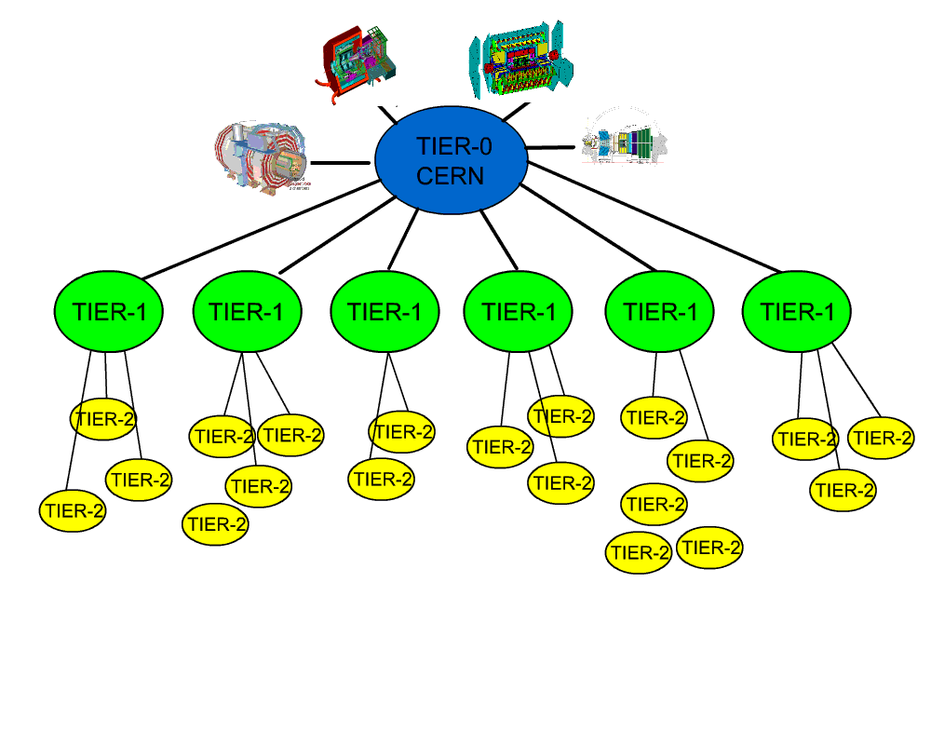
The Grid provides seamless access to computing power
and data storage capacity distributed over the globe
Worldwide LHC Computing Grid (WLCG): ~ 150 computing centres, ~ 35 countries
NorduGrid and SweGrid
Very successful operation of the LHC Grid in first
years of LHC operation allowed users (students !)
from all over the world to analyze the data quickly
→ fast release of physics results

Slide 21
A few additional numbers …..
Number of turns of the LHC ring made by protons in 1 second: ~11000
Number of beam-beam collisions per second at design operation: 40 million
Beam transverse size at the collision point: 16 μm (~ 4 times smaller than that
of a typical a human hair)
Magnets work at 1.9K (-270 degrees) → LHC is cooler than outer space
Energy stored in the beams (~350 MJ): like a British aircraft carrier at 12 knots
The CMS experiment weighs more (13000 tons) and contains more iron than
the Tour Eiffel
3000 km of cables used to transfer the signals from the ATLAS detector
to the control rooms
Each LHC experiment produces ~ 10 PB of data per year (1 PB=10⁶ GB)
This corresponds to ~ 20 million DVD (a 20 km stack …)
Cost: 6000 MCHF
Etc. etc.
WHY ???

Slide 22
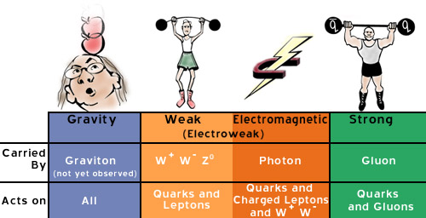


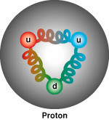
The elementary particles and their interactions are described by a
very successful theory: the Standard Model. All particles foreseen
by the SM have been observed, and the SM predictions have been
verified with extremely high precision over the last 35 years by
Experiments at CERN and other labs all over the world
u
c
t
g
up
charm
top
gluon
Quarks
s
γ
d
b
down
strange
bottom
photon
e
μ
τ
Force Carriers
W
Particles and forces
Leptons
electron
muon
tau
W boson
ν_{e}
ν
ν
Z
μ
τ
e-neutrino
μ-neutrino
τ-neutrino
Z boson
Generations of matter
I
II
II
Higgs
Boson?
© Brian Foster

Slide 23
However: several outstanding questions remain ….
✔
ATLAS, CMS
What is the origin of the particle masses ?
What is the nature of the Universe dark matter ?
Why is there so little antimatter in the Universe ?
(Nature’s favouritism allowed us to exist …)
What are the features of the primordial plasma
permeating the Universe ~10 μs after the Big Bang ?
What happened in the first moments of the Universe
life (10⁻¹¹ s after the Big Bang) ?
Are there other forces in addition to the known four ?
Are there additional (microscopic) space dimensions ?
Etc. etc.
ATLAS, CMS
LHCb
ALICE
ATLAS, CMS
ATLAS, CMS
LHC built to address these and other fundamental questions …

Slide 24
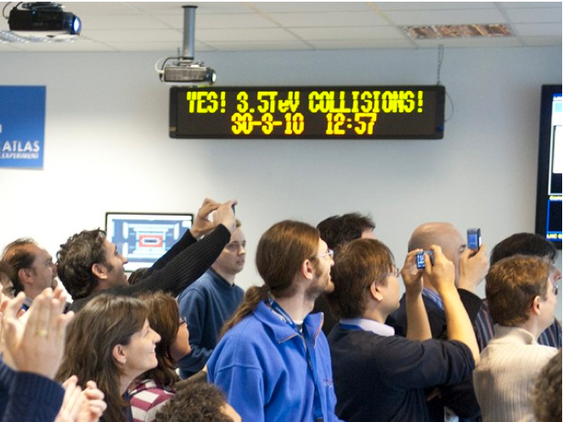
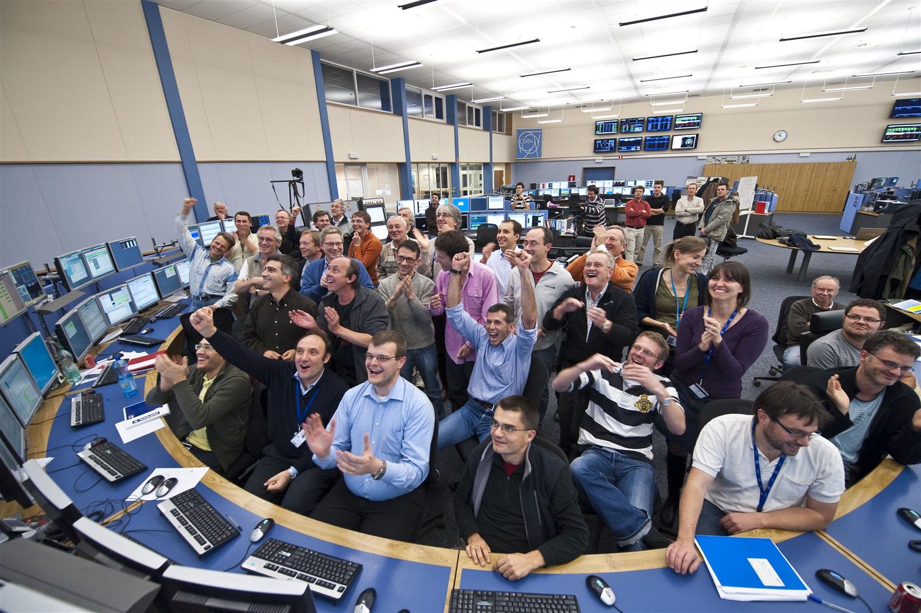
30 March 2010: first proton-proton collisions at
an unprecedented energy → exploration of a new
energy frontier starts
Since then:
The accelerator, experiments and computing performed beyond expectations
Huge amount of data recorded and analyzed
The Standard Model and the known particles have been “rediscovered” and
measured in the new energy regime
Many physics scenarios beyond the Standard Model have been investigated and
ruled out
July 2012: discovery by ATLAS and CMS of a new Higgs-like particle
with mass ~ 125 GeV (~ 130 proton masses)

Slide 25
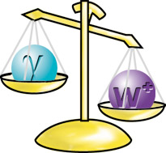
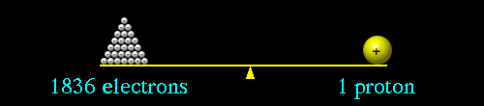
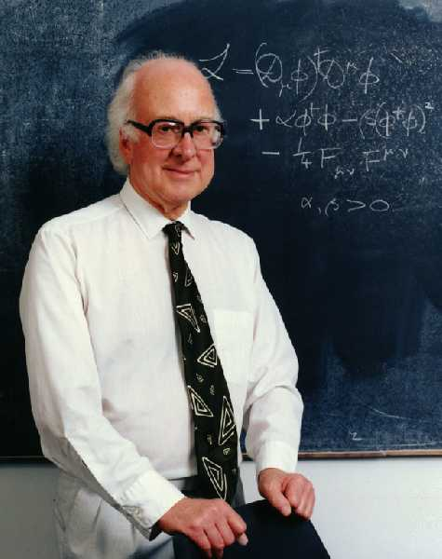
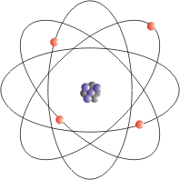
What is the origin of the particle masses ?
344000 electrons
1 top quark
Mass of top quark (heaviest elementary particle observed) ≈ mass of Gold atom
Electron mass is ~350000 times smaller: why ???
P.W. Higgs
Proposed solution (Brout, Englert, Guralnik, Hagen, Higgs, Kibble):
“Higgs mechanism”: origin of masses ~ 10⁻¹¹ s after the
Big Bang, when “Higgs field” became active → particles
acquired masses proportional to the strength of their interactions with the Higgs field
Consequences: existence of a Higgs boson
This particle has been searched for almost 40 years
at accelerators all over the world
→ finally found at the LHC !
Note: a world without “Higgs” would be a very strange one !
The proton may decay → atoms and chemistry may not exist,
Universe would be very different

Slide 26
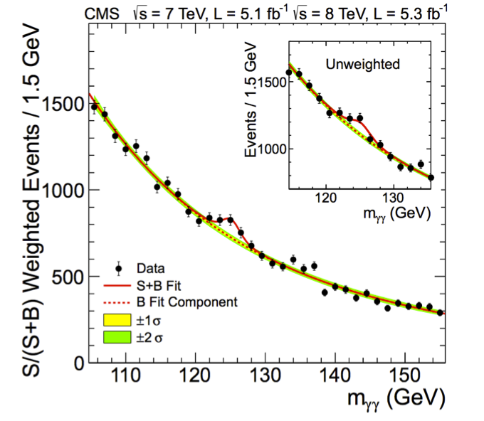
What did we observe ?
In the mass region around 125 GeV the
Higgs boson can decay into two photons

Slide 27
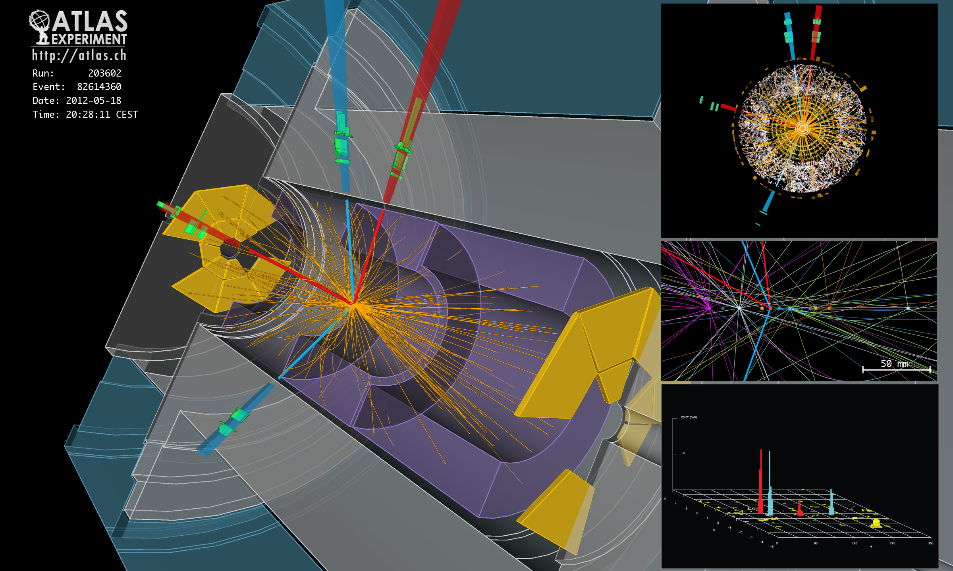
as well as into 4 electrons …
It was not easy: one H→ 4e produced every 10¹³ pp collisions
Finding it has required clever ideas and a huge amount of
meticulous experimental work

Slide 28
Three Frequently-Asked-Questions
1) Is this new particle a Higgs boson ?
YES, according to the LHC measurements. We will continue to measure its properties in detail with present and future data to understand if it is the Standard Model Higgs boson or a more exotic Higgs boson belonging to a more general theory.
2) Is the task of the LHC over ?
NO, this is just the beginning of the LHC exploration phase: the LHC was built to address many questions (see previous list) of which the origin of particle masses and the Higgs boson is only one (though a very fundamental
and crucial one !).
3) Will the Higgs boson change our day-by-day life ?
YES, it did already !

Slide 29

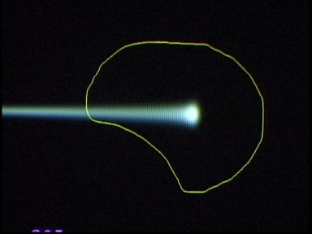
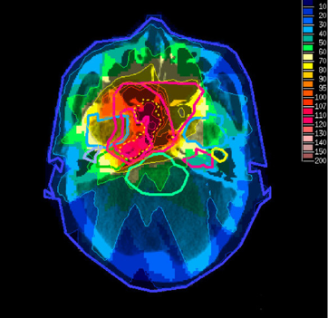
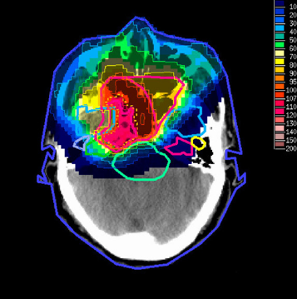

From fundamental science to everyone’s life
Extreme performance required in particle physics → cutting-edge technologies
developed at CERN and collaborating Institutes and then transferred to society.
Applications: medical imaging (e.g. PET), cancer therapy, materials science, airport
scanners, cargo screening, food sterilization, nuclear waste transmutation, etc. …
Not to mention the WEB and the GRID …
Hadron Therapy
Tumour Target
Protons
light ions
Accelerating particle beams
~30’000 accelerators worldwide
~17’000 used for medicine
X-ray
protons
> 90000 patients treated worldwide (30 facilities)
Imaging
e.g. PET scanner
Detecting particles
Notes:
29

Slide 30
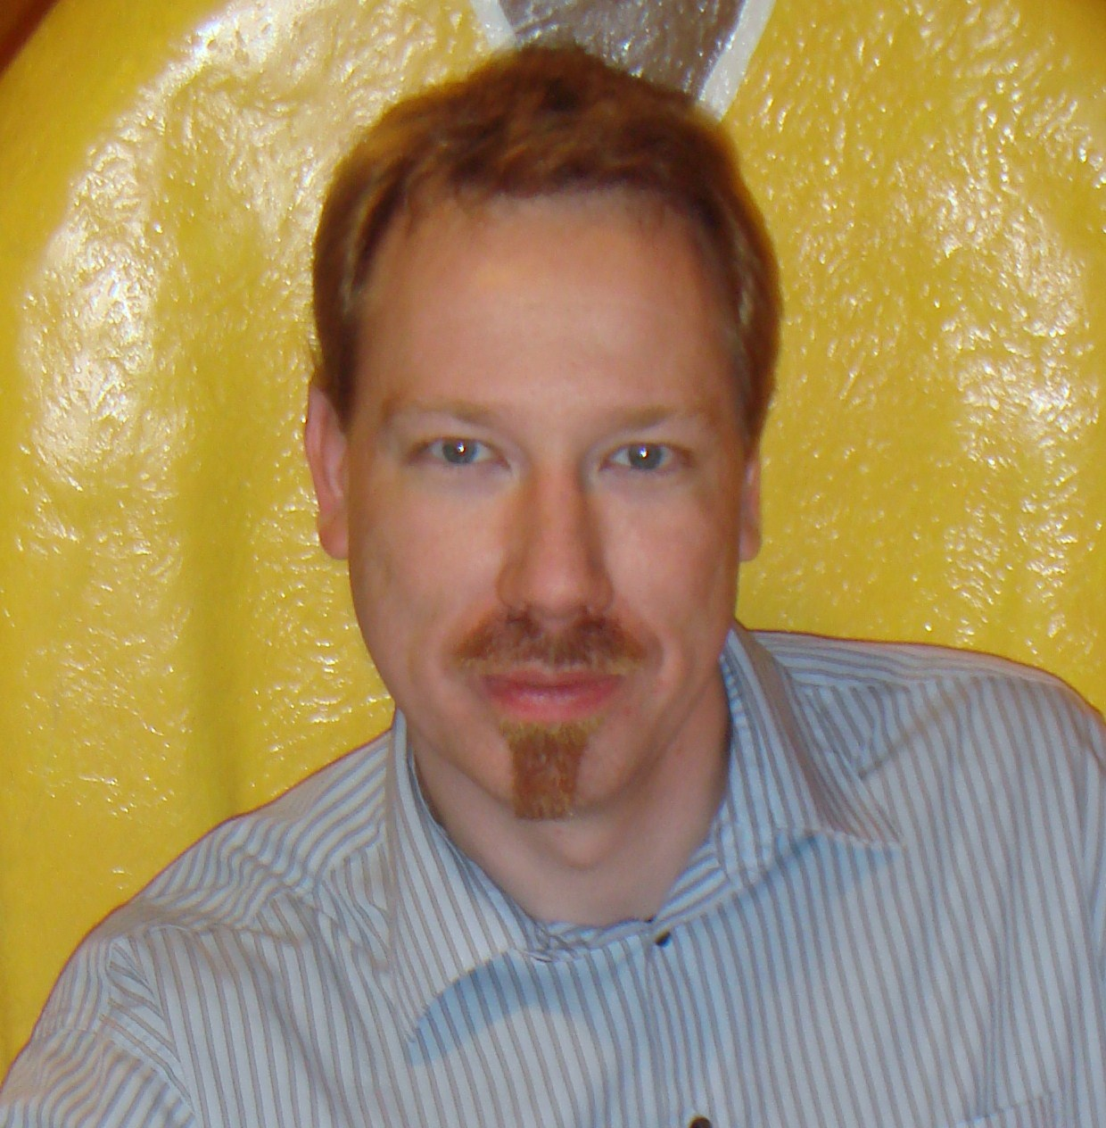
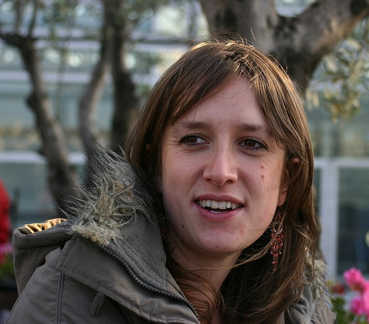






























Andreas Korn
Emily Nurse
Marija Vranjes
Milosavljevic
Georgios
Choudalakis
David Miller
Johanna Fleckner
Michael Boehler
Leonid Gladilin
Arnaud Lucotte
Ariel Schwartzman
Sebastian
Eckweiler
Anthony
Morley
Peter Waller
Seth Zenz
Junji Tojo
Stephan Horner
Alison Lister
Iacopo Vivarelli
Tatsuya
Masubuchi
Fabrizio
Salvatore
Andrew Nelson
Dominique Fortin
Peter Onyisi
Albert Olariu
Scott Snyder
Martin
Woudstra
Pascal
Pralavorio
Roberto
Di Nardo
Julie Kirk
Tancredi Carli
Jan Kretzschmar
Laurent Serin

Slide 31

Andreas Korn
Emily Nurse
Marija Vranjes
Milosavljevic
Georgios
Choudalakis
David Miller
Johanna Fleckner
Michael Boehler
Speakers selected by ATLAS to give talks at the ICHEP Conference
(the most important annual conference in our field) in Paris
in July 2010 (so important that President Sarkozy intervened)
At this conference, ATLAS and CMS presented for the first time
physics results based on data (following first collisions on 30 March 2010)
Leonid Gladilin
Arnaud Lucotte
Ariel Schwartzman
Sebastian
Eckweiler
Anthony
Morley
Peter Waller
Seth Zenz
Junji Tojo
Stephan Horner
Alison Lister
Iacopo Vivarelli
Tatsuya
Masubuchi
Fabrizio
Salvatore
Andrew Nelson
Dominique Fortin
Peter Onyisi
Albert Olariu
Scott Snyder
Martin
Woudstra
Pascal
Pralavorio
Roberto
Di Nardo
Julie Kirk
Tancredi Carli
Jan Kretzschmar
Laurent Serin

Slide 32
Age distribution of the ATLAS population
All 2690 (< 35 y 47.2%)
Male 81.8% (< 35 y 44.0%)
Female 18.2% (< 35 y 61.3%)
(Status 1.1.2010)
More than 1000 PhD students

Slide 33
Age distribution of the ATLAS population
All 2690 (< 35 y 47.2%)
Male 81.8% (< 35 y 44.0%)
Female 18.2% (< 35 y 61.3%)
(Status 1.1.2010)
More than 1000 PhD students
A bit of sociology: What is the the role of a young scientist
in a big experiment like ATLAS ?

Slide 34
From the point of view of the young people, there
are pros and cons in both, small and big experiments
Also in big experiments, the work of individuals (construction
of a detector component, physics analysis, etc.) takes place
in small groups (often order of ten people or less)
In a big experiment, unlike in a small one, the individual does not master the details of
the whole experiment. However, because ATLAS is a complex instrument with a very
rich physics programme, the individual is exposed (through meetings with and presentations
by colleagues) to many different technologies and a very broad spectrum of physics topics
ATLAS gives visibility to young people through coordination roles in the experiment
(conveners of physics groups are young post-docs), talks at Collaboration meetings and
International Conferences, etc. Also, since a large part of the worldwide high-energy physics
community works in ATLAS or CMS, for a young person presenting his/her work in ATLAS
plenary meetings is like talking at a big conference, in front of the field’s best experts
Because of the huge number of Universities and Institutions from all over the world,
post-docs have many, very interesting job opportunities
In a big international experiment like ATLAS, people interact with colleagues from all
over the worlds, i.e. with different languages, education, traditions. This
is very enriching and stimulating for everyone, in particular for the young people
→ a very special human adventure !

Slide 35


CERN and the LHC
Seeking answers to fundamental questions about elementary particles and the Universe.
Advancing the frontiers of technology (also to the benefit of society)
Training the younger generations
Bringing nations together through science
A new era of discoveries has started with the exploration of an unprecedented energy scale at the LHC and the observation of a Higgs boson: a big step forward in fundamental knowledge
Two final remarks:
Fundamental research is the fuel of progress
Knowledge, as art, is among the highest expressions
of human beings as clever beings
“Fatti non foste a viver come bruti ma per seguir virtute
et conoscenza”, Dante Alighieri (1265-1321),
Divina Commedia, Inferno, Canto XXVI

Slide 36
SPARES

Slide 37

Muon Spectrometer (|η|<2.7) : air-core toroids with gas-based muon chambers
Muon trigger and measurement with momentum resolution < 10% up to E_{μ} ~ 1 TeV
Length : ~ 46 m
Radius : ~ 12 m
Weight : ~ 7000 tons
~10⁸ electronic channels
3000 km of cables
3-level trigger
reducing the rate
from 40 MHz to
~200 Hz
Inner Detector (|η|<2.5, B=2T):
Si Pixels, Si strips, Transition Radiation detector (straws)
Precise tracking and vertexing,
e/π separation
Momentum resolution:
σ/p_{T} ~ 3.8x10⁻⁴ p_{T} (GeV) ⊕ 0.015
EM calorimeter: Pb-LAr Accordion
e/γ trigger, identification and measurement
E-resolution: σ/E ~ 10%/√E
HAD calorimetry (|η|<5): segmentation, hermeticity
Fe/scintillator Tiles (central), Cu/W-LAr (fwd)
Trigger and measurement of jets and missing E_{T}
E-resolution: σ/E ~ 50%/√E ⊕ 0.03
Notes:
37

Slide 38

The Higgs mechanism … as exemplified by Prof. David Miller
Imagine a room full of people quietly chattering … this is like space filled only
with the Higgs field ...

Slide 39

a well known actor walks in, creating a disturbance as he moves across the room,
and attracting a cluster of admirers with each step ... the actor is like a particle
traversing the Higgs field

Slide 40

this increase his resistance to movement, in other words, he acquires mass,
just like a particle moving through the Higgs field ...

Slide 41


... Imagine now that a rumour crosses the room ...
it creates the same kind of clustering,
but this time among the people in the
room. In this analogy, these clusters
are the Higgs particle.

Slide 42

How does the Higgs mechanism work ? An over-simplified picture …
At the time of the Big Bang particles were all massless (→ were moving at speed of light) and Higgs field was there as an “non-interacting ether”
(minimum of Higgs potential = 0).
10⁻¹¹ s after Big Bang:
phase transition
About 10⁻¹¹ s after the Big Bang → temperature became low enough for phase
transition (→ minimum of Higgs potential became negative) → ether becomes
“molasses” → particles interacting with ”molasses” acquire a mass and are
slowed down

Slide 43


What is the nature of the Universe Dark Matter ?
Recent astrophysical
measurements indicate that
the Universe is made of:
5% of known matter
25 % of “dark matter”
(no known particle can explain it)
70% of “dark energy”
Today we understand only 5%
of the Universe composition
Supersymmetry (a particle physics theory)
predicts new (heavy) elementary particles,
not yet observed. Among them the neutralino,
our present best candidate for the Universe
dark matter (its predicted features are in
agreement with astrophysics observations
and cosmological predictions).
It is expected to be light enough to
be produced abundntly at the LHC

