Slide 1
Agenda
Demonstrator scheme
Demonstrator specification
Design Status
Spectre simulation issues
schedule

Slide 2
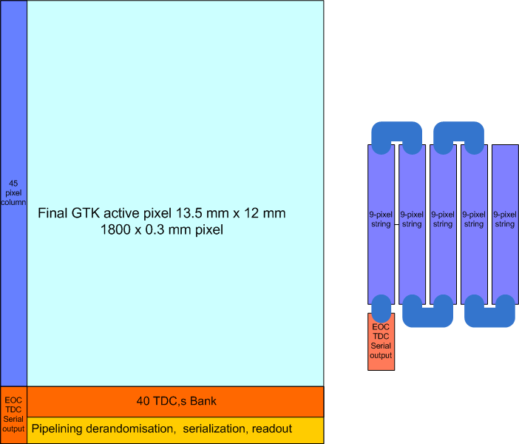
Column Demonstrator circuit
5-Folded 45-pixel column
Representing one long final column

Slide 3
Simulation problems
9-pixel column works fine in DM
  Down from preamp to the bus signal is as expected
  Coplanar WG well balanced, signal transition <100 ps
45-pixel column does not work well
  Distorted preamp signal
  Painful simulations
    Long hours
    Cadence crashes or get stuck …
Elena started from scratch,
  So far it is good

Slide 4
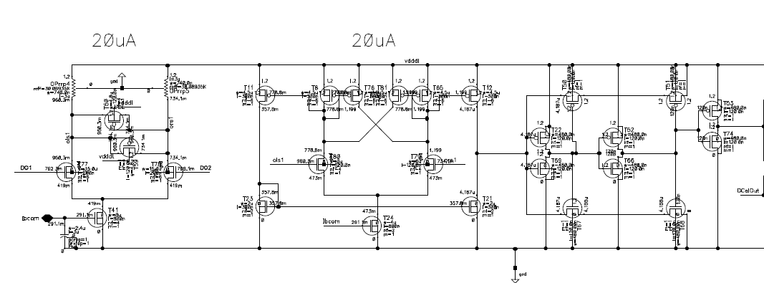
9-pixel top simulation

Slide 5
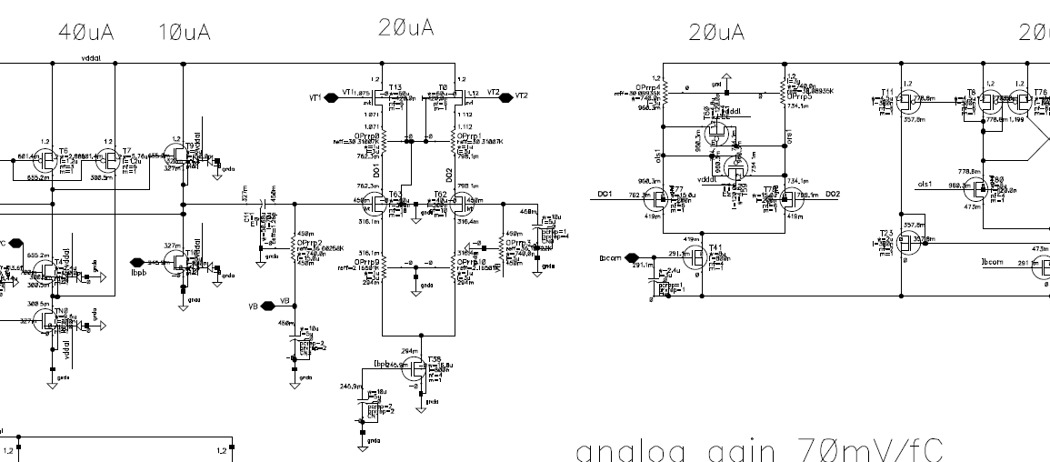
9-pixel top simu preamp

Slide 6
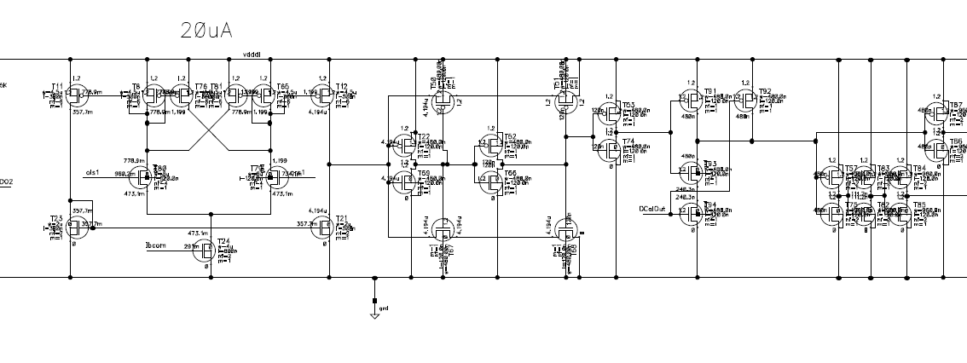
45 pixel column pixel 1 nodes

Slide 7
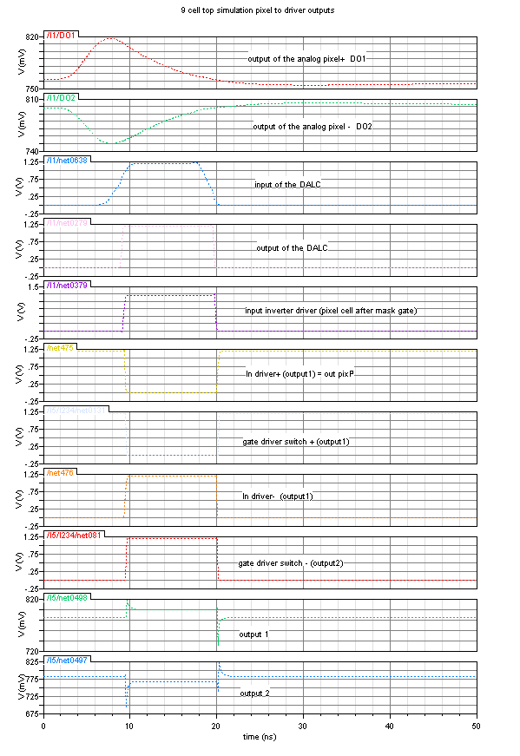
9 pixel top simulation

Slide 8
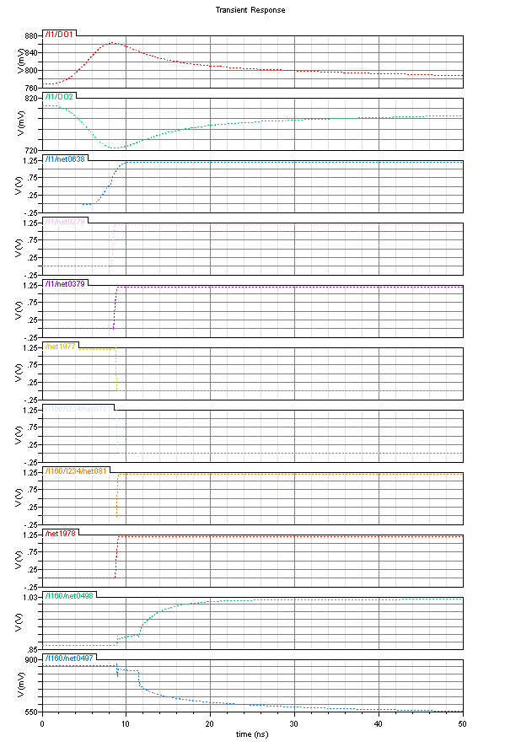
45 pixel top simulation

Slide 9
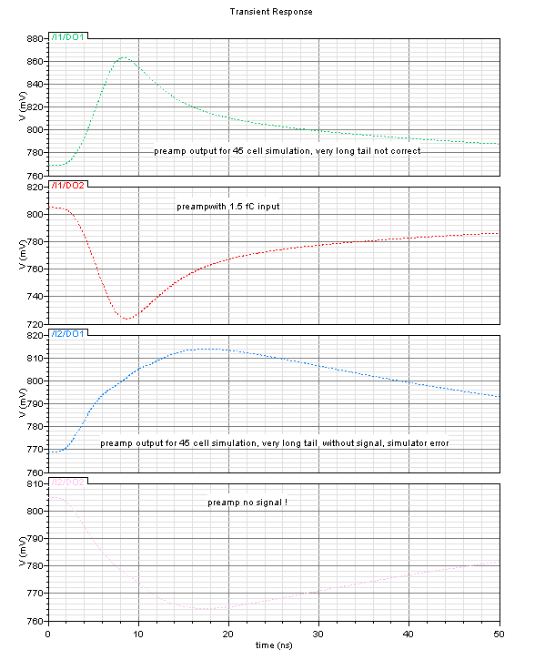
45 pixel Spectre crazy results

Slide 10
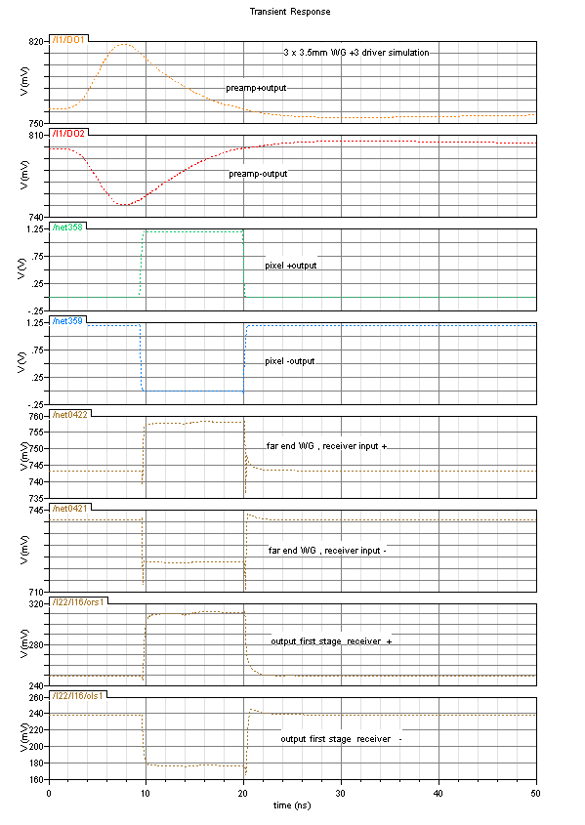
Simulation with a fresh file
From the one 9x9 block , a 2, 3, 4, 5 x9 simulations have been done gain.
Results are now satisfactory, here is for 3x9 bus (10.5 mm)
Input signal is 1.5 fC
From top to bottom:

Slide 11
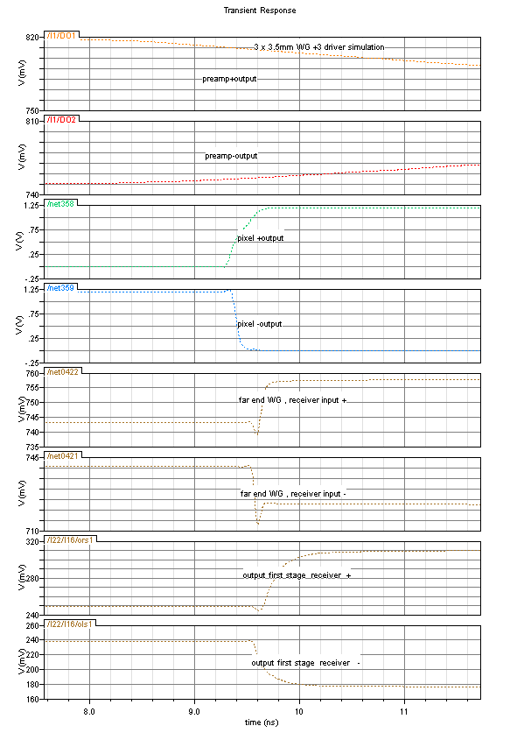
3x9 WG simulation data line
Close up
It turns out the fastest part of the circuit is the low swing waveguide with transition time of 50 ps.
Receiver first stage is 5 times slower.
the choice of the current in the simulation is 60 µA, a decrease to 30 µA might be possible

Slide 12
schedule
November milestone turns out to be tough
  Long delay in top analog simulation
  Digital simulation of the full custom of the end of column TDC circuits needs Verilog modeling
  Elena has started just now, she needs more than one month to finalize the complete database and finish floor-planning of the demonstrator and its verification.
  Certainly we should postpone submission in January

