Slide 1
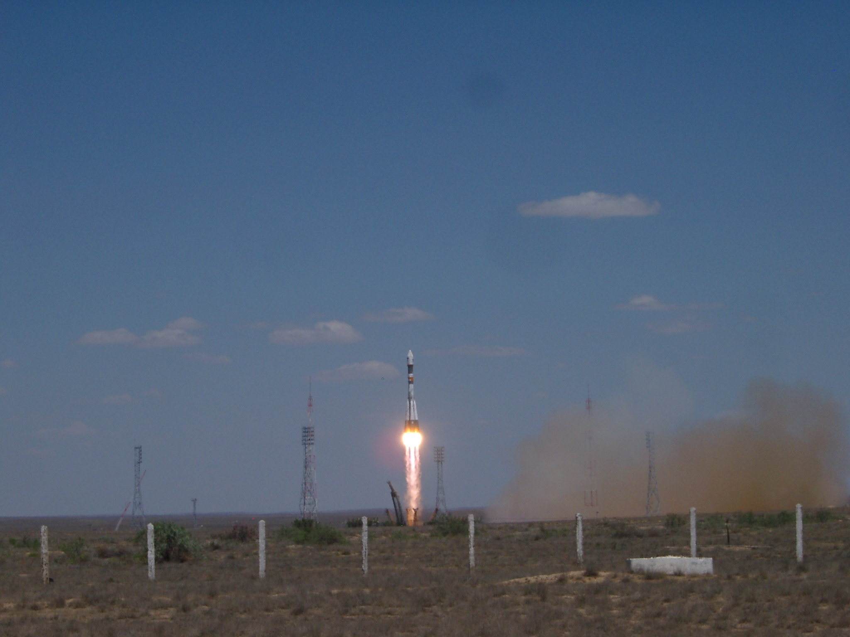
The Science and First Results of the PAMELA Space Mission
Mirko Boezio
INFN Trieste, Italy
On behalf of the PAMELA collaboration
CERN
October 28th 2008

Slide 2
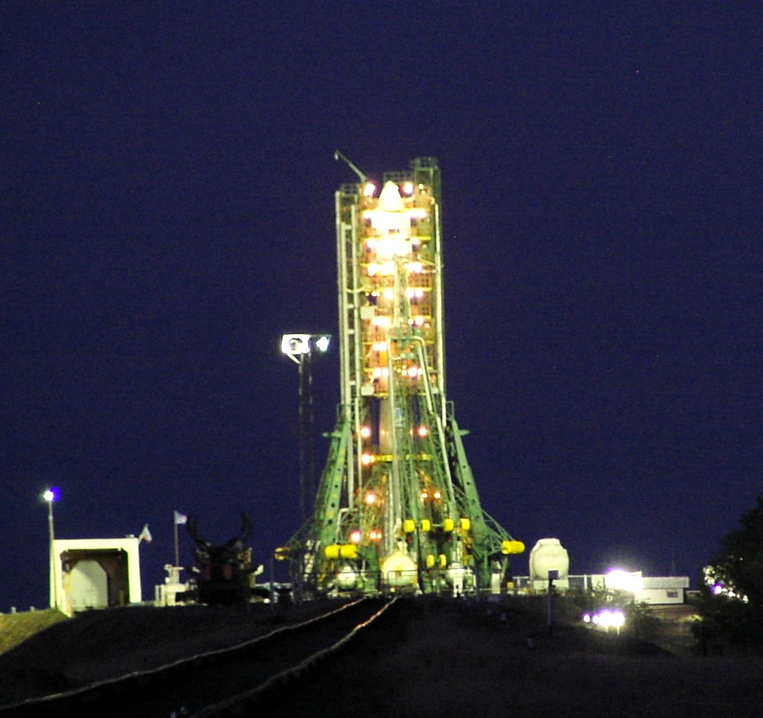
PAMELA
Payload for Antimatter Matter Exploration and Light Nuclei Astrophysics

Slide 3







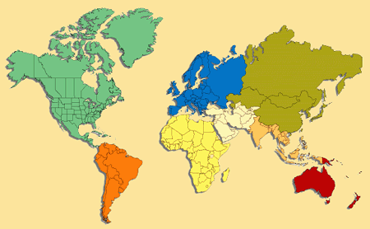





PAMELA Collaboration
Italy:
Bari
Florence
Frascati
Naples
Rome
Trieste
CNR, Florence
Russia:
Moscow
St. Petersburg
Germany:
Sweden:
Siegen
KTH, Stockholm

Slide 4
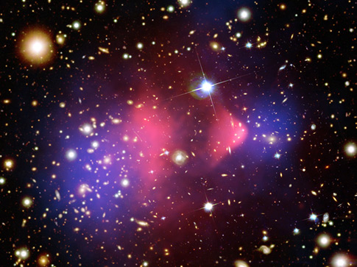
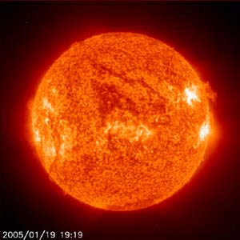
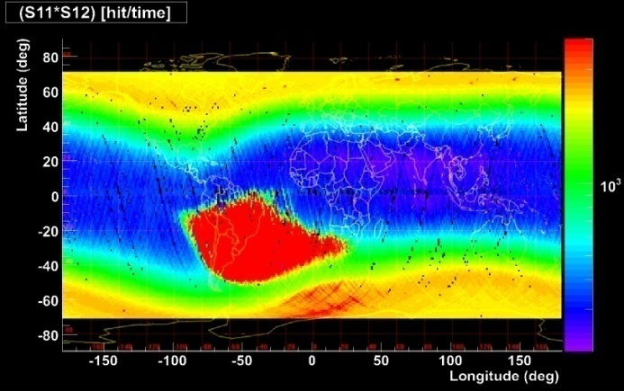
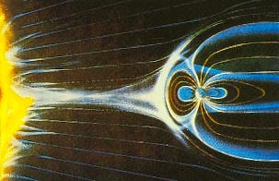
PAMELA as a Space Observatory at 1 AU
Search for dark matter annihilation
Search for antihelium (primordial antimatter)‏
Search for new Matter in the Universe (Strangelets?)
Study of cosmic-ray propagation
Study of solar physics and solar modulation
Study of terrestrial magnetosphere
Study of high energy electron spectrum (local sources?)

Slide 5
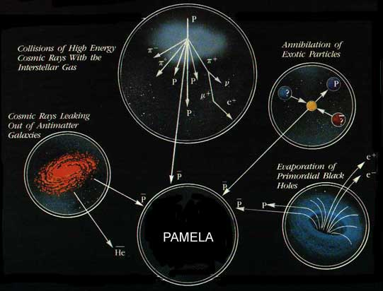
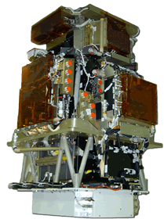
ANTIMATTER
e⁺ e⁻
Antimatter Lumps
in our Galaxy
Pulsar’s
magnetospheres

Slide 6
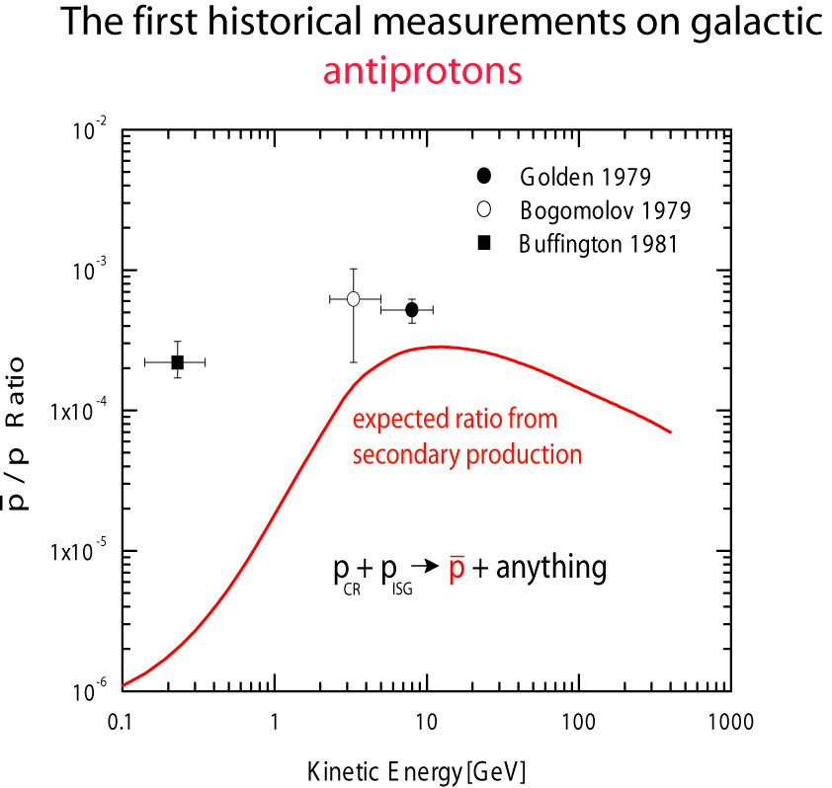

Slide 7
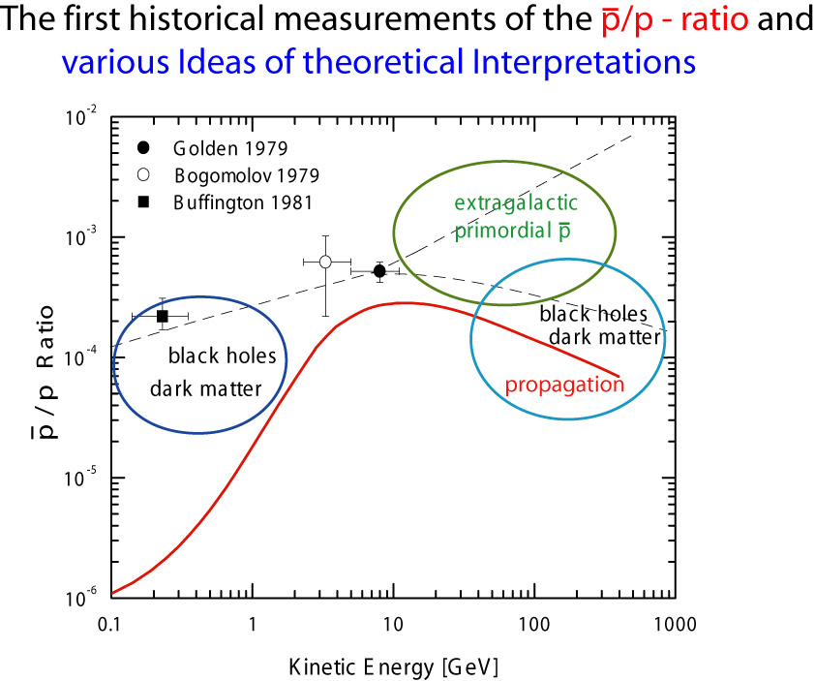
Background:
CR interaction with ISM
CR + ISM → p-bar + …

Slide 8
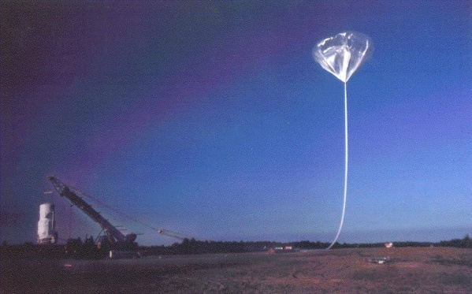
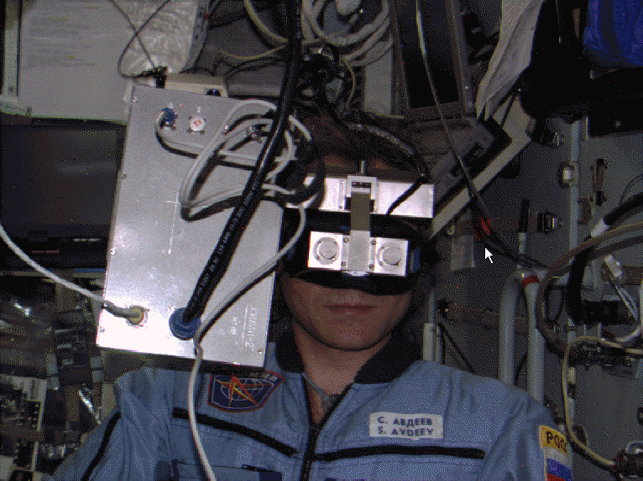
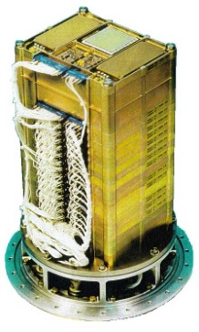
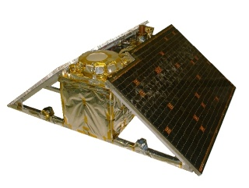
PAMELA prehistory
Balloon-borne experiments: MASS-89,91 TS-93 CAPRICE-94,97,98
Space experiments*: NINA-1,2 SILEYE-1,2,3 ALTEA
(*study of low energy nuclei and space radiation environment)
M 89
M 91
TS 93
C 94
C 97
C 98
NINA-1
NINA-2
1989 1990 1991 1992 1993 1994 1995 1996 1997 1998 1999 2000 2001 2002 2003 2004 2005 2006 2007
SILEYE-1
SILEYE-2
SILEYE-3
ALTEA
Notes:
Motivation and history of the WiZard collaboration. How it came the opportunity to fly on board of a Russian satellite.
The Astromag/WiZard experiment (PAMELA precursor), aiming to study the cosmic matter/antimatter radiation on board of the Space Station Freedom, is approved.
…unfortunatelly the Freedom project is cancelled after Challenger disaster.
Since second-half of the 80’s
the Wizard collaboration starts to study cosmic-ray antimatter through direct measurements on board of stratospheric balloons:
MASS-89 MASS-91 TS-93 CAPRICE-94 CAPRICE-97 CAPRICE-98
starts the collaboration with MePHI (Moscow), which brings to the construction of small experiments on satellite and space station (MIR and ISS), dedicated to the study of low energy nuclei (<200MeV/n) and the space radiation environment.

Slide 9


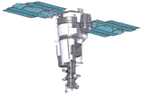
PAMELA history
1996: PAMELA proposal
22.12.1998: agreement between RSA (Russian Space Agency) and INFN to build and launch PAMELA.
Three models required by the RSA:
    Mass-Dimensional and Thermal Model (MDTM)
    Technological Model (TM)
    Flight Model (FM)
  → Starts PAMELA construction
2001: change of the satellite → complete redefinition of mechanics
2006: flight!!!
1989 1990 1991 1992 1993 1994 1995 1996 1997 1998 1999 2000 2001 2002 2003 2004 2005 2006 2007
Notes:
The agreement foresees, following the standard procedure for space missions, the realization of three models of the instrument:
-Mass&thermal
-Technological
-Flight

Slide 10
Design Performance
energy range
Antiprotons 80 MeV - 150 GeV
Positrons 50 MeV – 270 GeV
Electrons up to 400 GeV
Protons up to 700 GeV
Electrons+positrons up to 2 TeV (from calorimeter)
Light Nuclei (He/Be/C) up to 200 GeV/n
AntiNuclei search sensitivity of 3x10⁻⁸ in He/He
Simultaneous measurement of many cosmic-ray species
New energy range
Unprecedented statistics

Slide 11
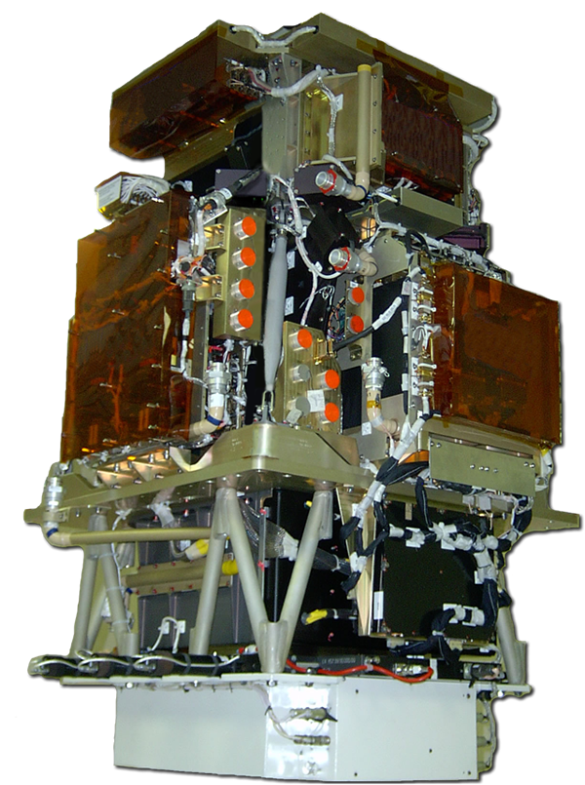
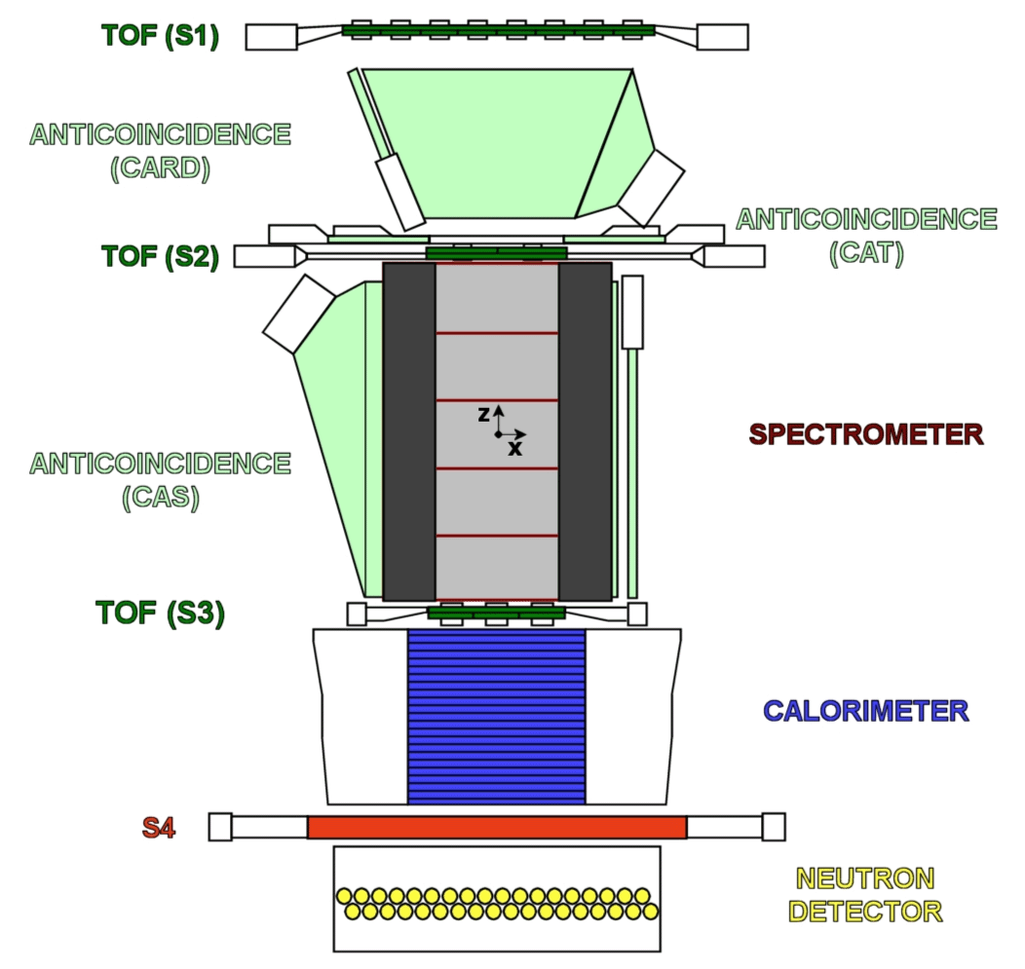
PAMELA detectors
Main requirements → high-sensitivity antiparticle identification and precise momentum measure
+ -
Time-Of-Flight
plastic scintillators + PMT:
Trigger
Albedo rejection;
Mass identification up to 1 GeV;
- Charge identification from dE/dX.
Electromagnetic calorimeter
W/Si sampling (16.3 X₀, 0.6 λI)
Discrimination e+ / p, anti-p / e⁻
(shower topology)
Direct E measurement for e⁻
Neutron detector
plastic scintillators + PMT:
High-energy e/h discrimination
GF: 21.5 cm² sr Mass: 470 kg
Size: 130x70x70 cm³
Power Budget: 360W
Spectrometer
microstrip silicon tracking system + permanent magnet
It provides:
  - Magnetic rigidity → R = pc/Ze
  Charge sign
  Charge value from dE/dx
Notes:
Overview of the apparatus

Slide 12
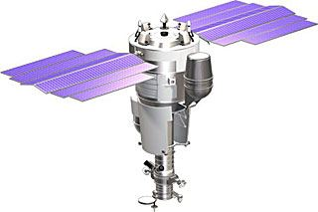
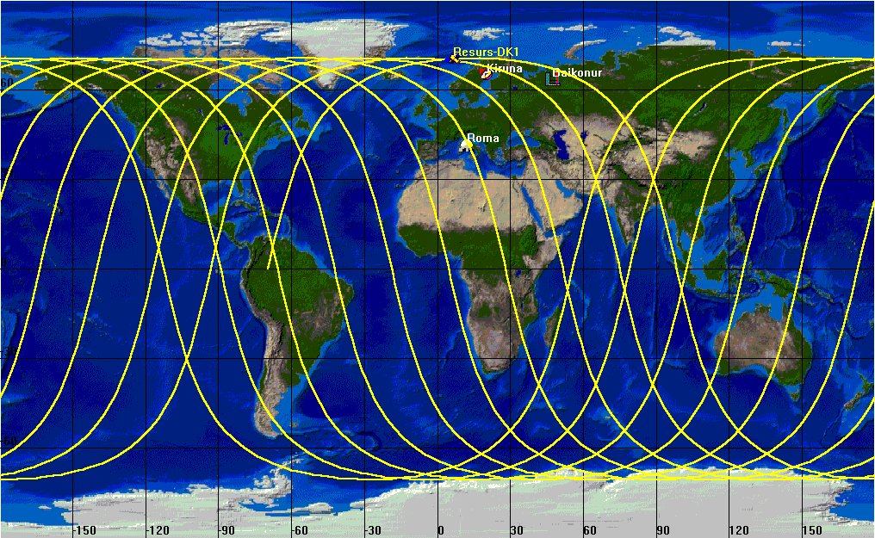
Resurs-DK1 satellite + orbit
Resurs-DK1: multi-spectral imaging of earth’s surface
PAMELA mounted inside a pressurized container
Lifetime >3 years (assisted)
Data transmitted to NTsOMZ, Moscow via high-speed radio downlink. ~16 GB per day
Quasi-polar and elliptical orbit (70.0°, 350 km - 600 km)
Traverses the South Atlantic Anomaly
Crosses the outer (electron) Van Allen belt at south pole
PAMELA
Resurs-DK1
Mass: 6.7 tonnes
Height: 7.4 m
Solar array area: 36 m²
350 km
70º
SAA
610 km
~90 mins

Slide 13
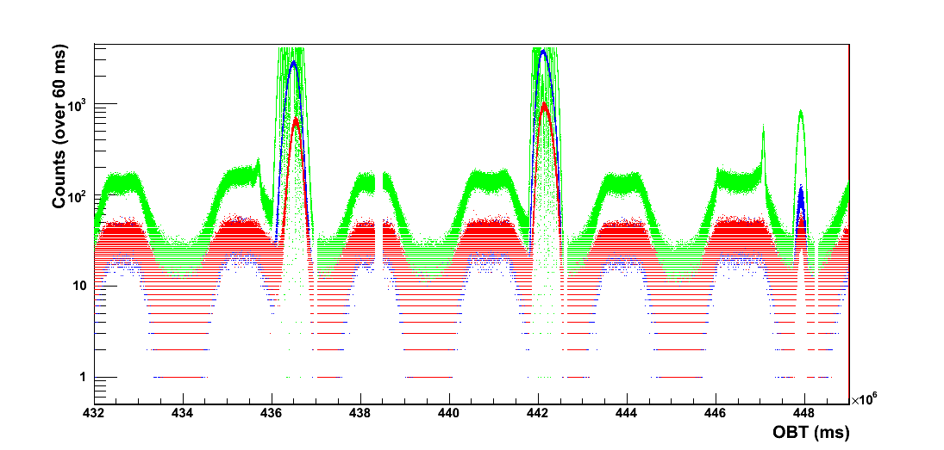
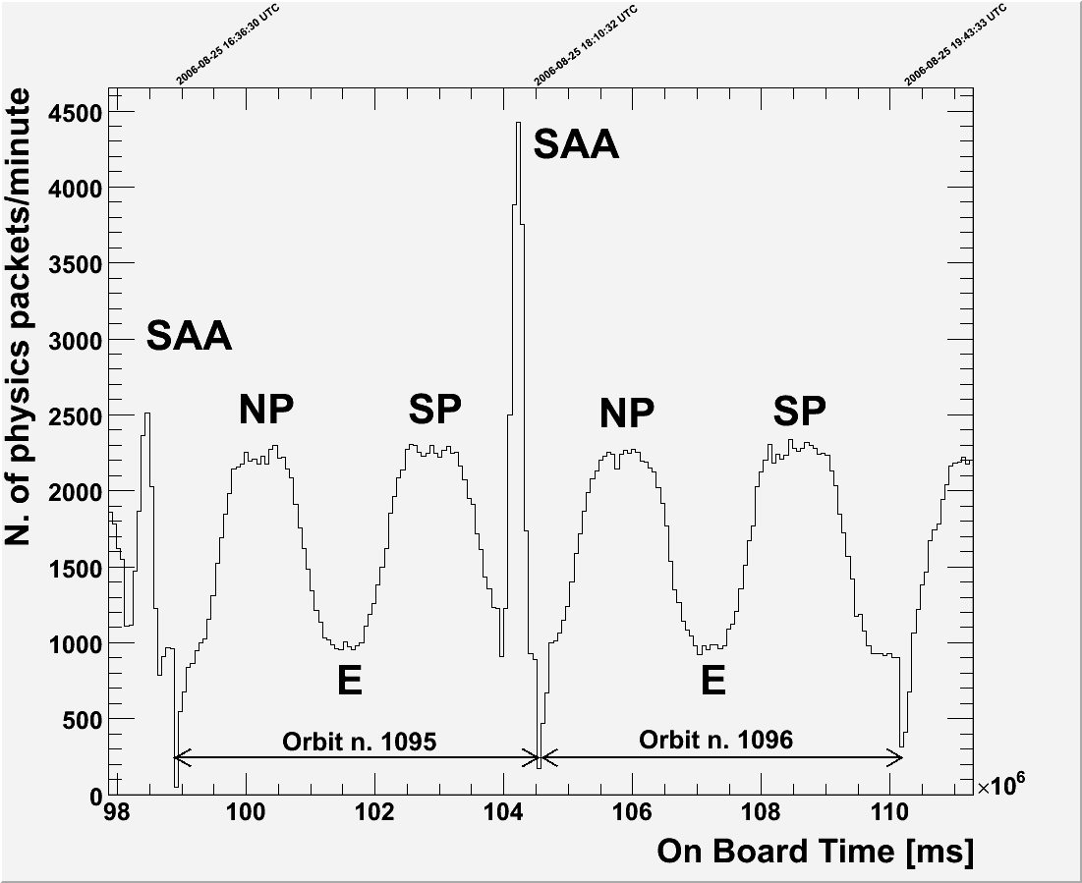
Download @orbit 3754 – 15/02/2007 07:35:00 MWT
Outer radiation belt
NP SP
EQ EQ
S1
S2
S3
Inner radiation belt
(SSA)‏
95 min
orbit 3751
orbit 3752
orbit 3753
Notes:
Outer rb = elettroni. Piu` vicina alla terra. Si attraversa al polo sud perche` il satellite e` piu` lontano. 600km a sud 350km nord.
La SSA e` un’estenzione della fascia interna. Causata dal fatto che in centro del dipolo magnetico e` spostato rispetto al cetro della terra.
Counting rates along the orbit. Comparison between different detectors (tof scintillators, neutron detector, anticounters) allows to check detector behavior in the space environment.
Conclusion: counting rates are consistent with satellite position along the orbit
Rate on S1, S2 S3:
- Duration of a orbit
- Environment: passage @ poles, equators and SSA

Slide 14

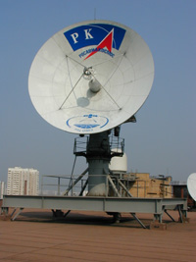
PAMELA milestones
Launch from Baikonur: June 15th 2006, 0800 UTC.
‘First light’: June 21st 2006, 0300 UTC.
Detectors operated as expected after launch
PAMELA in continuous data-taking mode since commissioning phase ended on July 11th 2006
As of ~now:
  ~650 days of data taking (~73% live-time)
  ~11 TByte of raw data downlinked
  >10⁹ triggers recorded and under analysis

Slide 15
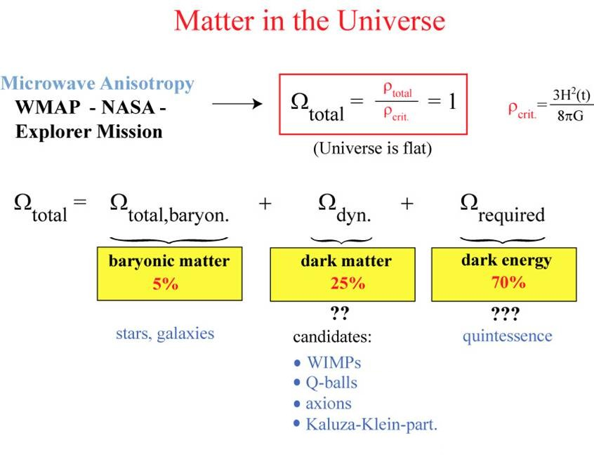
5%
23%
72%

Slide 16
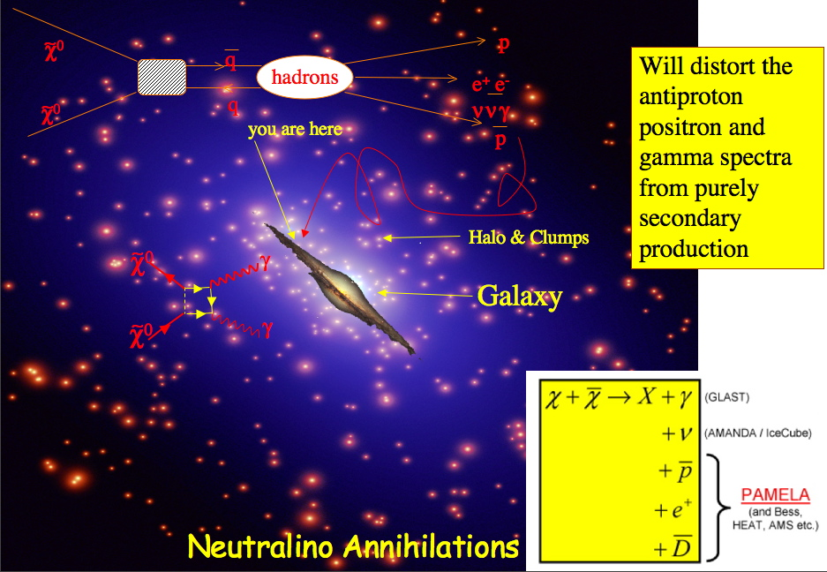
Cosmic-ray Antimatter from
Dark Matter annihilation
A plausible dark matter candidate is neutralino (χ), the lightest SUSY particle.
Annihilation of relic χ gravitationally confined in the galactic halo
→ Distortion of antiproton and positron spectra from purely secondary production
Most likely processes:
χχ → qq → hadrons→ anti-p, e⁺,…
χχ → W⁺W⁻,Z⁰Z⁰,… → e⁺,…
direct decay ⇒ positron peak Ee+~Mc/2
other processes ⇒ positron continuum Ee+~Mχ/20

Slide 17
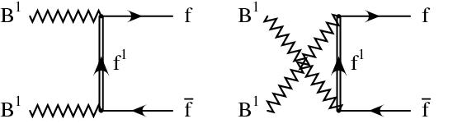
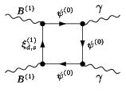
Another possible scenario:
KK Dark Matter
Lightest Kaluza-Klein Particle (LKP): B^{(1)‏}
Bosonic Dark Matter:
fermionic final states no longer helicity suppressed.
e+e⁻ final states directly produced.
As in the neutralino case
there are 1-loop
processes that produces monoenergetic
γ γ in the final state.

Slide 18
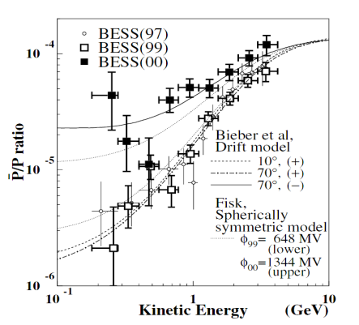
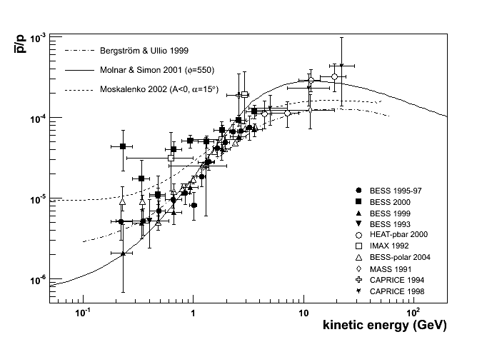
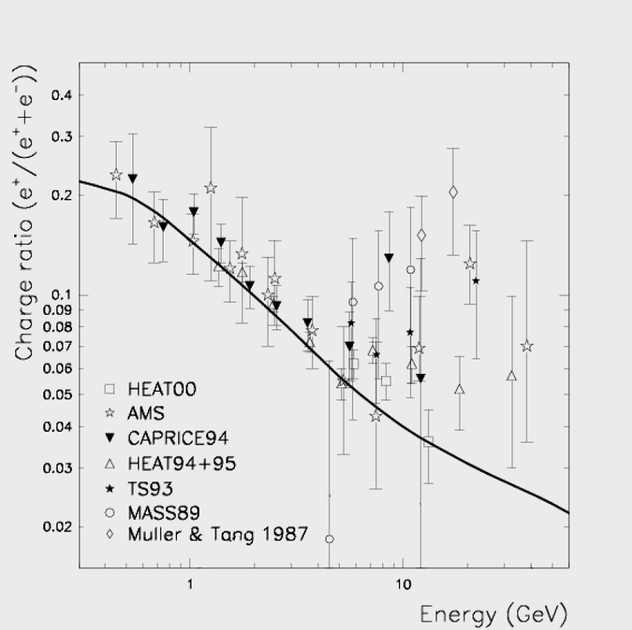
CR antimatter
Charge-dependent solar modulation
Solar polarity reversal 1999/2000
Asaoka Y. Et al. 2002
Present status
Antiprotons
Positrons
___ Moskalenko & Strong 1998
Positron excess?
?
¯
?
+
CR + ISM → p-bar + …
kinematic treshold:
5.6 GeV for the reaction
CR + ISM →π ± + x → μ ± + x → e± + x
CR + ISM → π⁰ + x → γγ → e±

Slide 19
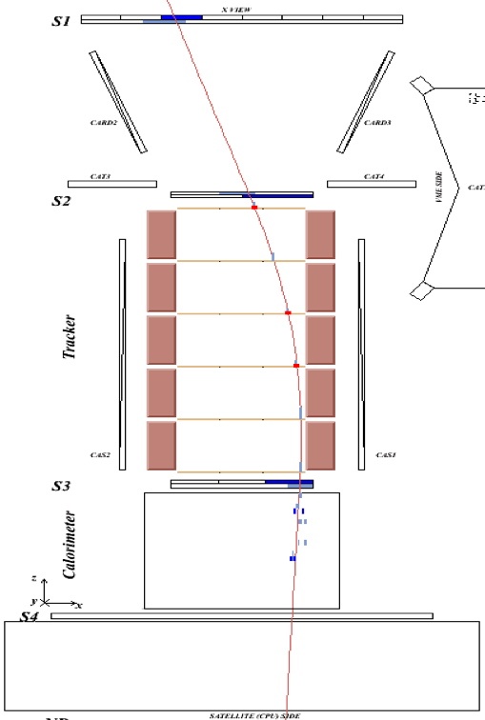
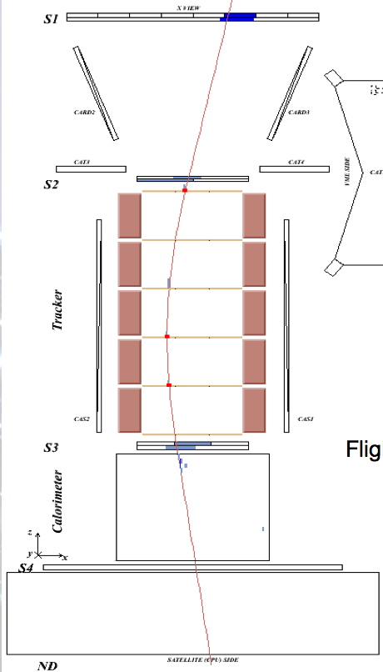
Flight data:
0.171 GV positron
Flight data:
0.169 GV electron

Slide 20
Flight data: 0.632 GeV/c
antiproton annihilation

Slide 21
Flight data: 0.763 GeV/c
antiproton annihilation

Slide 22
Antiprotons

Slide 23
Antiproton to proton ratio

Slide 24
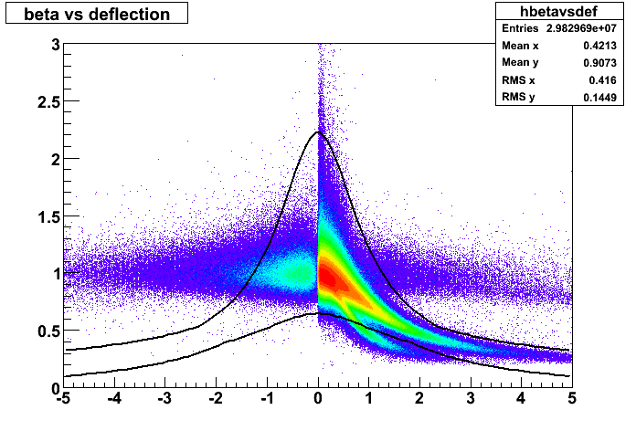
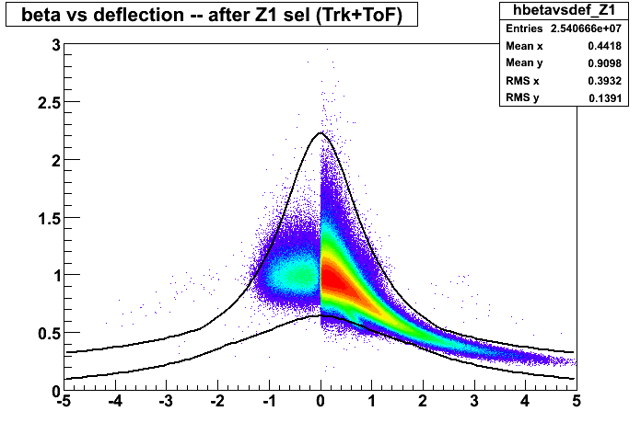
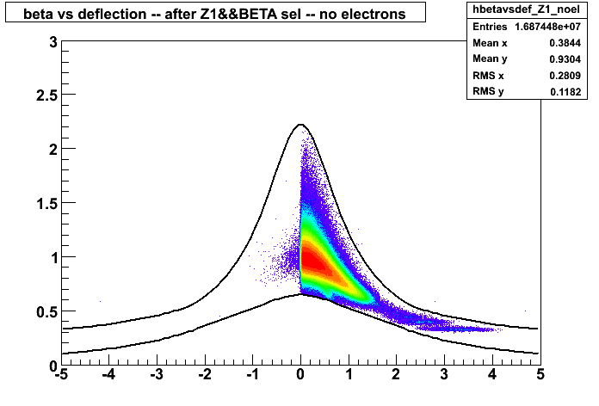
e⁻
e⁺
p
α
p
GV⁻¹
e⁻
e⁺
p
p
GV⁻¹
p
p
GV⁻¹

Slide 25
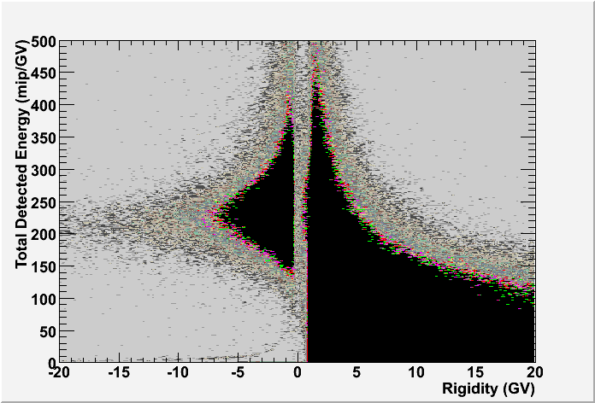
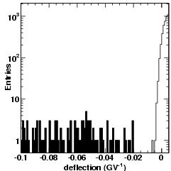
Calorimeter
selection
e⁻
e⁺
‘Electron’
p
p, d
‘Hadron’
Tracker Identification
Protons (& spillover)
Antiprotons
Strong track requirements:
MDR > 850 GV

Slide 26
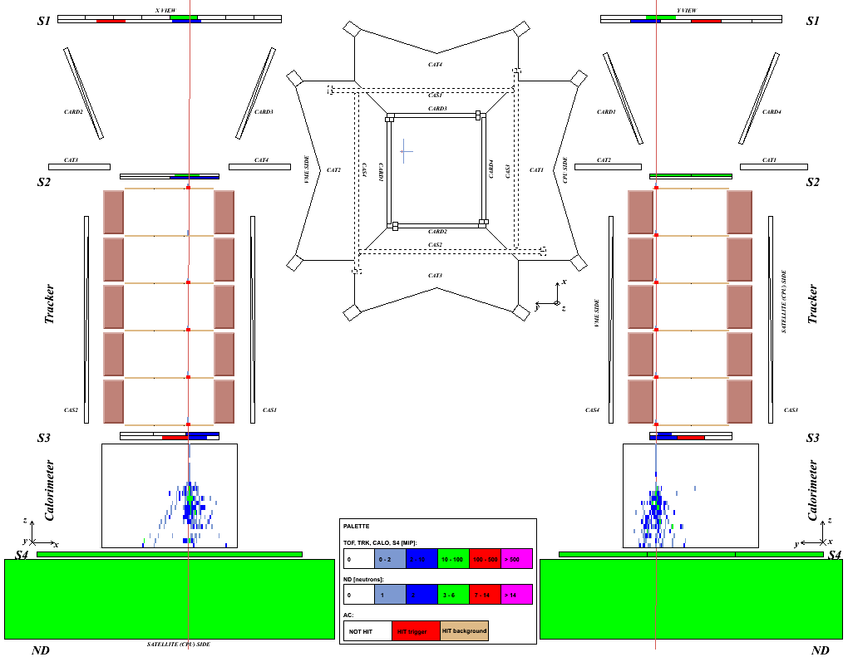
11.6 GV
interacting anti-proton

Slide 27
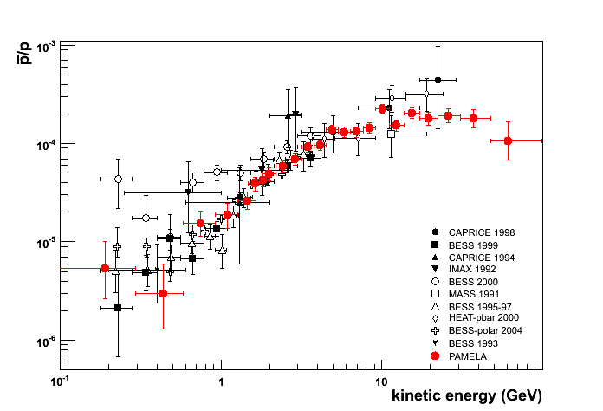
Antiproton to proton ratio
Astro-ph 0810.4994

Slide 28
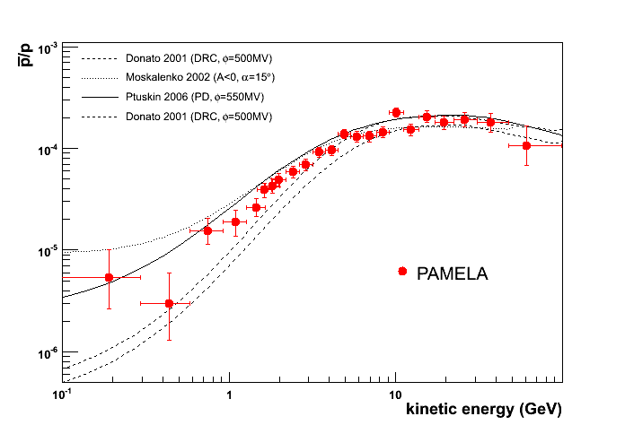
Antiproton to proton ratio
Seconday Production Models

Slide 29
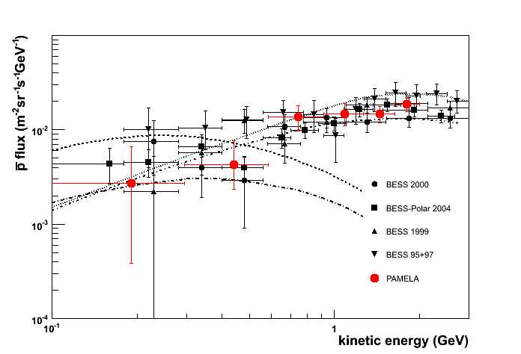
Antiproton Flux
statistical errors only
energy in the spectrometer
Secondary production
Preliminary
Primary production
Evaporation Mini Black Holes:
Yoshimura et al.
Maki et al.
From Petter Hofverberg’s PhD Thesis

Slide 30
Positrons

Slide 31
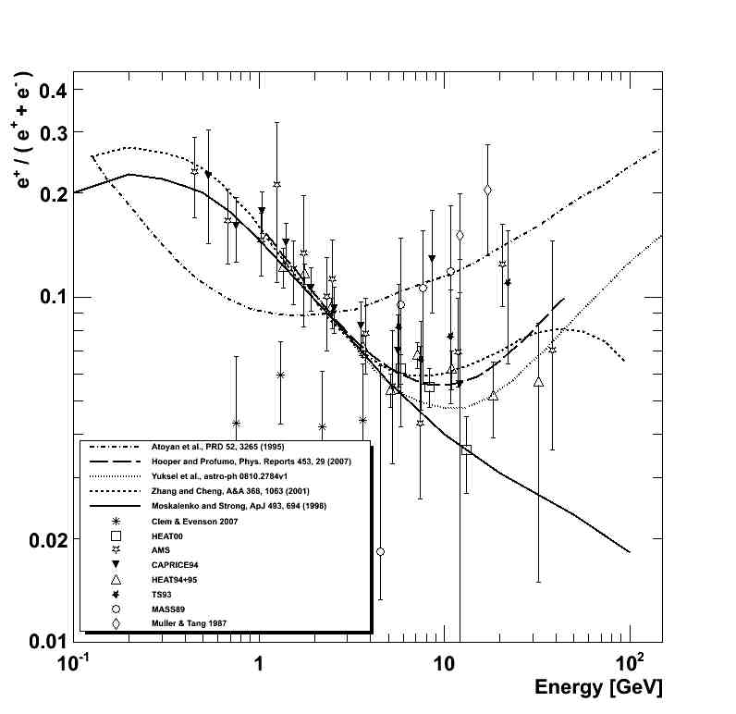
Pulsar Component
Yüksel et al. 08
Pulsar Component
Atoyan et al. 95
KKDM (mass 300 GeV)
Hooper & Profumo 07
Pulsar Component
Zhang & Cheng 01
Secondary production Moskalenko & Strong 98

Slide 32
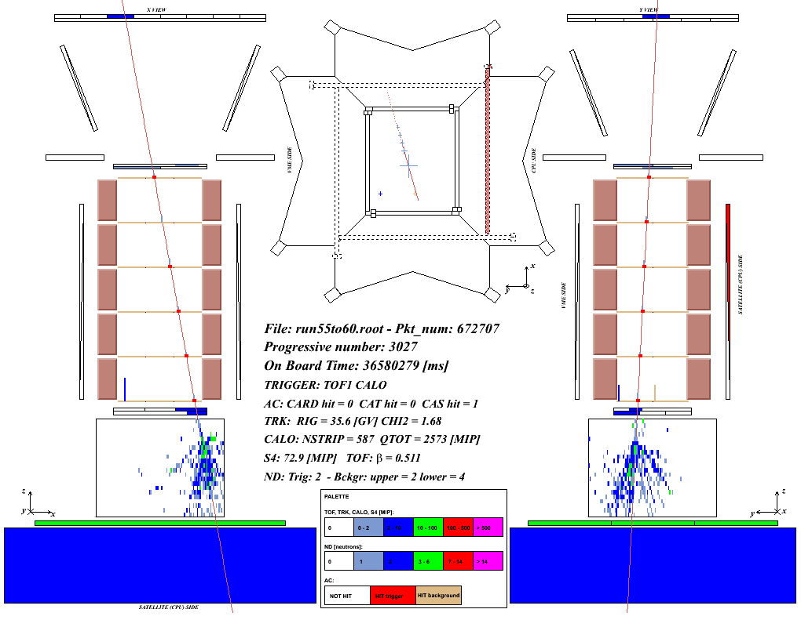
Flight data: 36 GeV/c
interacting proton

Slide 33
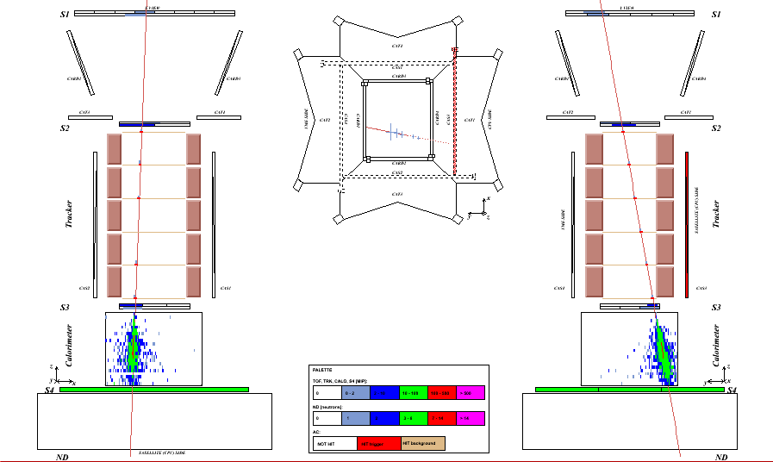
Flight data: 42 GeV/c
electron

Slide 34
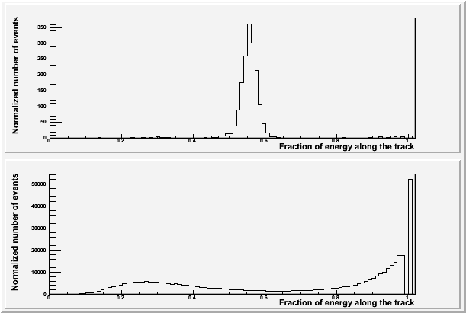
Positron selection with calorimeter
Rigidity: 20-30 GV
e⁻
p (int)
p (non-int)
p (non-int)
e⁺
p (int)
Fraction of charge released along the calorimeter track (left, hit, right)
Notes:
Total negative → 3067
Total positive → 189055
Selected electrons → 2032
Selected positrons → 322

Slide 35
Antiparticle selection
e⁻
e⁺
‘Electron’
‘Hadron’
p
p, d

Slide 36
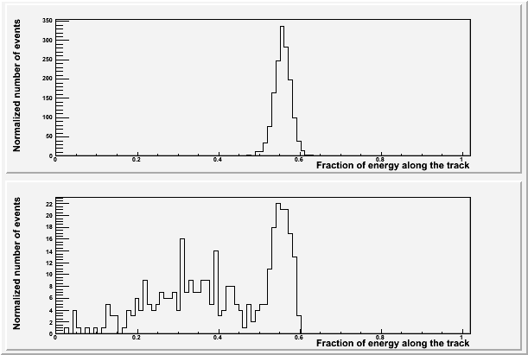
Positron selection with calorimeter
Rigidity: 20-30 GV
e⁻
e⁺
p
Fraction of charge released along the calorimeter track (left, hit, right)
+
Energy-momentum match
Starting point of shower
Notes:
Total negative → 3067
Total positive → 189055
Selected electrons → 2032
Selected positrons → 322

Slide 37
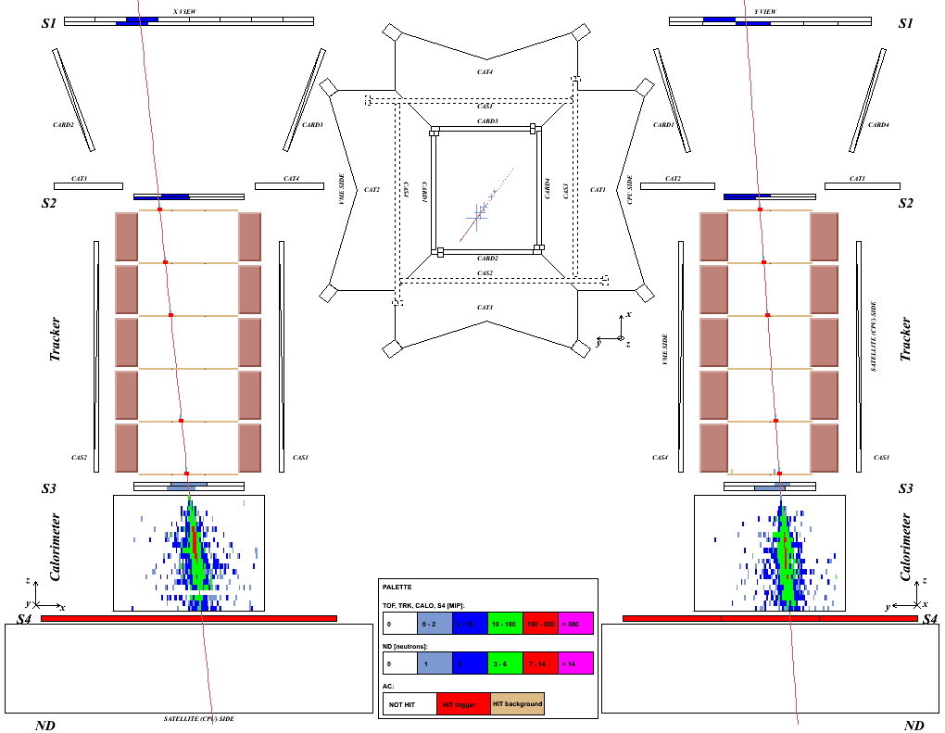
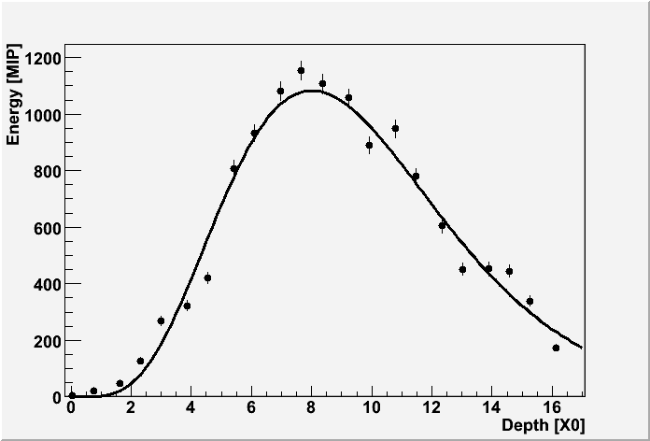
Flight data: 51 GeV/c
positron

Slide 38
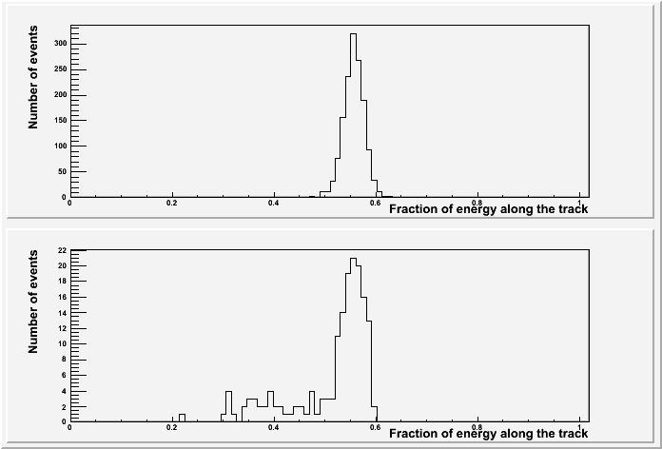
Positron selection with calorimeter
Rigidity: 20-30 GV
e⁻
e⁺
p
Fraction of charge released along the calorimeter track (left, hit, right)
+
Energy-momentum match
Starting point of shower
Longitudinal profile
Notes:
Total negative → 3067
Total positive → 189055
Selected electrons → 2032
Selected positrons → 322

Slide 39
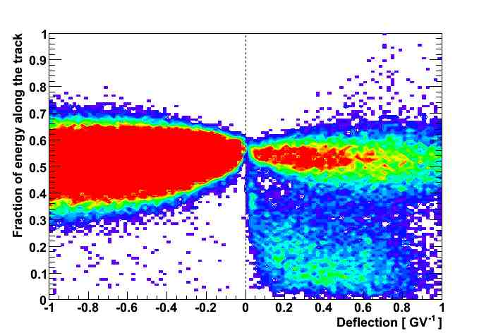
Positron selection with calorimeter
e⁻
e⁺
p
5 GV
Fraction of charge released along the calorimeter track (left, hit, right)
+
Energy-momentum match
Starting point of shower
Notes:
Total negative → 3067
Total positive → 189055
Selected electrons → 2032
Selected positrons → 322

Slide 40

Positron selection with calorimeter
Fraction of charge released along the calorimeter track (left, hit, right)
Flight data:
rigidity: 20-30 GV
Test beam data
Momentum: 50GeV/c
e⁻
e⁻
e⁻
p
e⁺
e⁺
p
Energy-momentum match
Starting point of shower

Slide 41

Positron selection
Rigidity: 20-30 GV
Fraction of charge released along the calorimeter track (left, hit, right)
Neutrons detected by ND
e⁻
e⁻
p
e⁺
e⁺
p
Energy-momentum match
Starting point of shower

Slide 42



Positron selection
Energy loss in silicon tracker detectors:
Top: positive (mostly p) and negative events (mostly e⁻)
Bottom: positive events identified as p and e⁺ by trasversal profile method
p
e⁻
p
e⁻
p
e⁺
p
e⁺
Rigidity: 10-15 GV
Rigidity: 15-20 GV

Slide 43
The “pre-sampler” method
CALORIMETER: 22 W planes: 16.3 X₀
2 W planes: ≈1.5 X₀
20 W planes: ≈15 X₀

Slide 44

The “pre-sampler” method
NON-INTERACTING in the upper part

Slide 45

The “pre-sampler” method

Slide 46
The “pre-sampler” method
POSITRON SELECTION
20 W planes: ≈15 X₀
2 W planes: ≈1.5 X₀
PROTON CONTAMINATION
2 W planes: ≈1.5 X₀
20 W planes: ≈15 X₀

Slide 47


e⁺ background estimation from data
Rigidity: 20-28 GV
e⁻
‘presampler’ p
e⁺
p
+
Energy-momentum match
Starting point of shower

Slide 48

e⁺ background estimation from data
Rigidity: 28-42 GV
e⁻
‘presampler’ p
p
e⁺
+
Energy-momentum match
Starting point of shower

Slide 49

e⁺ background estimation from data
Rigidity: 6.1-7.4 GV
e⁻
‘presampler’ p
e⁺
p
+
Energy-momentum match
Starting point of shower

Slide 50


Positron to Electron Fraction
● PAMELA
Charge sign dependent solar modulation
End 2007:
~10 000 e⁺ > 1.5 GeV

Slide 51


Solar Modulation of galactic cosmic rays
Study of charge sign dependent effects
Asaoka Y. et al. 2002, Phys. Rev. Lett. 88, 051101),
Bieber, J.W., et al. Physi-cal Review Letters, 84, 674, 1999.
J. Clem et al. 30th ICRC 2007
U.W. Langner, M.S. Potgieter, Advances in Space Research 34 (2004)
Pamela
AMS-01
Caprice / Mass /TS93
BESS

Slide 52




Solar modulation
Interstellar spectrum
Preliminary!!
(statistical errors only)
Increasing
GCR flux
July 2006
August 2007
February 2008
Decreasing
solar activity
PAMELA
Ground neutron monitor
sun-spot number

Slide 53

Charge dependent solar modulation
Preliminary!!
¯
+
¯
Pamela
2006
(Preliminary!)
+
A > 0
Positive particles
A < 0

Slide 54

Electron to positron ratio
e⁻/e⁺
Preliminary PAMELA results
Rigidity (GV)
U.W. Langner, M.S. Potgieter, Advances in Space Research 34 (2004)
Notes:
Modelli prevedono precisa rettangolo su el/positr. Err stat piccolo, intervallo grande, misura in funzione dell’energia.

Slide 55


Positron to Electron Fraction
End 2007:
~10 000 e⁺ > 1.5 GeV
~2000 > 5 GeV
Astro-ph 0810.4995

Slide 57

Pulsar Component
Yüksel et al. 08
KKDM (mass 300 GeV)
Hooper & Profumo 07
Pulsar Component
Atoyan et al. 95
Pulsar Component
Zhang & Cheng 01
Secondary production Moskalenko & Strong 98

Slide 58
Cosmic-Ray Propagation

Slide 59

Diffusion Halo Model

Slide 60

Galactic H and He spectra
(statistical errors only)
Preliminary
Very high statistics over a wide energy range
→ Precise measurement of spectral shape
→ Possibility to study time variations and transient phenomena

Slide 61

Secondary to Primary ratios

Slide 62

Charge identification capabilities
(tracker)
Beam-test data (@GSI 2006)
¹²C projectiles on Al and polyethylene targets
flight data (preliminary)
⁴He
B,C
³He
d
Be
p
Saturated clusters
Li
X view
Y view
Good charge discrimination of H and He
Single-channel saturation at ~10MIP affects B/C discrimination

Slide 63
Charge identification capabilities
(calorimeter)
Truncated mean of multiple dE/dx measurements in different silicon planes

Slide 64

Secondary nuclei
Preliminary!!
Preliminary
LBM
B nuclei of secondary origin:
  CNO + ISM → B + …
Local secondary/primary ratio sensitive to average amount of traversed matter (l_{esc}) from the source to the solar system
Local secondary abundance:
study of galactic CR propagation
(B/C used for tuning of propagation models)

Slide 65
Antiproton to proton ratio

Slide 66
Solar Physics

Slide 67

Solar Physics with PAMELA

Slide 68







December 2006 Solar particle events
Dec 13th largest CME since 2003, anomalous at sol min

Slide 69


December 13th 2006 event
from 2006-12-1 to 2006-12-4
Preliminary
Increase of low energy component

Slide 70

December 13th 2006 event
from 2006-12-1 to 2006-12-4
from 2006-12-13 00:23:02 to 2006-12-13 02:57:46
Preliminary
Increase of low energy component

Slide 71

December 13th 2006 event
from 2006-12-1 to 2006-12-4
from 2006-12-13 00:23:02 to 2006-12-13 02:57:46
from 2006-12-13 02:57:46 to 2006-12-13 03:49:09
Preliminary
Increase of low energy component

Slide 72

December 13th 2006 event
from 2006-12-1 to 2006-12-4
from 2006-12-13 00:23:02 to 2006-12-13 02:57:46
from 2006-12-13 02:57:46 to 2006-12-13 03:49:09
from 2006-12-13 03:49:09 to 2006-12-13 04:32:56
Preliminary
Decrease of high energy component
Increase of low energy component
Increase of low energy component

Slide 73

December 13th 2006 event
from 2006-12-1 to 2006-12-4
from 2006-12-13 00:23:02 to 2006-12-13 02:57:46
from 2006-12-13 02:57:46 to 2006-12-13 03:49:09
from 2006-12-13 03:49:09 to 2006-12-13 04:32:56
from 2006-12-13 04:32:56 to 2006-12-13 04:59:16
Preliminary
Increase of low energy component

Slide 74

December 13th 2006 event
from 2006-12-1 to 2006-12-4
from 2006-12-13 00:23:02 to 2006-12-13 02:57:46
from 2006-12-13 02:57:46 to 2006-12-13 03:49:09
from 2006-12-13 03:49:09 to 2006-12-13 04:32:56
from 2006-12-13 04:32:56 to 2006-12-13 04:59:16
from 2006-12-13 08:17:54 to 2006-12-13 09:17:34
Preliminary
Increase of low energy component

Slide 75
Radiation Belts
South Atlantic Anomaly
Secondary production from CR interaction with atmosphere

Slide 76


Proton flux at various cutoffs
→Atmospheric neutrino contribution
→Astronaut dose on board International Space Station
Indirect measurement of cross section in the atmosphere nell’atmosfera
Agile e Glast background estimation
Grigorov, Sov. Phys. Dokl. 22, 305 1977
NINA ApJ Supp.132 365, 2001
AMS Phys. Lett. B 472 2000.215,
  Phys. Lett. B 484 2000.10–22
Lipari, Astrop. Ph. 14, 171, 2000
Huang et al, Pys Rev. D 68, 053008 2003
Sanuki et al, Phys Rev D75 043005 2007
Honda et al, Phys Rev D75 043006 2007
--- M. Honda, 2008

Slide 77

Pamela World Maps: 350 – 650 km alt
36 MeV p, 3.5 MeV e⁻

Slide 78

Pamela maps at various altitudes
PRELIMINARY !!!!
Altitude scanning

Slide 79
Other Objectives

Slide 80



Search for the existence of Antimatter in the Universe
PAMELA AMS
in Space
AMS
Search for the existence of anti Universe
Search for the origin of the Universe
Accelerators
The Big Bang origin of the Universe requires
matter and antimatter
to be equally abundant at the very hot beginning

Slide 81
What about heavy antinuclei?
The discovery of one nucleus of antimatter (Z≥2) in the cosmic rays would have profound implications for both particle physics and astrophysics.
  For a Baryon Symmetric Universe Gamma rays limits put any domain of antimatter more than 100 Mpc away
  (Steigman (1976) Ann Rev. Astr. Astrophys., 14, 339; Dudarerwicz and Wolfendale (1994) M.N.R.A. 268, 609, A.G. Cohen, A. De Rujula and S.L. Glashow, Astrophys. J. 495, 539, 1998)

Slide 82
Antimatter Direct research
Antimatter which has escaped as a cosmic ray from a distant antigalaxy
  Streitmatter, R. E., Nuovo Cimento, 19, 835 (1996)‏
Antimatter from globular clusters of antistars in our Galaxy as antistellar wind or anti-supernovae explosion
  K. M. Belotsky et al., Phys. Atom. Nucl. 63, 233 (2000), astro-ph/9807027

Slide 83


Cosmic-ray antimatter search
“We must regard it rather an accident that the Earth and presumably the whole Solar System contains a preponderance of negative electrons and positive protons. It is quite possible that for some of the stars it is the other way about”
P. Dirac, Nobel lecture (1933)‏
BESS combined (new)‏
expected

Slide 84
High Energy electrons
The study of primary electrons is especially important because they give information on the nearest sources of cosmic rays
Electrons with energy above 100 MeV rapidly loss their energy due to synchrotron radiation and inverse Compton processes
The discovery of primary electrons with energy above 10¹² eV will evidence the existence of cosmic ray sources in the nearby interstellar space (r≤300 pc)

Slide 85

A calorimeter self-triggering showering event. Note the high energy release in the core of the shower and the high number (26) neutrons detected.
CALO SELF TRIGGER EVENT: 167*10³ MIP RELEASED
279 MIP in S4
26 Neutrons in ND

Slide 86
Search for New Matter in the Universe:
An example is the search for “strangelets”.
There are six types of Quarks found in accelerators.
All matter on Earth is made out of only two types of quarks. “Strangelets” are new types of matter composed of three types of quarks which should exist in the cosmos.
Carbon Nucleus
Strangelet
A stable, single “super nucleon” with three types of quarks
ii. “Neutron” stars may be one big strangelet
n
s
d
u
p
u
d
d
s
d
u
d
u
s
d
d
u
d
u
s
u
u
u
s
u
s
u
u
u
d
d
u
d
d
s
d
u
u
d
d
u
d
d
u
d
d
s
u
u
d
d
u
u
d
d
d
d
d
d
s
d
u
u
u
u
s
u
u
u
u
u
d
d
d
AMS courtesy

Slide 87
Conclusion
PAMELA is the first space experiment which is measuring the antiproton and positron energy spectra to the high energies (>100GeV) with an unprecedented statistical precision
PAMELA is looking for Dark Matter candidates and “direct”measurement of particle acceleration in astrophysical sources
Furthermore:
  PAMELA is providing measurements on elemental spectra and low mass isotopes with an unprecedented statistical precision and is helping to improve the understanding of particle propagation in the interstellar medium
  PAMELA is able to measure the high energy tail of solar particles.
  PAMELA is setting a new lower limit for finding Antihelium

Slide 88
THANKS http:// pamela.roma2.infn.it

