Slide 1
TOF Report
Chiara Zampolli for ALICE TOF
ALICE Offline Week, October 2008

Slide 2

TOF OCDB Status
The present status of the TOF OCDB is almost the final one.
The major change that is foreseen concerns the handling of the HV DPs:
  From reference, they should become information used during reconstruction → moved to and stored in the OCDB
  The size of the object won’t vary – limited to < 15 kB...
    10 floats + 1 short int stored per DP
  ...even if the processing of the values may change

Slide 3
Input Data, Run Types
The Input Data won’t change
  DAQ FXS
  DCS FXS
The presently defined Run Types won’t change
  PHYSICS
  NOISE
  PULSER

Slide 4
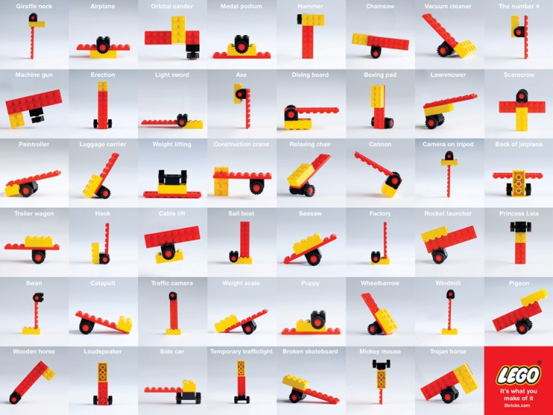
Reco Params
Three Reco Parameters types have been defined:
  Low Flux → presently set as default, for pp
  High Flux → for PbPb
  Cosmic → for cosmic runs
No other event types will be reconstructed by TOF

Slide 5

Preprocessor and DA
The current status of the preprocessor should not change, apart from (possibly) a different handling of the HV info when these will be ported to the OCDB
  Some new configuration parameter may be added for processing noise runs
The present DAs will stay the same
...if no bug is suddenty discovered, of course...
The main reason for failures in the past runs (cosmics) was due to an obsolete file present in the DAQ monitoring machine (PHYSICS runs).

Slide 6
Second Order Calibration
The TOF second order calibration was deeply discussed during the past offline weeks (see July ‘07, October ‘07)
On-the-Fly offline calibration splitted into two steps:
  TTask (post-reconstruction process):
    Filling a tree:
      one entry/TOF channel;
      Each entry being a 1D array with the necessary information to perform calibration;
    Running at the EOR;
    Writing the tree into AliEn (as reference data) → don’t need CDB access
  Job/Macro:
    Chaining the trees so far created over many runs
    Running the calibration process
    Writing the calibration parameters on the CDB

Slide 7
TOF Offline calib strategy
Run 0
Run 1
Chunk 0
Chunk 1
Chunk n
Chunk 0
Chunk 1
Chunk n
ESD 0
ESD 1
ESD n
ESD 0
ESD 1
ESD n
Tree 0
Tree 1
Tree 2
Tree n
Calibrator 0
Calibrator 1
Calibrator 2
Calibrator n
OCDB

Slide 8
TOF Calibration Objects Validity
Run Range:
  Both online and offline calibration objects have by default infinite validity, since they have to be used for subsequent runs;
  Nevertheless, possibility to set First and Last Validity Run, especially to be able to handle correctly the switch between calibration with online/offline objs (see later).
Switch Online/Offline Calibration:
  A “dummy” (“invalid”) offline calibration object is to be stored in the OCDB by the TOF experts at the very beginning;
  Online calib objs used till a “valid” offline calib obj is put in the OCDB; at that moment, the offline calibration takes over;
  If, for some reason, a reset of the offline calibration has to occur, a new “invalid” offline calibration object has to be put in the OCDB, and online calibration is restored; both for online/offline objs the run range changes, the first run becoming the current one.

Slide 9
Managing the OCDB during reco
Run validity
0
1
2
3
4
5
100
101
102
103
104
∞
Run 0
1
2
Online
3
4
Offline Calib obj not valid
100
Reset!
Offline Calib obj
no more valid
Offline Calib
obj valid
101
Offline Calib obj valid
102
103
104
Not valid
Run 0
1
Valid
2
Offline
3
4
Not valid
100
101
Valid
102
103
104
Alberto, Jan Fiete

Slide 10

Conclusions
No major changes foreseen
TOF calibration design almost the final one – only minor details still to be defined

