Slide 1
Alignment of the ALICE MUON Spectrometer
Photogrammetry
&
Alignment with tracks

Slide 2
Plan
ALICE forward MUON spectrometer
geometry
expected initial misalignments
Day 0 misalignment - Survey and photogrammetry
brief approach description
current results
Alignment with particles
brief approach description
current alignment performances
Further developments

Slide 3
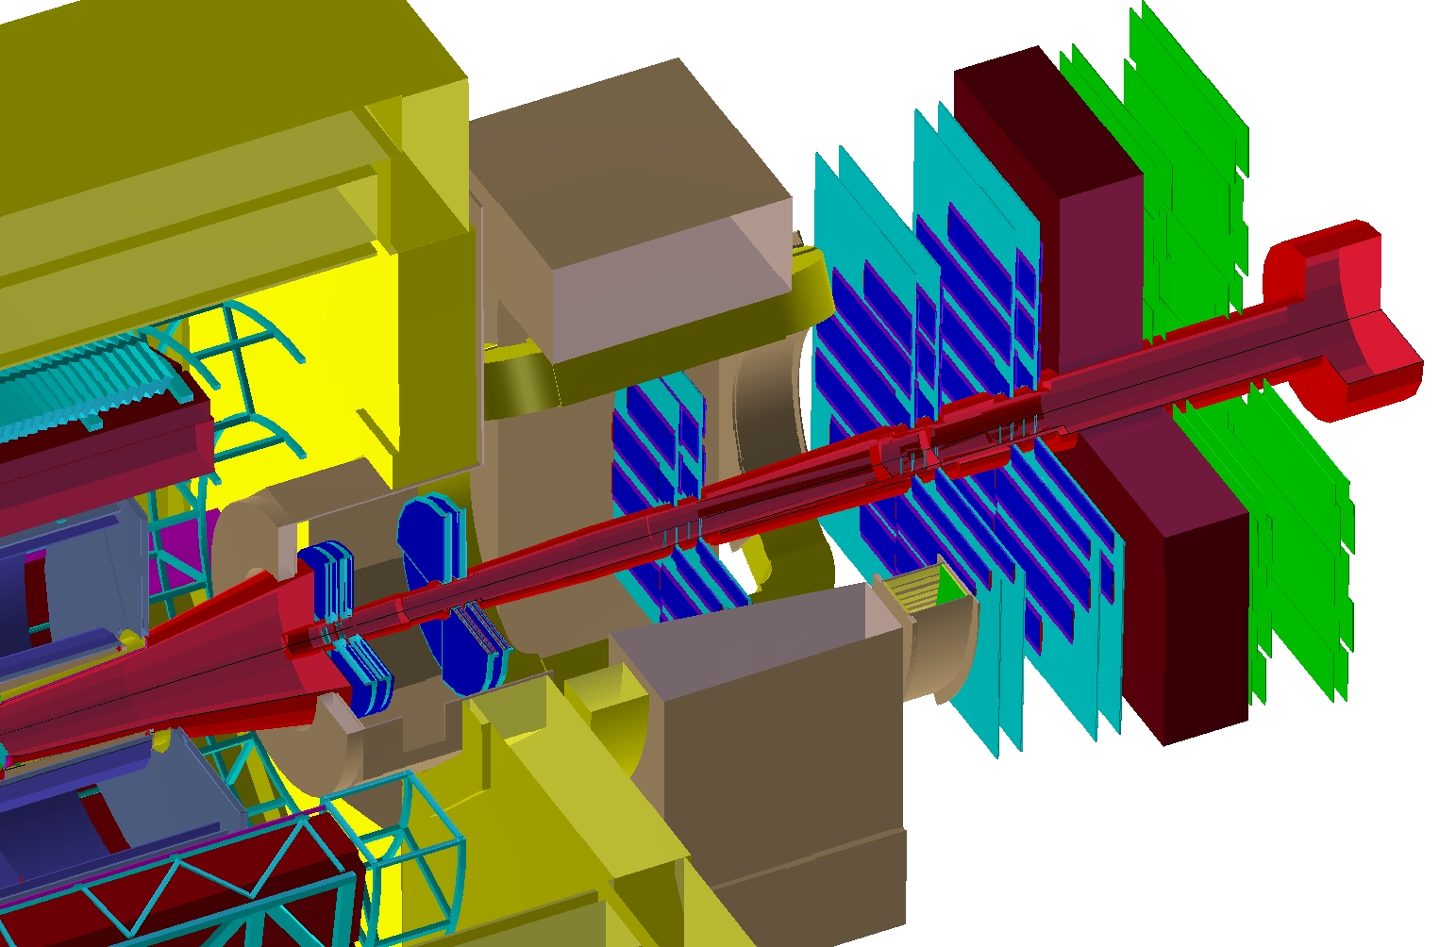
Geometry and expected misalignments
Tracking Chambers
Stations 1,2,3,4 and 5
Quadrants type
MUON tracking detectors:
5 stations
2 quadrant type
3 slat type
10 chambers (2 chambers / station)
156 detection elements
2x4; 2x4; 2x18; 2x26; 2x26
provide
x (1 mm) - non bending plane
y (0.1 mm) - bending plane
Slats type
MUON tracking detectors:
Expected initial precision:
chambers x,y,z ~ 1 mm
detection elements x,y,z ~ 500 μm
Geometrical Monitoring System:
chambers x,y,z ~ 20 μm

Slide 4
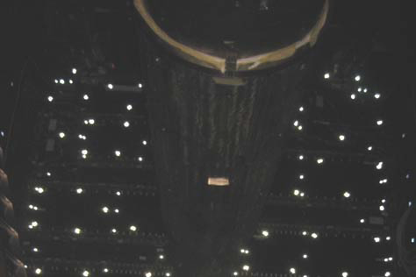
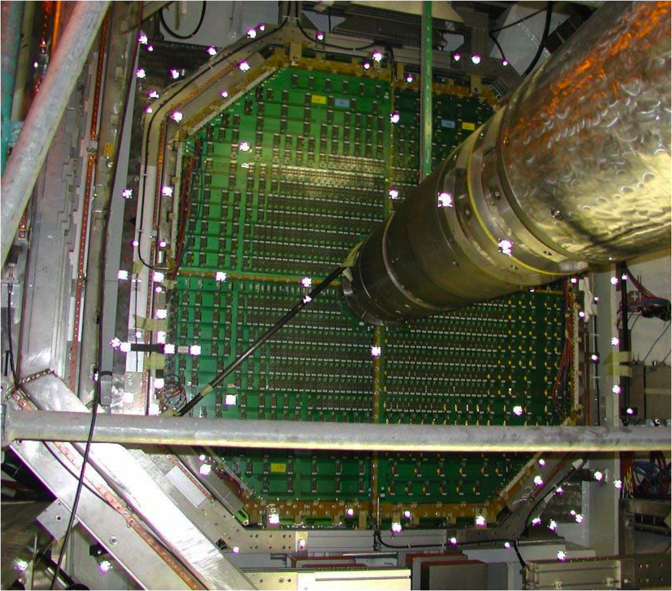
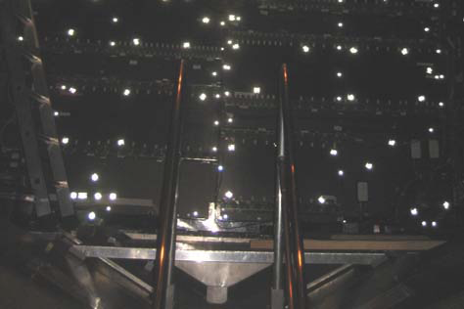
Photogrammetry and Survey
Survey and Photogrammetry should provide Day 0 misalignment file
Survey: half-chamber with respect to ALICE
Photogrammetry: slat or quadrant with respect to chamber
Useful for:
Check of coded geometry in AliRoot
GMS
Alignment with tracks
Currently available:
Photogrammetry - chamber 8I
Survey+Photogrammetry - chambers 1, 2, 3, 4 & 5
Used targets

Slide 5
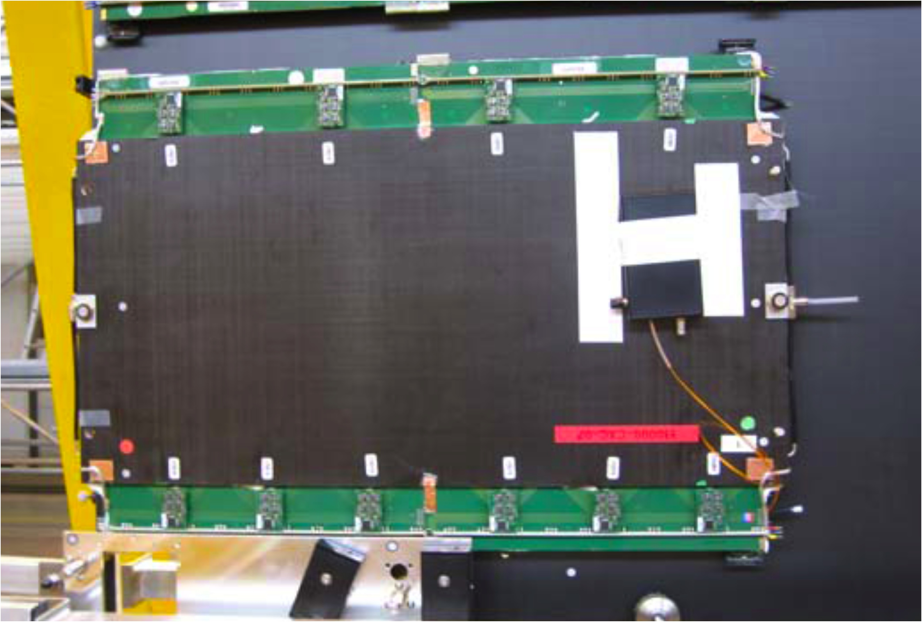
Approach for all Detection Elements
Sticker targets:
Unknown local position
If enough (>3) fit a plane
Provide ψ and θ rotation
2. Button targets:
Known local position
Fit local to global transformation (using known ψ and θ)
provide x,y,z translation and ψ, θ and φ rotation

Slide 6
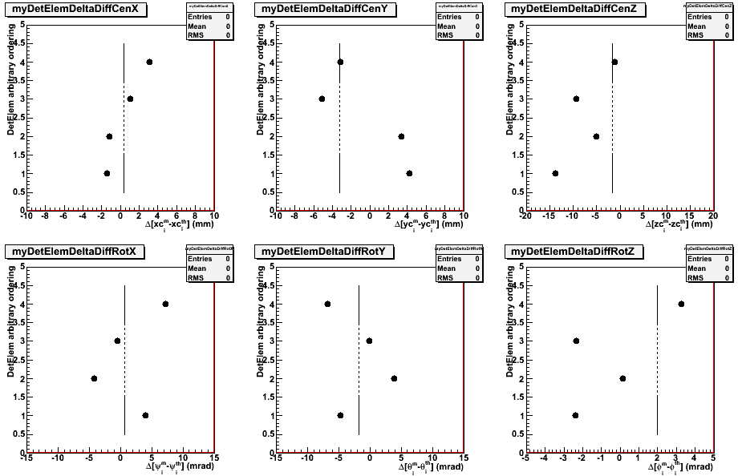
Current results – Ch1 (quadrants)
Lines: misalignments of (half-)chambers with respect to Alice
Circles: misalignments of detection elements with respect to chamber

Slide 7
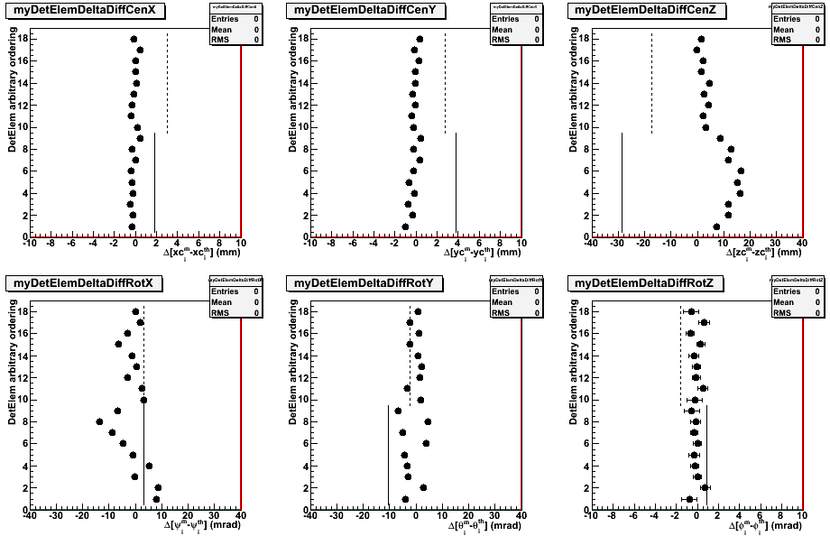
Current results – Ch5 (slats)
Support panel is bended
All results within mechanical specifications
Lines: misalignments of (half-)chambers with respect to Alice
Circles: misalignments of detection elements with respect to chamber

Slide 8
Latest developments / updates
Survey to alignment code
New MUONSurvey classes committed to SVN
Input data from survey/photogrammetry report stored in the ALICE Survey Data Depot
Use AliSurveyObj and AliSurveyPoint to read data
Produce misalignment data using AliAlignObj and stores it in (local) OCDB
Macro available for each of the already surveyed chambers
Write class/macro for the full detector

Slide 9
Alignment approach
Real life, unknown position
Real track
Optimum approach:
Use theoretical geometry to reconstruct tracks
For each track calculate residual at each detector
F_{j}(t₁,t₂,… ;d₁,d₂,…) = T_{j} - C_{j}
Minimize χ² = Σ (T_{j}-C_{j})²/σ_{j}²
Limitations for simultaneous minimization (matrix inversion):
Huge number of parameters!
Special structure of alignment problem
1 set of global parameters (detector misalignments)
several sets of independent local parameters (track parameters)
allows exact solution using matrix inversion by partitioning
Correlations taken into account
Theoretical position
Reconstructed (biaised) track
Common approach:
Use theo. geometry to reconstruct tracks
Calculate residuals (track-cluster)
Shift by residual average (n tracks)
Iterate until convergence
Problems:
Convergence is not guaranteed
Residuals are biased
Alignment parameters will then be biased
Correlations not taken into account

Slide 10
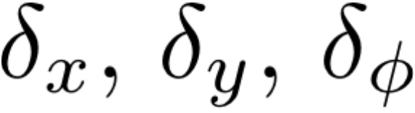
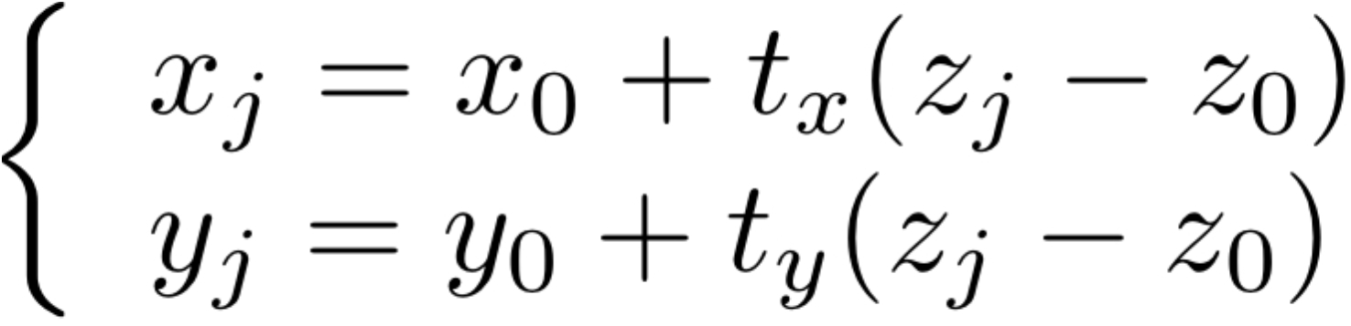
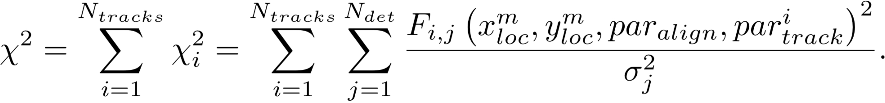
Alignment with tracks : Millepede
Developed by V. Blobel: http://www.desy.de/~blobel/wwwmille.html
AliMillepede, modified from a c++ translation by S. Viret (LHCb) of original fortran package:
http://alisoft.cern.ch/viewvc/trunk/STEER/AliMillepede.cxx?root=AliRoot&view=log
AliMUONAlignment, MUON specific alignment code using AliMillepede:
http://alisoft.cern.ch/viewvc/trunk/MUON/AliMUONAlignment.cxx?root=AliRoot&view=log
MUON
What you need to do:
Define your “alignment parameters”
Global parameters
Define your “track model” (B=0)
Local parameters
Define your “measurement”
Must be sensitive to the parameters
Write a linear expression of your χ² to minimize:
Per detection element:
B=0, straight track (4 parameters)
X (~1.0 mm) and Y (~0.1 mm) position of hit

Slide 11
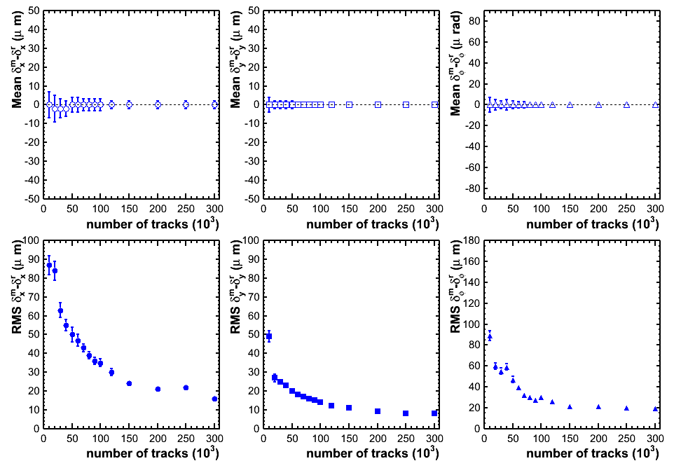
Current Results B=0, N track dependence
Input misalignments:
Uniform
|Δ_{X,Y}|<300 μm
|Δ_{φ}|< 500 μrad
Alignment precision:
RMS_{X} = 20 μm
RMS_{Y} = 10 μm
RMS_{φ} = 20 μrad
All stations are included
Constrains are essential
100k - 150k is a reasonable number
Need more realistic events

Slide 12
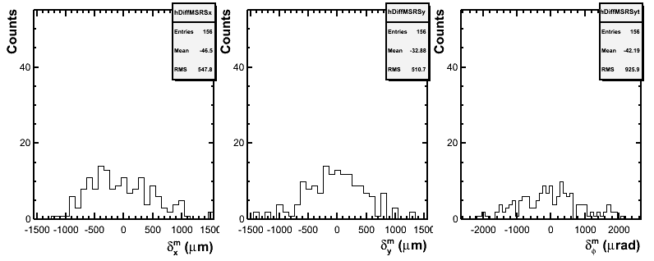
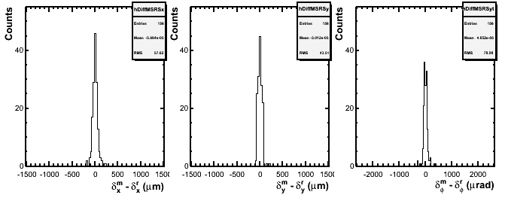
Realistic / Pessimistic B=0
Input misalignments:
Gaussian
σ_{X,Y}=500 μm
σ_{φ}= 900 μrad
v4-07-00
AliGenMuonCocktailpp event:
At least 1 muon
No soft pt cut
Generated 320k “pp muon” events -> 46k used out of 210k tracks
Alignment precision:
RMS_{X} = 58 μm
RMS_{Y} = 44 μm
RMS_{φ} = 79 μrad
Encouraging!
Further test needed (constraints)
Higher statistics

Slide 13
Latest developments / updates
Alignment evaluation and validation
Study the alignment performance using the track residuals
(Half-)Chamber degrees of freedom
Possibility to generate (half)chamber misalignments included to AliMUONGeometryMisAligner
Extend alignment code to include (half-)chamber degrees of freedom
Math for derivatives calculation
Implementation into AliMUONAlignment
Test with expected (half-)chambers misalignments
Remaining translation and 2 rotations degrees of freedom
Possibility to generate misalignments along z and around x and y
Extend alignment code to include them
Math for derivatives calculation
Implementation into AliMUONAlignment
Test with expected misalignments
Test physics impact

Slide 14
MUON Calibration: Alignment requirements
Size of raw data (muon stream) to be copied on disk: 25 G
Access to OCDB:
During raw data reconstruction to all relevant entries: MUON,
ITS(SPD), FMD, ...
During alignment phase to MUON/Align
Need of AliRoot reconstruction: Yes
Needed CPU:
Reconstruction of raw data up to ESDs level:
12 CPU days *2 (minimum number of reconstruction passes)
Reading ESDs and running alignment code : ~10h (include various test for optimization
Output size
ESDs from reconstruction :
8.5 G *2 (at least 1 extra pass to validate alignment)
Alignment output for monitoring/validation : 3 G

Slide 15
MUON Calibration: Alignment strategy
The alignment task is crucial to be ready for the official reconstruction production
In any case it is imperative (for a small subset of data, e.g. B=0) to
have fast access to raw data
be able to run (various) reconstructions over same set of data
Tools:
Alice Grid ( ~5000 machines & several Pbytes)
Cern Analysis Facility
Shall we foresee other Analysis Facilities?
Strategy about the tool we plan to use
If CAF is the right tool, the access to raw data, OCDB and AliRoot installation will be necessary
At least 2 reconstruction passes on the same data should be run, the second one to test and validate the found alignment parameters. For the first ever alignment we will expect 3 passes to be needed as we may start from very far away
All the above work is to be repeated for each B=0 run

Slide 16
Summary & ToDo
Alignment to do list
AliMillepede development
AliMillepede class optimization (fully use symmetric properties of matrix)
AliMUONAlignment development
Complete and test extension to other degrees of freedom
Test alignment performances with more realistic events
Re-start B-on case study
Define a valid linear track approximation
Select high transverse momentum tracks
Complete study of alignment performance (including physics)
Initial misalignment
Number of tracks
Read survey (photogrammetry files)
Process data as it becomes available
Most of the chambers will be resurveyed at the end of the shutdown

