Slide 1
High Pt Particle Identification with the TPC

Slide 2
Introduction
Analysis developed within the Analysis Task Force having the aim to check the high Pt identification on a track by track basis within the AOD framework
The AOD track contains the detector signals and the combined responses
Base idea for ID within AODs:
- a priori concentrations taken by a multiple fit on the TPC signal yield
- responses are the combined ones
- probabilities calculated by such concentrations and responses
First step : use the TPC only responses (ESDs)

Slide 3
Procedure
ESD tracks filtered according to AliESDTrackCut loose
TPC signal sampled in momentum bins (1 GeV/c each)
In each momentum bin the “a priori” concentrations have been exctrated according to a 3 gaussian fit (electron and muons afterwards considered equal zero)
The 5 species probabilities have been calculated per each track, using such concentrations and the TPC responses
The track is identified according to the most probable species principle

Slide 4
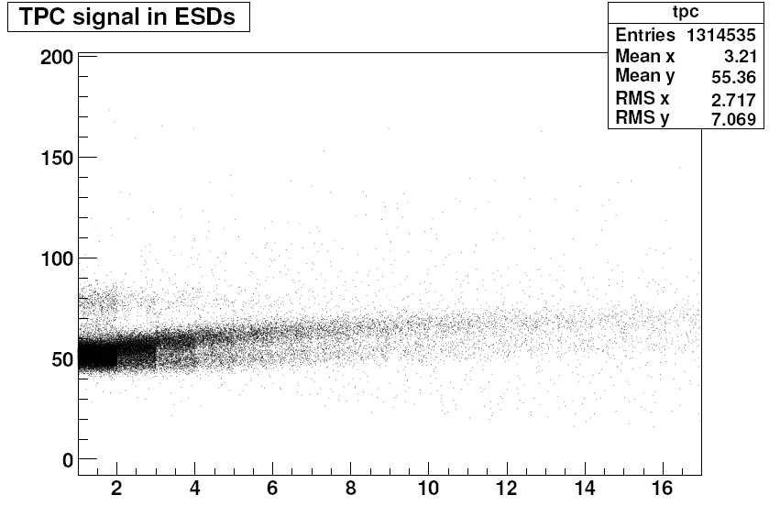
Data sample: /PWG4/arian/jetjetAbove_50_real
TPC signal a. u.
P (GeV/c)

Slide 5
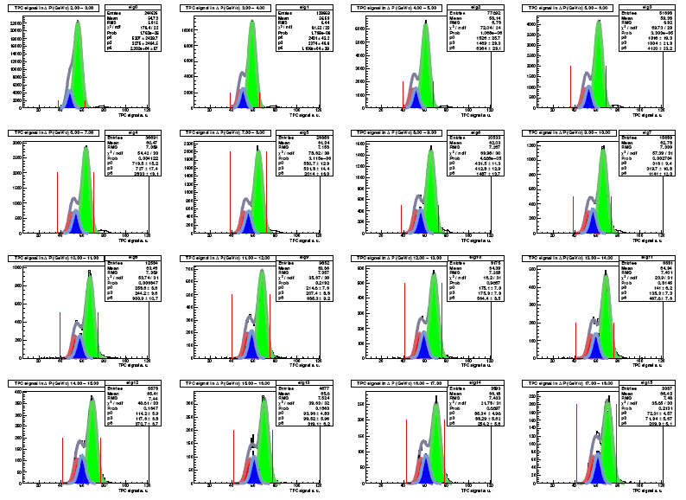
π
K
p

Slide 6
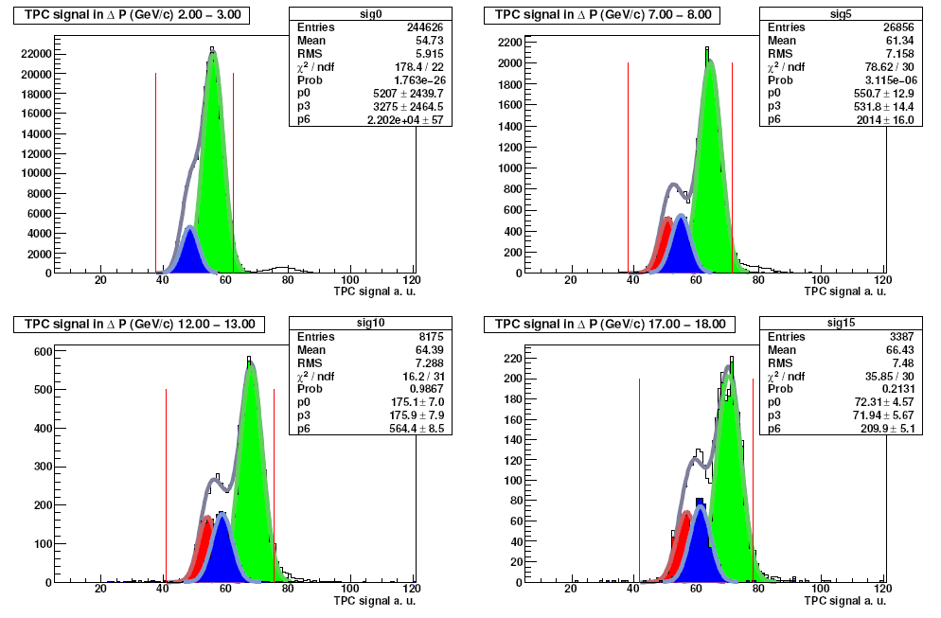
zoom
π
K
p
3 parameters fit (per each particle species the mean and the sigma were fixed)
The inteval should reject other contributions and reduce sistematic errors

Slide 7
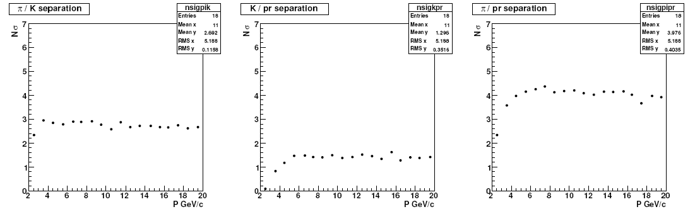
Separation power
sigma / mean is constant already at the simulation level

Slide 8
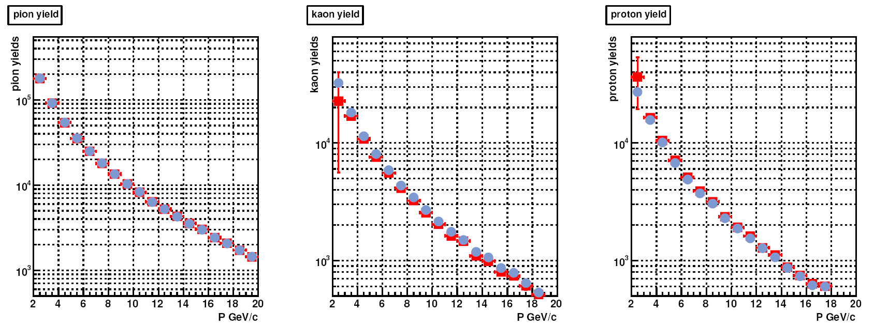
Yields
Light blue : true yield
Red : extracted
Pions : ok
Kaons : systematic decrease
Protons : systematic increase
(Constraint on N entries doesn’ t help)

Slide 9
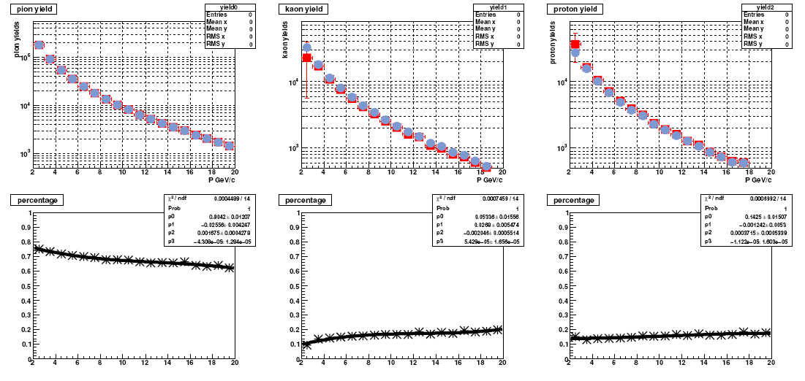
P-dependent concentrations

Slide 10
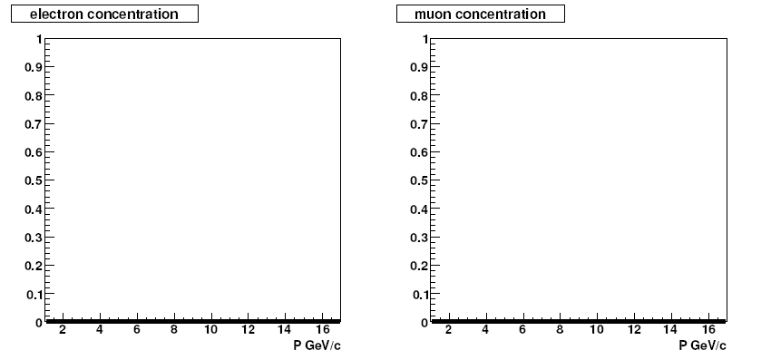
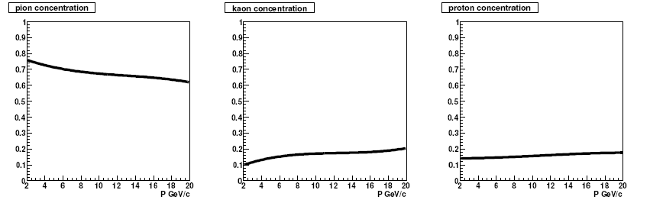
PID : track-by-track basis
PID performed with such a priori concentrations in two cases:
- TPC only responses
- Combined ESD responses

Slide 11
Efficiency maps
Pure efficiency : # ID _{[i -species ]} / # TRUE_{[i -species ]}
Maps from the CORRFW:
P dependent concentration functions plugged into the AliCFTrackCutPid
AliCFContainer (variables : P_{T} , η )

Slide 12
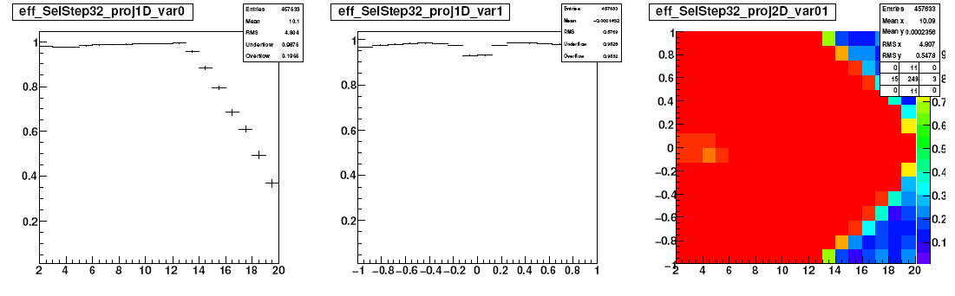
Pions : TPC responses only
P_{T} (GeV/c) η P_{T} (GeV/c)

Slide 13
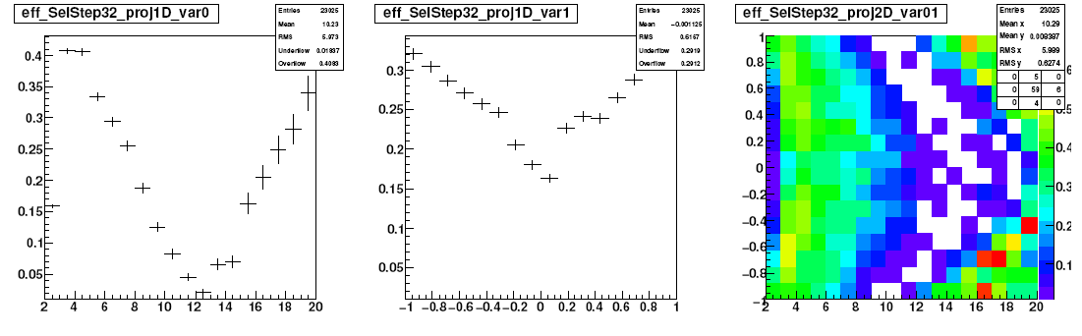
Kaons : TPC responses only
P_{T} (GeV/c) η P_{T} (GeV/c)

Slide 14
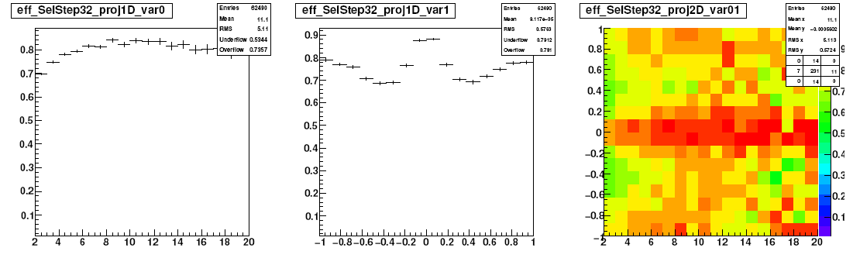
Protons : TPC responses only
P_{T} (GeV/c) η P_{T} (GeV/c)

Slide 15
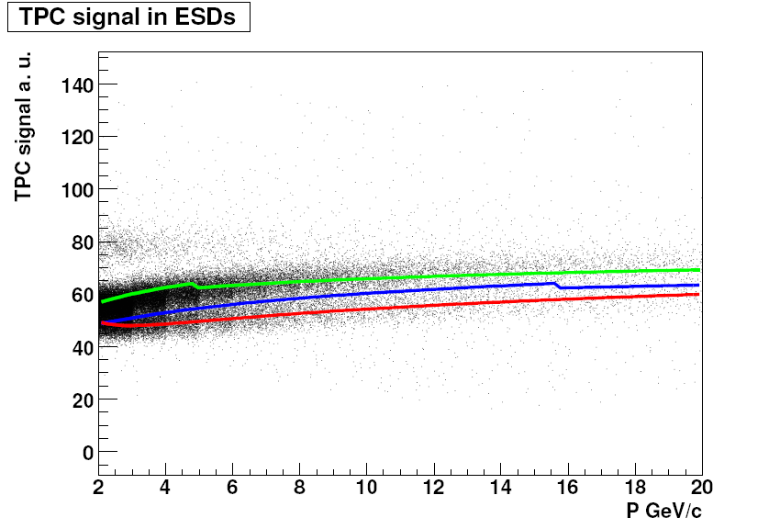
Bethe-Bloch formula for TPC responses
See AliTPCpidESD::Bethe

Slide 16
Combined PID case

Slide 17
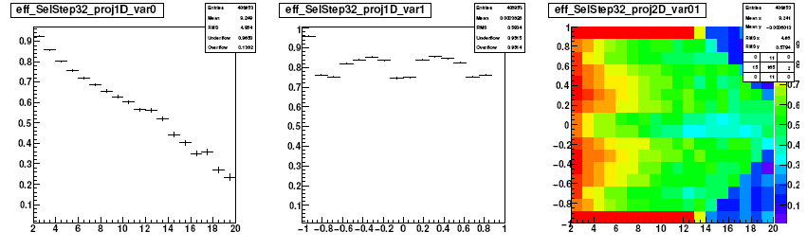
Pions - combined PID
P_{T} (GeV/c) η P_{T} (GeV/c)

Slide 18
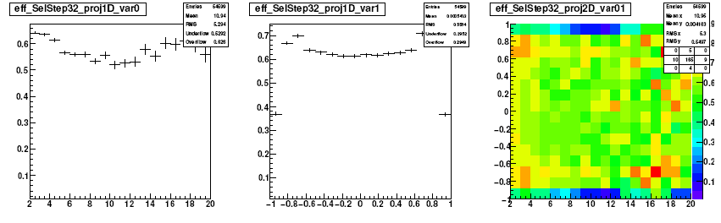
Kaons - combined PID
P_{T} (GeV/c) η P_{T} (GeV/c)

Slide 19
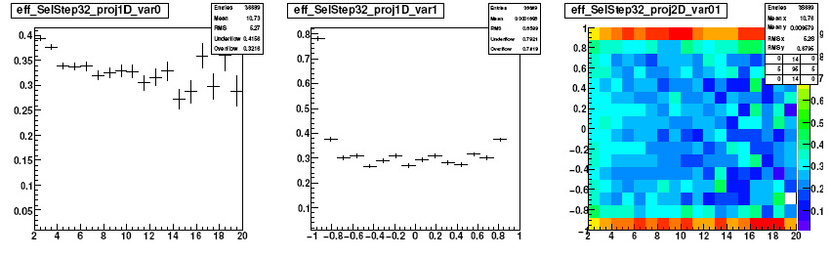
Protons - combined PID
P_{T} (GeV/c) η P_{T} (GeV/c)

Slide 20
A cross check….
The pion, kaon, proton gaussians are known -> recalculate the TPC responses accordingly
No use of AliCFTrackCutPid, but AliCFContainer still used
Φ dependent efficiency also taken into account

Slide 21
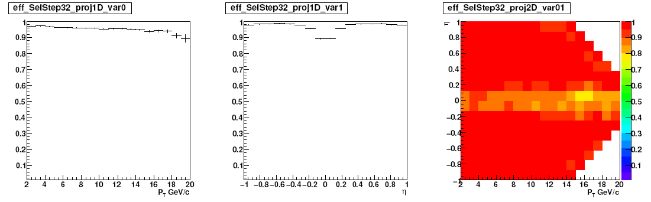
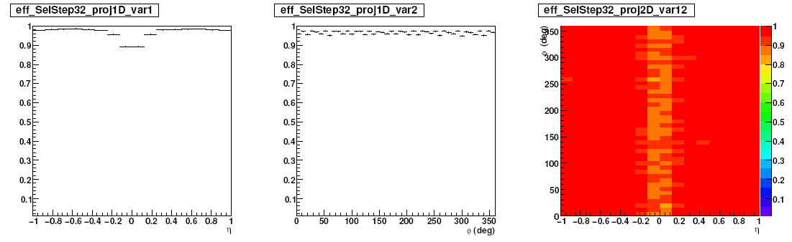
Efficiency maps: Pions

Slide 22
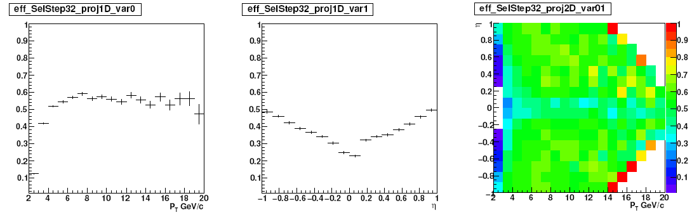
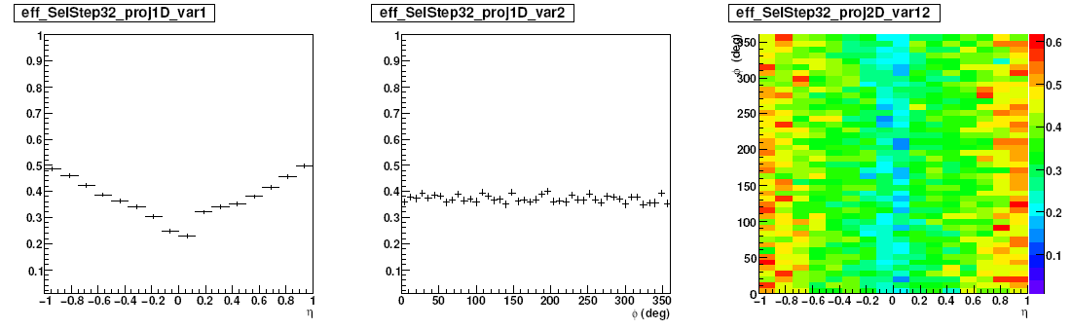
Efficiency maps: Kaons

Slide 23
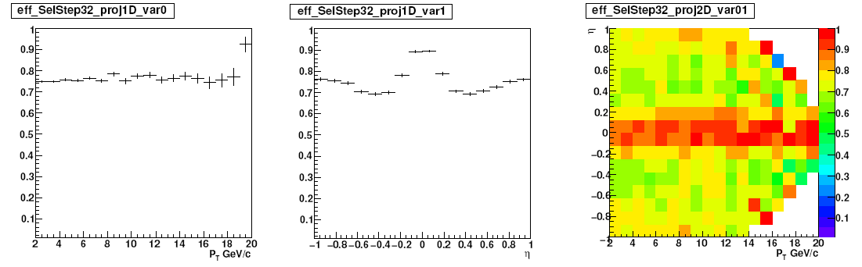
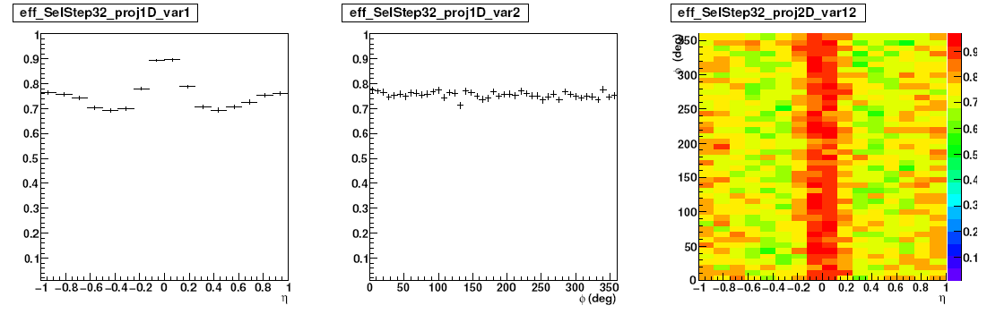
Efficiency maps : protons

Slide 24
Conclusions
TPC responses as stored in ESDs have to be revisited to identify particles at high momenta
Combined responses are affected by them. The high P identification is not reliable within the AOD framework
The high P_{T} PID performed again in an ideal case (assuming full and complete knowledge of the TPC resolutions and particle-dependent mean) but not complete… (e, μ to be taken into account)
Rapidity dependence to be understood
Such a procedure can be performed using AOD tracks (->AliAODPid) and MC information
Possible bugs in the data sample to be checked, hopefully new production PWG4-dedicated….

Slide 25
Backup

Slide 26
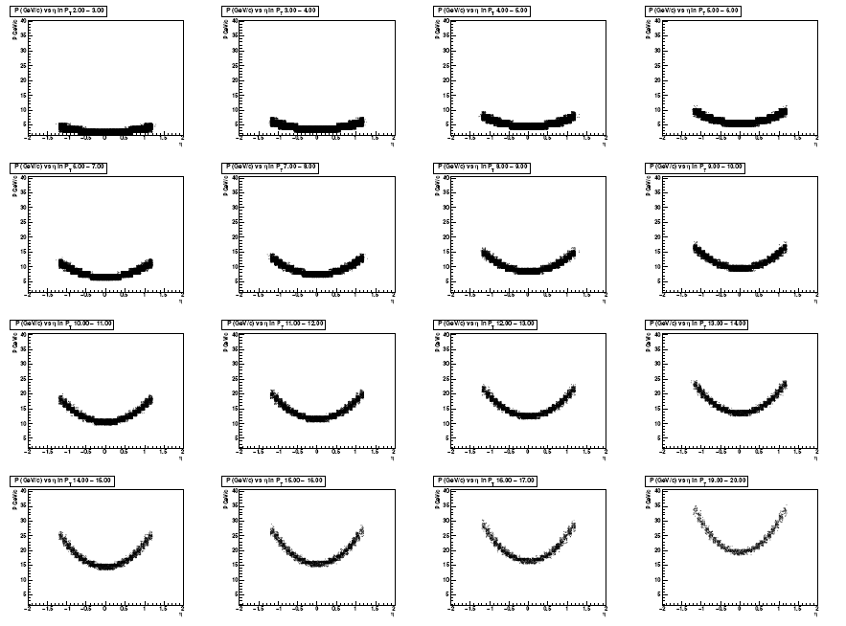
P - η in P_{T} bins (1 GeV/c )

Slide 27
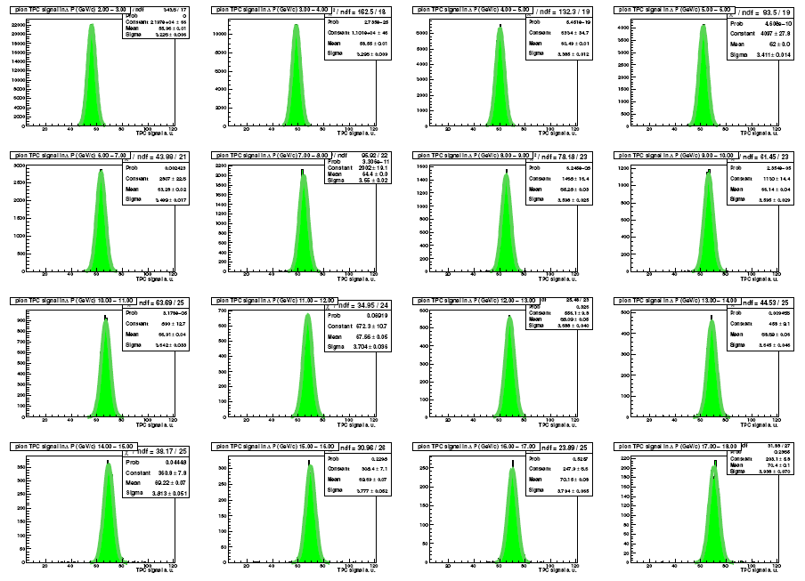

Slide 28
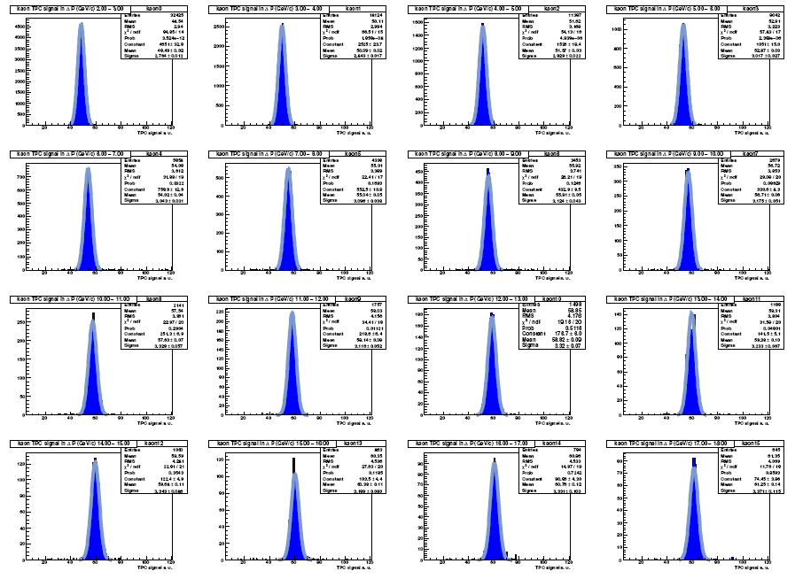

Slide 29
