Slide 1


Radioactive ion beam production at other facilities
P. Delahaye, GANIL
And M. Hass, Weizmann Institute/SOREQ

Slide 2
GANIL – SPIRAL 1
Most intense beams of ⁶He and ¹⁸Ne
⁶He
  2.10⁸/s at low energy, 3.10⁷ post-accelerated
  ¹³C beam 75AMeV on a graphite target (1.5 - 3kW)
¹⁸Ne
  10⁷/s at low energy (2+), 3.10⁶ post-accelerated
  ²⁰Ne beam 95AMeV on a graphite target (1.5 - 3kW)
Graphite target, very efficient ionization with an ECR source

Slide 3
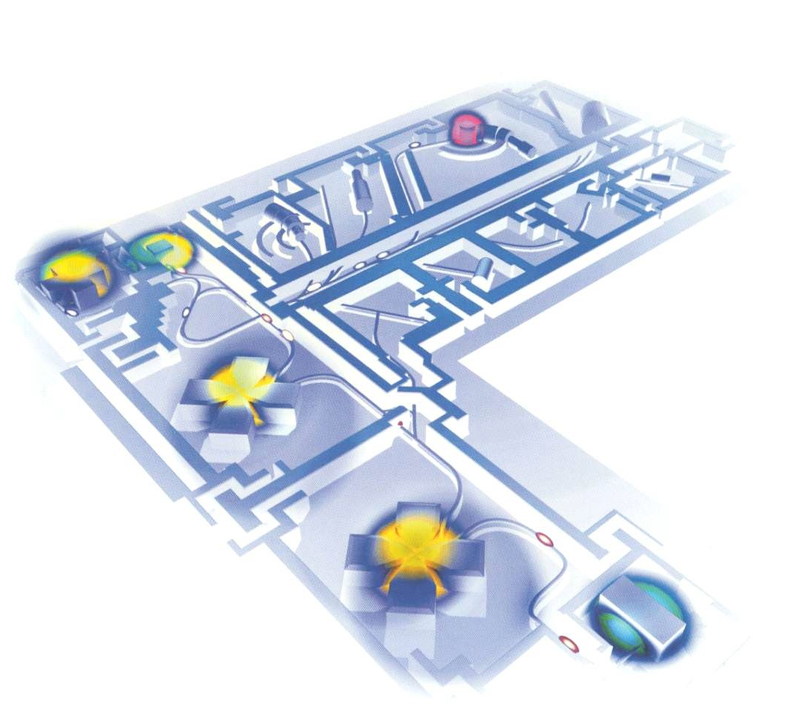
GANIL – SPIRAL 1
Experimental areas
Production cave
Post-acceleration
Of radioactive ions
CIME
CSS2
Acceleration
Stable ions
CSS1
Ion sources

Slide 4
Gaseous elements with Nanogan 3 and cold transfer tube
Cold transfer tube
=
Gazeous elements

Slide 5

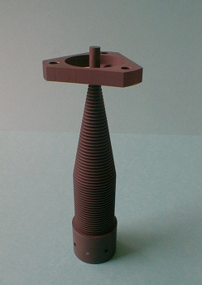
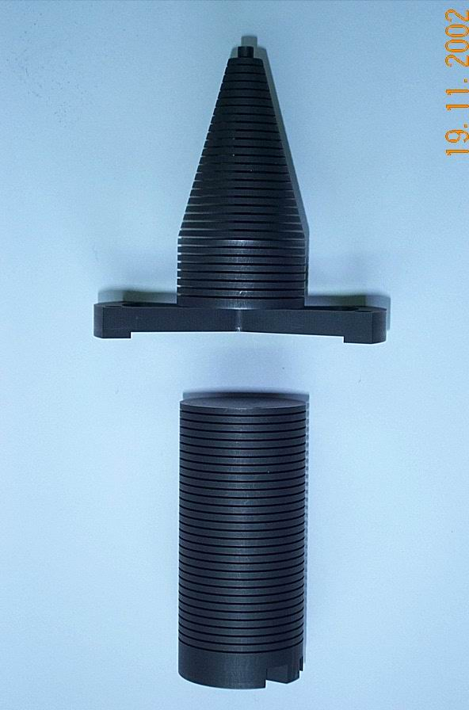
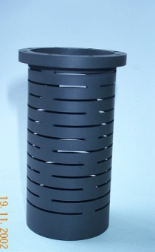
Graphite targets
Projectile fragmentation!
3 kW
1,5 kW
Ne, Ar, Kr, N, O, F
He

Slide 6
Projects at SOREQ and GANIL
GANIL - SPIRAL 1: new target materials for target fragmentation and fusion – evaporation
GANIL – SPIRAL 2:
  UCx targets with 5mA 40 MeV d hitting a neutron converter in ¹²C
  Fusion – evaporation and transfer reactions with light - or medium heavy - intense beams
SOREQ - SARAF:
  Phase 1: 2mA 5 MeV d on neutron converter (Li)
  Phase 2: 2mA 40 MeV d on neutron converter (Li)

Slide 7
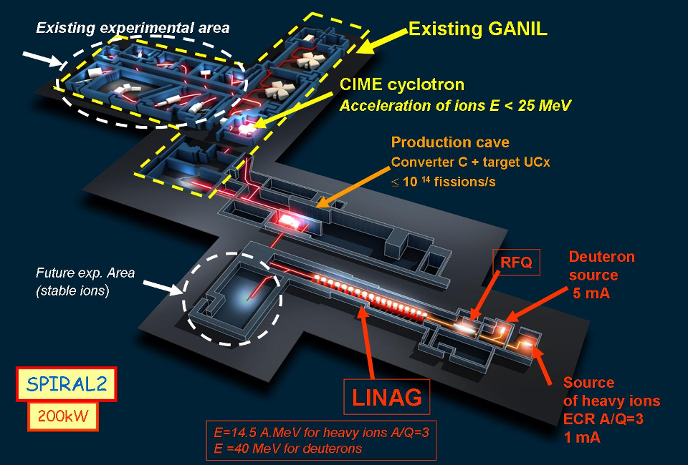
/A

Slide 8
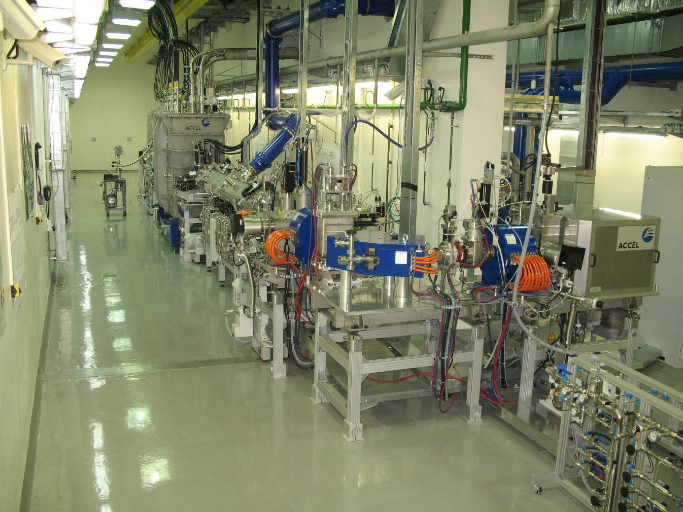
SARAF - Soreq
deuterons / protons
linear accelerator
5 MeV at Phase 1
with only 1 SM (2008)
40 MeV at Phase 2
with 6 SMs (2013)
2 mA current
6 SMs
β_{o}=0.15
RFQ
β_{o}=0.09
Nagler, LINAC2008
Piel, EPAC2008
Pekeler, LINAC2006
2008
40 MeV , 2 mA Lithium Converter

Slide 9
What interests for beta-beams?
Development of light RIBs for nuclear physics
  Joint (SOREQ+GANIL) development and tests of BeO targets with ISOLDE for high intensity ⁶He beams
  SOREQ: tests of a BN target for ⁸Li production
  GANIL: possibilities for testing (production) diffusion, effusion and ionization of ⁸B and ⁸Li beams at SPIRAL 1

Slide 10
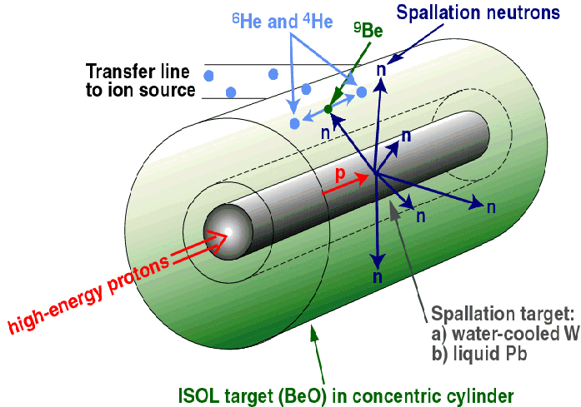
BeO and ⁶He: EURISOL
⁹Be(n,α)
Converter technology:
(J. Nolen, NPA 701 (2002) 312c)
CEA Saclay Optimized Geometry
T. Stora et al, EURISOL-TN03-25-2006-0003
N Thollieres et al. EURISOL-TN03-25-2006-0004
Preferred to direct irradiation (heat transfer and efficient cooling allows higher power)
⁶He in target yield is ~2x10¹³ ions/s (dc) for ~200 kW on target
Use of a 4MW target is a priori possible

Slide 11
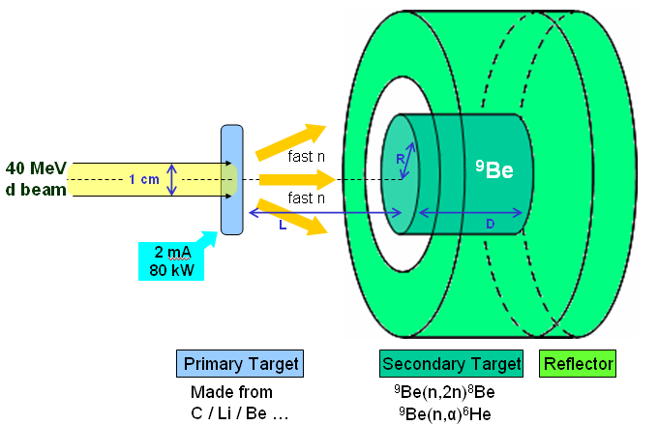
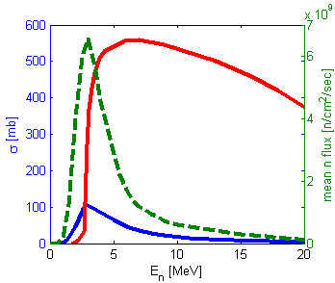
SARAF and GANIL
Optimization Calculations (SOREQ/WI)
MCNPTM Monte Carlo N-Particle transport code
Expected in target yields for BeO:
SARAF (40 MeV, 2 mA): 8∙10¹² [⁶He/sec]
SPIRAL2 (40 MeV, 5 mA): 2∙10¹² -2∙10¹³ [⁶He/sec]
Expected in target Yields for a BN target:
SARAF (40 MeV, 2 mA): 2∙10¹² [⁸Li/sec]
Hass et al., J. Phys. G: Nucl. Part. Phys., 35, 014042 (2008).

Slide 12
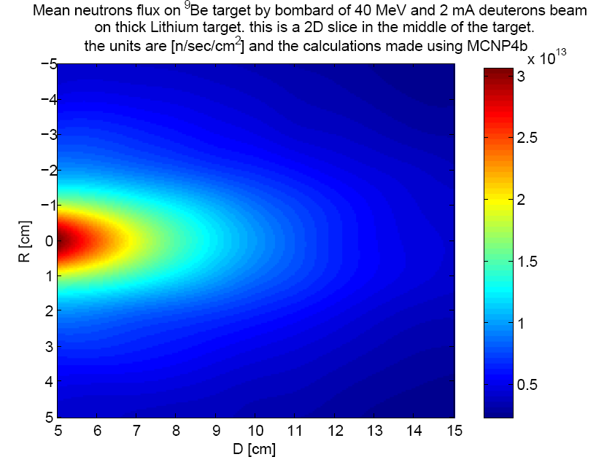
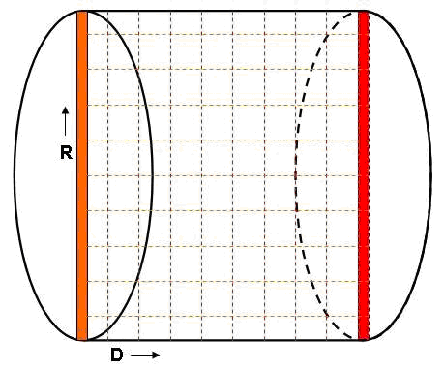
SOREQ/WI: neutron flux simulation
2D slice inside the secondary target

Slide 13
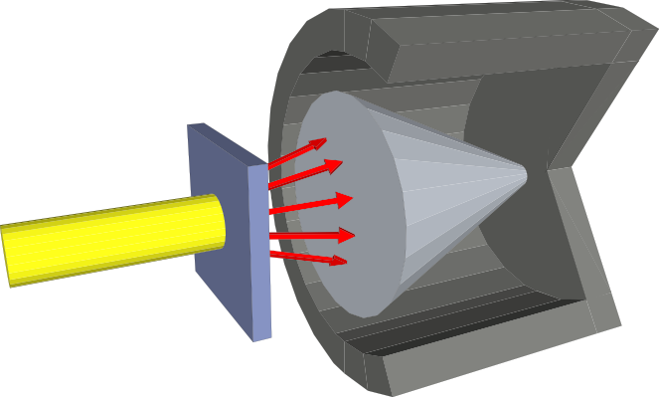
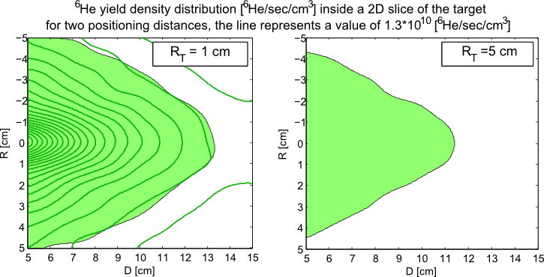
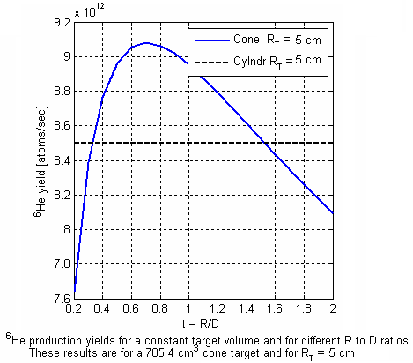
SOREQ/WI: target geometry
Cone shaped target
2D slice of the target
* R_{T} stands for the distance between the two targets

Slide 14
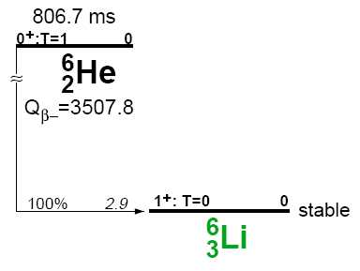
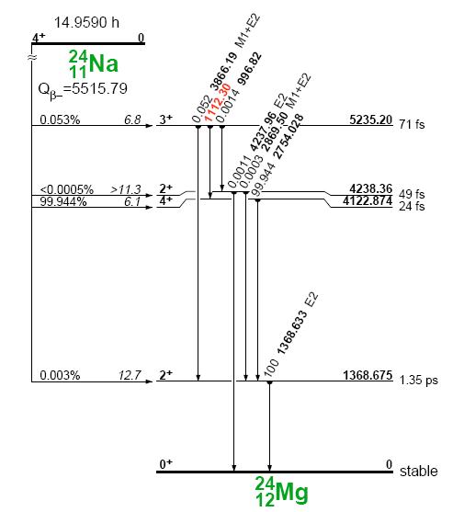
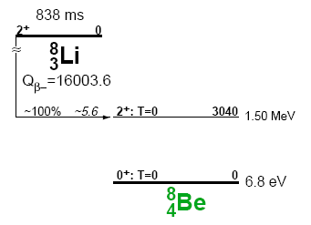

Plans SOREQ
²⁷Al(n,α)²⁴Na
γ
²⁷Al(n,α)²⁴Na
NG
Production
Monte Carlo
Simulations
¹¹BN(n,α)⁸Li
β
¹¹BN(n,α)⁸Li
NG /
Phase 1
Production
extraction
Monte Carlo
Simulations
⁹BeO(n,α)⁶He
β
⁹BeO(n,α)⁶He
15.2.2008 Aluminum cubes irradiation experiment number 1. Preliminary experiment for verification of target geometry in compare to Monte Carlo simulations.
Phase 1 /
Ganil /
ISOLDE
Production
extraction
Monte Carlo
Simulations
28.4.2008 Aluminum cubes irradiation experiment number 2. Preliminary experiment for verification of target + reflector geometries in compare to Monte Carlo simulations and previous experiment.
⁶He production
and extraction
numbers

Slide 15
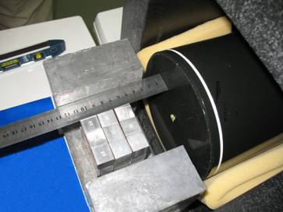
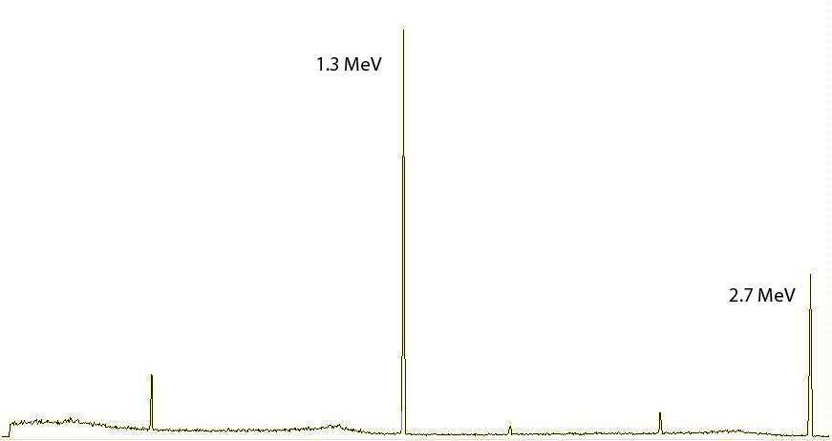
Aluminum Cubes Experiment
1.4∙10⁹ n/s
T.Y.Hirsh et al. PoS(NUFACT08)090, 2008.

Slide 16
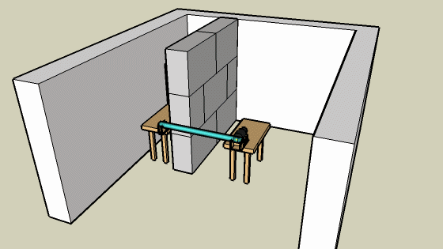
⁸Li Production Experiment
⁸Li production measurement.
¹¹BN(n,α)⁸Li by fast neutrons.
Automatic measurement system using a fast air-pressure rabbit.
Detection of betas from ⁸Li decay.
A benchmark for simulations.
⁶He production is also possible by replacing the target by BeO.
3 sec
0.1 sec
3 sec
irradiation
movement
measurement
time

Slide 17
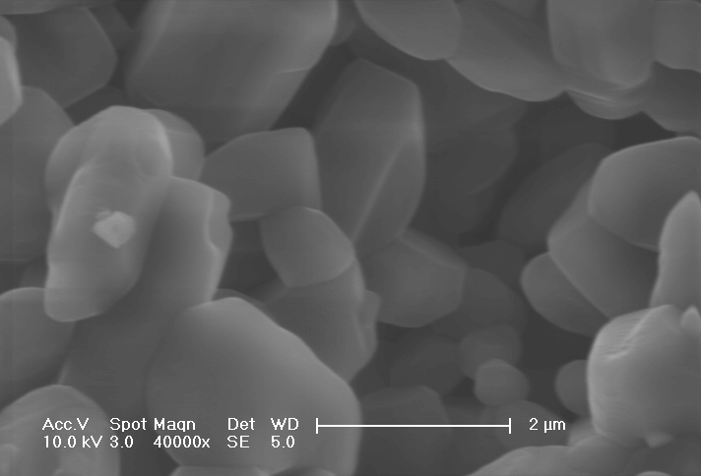
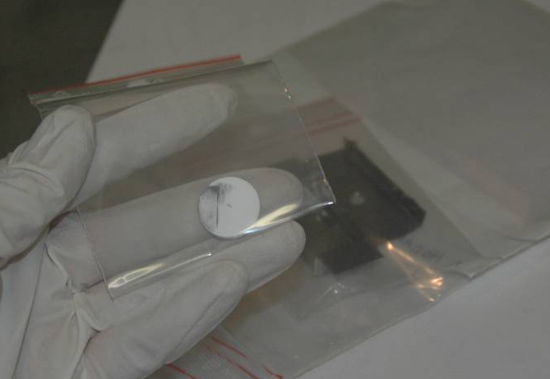
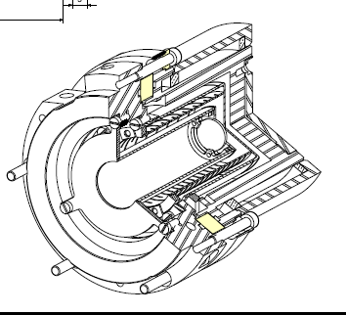
Joint efforts BeO
SEM BeO SOREQ/WI
Heating tests with Ta or Mo container at ISOLDE
R. Hodak PhD Thesis
T. Stora
On line experiment foreseen mid of April with Ta converter
oven
BeO catcher pellet
Diffusion and effusion test of ⁶He produced by SPIRAL 1 in a BeO pellet
Target is becoming a catcher – experiment at SIRA for mid 2010
Safety issues are being addressed

Slide 18
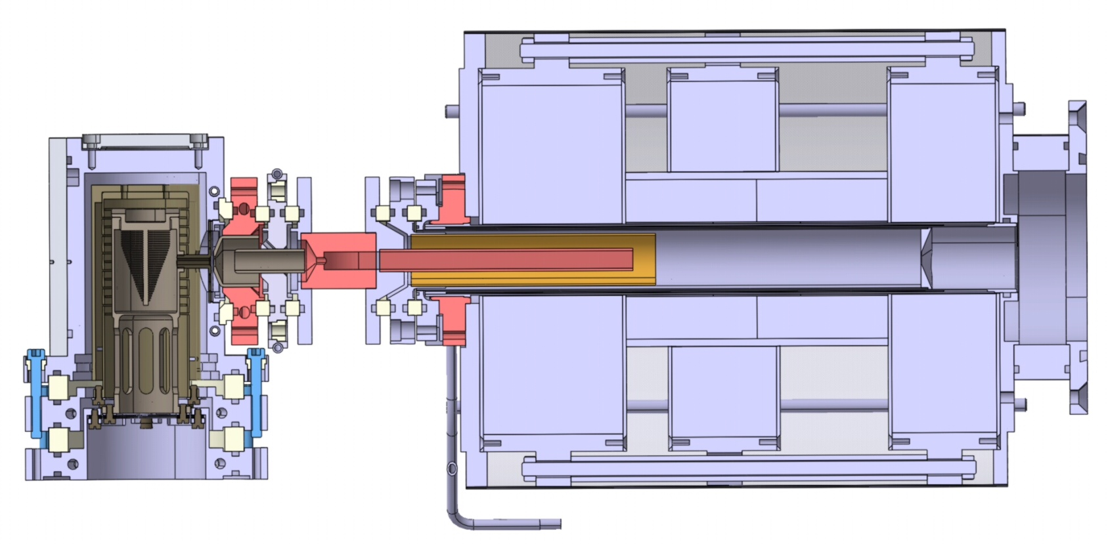
Future possibilities GANIL SPIRAL 1
1+ N+ ⁸Li ions in “Nanonake”
¹³C on ¹²C target
1+ Beam
N+ RIB
Primary beam
deceleration
Experiment scheduled in May
C. Eleon et al. NIMB206 (2008) 4362-4367 (EMIS2007) C. Eleon et al RSI 79, 02A904 (2008)

Slide 19
Testing a difficult beam: ⁸B
Production using fragmentation of ¹³C on ¹²C
Flushing CF4 in the target surrounding to produce BF₃
Ionization in Nanogan (0 to N+)
  Was already tested with ³²S and ³⁶Ar on graphite target but high background of ²⁴Na

Slide 20
Summary
In the frame of EUROnu
  Production tests of 8Li from a BN target irradiated by fast neutrons at SOREQ with neutron generator and SARAF phase 1 (2009)
  Production tests of ⁶He from a BeO target irradiated by fast neutrons at SOREQ from SARAF phase 1
  Diffusion of ⁶He in BeO at GANIL (2010)
  ⁸Li (production) diffusion in graphite and ECR-ionization tests possible at GANIL (May – June 2009)
  Possibility of testing diffusion and ECR-ionization of ⁸B in a parasitic beam time at GANIL (?)

Slide 21
People and institutes
Michael Hass
Tsviki Hirsh
Vivek Kumar
Kuljeet Singh
Dan Berkovits
Leo Weissman
Yoram Nir-El
F. De Oliveira
M.G. St Laurent
P. Delahaye
H. Franberg
R. Leroy
Pichard
G. Lhersonneau
Thanks a lot for your attention!

Slide 22
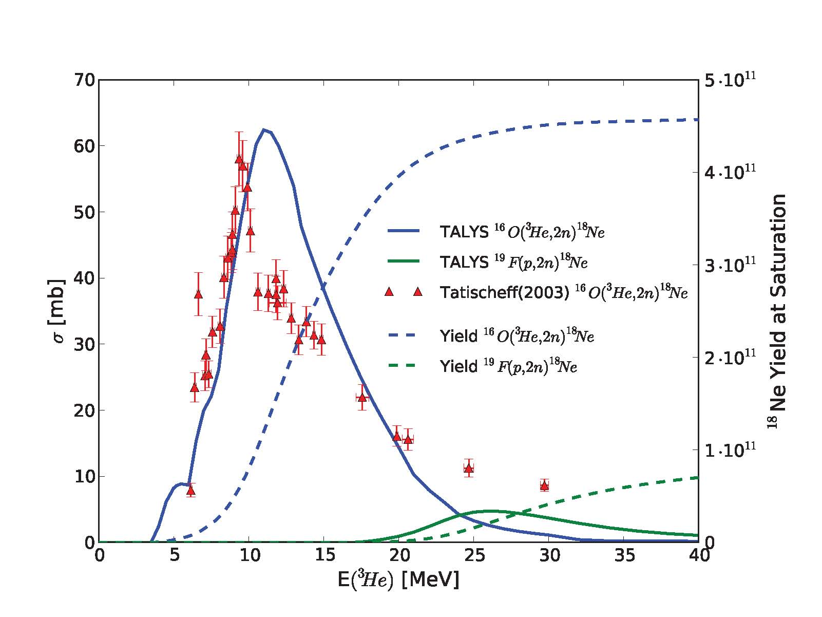
What about ¹⁸Ne?..

