Slide 1
Review of radiation levels in RR77 and RR73
The FLUKA team

Slide 2
RR Shielding Options - FLUKA Calculations
FLUKA simulations performed based on the RR shielding installation options suggested by S. Weisz
Impacts & Options to be studied – High-Energy Hadron Fluence ONLY
  Past situation
  Efficiency of different shielding parts
  Best solution
  Other possible constraints
Applied loss scenario
  Beam 1 only, 7 TeV, nominal losses
  Mixed case horizontal, vertical, skew – 1/3 each
Loss assumptions as used for normalization of the following results
  Annual loss: 1.15 x 10¹⁶ protons per year (nominal)

Slide 3
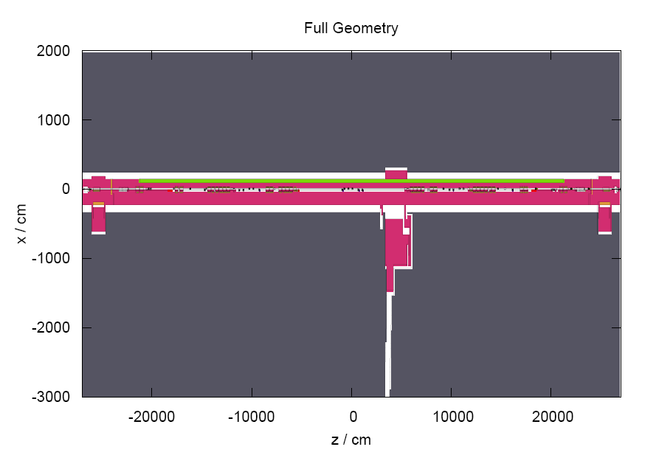
Fluka geometry:IR7
Beam1
Beam2
TCPs (beam 2)
RR73
UJ76
RR77
TCPs (beam 1)
IP7
TZ76

Slide 4
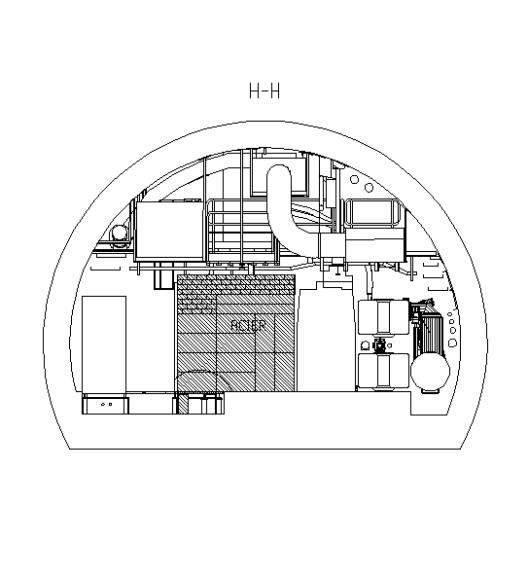
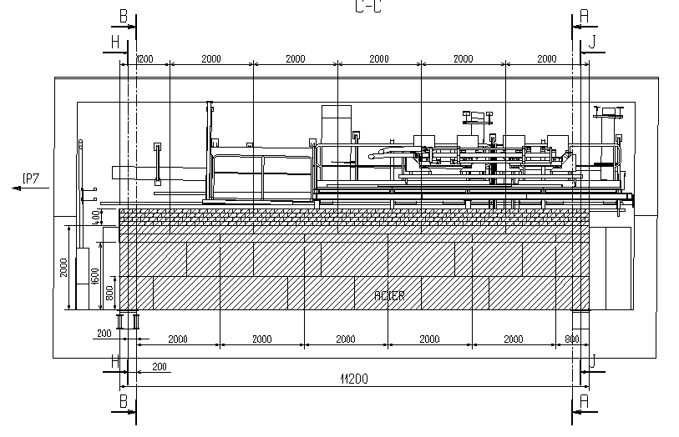
Just as a Reminder
S. Weisz, 4th R2E Meeting, 20.06.2008,

Slide 5
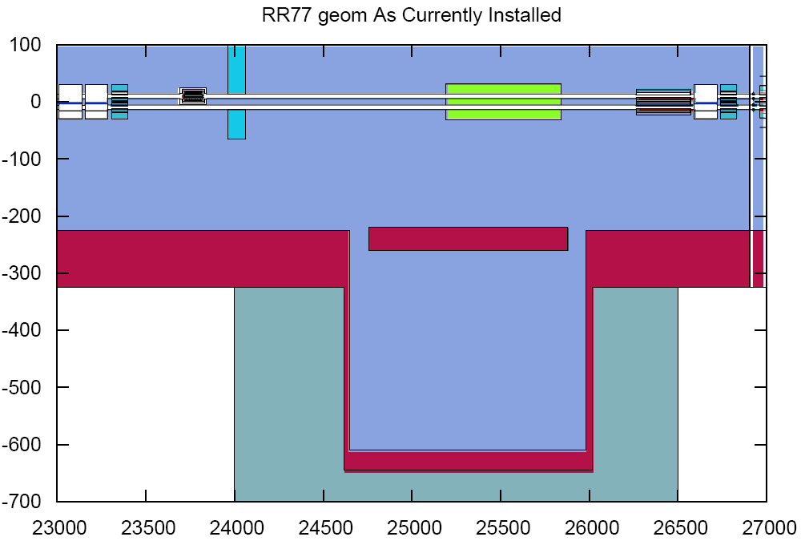
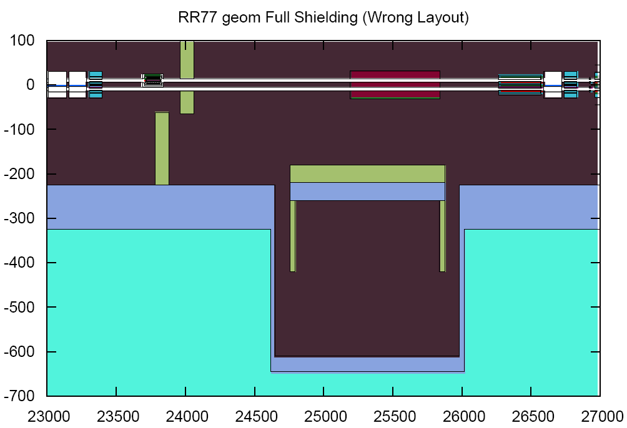
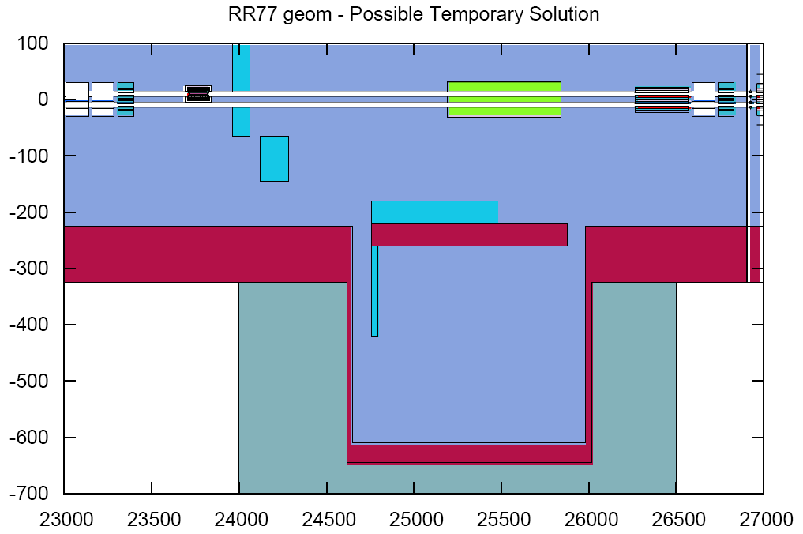
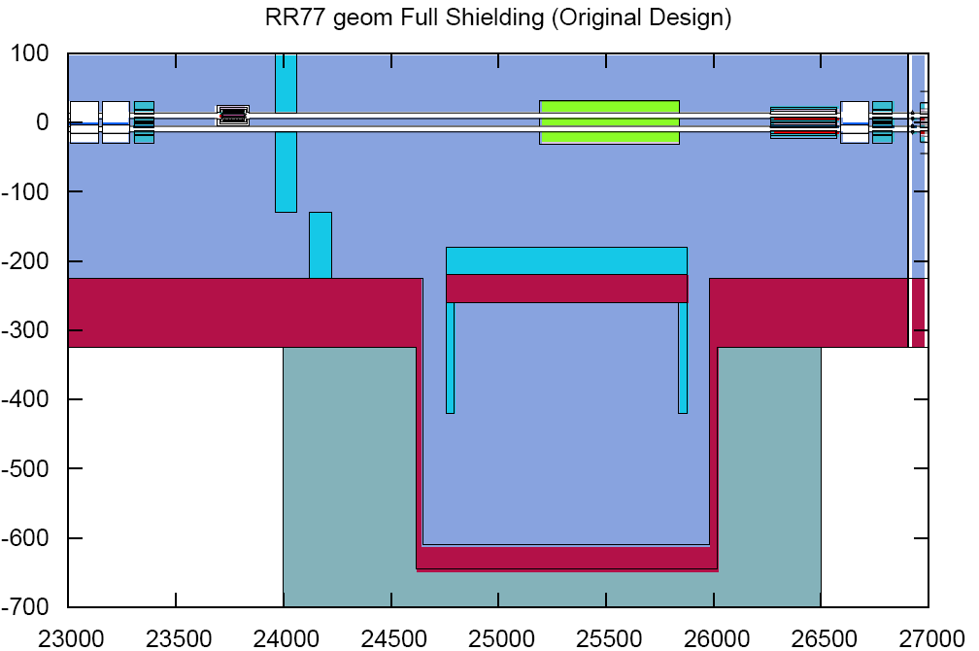
Different Geometry Options
Beam 1
TCLA.A7R7.B1

Slide 6
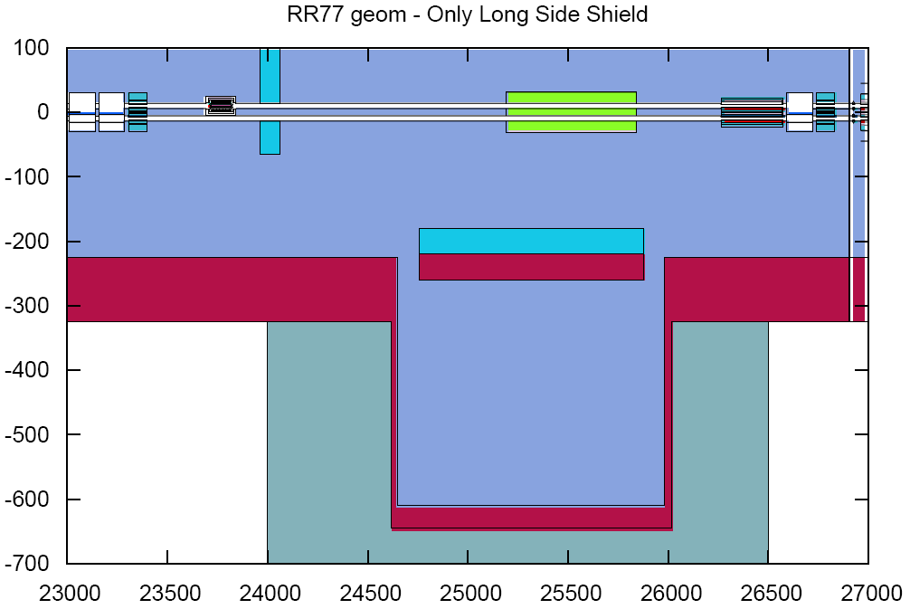
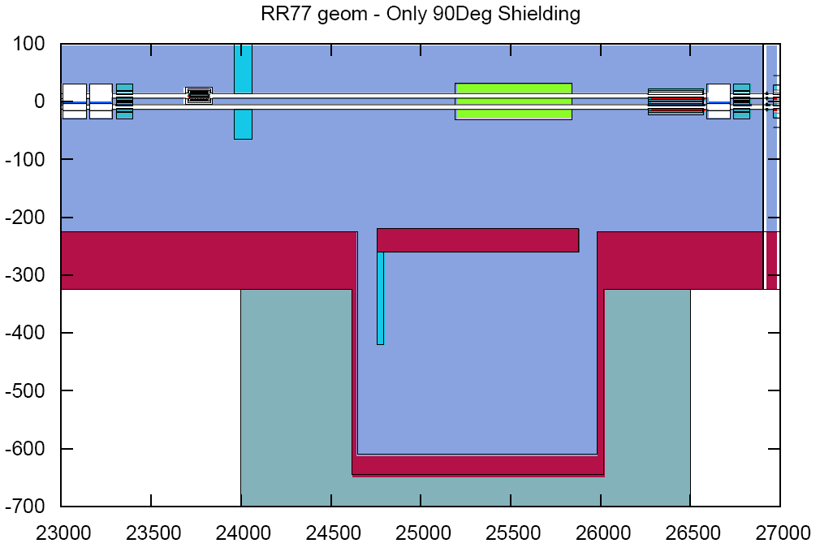
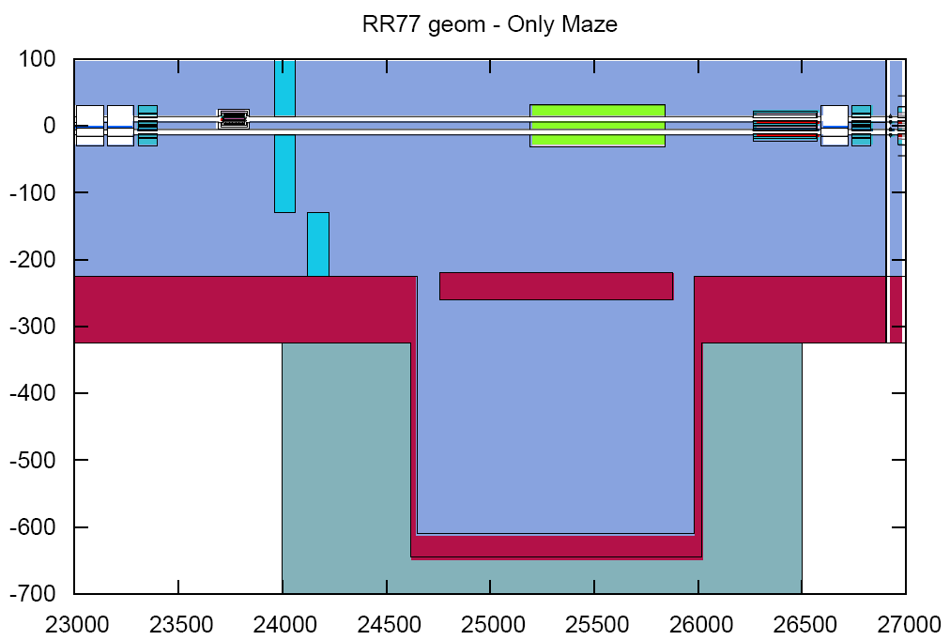
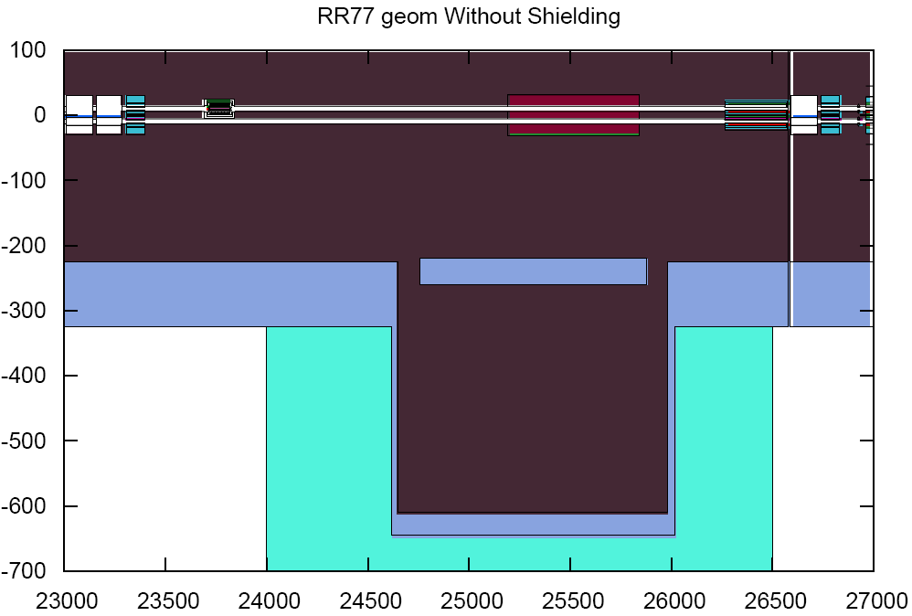
Different Geometry Options

Slide 7
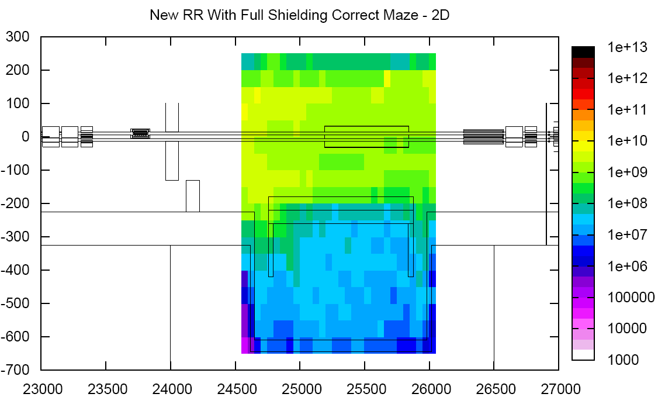
The Perfect Case
1.15 x 10¹⁶ p/year

Slide 8
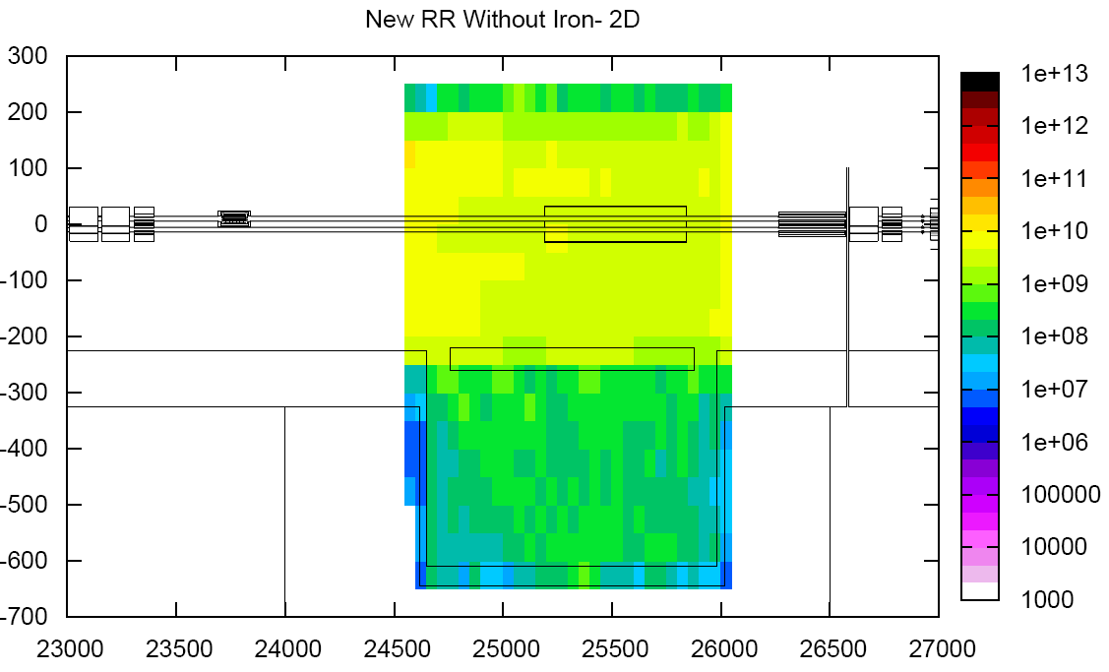
The Unshielded Case
1.15 x 10¹⁶ p/year

Slide 9
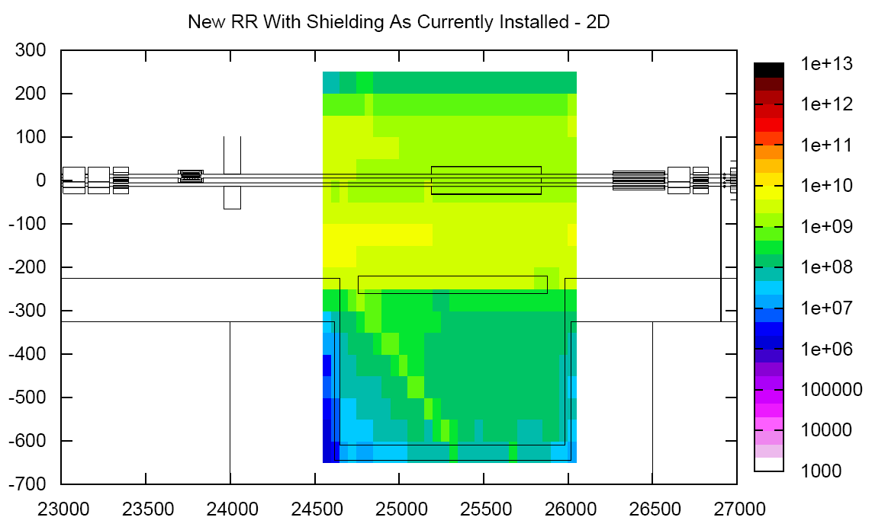
The First Shielding Leg acting as ‘Spoiler’
1.15 x 10¹⁶ p/year

Slide 10
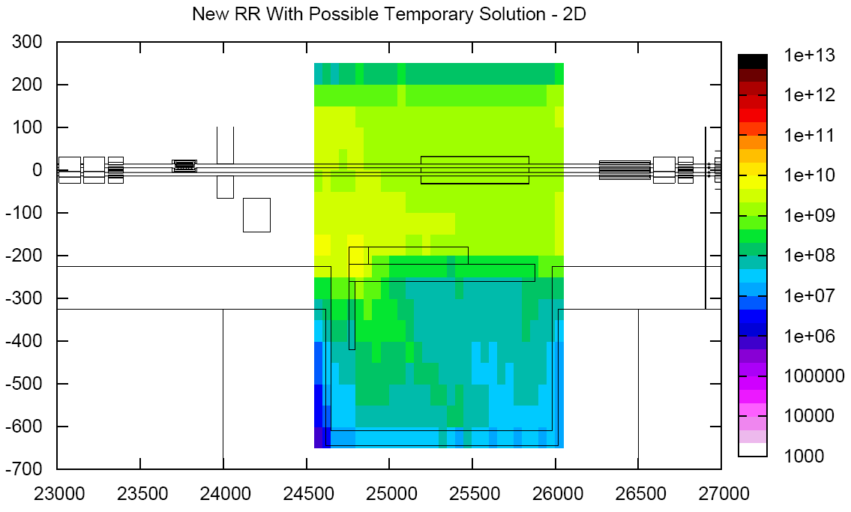
Impact of the ‘Temporary Solution’
(not relevant anymore, since full shielding will be implemented during the shutdown)
1.15 x 10¹⁶ p/year

Slide 11
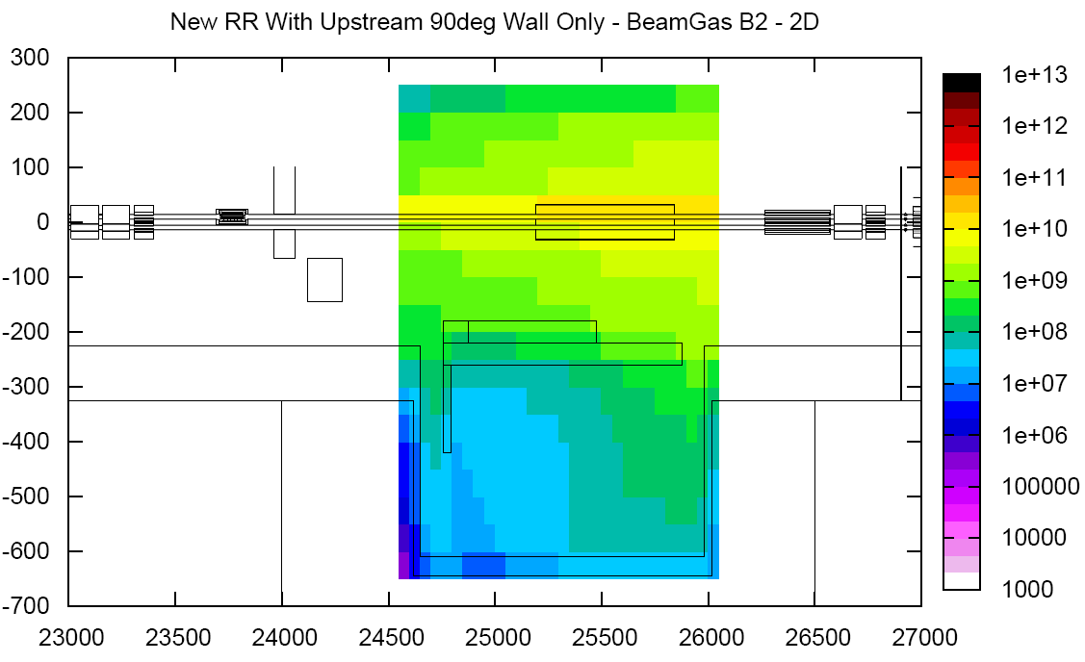
Temporary Solution and Beam-Gas (Beam 2)
Very conservative gas density
RR not fully shielded
1 x 10¹⁵ H₂/m³

Slide 12
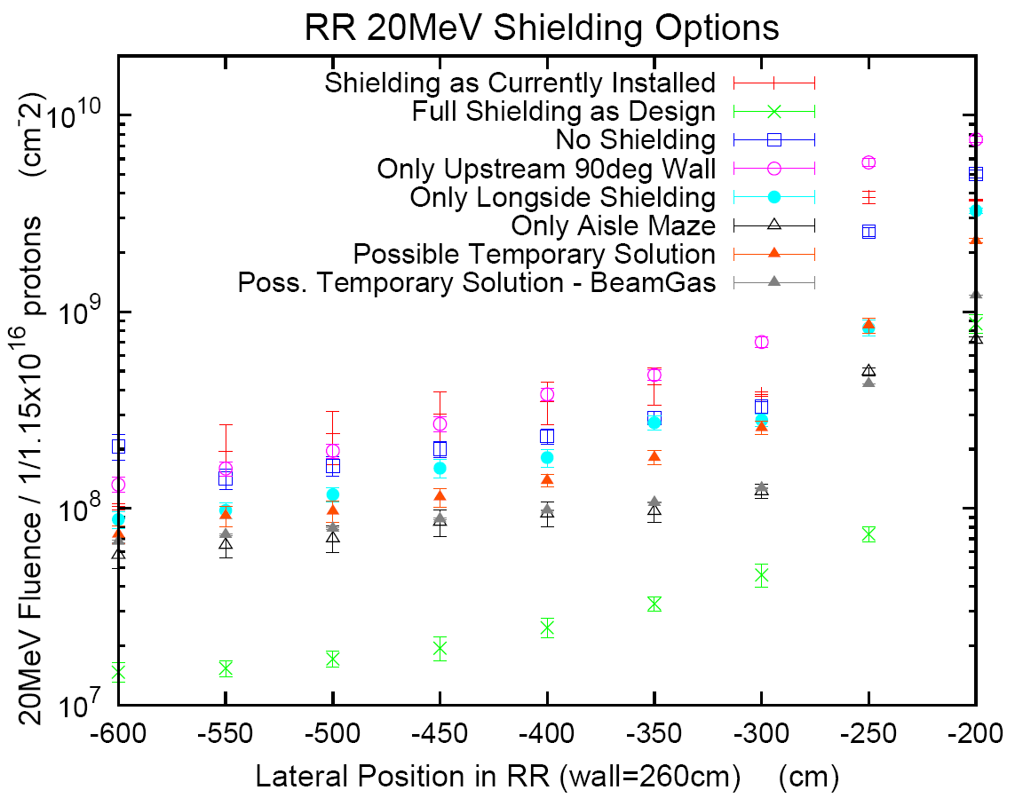
Combined Results – Norm.: 1 x 10¹⁶ p/year
Very conservative
assumption:
1x10¹⁵ H₂/m³

Slide 13
© T. Wijnands
cm⁻²
10⁴
10⁵
10⁶
10⁷
10⁸
10⁹
10¹⁰
10¹¹
10¹²
10¹³
Aircraft Altitudes
LHC Machine electronics equipment
LHC Detectors
sea
Level
^{(Lowest !!!)}
Airbus
A330
UAs
RE38
UJ76
UAs
Under
ARC dipole
DS Q8
TAN
(low)
UX45
(peak)
UJ33
UJ32
Under
ARC quad
CNGS
2007
Some
Failures
RR73
RR77
e.g., some estimated LHC-Levels for Hadrons
(E > 20 MeV) per cm² per nominal year

Slide 14
Conclusions
Previous installed shielding (one leg only) is ‘worst case possible’
Temporary solution (simplified block + part of the direct RR shielding) is the best compromise (patch!)
Beam-Gas only an issue if maximum gas density values (1x10¹⁵ H₂/m³) are reached
Design solution offers best protection and will be installed during the shutdown (possibly not up to the full height; to be checked with respect to electronics location)
For nominal conditions this still results in several 1x10⁷ cm⁻²/year high-energy hadron fluence
The current calculations are based on the perfect nominal case and respective safety margins should be taken into account
Suggested safety margin (given the uncertainty in the loss distribution, as well as statistical limitations and long distances): at least a factor of 2-3
Adding extra shielding and relocation of all electronics are not an option:
  It’s important to be sure the electronics in RR77 and RR73 can withstand the radiation levels foreseen

