Slide 1



Slide 2
Rules in S‘Cool LAB

Slide 3

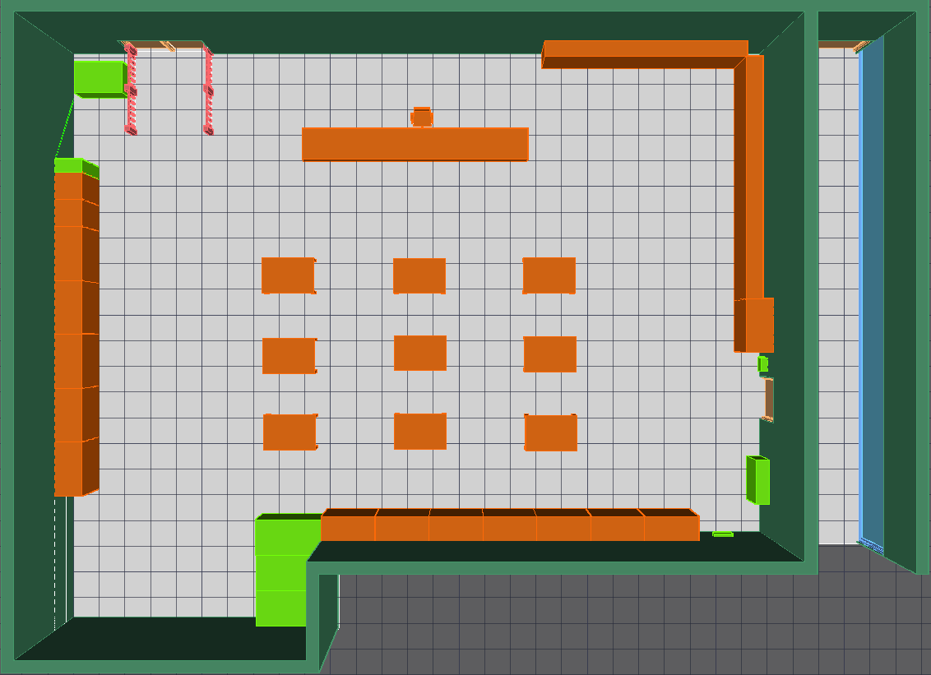



Bags
To avoid collisions, please place your bags and jackets in the designated shelf!

Slide 4

Emergency exits

Slide 5
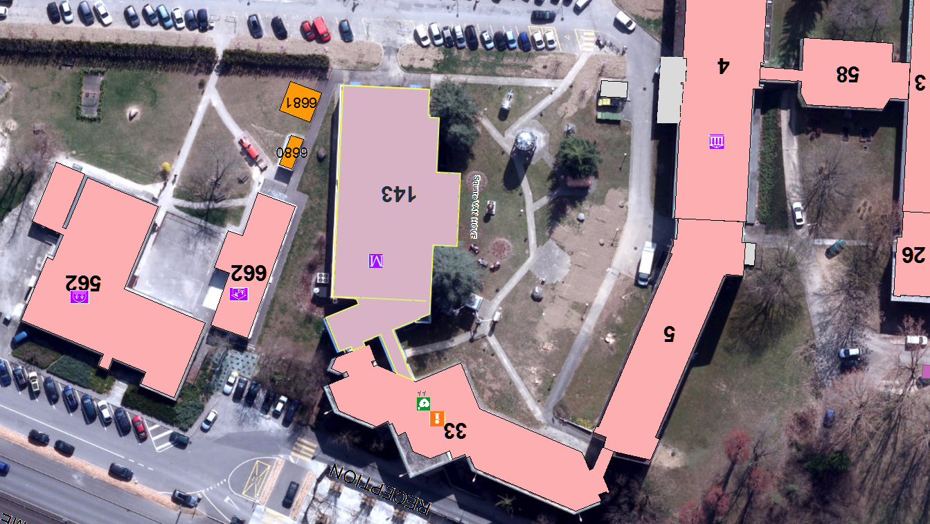


Assembly point

Slide 6
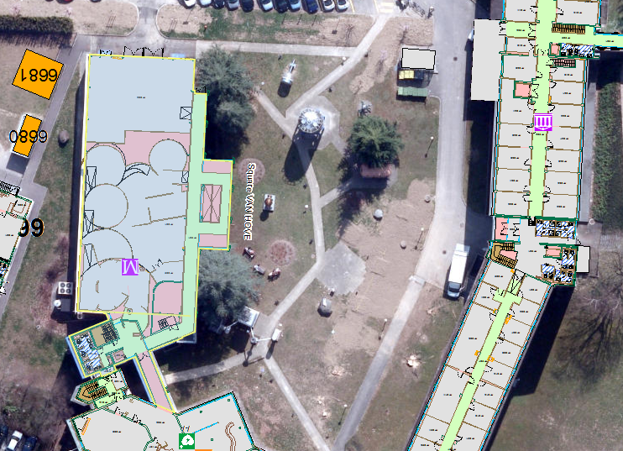

Rest rooms

Slide 7
Cloud Chamber Workshop

Slide 8
Outline
History
Step by step tutorial
Build your own particle detector
Tidying up
Discussion and explanations

Slide 9
History

Slide 10
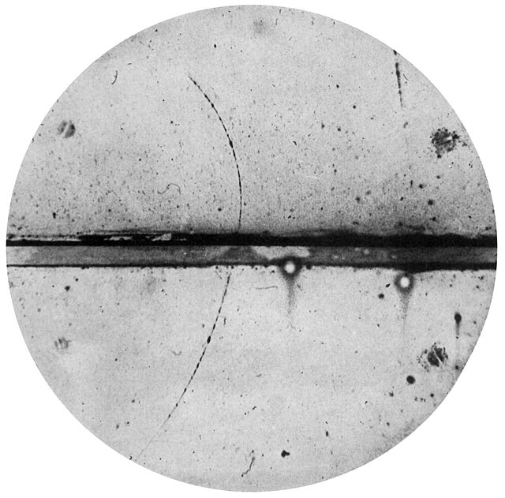
History
Charles T. R. Wilson (1869 - 1959)
Carl Anderson (1905 - 1991)
This Scottish physicist perfected the first (expansion) cloud chamber in 1911 and received the Nobel Prize in 1927.
This physicist discovered the positron in 1932 and the muon in 1936 using a cloud chamber. He received the Nobel Prize in 1936.
C. T. R. WILSON: On an Expansion Apparatus for Making Visible the Tracks of Ionising Particles in Gases and Some Results Obtained by Its Use. Proc. R. Soc. Lond. A. 1912 87 277-292 DOI:10.1098/rspa.1912.0081
Carl D. Anderson (1905–1991) - Anderson, Carl D. (1933). "The Positive Electron". Physical Review 43 (6): 491–494. DOI:10.1103/PhysRev.43.491.

Slide 11
Step by step tutorial

Slide 12
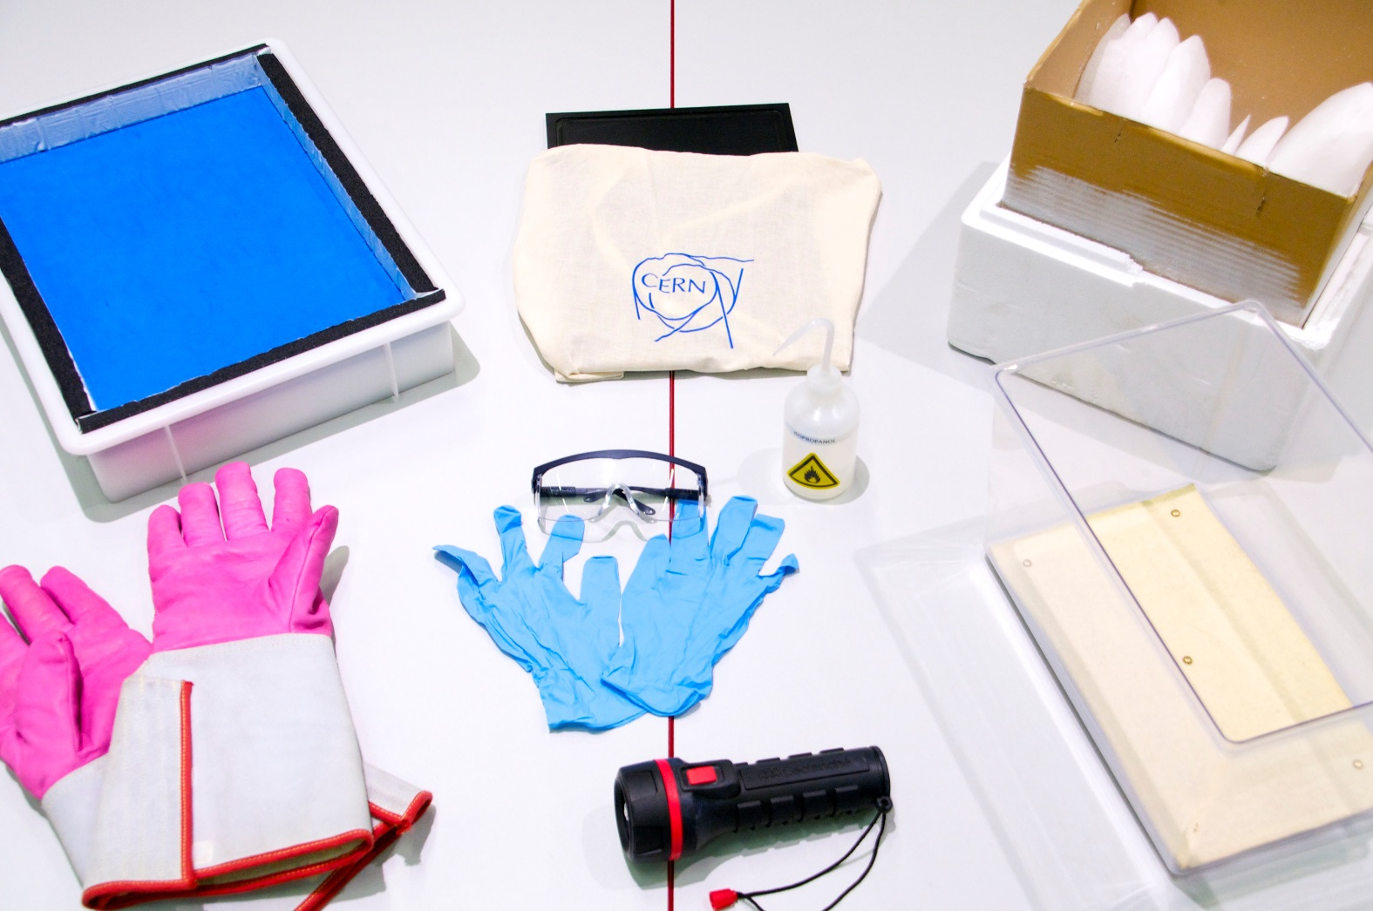
Build your cloud chamber - step by step

Slide 13
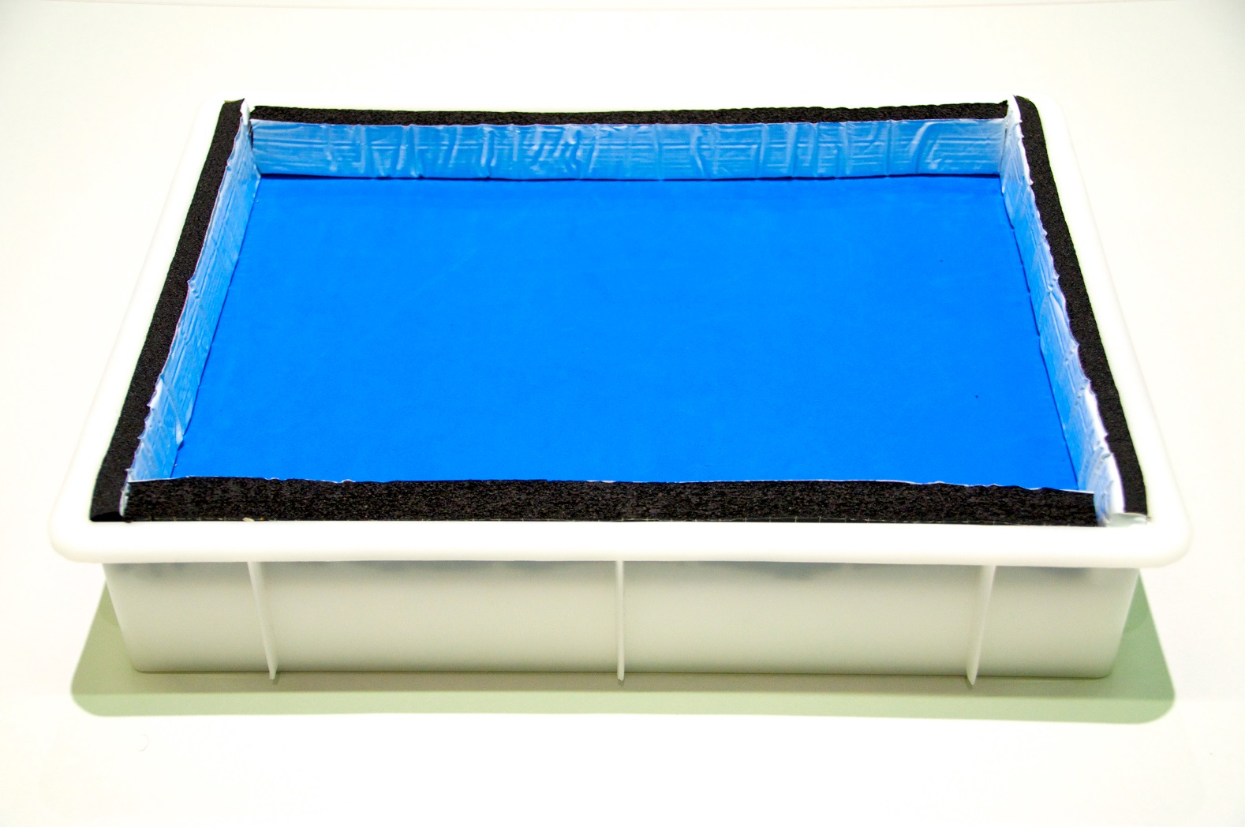
Build your cloud chamber - step by step

Slide 14
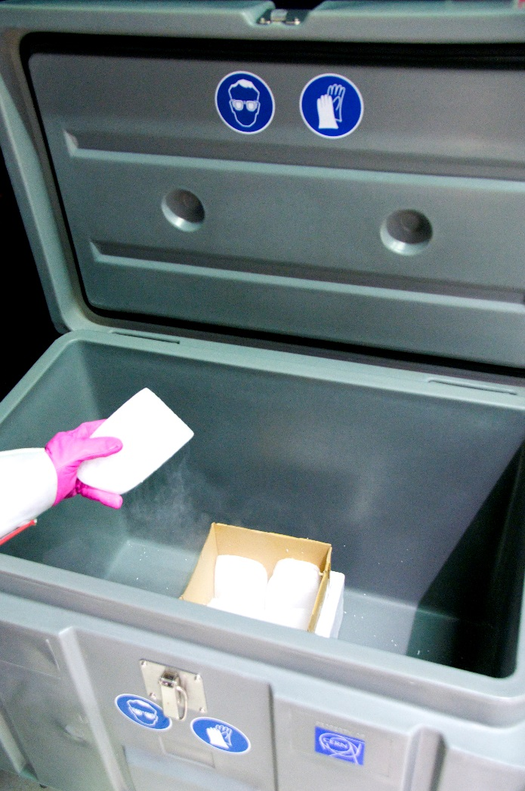
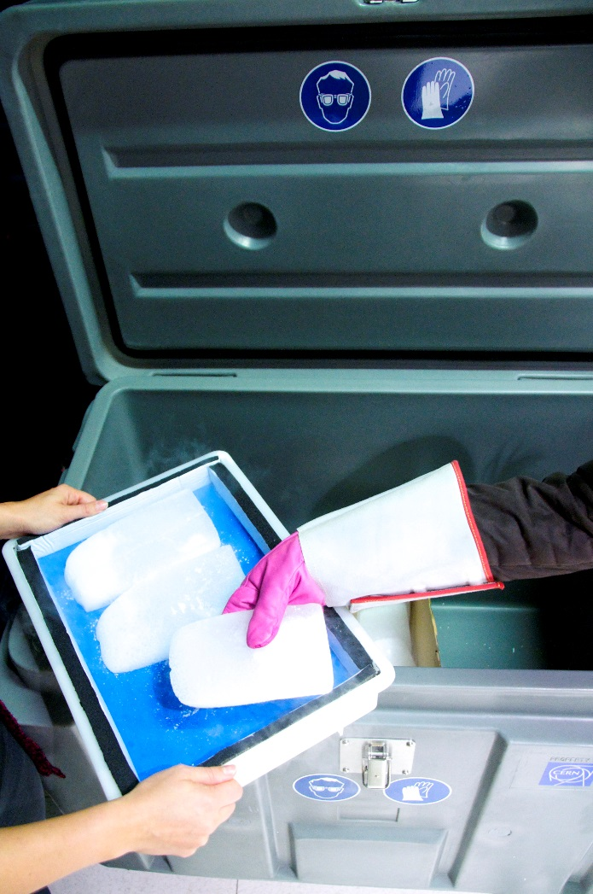
Build your cloud chamber - step by step

Slide 15
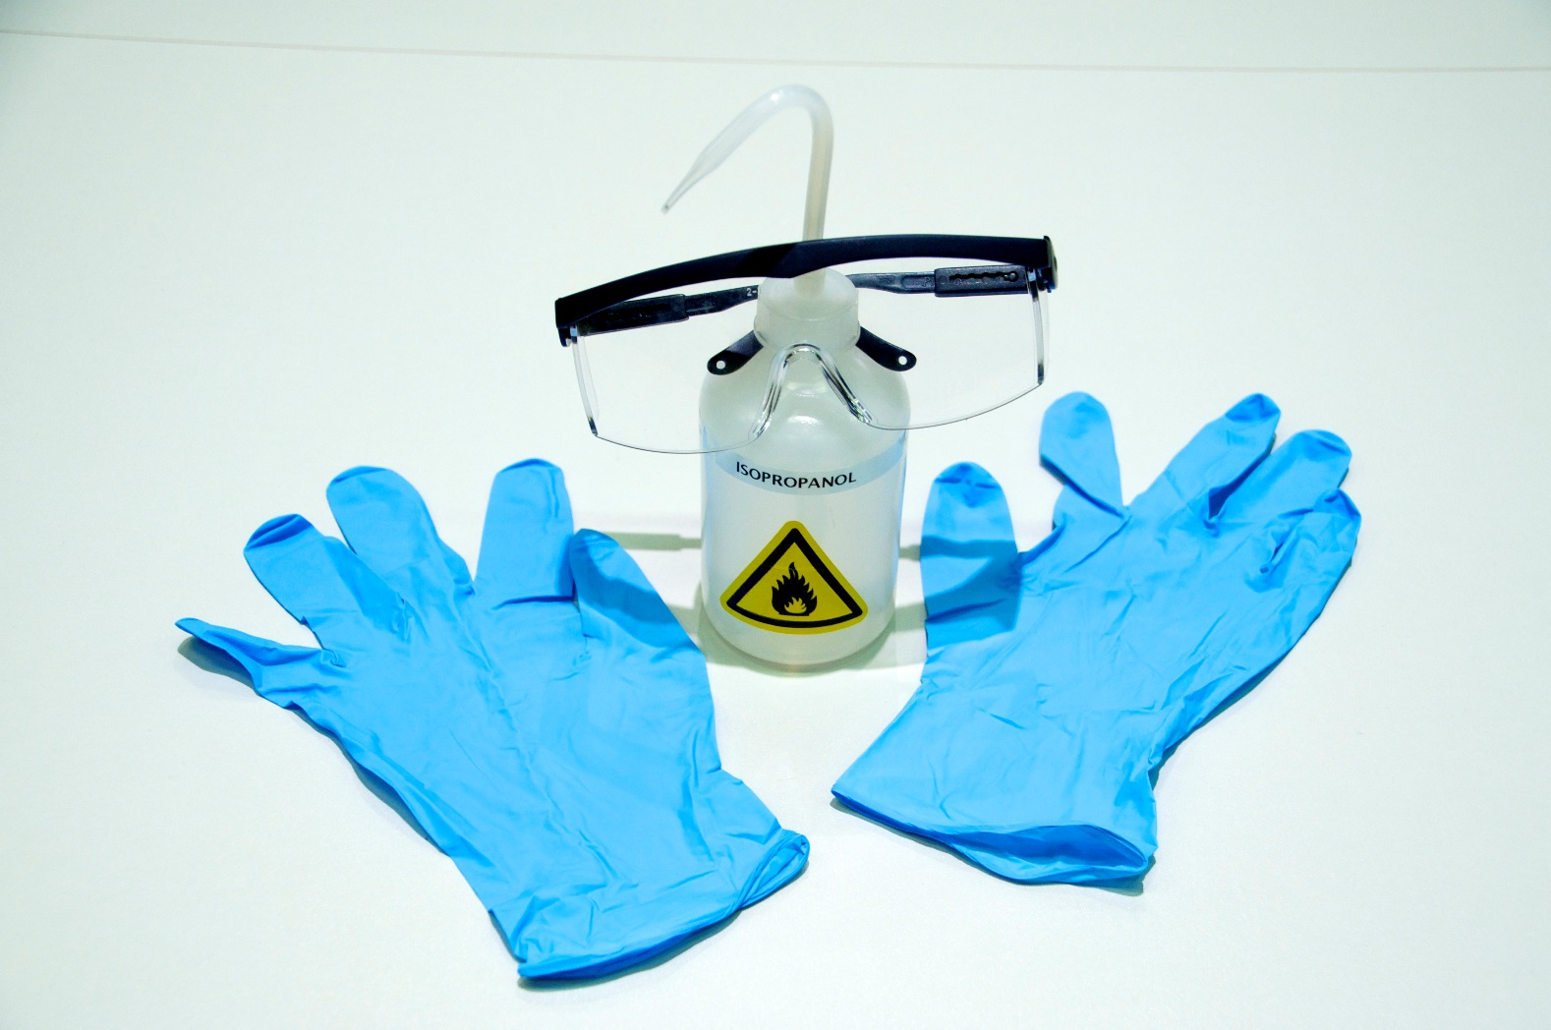
Build your cloud chamber - step by step

Slide 16
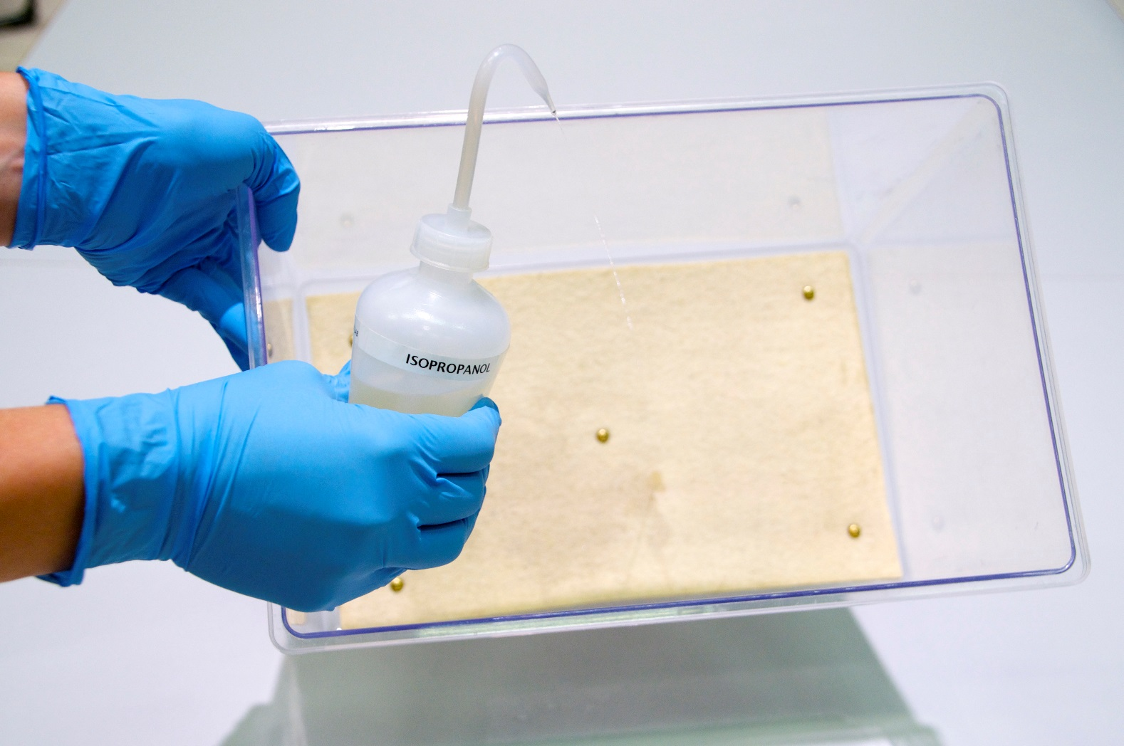
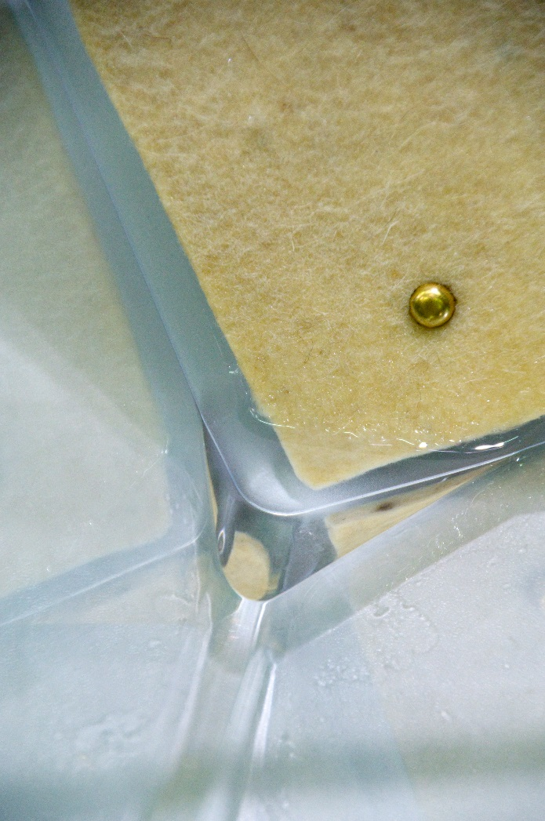
Build your cloud chamber - step by step

Slide 17
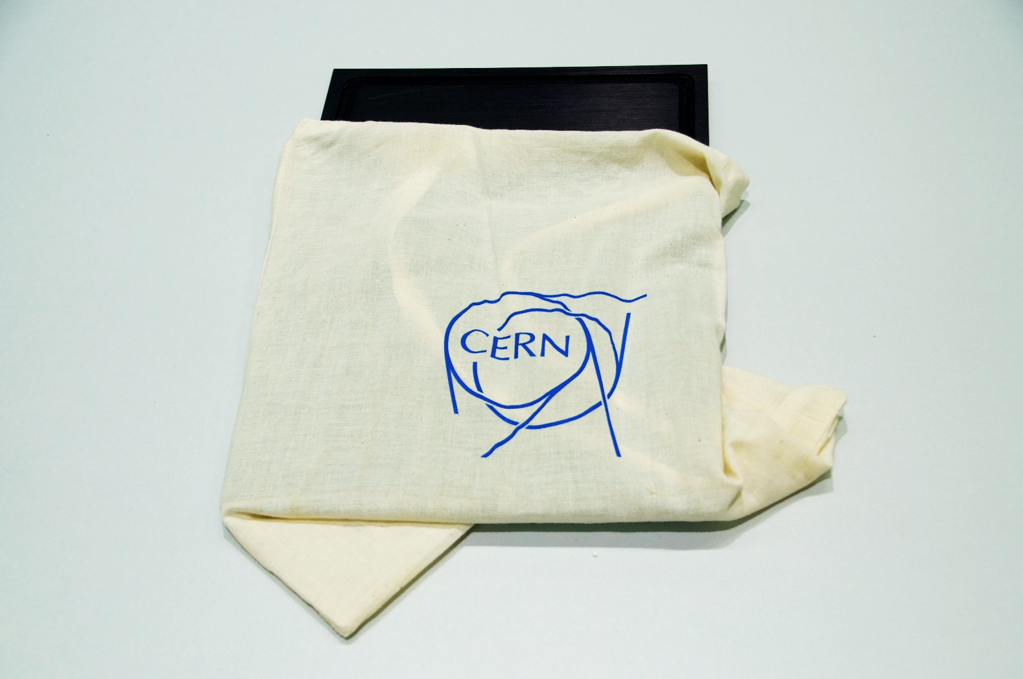
Build your cloud chamber - step by step

Slide 18
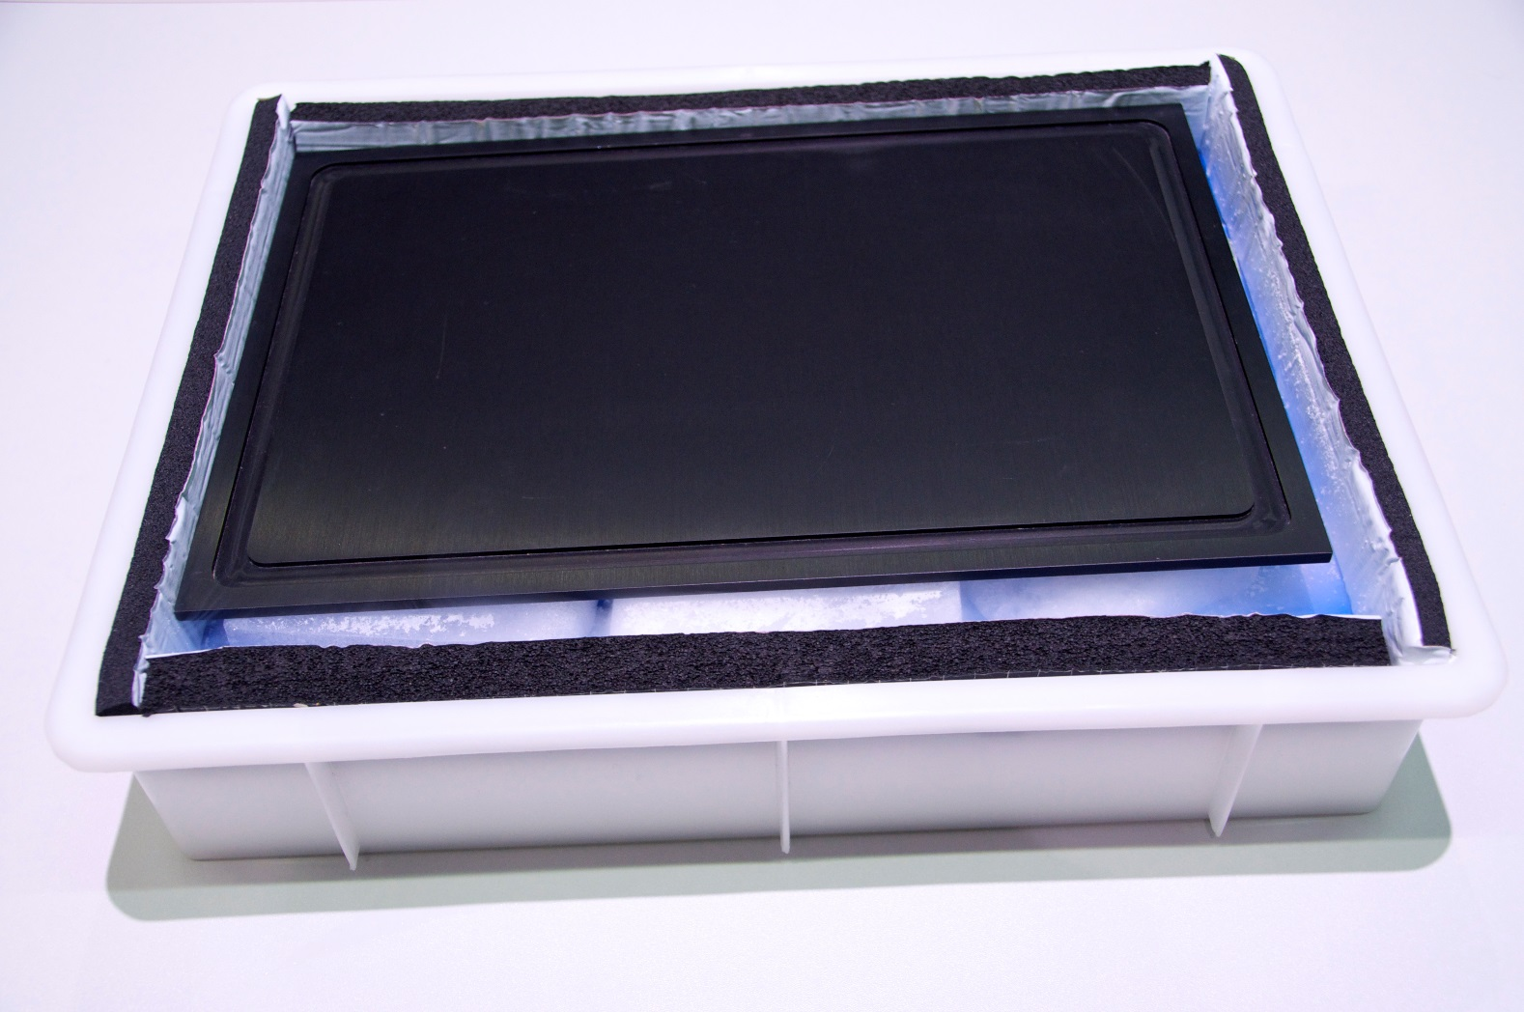
Build your cloud chamber - step by step

Slide 19
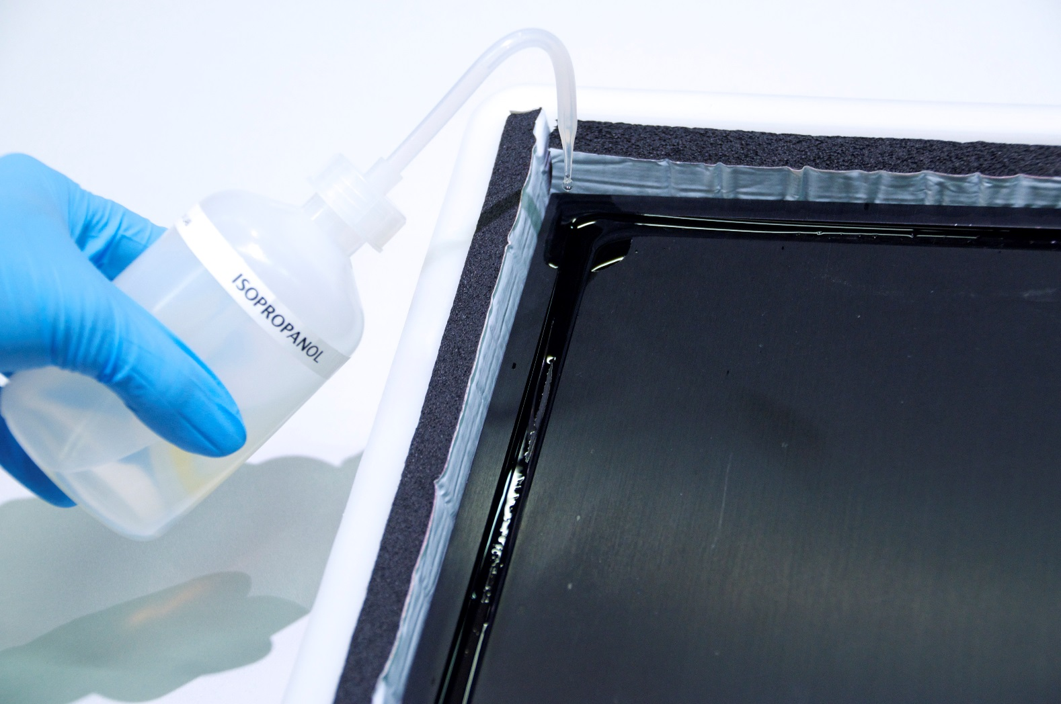
Build your cloud chamber - step by step

Slide 20
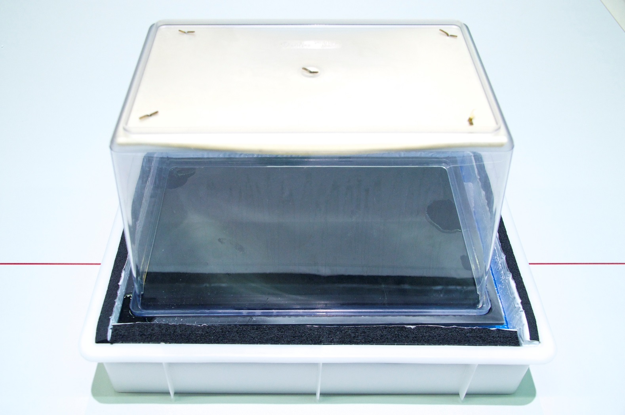
Build your cloud chamber - step by step

Slide 21
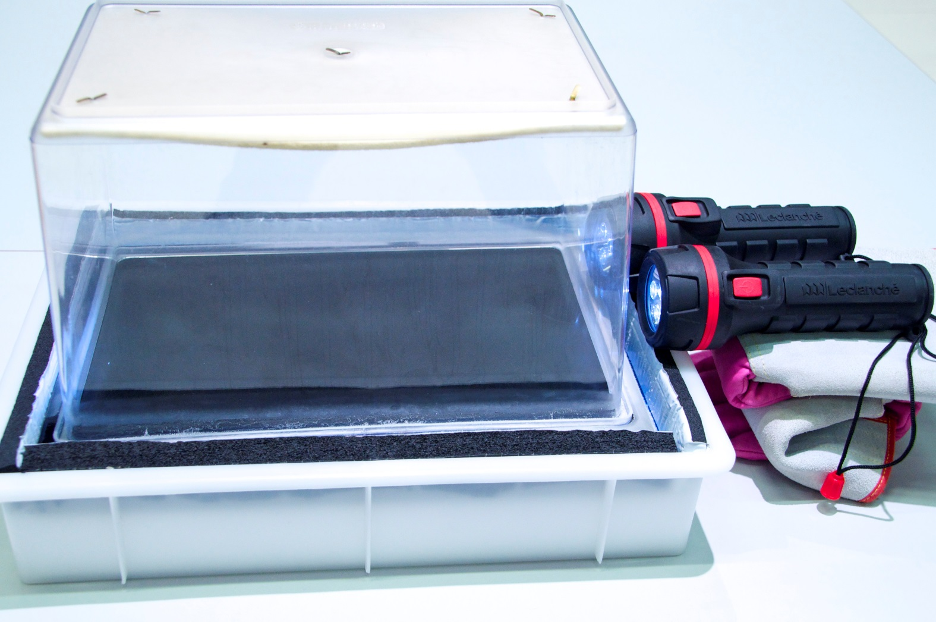
Build your cloud chamber - step by step

Slide 22

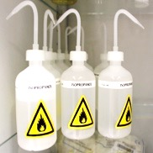
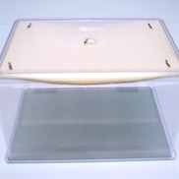
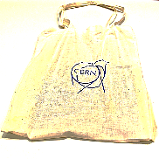
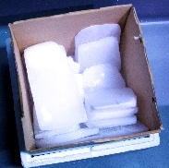
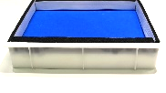
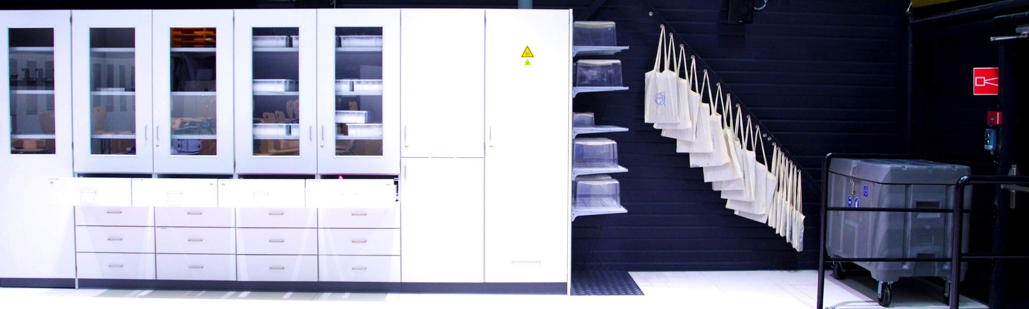
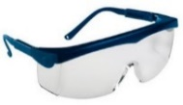



☞ Build your own particle detector!

Slide 23
☞ Build your own particle detector!
Tasks
Observe your Cloud Chamber
Find the optimal torch position and the optimal observation position
Describe visible tracks (shape, length, width, …)
Discuss the reason for these tracks
Count the number of tracks you can see for 1 minute, repeat this measurement 2 times

Slide 24
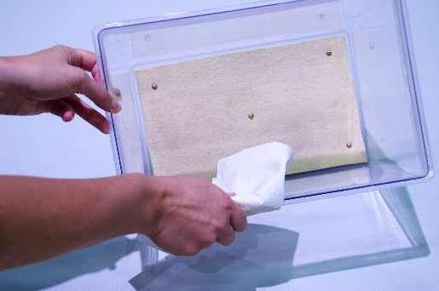
☞ Tidying up
!

Slide 25
Discussion and explanations
Whiteboard

Slide 26
Additional Material

Slide 27
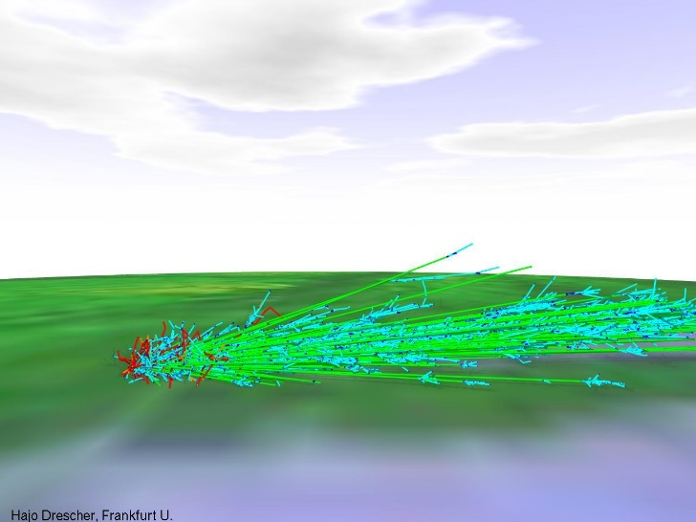
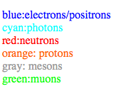
Air Shower Simulation
Cosmic Ray Air Shower Pictures
by H.-J. Drescher drescher@th.physik.uni-frankfurt.de.
Air showers are cascades of secondary particles induced in the atmosphere by high energy cosmic rays. What you see here is a visualisation of realistic simulations of these showers. Of course, not all of the particles in a shower are displayed, there are far too many! The fraction displayed here is about 1e-6, sampled with a thinning algorithm.
http://th.physik.uni-frankfurt.de/~drescher/CASSIM/

Slide 28
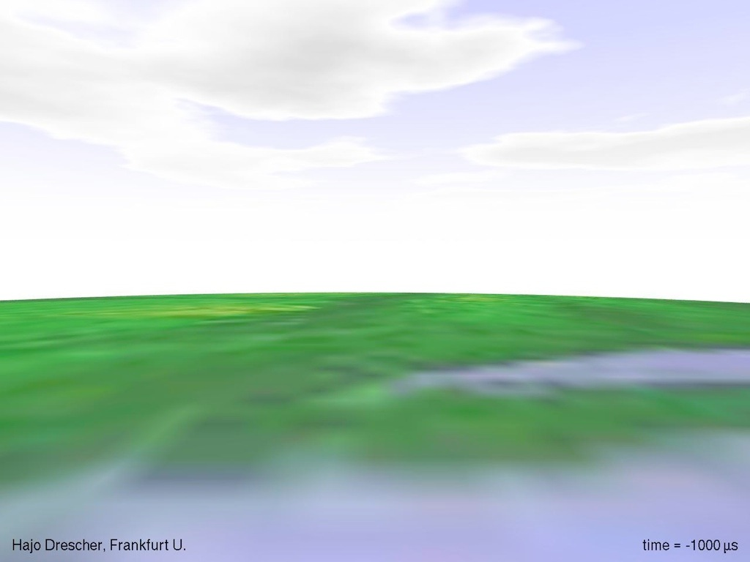

Slide 29


Slide 30


Slide 31


Slide 32


Slide 33


Slide 34
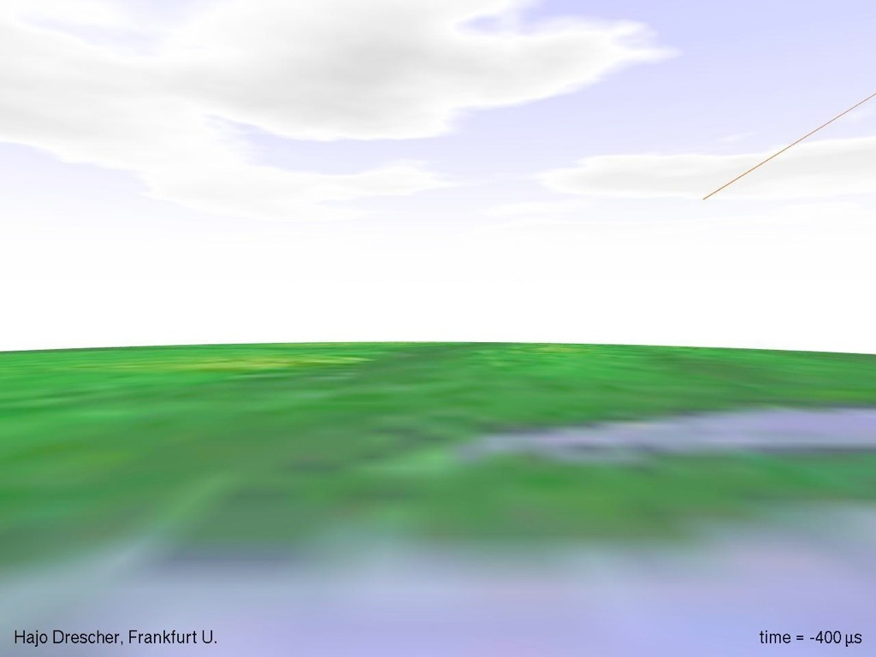

Slide 35
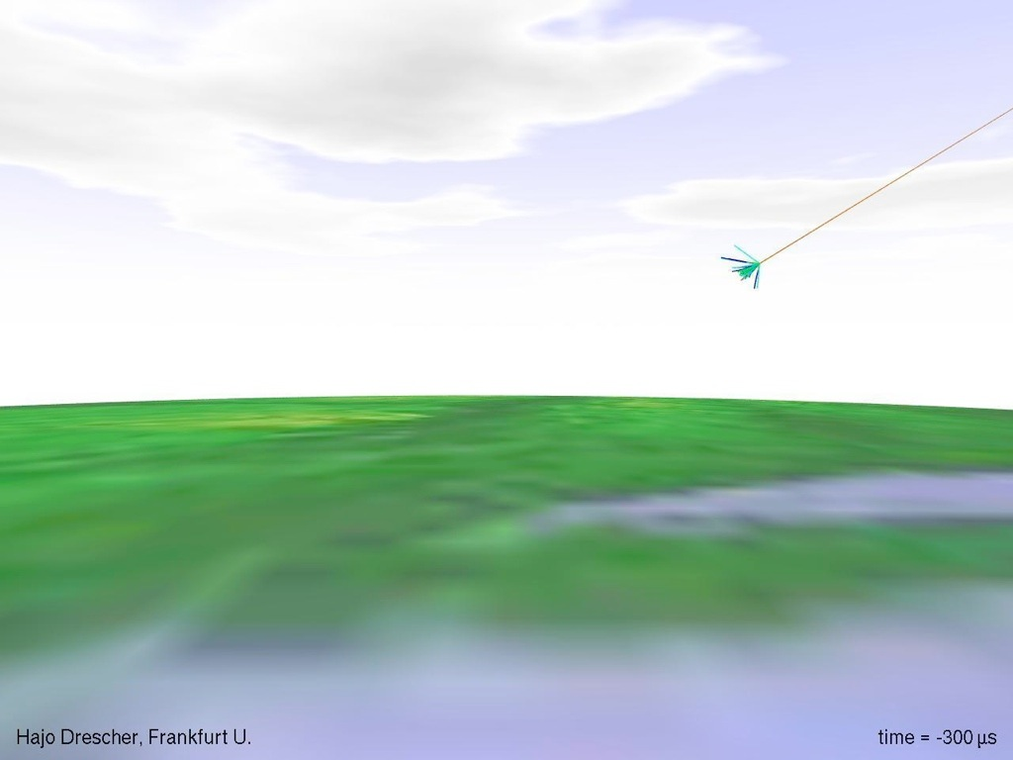

Slide 36
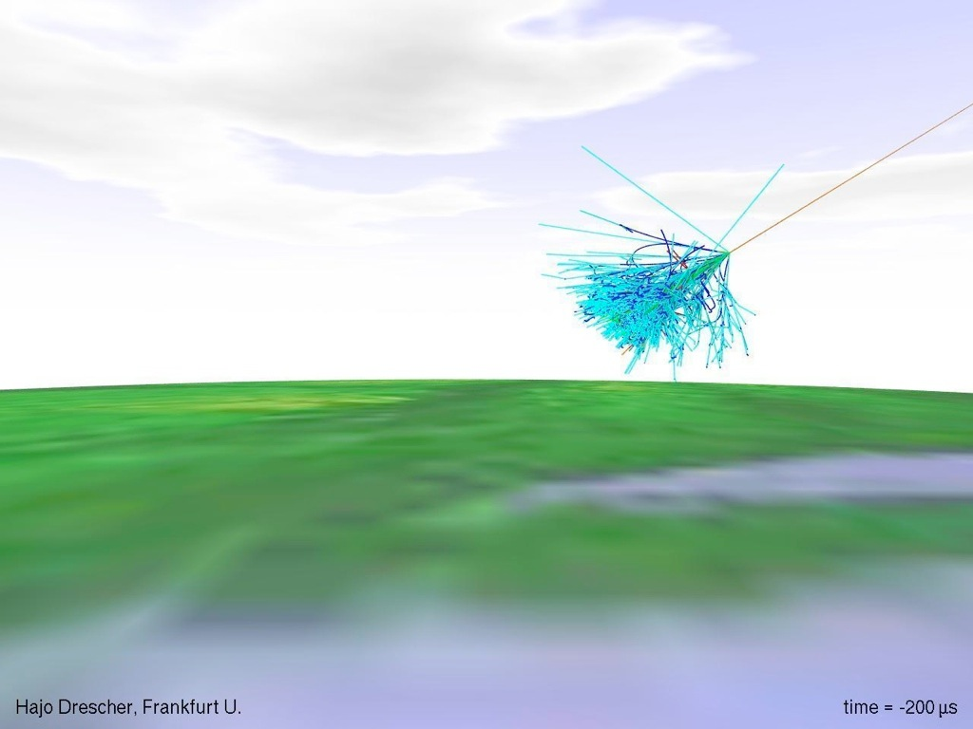

Slide 37
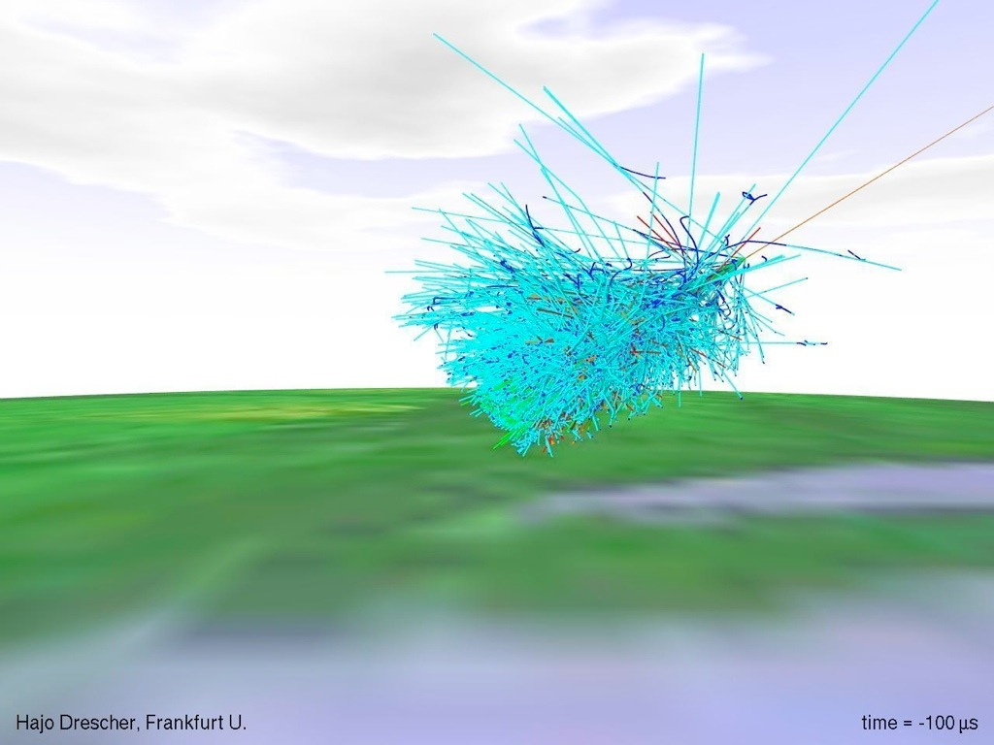

Slide 38
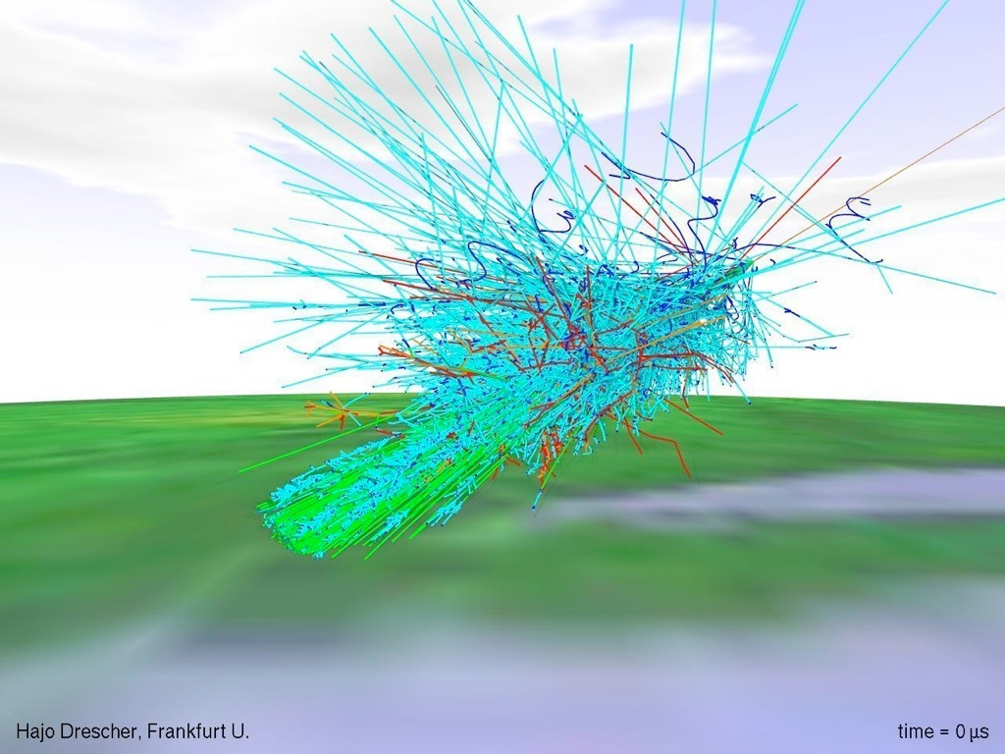

Slide 39
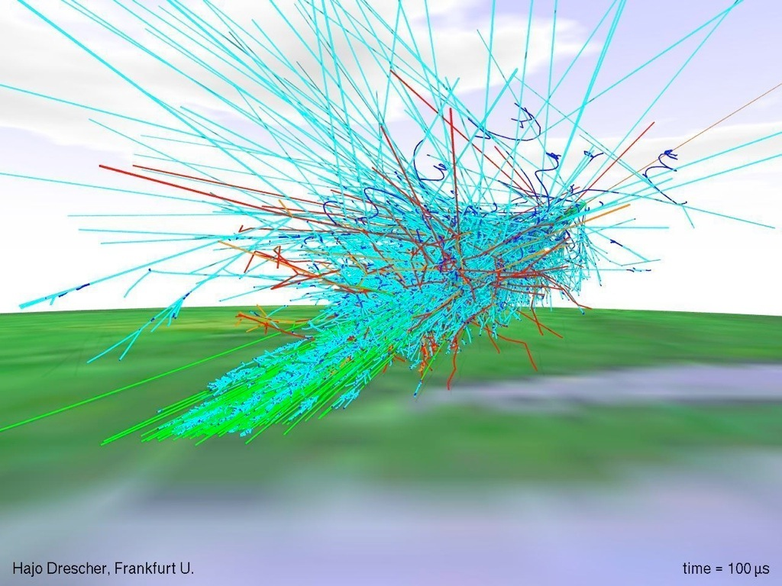

Slide 40


Slide 41
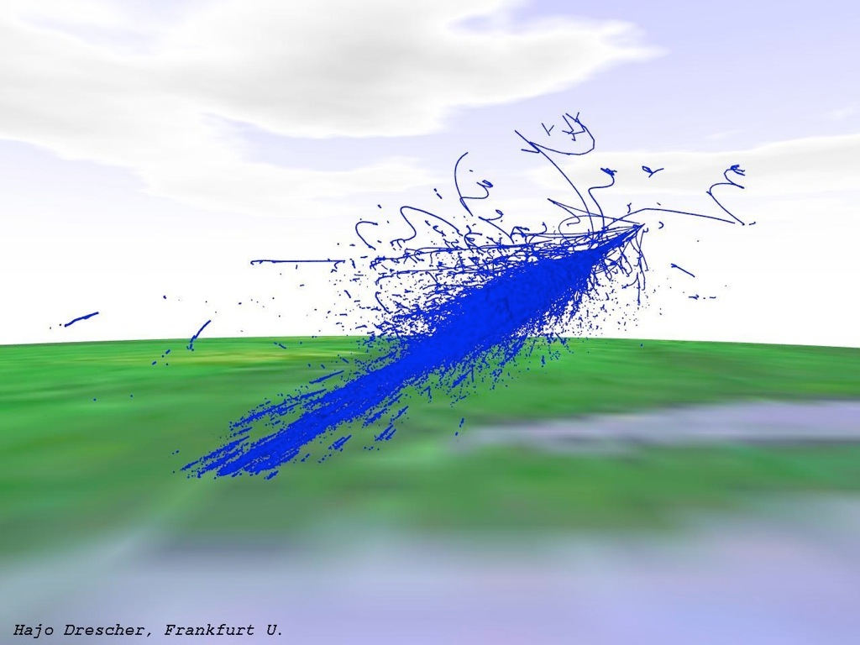

Slide 42
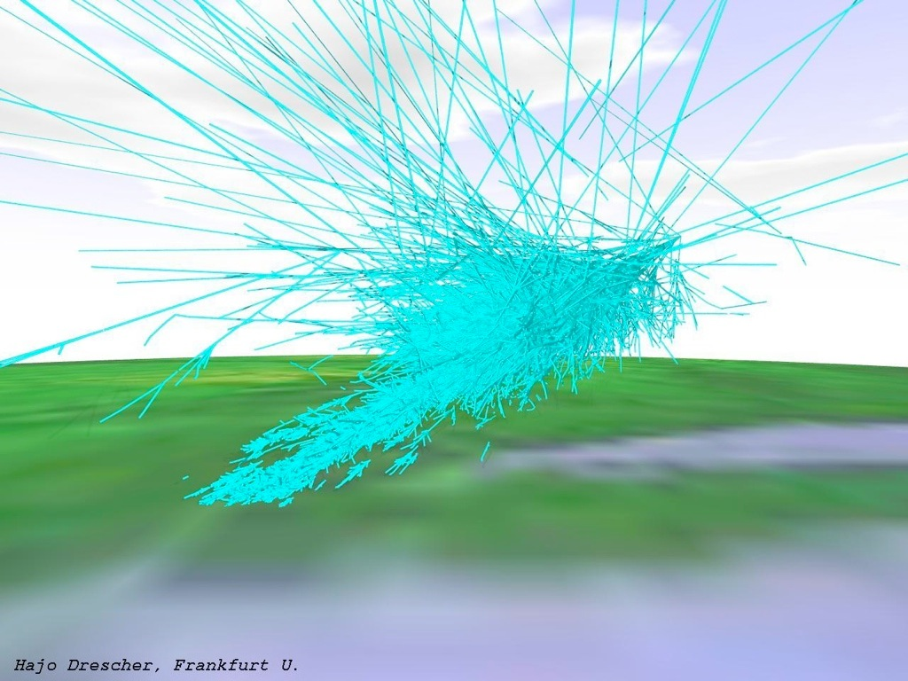

Slide 43
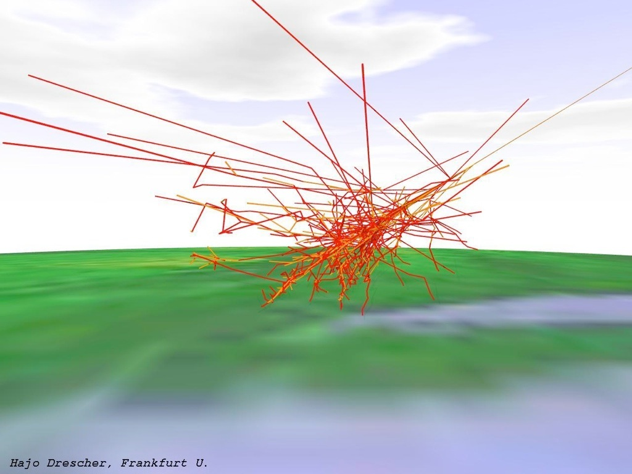

Slide 44
