Slide 1
Control room – On D cluster
Perret Ph., Charrondiere M. 20-05-2015

Slide 2
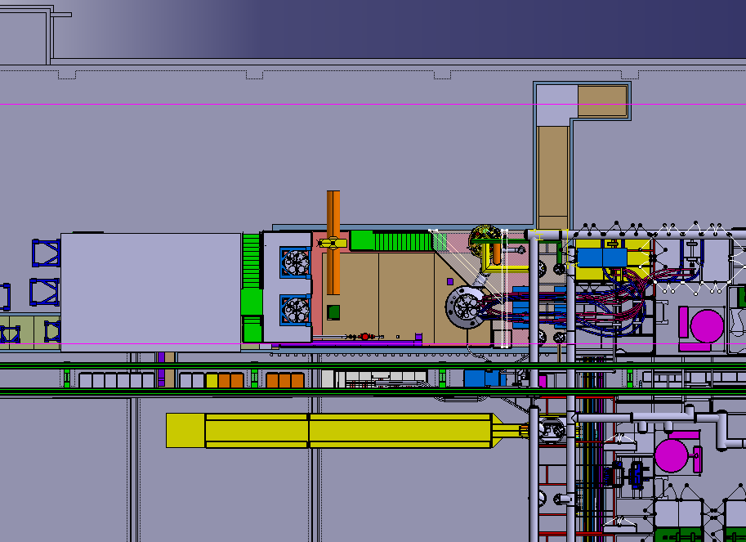

Slide 3
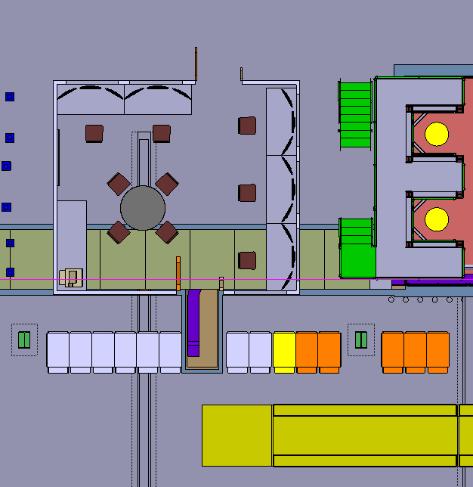
Cryogenics & Water control
Cluster D – Vertical benches

Slide 4
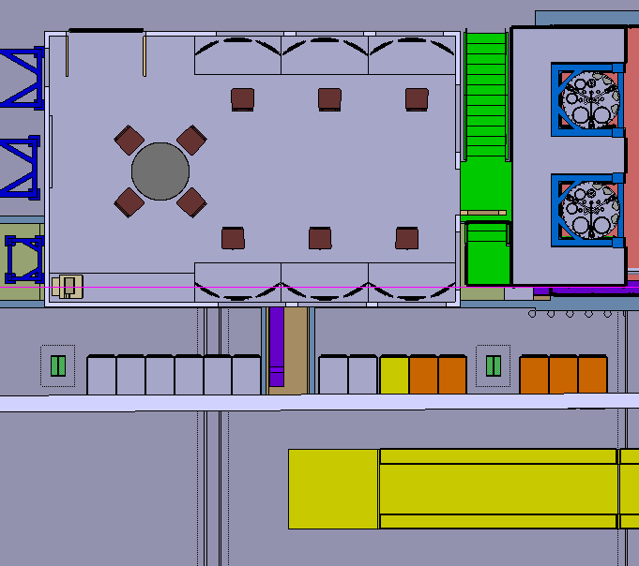
GPN PC
SCLink &
Future STRING
Horizontal benches

Slide 5
Estimative budget for construction
Air conditioning | 20000€ (21000CHF) | A.R.O
Metallic structure & walls | 80000€ (83000CHF) | Sarvadon
Lighting | - | -
Sound insulation | - | -
Desks (12) + simple conf. desks (2) | ~ 40000CHF | ErichKeller S.A.
PC & screens (12) | 18000CHF | BE/CO
Chairs (20) | 10000CHF | Cern store
GPN & TN | - | -
Electrical network | - | -
Total | 172000CHF
=> Price enquiry to be prepared with department of Finance

Slide 6
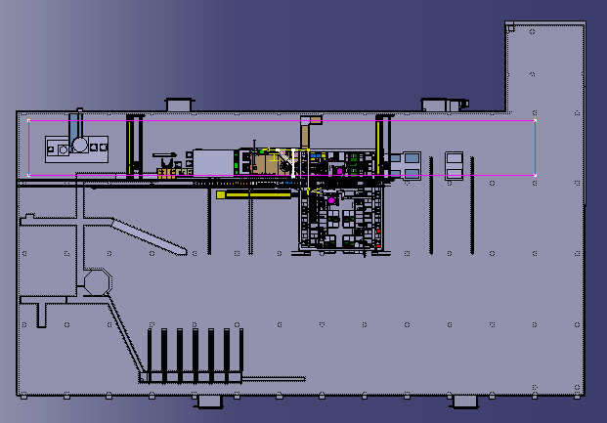
SALEVE
DIVONNE
BELLEGARDE
JURA

Slide 7
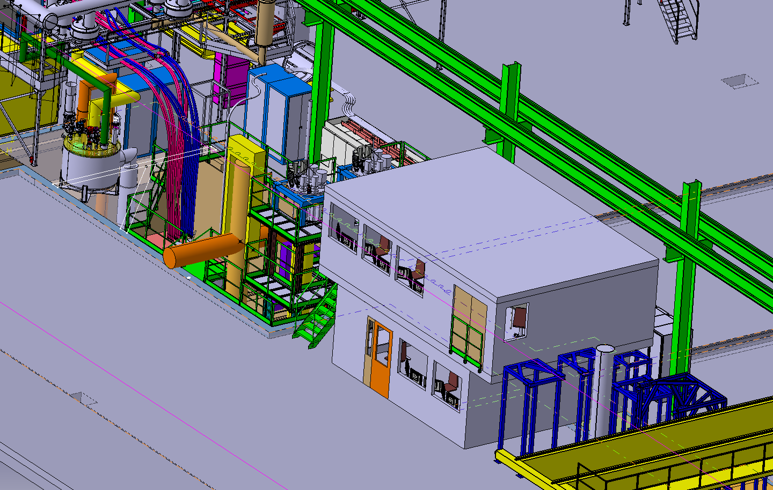
From DIVONNE/SALEVE angle

Slide 8
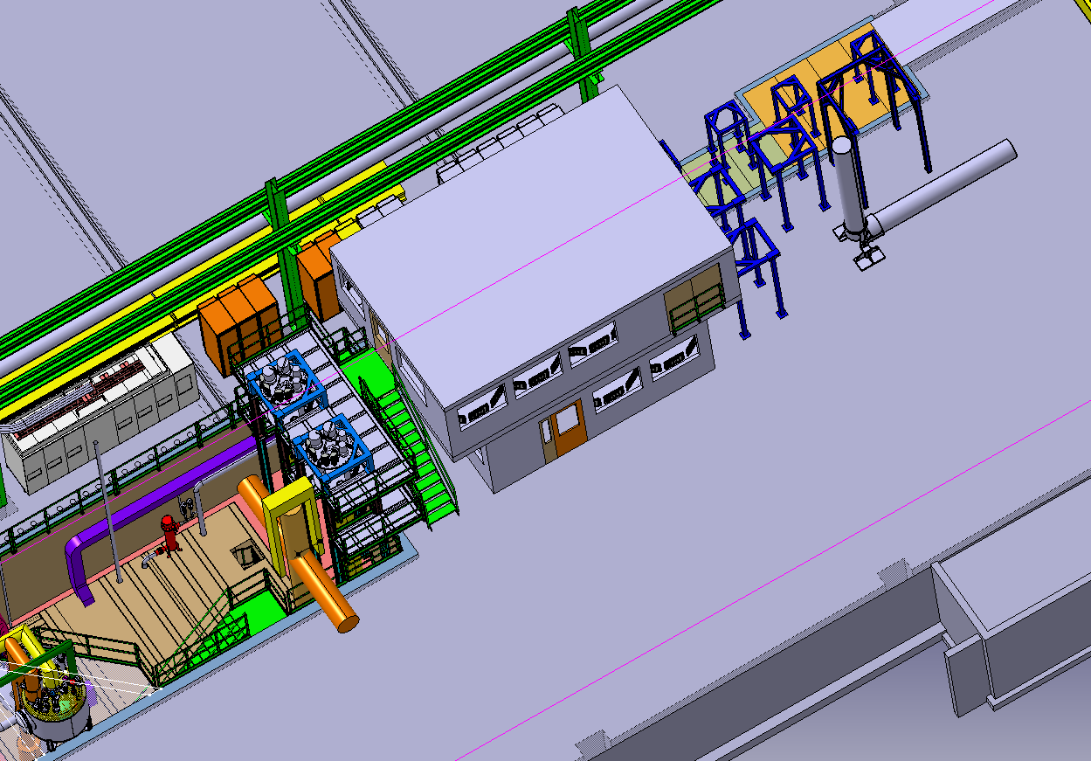

Slide 9
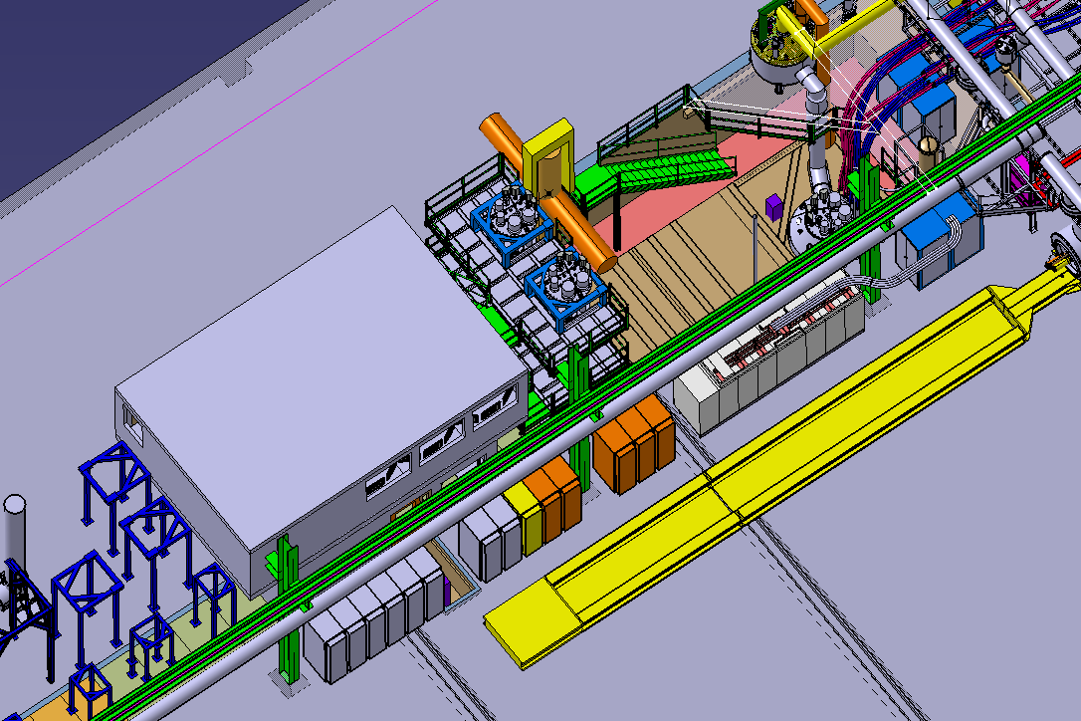

Slide 10
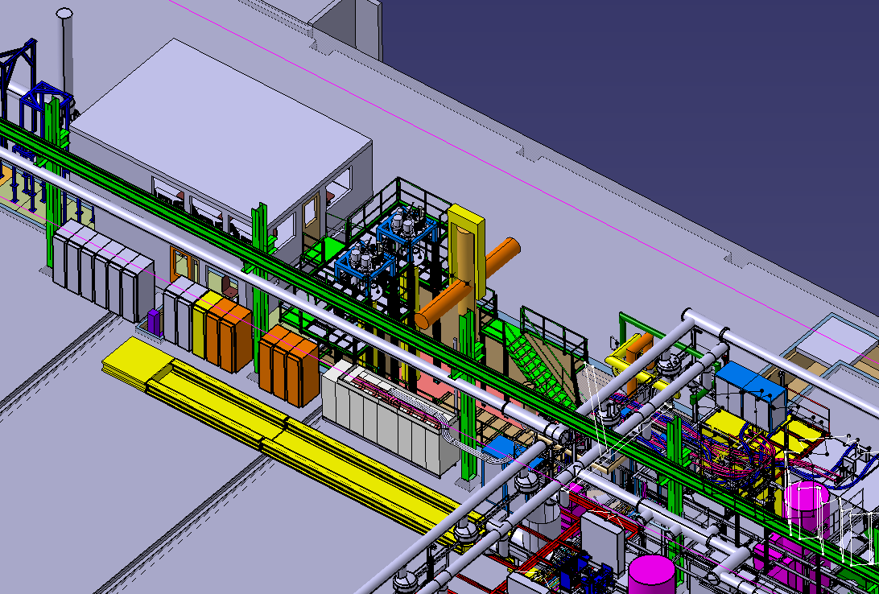
From JURA/BELLEGARDE angle

Slide 11
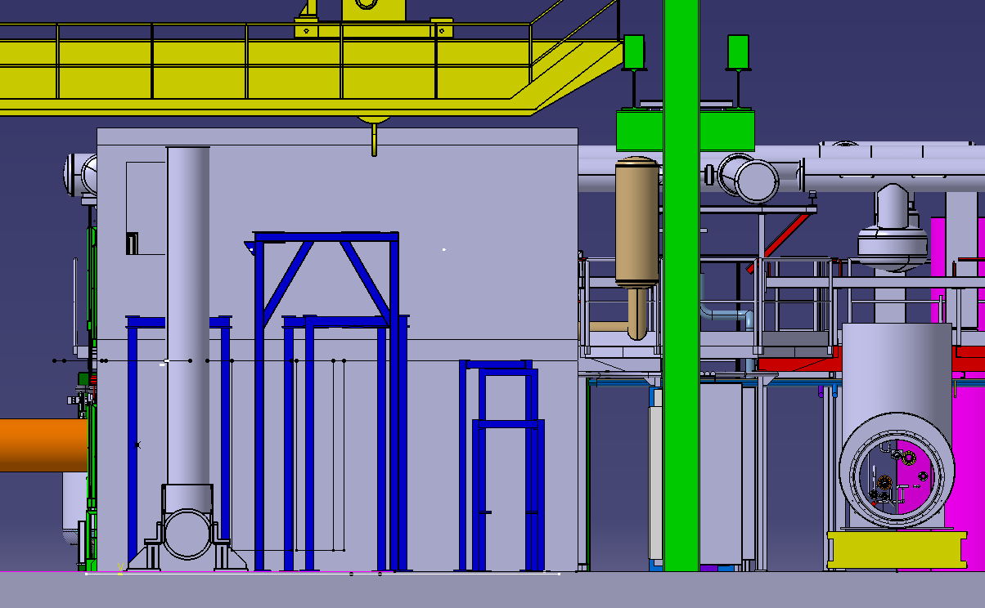
DIVONNE wall

Slide 12
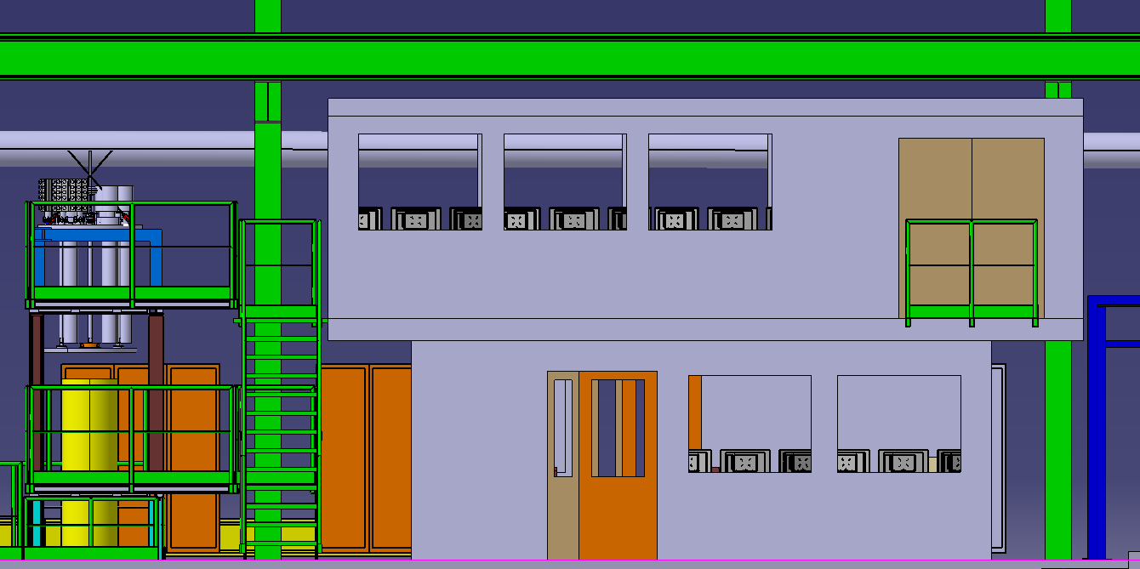
SALEVE wall

Slide 13
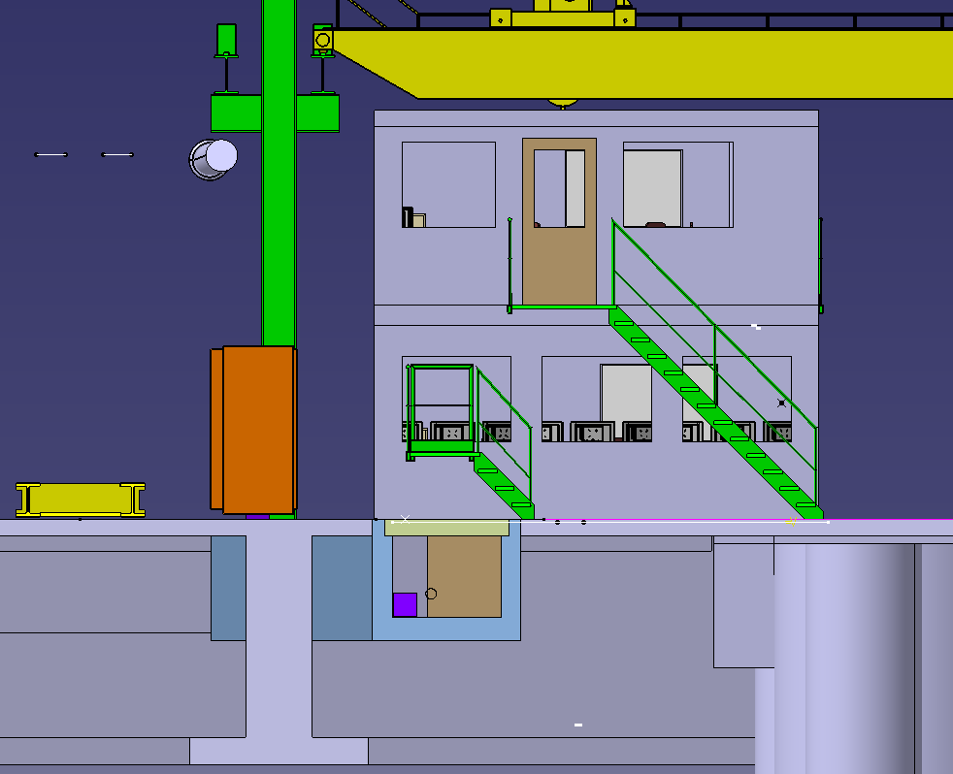
BELLEGARDE wall

Slide 14
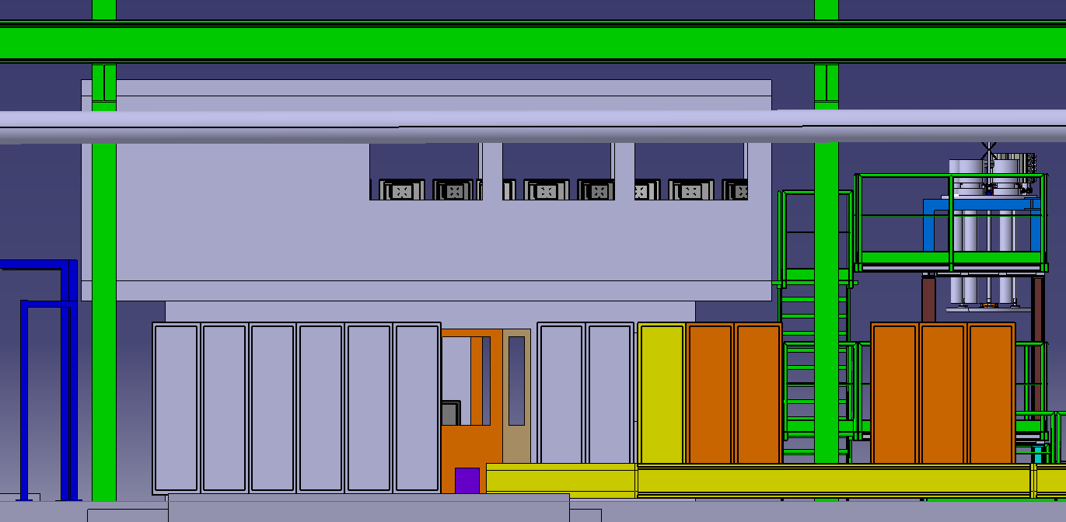
JURA wall

Slide 15
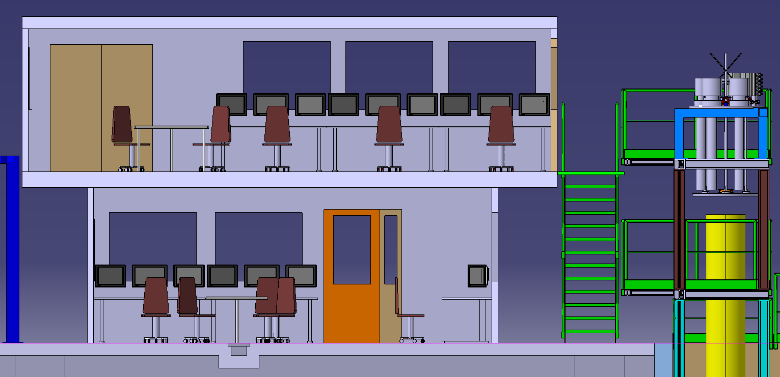
DIVONNE/BELLEGARDE cross-section

Slide 16
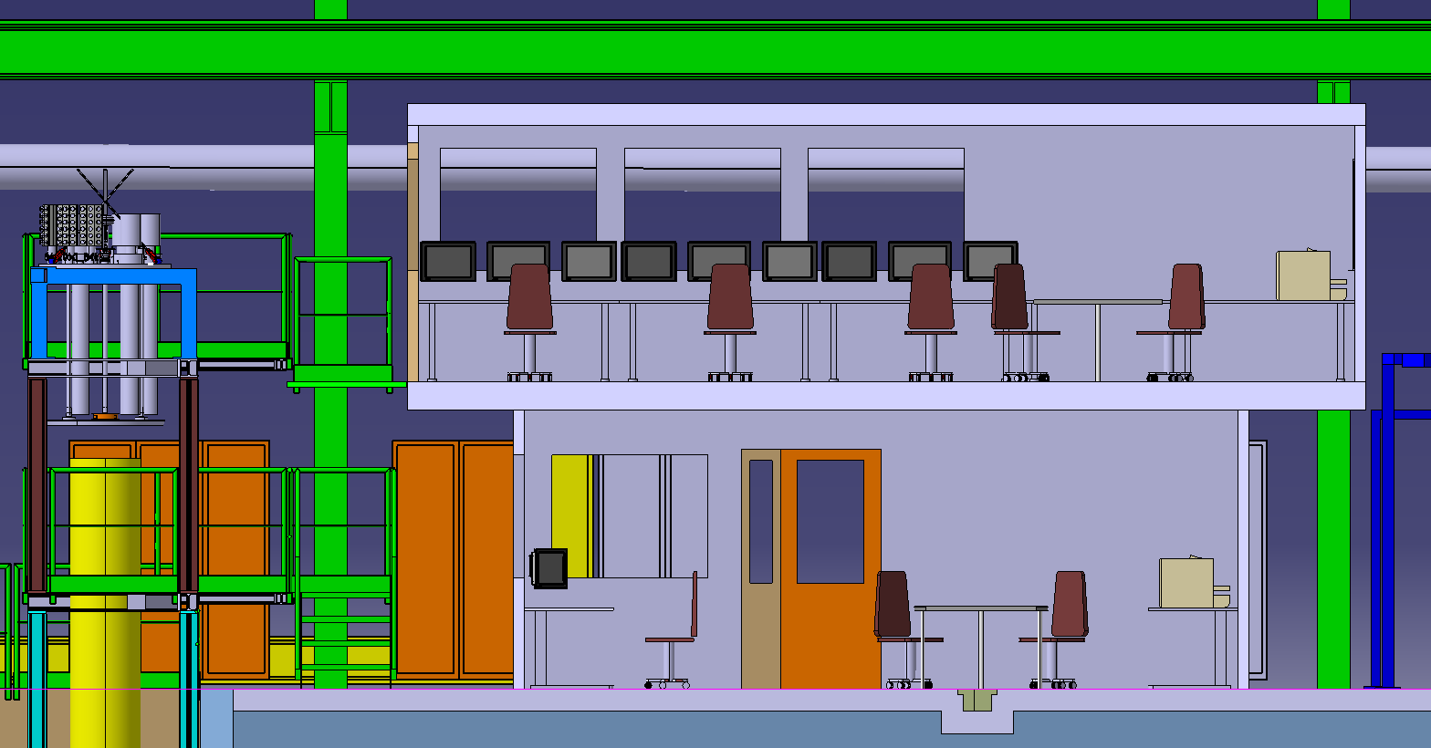
BELLEGARDE/DIVONNE cross-section

Slide 17
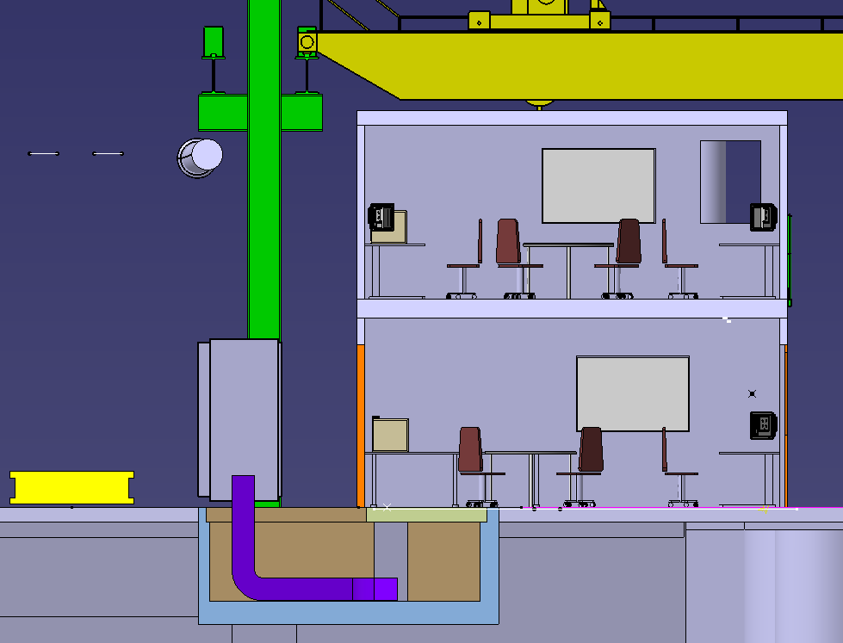
JURA/SALEVE cross-section

Slide 18
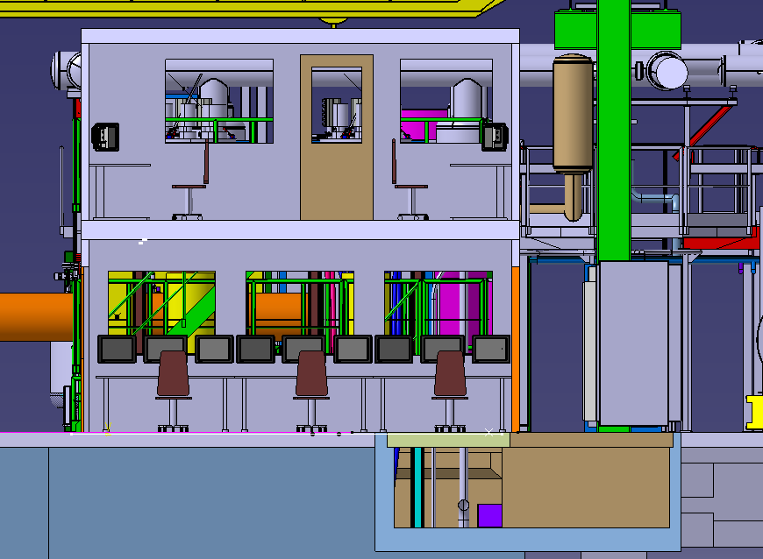
SALEVE/JURA cross-section

