Slide 1
CERN comments on:
Cryogenics, Magnet Integration, Test facility
(M. Modena, V. Parma, M. Bajko)

Slide 2
Integration:
Based on FCM experience, no major comments/requests from V.Parma.
In the case of FCM, the work load was absorbed inside different Sections of the Magnet Group, including design office support and Fellow contributions.
For the moment we could imagine a similar approach. Everything to be better defined after a successful proposal application and first magnet design indications.

Slide 3
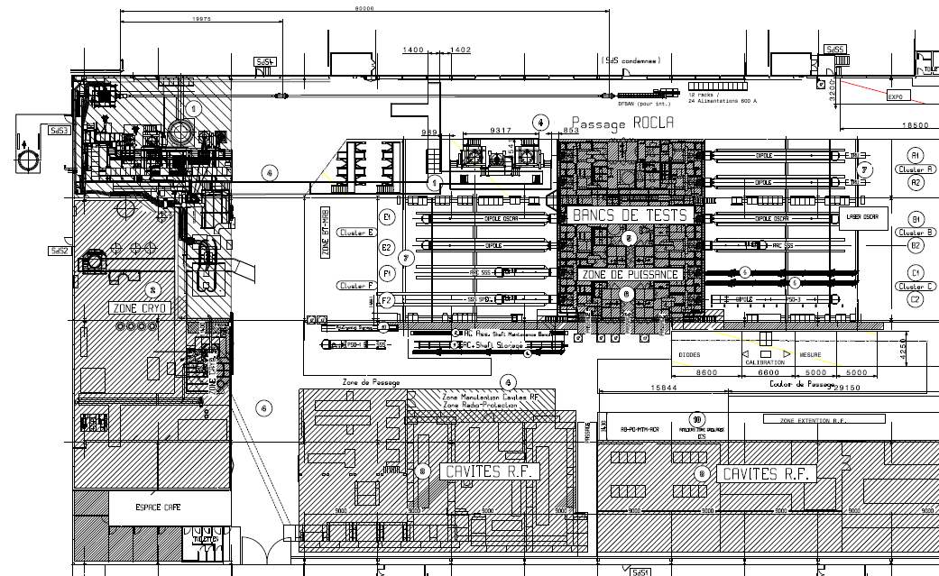
Magnet Tests:
Today the testing location at CERN would be the test station in in SM18
SC LINK TEST STATION
VERTICAL TEST CRYOSTATS
CLUSTERS
F E D
HORIZONTAL TEST BENCHES
CLUSTERS
C B A
CRYOGENIC ZONE
Superconducting RF CAVITY TEST ZONE
LN₂ TEST ZONE

Slide 4
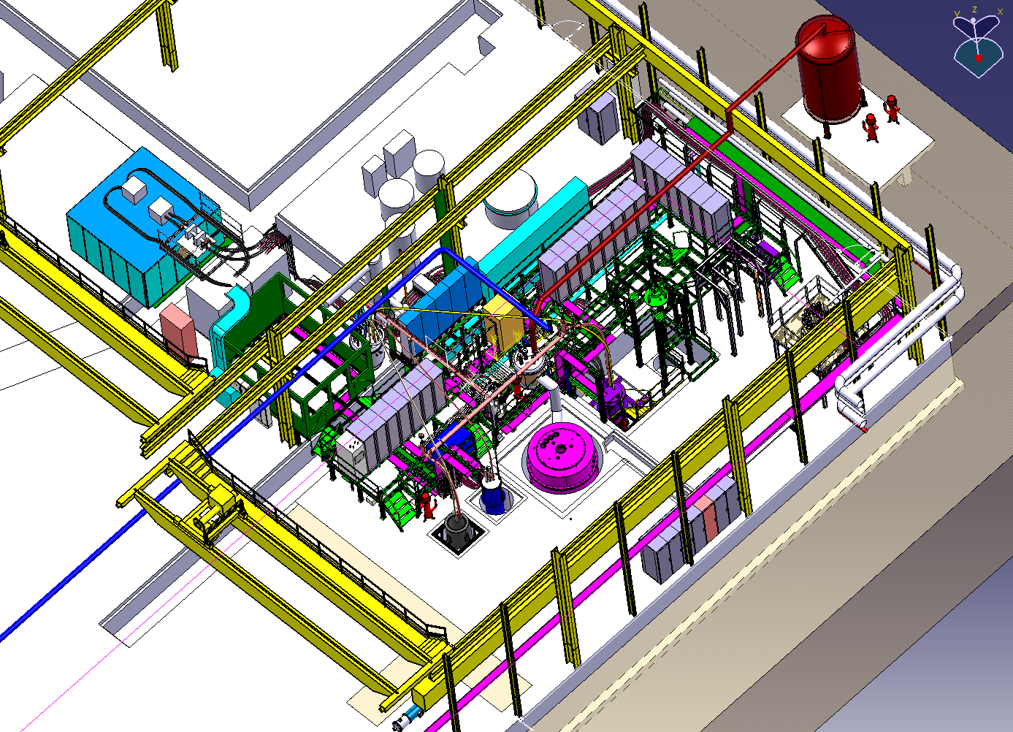
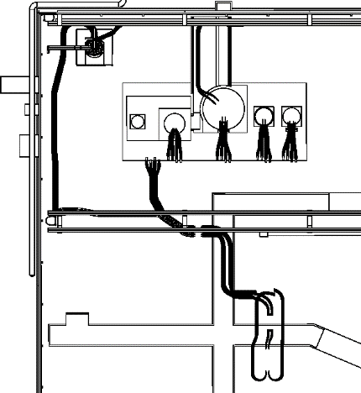
Characteristics of the vertical test cryostats
Magnet Tests:
3 cryostats + 1 feed box powered by a single power converter
Typically used for models and small size (corrector) magnets
FEED BOX
He Gas
DIODE/LEADS
T min 4.2K
LONG
D 600 mm
L 3800 mm
SIEGTAL
D 800 mm
L 1400 mm
POWER CONVERTER
I MAX 20 kA

Slide 5
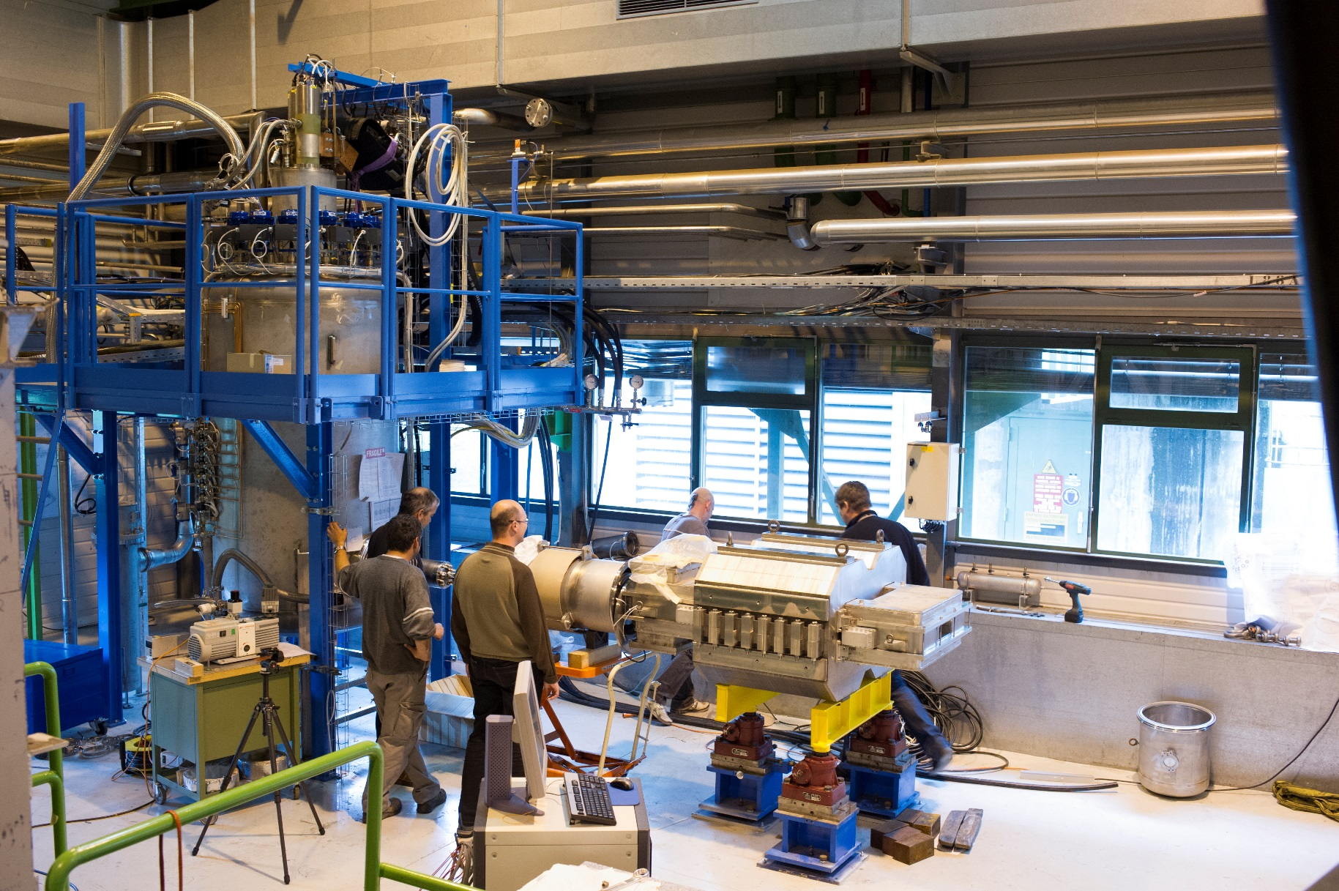
Magnet Tests:

Slide 6
Magnet Tests remarks:
Today in SM18 is not possible to perform power test directly in LN2, so test would be done with GHe at the equivalent temperature.
In 2019 there could be a possible interference for the magnet test with the HL-LHC string test. This point must be discussed and other scenario are possible (ex. to displace the feed-box for the magnet tests to a new position).

Slide 8
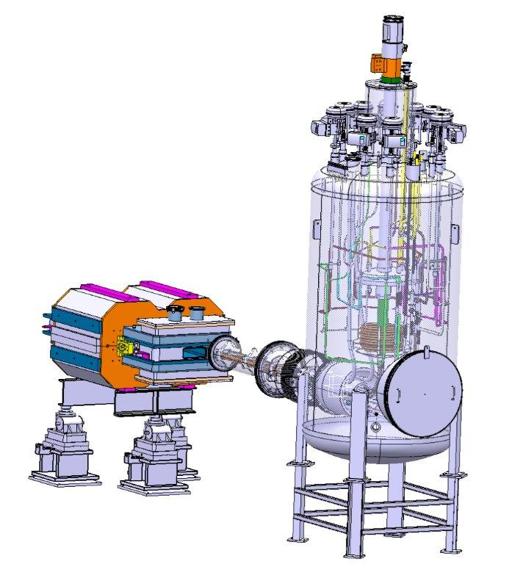
Magnet Tests

