Slide 1
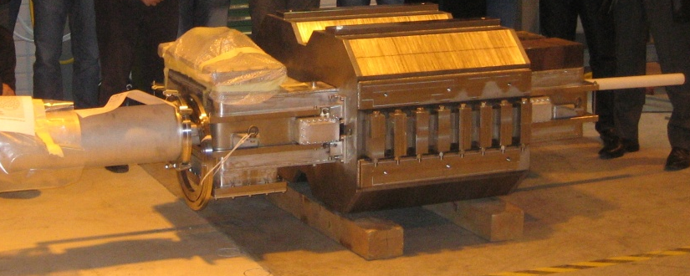
FCM:
Concept and test results

Slide 2
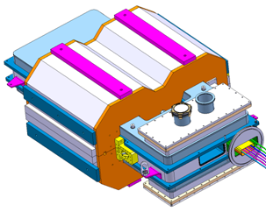
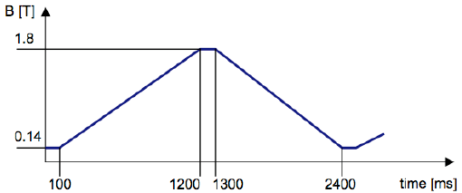
Specifications:
iron Dominated, Pulsed, Superconducting dipole magnet
B_{nom} = 1.8 T at dB/dt_{nom} = 1.5 T/s triangular cycle
Q_{AC} < 2 W/m_{magnet} average over the reference cycle
Good field region (≈ 10⁻⁴ homogeneity):
Stable performance over a large number of cycles

Slide 3
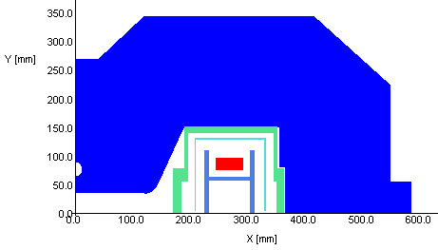
FCM magnet:
Superconducting coil
Warm Yoke
Cryostat
Thermal shield
Coil support

Slide 4
The FCM magnet:
Short prototype model:
Yoke length: 0.76 m
Yoke width: 1.17 m
Magnet overall length: 1.69 m
Magnet weight: 4 tons
Aperture 70 mm

Slide 5
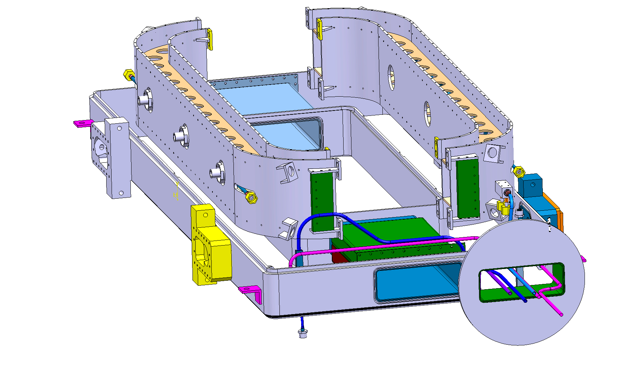
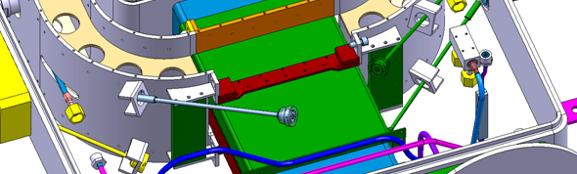
Magnet Design (1/4):
Coil support structure
The coil support is attached to the cryostat by means of 8 rods.

Slide 6
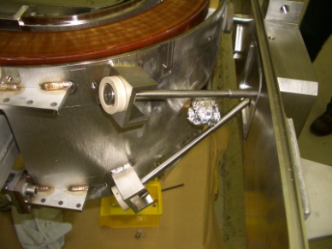
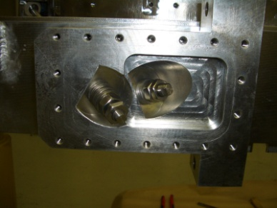
Mechanical support
Rods are made of invar:
Heat input per rode between 0.4 and 0.9 W (computed).

Slide 7
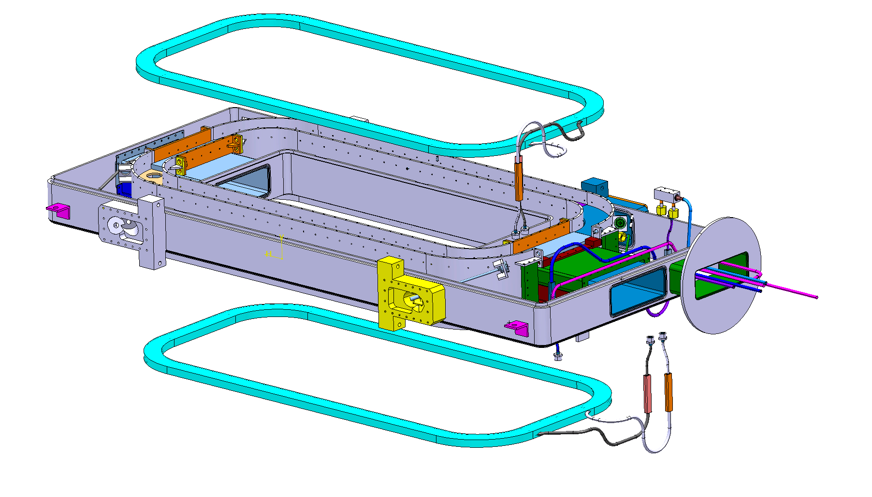
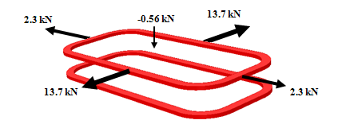
Magnet Design (2/4):
Superconducting Coils

Slide 8
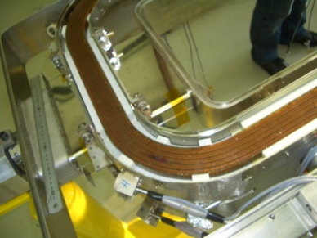
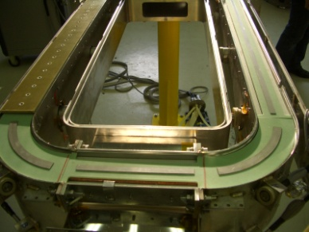
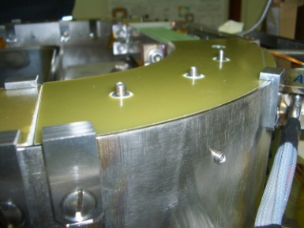
Coil pre-stress:
G10 spacers between the coil and the structure:

Slide 9
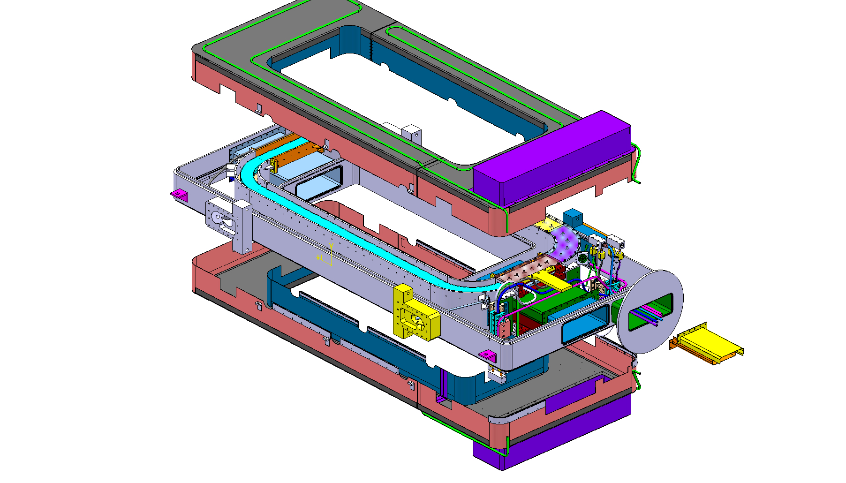
Magnet Design (3/4):
50 K thermal screen
Stainless-steel thermal screen

Slide 10
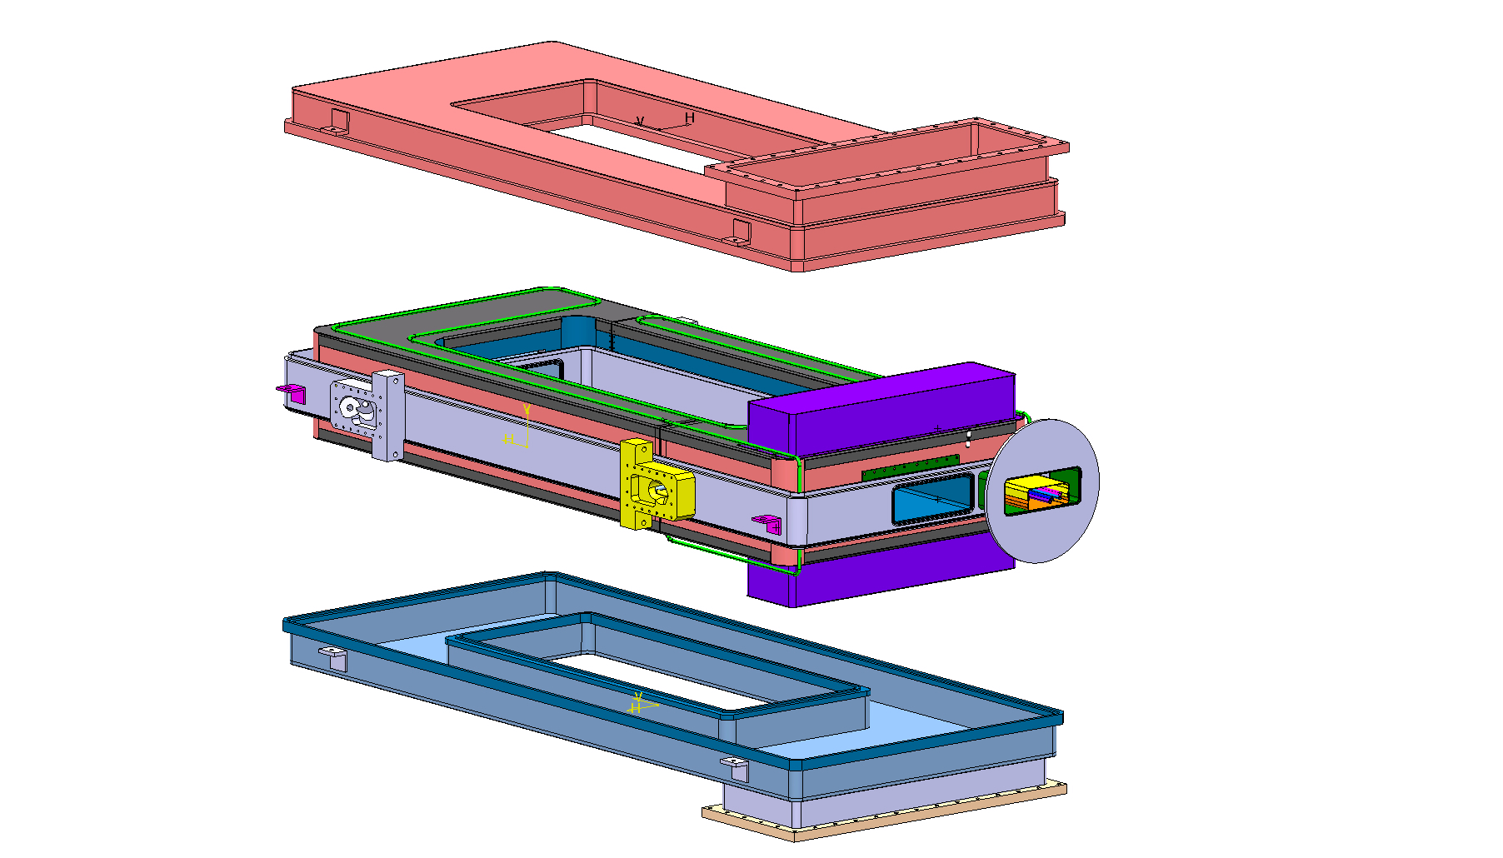
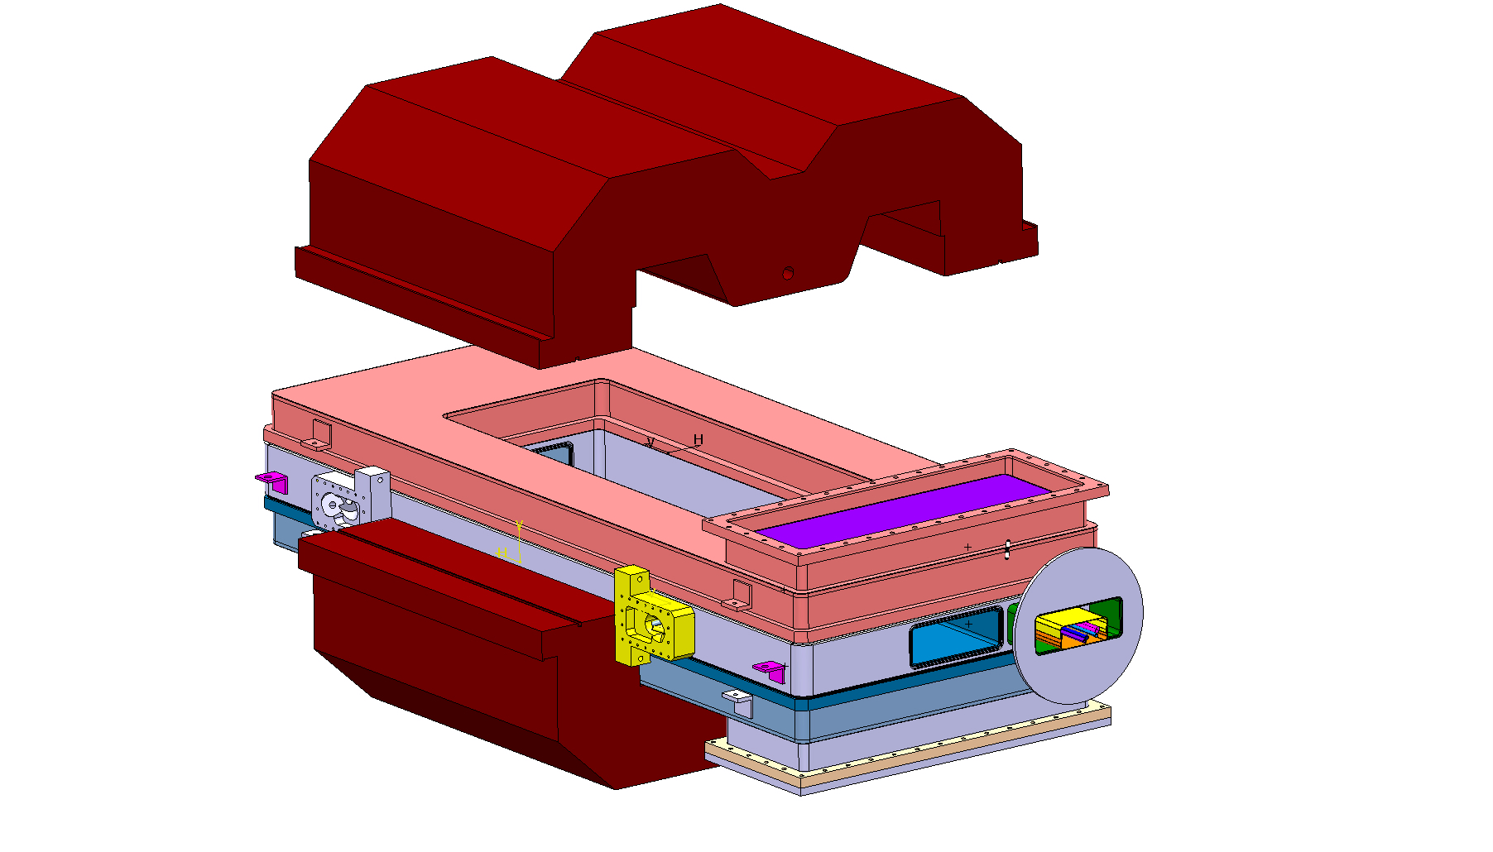
Magnet Design (4/4):
Top and bottom cover for the cryostat + iron yoke

Slide 11
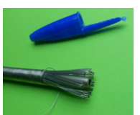
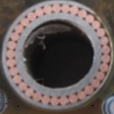
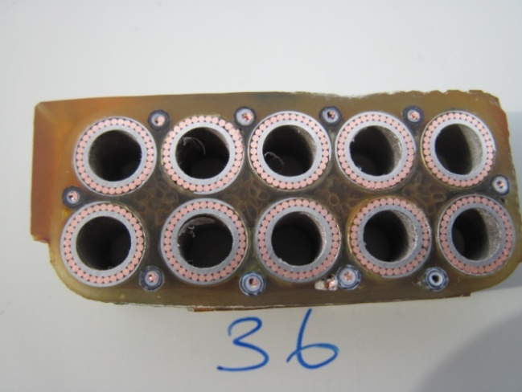
Cable and coil:
Cable-around-conduit conductor made of Nb-Ti strands
Coils cross-section
5 mm
Cable cross-section
45 mm
20 mm
Co-wound quench detection wire

Slide 12
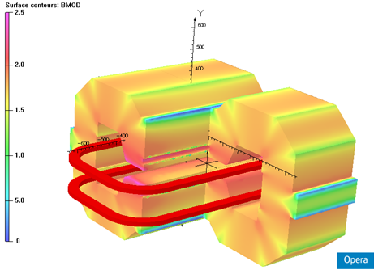
Magnet Design:
Peak field on the conductor within 1 T

Slide 13
Magnet Design:

Slide 14
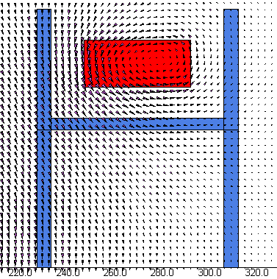
Field lines in the coil

Slide 15
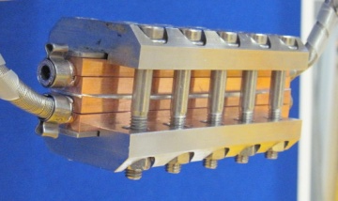
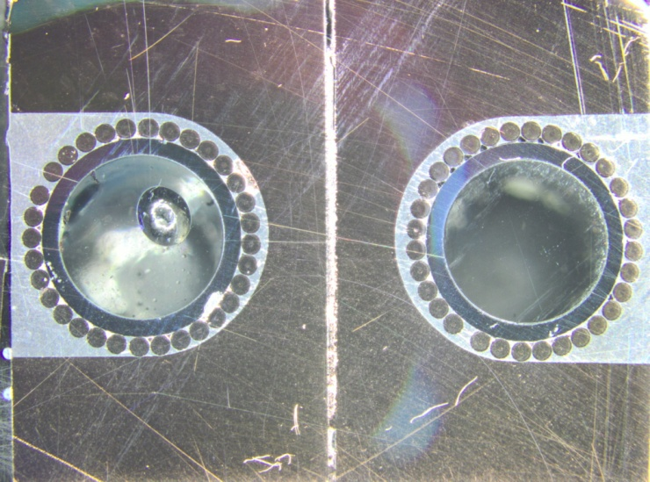
Electrical joints:
Demountable connection:
Measured between 2.4 nΩ and 4nΩ
Indium
Sn-Ag solder
Cable
Copper

Slide 16
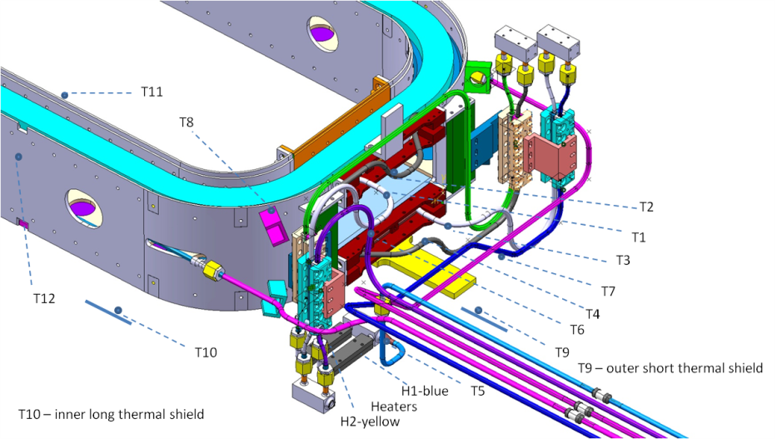
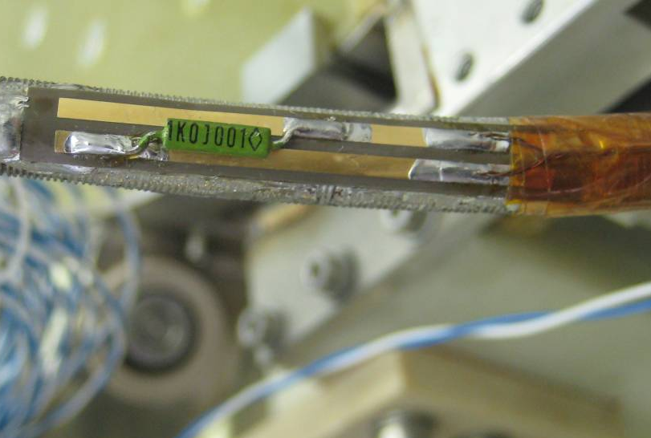
Instrumentation
Magnet equipped with 12 temperature sensors (At 4.5 K measurement error is 12 mK)
The mechanical structure and the rods are equipped with strain gauges

Slide 17
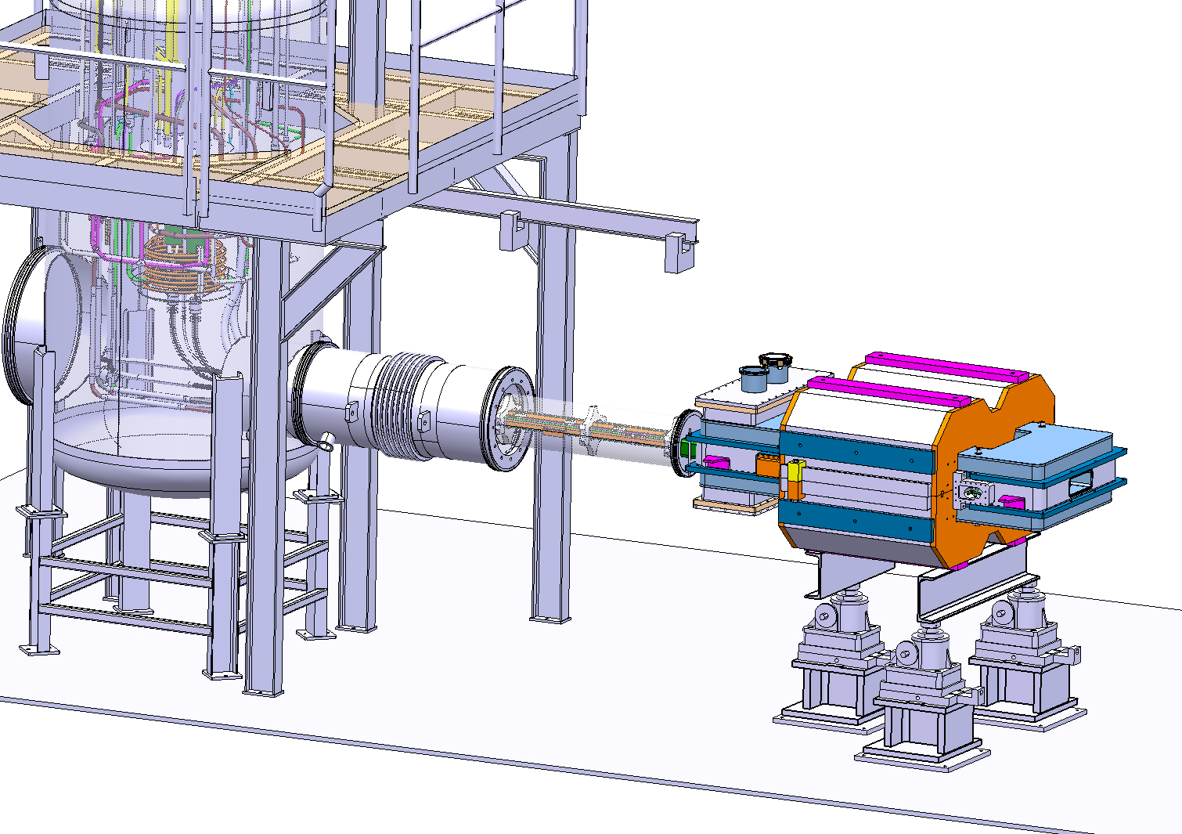
Magnet testing
The magnet was tested in 2012

Slide 18
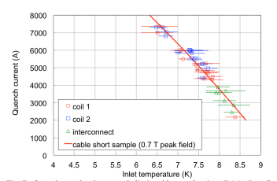
Test results
One training quench at 4.5 K to reach 6 kA
20000 cycles to 6 kA without quench
Current pushed to 7.5 kA (magnetic forces 50% higher) → mechanical design is robust.

Slide 19
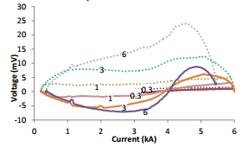
Test results
Coils protected by a 5 mΩ dump resistor.
The quench detection with the co-wound wire was proven effective.
AC loss < 2W (1.2 W from computation).

Slide 20
Spare slides:

Slide 21
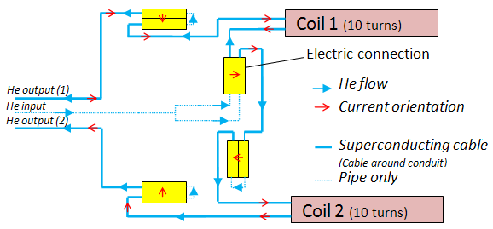
Electrical and cooling circuits:

