Slide 1
Superferric magnets @ CEA

Slide 2
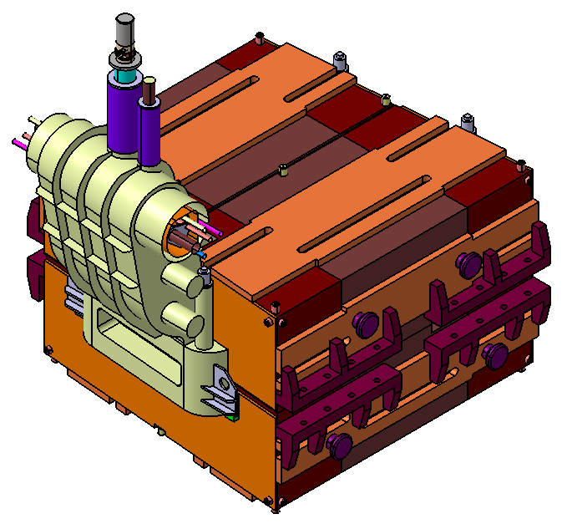
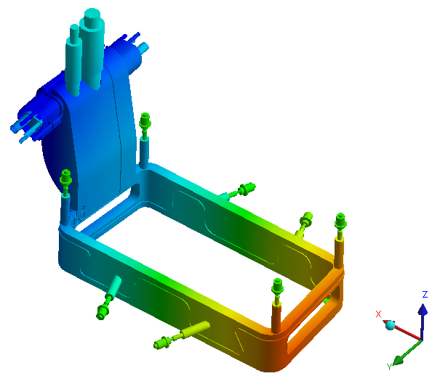
CEA is involved in the FAIR/GSI project:
Responsible for the conceptual design preparation
and technical follow-up of 24 superferric dipoles
Support during the testing phase at CERN
Skills:
Magnetic design (TOSCA/Roxie)
Mechanical design (CAST3M/ANSYS)
Cryogenics (ANSYS/COMSOL)

Slide 3
R&D on HTS at CEA

Slide 4
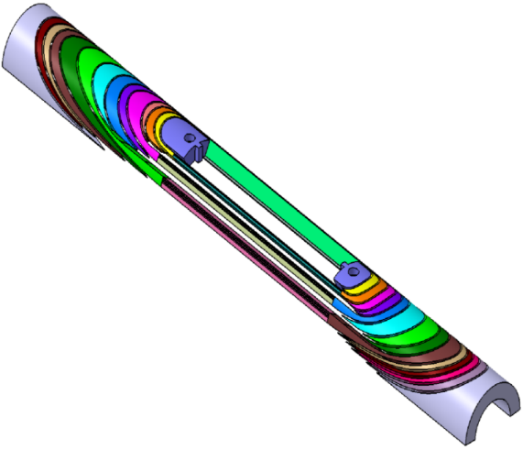
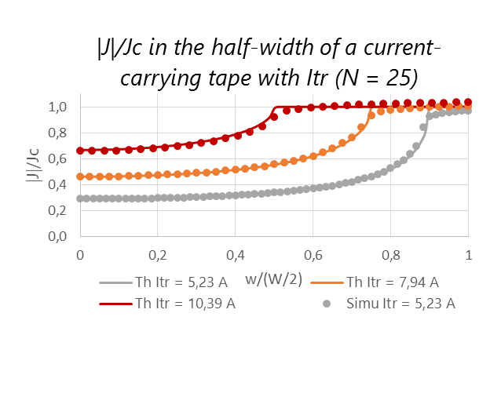
HTS present activities at SACM - projects
HTS Projects
EuCARD2 cos theta design
3D CAD coil end spacers
Areas: accelerators magnets (dipoles), high-field magnets (solenoids)
EuCARD: 5 T HTS insert; block design and fabrication
EuCARD2: 5 T HTS dipole; cos theta design and fabrication
NOUGAT: 10 T HTS insert solenoid (in a 20 T resistive background field)
PhD: Contribution to the design and tests of YBCO high-Tc superconducting inserts: screening currents and protection, (Guillaume Dilasser)
Comparison with analytical formulas taken from E. Zeldov, Magnetization and transport currents in thin superconducting films

Slide 5
HTS Activities
ReBCO conductors
Simulations:
  3D Quench propagation in HTS coils (CAST3M),
  2D and 3D screening currents developments (MATLAB, CAST3M),
  Metallic-insulation simulations (MATLAB)
Winding and fabrication:
  Stacked tapes and Roebel conductors,
  Dipoles: block design and cos theta design,
  Solenoids: pancakes and double pancakes.

Slide 6
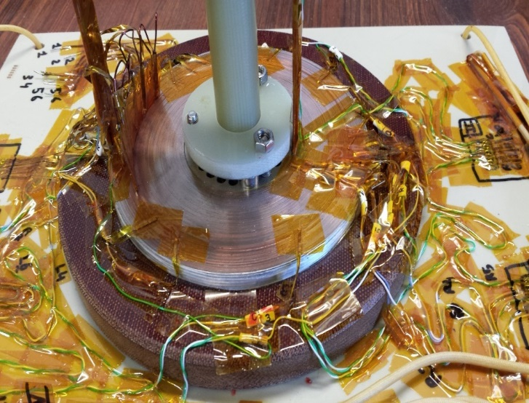
HTS activities at SACM - topics
HTS Activities
Experiments:
  Tests of YBCO coils
  EuCARD insert, EuCARD2 cos theta, pancakes, small solenoids)
  Screening currents: measurements of remanent magnetic field and creep in small YBCO coils,
  Vortex shaking: screening current damp in YBCO coils,
  Coils with metallic insulation: stability and quench protection in YBCO MI pancakes
NOUGAT
Non-insulated pancake
Tests @ 77 K

Slide 7
R&D on cryogenics at CEA

Slide 8
FET-OPEN proposal for a HTS fast cycled magnet for Energy Efficiency and Operational Flexibility
Motivations
SC magnets are the choice of reference to generate high magnetic fields (above 2 T), in a range where NC magnets are neither economic, nor technologically viable
Compared with NC magnets, SC magnets can provide at low field (up to 2 T) better wall-plug efficiency (lower power consumption), increased design options (gap width) and increased operational flexibility (steady state operation)
A superconducting magnet will be competitive at low field (up to 2 T) if we decrease the wall-plug power per unit magnet length by a factor 10 times compared with a NC magnet. One can achieve this by:
  Operating the magnet between 65 to 77K (Nitrogen)
  Using a low losses HTS cable

Slide 9
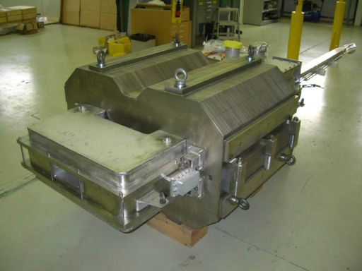
Technical breakthroughs and achievements
Develop a low losses HTS YBCO cable
Design coils compatible with the existing FCM magnet to reuse its mechanical structure and its cryostat
Develop innovative technological solutions
  Manufacturing techniques
  Impregnation
  Cooling techniques
Tests and measurements of the prototype @ CERN
Fast Cycled Magnet – CERN
Warm iron yoke / NbTi cable (Nuclotron)
Overall budget of 3,4 Meuros, duration of 4 years

Slide 10
Project organization - under discussion
WP0: Project coordination, outreach and dissemination - CEA
WP1: Magnet design - WP leader CEA
CEA: Magnetic design, mechanics, cryogenic solutions for 70K, quench and protection
CERN: Comparative studies and analysis for different HTS materials, tapes and cables (for operating temperatures in the range 4K-77K)
Twente University: AC losses (theory and computations)
WP2: Cable characterization – WP leader University of Twente
AC losses measurements, Jc, magnetization, mock-up
WP3: HTS Cable – WP leader CERN
Bruker: YBCO Tape development and fabrication
CERN: Cable design and cable fabrication
WP4: Technical follow-up - WP leader CEA
Sigmaphi: engineering and fabrication of coil version A
BNL: engineering and fabrication of coil version B
CERN: cryostat design / magnet integration / test facility setup
WP5: Tests – WP Leader CERN

