Slide 1
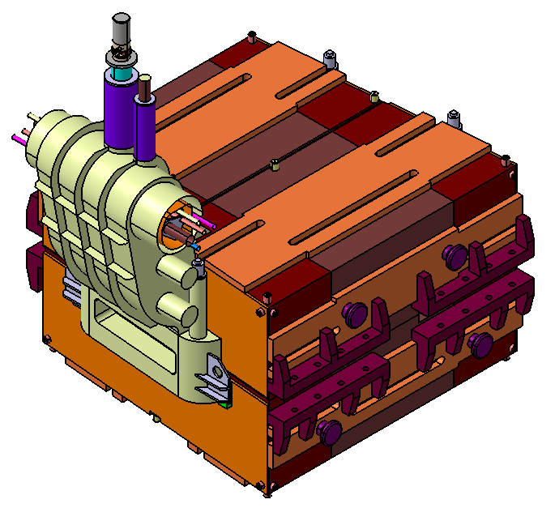
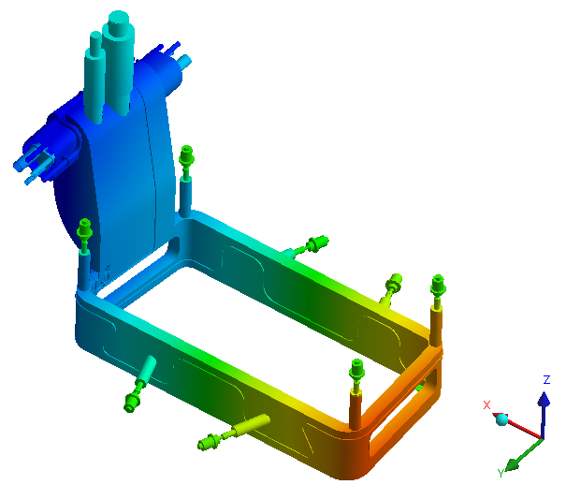
Superferric magnets @ CEA
CEA is involved in the FAIR/GSI project:
Responsible for the conceptual design preparation
and technical follow-up of 24 superferric dipoles
Support during the testing phase at CERN
Skills:
Magnetic design (TOSCA/Roxie)
Mechanical design (CAST3M/ANSYS)
Cryogenics (ANSYS/COMSOL)

Slide 2
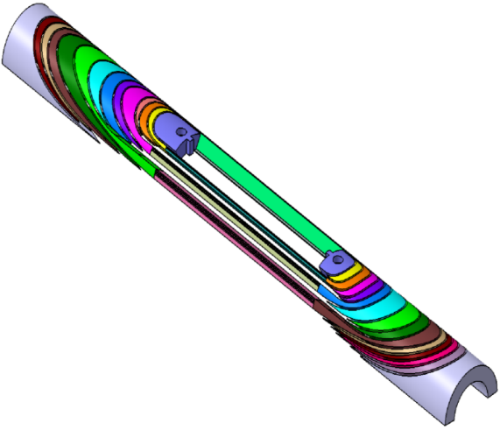
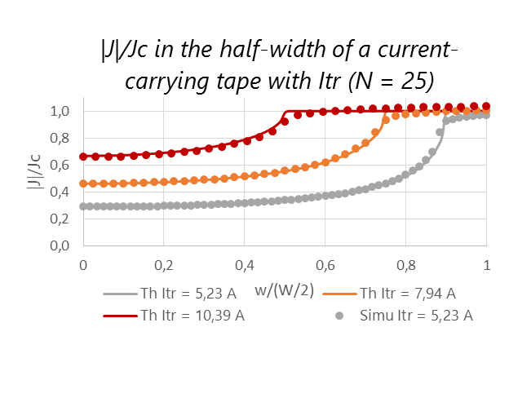
HTS present activities at SACM - projects
HTS Projects
EuCARD2 cos theta design
3D CAD coil end spacers
Areas: accelerators magnets (dipoles), high-field magnets (solenoids)
EuCARD: 5 T HTS insert; block design and fabrication
EuCARD2: 5 T HTS dipole; cos theta design and fabrication
NOUGAT: 10 T HTS insert solenoid (in a 20 T resistive background field)
PhD: Contribution to the design and tests of YBCO high-Tc superconducting inserts: screening currents and protection, (Guillaume Dilasser)
Comparison with analytical formulas taken from E. Zeldov, Magnetization and transport currents in thin superconducting films

Slide 3
HTS Activities
ReBCO conductors
Simulations:
  3D Quench propagation in HTS coils (CAST3M),
  2D and 3D screening currents developments (MATLAB, CAST3M),
  Metallic-insulation simulations (MATLAB)
Winding and fabrication:
  Stacked tapes and Roebel conductors,
  Dipoles: block design and cos theta design,
  Solenoids: pancakes and double pancakes.

Slide 4
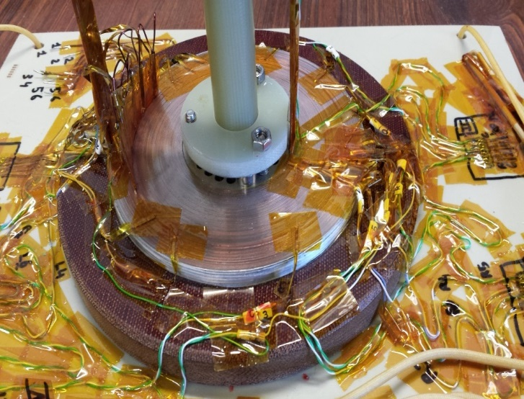
HTS activities at SACM - topics
HTS Activities
Experiments:
  Tests of YBCO coils
  EuCARD insert, EuCARD2 cos theta, pancakes, small solenoids)
  Screening currents: measurements of remanent magnetic field and creep in small YBCO coils,
  Vortex shaking: screening current damp in YBCO coils,
  Coils with metallic insulation: stability and quench protection in YBCO MI pancakes
NOUGAT
Non-insulated pancake
Tests @ 77 K

Slide 5
Cryogenics for HTS magnets
An alternative to pure conduction cooling are the use of thermal links between the cold source and the coil:
- for a cold source : liquid nitrogen or cryocooler
-for a dry magnet coil
Heat transfer higher and thermal diffusion lower
Thermal link imbedded within the mechanical structure to reach the warmest part to cool
Two-phase closed loop coupled with a cryocooler
Pulsating Heat pipes coupled with a cryocooler
Notes:
La presentazione del lavoro partirà da un’introduzione del contesto all’interno del quale esso è stato svolto, per capirne lo scopo ultimo,
2) Tratterà in seguito i due principali filoni di studio: da una parte l’elio superluido con…. E dall’altra parte…
3) Si concluderà con una riflessione complessiva del lavoro ed i suoi sviluppi futuri

Slide 6
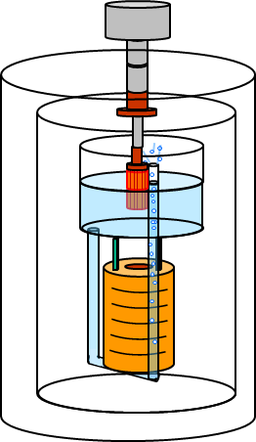
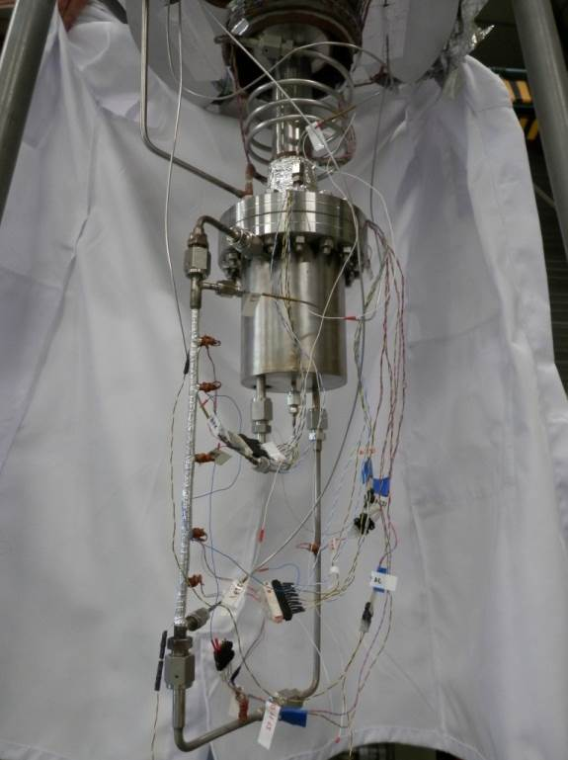
Two-phase closed loop
Loop design at CEA Saclay in liquid helium and to be tested in liquid nitrogen
Cryocooler Gifford-MacMahon
  1.5 W at 4.2 K
Stainless-steel condenser can with a horizontal fins copper heat exchanger
Heat exchanger connected to the second stage of the cryocooler
35 cm high loop
Good Heat transfer = convection + boiling
Notes:
Il tema è strettamente collegato al fenomeno della superconduttività….
Le applicazioni tecnologiche più note che sfruttano tale fenomeno sono quelle che richiedono la genesi di intensissimi campi magnetici che siano allo stesso tempo STABILI
Quindi PERCHE’ utilizzare l’elio superfluido? Perché è un eccellente liquido refrigerante

Slide 7
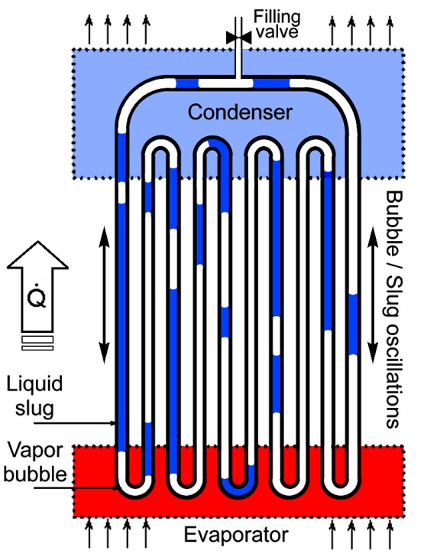
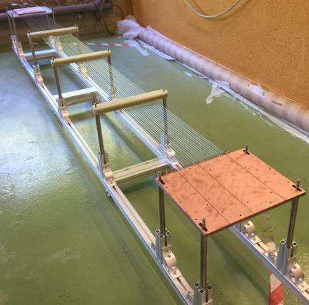
Pulsating Heat pipes
Long nitrogen PHP are under construction an tested at CEA-Saclay
Enormous thermal conductivity equivalent to 5 to 15 kW/m.K on small PHP (50 cm)
To be tested for long length, with elbows, … i.e. constraints from magnet design
Notes:
Il tema è strettamente collegato al fenomeno della superconduttività….
Le applicazioni tecnologiche più note che sfruttano tale fenomeno sono quelle che richiedono la genesi di intensissimi campi magnetici che siano allo stesso tempo STABILI
Quindi PERCHE’ utilizzare l’elio superfluido? Perché è un eccellente liquido refrigerante

