Slide 1
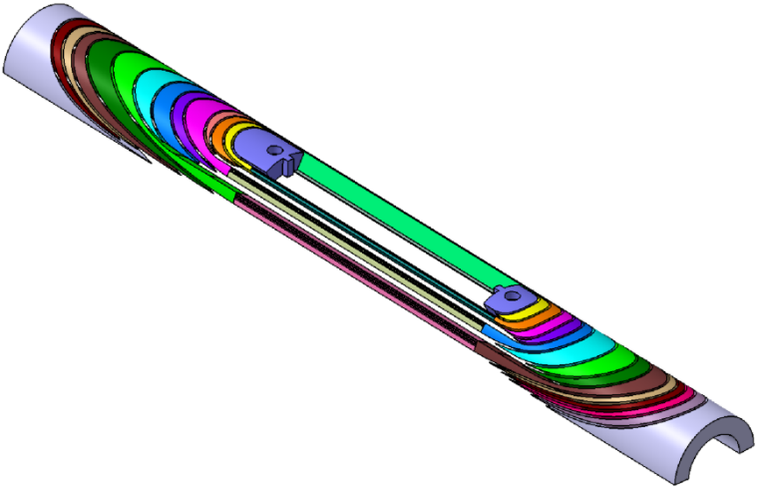
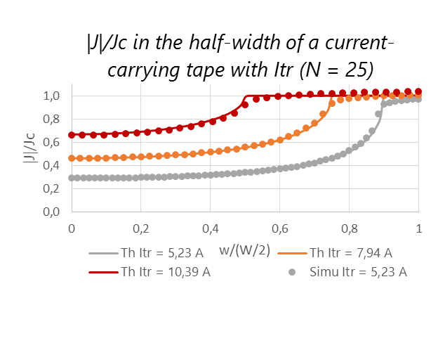
HTS present activities at SACM - projects
EuCARD2 cos theta design
3D CAD coil end spacers
Areas: accelerators magnets (dipoles), high-field magnets (solenoids),
EuCARD: 5 T HTS insert; block design and fabrication,
EuCARD2: 5 T HTS dipole; cos theta design and fabrication,
NOUGAT: 10 T HTS insert solenoid (in 20 T resistive background field)
PhD: Contribution to the design and tests of YBCO high-Tc superconducting inserts: screening currents and protection, (Guillaume Dilasser)
Comparison with analytical formulas taken from E. Zeldov, Magnetization and transport currents in thin superconducting films

Slide 2
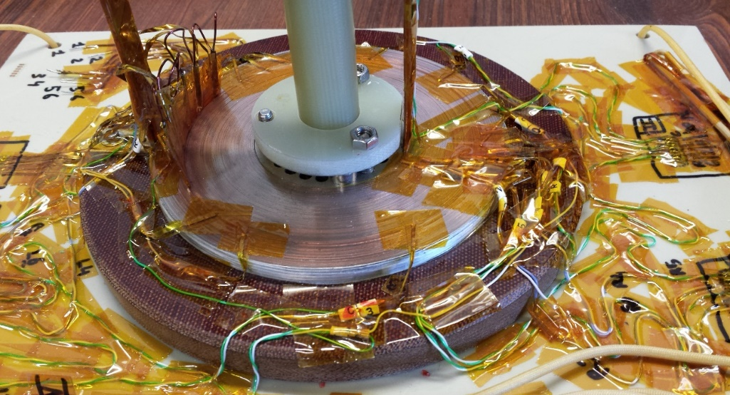
HTS activities at SACM - topics
ReBCO conductor,
Winding and fabrication:
  Stacked tapes and Roebel conductors,
  Dipoles: block design and cos theta design,
  Solenoids: pancakes and double pancakes.
Experiments:
  Tests of YBCO coils (EuCARD insert, EuCARD2 cos theta, pancakes, small solenoids)
  Screening currents: measurements of remanent magnetic field and creep in small YBCO coils,
  Vortex shaking: screening current damp in YBCO coils,
  Coils with metallic insulation: stability and quench protection in YBCO MI pancakes,
Simulations:
  3D Quench propagation in HTS coils (CAST3M),
  2D and 3D screening currents developments (MATLAB, CAST3M),
  Metallic-insulation simulations (MATLAB)
NOUGAT
Non-insulated pancake
Tests @ 77 K

