Slide 1
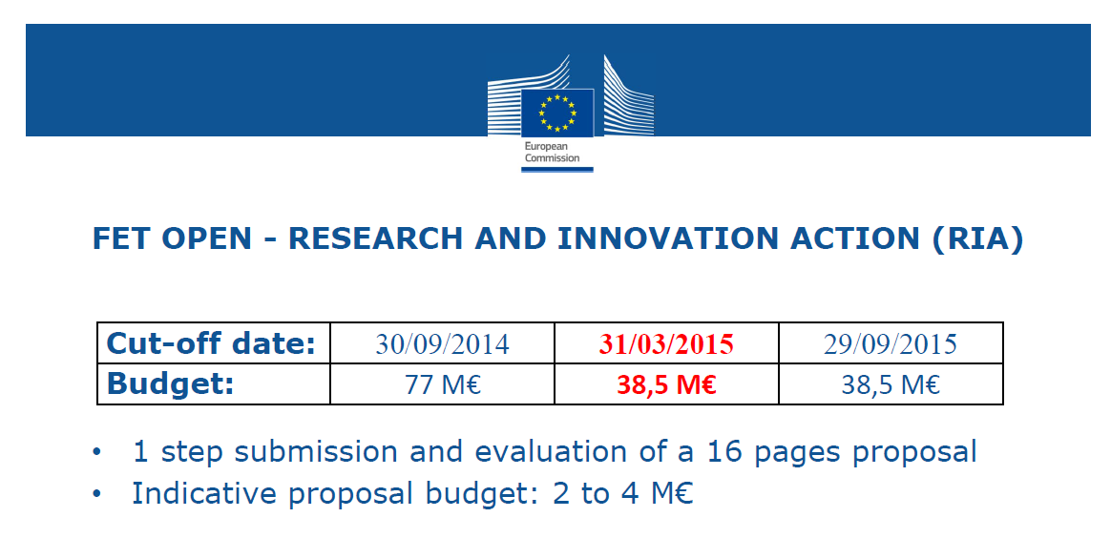
FET-OPEN-RIA
FET-Open - novel ideas for radically new technologies
Deadline Date 29-09-2015 17:00:00 (Brussels local time)
Duration: 3 to 4 years
100% funding
L. Quettier

Slide 2
FET-OPEN Evaluation criteria
Excellence (60%)
– Clarity of targeted breakthrough and its specific science and technology contributions towards a long-term vision;
– Novelty, level of ambition and foundational character;
– Range and added value from interdisciplinarity;
– Appropriateness of the research methods.
L. Quettier

Slide 3
FET-OPEN Evaluation criteria
Impact (20%)
• Importance of the new technological outcome with regards to its transformational impact on technology and/or society;
• Quality of measures for achieving impact on science, technology and/or society;
• Impact from empowerment of new and high potential actors towards future technological leadership.
2 approaches
– create ecosystem for next steps
– technological development with impact on society – industry (support to
Companies)
dissemination
• exploitation
• consider legal – ethical – business - users
L. Quettier

Slide 4
FET-OPEN Evaluation criteria
Quality and efficiency of the implementation (20%)
• Quality of the work plan and clarity of intermediate targets;
• Relevant expertise in the consortium;
• Appropriate allocation and justification of resources (person-months, equipment, budget).
• plan can have decision points that stop certain parts
• management and decision structure including
– risk management
– conflict resolution
– IPR and publication policy
L. Quettier

Slide 5
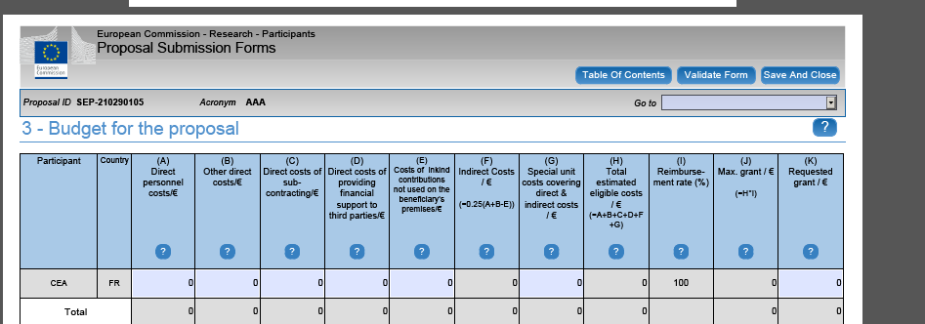
Budget and reimbursement rate
Direct personnel
Permanent manpower
Temporary manpower
Other costs
Equipment
Good and services
Travel
Overhead of 25%
L. Quettier

Slide 6
Project organization
 | CEA (Coord: L.Quettier) | CERN(Coord: M.Modena) | Twente (Coord: M. Dhalle) | Bruker EST (Coord: ?) | Sigmaphi (Coord: ?) | BNG (Coord: ?)
WP0 | Management, Communication, Outreach & Dissemination (Resp. L.Quettier) | (Deputy: M. Modena)
WP1 | Magnet design: conceptual, e.m. design, field quality evaluation, mechanical design, analysis of cryogenics solutions for 70 K operation, quench and protection studies (WP Resp:CEA) | Comparative studies and analysis for different HTS material, tapes and cables solutions (with cryogenic operation at different temperature between 4.2 and 70 K) (Resp:TBC) | Prototypes AC loss theory and computation (Resp:TBC)
WP2 |  |  | Cable characterization, AC loss theoretical computation, Jc, Mock-up, models. Tests and loss measurements. (WP Resp: M. Dhalle)
WP3 |  | HTS Cable design and procurement (WP Resp: A. Ballarino) |  | HTS tape (YBCO) development and production (Resp:TBC)
WP4 | Technical follow-up (WP Resp:CEA) | Cryostat design, coils/magnets integration, test facility setup (Resp: V. Parma) |  |  | Engineering and coil fabrication version A (Resp:TBC) | Engineering and coil fabrication version B (Resp:TBC)
WP5 |  | Prototypes tests. (WP Resp: M. Bajko)
L. Quettier

Slide 7
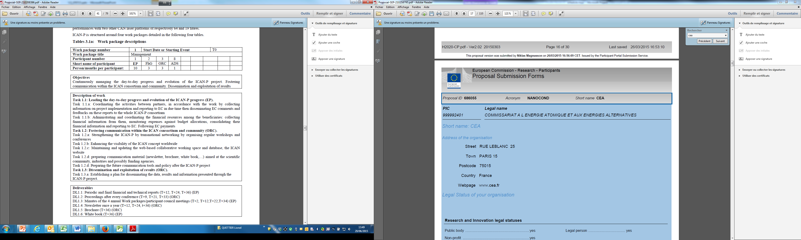
Project organization
For each WP:
Describe sub-tasks
Define HR
Delivrables
L. Quettier

Slide 8
Risk assessment
Risk assessment for each WP:
WP | Potential risk or failure mode | Severity | probability of occurrence | mitigation measures
WP1
L. Quettier

Slide 9
EE-FCM
FET-OPEN proposal for a HTS fast cycled magnet for Energy Efficiency and Operational Flexibility
Motivations
SC magnets are the choice of reference to generate high magnetic fields (above 2 T), in a range where NC magnets are neither economic, nor technologically viable
Compared with NC magnets, SC magnets can provide at low field (up to 2 T) better wall-plug efficiency (lower power consumption), increased design options (gap width) and increased operational flexibility (steady state operation)
A superconducting magnet will be competitive at low field (up to 2 T) if we decrease the wall-plug power per unit magnet length by a factor 10 times compared with a NC magnet. One can achieve this by:
  Operating the magnet between 65 to 77K (Nitrogen)
  Using a low losses HTS cable
L. Quettier

Slide 10
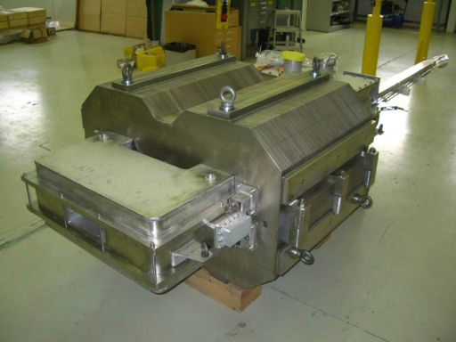
Technical breakthroughs and achievements
Develop a low losses HTS YBCO cable
Design coils compatible with the existing FCM magnet to reuse its mechanical structure and its cryostat
Develop innovative technological solutions
  Manufacturing techniques
  Impregnation
  Cooling techniques
Tests and measurements of the prototype @ CERN
Fast Cycled Magnet – CERN
Warm iron yoke / NbTi cable (Nuclotron)
Project duration of 4 years
L. Quettier

Slide 11
Project organization - under discussion
WP0: Project coordination, outreach and dissemination - CEA
WP1: Magnet design - WP leader CEA
CEA: Magnetic design, mechanics, cryogenic solutions for 70K, quench and protection
CERN: Comparative studies and analysis for different HTS materials, tapes and cables (for operating temperatures in the range 4K-77K)
Twente University: AC losses (theory and computations)
WP2: Cable characterization – WP leader University of Twente
AC losses measurements, Jc, magnetization, mock-up characterization
WP3: HTS Cable – WP leader CERN
Bruker: Low losses YBCO Tape development and fabrication
CERN: Cable design and cable fabrication
WP4: Technical follow-up - WP leader CEA
Sigmaphi: engineering and fabrication of coil version A
BNL: engineering and fabrication of coil version B
CERN: cryostat design / magnet integration / test facility setup
WP5: Tests – WP Leader CERN
L. Quettier

