Slide 1

SC technology for future HEP particle accelerators
Sergey Belomestnykh
ICHEP 2016
4 August 2016

Slide 2
Outline
Introduction: Future HEP particle accelerators and superconducting (SC) technology
Superconducting RF (SRF) technology challenges for future lepton colliders: ILC; FCC-ee/CEPC
High-field SC magnet technology needs for future hadron colliders: FCC-hh/SppC
Summary
TESLA SRF cavity
Short model of a SC magnet

Slide 3
Introduction
Superconducting radio frequency accelerating cavities and High-field superconducting magnets and are a cornerstone technologies of future high-energy particle accelerators.
Due to short time allotted for the talk, I will address only future HEP colliders, which present most challenging demands.
Future generation of lepton colliders will require RF systems to be “affordable” and able to support high luminosity.
The former necessitates cavities operating at high accelerating gradients (acceleration system length) with low cryogenic losses (high quality factor). The latter means supporting very high beam currents (higher order mode damping) and delivering very high power to the beams (RF power couplers).
Next hadron colliders require a step up from the state-of-the-art accelerator-grade SC magnet technology: from 11 T (HL-LHC) to 16 T or even 20 T.
In this talk I will briefly discuss state of the art of these two technologies, outline how they enable future generation of HEP colliders and discuss challenges.

Slide 4
Future colliders: scale of the problem
SRF: 800 cavities at 23.6 MV/m for EXFEL vs. 16,000 cavities at 31.5 MV/m for ILC
SRF: 22 MW SR power for LEP2 vs. 100 MW SR power for FCC-ee
SC magnets: 27 km LHC vs. 80 to 100 km FCC
SC magnets: 11 T Nb₃Sn for HL-LHC vs. 16 T Nb₃Sn / 20T hybrid for FCC-hh/SppC

Slide 5
SRF technology for ILC: state of the art
The ILC TDR specs, 31.5 MV/m with Q > 10¹⁰ and 90% yield, have been demonstrated on a small scale.
Average gradient of XFEL cryomodules is 27.9 MV/m* with only 5 of 98 tested CM modules below spec (23.6 MV/m).
Field emission (FE) is still an issue at high gradients.
ILC cost is still a big concern for funding agencies.
*⁾ Administratively limited to 31 MV/m

Slide 6
SRF technology for ILC: path to cost reduction
From the ILC TDR: “[the cost] is dominated by the SRF components and related systems, together with the conventional facilities. These two elements account for 73% of the total. The main linac itself corresponds to 67% of the total project.”
Reducing the main linac cost is the most efficient way to bring the ILC cost down.
Possible directions for short-term R&D: improve accelerating gradient and cavity Quality factor (Q); reduce cost of cavity and component fabrication; simplify cavity treatment. Long-term R&D would concentrate on alternative materials, e.g. Nb₃Sn.
Main Linac Cost Breakdown from ILC TDR

Slide 7
Recent R&D progress on high Q / high gradient:
“standard” vs “N infused” cavity surface treatment
FNAL recently demonstrated (on single-cell cavities) a new treatment, which utilizes “nitrogen infusion”.
Achieved so far:
  45.6 MV/m → 194 mT
  with Q ~ 2∙10¹⁰!
Systematic effect observed on several cavities.
R&D to focus on :
  Optimize the recipe;
  Implement and demonstrate improvement with statistics on nine cells cavities;
  Better understanding and mitigation of FE;
  Demonstrate preservation of performance in cryomodule;
  Transfer technology to industry.
Courtesy A. Grassellino (FNAL)
Increase in Q by a factor of two
Increase in gradient ~15%

Slide 8
Potential ILC cost reduction
A cost model based on the ILC TDR and new progress in the SRF technology on cavity achievable efficiency (Q) and acceleration (E_{acc}), showing potential cost reduction up to 20%.

Slide 9
Future circular lepton colliders
Future e⁺e⁻ colliders, FCC-ee and CEPC, are considered as a potential first step toward hadron colliders FCC-hh and SppC, a la LEP before LHC.

Slide 10
Parameters of the circular lepton colliders
SRF systems for these machines will have to deal with very high RF power, high beam currents and strong HOM damping.
“Ampere-class” machine
Courtesy E. Jensen (CERN)
short bunches
“high gradient” machines

Slide 11
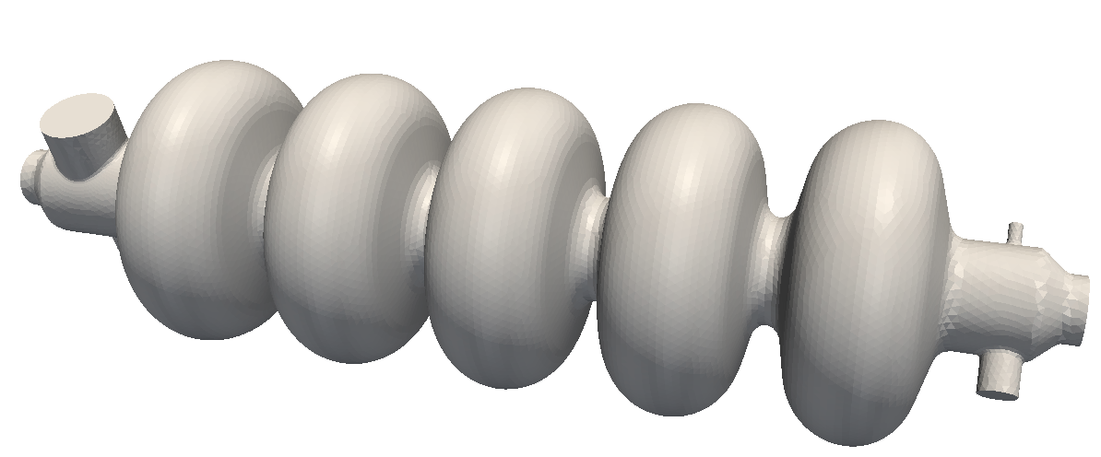
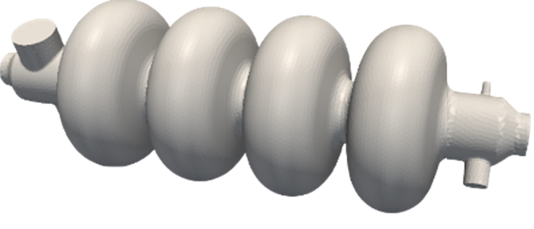
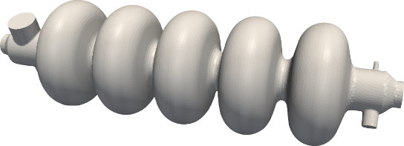
SRF technology for FCC-ee
Parameters of the FCC-ee options cover very wide range and cannot be satisfied with one SRF system design.
At the “high current” end, where the total voltage is relatively small, the design will be determined by strong HOM damping requirements and RF power couplers. Hence, single-cell cavity design. The gradients will be moderate (4-5 MV/m). Nb/Cu at 4 K is OK.
At the “high gradient” end, the total voltage is large and the design will be driven by optimization of the accelerating gradient in CW mode of operation. The number of cells per cavity will be limited to 4-5 to ensure adequate HOM damping. Nb/Cu or other alternatives (Nb₃Sn?) are under consideration, but require R&D.
Higher currents
400MHz, 1 cell, Nb/Cu
400MHz, multi-cells, Nb/Cu
Higher gradient
800MHz, multi-cells, Nb/Cu - bulk Nb
Courtesy E. Jensen (CERN)

Slide 12
SRF technology for CEPC
CEPC’s main physics goal is operation at 240 GeV center-mass energy as a Higgs factory.
The collider RF system will consist of 384 650-MHz 5-cell SRF cavities operating at 19.3 MV/m with Q of 4∙10¹⁰.
Nitrogen doping and magnetic flux expulsion technologies will be used to support high Q.
Thin film SRF technology, e.g. Nb₃Sn is under consideration as possible alternative.
CEPC layout from J. Y. Zhai, et al., SRF2015

Slide 13
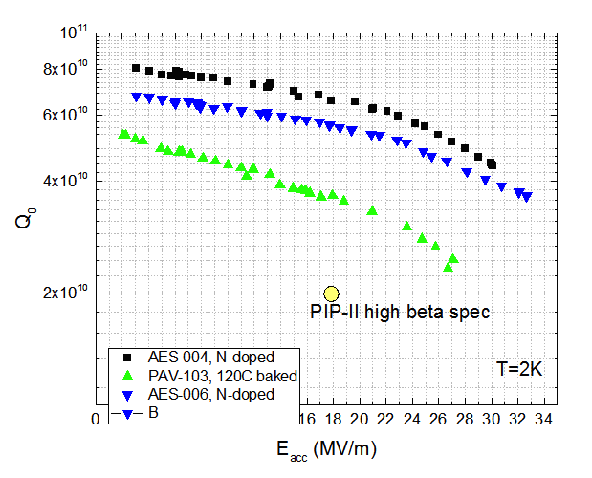
Nitrogen doping for 650 MHz
Applying nitrogen doping to 650 MHz (β = 0.9) leads to doubling Q compared to 120°C bake (standard surface treatment ILC/XFEL), ~7∙10¹⁰ at 2 K – world record at this frequency.
CEPC spec
Courtesy A. Grassellino (FNAL)

Slide 14
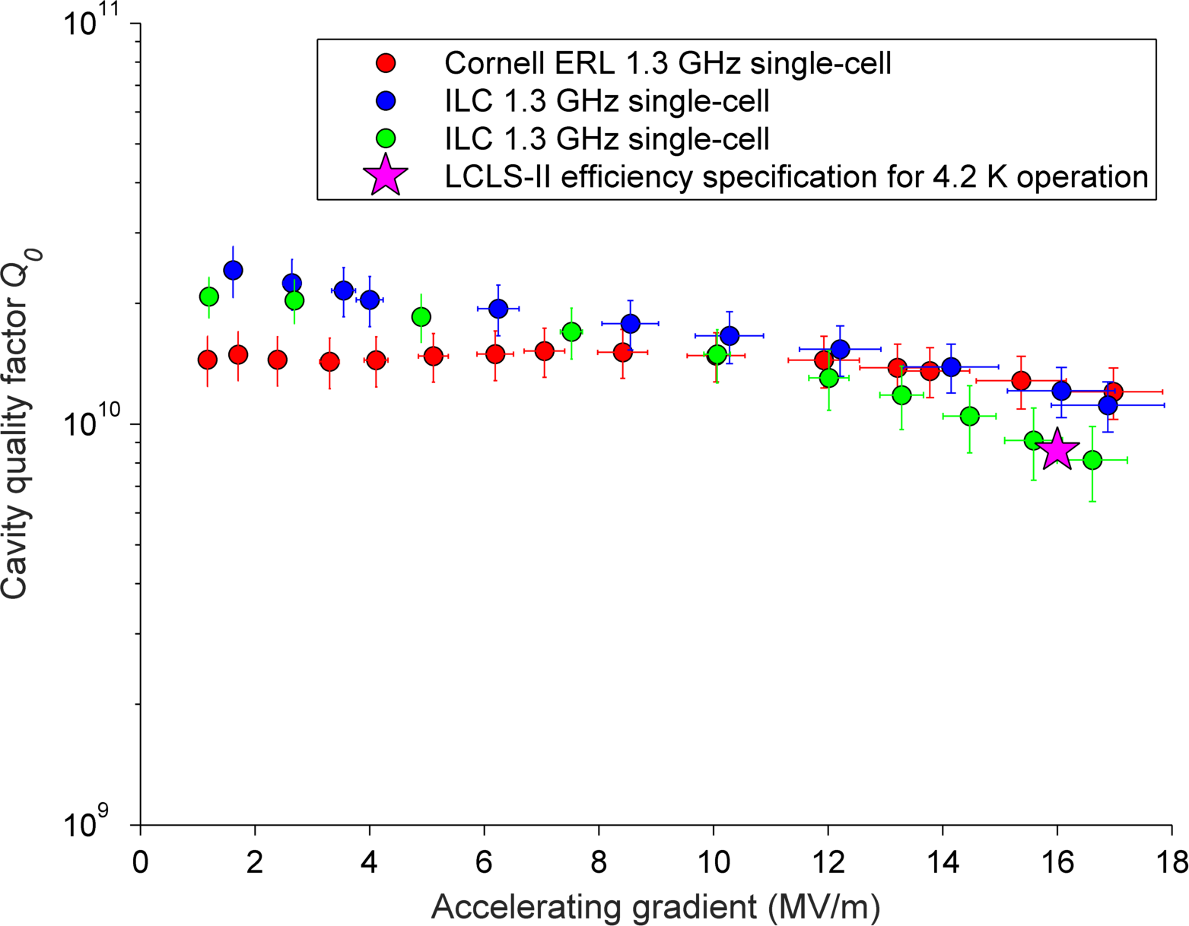
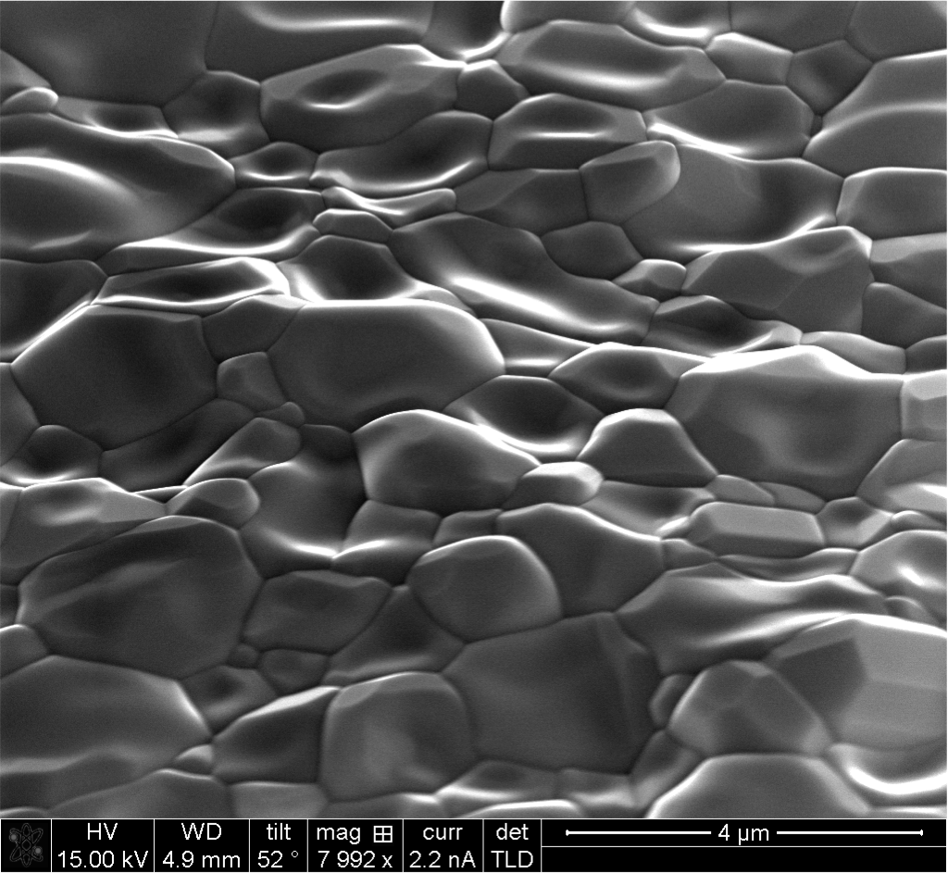
Nb₃Sn SRF cavity R&D
R&D on 1.3 GHz single-cell cavities at Cornell: Recent test results consistently demonstrate gradients >16 MV/m with Q > 10¹⁰ at 4.2 K.
Very promising for future colliders. Next steps: extend this technology to multi-cell cavities and lower frequencies.
Nb₃Sn cavity surface
Courtesy Cornell University
Courtesy D. Hall and M. Liepe (Cornell)

Slide 15
High-field SC magnet technology for future hadron colliders
Proposed future hadron colliders – HE-LHC, FCC-hh, SppC – require developing SC magnet technology beyond state-of-the-art.
State-of-the-art accelerator magnet technology will be utilized in HL-LHC and is based on 11-T class Nb₃Sn magnets.
HE-LHC and FCC-hh plan to use 16 T magnets while SppC would need 20 T magnets.
The former can be developed using Nb₃Sn technology while the latter would need to use HTS, most likely in a hybrid magnet configuration.
In both cases cost reduction for Nb3Sn and HTS superconductor is mandatory to make the projects affordable.
U.S. DOE is establishing a national Magnet Development Program (MDP) to develop SC magnet technology suitable for future energy-frontier colliders.

Slide 16
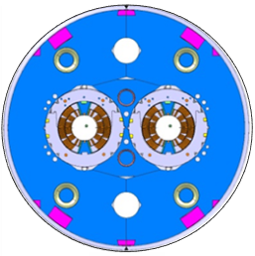

11-T class magnets for HL-LHC
Nb₃Sn dipole for LHC collimation system upgrade
  60 mm aperture
  B_{nom} = 11.2 T at I = 11.85 kA
  cold mass cross-section is compatible with the LHC MB
STAINLESS STEEL
SKIN
IRON YOKE
Nb₃Sn IR quadrupole for LHC luminosity upgrade
  150 mm aperture
  G_{nom} = 140 T/m at 17.5 kA
NB₃SN COIL
STAINLESS STEEL
COLLAR
Courtesy A. Zlobin (FNAL)

Slide 17
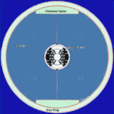
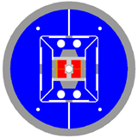
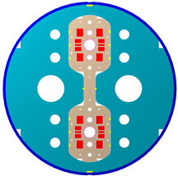
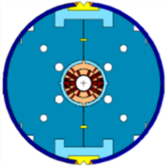
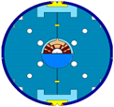
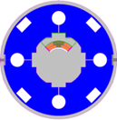
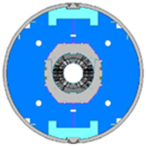
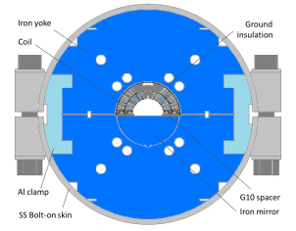
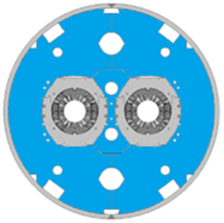
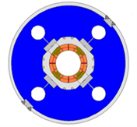
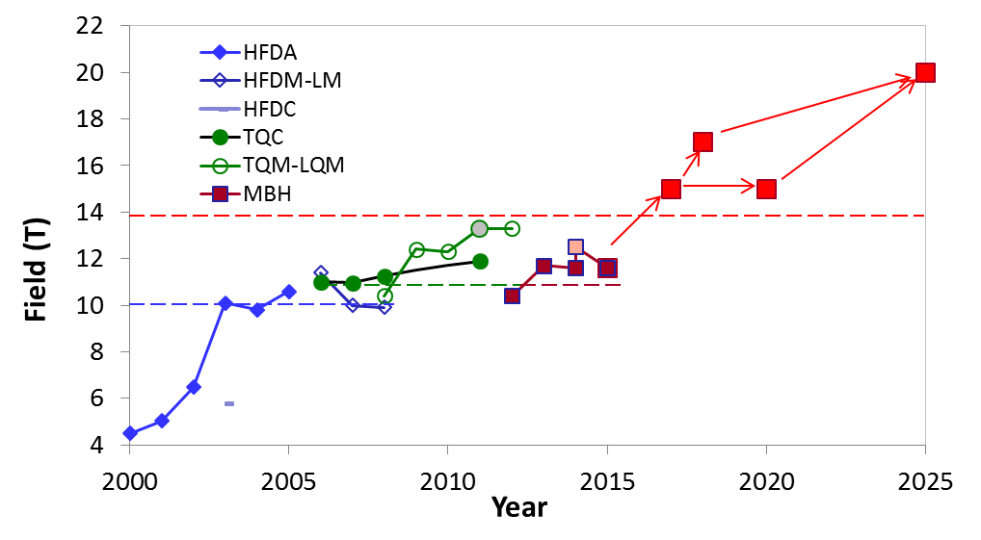
Timeline for high-field accelerator magnet R&D
FCC
Record field 13.8 T
D20 (LBNL)
50 mm dipole
13.5 T (1997)
HD2 (LBNL)
35 mm dipole
13.8 T (2008)
VLHC
LARP
HL-LHC
HFDC (R&W)
40 mm 10 T dipole
HFDA HFDM-LM 43.5 mm Dipole mirror
10 T dipole
TQC TQM-LQM
90 mm 200 T/m Quadrupole quadrupole mirror
MBHSP MBHSM
60 mm 11 T dipole Dipole mirror
MBHDP
60 mm 11 T dipole
Courtesy A. Zlobin (FNAL)

Slide 18
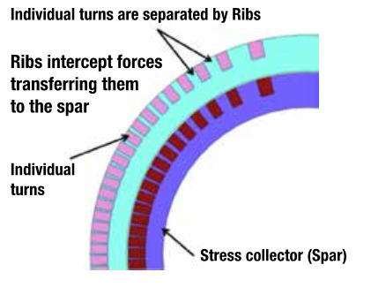
Magnet Development Program
This is a generic R&D program designed to achieve 4 goals and address the driving questions.
Baseline cos-theta design
Canted cos-theta concept

Slide 19
Magnet cost reduction strategy
Reduce magnet cross-section
Increase magnet length
Reduce component cost
Reduce labor
Improve performance - margin, B_{op}, T_{op}
B. Palmer (BNL), 2014

Slide 20
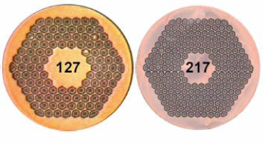
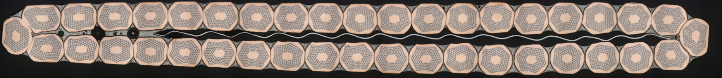
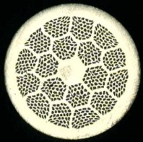
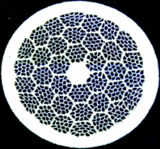
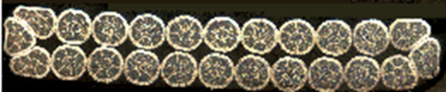
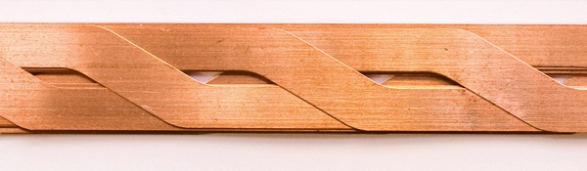
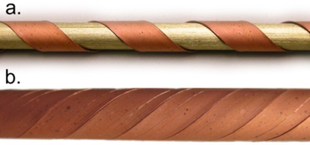
Conductor R&D program
Nb₃Sn strand and cable
  Internal Tin, Powder-In-Tube wires → Rutherford cable
HTS conductor and cable
  Bi-2212 wire → Rutherford cable
  ReBCO tape → ROEBEL cable or CORC
Objective: improve J_{e} and reduce cost
Nb₃Sn RRP strand, OST
40-strand Nb3Sn Rutherford cable
24-strand HTS Rutherford cable
Bi2212 PIT strand, OST
ROEBEL cable
Cable On Round Core (CORC)

Slide 21
A new generation of Nb₃Sn conductors
The key factor of Nb₃Sn conductors for 16 T Nb₃Sn magnets: critical current density, J_{c}
  What we have: J_{c} (15 T) = 1300-1500 A/mm² for present state-of-the-art.
  What we need: J_{c} (15 T) = 2000-3000 A/mm² for fabricating 16 T magnets economically.
We need 50-100% improvement of 15 T J_{c} over present Nb₃Sn conductors.
How can we achieve such an improvement when J_{c} of Nb₃Sn have plateaued for nearly two decades?
A new technique:
by generating ZrO₂ artificial pinning centers (APC), J_{c} was doubled.
This new Nb₃Sn has sufficient J_{c} for fabricating 16 to18 T magnets.
Its J_{c} at 20 T matches HTS.
More improvement by further optimization: add titanium dopant.
Next steps:
Extend this technology to practical conductors.
Further optimization.
X. Xu et al., Adv. Mater. 27, 1346-50, 2015.
15 T J_{c} can be improved by a factor of 3.

Slide 22
Summary
Future energy-frontier colliders require advances in SC technology beyond state-of-the-art.
Cost reduction is very important aspect of R&D aimed at developing this technology
Electron-positron colliders will require large-scale SRF installations, e.g. 16,000 cavities for ILC.
Recent advances – nitrogen doping and nitrogen infusion, magnetic flux expulsion – demonstrate that there is still room for improvement using bulk Nb.
Further progress can be achieved with thin film techniques, especially Nb₃Sn cavities.
High-field SC magnet technology is a cornerstone for future hadron colliders, which require fields of 16 to 20 T, beyond state-of-the-art.
R&D goals here include exploring performance limits of Nb₃Sn; developing 16-T class accelerator quality magnets; pursuing Nb₃Sn and HTS conductor development to increase performance and reduce cost.

