Slide 1
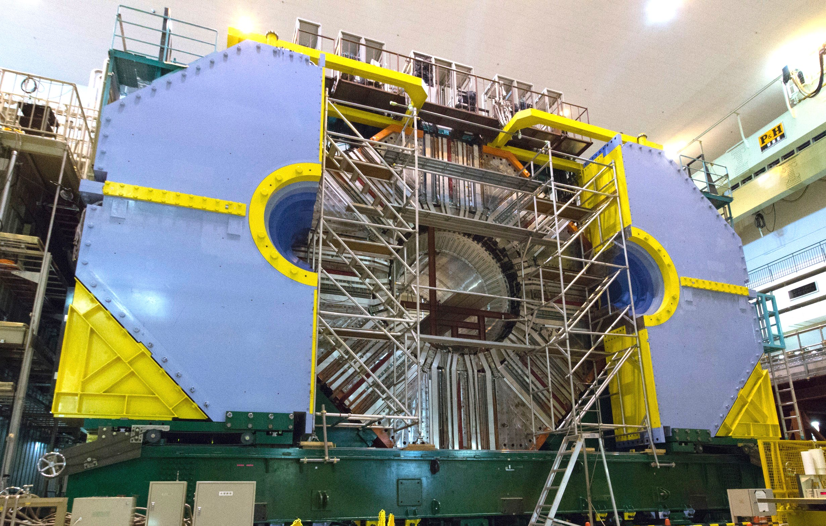




Outreach Activities in the
Belle II Collaboration
Toru Iijima
Kobayashi-Maskawa Institute
Nagoya University
for the Belle II Collaboration
August 5, 2016

Slide 2
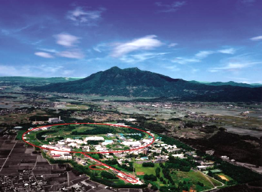
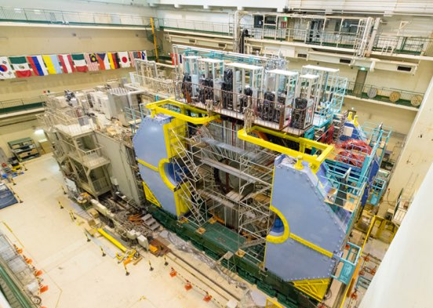
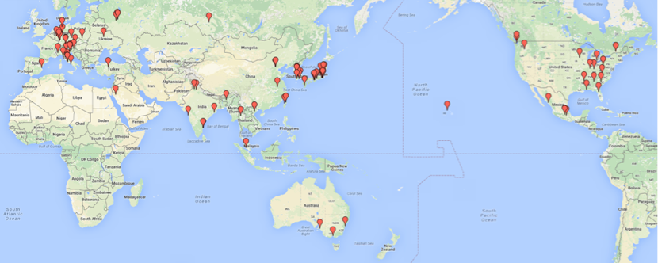
SuperKEKB/Belle II
New intensity frontier facility at KEK
  Target luminosity ; L_{peak} = 8 x 10³⁵cm⁻²s⁻¹
            L_{int} > 50 ab⁻¹
            ⇒ ~10¹⁰ BB, τ⁺τ⁻ and charms per year !
Will start collision w/o vertex detector in 2017, w/ full detector in 2018, to find
  New Physics in decays of heavy flavor particles
  New exotic states (X, Y, Z, …)
  and more !
Belle II is run by truly international collaboration of 649 colleagues, 100 institutions, 23 countries/regions.
The first particle collider after the LHC !

Slide 3

Belle II Outreach
Formed in June 2015 to improve publicity of the project, for general public, students, scientific community, funding agency.
Missions
  Transmit information via
    Public HP (for general audience)
    Facebook, Twitter
  Operate education programs
    B-Lab, Belle Plus, …
  Archiving outreach materials
    photos, movies, …
  Press release, news
Close cooperation with PR office and outreach coordinators at KEK and also at other institutes
Organization
Outreach coordinator (T.I)
Managers for FB/Tw, HP, B-Lab etc.
Liaisons from each subgroup
(detectors, physics)
PR office and outreach coordinator
(KEK and other institutes)

Slide 4
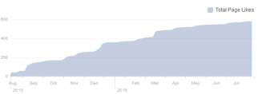
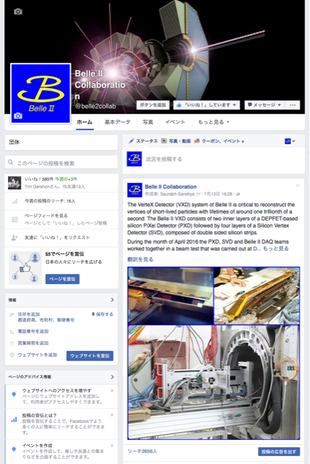
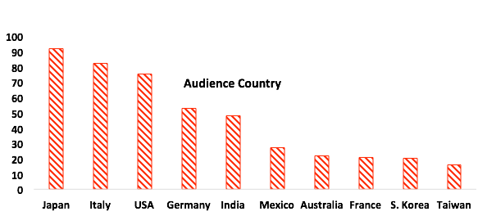
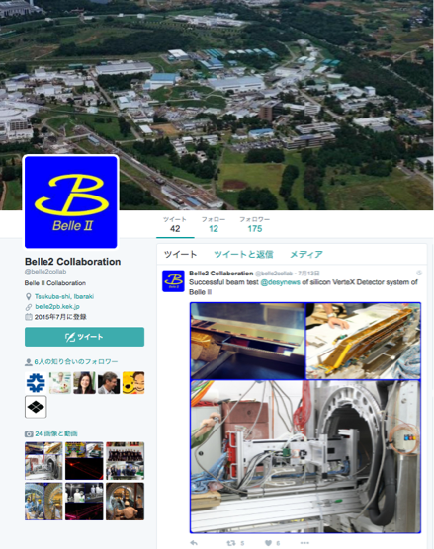

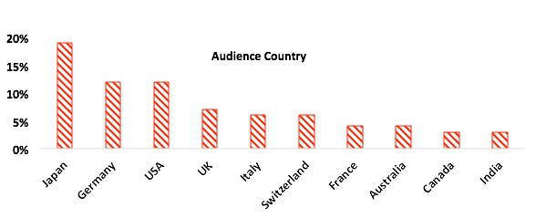





Facebook & Twitter
S. Sandilya, T. Pedlar, M. Takizawa,
R. Seddon, K. Miyabayashi et al.
Regularly update, twice a week (Wed. and Sat.)
Based on inputs from collaborators (mainly subgroup liaisons), contents are prepared by FB/Tw managers, briefly reviewed by the committee members.
Japanese FB/Tw are also operated.
Total audience size on FB is 585 (just started !)
Suggestion for posts by liaisons etc.
Drafted by FB/Tw managers
Brief review by committee members
Final permission by T.I and T. Browder
POST !

Slide 5
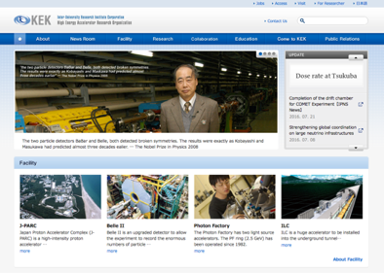
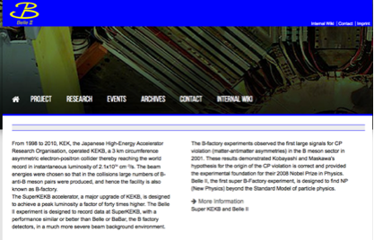
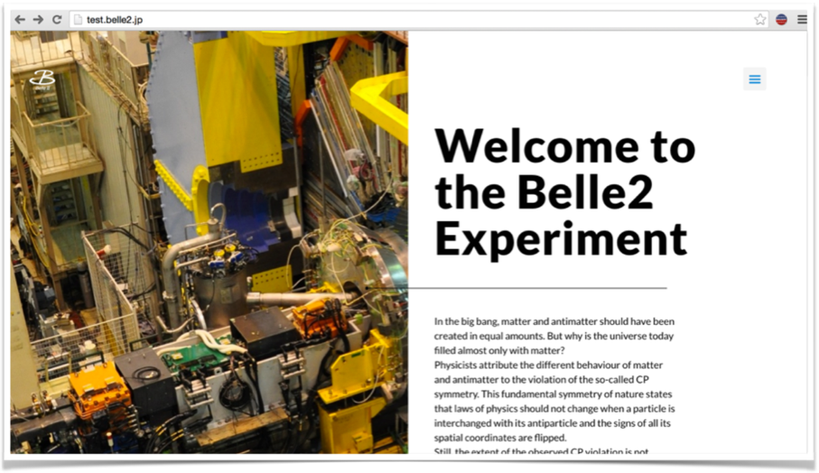

Public Home Page
C. Sfienti et al.
In preparation to transmit information to general audience.
Utilize commercial hosting service
  Simple domain name (belle2.jp)
  Free from lab. regulations
  Easy maintenance
Contents
  Physics
  SuperKEKB
  Detectors
  Collaboration
  News (Blog like)
  Video and twitter feed on
  Link to educational programs
KEK
Research HP
belle2.org
Public HP
belle2.jp

Slide 6


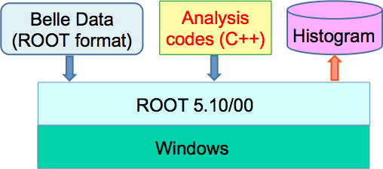
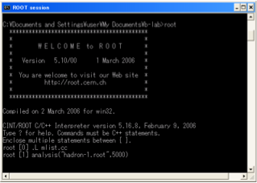
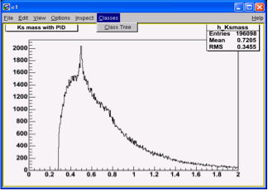
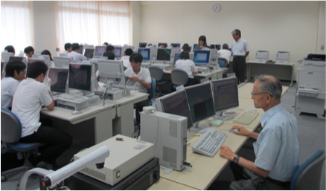
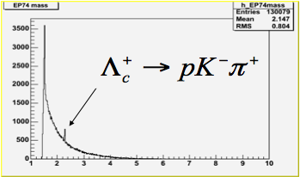
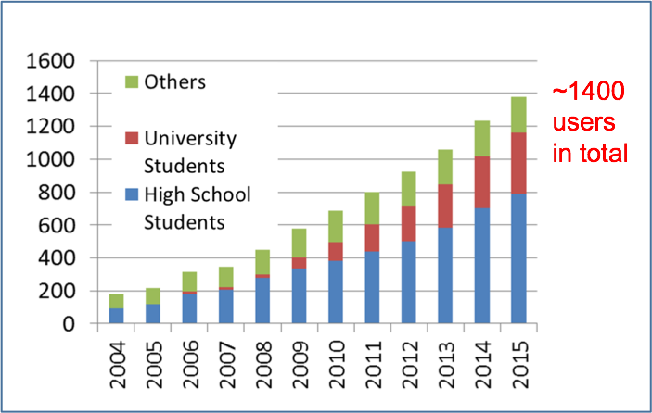
B-Lab
http://belle.kek.jp/b-lab/b-lab-english
Open data analysis program using Belle data.
Started in 2004 by the Belle collaboration.
Open 1.3fb⁻¹ data in ROOT format with information on momenta, charge and PID for new particle (new resonance) searches.
Will be modified and used also for Belle II (“B-Lab2”).
Number of participants
Lecture at a high school
Λc⁺ → pK⁻π⁺ discovered by a group of high school students
Please visit poster #834 by S. Nishida et al.

Slide 7
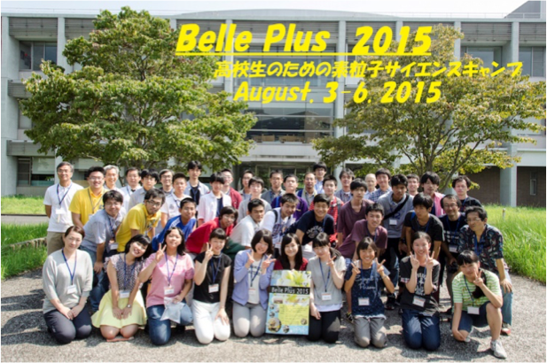
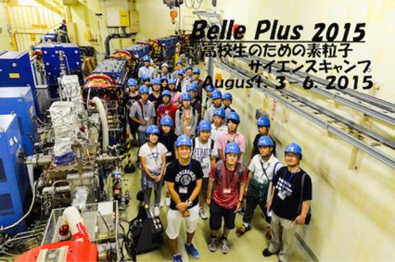
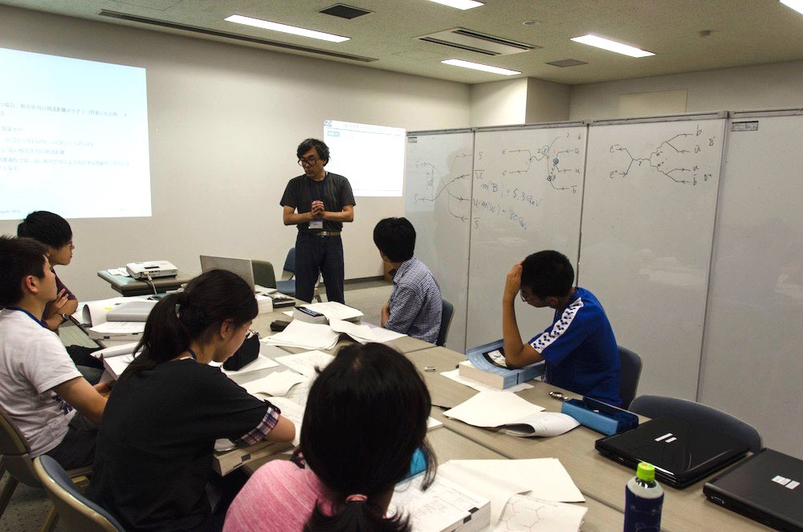
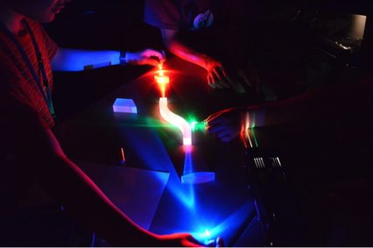
Belle-Plus
Summer (high school ) student program to offer real experience of science at KEK.
Started in 2006, and held every year (except for 2010).
About 20 students stay in KEK for 4 days to take
  Lectures on particle physics
  (Super)KEKB and Belle(II) tour
  Experimental or theoretical course
    CR experiments
    Calculation of Feynman diagrams
    others
  Presentation
More details in poster #834 by S. Nishida et al.

Slide 8
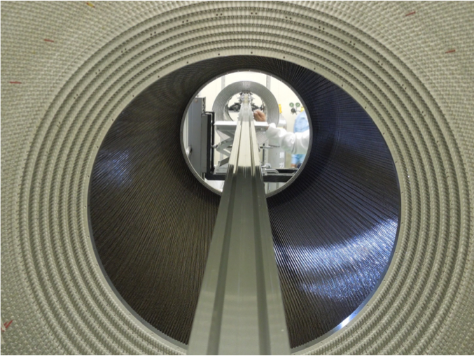
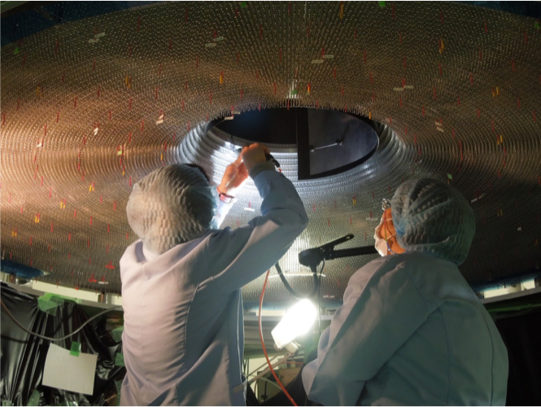
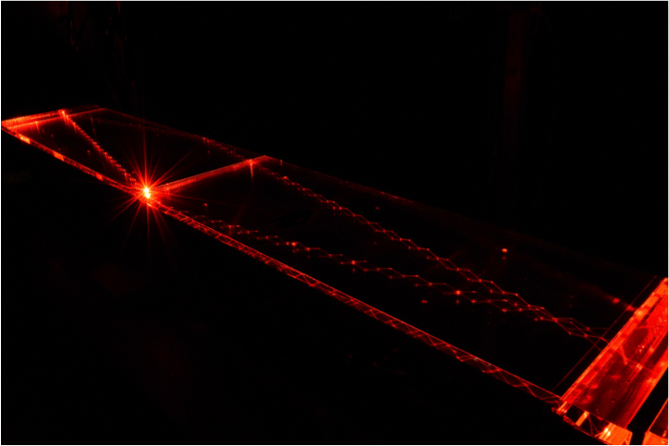
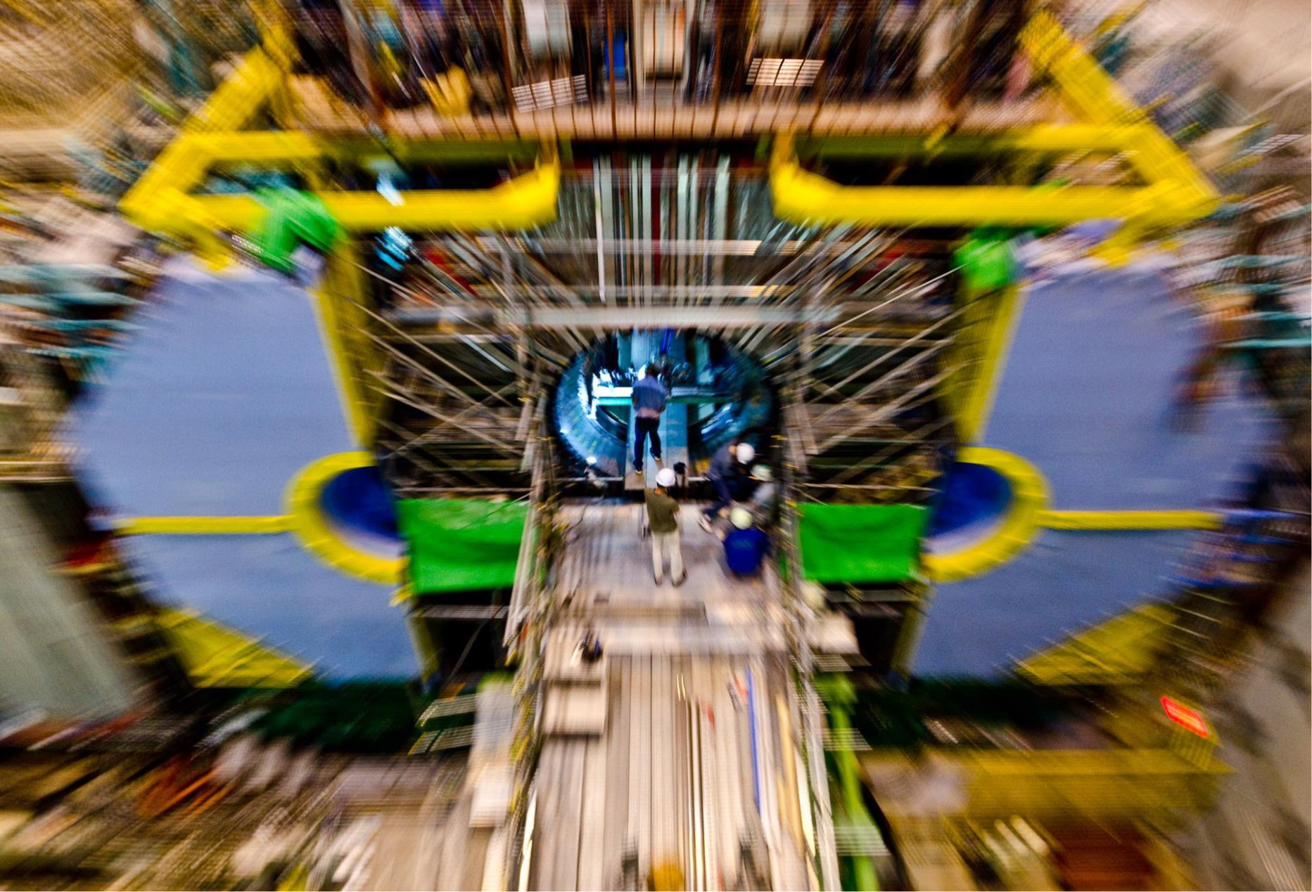
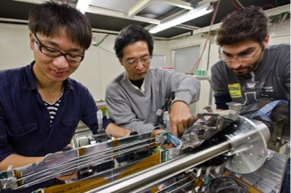
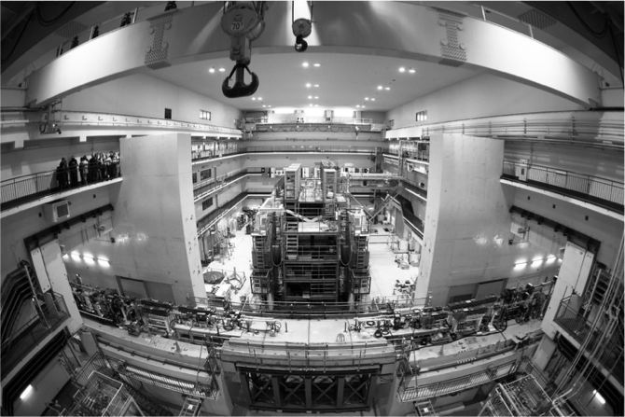
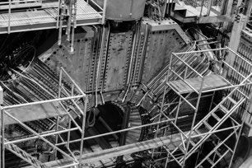
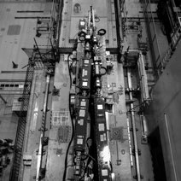
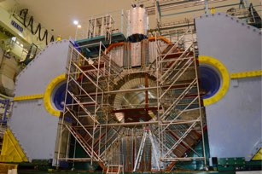
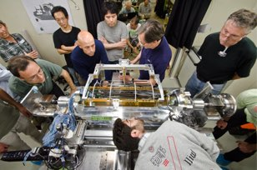
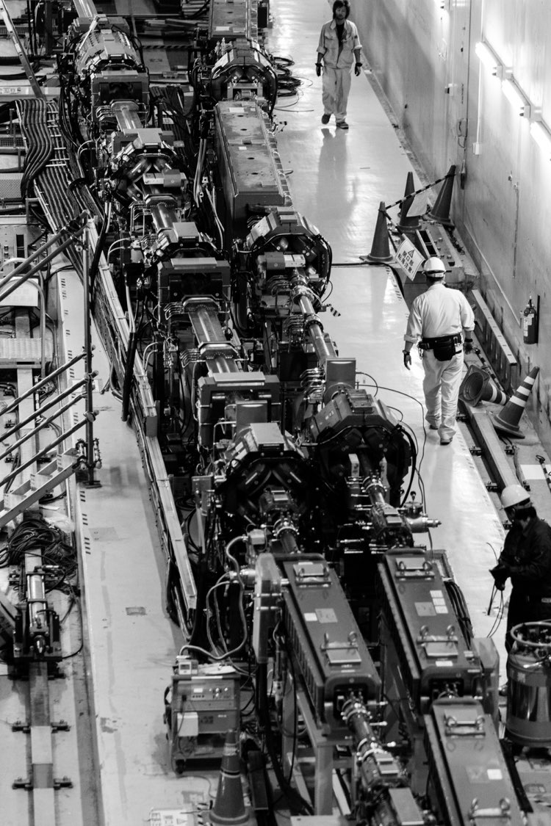
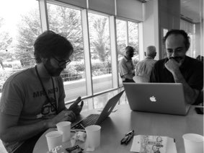
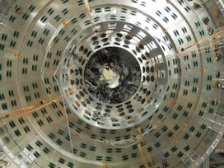
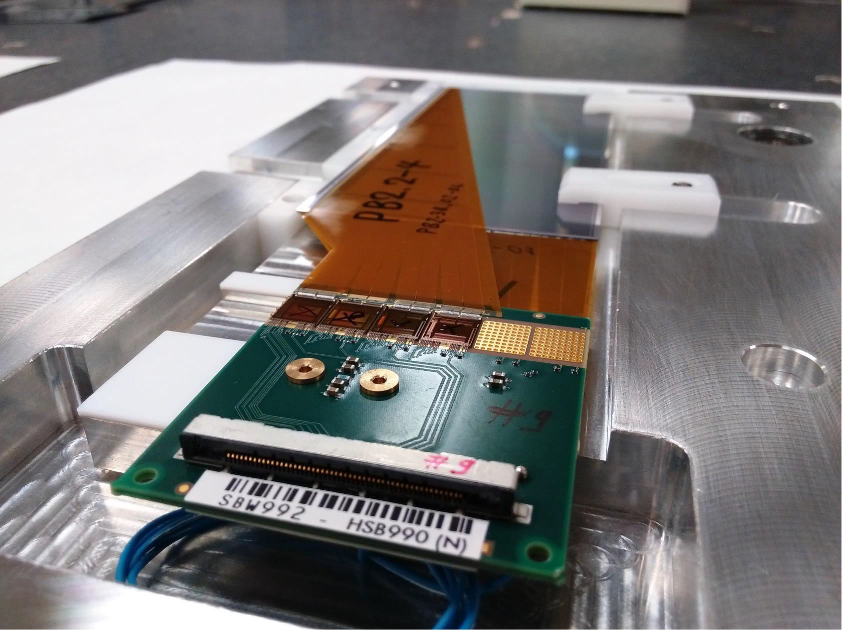
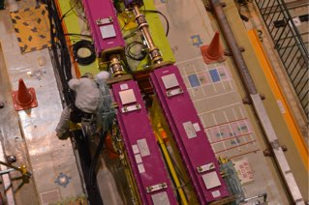
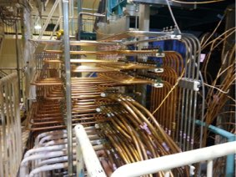
Archiving materials
Twiki at KEK → Confluence at DESY
  Google drive is also used to share photographs (taken privately).
Photography competition
  Encourage collaborators to take and provide nice photographs.
  Held at each Belle II general meeting (3 times a year)
  Choose best 3 photos by voting among the Belle II collaborators.
S. Sandilya et al.

Slide 9
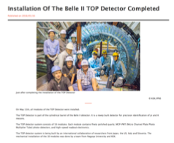
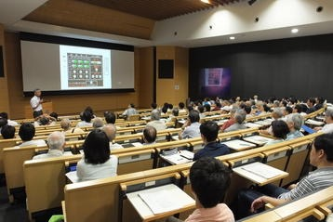
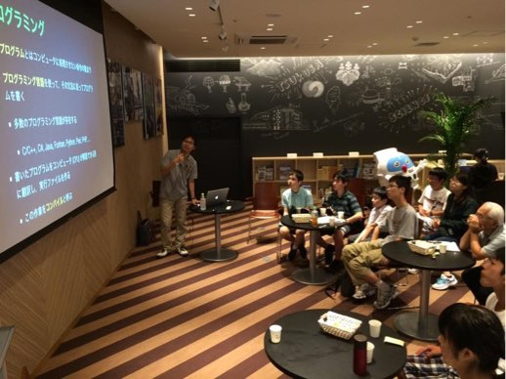
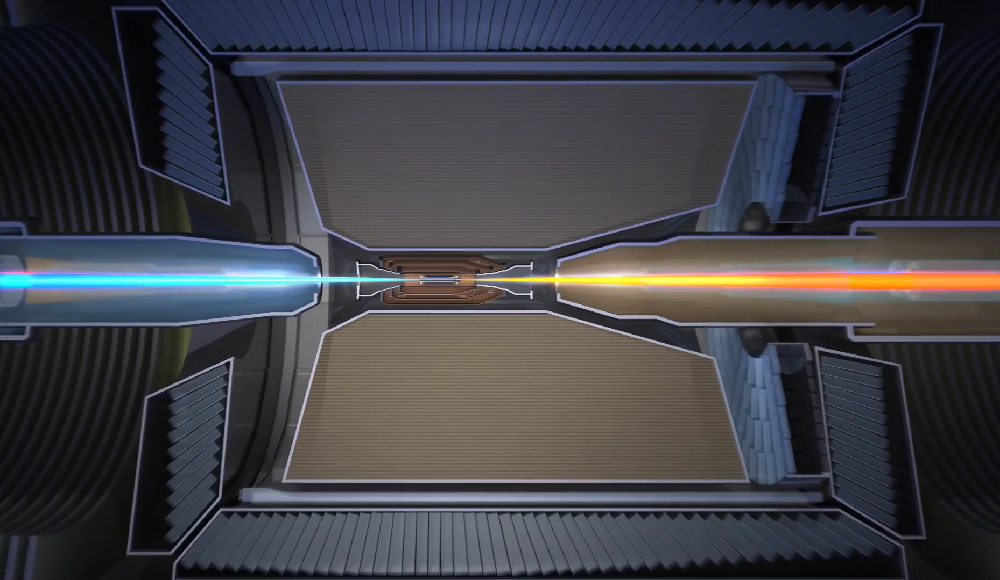
Cooperation with
KEK/IPNS PR Office
Belle II outreach works in close collaboration with KEK PR office and KEK/IPNS outreach coordinator.
Transmission of news, topics, press release
Lectures on SuperKEKB/Belle II
KEK Science Cafe
Creation of multimedia materials
Movie “A Search for New Physics
- The Belle II Experiment”
KEK public lecture
KEK Science Cafe
Please listen to the talk by S. Takahashi tomorrow !

Slide 10
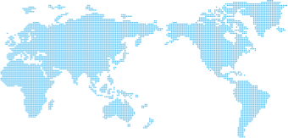
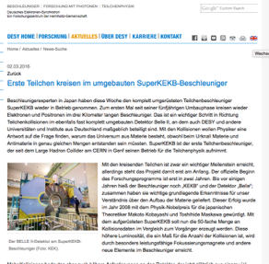
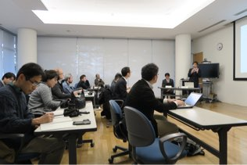
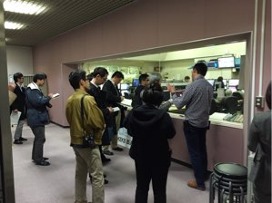
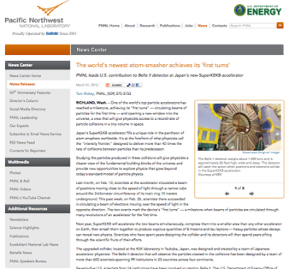
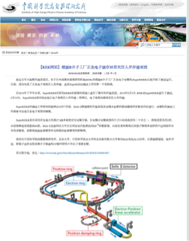
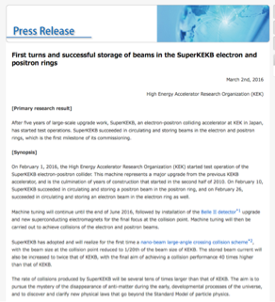
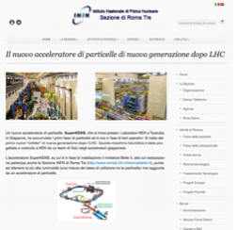

Press release
The 1st press release from the SuperKEKB/Belle II project: “First turns and successful storage of beams in the SuperKEKB electron and positron rings” (March 2, 2016)
Original press release both in English and Japanese from KEK
Press conference at KEK
Followed by local press release in each country/region.
DESY
PNNL
IHEP
KEK
INFN
at more institutes

Slide 11

Summary
Belle II experiment is coming up !
Belle II is ramping up outreach and educational activities to appeal to the international particle physics project.
We are happy to share information and expertise for outreach and education.
Belle II is gaining momentum !
Coming events (milestones)
2016
2017
2018
2019
Belle II roll-in
Global CR run
Fist collision (phase2)
VXD installation
Stay Tuned for
Belle II Outreach !
Start physics run
(phase3)

Slide 12
Backup Slides

