Slide 1
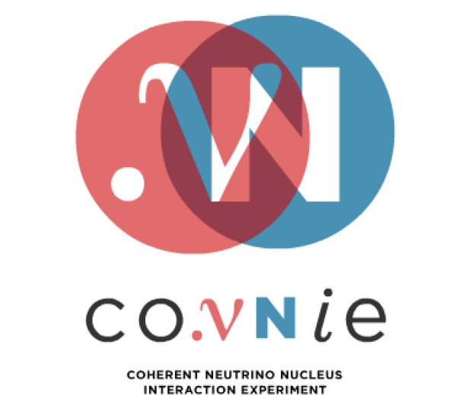
Results from Engineering Run of the Coherent Neutrino Nucleus Interaction Experiment (CONNIE)
Gustavo Cancelo
6 August 2016

Slide 2
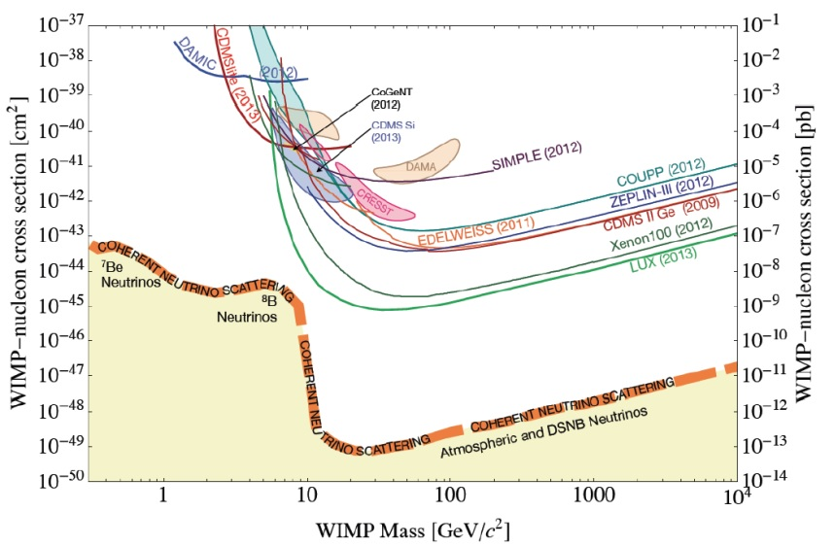
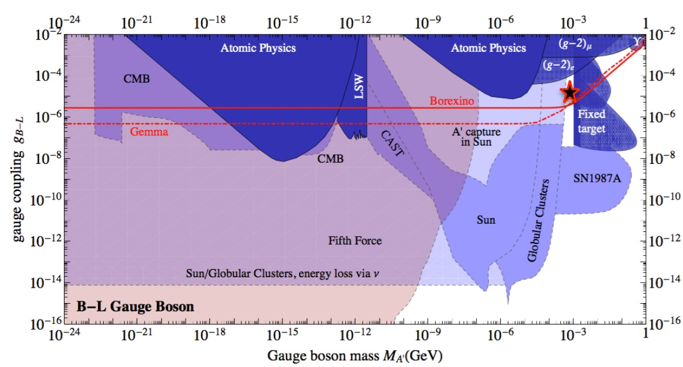
New physics in the low energy neutrino sector
Understanding solar, atmospheric and DSNB neutrinos.
  Important to determine the background in direct search of Dark Matter.
Supernovas
  MeV-neutrino physics has great relevance for energy transport in supernovas and it is related to the ongoing eﬀort to develop new supernova detectors.
Probing models in a region of parameter space for new physics in the low energy neutrino sector.
  A’ boson, magnetic moment, etc.
Direct DM searches and expected neutrino floor
arXiv: 1202.6073

Slide 3
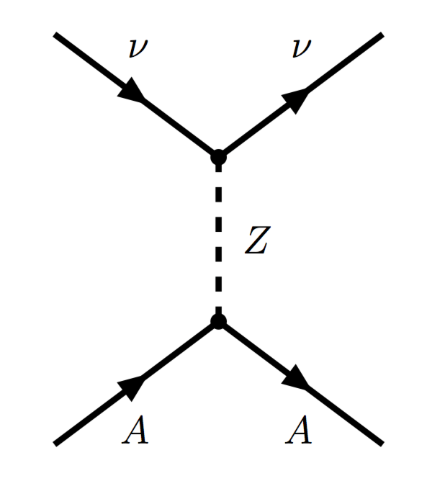

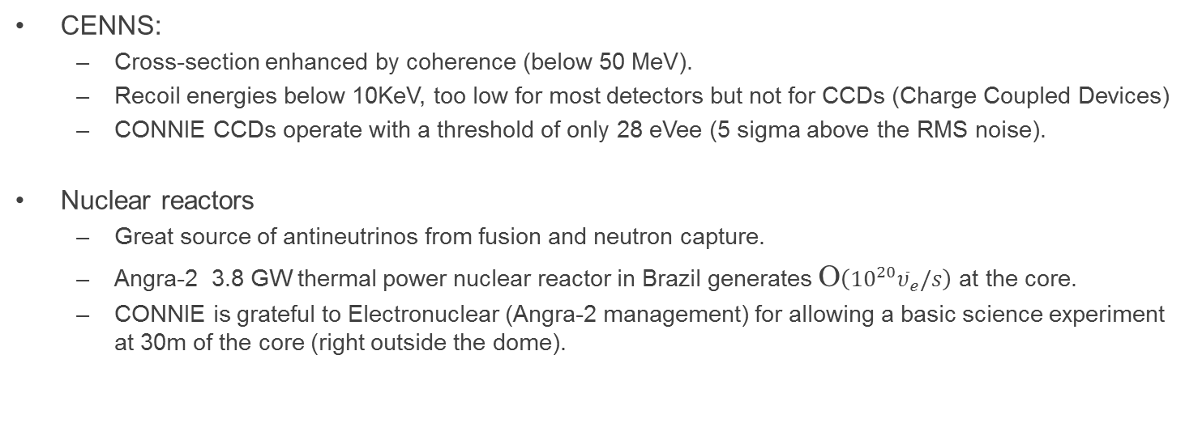
Nuclear reactor neutrino experiments CENNS
Standard model differential cross section
CENNS:
  Cross-section enhanced by coherence (below 50 MeV).
  Recoil energies below 10KeV, too low for most detectors but not for CCDs (Charge Coupled Devices)
  CONNIE CCDs operate with a threshold of only 28 eVee (5 sigma above the RMS noise).
Nuclear reactors
  Great source of antineutrinos from fusion and neutron capture.
  Angra-2 3.8 GW thermal power nuclear reactor in Brazil generates O$\left({10}^{20}{\overline{υ}}_{e}/s\right)$ at the core.
  CONNIE is grateful to Electronuclear (Angra-2 management) for allowing a basic science experiment at 30m of the core (right outside the dome).

Slide 4

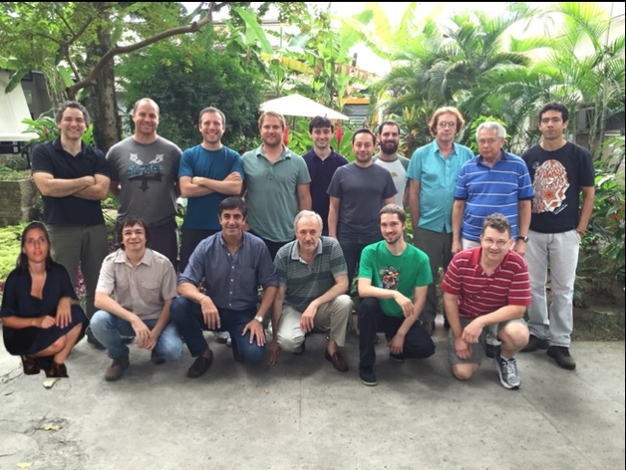
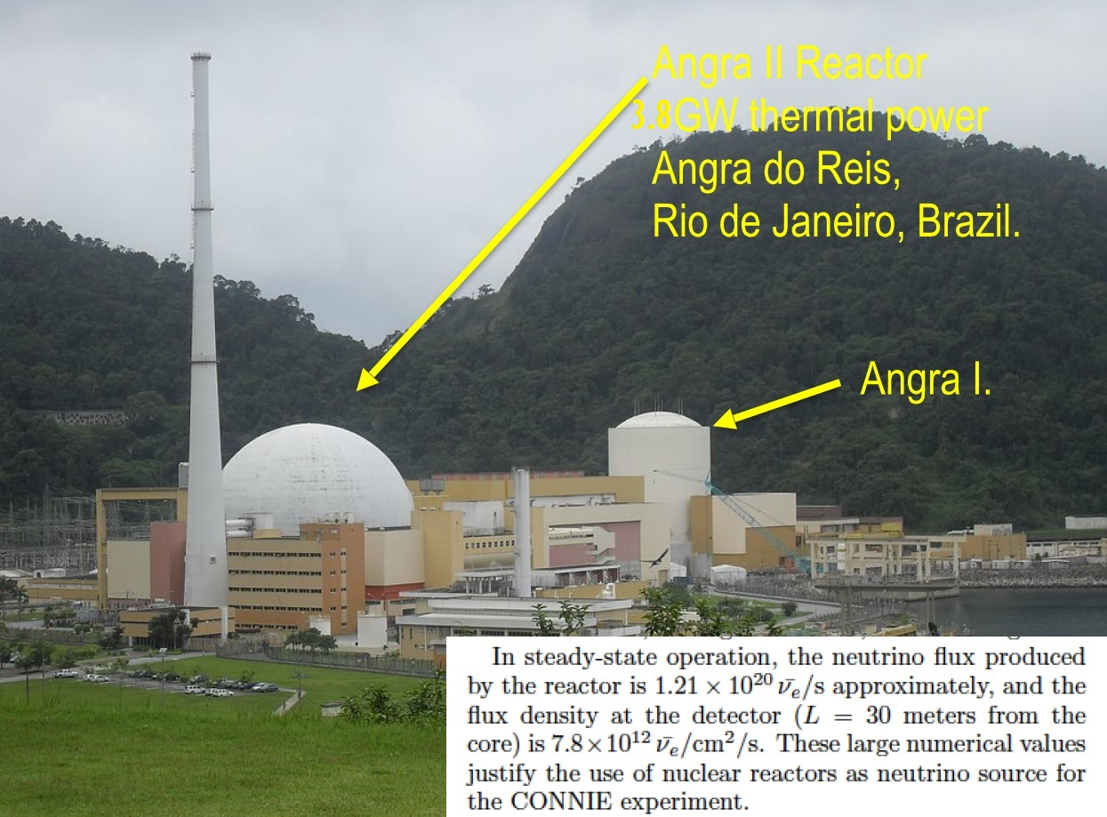
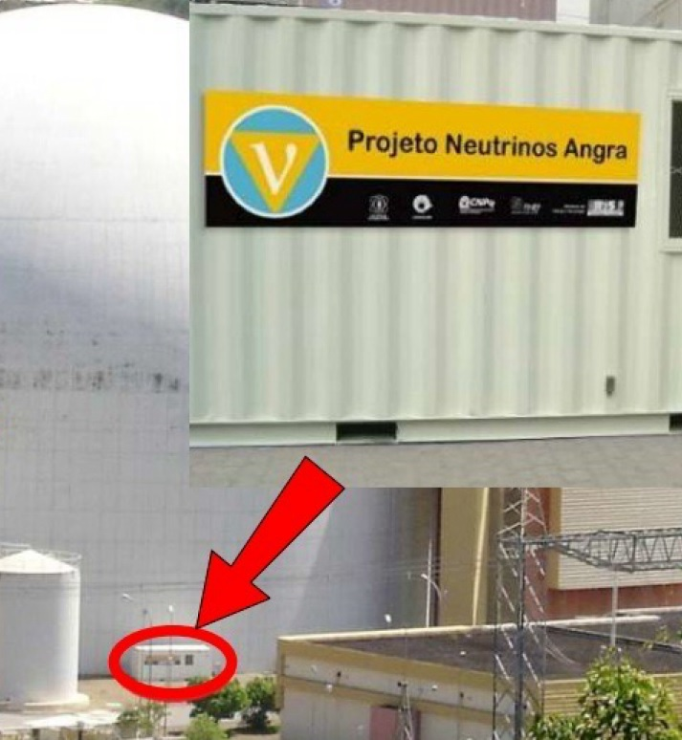
The CONNIE experiment
1st workshop Rio de Janeiro, 2015
Institutions:
  Universidad Nacional Autónoma de México, Ciudad de México, México
  Centro Atómico Bariloche - Instituto Balseiro, CNEA/CONICET, Argentina
  Universidade Federal do Rio de Janeiro, Instituto de Física, Rio de Janeiro, Brazil
  Fermi National Accelerator Laboratory, Batavia, IL, United States
  Facultad de Ingeniería - Universidad Nacional de Asunción, Paraguay
  Centro Brasileiro de Pesquisas Fisicas, Rio de Janeiro, Brazil
  Depto. de Ing. Electrica y de Computadores, Universidad Nacional del Sur, Bahia Blanca, Argentina
  Instituto de Investigaciones en Ing. Electrica ”Alfredo Desages”,CONICET - Universidad Nacional del Sur, Baíha Blanca, Argentina.
  Universität Zürich Physik Institut, Zurich, Switzerland
  Comisión de Investigaciones Cientíﬁcas Provincia Buenos Aires, La Plata, Argentina.
  Pontiﬁcia Universidade Católica, Rio de Janeiro, Brazil.
  University of Michigan, Ann Arbor, MI, U.S.A.

Slide 5
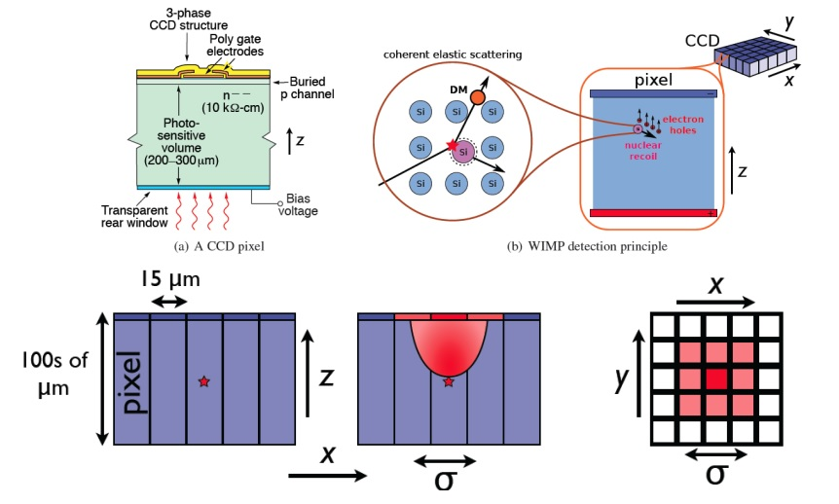
Thick CCD detector technology: 650um (250um used for the Eng. run)
Fully depleted 650 um thick detectors with a pixel size of 15um x 15um (LBNL S. Holland et al).
Dark current ~ 0.1e-/pix/day when operated at ~140K.
Energetic particles produce ionization e-h pairs that are captured by one or more pixels.
Since the electric field is in the z direction the e-h pairs are free to diffuse in x and y.
The charge diffusion is proportional to the depth of the generation point.

Slide 6
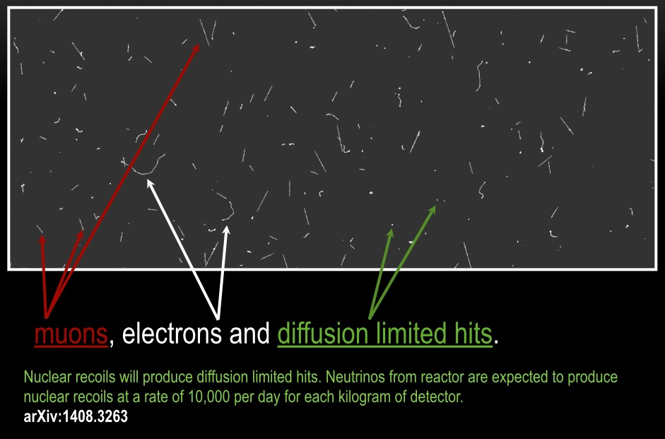
Thick CCD images: 2D image plus 3rd dimension given by diffusion

Slide 7
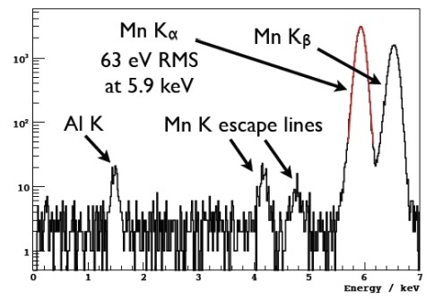
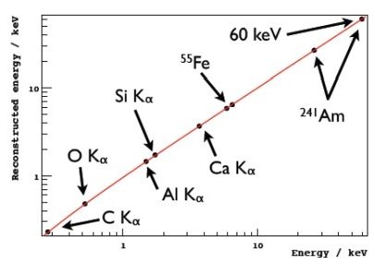
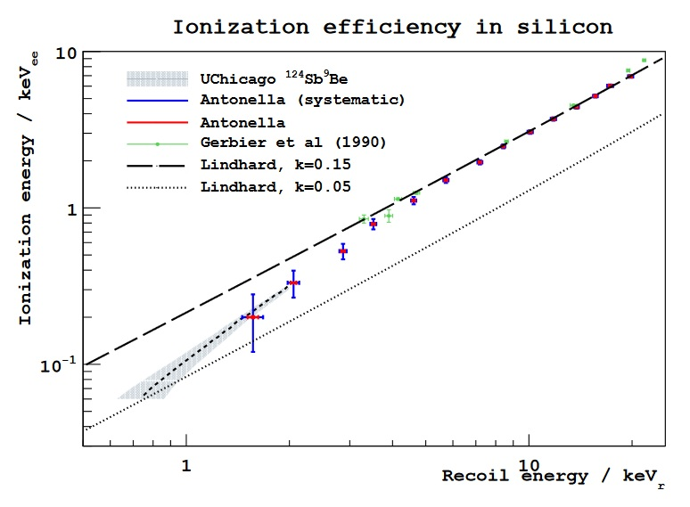
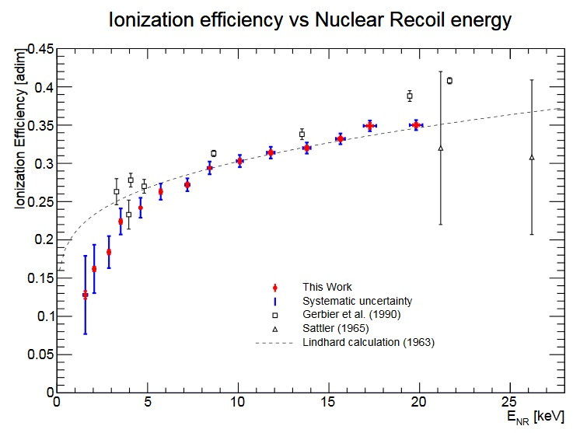
Calibration
Linearity response measured with x-rays and verified by simulations
Ionization efficiency uses results from recent experiments (to be published) and Lindhard.
CONNIE silicon detectors are calibrated in the operation region.
arXiv:1608.00957

Slide 8
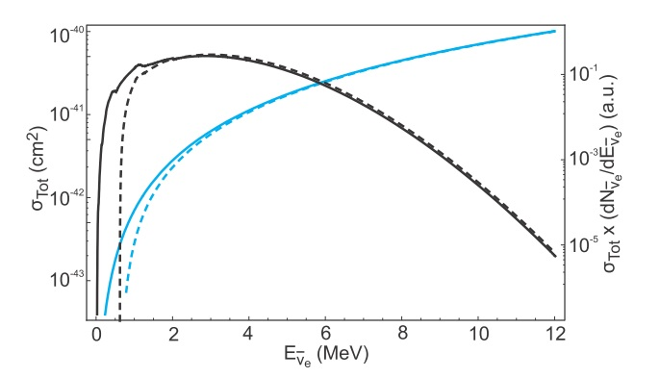
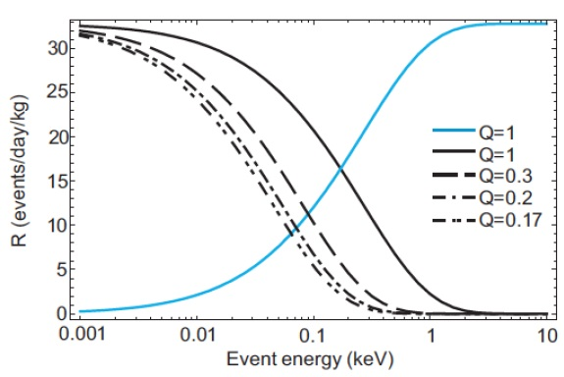
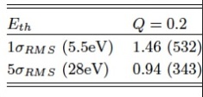
Expected event rate (arXiv:1405.5761)
CONNIE cross section (light blue)
CONNIE cross section convolved with the reactor spectrum
About 1 event/day for a 52 gram of fiducial mass.
This engineering run was 1 gram (4g total mass).
CONNIE has been upgraded in July 2016 to a total mass of 80 grams.

Slide 9
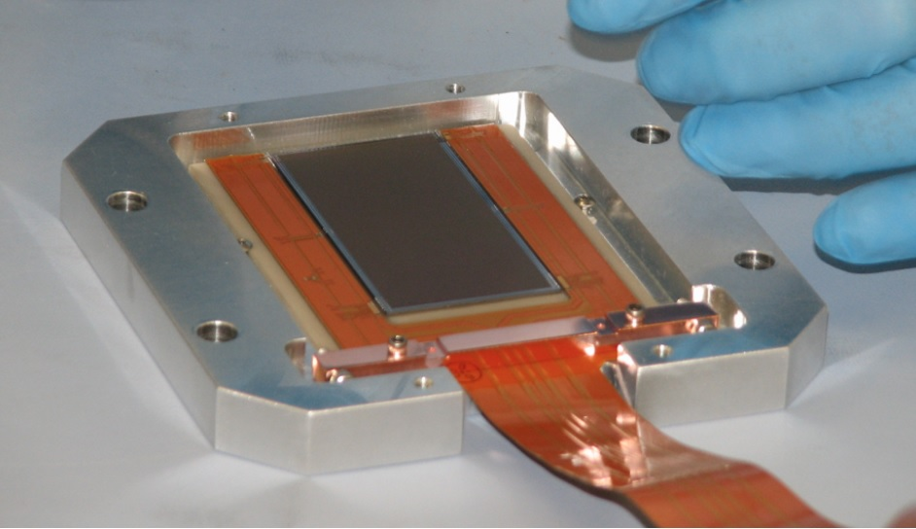
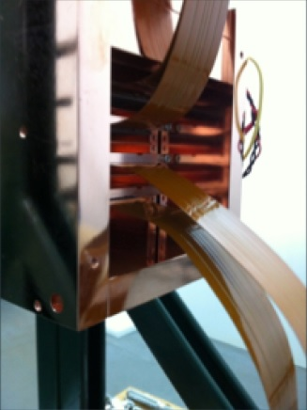
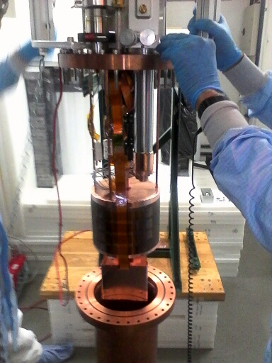
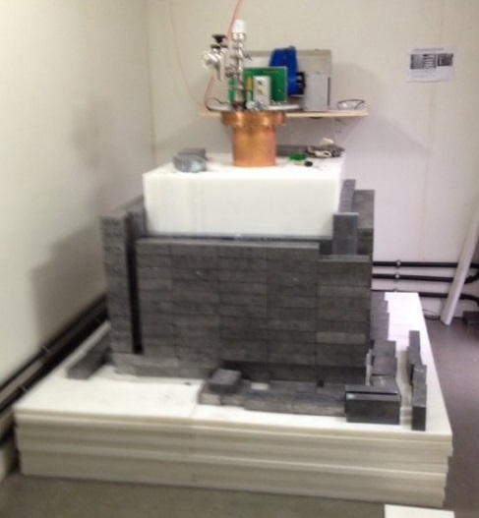
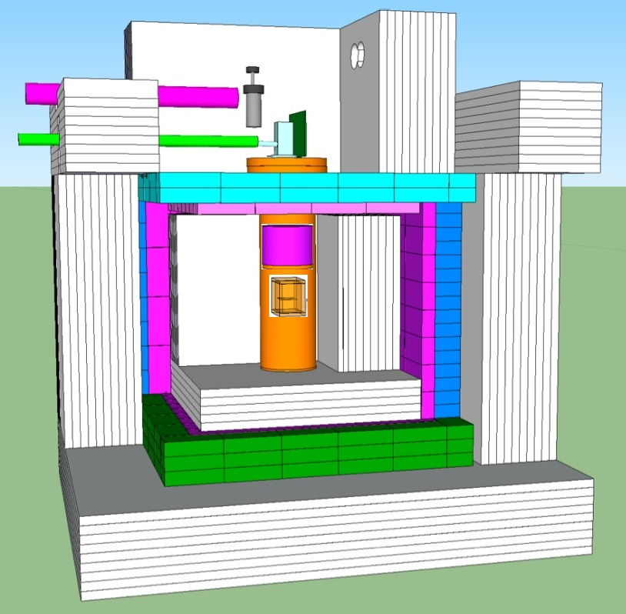
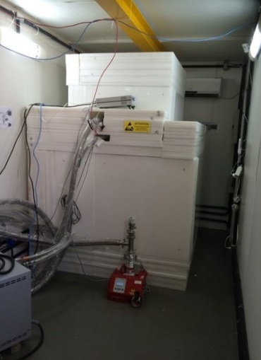
CONNIE Engineering run (2 CCDs of size 2K pix x 4K pix)
CCD Detector
CCD Detectors in copper box

Slide 10
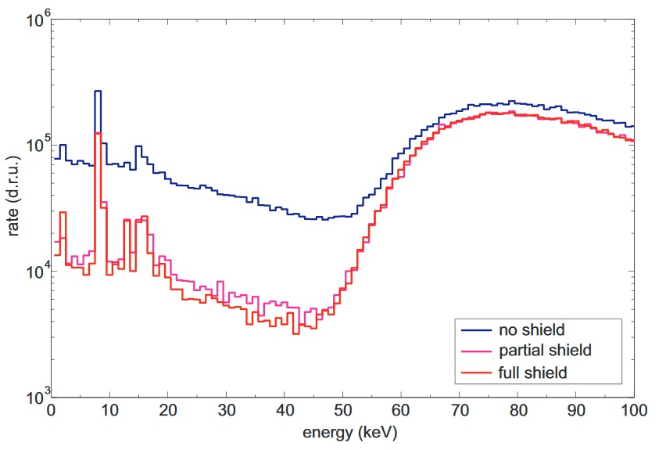
Background
A passive shield made of an inner layer of polyethylene, a mid layer of lead and an outer layer of polyethylene shows an order of magnitude reduction in the background rate.
The background is stable vs. time

Slide 11
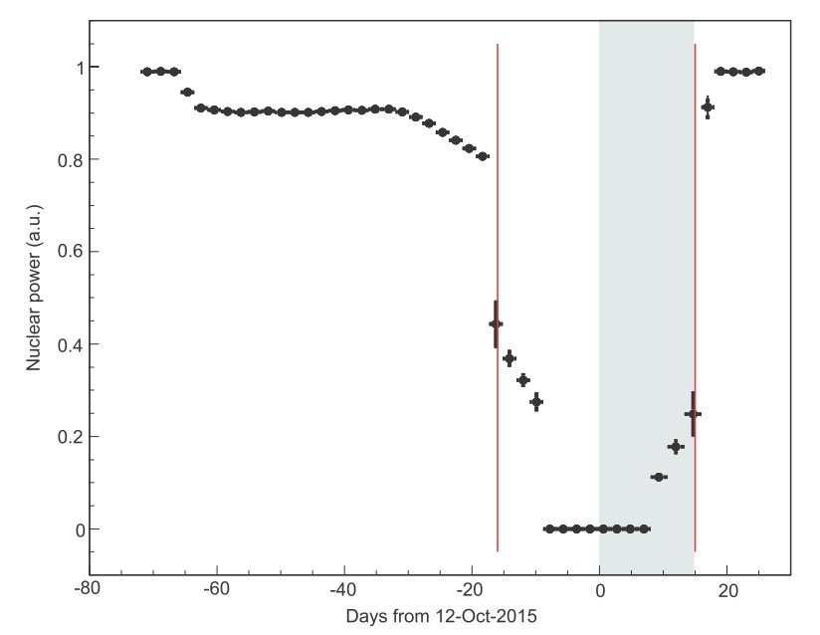
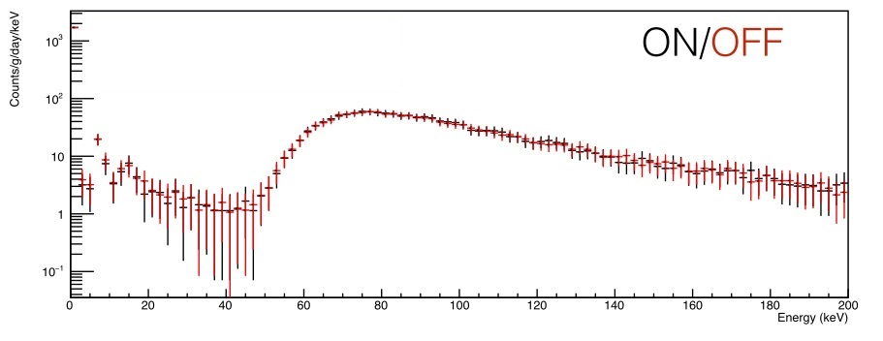
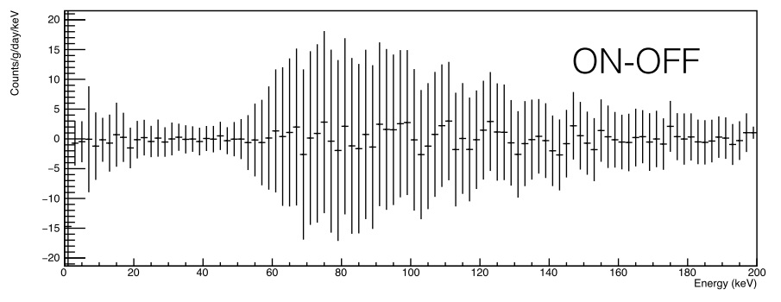
Eng. run: ~10 days reactor ON/OFF comparison, 1g detector
Reactor ON
Reactor OFF
Only 10 days of reactor shutdown used for in the analysis. The rest of the shutdown data was not used due to an increase of the CCD noise caused by noise increase in the AC lines of the power plant.
The power plant shutdown added hundreds of people working and using the same AC power lines that CONNIE uses.
The problem has been remedied but we lost 2 weeks of shutdown data.

Slide 12
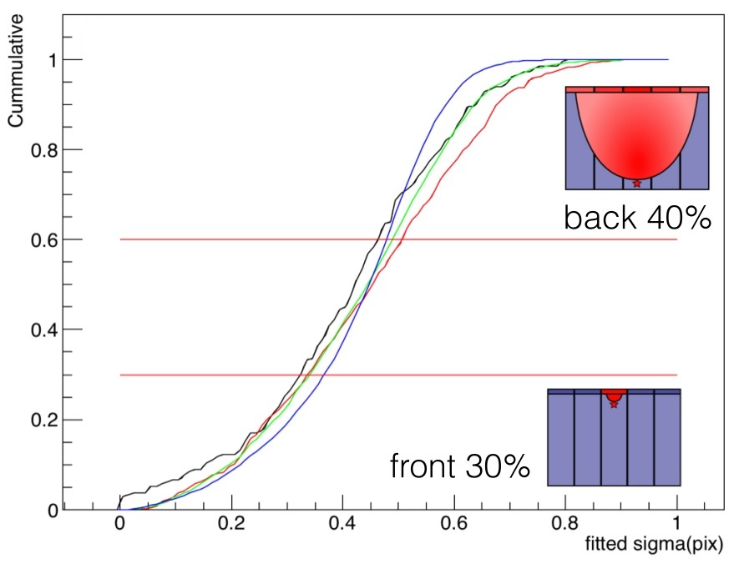
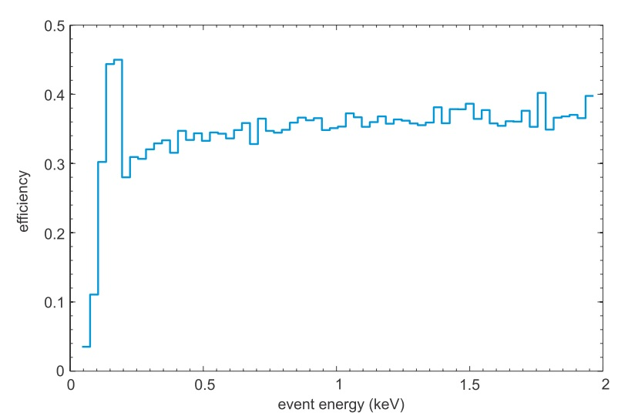
Hit size used to select events in core of the CCD to remove low energy X-rays
Diffusion based cuts for several energy bins (black, red, green, blue)
Detector efficiency after cuts
Work in progress: Future signal processing and estimation methods could improve the efficiency.

Slide 13
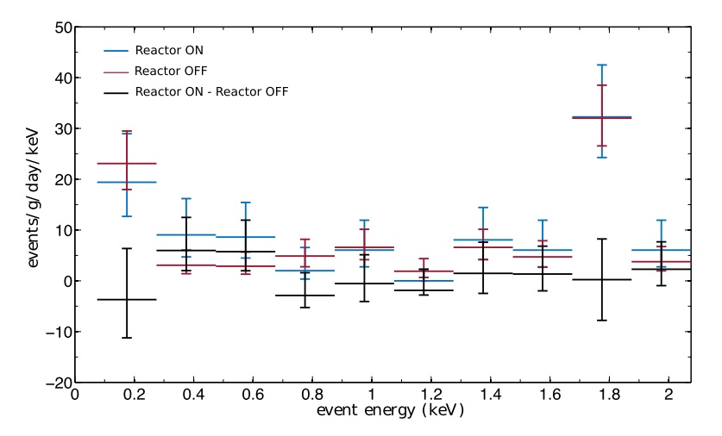
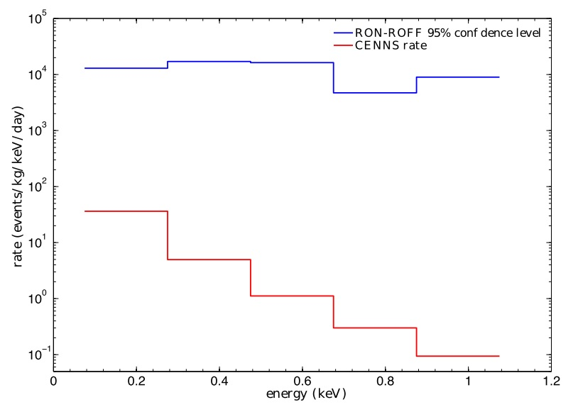
Eng. Run reactor ON/OFF result (2016 JINST 11 P07024)
Detector efficiency after cuts
Si fluorescence peak
No excess is observed coming from nuclear ﬁssion at the power plant. The
upper limit for the neutrino event rate is set two orders of magnitude above the expectations for
the standard model.

Slide 14
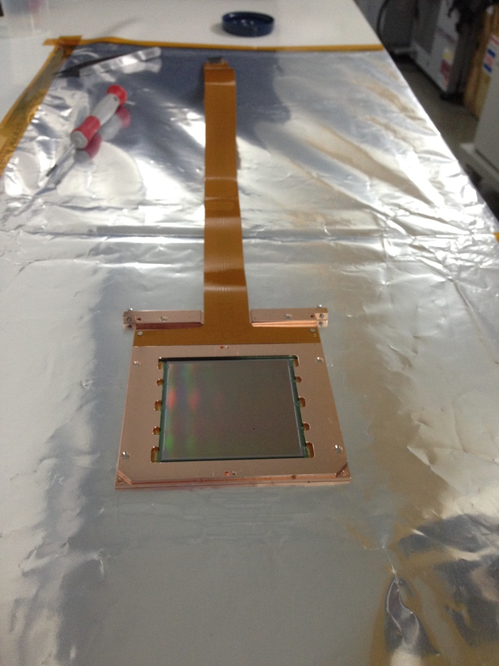
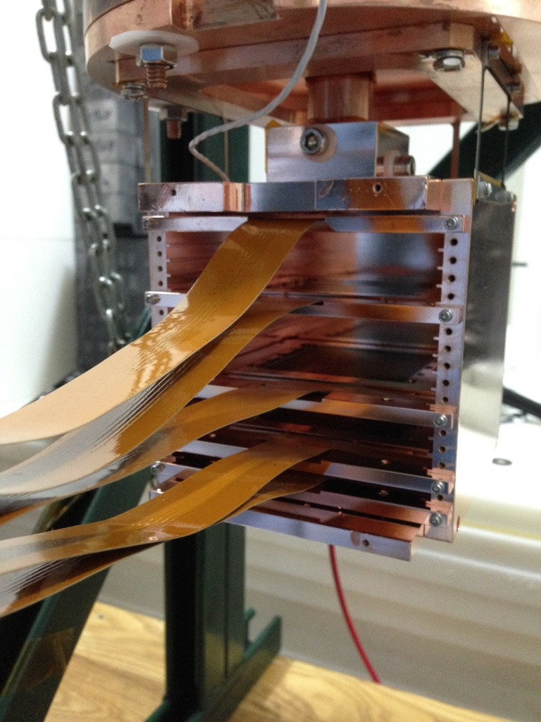
CONNIE100: Upgrade to 80 gr of mass July 2016
The detector was upgraded to 14 CCDs of 4Kx4K pixels each.
Each CCD has a mass of 5.75g for a total of 80.5 grams.
  This is 80 times more mass than the engineering run.
4Kx4K pixel CCD on Si substrate and copper frame. Wire-bonded to flex circuit
5 CCDs installed in the copper during a test previous to the installation of the 14 science grade CCDs

Slide 15
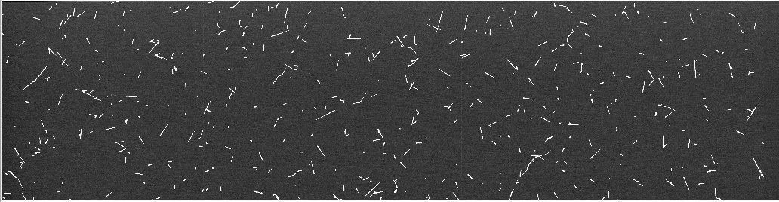
CONNIE100: Upgrade to 80 gr of mass July 2016
All CCDs are working with an average noise below 2e- and RMS of 0.06e- of noise channel spread.
Currently running optimizations for dark current, and noise (very close to goals).
Measuring background.
Although we are still optimizing detector operation parameters, in only a week we have collected an order of magnitude more data than during the engineering run.
Next Power plant shutdown planned for November 2016.
We are looking forward to a very successful science run.
CCD image (segment) taken on July 26, 2016. Image look great.

