Slide 1


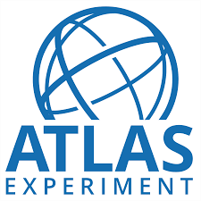
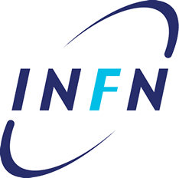
The CEVALE2VE case
outreach and diversity
Arturo Sánchez, on behalf the CEVALE2VE team
University of Naples and INFN
ICHEP, August 6th, 2016

Slide 2
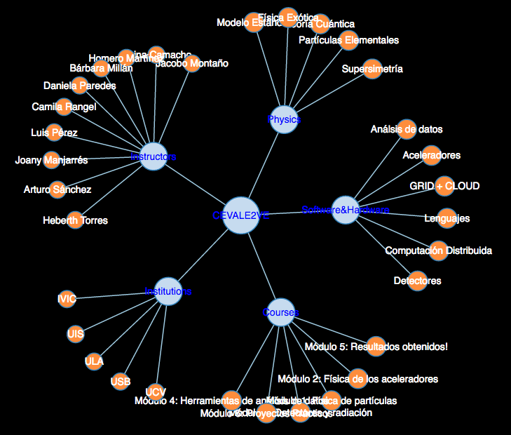
cevale2ve
‹#›
Outline
The Organization
  Vision and Objectives
  Members
  Institutions
Education
  Postgraduate Course
  Students supervision
Outreach
  Tools
  Public Lectures & Diplomacy
  Masterclasses & ATLAS Virtual Visits
Summary
“Centro Virtual de Altos Estudios en Altas Energías” or “Virtual Centre of Studies on High Energy Physics of Venezuela”

Slide 3
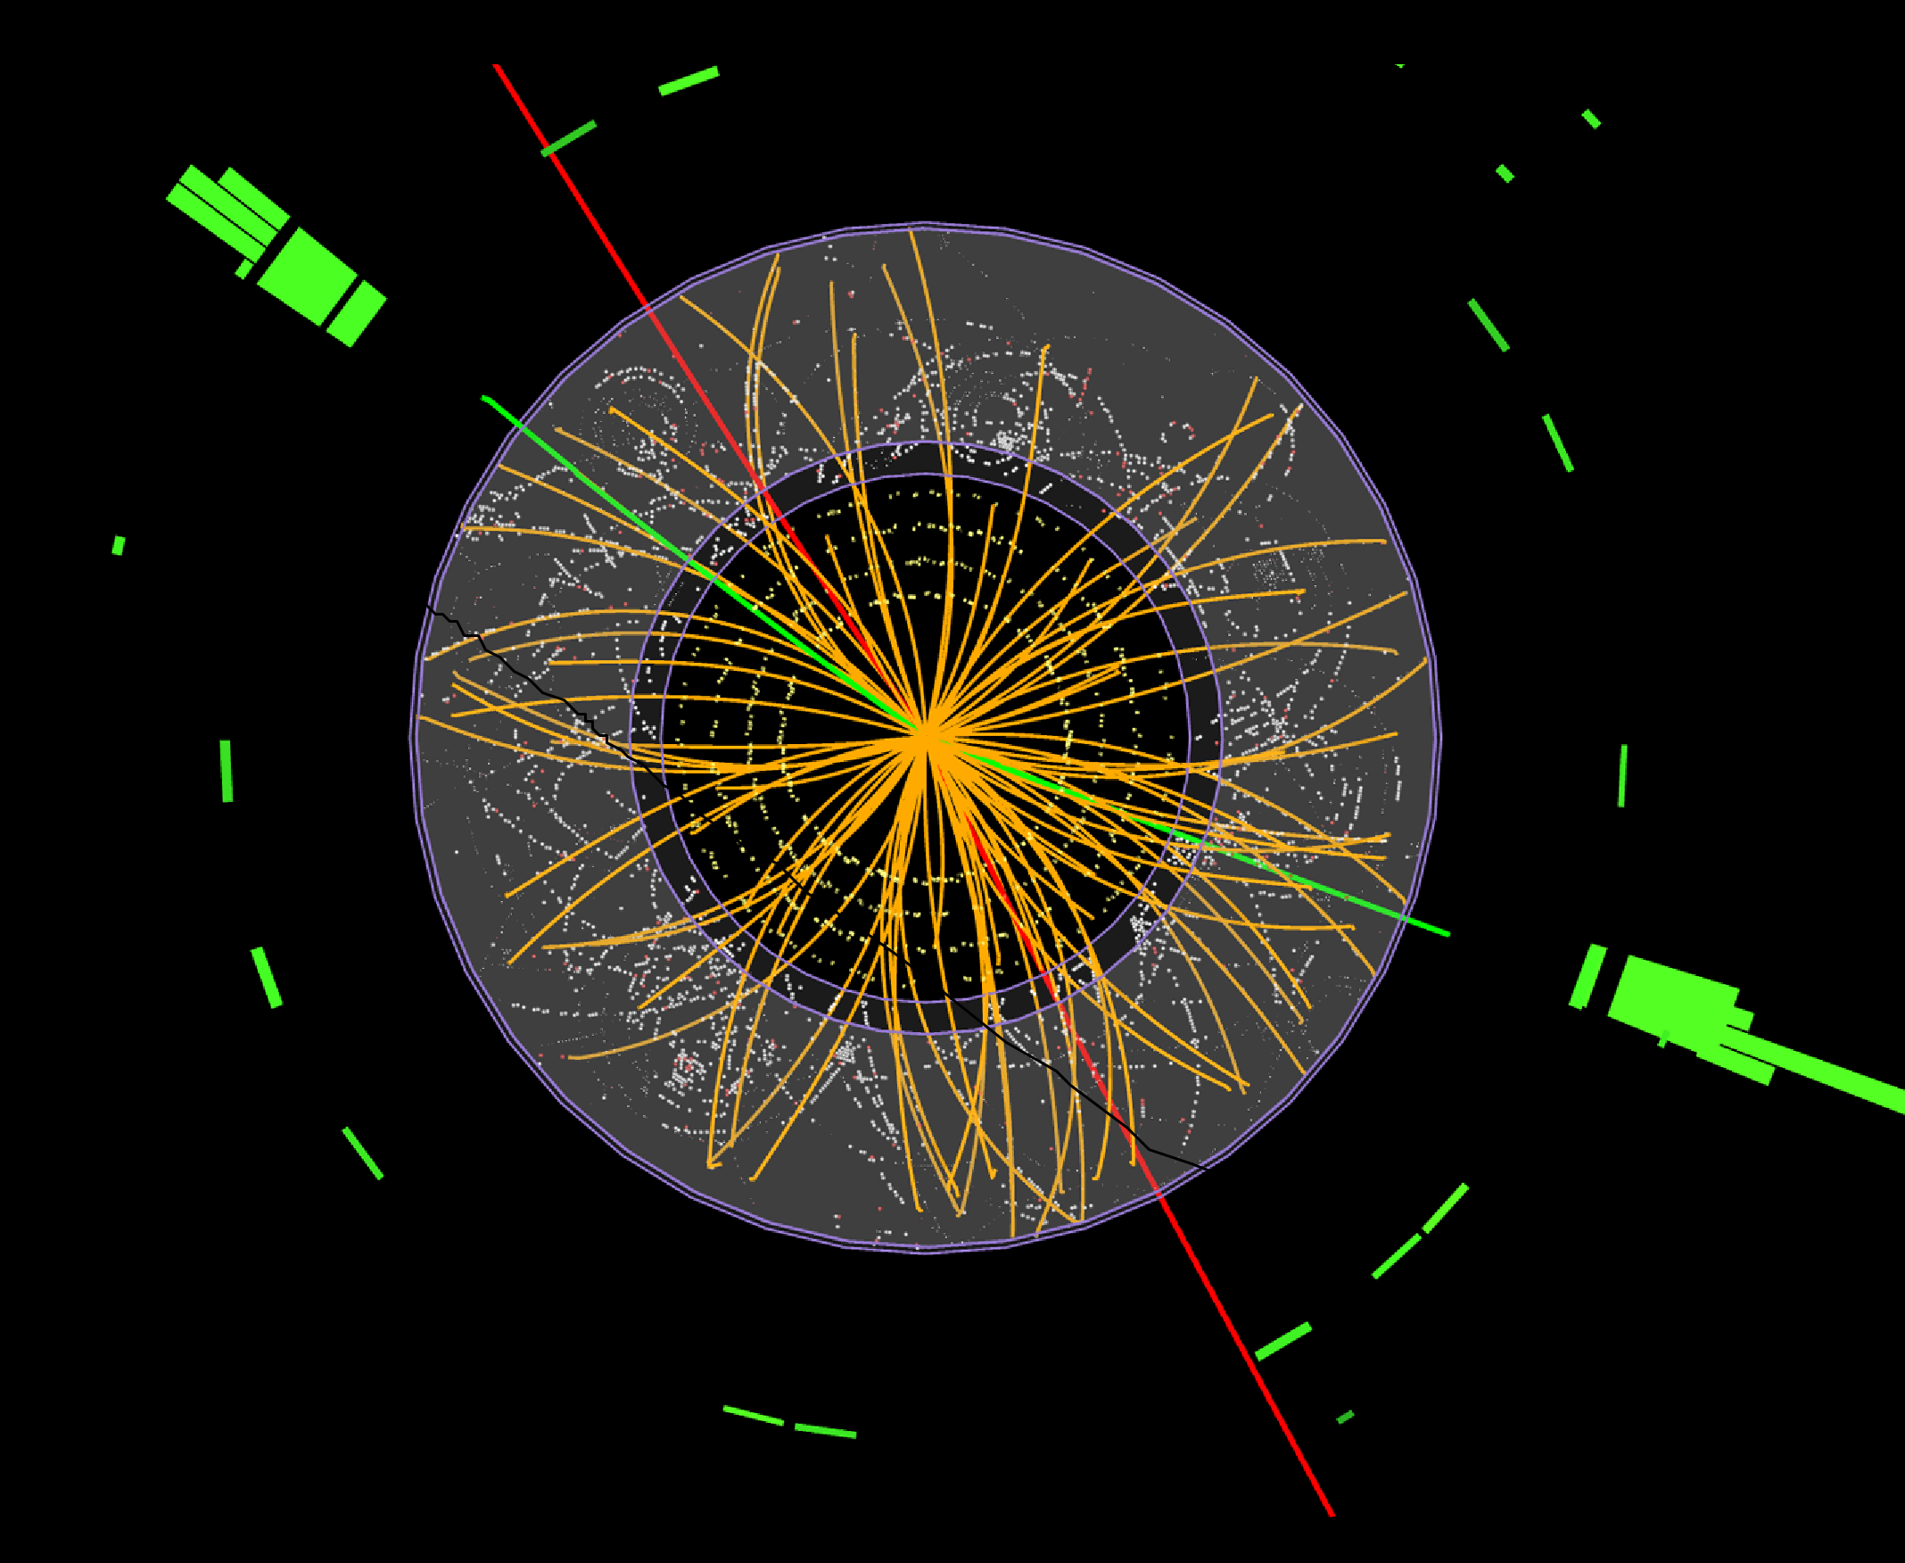
cevale2ve.org
‹#›
The Organization

Slide 4
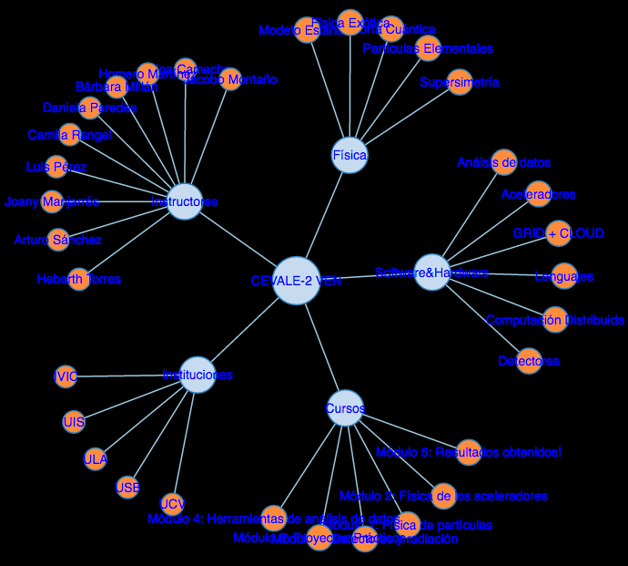
‹#›
Virtual research and learning community
Created with the goal of promoting the scientific dissemination, education and research in the field of high energy physics (HEP) in the venezuelan and latin american scientific community.
1.1 Vision and Objectives
Education and interest in research: positively influence and stimulate physics student's interest in HEP research
Awareness of opportunities: educate and invigorate the students with further study opportunities in physics and possible career paths in research
Create networks: in both directions!
Modernization of the education and training: through the use of e-learning tools
Policy making: working towards formalizing the involvement of Venezuela institutions in HEP experiments

Slide 5
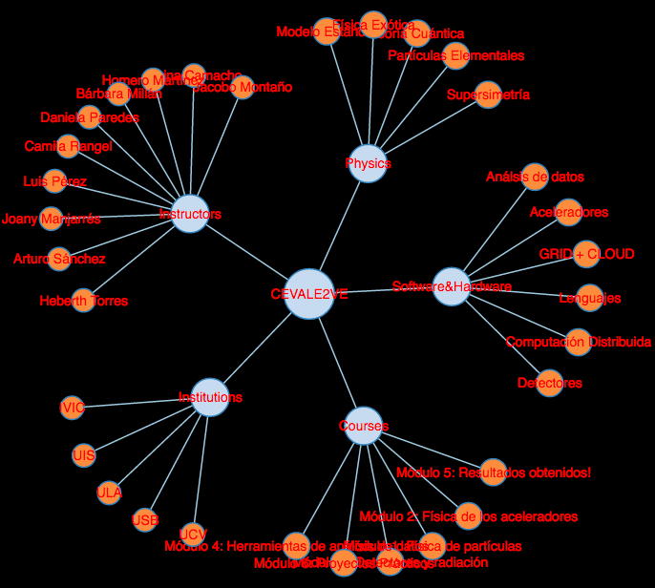
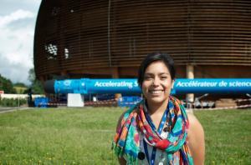
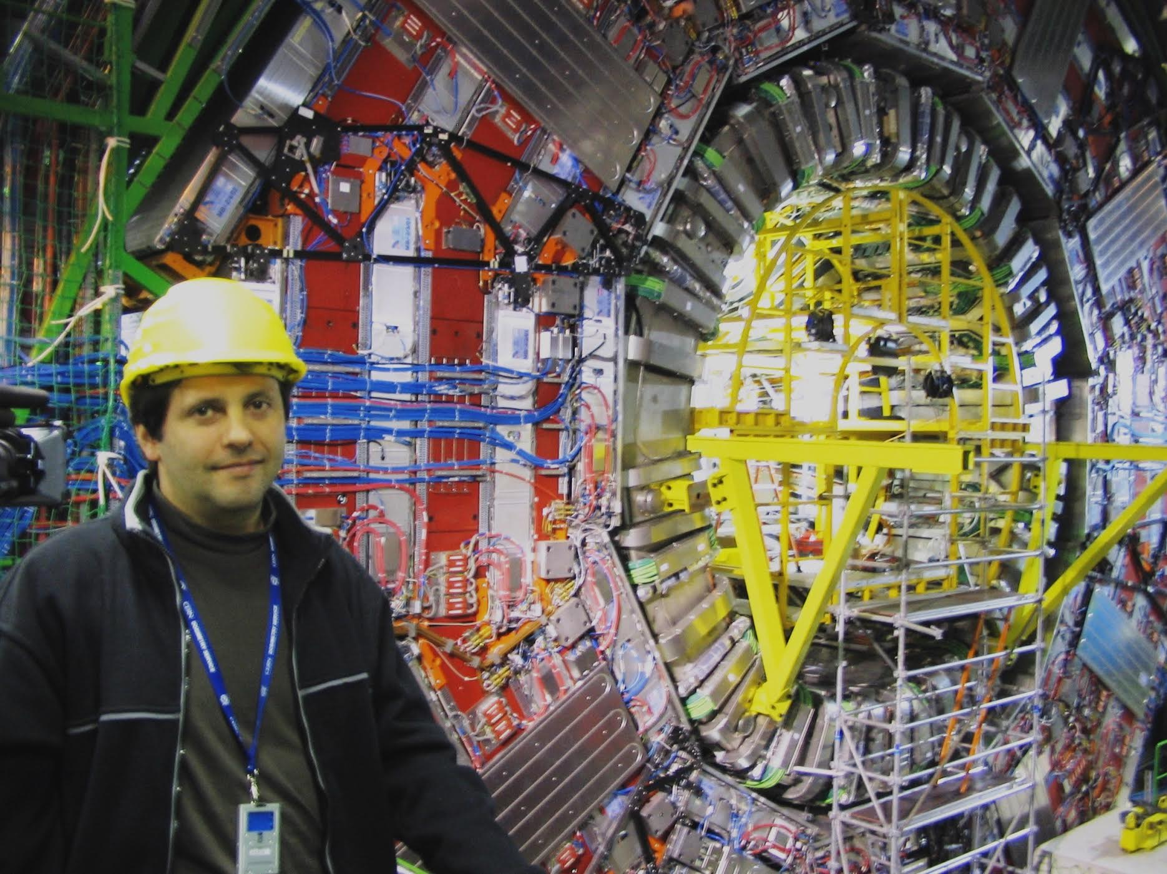
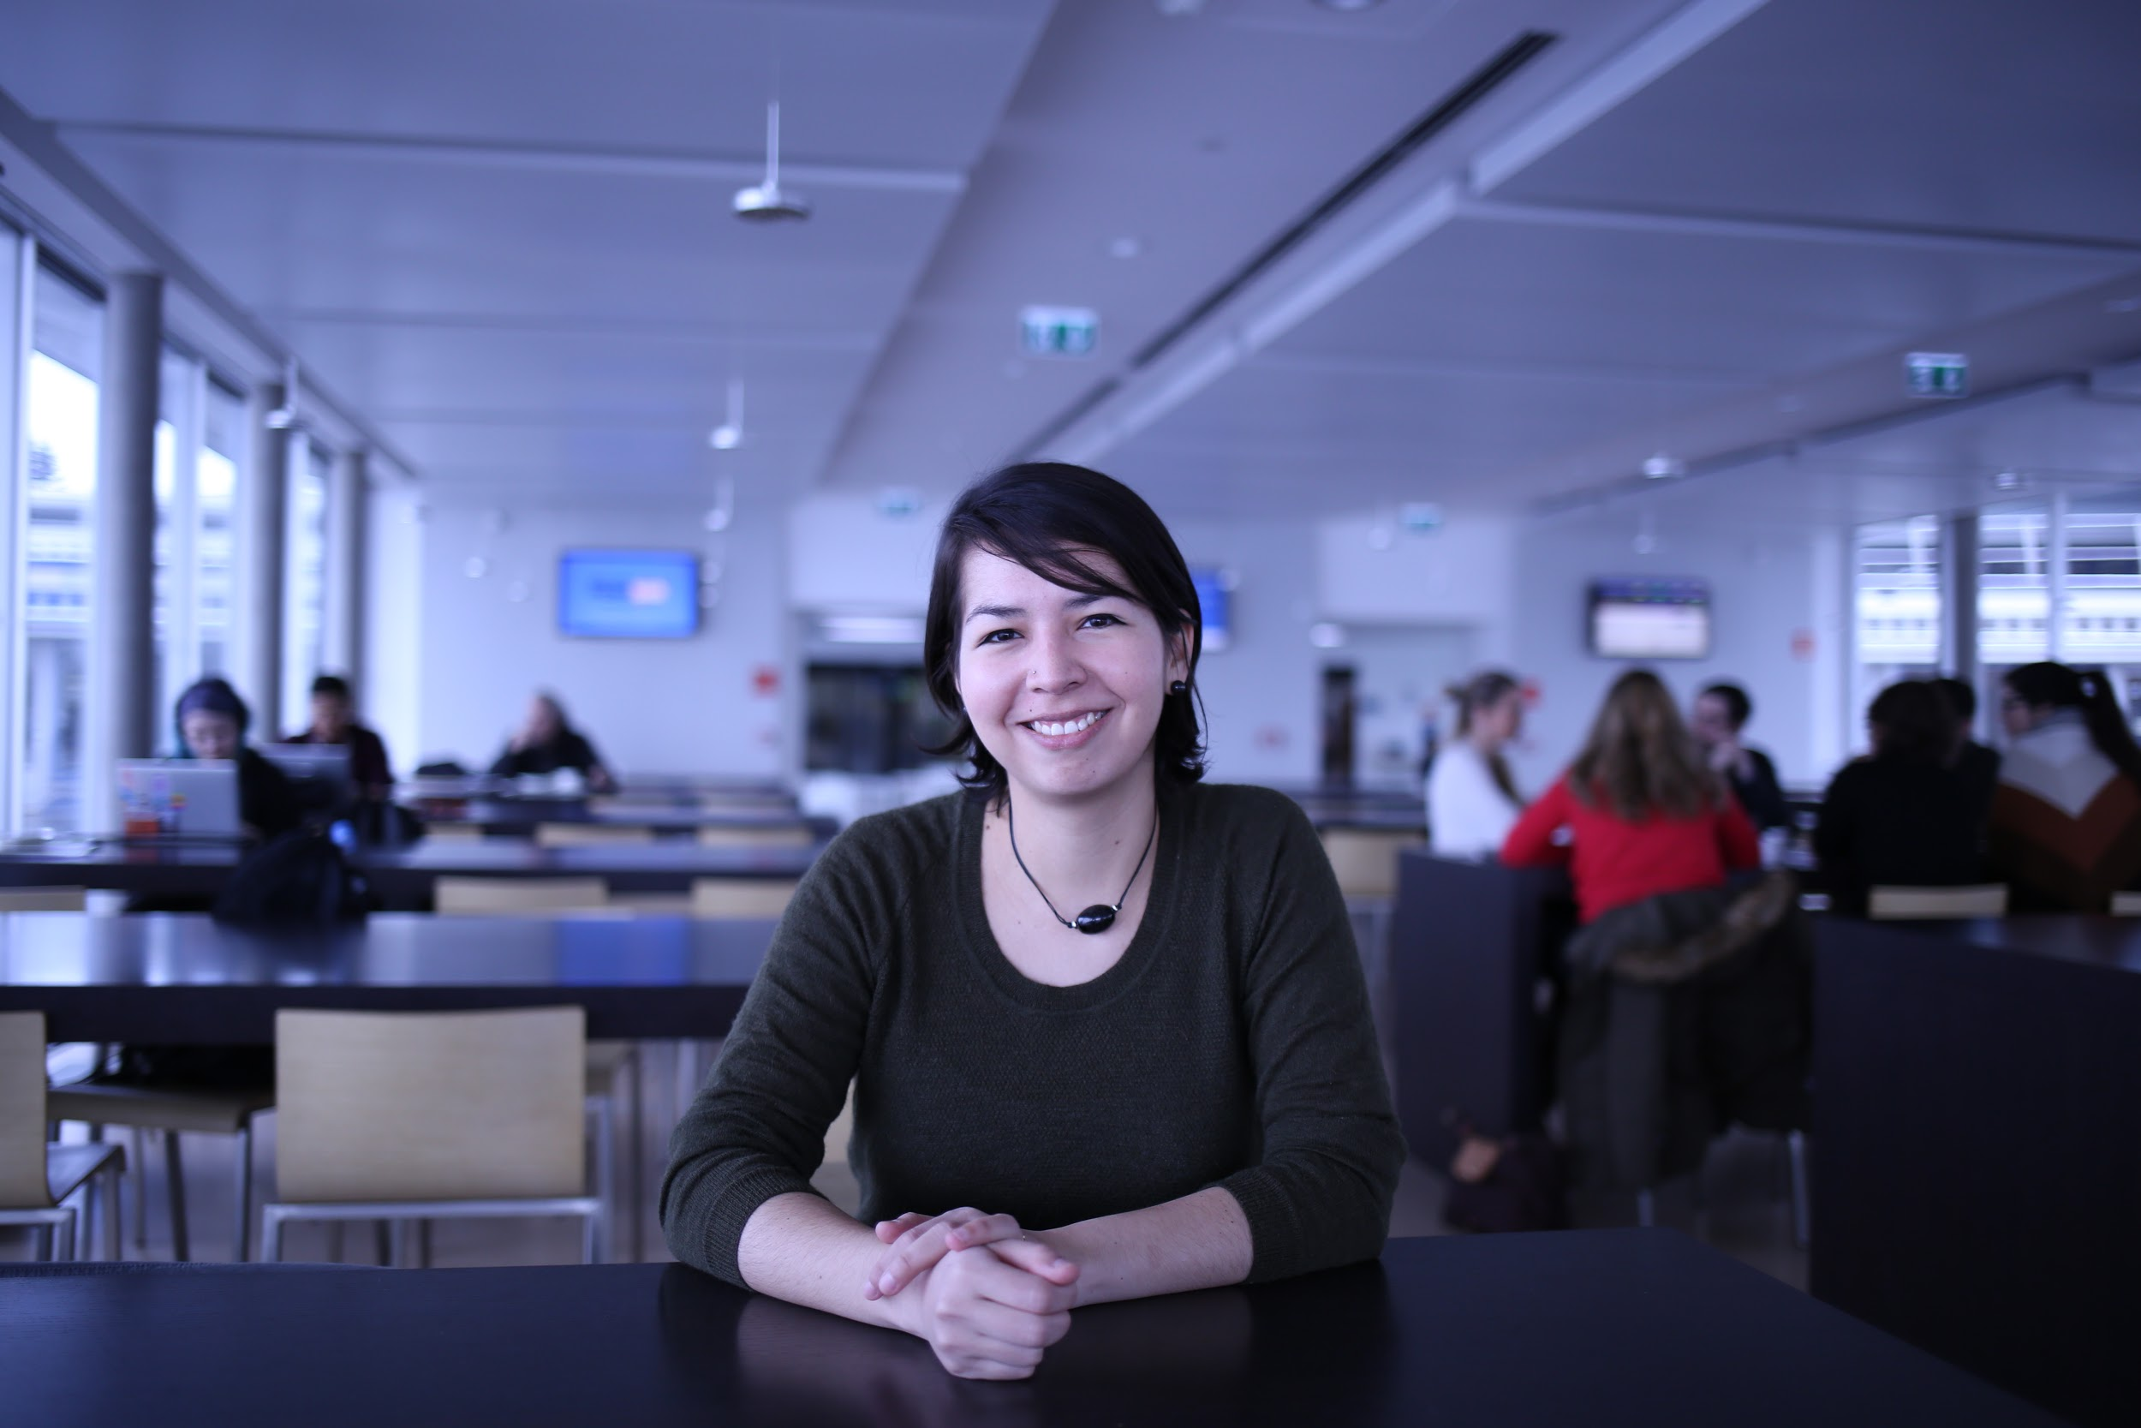
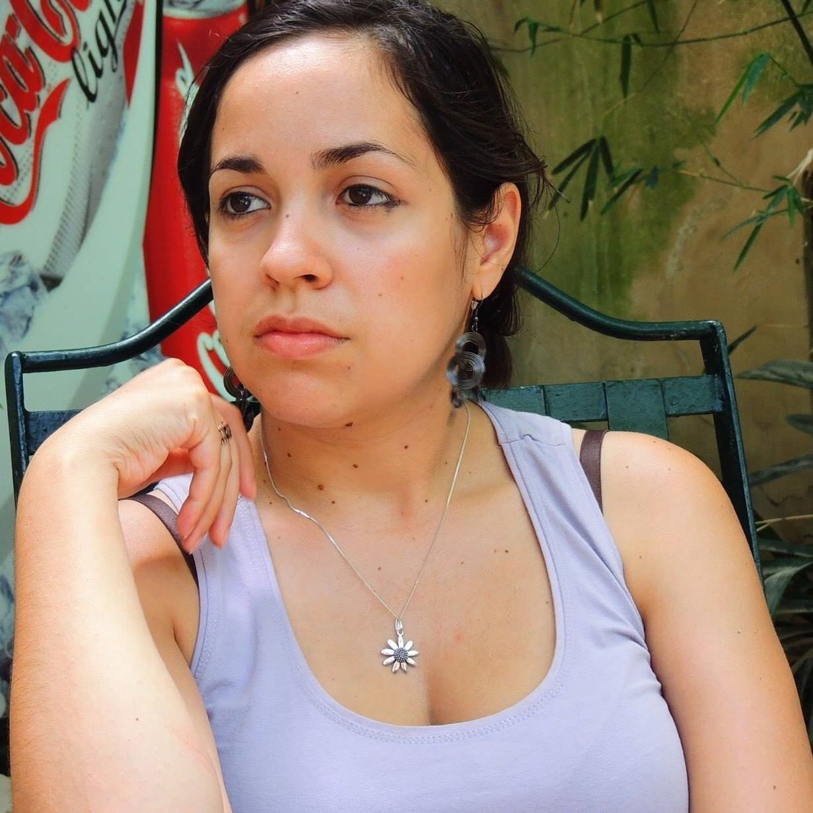
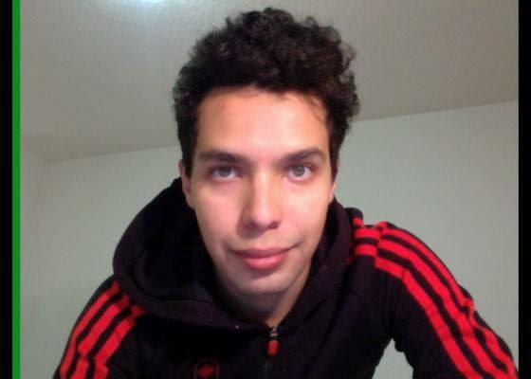
‹#›
1.2 Members
The community involves venezuelan researchers working in international collaborations: HEP experiments detector developments and computing science, developing an academic environment suitable for the steering of the new generations of physicists in Venezuela and other countries of the region.
We are 11 Venezuelan working for European and North American universities linked to CERN and other HEP institutions

Slide 6
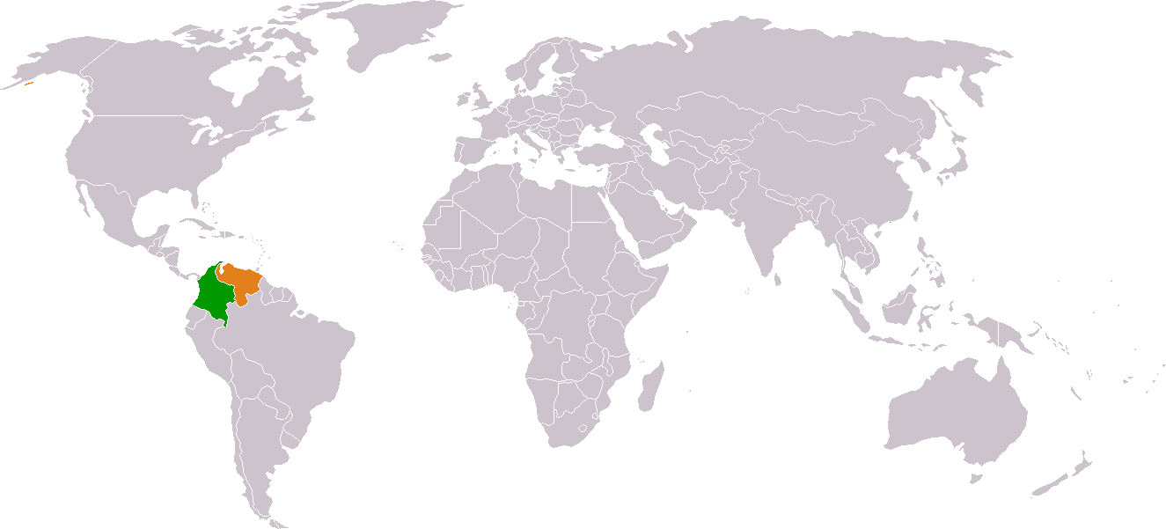



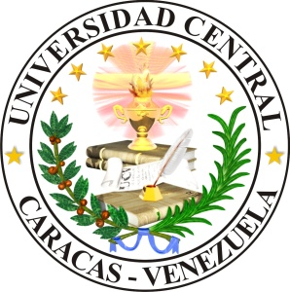

‹#›
1.3 Institutions
The Institutions
continue
participating
And we all always looking new ways to call the attention of students and professors to be part of the project!

Slide 7
cevale2ve.org
‹#›
2. Education

Slide 8
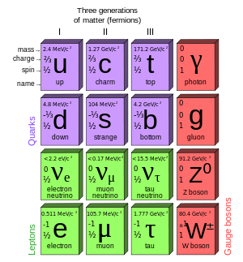
‹#›
2.1 Postgraduate Course I
We developed a course for university students in physics.
The ideal audience is master and PhD students from the latin american countries.
The classes are in spanish but the written materials are -yet- in english
The classes were possible using Google hangout and transmitted and recorded in YouTube.
The program contains subjects that go from the Standard model, to accelerator and detector technology, data analysis under ROOT and statistics.
The program in Modules:
Introduction to Standard Model (SM) and physics Beyond the SM
Accelerator principles
Particle detector principles
Introduction to statistics
Data analysis and computer Tools based in ROOT
A serie of seminars by invited speakers working in relevant areas of physics
The course has a total duration of 60 hours.
We, the instructors are Europe, so the class starts at 21hrs and for the students is 14hrs and 15hrs depending of the country :)

Slide 9
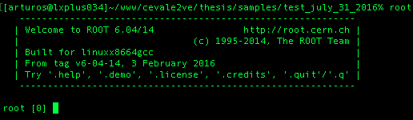
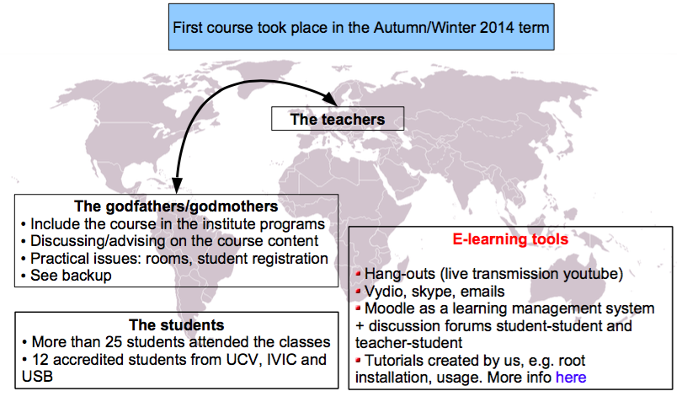
‹#›
2.1 Postgraduate Course II
First Post-graduate course completely online
During the second half of 2014 took place the first course “Introduction to Particle Physics” for master's and doctoral students.
With 3 venezuelan institutions!
ROOT
here
Notes:
Subjects of the course

Slide 10
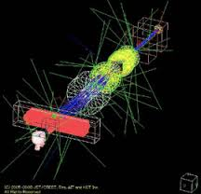
‹#›
2.1 Postgraduate Course III
Second Post-graduate course completely online
Just a week ago we close the second edition of the course “Introduction to Particle Physics” for master's and doctoral students.
This time with 4 Colombo-Venezuelan institutions!
Second course took place the Spring/Summer 2016
Updated 2016!
The Students
More that 30 students attended the classes
10 accredited students from UCV, USB and UIS
ROOT
here

Slide 11
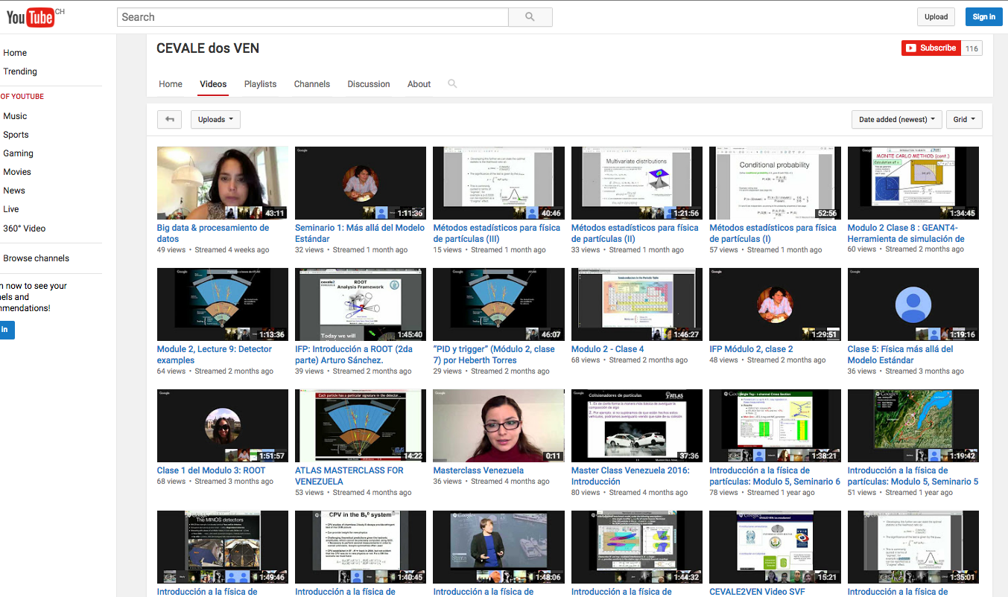
‹#›
...producing >70 hours of online audio-visual content and ~9K view of our videos... (dozens of comments in the tutorials!)
https://www.youtube.com/channel/UCQFMVmz9Yd48XyHXx6lsTjw

Slide 12
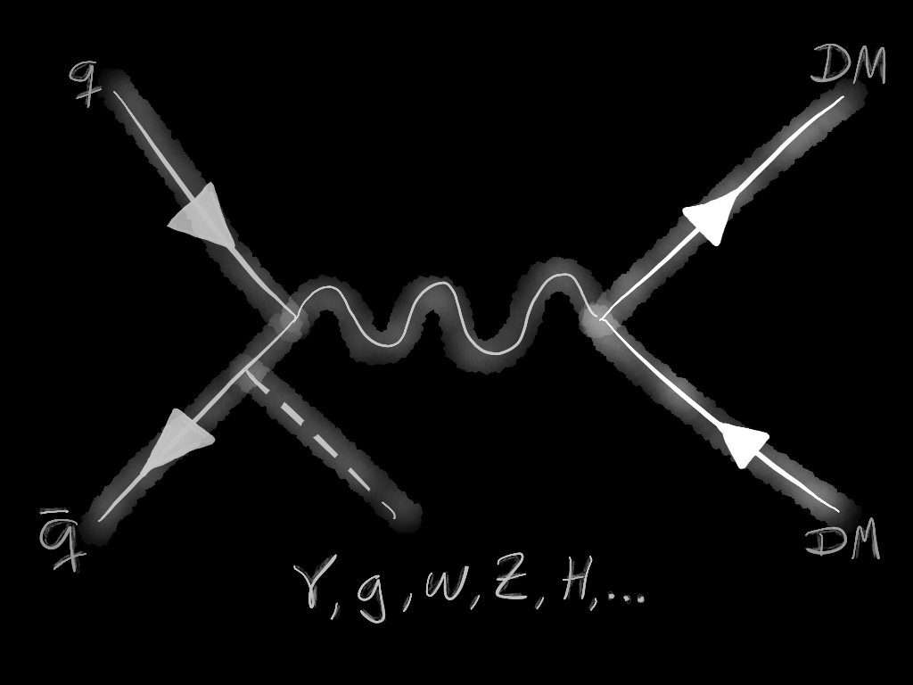


‹#›
2.2 Students Supervisions
In Physics:
We have a Master student in physics developing a thesis in the evaluation of a Dark Matter model production in association with heavy quarks in colliders like the LHC.
She was part of our first session of the course in 2014-2015 and is currently enrolled in the UCV in Venezuela.
This project is itself a test-field for newer technologies and tools in e-learning and data analysis!
The plan is to finalize at the end of 2016.
In Languages:
This have been another beautiful example of the interdisciplinarity that can be involved.
A university student in Languages was part of our group helping in the translation of all the classes of the first course into spanish.
The idea of this project is to have a dual spanish-english set of classes and slides that allow us to expand the impact of the classes to other students.
She just got her bachelor's degree few weeks ago at ULA in Venezuela!

Slide 13
cevale2ve.org
‹#›
3. Outreach

Slide 14
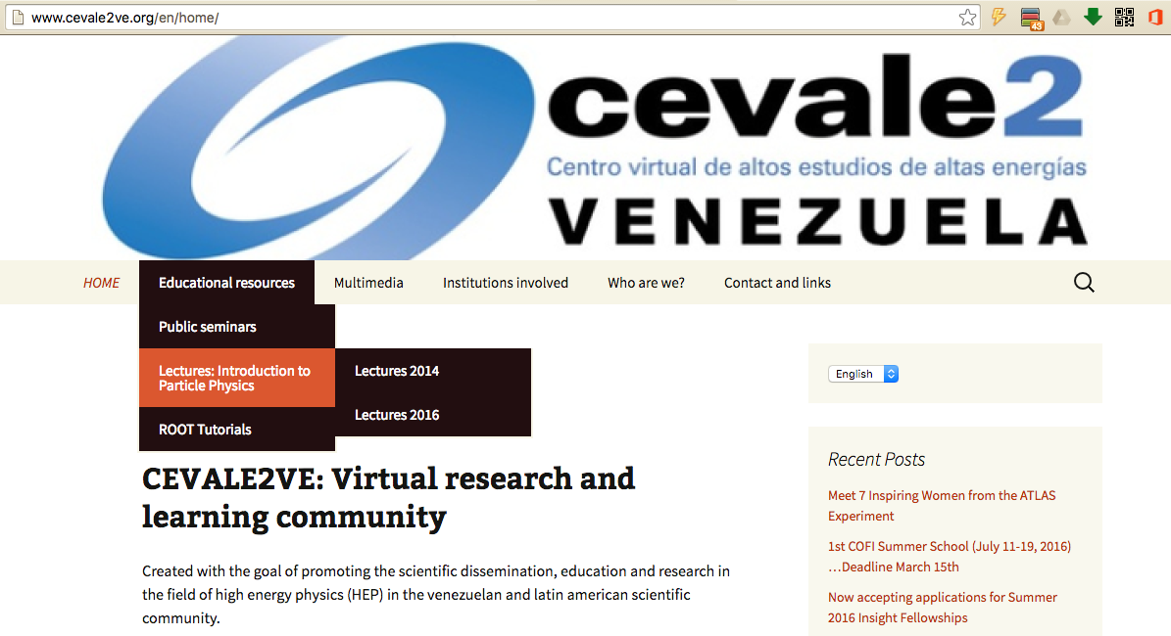
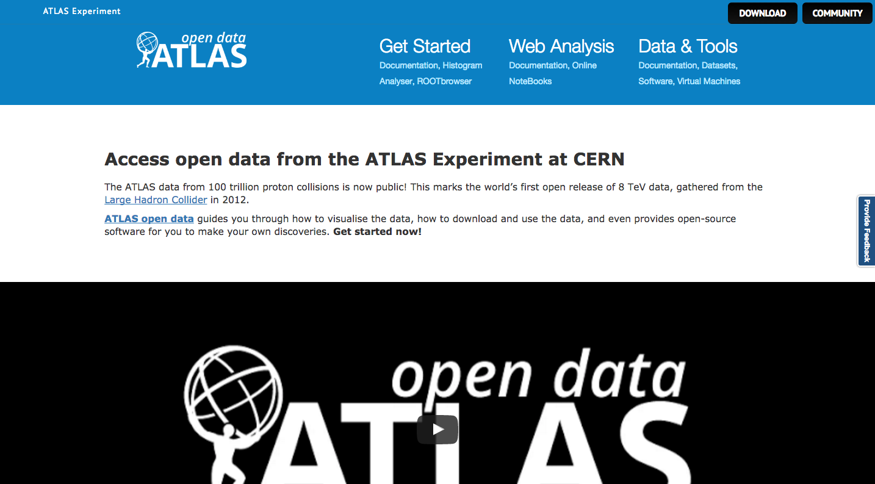




‹#›
3.1 Tools
The recent release of the ATLAS Open Data portal is one of the examples of the constant feedback between the two!
...As part of HEP collaborations, many of the tools that we use to teach are in synchrony with those used in other outreach projects
(like the CERN OpenData)
Tools like the software or the techniques. As well in the communication and organizational part
ATLAS Outreach
Data & Tools
CEVALE2VE Outreach Group: Several ATLAS and not ATLAS physics institutions/members
link

Slide 15
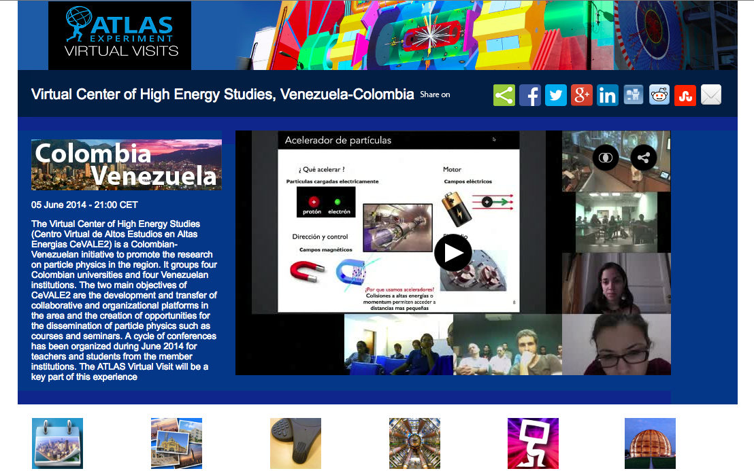
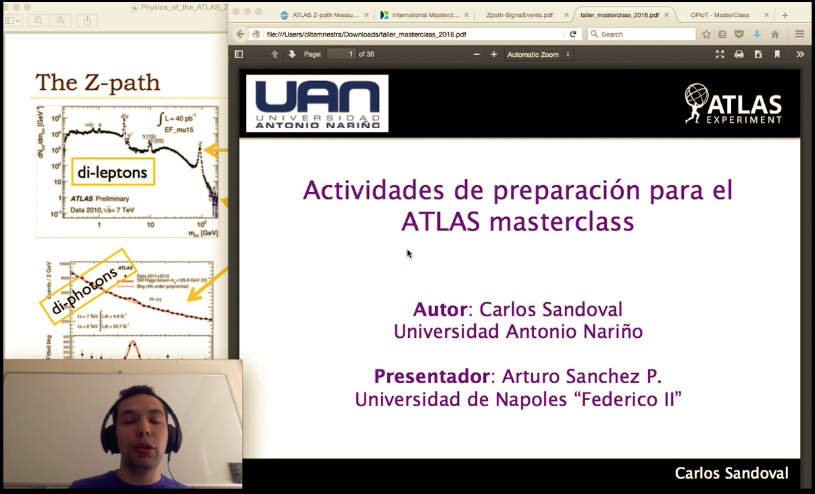
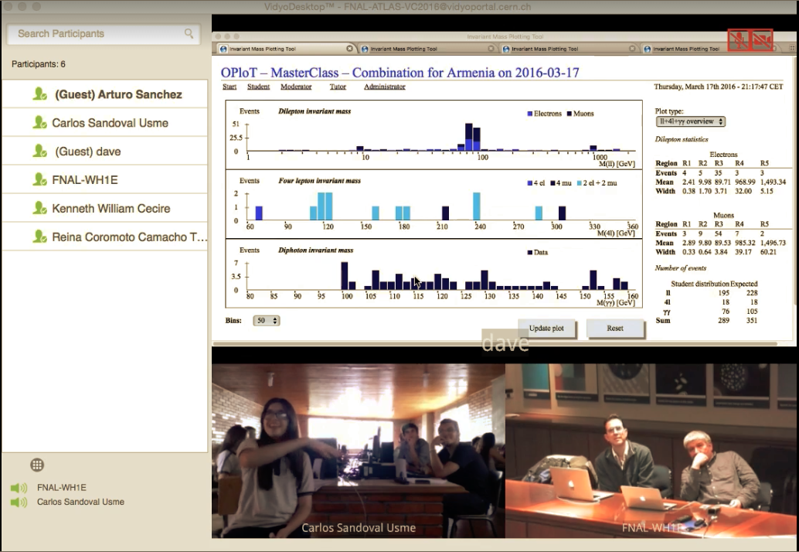
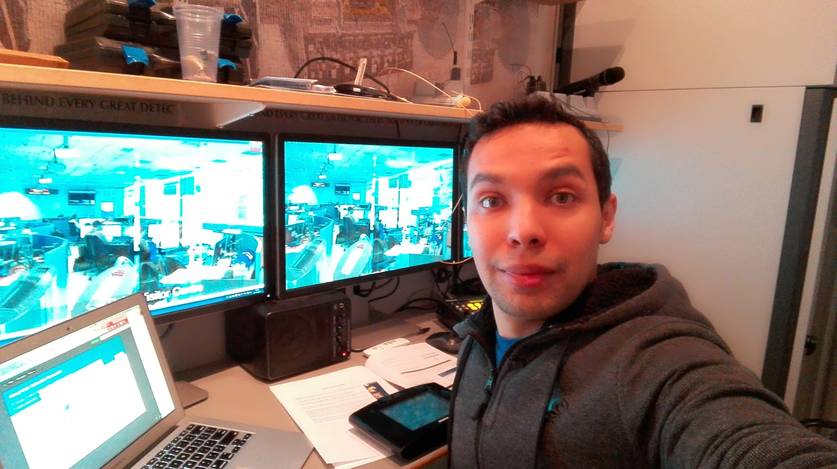
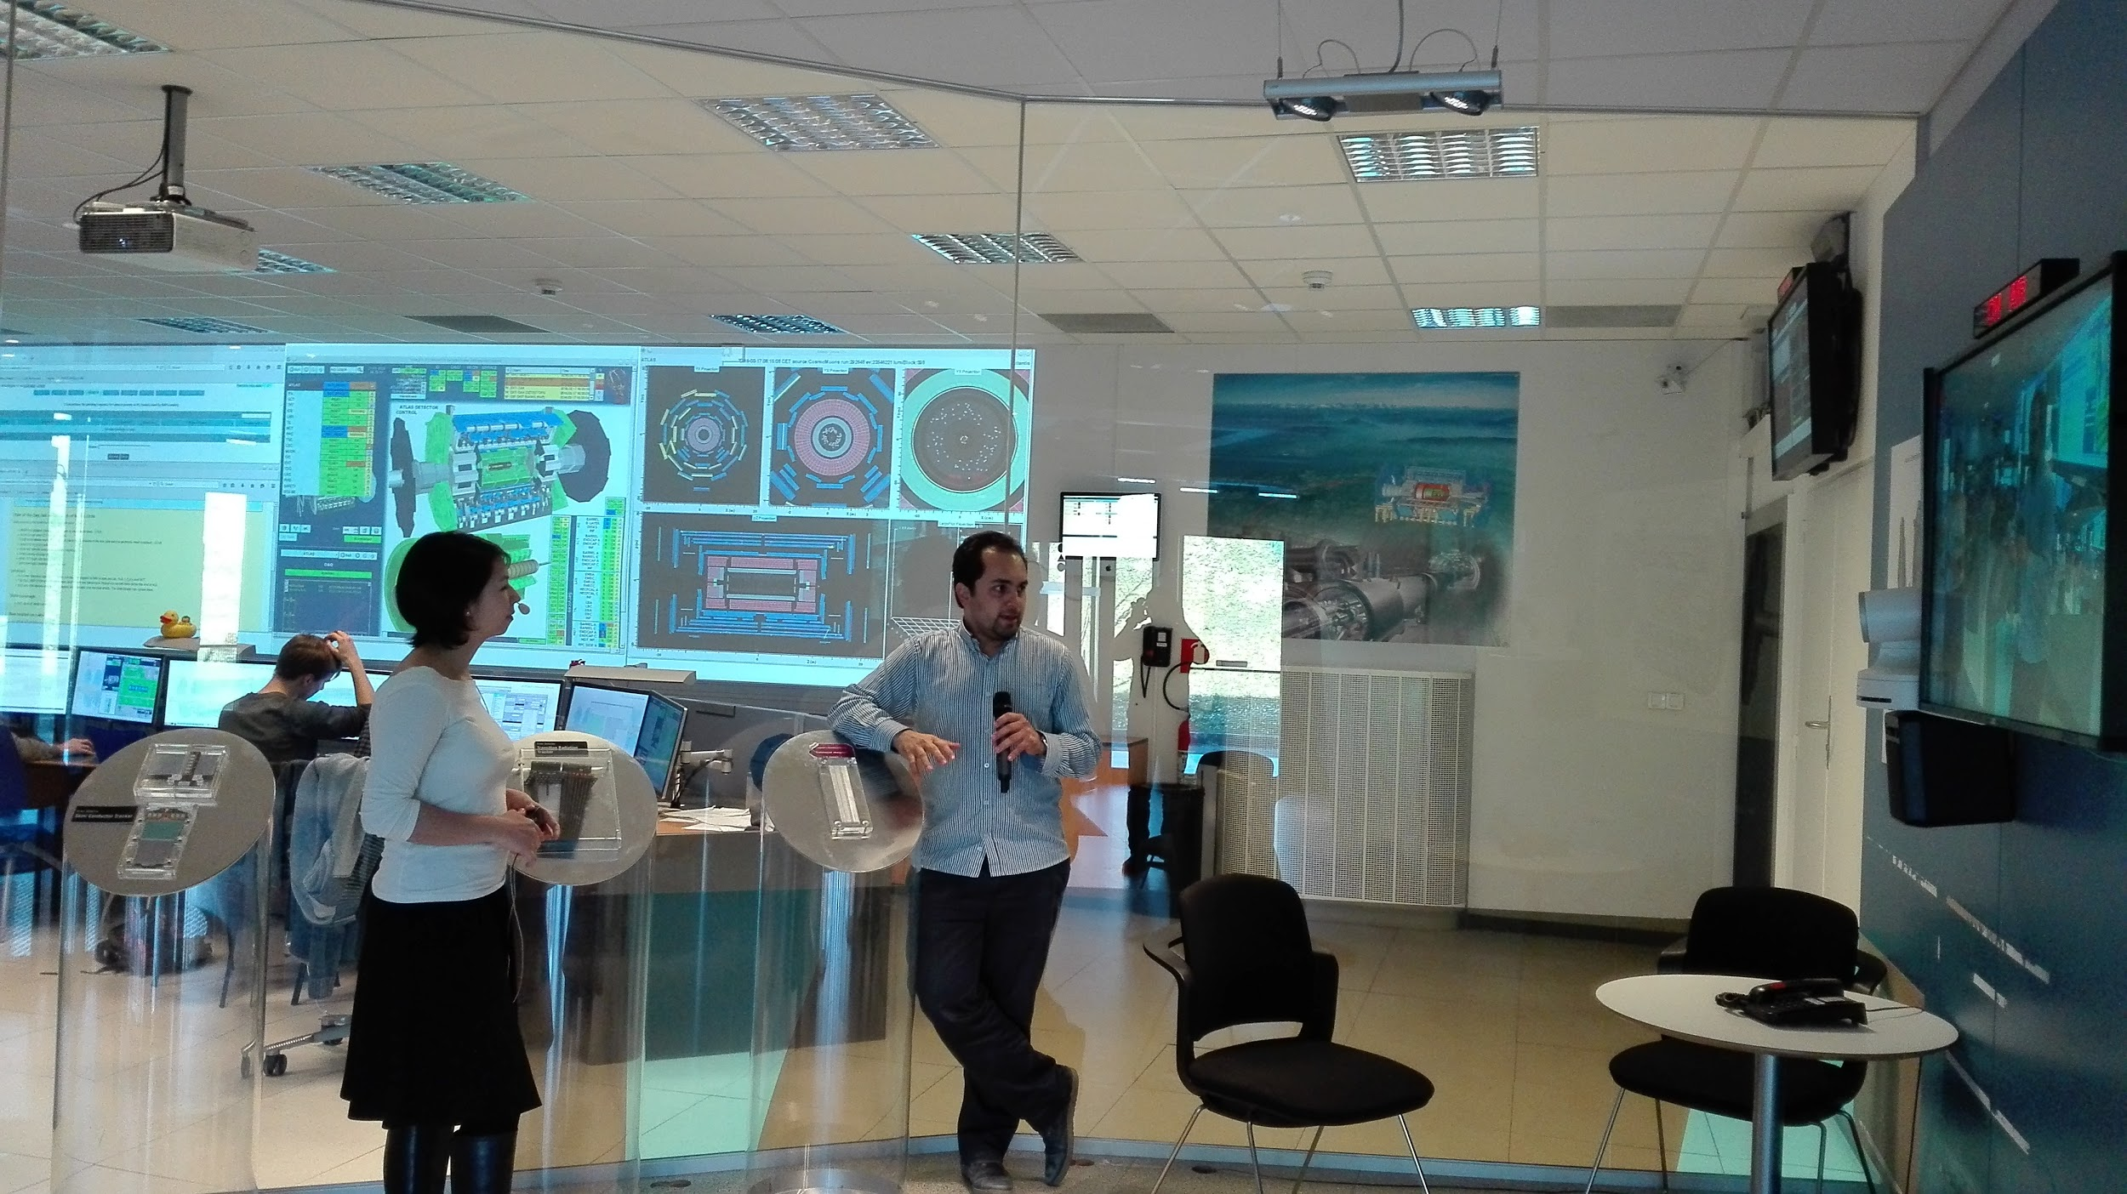

‹#›
3.2 Masterclasses and ATLAS Virtual Visits
First time of Venezuela in Masterclasses!
At the front-end and back-end of the Virtual Visit Venezuela + Colombia 2016

Slide 16
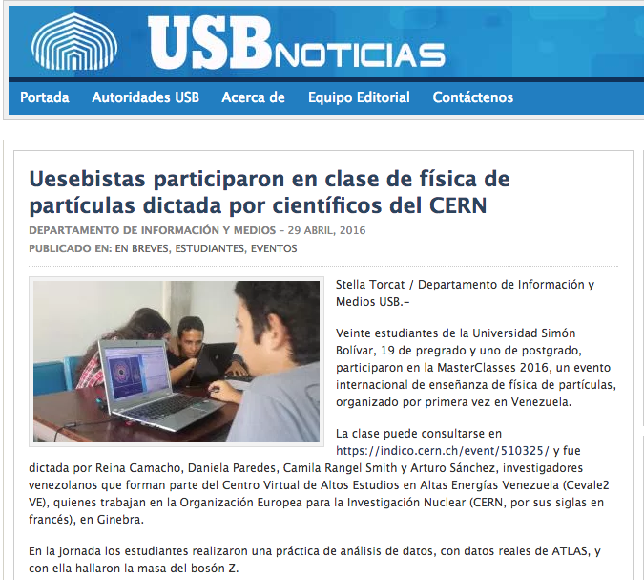
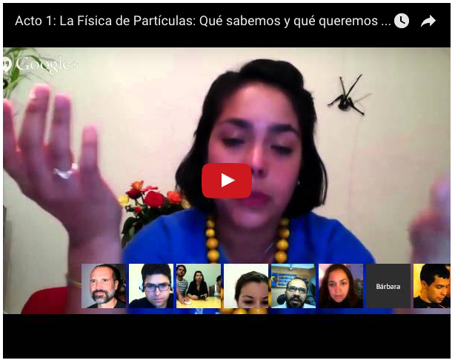
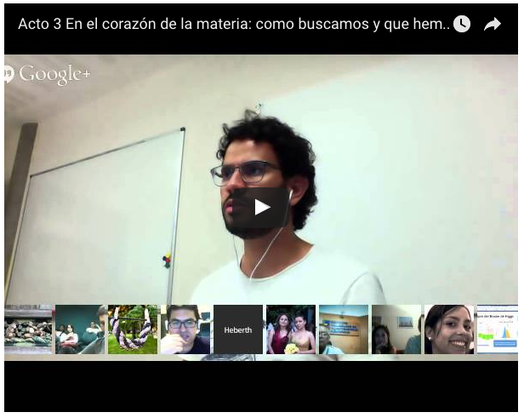
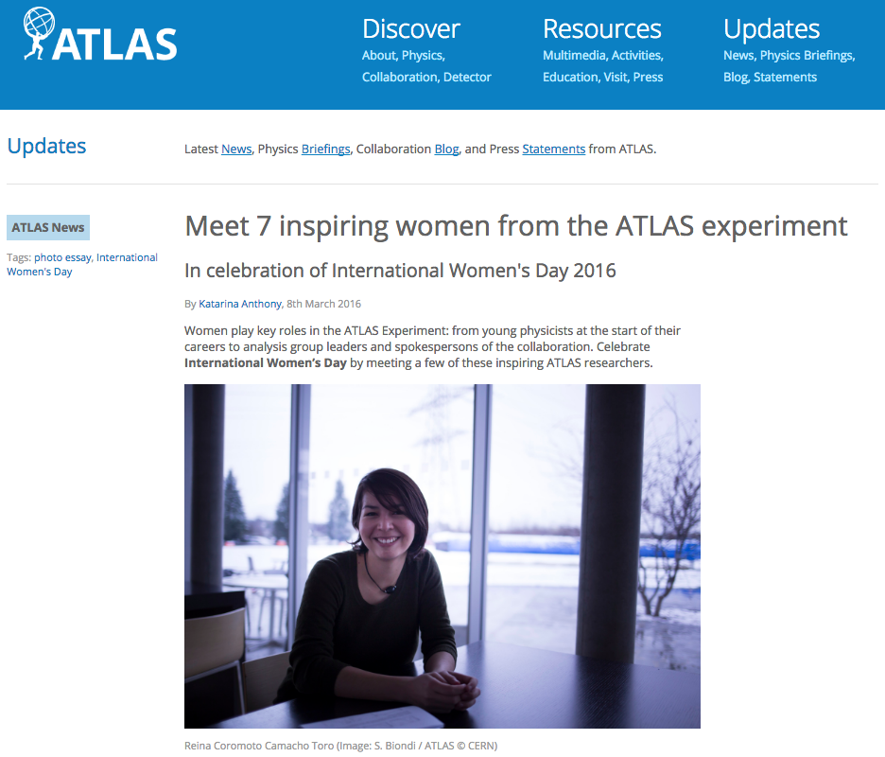
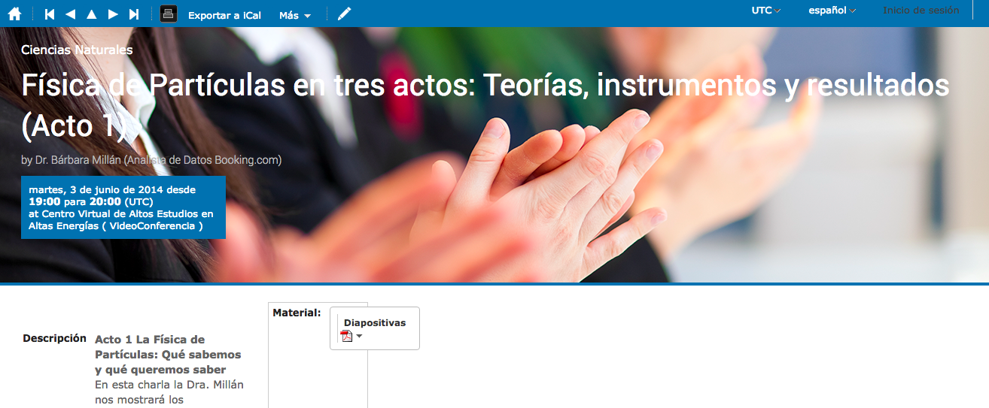
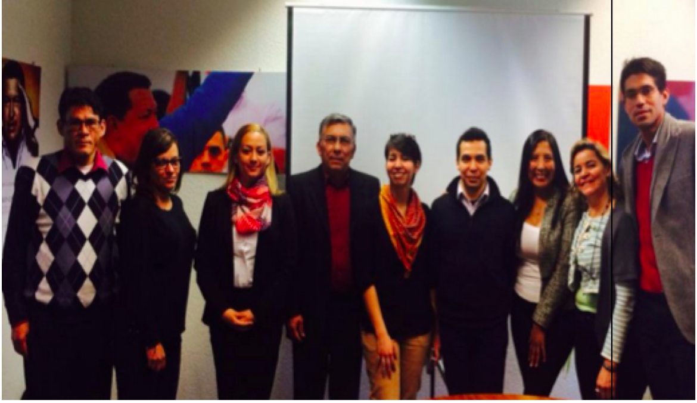
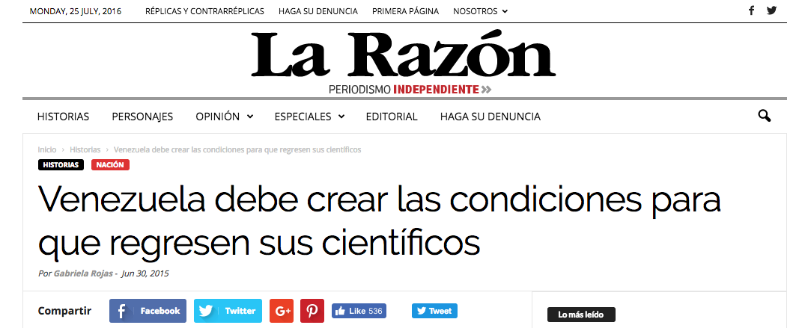
‹#›
3.4 Public Lectures & Diplomacy
We have been looking to communicate the projects and results to the public and diplomatic members. And, we always get help of different media here and there, thanks!

Slide 17
cevale2ve.org
‹#›
Summary
The CEVALE2VE is a HEP educational and outreach project for Latin America.
With the help of a lot of people in both side of the ocean, we developed a course in particle physics as an “excuse” to create and strengthen ties between members of the scientific community.
Several students have got a good start in their advance studies thanks to this collaboration and their incredible energies: some of our students have participated in the HEP CERN-LA school, CERN/DESY summer student programs
Next project? With the ICTP Physics Without Frontiers program, sponsored by ATLAS, in October 2016, we go to Venezuela and Colombia for personal contact with the students, professors and general public in several outreach activities for two weeks!

Slide 18
cevale2ve.org
Backup
‹#›

