Slide 1
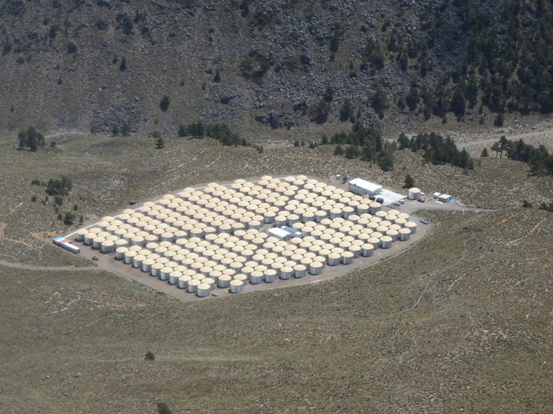
Searches for Dark Matter with the
High Altitude Water Cherenkov (HAWC)
Gamma-Ray Observatory
Kirsten Tollefson for the HAWC Collaboration
Michigan State University
ICHEP 2016, Chicago, August 4, 2016
Picture taken July 8, 2015
Notes:
Today I will be introducing you to a new experiment the High Altitude Water Cherenkov Gamma-Ray Observatory or HAWC (with a C not a K).

Slide 2
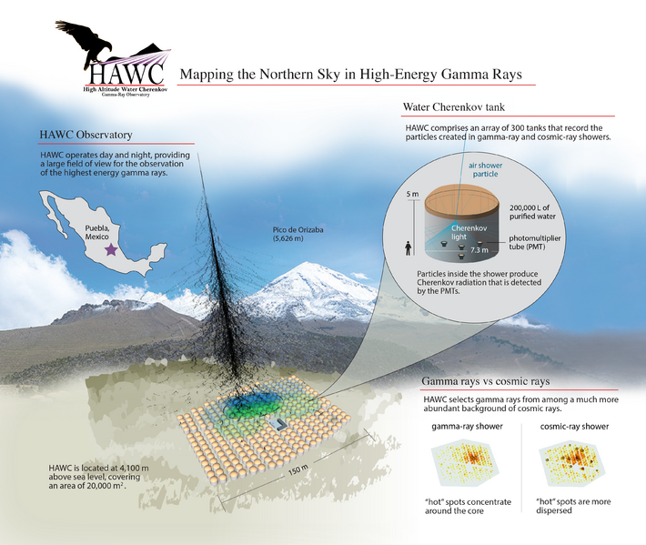
TeV gamma-ray sources
Notes:
Don’t spend time on this if still right after Segev’s talk.
HAWC looks for gamma-ray showers hitting the ground using Cherenkov light in 300 tanks of water. Deployed at 4,100 meters near Puebla, MX.

Slide 3
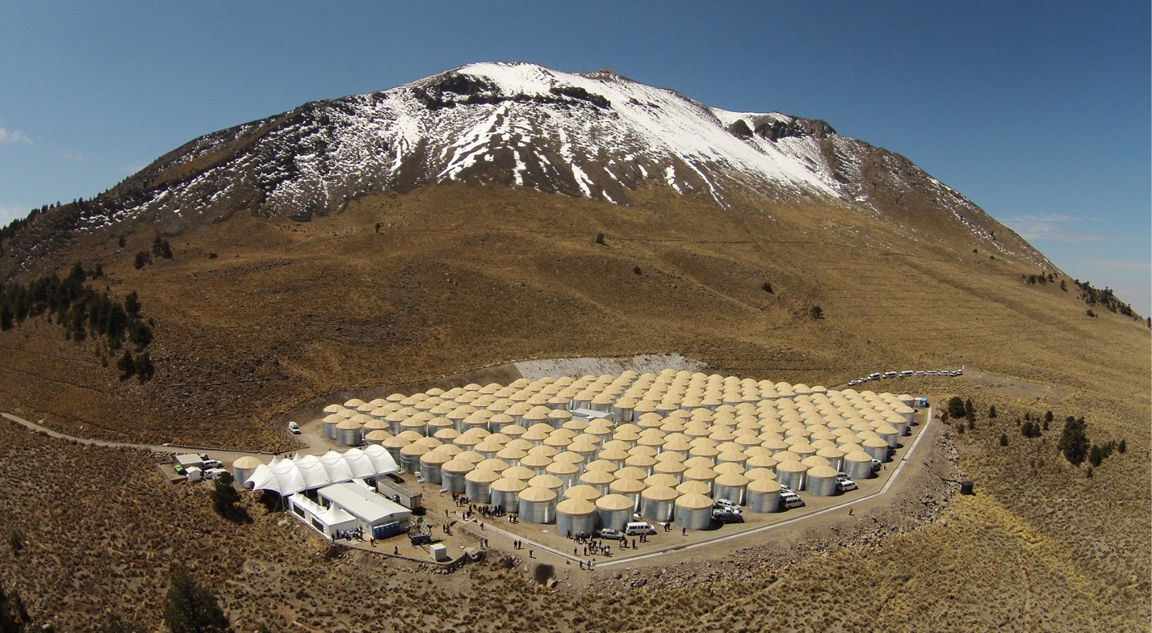
LMT Radio Telescope
Began Operation of:
HAWC-30: Aug. 2012
HAWC-111: Aug. 2013
HAWC-250: Nov. 2014
HAWC-300: Mar. 2015
Current results using:
1 year of data with full detector
Pass 4 reconstruction
HAWC-250
HAWC-30
HAWC-111
300 water tanks covering 22,000 m²
Inauguration Day, March 20th, 2015
Notes:
Point out that results I’m going to show use 1 year of data with the full detector. Otherwise Segev has a similar graphic.

Slide 4
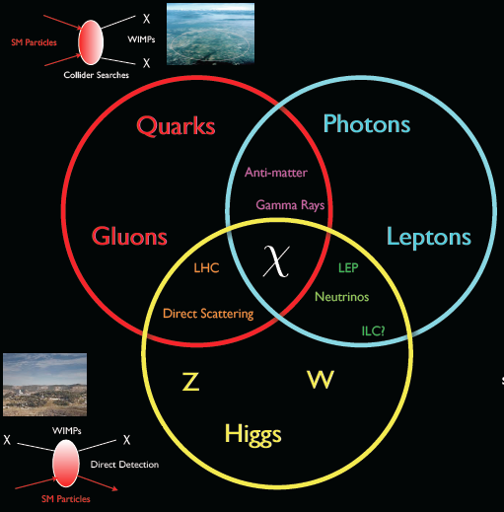
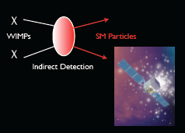

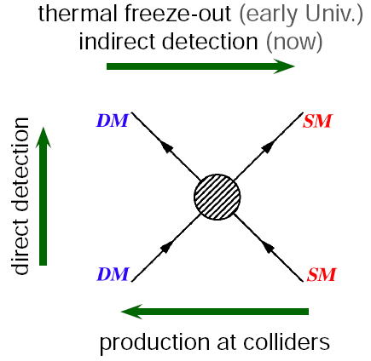
Looking for Dark Matter, χ
More
More indirect DM talks tomorrow in Joint Session at 5pm in Chicago 10
T. Tait
Notes:
Mention several ways to look for DM being presented at this conference. Create DM at colliders. See DM directly when it interacts in a detector or indirectly when it annihilates with itself or decays. HAWC looks for DM indirectly. Experiments such VERITAS, MAGIC, Fermi, etc.

Slide 5
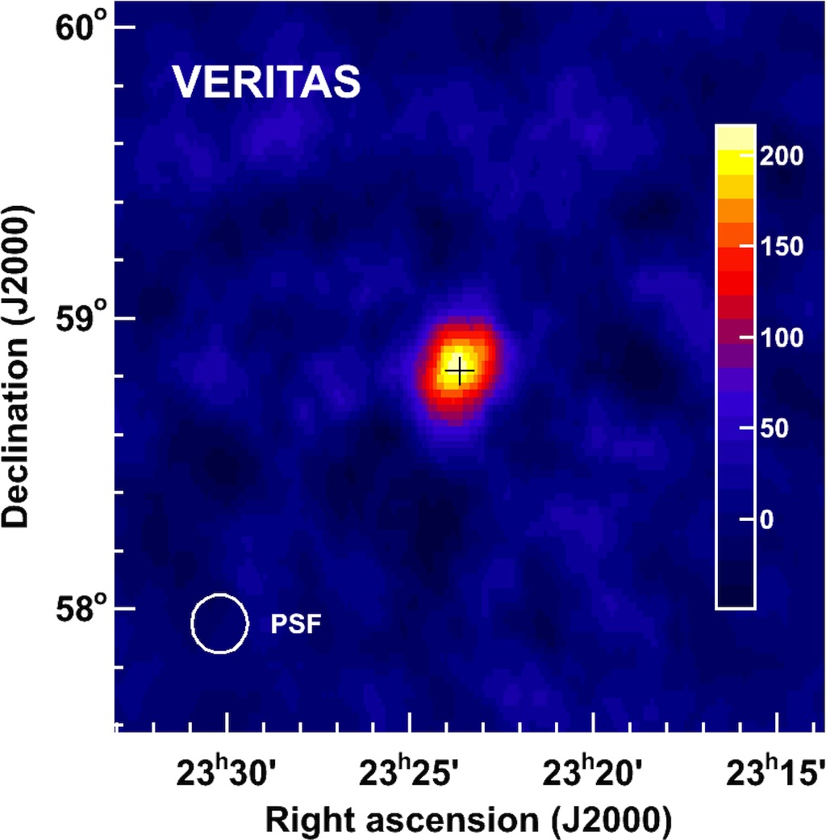
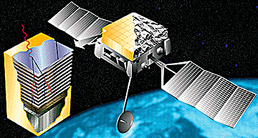
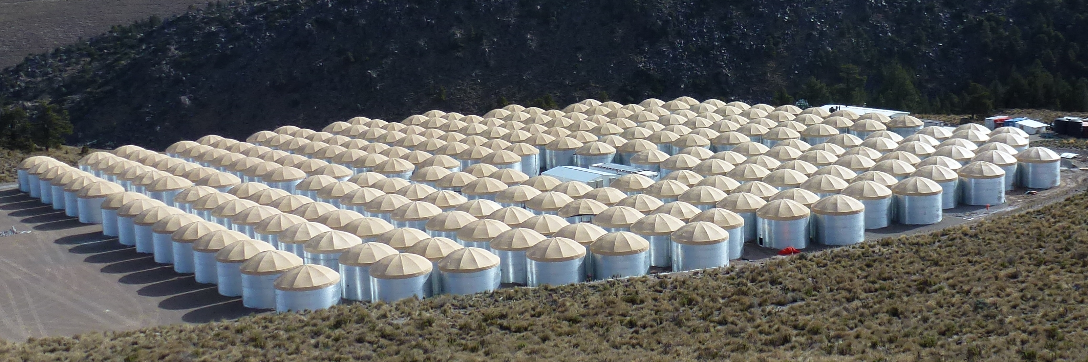
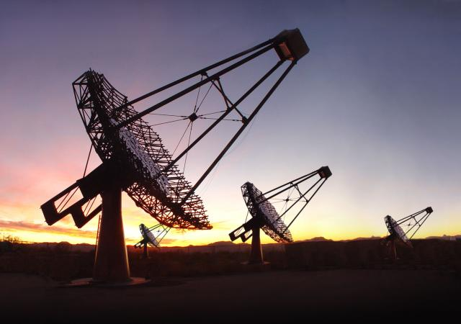
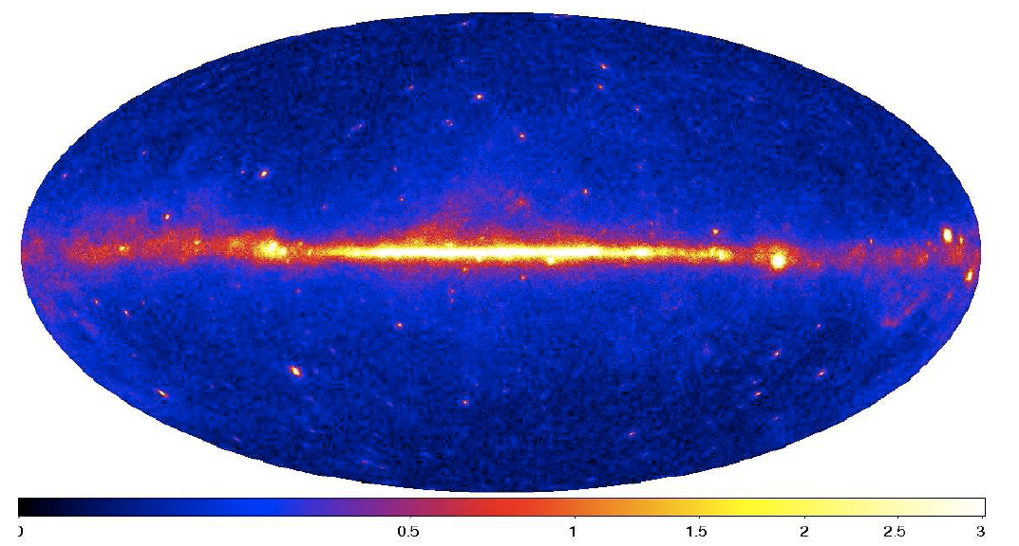
Gamma-Ray Detectors
Wide Field of View, Continuous Operations
TeV Sensitivity
Space Based
Extensive Air Shower (EAS) Arrays
Imaging Atmospheric Cherenkov Telescopes (IACTs)
Fermi
AGILE
EGRET
HAWC
ARGO
Milagro
Tibet
30 MeV – 300 GeV
VERITASHESS
MAGIC
CTA
500 GeV – 100 TeV
FermiLAT
50 GeV – 20 TeV
Notes:
There have been several talks this week from gamma-ray detectors but so far they have concentrated on satellites or imaging atmospheric cherenkov telescopes (IACTs). I’m going to tell you about a new Extended Air Shower (EAS) currently being built called HAWC which is the successor of Milagro. Like the satellites, HAWC has a wide-field-of-view and high duty cycle but it also has a much higher energy reach and effective area like IACTs. It’s main disadvantage compared to the others is worse background rejection.
Like the satellites HAWC has a wide-field of view and a high-duty cycle but it also has a large effective area. Like the ACTs HAWC has TeV sensitivity
HAWC is the successor to the first generation, wide field-of-view, high duty cycle, TeV gamma-ray observatory Milagro.
Strengths:
Extreme high-energy reach.
Wide field-of-view to catch transient emission.

Slide 6

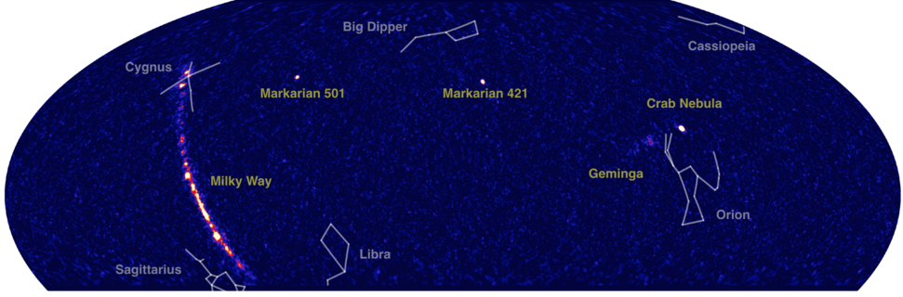
HAWC Sky Map
1 year of HAWC-300 Data
TeV gamma-ray sources
Observational Strengths:
Continuous Operation (duty cycle > 95%)
Wide Field-of-View (instantaneous FOV = 2 sr)
Sensitive to Extended and Transient Emission
Extreme High-Energy Reach (100 GeV - 100 TeV)
Notes:
Point out strengths of HAWC compared to VERITAS, Fermi.
HAWC 1st year of data, taken over 283 days. Gamma-ray sources are labeled in yellow. The bright stars are unrelated to the gamma-ray emission but we draw in some of the common constellations in white to illustrate the size and location of the gamma-ray objects.

Slide 7
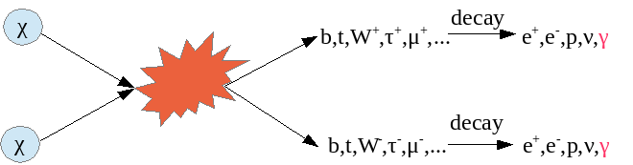

Dark Matter
Annihilation and Decay
Assume 100% branching ratios
Annihilation
Decay
Use M_{χ} from 0.5 – 100 TeV
Photon spectrum from PYTHIA 8 for M_{χ} = 9.6 TeV
Notes:
Popular DM candidate are WIMPs that annihilate with themselves or decay. Most indirect analyzes assume the WIMPs annihilate/decay into a given particle 100% of the time.
What I want to know is how many gamma-rays (flux) HAWC would detect from WIMP annihilation or decay assuming the WIMP.
Note in these equations that the annihilation flux depends on the velocity-weighted cross-section and inversely on its mass squared and goes as the density squared. Decay depends inversely on the WIMP’s decay lifetime and its mass and density.
First ingredient I need is the particle physics part – How many photons of a given energy does the annihilation or decay of a WIMP produce? Use Pythia 8 to simulate the WIMP annihilation and decays for WIMP masses from 0.5 TeV up to 100 TeV into 5 different channels – bb, tt ww, tau tau and mu mu.
Note that photon spectrum peaks at higher energies (above 1 TeV) for taus and mus.
HAWC’s sensitivity to gamma-rays is ~100 GeV to 100 TeV, in current analyzes using energy bins that are roughly from 1 TeV to 10 TeV.
If someone asks about heavy WIMP masses – see back-up slides. Heavier mass WIMPs are becoming more popular as LHC doesn’t see them and to explain several of the astrophysical excesses currently being seen such as the IceCube PeV neutrinos, AMS/PAMELA/Fermi positron excess and HESS’s galactic center gamma-ray excess.
From Pat:
Yes, I think it's because of helicity suppression that DM is supposed to prefer annihilating into the heaviest thing around.
This is why the two typical channels people use are tautau and bbbar.
Tautau if there's some particle physics reason why it can't couple to quarks,
bbbar if it can (typically it's bbbar not ttbar since the vanilla WIMP searches usually are below the top mass range, though we aren't).

Slide 8
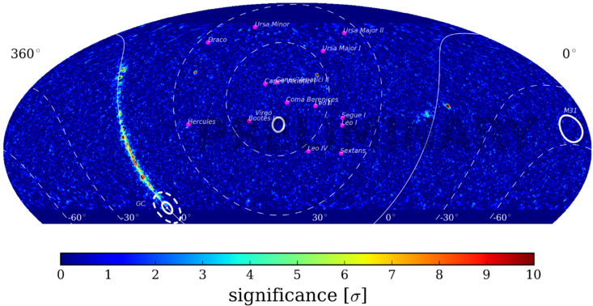
Dark Matter Sources in HAWC’s Field-of-View
Pink Dots – Dwarf Spheroidal Galaxies
Virgo galaxy cluster
M31 galaxy
Galactic Center
Notes:
Astronomers have told us which astrophysical sources have large amounts of DM.
Galactic coordinates
Results shown today will focus on the 14 dwarf spheroidal galaxies indicated by the pink dots and the M31 galaxy and Virgo galaxy cluster.
Most of the high latitude sky has not been observed at TeV energies

Slide 9
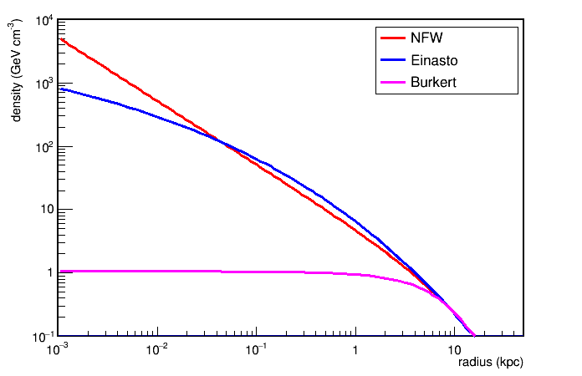
Dark Matter
Annihilation and Decay
Annihilation
Decay
J - factor
D - factor
Example of DM density profiles for the Milky Way
All sources treated as point-like
Used a smooth NFW dark matter density profile taken from Geringer-Sameth et al., Astrophys. J. 801 no.2, 74 (2015)
J and D factors were calculated using CLUMPY
Density (GeV/cm³)
Radius (kpc)
Notes:
Second ingredient is the astrophysical part. What is the distribution of the DM in the source along HAWC’s line of sight?
Plots shows examples of different DM density profiles with the DM matter more peaked towards the center of the source (NFW, Einasto) or more smooth/constant throughout (Burkert).
Common vernacular is to lump the astrophysical part into the J-factor/D-factor terms.
HAWC is currently using a smooth NFW density profile (several other experiments have used this one so can more easily compare results).
For now all sources have been treated as point-like sources.

Slide 10
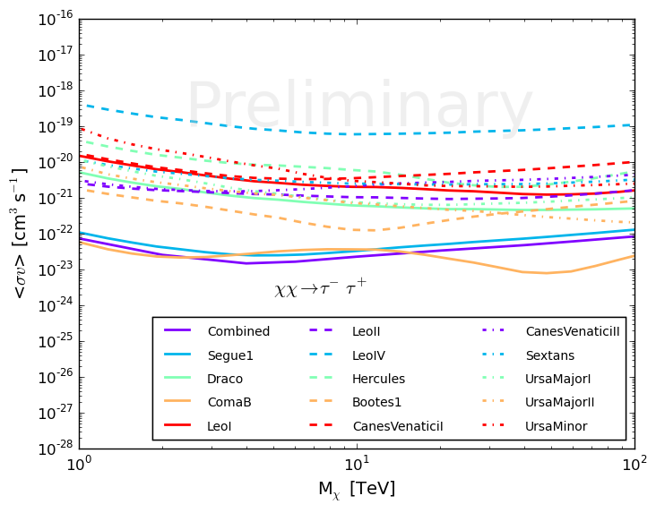
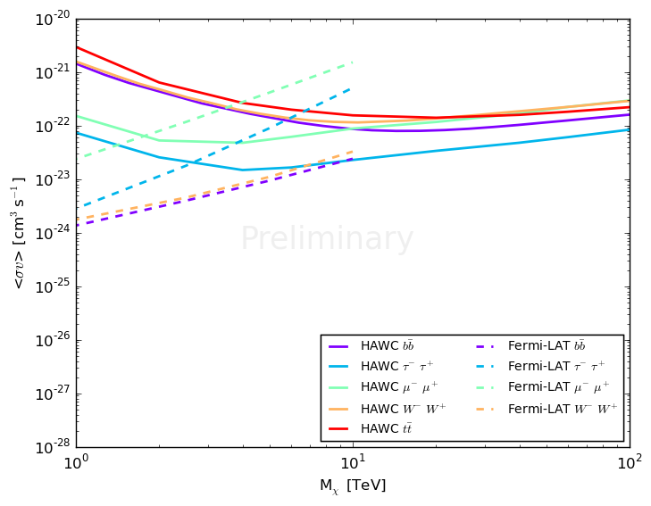

DM Annihilation Cross-Section Limits from 14 Dwarf Galaxies
EXCLUDED
EXCLUDED
HAWC
Fermi-LAT
14 individual dwarf galaxy limits plus combined stacked analysis (purple line) assuming 100% of the time WIMPs decay to τ+τ−
HAWC’s combined limits for 5 different decay channels compared to Fermi-LAT’s results from Ackermann et. al. (Fermi-LAT Collaboration), Phys. Rev. D 89, 042001, 2014
Notes:
Have results from each of the 14 dwarfs plus do a stacked analysis (purple line) of all 14. Notice that Coma B and Segue 1 drive the limits for tau tau channel which gives our tightest limits.
HAWC’s combined limits for 5 channels compared to Fermi-LAT’s results from a stacked analysis of dwarfs (Andrea said 15 used).

Slide 11
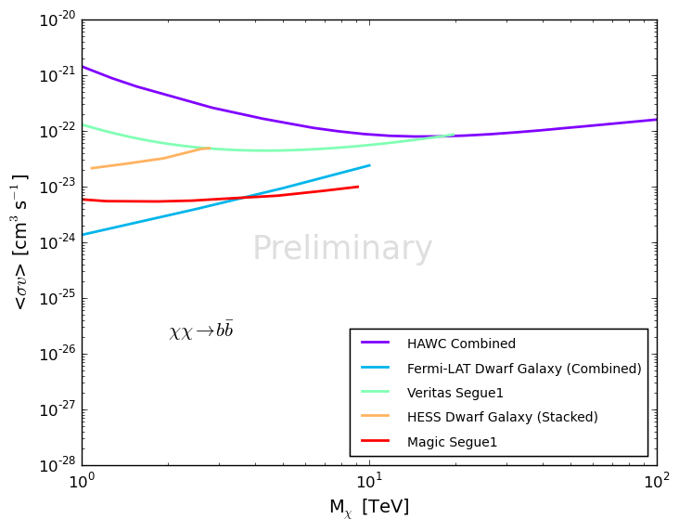
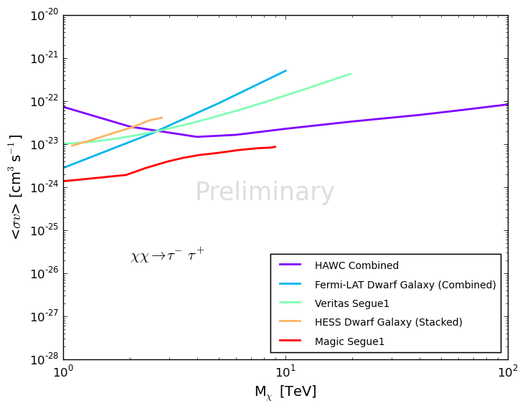
DM Annihilation Cross-Section Limits from 14 Dwarf Galaxies
EXCLUDED
EXCLUDED
HAWC’s combined limit assuming WIMP decays to bbbar (left plot) or taus (right plot) 100% of the time compared to results from other gamma-ray experiments:
Fermi-LAT from Ackermann et al. (Fermi-LAT Collaboration), Phys. Rev. D 89, 042001 (2014)
VERITAS from Aliu et al. (VERITAS Collaboration), Phys. Rev. D 85, 062001 (2012)
HESS from Abramowski et al. (HESS Collaboration), Phys. Rev. D 90 (2014) 11
MAGIC from Aleksic et al. (MAGIC Collaboration), JCAP 02 (2014) 008
Notes:
For each channel compare stacked results with Fermi, Veritas, HESS and Magic.
HAWC only experiment that extends out to 100 TeV

Slide 12
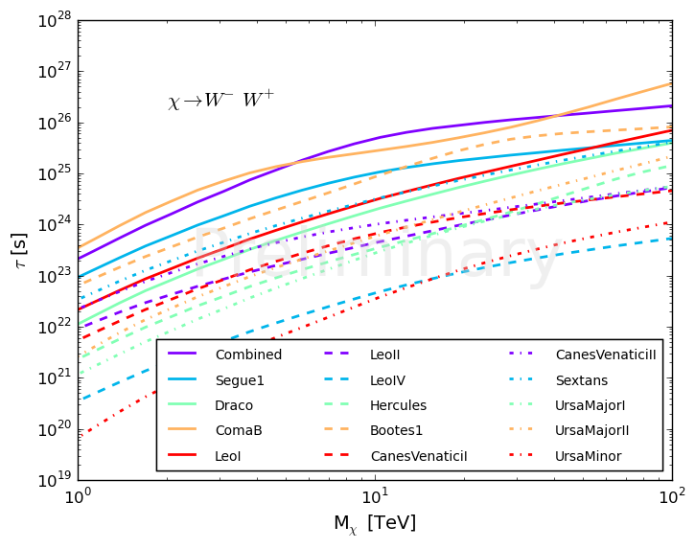
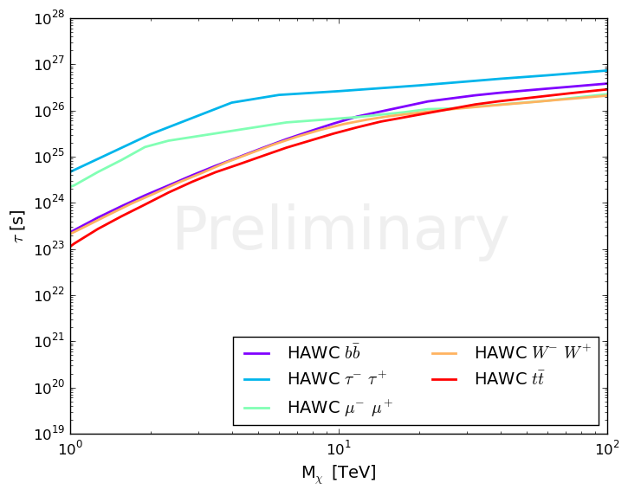
DM Decay Lifetime Limits from 14 Dwarf Galaxies
τ (s)
τ (s)
EXCLUDED
EXCLUDED
14 individual dwarf galaxy limits plus combined stacked analysis (purple line) assuming WIMP decays to W⁺W⁻ 100% of the time
HAWC’s combined limits for 5 different decay channels
Notes:
HAWC also does decay. Showing WW for all

Slide 13
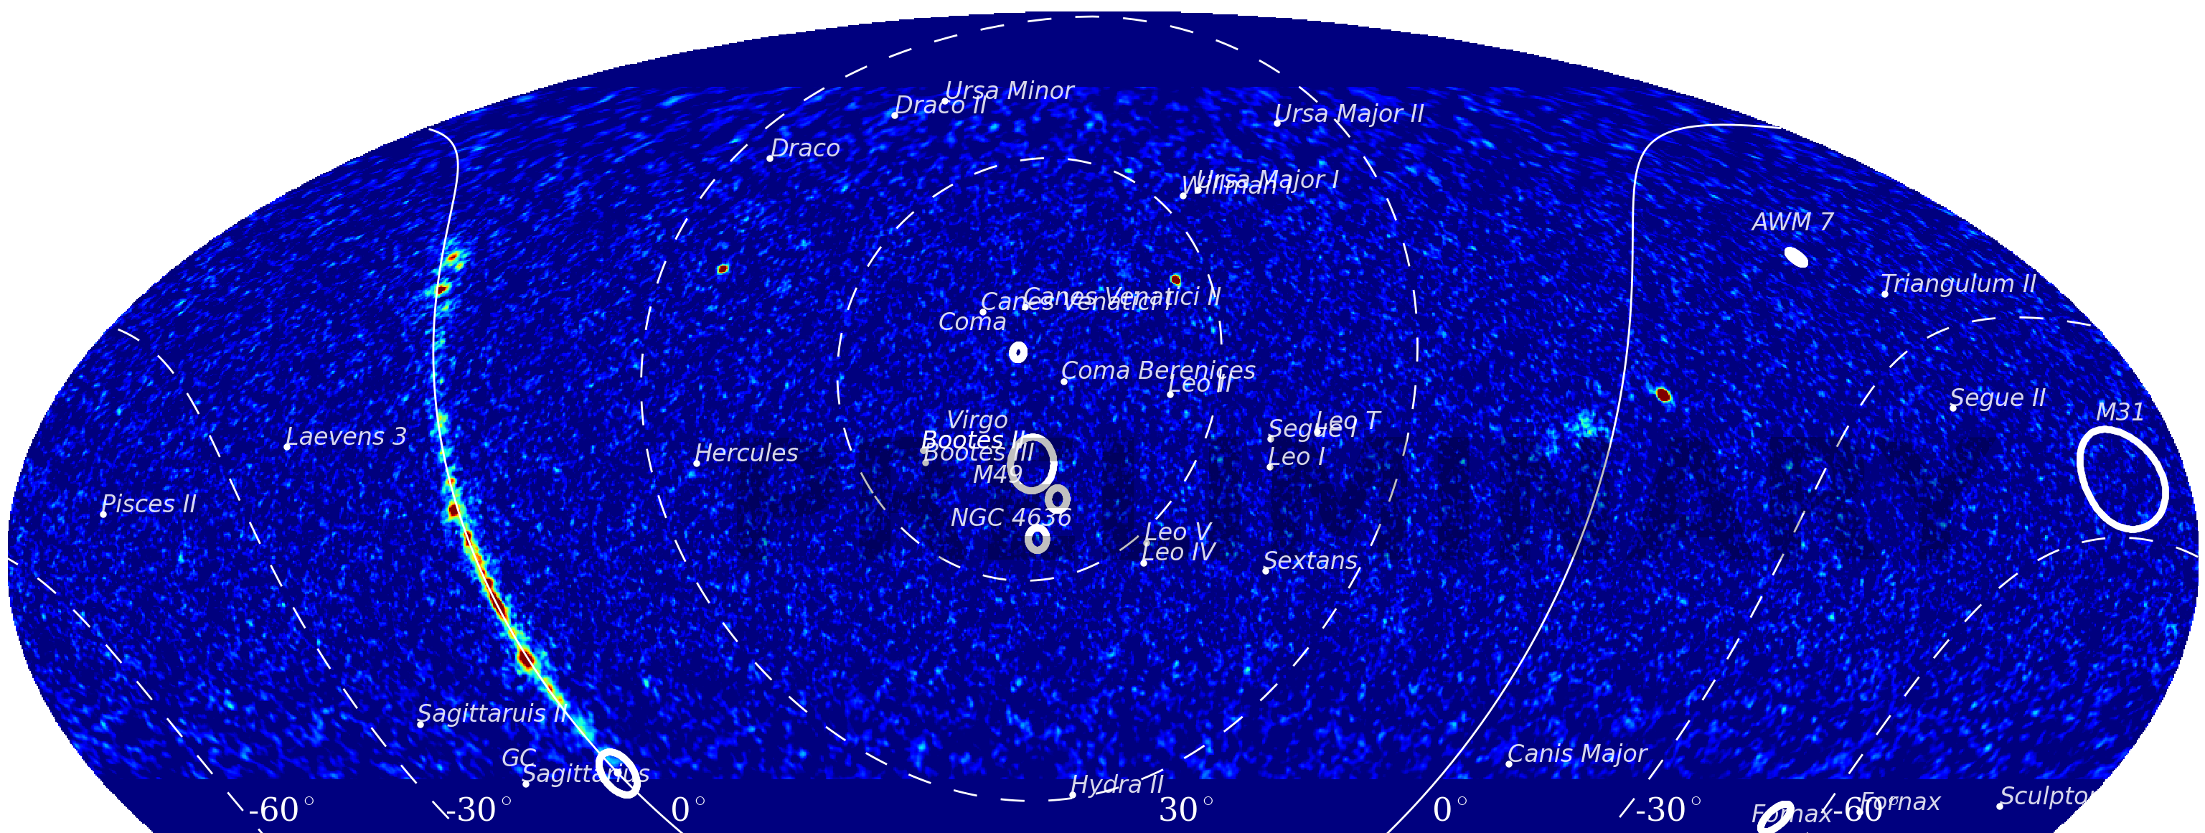
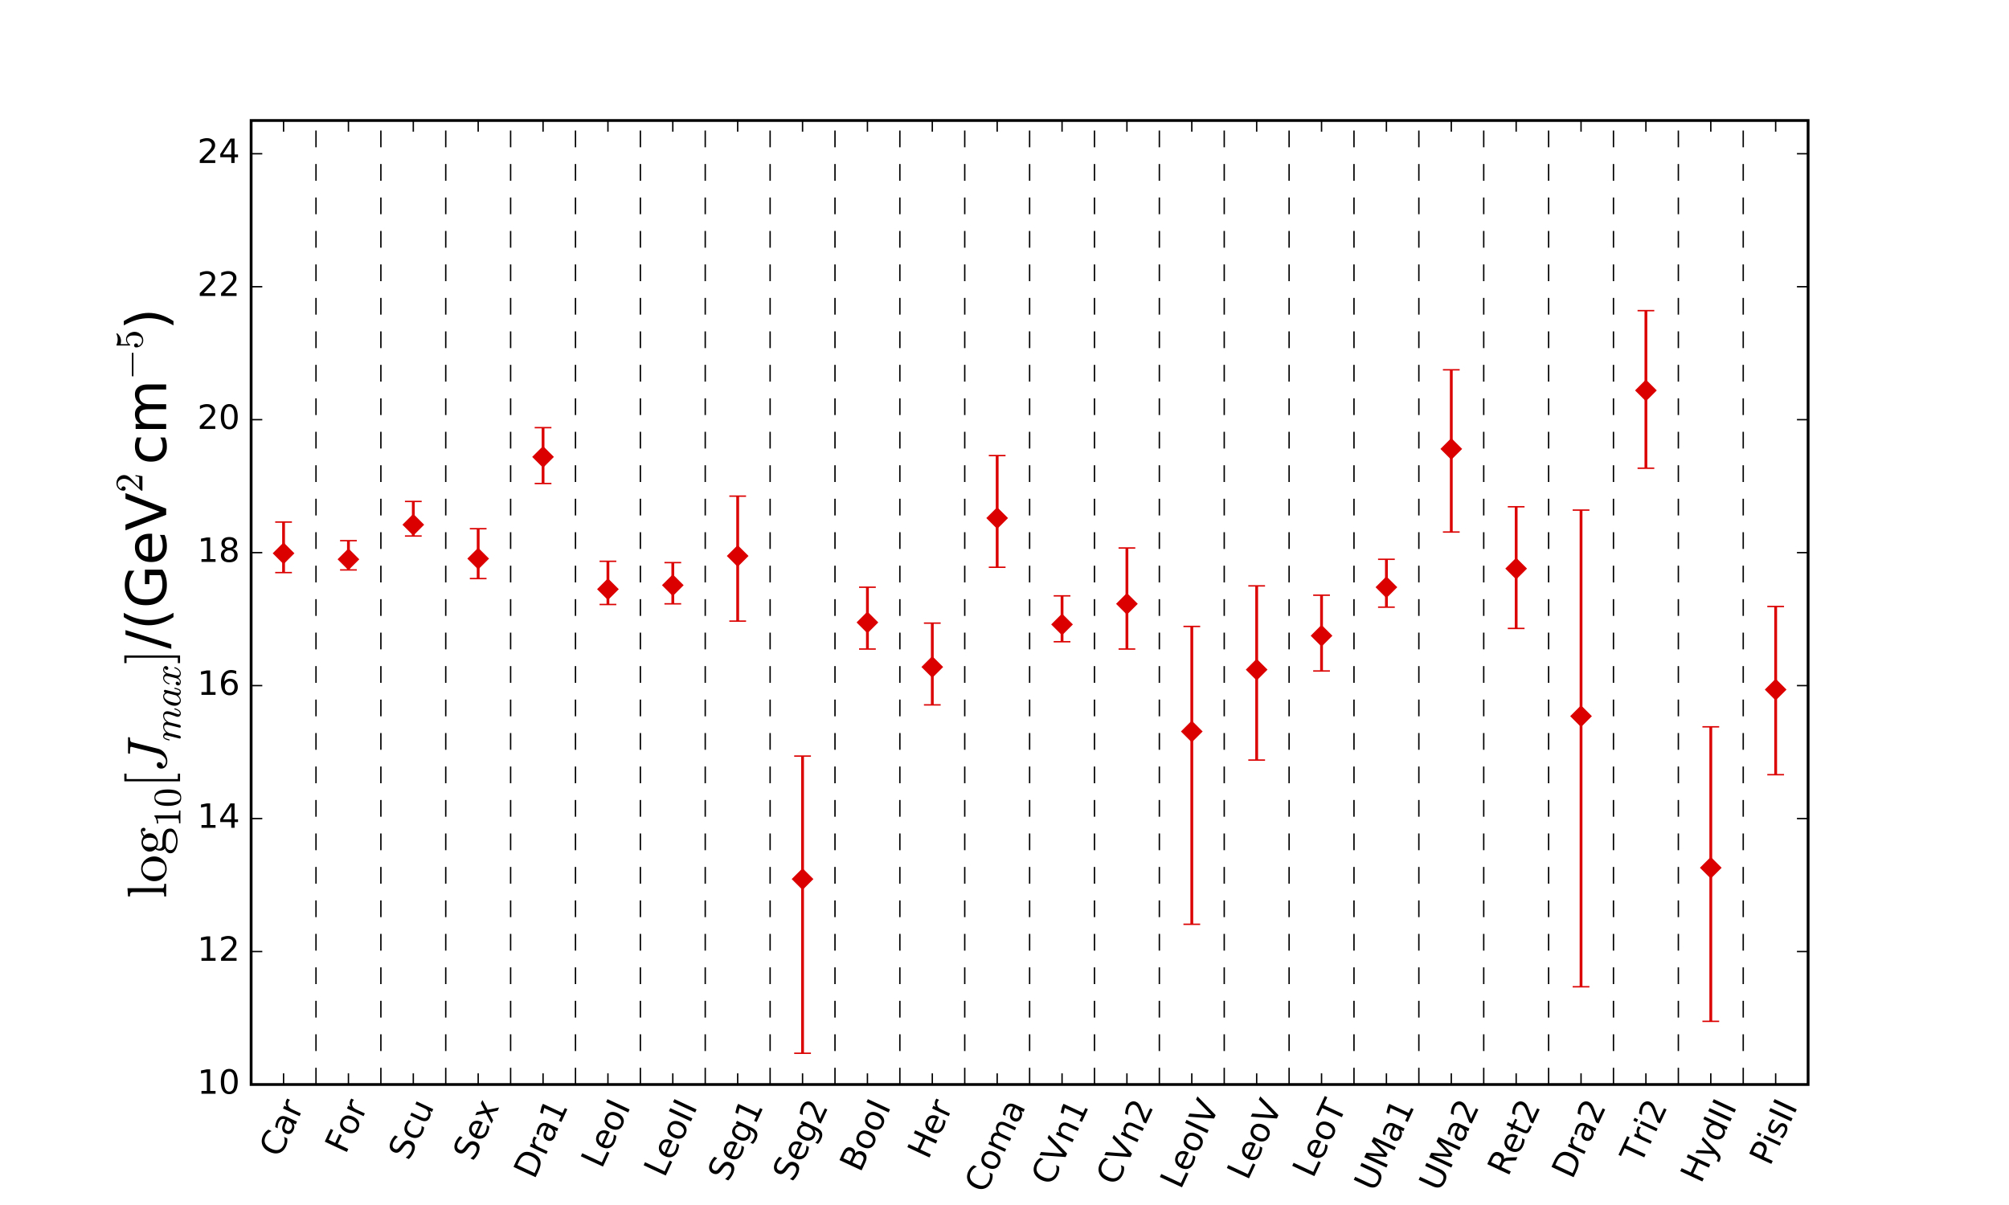
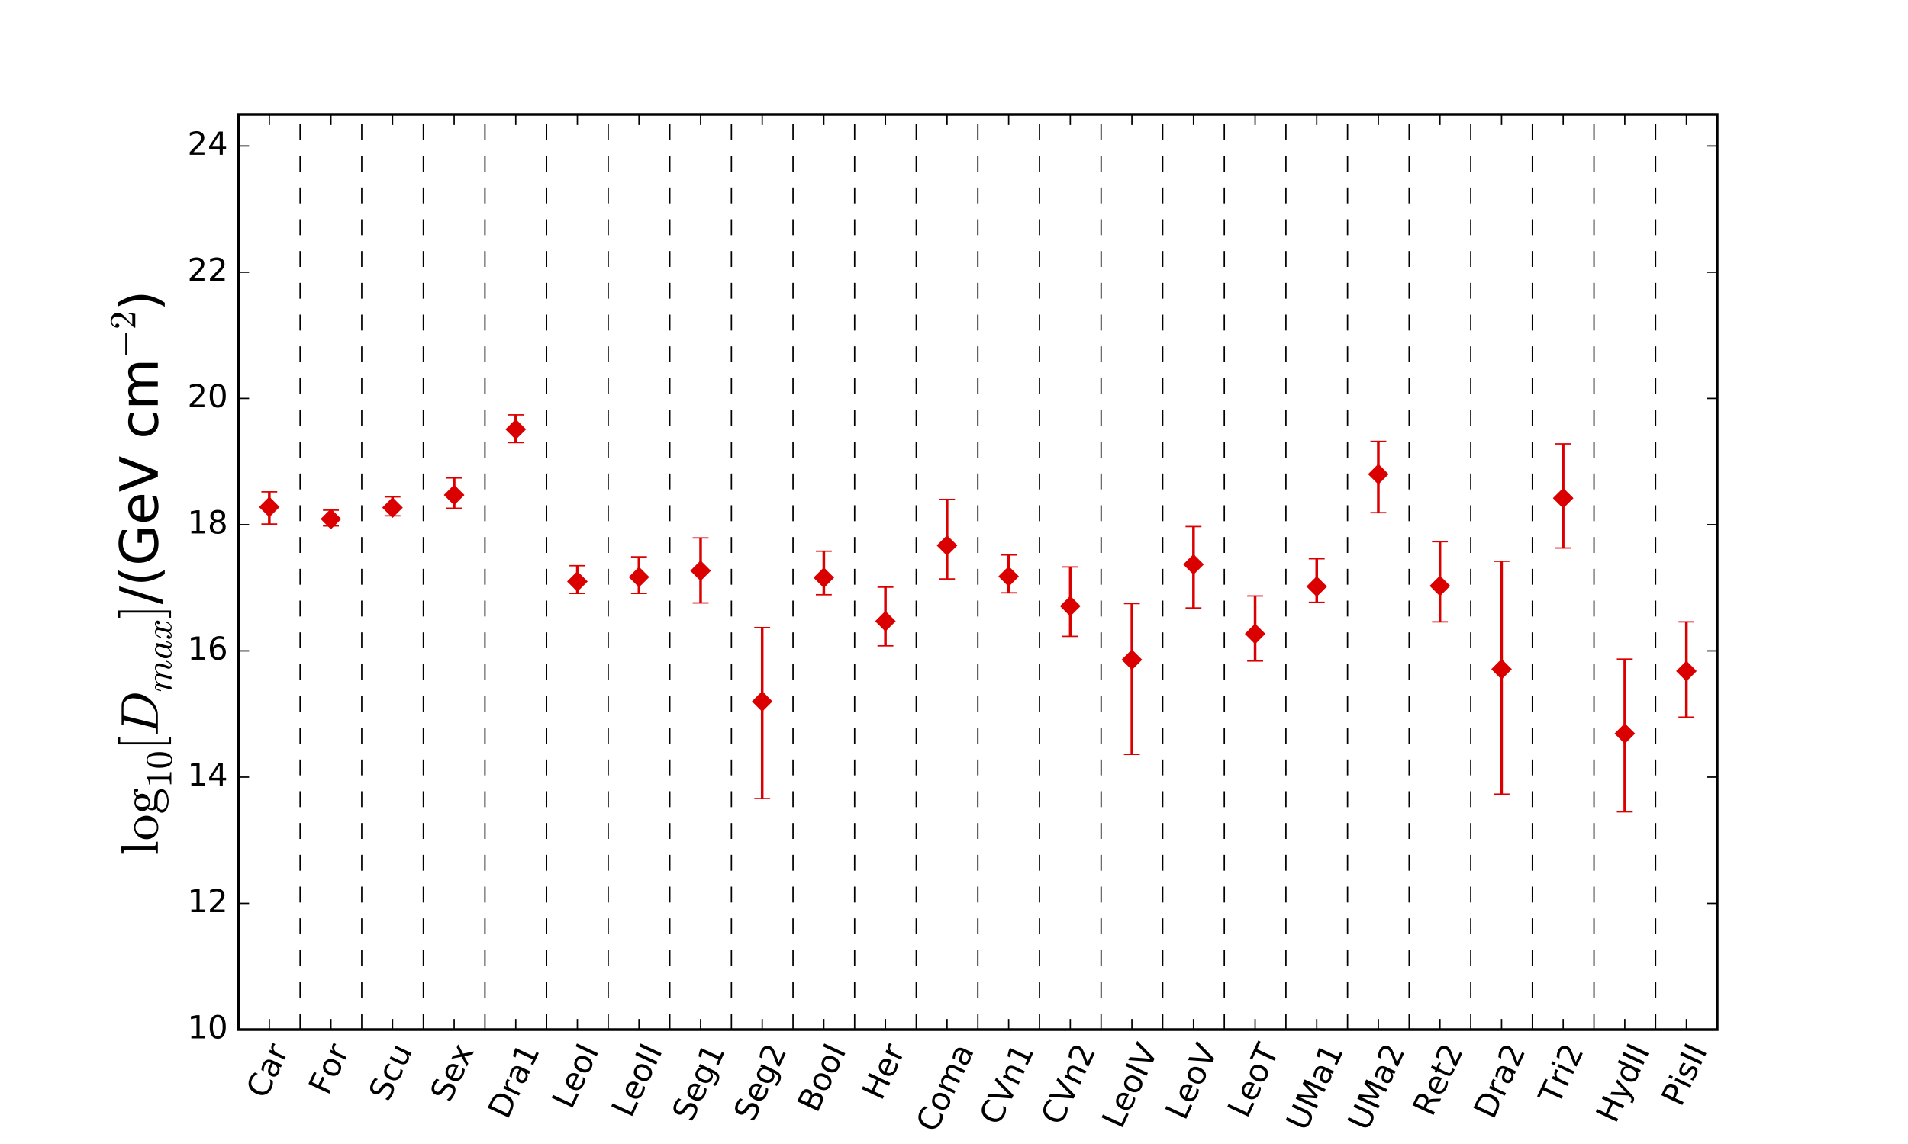
Upcoming Improvements to Dwarf Galaxy Analysis
Add more targets:
  27 known in HAWC’s field-of-view
  Best targets for annihilation are not the same as for decay
  include ones with larger J and D factors
Better detector characterization at lowest and highest energies
Currently upgrading HAWC with outrigger tanks which will improve sensitivity above 10 TeV
Segue 1
Triangulum II
Hayashi et. al. 2016
Notes:
From Pat: Another motivation for looking at lots of dwarfs instead of just the "best" ones is decay. For instance, Leo I doesn't contribute much for annihilation, so is not considered "best" by most people for observations. But for decay, it is one of the 5 strongest.
Andrea pointed out that not usually called dwarf galaxies unless they have spectroscopic confirmation. Suggested call them targets if not been confirmed yet. Sent email to Pat to ask about that.
From Pat:
Yes, "targets" is probably safer than "dwarfs" for these 27 objects. Of the ones we're not using, most have been known for a while and just don't have well-defined density profiles. This is often due to lots of unassociated stars nearby (like for Saggitarius) or if the DM cloud looks like the DM has been tidally stripped, so that the DM profile is suspect. A few of them were from Pan-Starrs and just don't have specroscopic studies on them yet.
While all are suspected of being dwarfs, those 13 may end up not being classified as dwarfs or never verified. Or could be well-known dwarfs any day, if the studies needed are done and get good data.

Slide 14
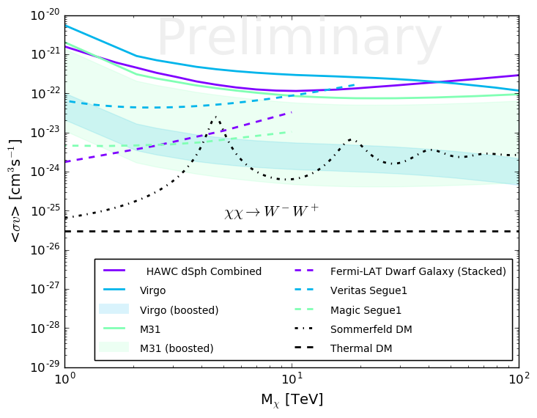
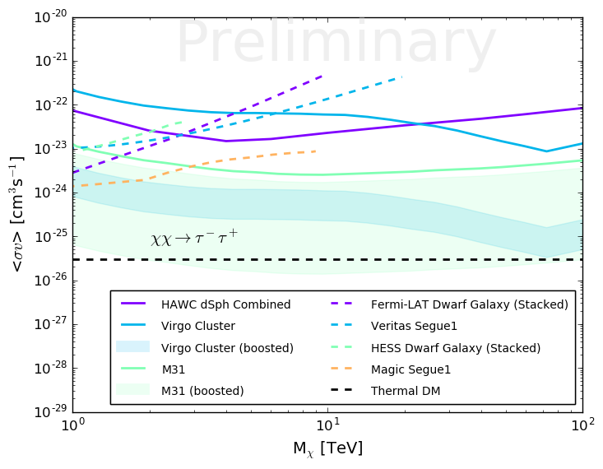
DM Annihilation Cross-Section Limits from M31 and Virgo
EXCLUDED
EXCLUDED
HAWC’s limits for M31, the Virgo cluster and combined dwarf galaxies assuming WIMP decays to W⁺W⁻ (left plot) or τ⁺τ⁻ (right plot) 100% of the time compared to other experiments. A possible enhancement in cross-section due to the Sommerfeld effect is taken from Fen et al., Phys. Rev. D 82, 083525 (2010)
The shaded bands represent the 1-year expected sensitivity reach using a range of boost factors (B = 1-200 for M31 and B = 200-400 for Virgo) from the effect of substructure (see refs 1-7 listed at end of talk) in the extended sources M31 and Virgo.
Notes:
Boost factor is the effect of DM substructure on the annihilation flux. In annihilation the flux goes as the density squared to a distribution of subhaloes inside the larger halo may boost the DM annihilation flux considerably.
Shaded areas represent a range of cross-section values due to the possible range of boost factors.

Slide 15
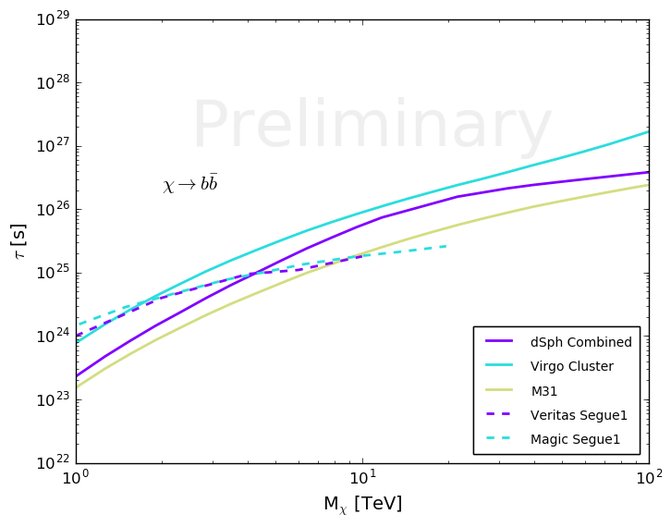
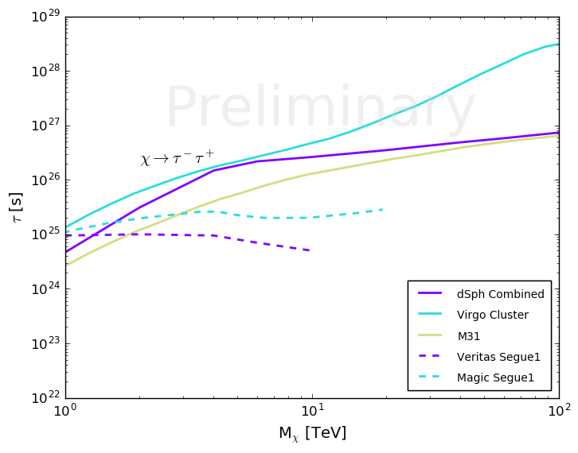
DM Decay Lifetime Limits from M31 and Virgo
τ (s)
τ (s)
EXCLUDED
EXCLUDED
HAWC’s lifetime limits for M31, the Virgo cluster and combined dwarf galaxies assuming WIMP decays to b bbar (left plot) or τ+τ- (right plot) 100% of the time compared to VERITAS and MAGIC.
Note the plots don’t include Fermi-LAT’s stacked dwarf analysis results (see arXiv: 1510.00389)
Notes:
Put notes here about J and D factors!

Slide 16
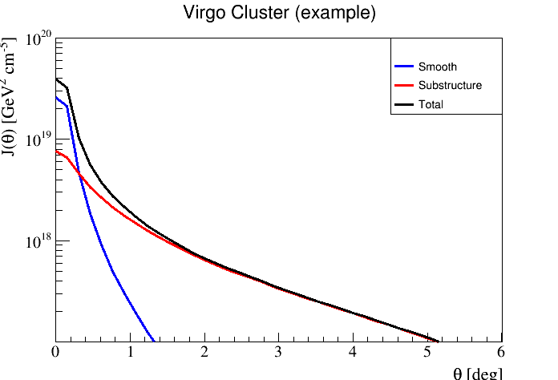
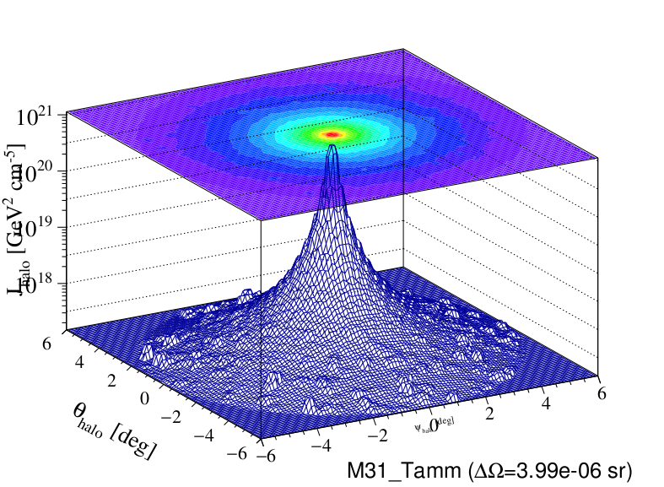
Improvements to M31 and Virgo Analyzes
Consider the full extent of large sources (i.e. don’t treat them as point-like)
  Contribution of substructure (its clumpyness) becomes more important at larger extents
Include more extended sources and do a stacked analysis
Notes:
How reliable is it to assume these are point sources?
Model the DM distribution as a smooth distribution with substructure on top. Here’s an example of possible DM distribution for M31. Note the substructure is only important out at farther extents.
Using the J-factor corresponding to the smooth profile and the source as a point source is a conservative limit, this will get better when use the full extent of the source. This is one of HAWC strengths that hasn’t been utilized yet.

Slide 17
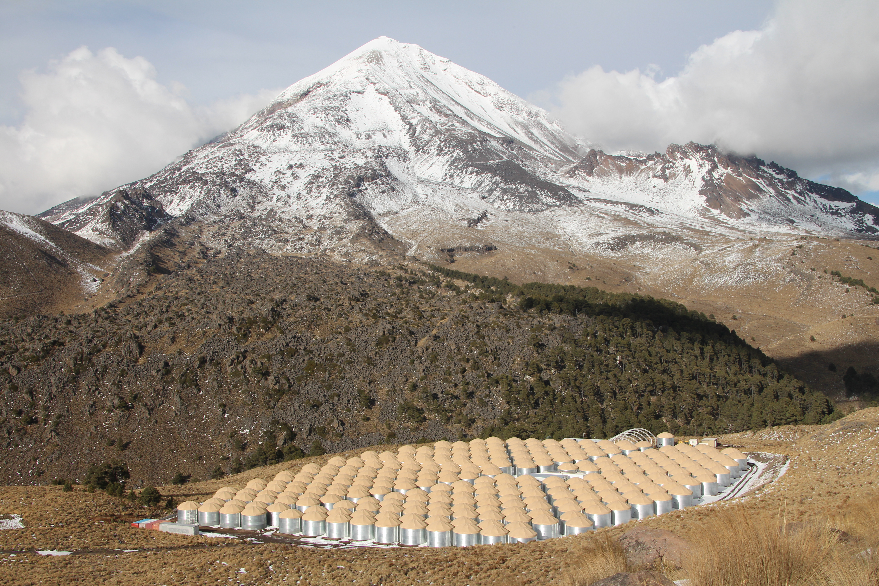
Pico de Orizaba
Summary
HAWC has observed no significant excess of gamma-rays from dark matter in 14 dwarf spheroidal galaxies, the M31 galaxy or Virgo galaxy cluster so sets limits on WIMP annihilation cross-sections and decay lifetimes in 5 different channels.
HAWC has the best cross-section limits for M_{χ}>2-3 TeV in the lepton channels (τ+τ− and μ+μ−) and for M_{χ}>10 TeV in all 5 channels.
HAWC has the best lifetime limits for M_{χ}>2 TeV.
Coming soon: analysis improvements and publications
A joint Fermi/VERITAS/HAWC working group has been formed to standardize and combine their DM searches.
Taken March 18, 2015

Slide 18
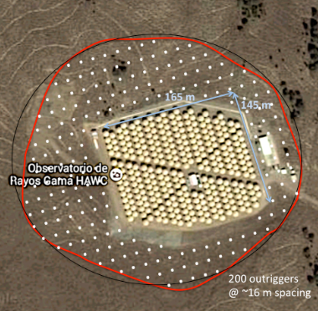
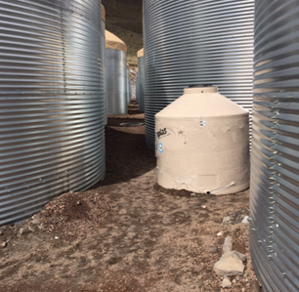
Upgrades and Southern Sky Survey
Enhance sensitivity > 10 TeV with Outrigger tanks
Demo Outrigger
No TeV Survey of the Southern Sky – YET!
Looking at southern hemisphere sites - see poster by M. DuVernois
Workshop planned in Puebla, MX for Nov. 10-12. For details see: http://events.icecube.wisc.edu/conferenceDisplay.py?confId=81
Notes:
Complement for CTA. Currently no TeV survey of the Southern Hemisphere yet.

Slide 19
References for M31 and Virgo analyzes
TeV gamma-ray sources
Notes:
Put notes here about J and D factors!

Slide 20
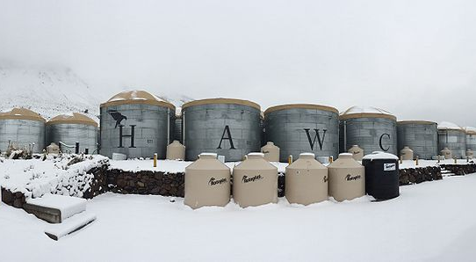
Extras
TeV gamma-ray sources
Notes:
April 20, 2016

Slide 21
TeV-Mass Dark Matter
High-mass high-flux DM proposed to explain several astrophysical observations
  PAMELA/Fermi/AMS positron excess
  H.E.S.S. Galactic center gamma-ray excess
  IceCube PeV neutrinos
Lack of observed DM at LHC implies M_{χ}>1 TeV
Can be consistent with DM production
  DM production by decay of heavy particles
  Sommerfeld enhancement give larger cross-sections today than in early universe
Notes:
Get refs for these statements! Look in grant proposal.

Slide 22
J and D Factors for 14 Dwarf Spheroidals
Notes:
Put notes here about J and D factors!

Slide 23
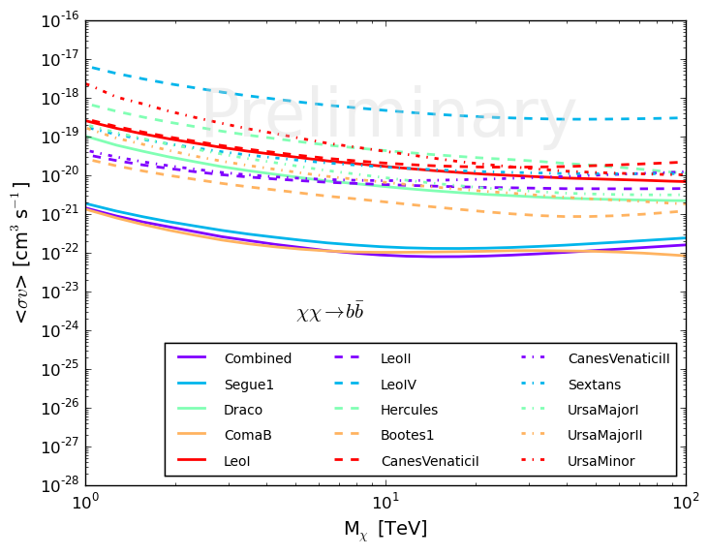
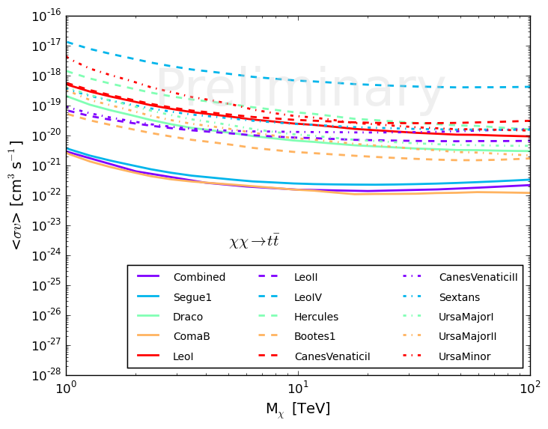
DM Annihilation Cross-Section Limits from 14 Dwarf Galaxies
EXCLUDED
EXCLUDED
14 individual dwarf galaxy limits plus combined stacked analysis (purple line) assuming 100% of the time WIMPs decay to b bbar
14 individual dwarf galaxy limits plus combined stacked analysis (purple line) assuming 100% of the time WIMPs decay to t tbar
Notes:
BACKUP SLIDE

Slide 24
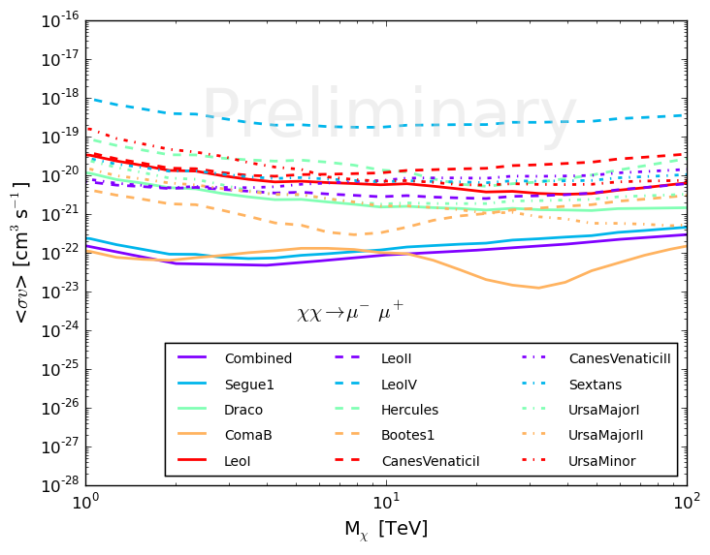
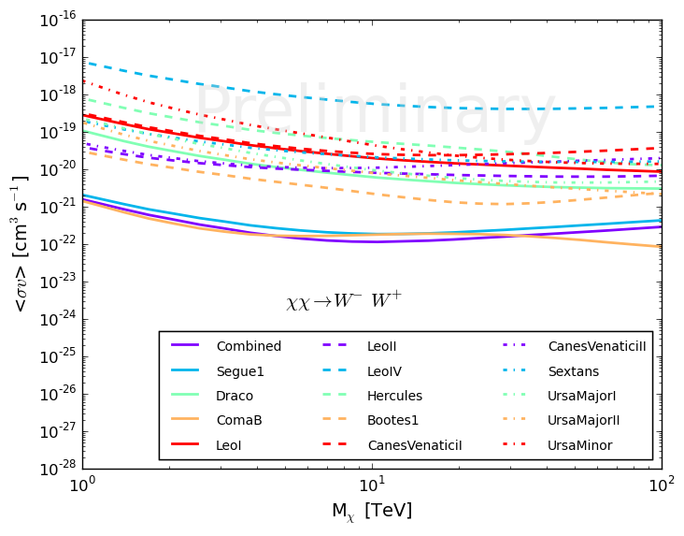
DM Annihilation Cross-Section Limits from 14 Dwarf Galaxies
EXCLUDED
EXCLUDED
14 individual dwarf galaxy limits plus combined stacked analysis (purple line) assuming 100% of the time WIMPs decay to μ+μ−
14 individual dwarf galaxy limits plus combined stacked analysis (purple line) assuming 100% of the time WIMPs decay to W+W−
Notes:
BACKUP SLIDE

Slide 25
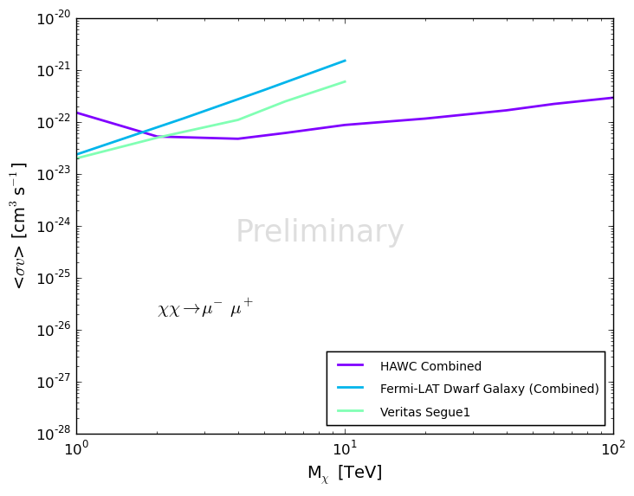
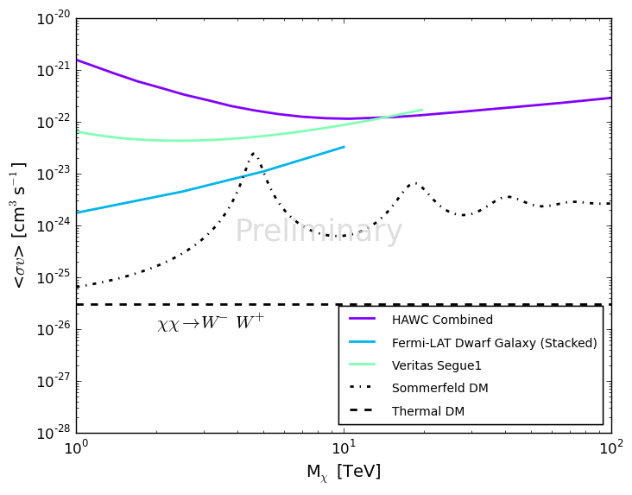
DM Annihilation Cross-Section Limits from 14 Dwarf Galaxies
EXCLUDED
EXCLUDED
HAWC’s combined limit assuming WIMP decays to μ+μ− (left plot) or W+W- (right plot) 100% of the time compared to results from other gamma-ray experiments:
Fermi-LAT from Ackermann et al. (Fermi-LAT Collaboration), Phys. Rev. D 89, 042001 (2014)
VERITAS from Aliu et al. (VERITAS Collaboration), Phys. Rev. D 85, 062001 (2012)
HESS from Abramowski et al. (HESS Collaboration), Phys. Rev. D 90 (2014) 11
MAGIC from Aleksic et al. (MAGIC Collaboration), JCAP 02 (2014) 008
Notes:
Put notes here about J and D fac

Slide 26
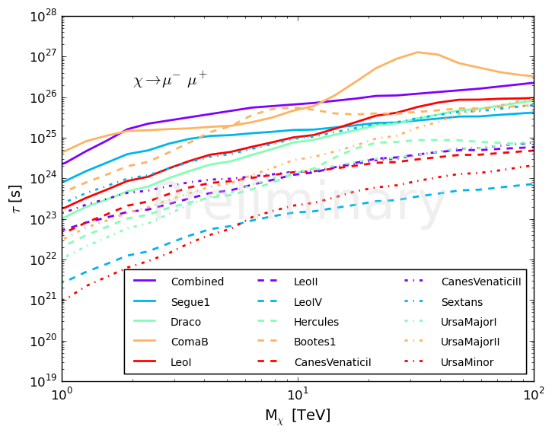
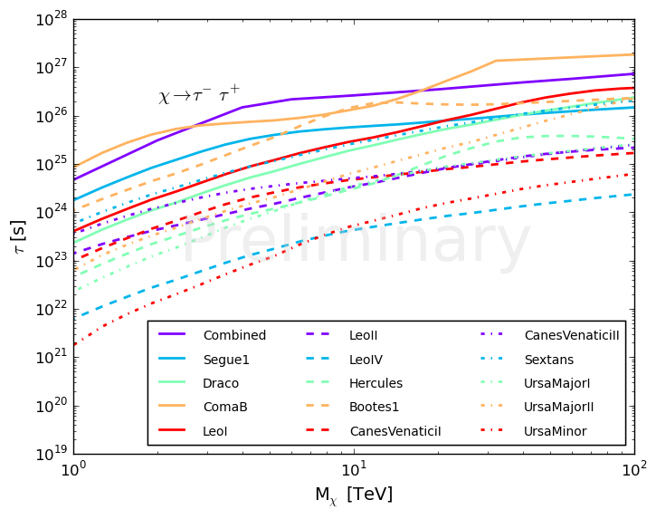
DM Decay Lifetime Limits from 14 Dwarf Galaxies
τ (s)
τ (s)
EXCLUDED
EXCLUDED
HAWC individual dwarf galaxy limits plus combined stacked analysis (purple line) assuming WIMP decays to μ+μ− 100% of the time
HAWC individual dwarf galaxy limits plus combined stacked analysis (purple line) assuming WIMP decays to τ+τ− 100% of the time
Notes:
Put notes here about J and D factors!

Slide 27
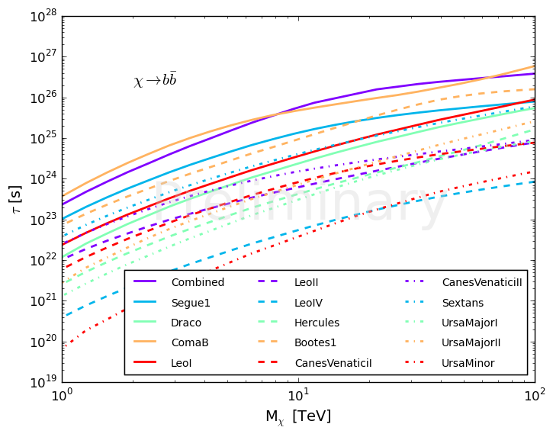
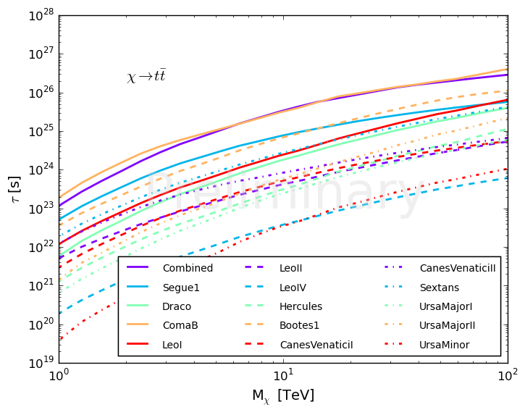
DM Decay Lifetime Limits from 14 Dwarf Galaxies
τ (s)
τ (s)
EXCLUDED
EXCLUDED
HAWC individual dwarf galaxy limits plus combined stacked analysis (purple line) assuming WIMP decays to b bbar 100% of the time
HAWC individual dwarf galaxy limits plus combined stacked analysis (purple line) assuming WIMP decays to τ+τ− 100% of the time
Notes:
Put notes here about J and D factors!

Slide 28
J and D Factors for M31 and Virgo analyzes
1 − 200
200 − 400
Notes:
Put notes here about J and D factors!

Slide 29
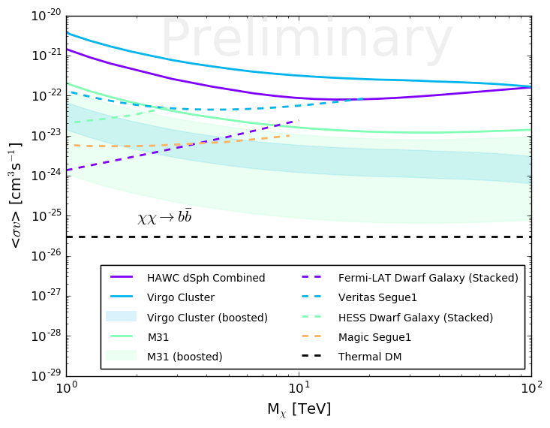
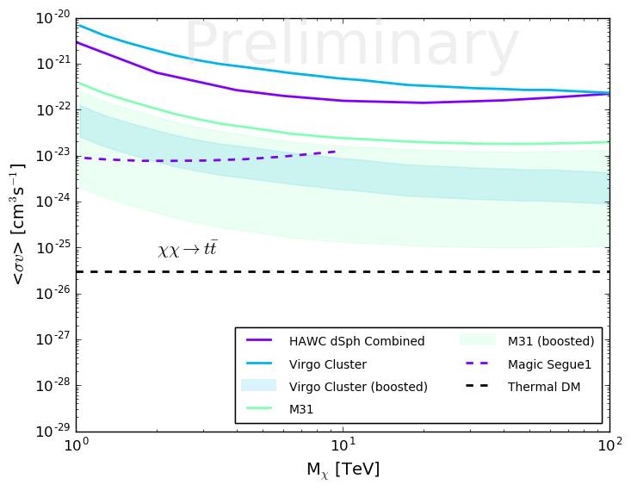
DM Annihilation Cross-Section Limits from M31 and Virgo
EXCLUDED
EXCLUDED
HAWC’s limits for M31, the Virgo cluster and combined dwarf galaxies assuming WIMP decays to b bbar (left plot) or t tbar⁻ (right plot) 100% of the time compared to other experiments.
The shaded bands represent the 1-year expected sensitivity reach using a range of boost factors (B = 1-200 for M31 and B = 200-400 for Virgo) from the effect of substructure (see references 1-7 listed at end of talk) in the extended sources M31 and Virgo.
Notes:
BACKUP

Slide 30
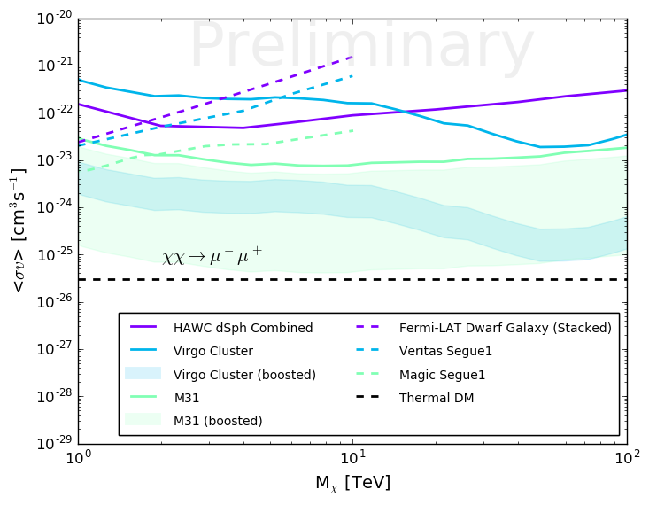
DM Annihilation Cross-Section Limits from M31 and Virgo
EXCLUDED
HAWC’s limits for M31, the Virgo cluster and combined dwarf galaxies assuming WIMP decays to μ+μ− 100% of the time compared to other experiments.
The shaded bands represent the 1-year expected sensitivity reach using a range of boost factors (B = 1-200 for M31 and B = 200-400 for Virgo) from the effect of substructure (see references 1-7 listed at end of talk) in the extended sources M31 and Virgo.
Notes:
BACKUP

Slide 31
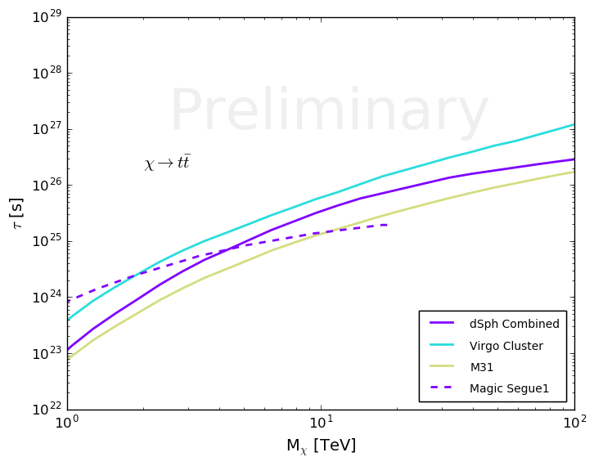
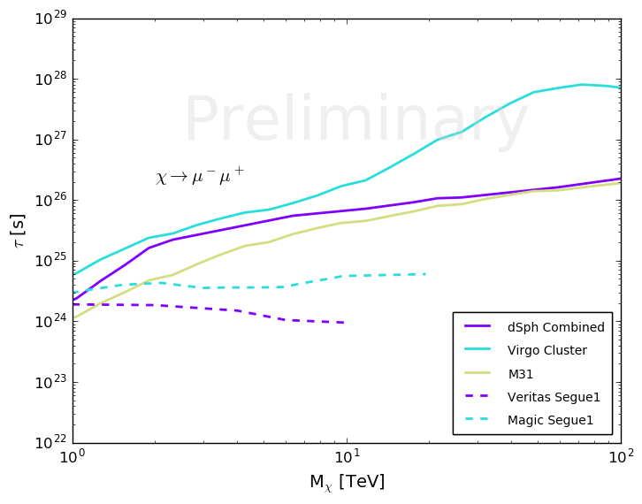
DM Decay Lifetime Limits from M31 and Virgo
τ (s)
τ (s)
EXCLUDED
EXCLUDED
HAWC’s lifetime limits for M31, the Virgo cluster and combined dwarf galaxies assuming WIMP decays to t tbar (left plot) or μ+μ- (right plot) 100% of the time compared to VERITAS and MAGIC.
Notes:
Put notes here about J and D factors!

Slide 32
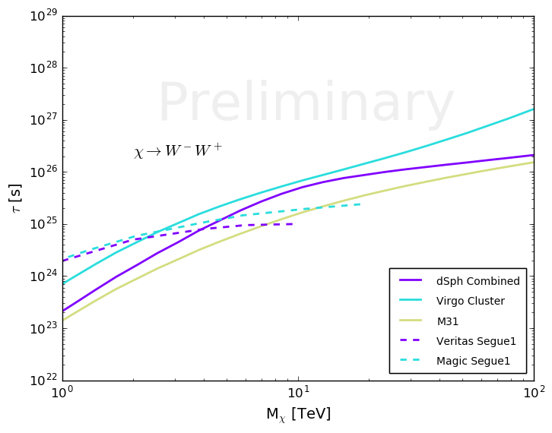
DM Decay Lifetime Limits from M31 and Virgo
τ (s)
EXCLUDED
HAWC’s lifetime limits for M31, the Virgo cluster and combined dwarf galaxies assuming WIMP decays to W+W- 100% of the time compared to VERITAS and MAGIC.
Notes:
Put notes here about J and D factors!

Slide 33

Differential Sensitivity
Sensitivity E² dN/dE TeV/(cm² s¹)
TeV gamma-ray sources
1 TeV
100 TeV

